Slide 1
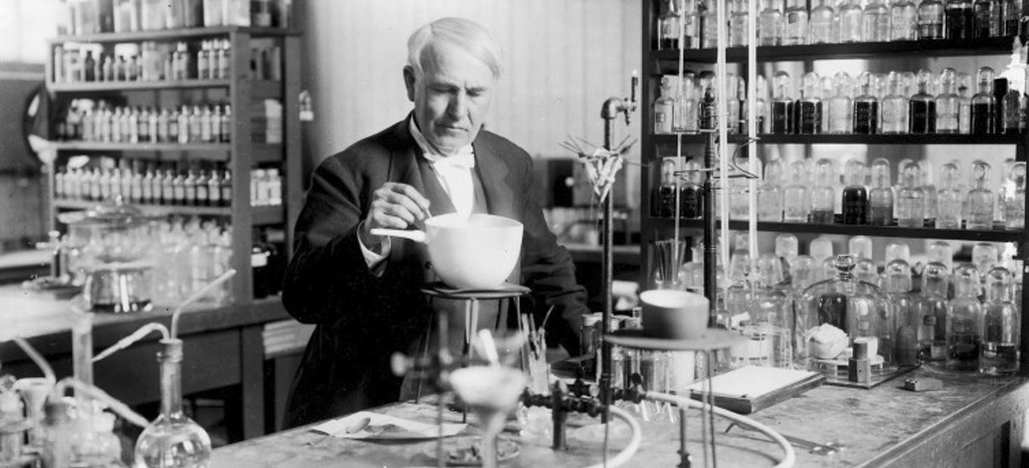
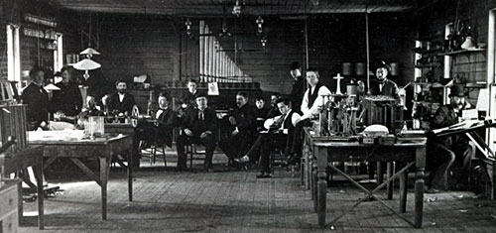
Teamwork

Slide 2


Elon Musk and Jeff Bezos (# of Employees)
33,000
?
?
566,000

Slide 3


Slide 4
Importance of Teamwork

Slide 5
ABET Teamwork
Ability to apply mathematics, science, and engineering principles.
Ability to design and conduct experiments, analyze, and interpret data.
Ability to design a system, component, or process to meet desired needs.
Ability to function on multidisciplinary teams.
Ability to identify, formulate, and solve engineering problems.
Understanding of professional and ethical responsibility.
Ability to communicate effectively.
The broad education necessary to understand the impact of engineering solutions in a global and societal context.
Recognition of the need for and an ability to engage in life-long learning.
Knowledge of contemporary issues.
Ability to use the techniques, skills and modern engineering tools necessary for engineering practice.

Slide 6
ABET Teamwork
d) Ability to function on multidisciplinary teams.
f) Understanding of professional and ethical responsibility.
h) The broad education necessary to understand the impact of engineering solutions in a global and societal context.

Slide 7
Team Skills Necessary for Jobs
Technical Skills
Communication Skills
Interpersonal Skills
Problem Solving and Critical Thinking
Enthusiasm, Commitment, and Motivation
http://www.engineering.com/JobArticles/ArticleID/13894/5-Skills-Hiring-Managers-Look-for-in-Engineering-Grads.aspx

Slide 8
Teamwork Skills

Slide 9

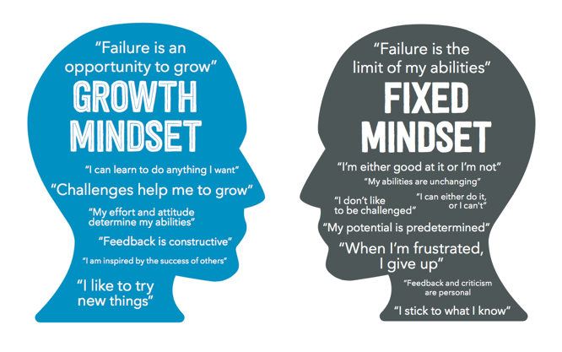
Growth Mindset
Grit is essential to success

Slide 10
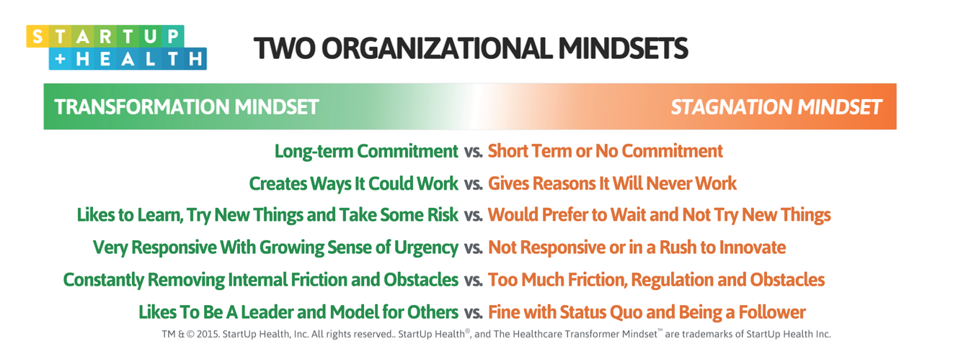
Organizational Mindsets
Notes:
Commitment and making it work
Learning and trying new things
Remove internal friction and be a model for others

Slide 11
Groupthink
Put faith in one leader
  Limits input from others
“I take it we are all in complete agreement on the decision here… Then I propose we postpone further discussion of this matter until our next meeting to give ourselves time to develop a disagreement and perhaps gain some understanding of what the decision is all about.”
- Alfred P. Sloan, former CEO of General Motors

Slide 12
Leadership for Teamwork (Dale Carnegie)
Try to understand different perspectives
Indirectly identify mistakes, except your own
Ask leading questions rather than ordering
Compliment hard work and good ideas
Sell your ideas and break them up in pieces

Slide 13
Teamwork Interaction

Slide 14
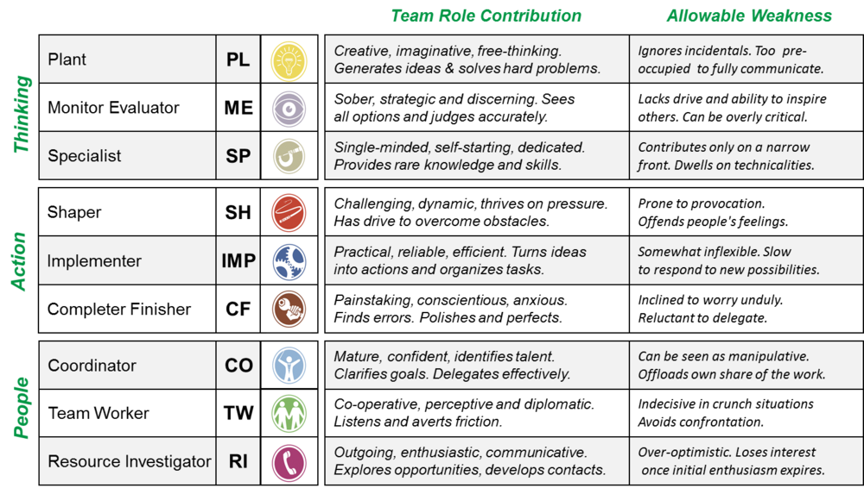
Team Roles

Slide 15
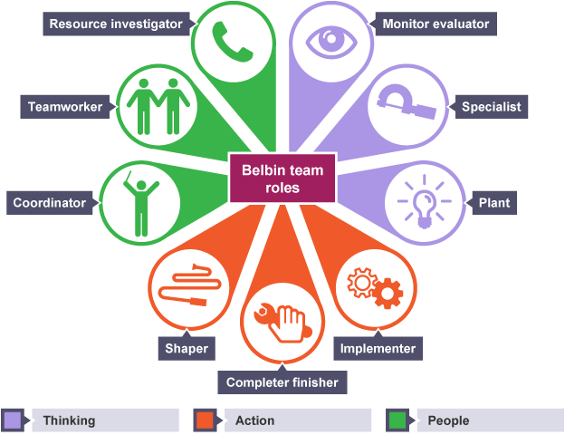
Team Roles

Slide 16
Team Dynamics
Team roles should change over semester
Identify your strengths/weaknesses
Work distribution adapts to performance
Contact your recitation professor or TA as soon as you realize that something is wrong with your team

Slide 17
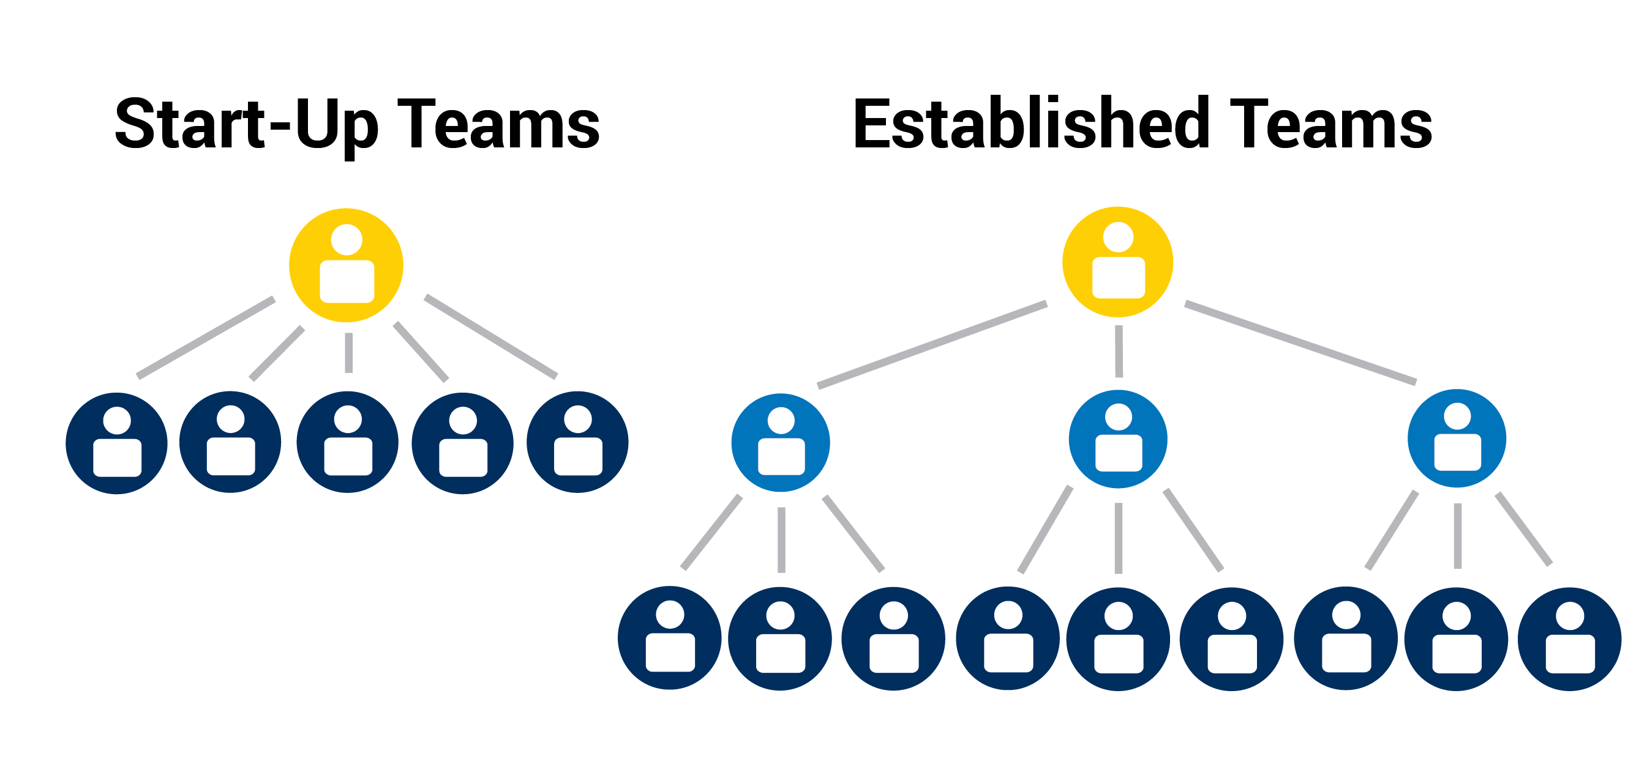
Professional Team Structure

Slide 18
Teamwork Skit

Slide 19
Format of Teamwork Skit
Volunteer TAs act out breakdown in SLDP teams
Two groups represent bad scenario, then improvement
We’ll discuss in the middle
Based on experience, but this is acting
Group 1
Difficulty
Redo
Group 2
Difficulty
Move Forward

Slide 20
Group 1 – Benchmark A Approaching
Kashish, feeling awkward
Zach, his buddy
Ipsita, an experienced teammate
Fariha, receiving unwanted attention
Haley, TA
Notes:
After Group 1's 1st skit: When you're working in a group, what do you do in a situation where you feel uncomfortable?
After Group 1's 2nd skit: If you notice that you or one of your teammates is being treated differently, how do you fix the situation?

Slide 21
Group 2 – Milestone Presentation
Tej, trying to hold team together
Roy, who wants to help
Ipsita and Haley, their frustrated teammates
Hannah, a recitation professor
Notes:
After Group 2's 1st skit: How big of a role does communication play in creating an effective team? Is there such as a thing as too much or too little communication?
After Group 2's 2nd skit: Microaggressions are constant, behavioral tendencies or verbal remarks towards a person that are negative or degrading. When working with a team in EG, you are seeing your group members multiple times a week, and sometimes every day. Microaggressions create a hostile work environment and can ruin a team dynamic that would've otherwise been successful. In this last skit, one of the main examples of this was Tej calling Roy and Ipsita by the wrong name because he wanted the "American" version. Over time, it demeaned them and isolated them. What would you all do in a situation like this where something that seems extremely small can build up to make you feel attacked?

Slide 22
Teamwork Resources

Slide 23
Teamwork Agreement
Communication
Meetings
Differences of opinion
Responsibilities
Workload
This contract will be used when you discuss team problems with your professor and TA

Slide 24
Tools for Teamwork
Collaborative software
  Google Drive/Microsoft 365
  Fusion 360
Communication
  Slack, Google Hangouts, Snapchat, Facebook
  Email all files at the end of a work day
Time management
  Use Google calendar to plan your week
  Create a when2meet.com survey

Slide 25
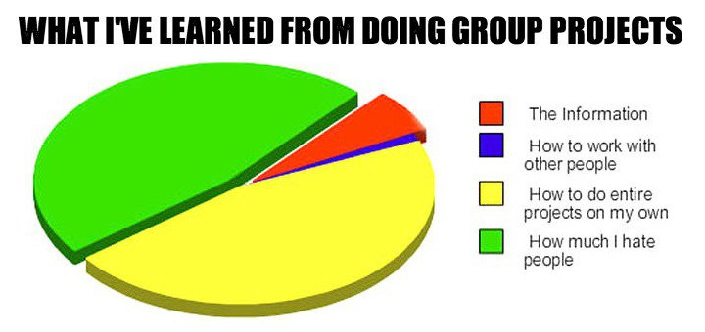
Worst-Case Scenario
http://berinkinsman.com/2014/11/07/group-project-survival-guide/

Slide 26


Teamwork Opportunities - Courses
1st Year
2nd & 3rd Year
Senior Design Capstone
4th Year

Slide 27
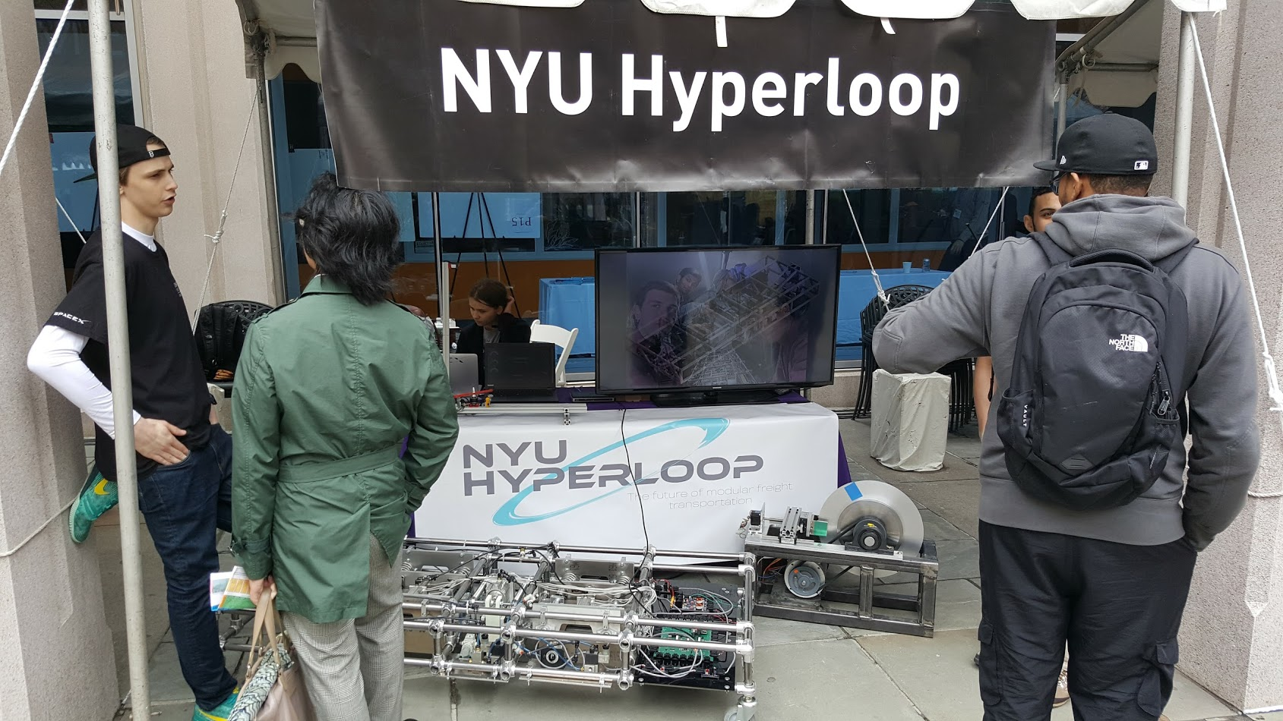
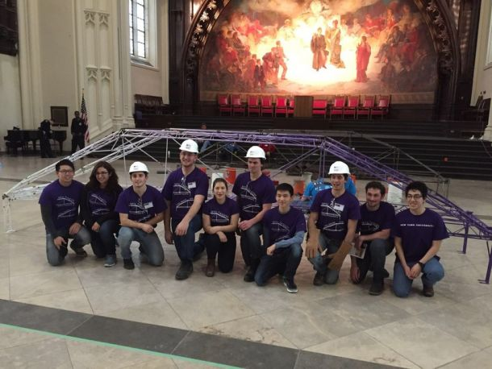
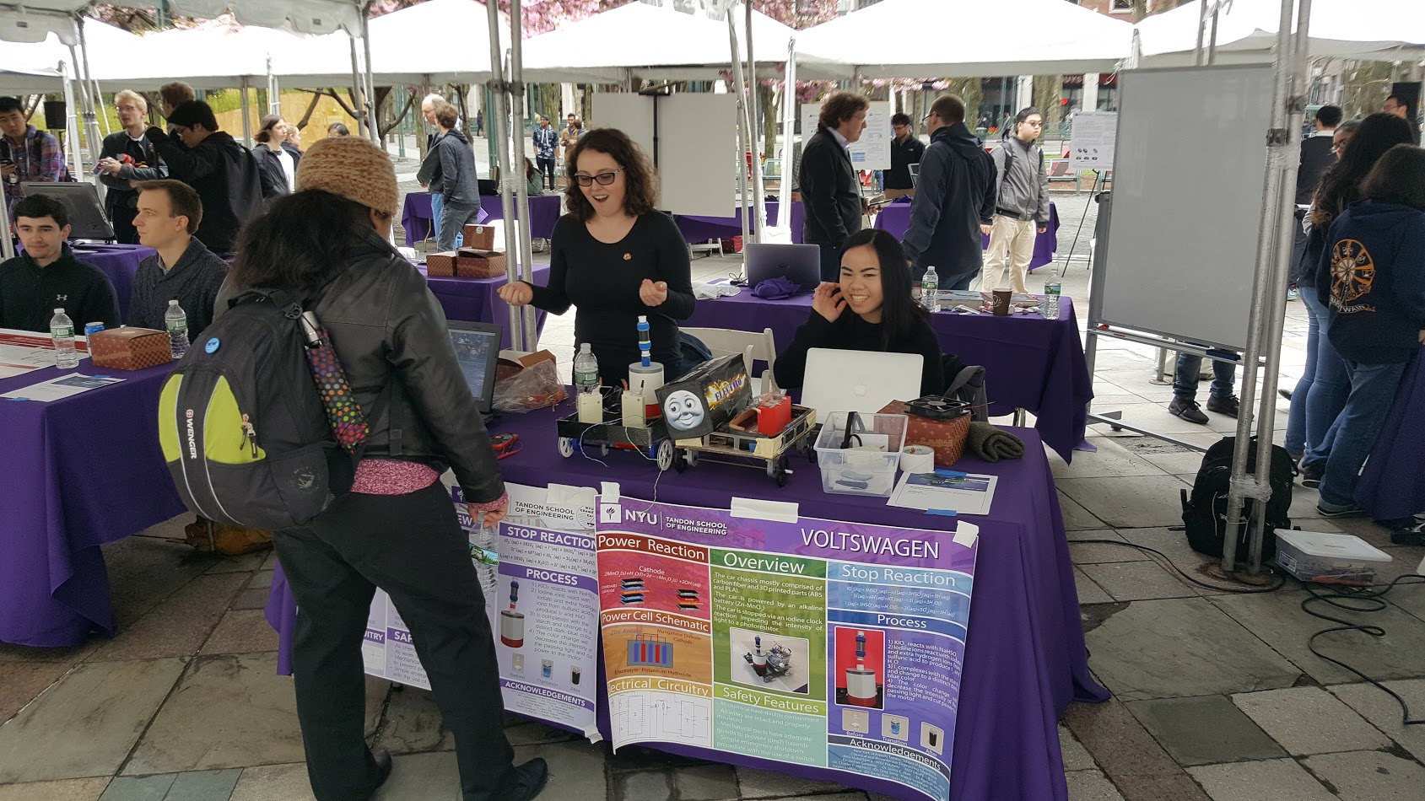
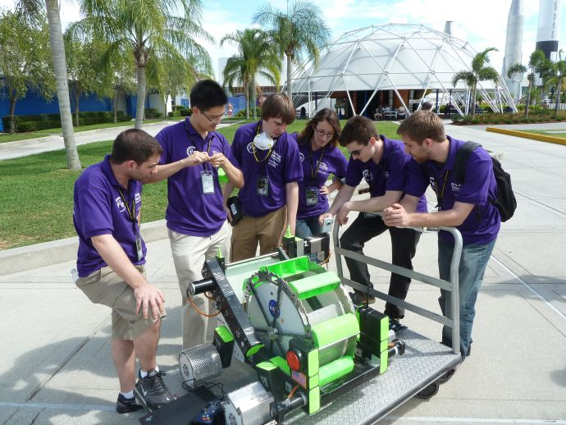
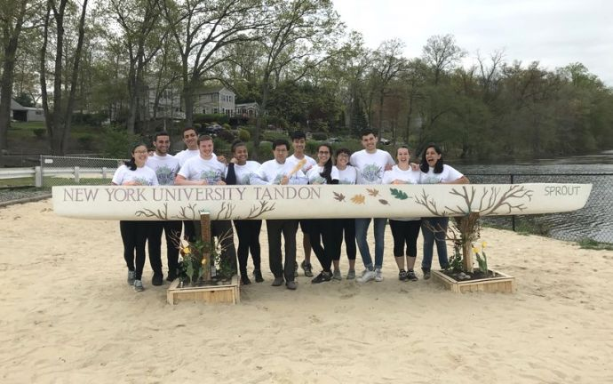
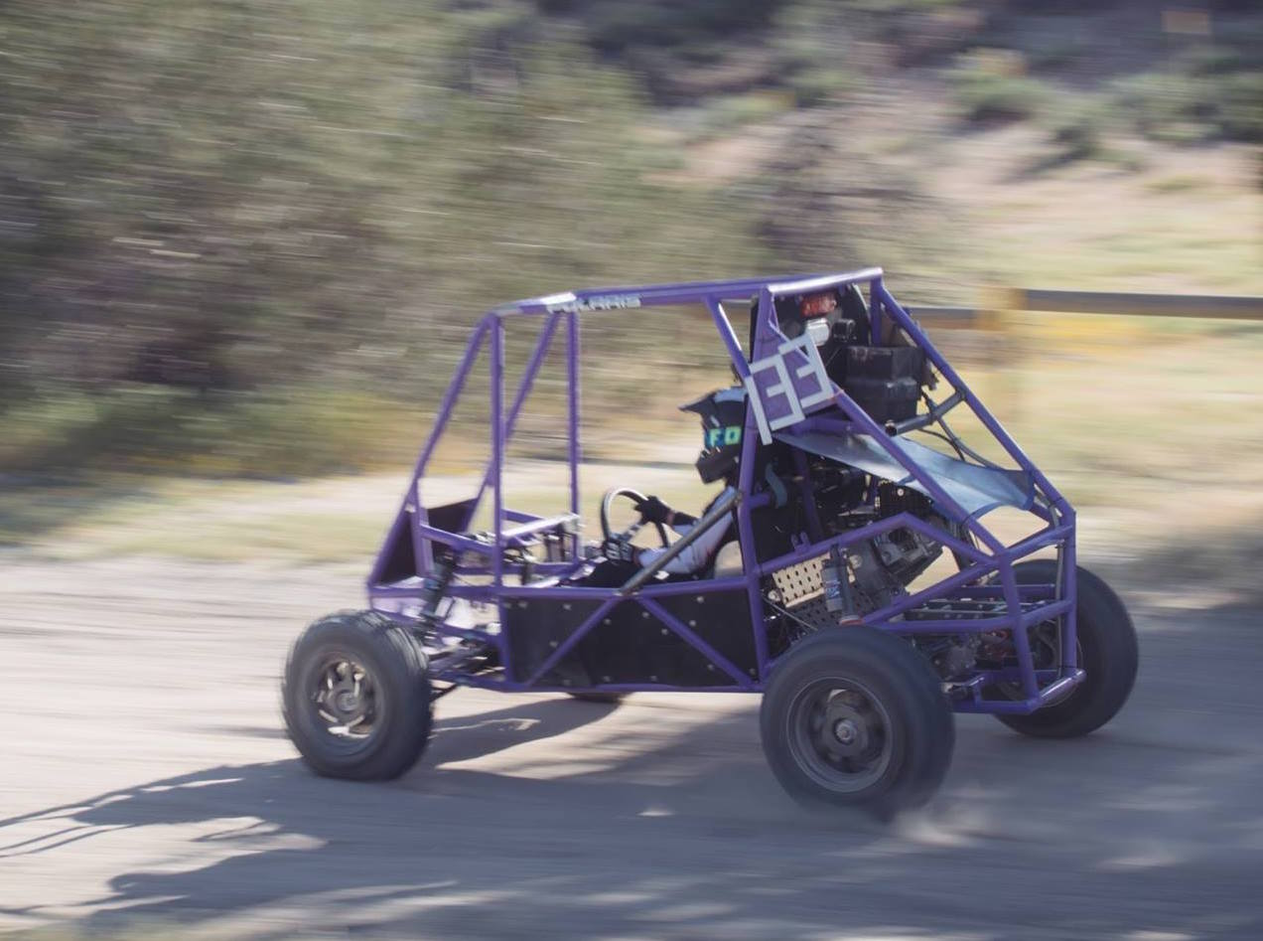
Teamwork Opportunities - Extracurricular

Slide 28
Works Cited
Lingard, R., & Barkataki, S. (2011, October). Teaching teamwork in engineering and computer science. In Frontiers in Education Conference (FIE), 2011 (pp. F1C-1). IEEE.
Reid, K., & Reeping, D. (2014). A classification scheme for “introduction to engineering” courses: defining first-year courses based on descriptions, outcomes, and assessment. In American Society for Engineering Education Annual Conference & Exposition. Indianapolis, IN (1-11). Washington DC: American Society for Engineering Education.
Dweck, C. S. (2006). Mindset: The new psychology of success. Random House Incorporated.
Krein, Steven (2015). Two Organizational Mindsets. StartUp Health, Inc. https://www.slideshare.net/StartUpHealth/startup-health-the-transformation-mindset
Carnegie, D. (2010). How to win friends and influence people. Simon and Schuster.
Belbin, R. M. (2012). Team roles at work. Routledge.

Slide 29
Special Thanks!
Team 2
Tej Khanna
Ipsita Chatterjee
Haley Enns
Ruhit Roy
Hannah Munson
Team 1
Kashish Garg
Zach Gonzalez-Ruskiewicz
Ipsita Chatterjee
Fariha Imam
Haley Enns

Slide 30
Teamwork

