Slide 1

SUSTAINABLE ENERGY APPLICATIONS (VIRTUAL)
EG1003 | LAB 10

Slide 2
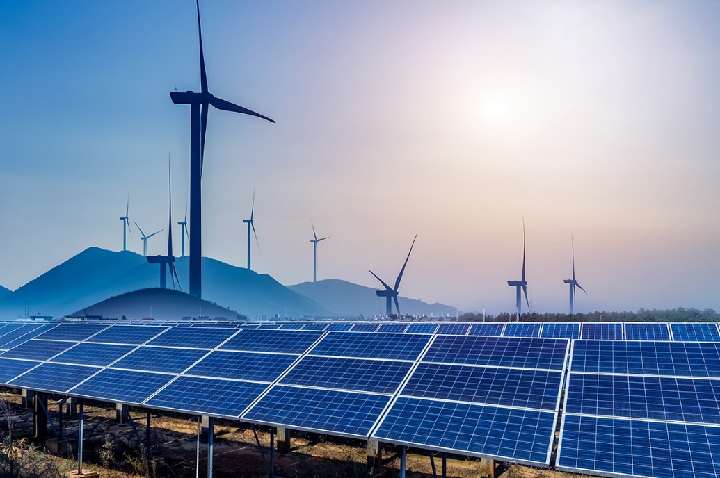
OVERVIEW
Objective
Background Information
Materials
Procedure
Assignment
Closing
Figure 1: Renewable Energy Sources
Courtesy of Physics World
1

Slide 3
OBJECTIVE
To evaluate different sources of renewable energy
To power a sustainable energy vehicle
To analyze historical trends of renewable energy usage
2

Slide 4
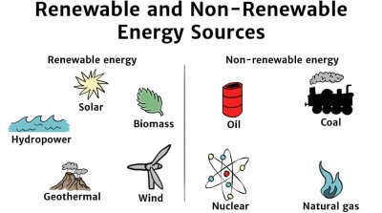
BACKGROUND INFORMATION
Renewable energy – energy harnessed from naturally replenished resources
Figure 2: Renewable vs. Non-Renewable Energy Sources Courtesy of Solar Schools
3

Slide 5
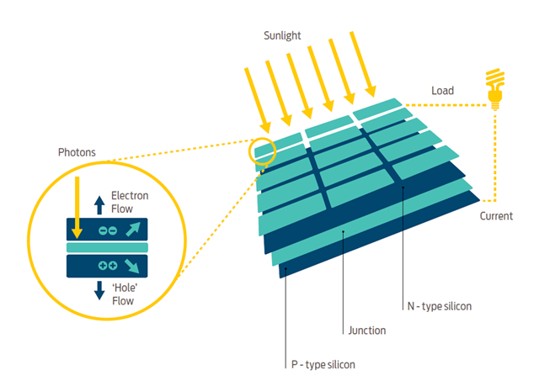
BACKGROUND INFORMATION
Solar panels – convert sunlight to electrical energy
  Incident sunlight excites electrons to
  next energy level, emitting energy
  Usually made of silicon
Figure 3: How Solar Panels Work
Courtesy of Good Energy
4

Slide 6
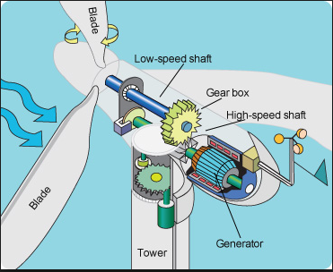
BACKGROUND INFORMATION
Wind turbine – converts wind energy to electrical energy
  Wind causes pressure difference on turbine blades
  Utilizes gear ratios to power generator
Figure 4: How Wind Turbines Work
Courtesy of Tech-Addict
5
Notes:
Rotating blades turn a low-speed shaft to a gearbox, which outputs power to an electrical generator through a high-speed shaft.

Slide 7
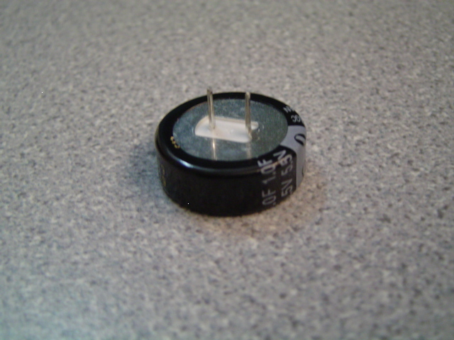
BACKGROUND INFORMATION
Capacitor - stores charge temporarily
  Are polarized
  Charged logarithmically (initially charges very fast but rate of charging slows down)
Positive
Negative
Figure 5: Polarized Leads of 1 Farad Capacitor
6

Slide 8

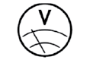
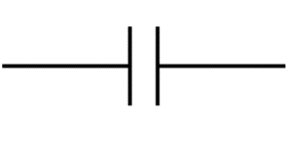

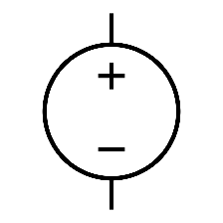
BACKGROUND INFORMATION
Symbols for common electrical components:
  Battery
  Capacitor
  DC source
  Voltmeter
  Ammeter
7

Slide 9
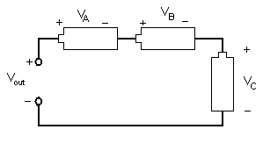
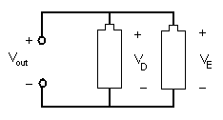


BACKGROUND INFORMATION
Series circuit
  Current is equal across components
  Voltage across each component:
  $${V_{out}=V}_{A}+V_{B}+V_{C}$$
Parallel circuit
  Current varies across components
  Voltage across each component:
  $${V_{out}=V}_{D}=V_{E}$$
Figure 6: Series Circuit
Figure 7: Parallel Circuit
8

Slide 10
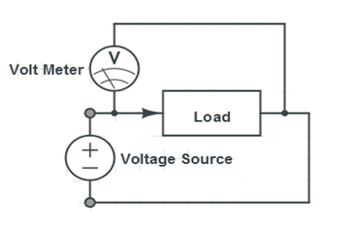
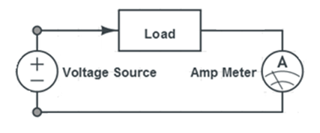
BACKGROUND INFORMATION
Digital multimeter – reads current and voltage across circuits
  Measure current in series, called ammeter
  Measure voltage in parallel, called voltmeter
Figure 8: Circuits for Using a Multimeter
9

Slide 11
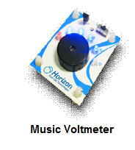
MATERIALS
TinkerCAD
10

Slide 12
PROCEDURE
Part 1 and 2 will be completed on TinkerCAD
Part 1: Test the power storage device
  Charge a capacitor
Part 2: Calculate power and test the different circuit arrangements
  Calculate the power for the solar panels and wind turbines
  Test batteries in parallel
  Test batteries in series
  Data Analysis
Part 3: Case Study – Historical Energy Statistics
11

Slide 13
PROCEDURE
Extra Credit
Predict the expected yearly energy consumption of wind and solar power for 2030, 2040, and 2050 utilizing Excel
Must be completed with reasonable justification to lab TA before end of lab
Must be included in team presentation
13

Slide 14
ASSIGNMENT
Team lab report
  Answer discussion questions in manual
  Include picture and explanation of TinkerCAD circuits
  Include spreadsheet with power source data
  Include pictures and screenshots of all circuits
  Include the data analysis graphs
  Due at 11:59 PM the night before Lab 11
Team presentation
  Address discussion points in manual
14

Slide 15
CLOSING
Measure current in series and voltage in parallel
Submit all work electronically
Take pictures of the vehicle design
Take screenshots of the final graphs in Excel
Clean up workstations
Return all unused materials to the TA
15

Slide 16
QUESTIONS?

