Slide 1

SOFTWARE FOR ENGINEERS
LAB 1A & 1B
EG 1004 Introduction to Engineering & Design

Slide 2
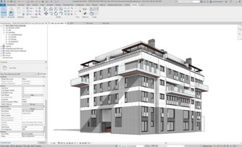
OVERVIEW
Objective
Background Information
Materials
Procedure
Competition Rules
IDBE Implementation
Assignment
Closing
Figure 1: Autodesk Revit courtesy of Modelical

Slide 3


OBJECTIVE
Familiarization with software relevant to this course
`
`
Microsoft Excel
Autodesk Revit

Slide 4
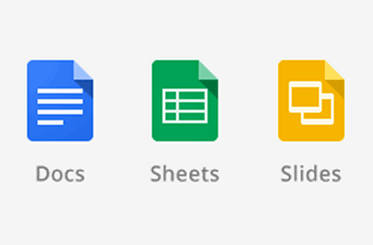
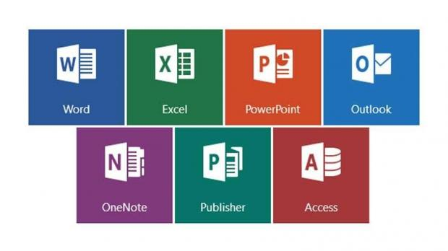
BACKGROUND
Microsoft Word or Google Documents
Word processing program
Create lab reports, proposals, documents
Microsoft Excel or Google Sheets
Spreadsheet program
Create tables, charts, graphs, data analysis
Microsoft PowerPoint or Google Slides
Professional presentation program
Notes:
Tandon Areas of Excellence
Sustainability
Urban
Telecommunications & IT
Health
Artificial Intelligence
Professional Skills & Tandon Resources
MakerSpace & RAD
Teamwork & Vertically Integrated Projects
Career Services
Project Management & Technical Writing
World Trade Center Construction

Slide 5
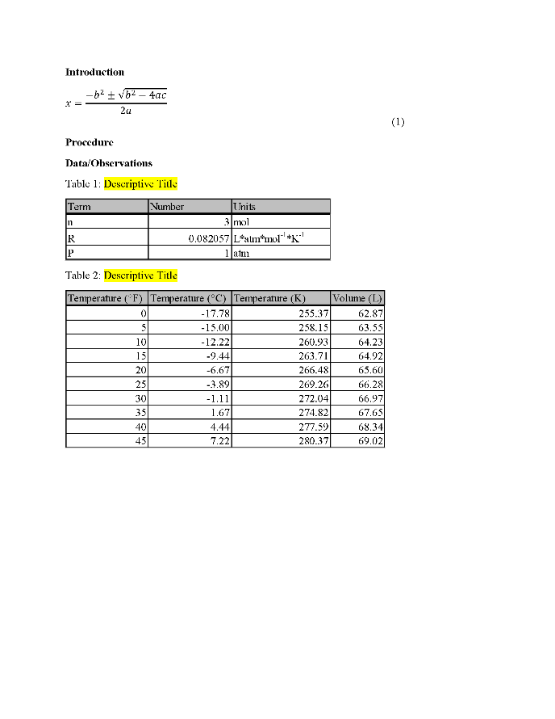
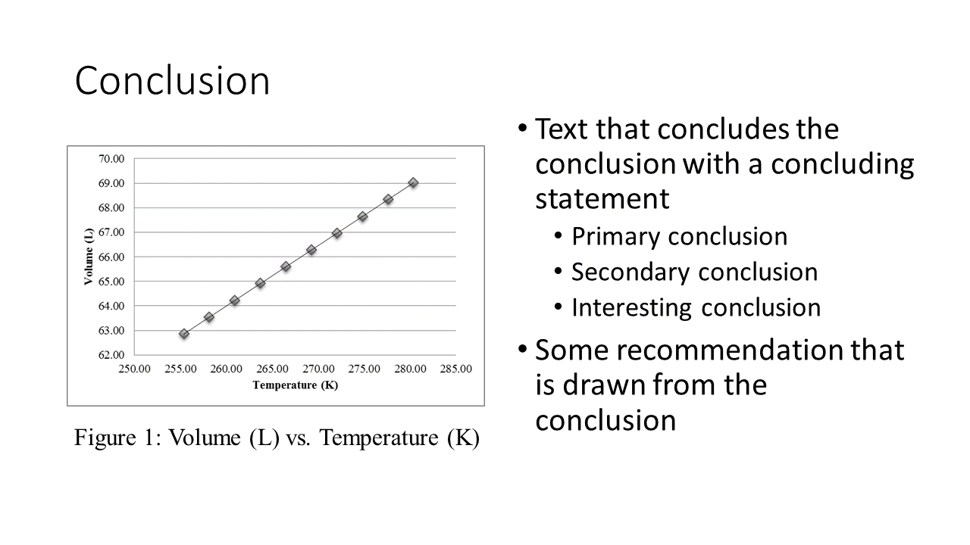
WORD & POWERPOINT
Figure 2: Examples of Word (Left) and PowerPoint (Right)
Notes:
Tandon Areas of Excellence
Sustainability
Urban
Telecommunications & IT
Health
Artificial Intelligence
Professional Skills & Tandon Resources
MakerSpace & RAD
Teamwork & Vertically Integrated Projects
Career Services
Project Management & Technical Writing
World Trade Center Construction

Slide 6
EXCEL
Figure 3: Example of Excel
Notes:
Tandon Areas of Excellence
Sustainability
Urban
Telecommunications & IT
Health
Artificial Intelligence
Professional Skills & Tandon Resources
MakerSpace & RAD
Teamwork & Vertically Integrated Projects
Career Services
Project Management & Technical Writing
World Trade Center Construction

Slide 7
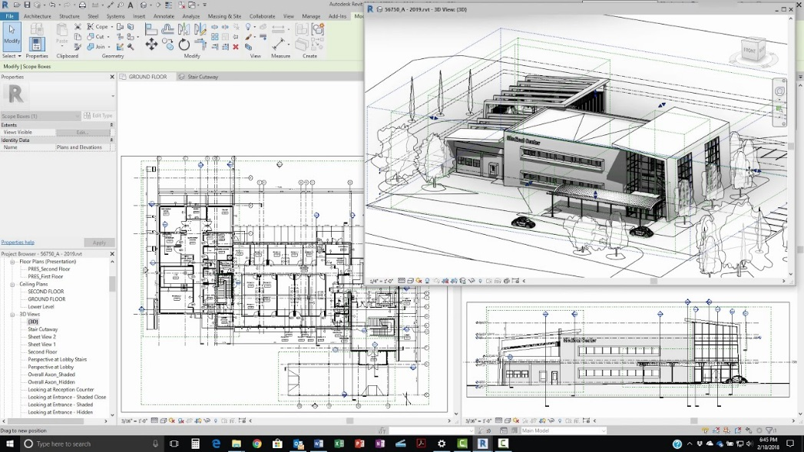
BACKGROUND INFORMATION
Revit
  Building modeling software for architects and civil engineers
  Creates homes, buildings, and structural support systems
  Used to create floor, plumbing, electrical, and HVAC plans
Figure 4: Revit in use courtesy of Revit News
Notes:
Tandon Areas of Excellence
Sustainability
Urban
Telecommunications & IT
Health
Artificial Intelligence
Professional Skills & Tandon Resources
MakerSpace & RAD
Teamwork & Vertically Integrated Projects
Career Services
Project Management & Technical Writing
World Trade Center Construction

Slide 8
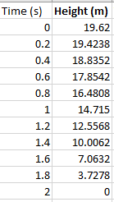
PROCEDURE
Go to Lab 1A – Introduction to Microsoft Office
Excel
  Case Study I: Free-Fall
    Plot velocity vs. time
    Plot a trendline and solve for acceleration
  Case Study II: Historical Energy Statistics
    Create line graphs to model yearly trend
    Create pie charts to model distribution in energy sources
Figure 5: Excel Data Table (Case Study I)
Notes:
Tandon Areas of Excellence
Sustainability
Urban
Telecommunications & IT
Health
Artificial Intelligence
Professional Skills & Tandon Resources
MakerSpace & RAD
Teamwork & Vertically Integrated Projects
Career Services
Project Management & Technical Writing
World Trade Center Construction

Slide 9
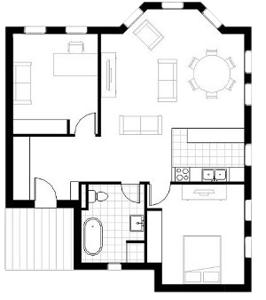
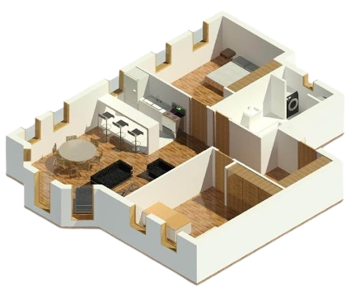
PROCEDURE
Go to Lab 1B – Introduction to Autodesk Revit
Revit
  Create a 350 – 400 square foot apartment
  Contains one of each: bathroom, kitchen, bedroom with bed, table, and desk
  Must have adequate lighting (at least one window) and space
Figure 6: Small apartment in Revit courtesy of Balkan Architect
Notes:
Tandon Areas of Excellence
Sustainability
Urban
Telecommunications & IT
Health
Artificial Intelligence
Professional Skills & Tandon Resources
MakerSpace & RAD
Teamwork & Vertically Integrated Projects
Career Services
Project Management & Technical Writing
World Trade Center Construction

Slide 10
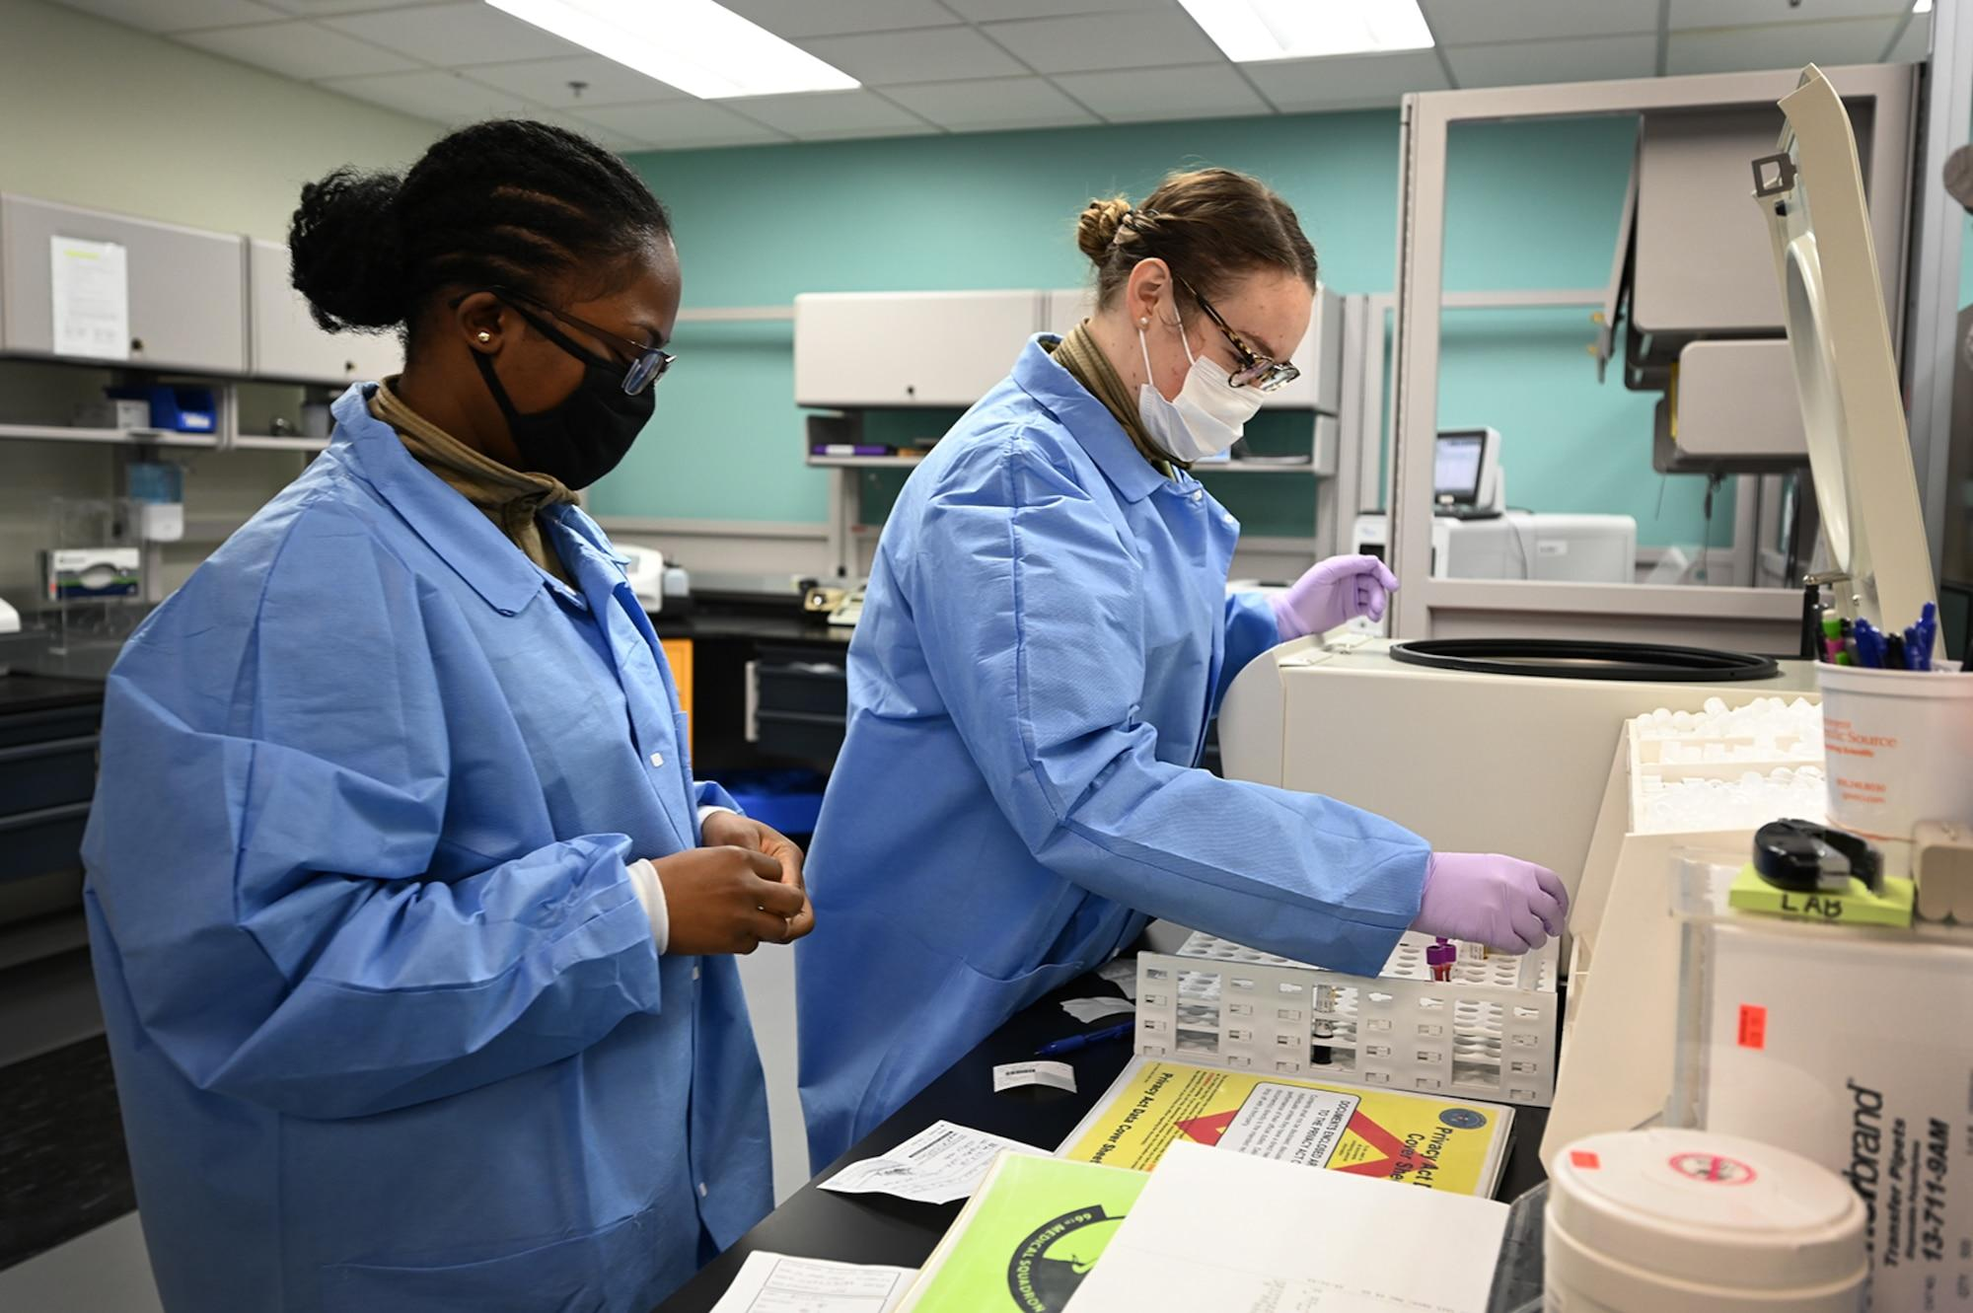
IDBE IMPLEMENTATION
Strength and Areas of Improvement
  What skills can you bring to a team?
  What skills would you like to develop in EG?
Share an element of your identity that is important to you
Community Agreement
  What kind of learning environment would you like to be a part of?
Figure 7: Lab Team Working Together
Notes:
Tandon Areas of Excellence
Sustainability
Urban
Telecommunications & IT
Health
Artificial Intelligence
Professional Skills & Tandon Resources
MakerSpace & RAD
Teamwork & Vertically Integrated Projects
Career Services
Project Management & Technical Writing
World Trade Center Construction

Slide 11
ASSIGNMENT
No lab report for Lab 1A or Lab 1B
No presentation for Lab 1A or Lab 1B
Submit the ZIP file of the two excel files and RVT files on the EG1004 website (eg.poly.edu)
Due at 11:59 PM the night before Lab 2
Notes:
Tandon Areas of Excellence
Sustainability
Urban
Telecommunications & IT
Health
Artificial Intelligence
Professional Skills & Tandon Resources
MakerSpace & RAD
Teamwork & Vertically Integrated Projects
Career Services
Project Management & Technical Writing
World Trade Center Construction

Slide 12
CLOSING
All students must attempt to use the software
TAs are always available for assistance
Must submit the ZIP and RVT files to the EG1004 website before next lab
Go to the EG1004 student manual (manual.eg.poly.edu) for lab instructions
Notes:
Tandon Areas of Excellence
Sustainability
Urban
Telecommunications & IT
Health
Artificial Intelligence
Professional Skills & Tandon Resources
MakerSpace & RAD
Teamwork & Vertically Integrated Projects
Career Services
Project Management & Technical Writing
World Trade Center Construction

Slide 13
QUESTIONS?

