Slide 1

Student’s Guide to

Slide 2
Table of Contents
Slide 3
Slide 4 – Slide 8
Slide 9 – Slide 11
Slide 12 – Slide 13
Slide 14 – Slide 15
Slide 16
Slide 17 – Slide 19
Slide 20 – Slide 23
Slide 24 – Slide 28
General Requirements
Enabling Auto Scheduling Mode
Status Date
Adding Progress Line
Change Timescale
Adding Milestones
Create/Change Resources
Calculating Labor Times
Copy Picture Into Presentation

Slide 3
General Requirements
Make sure you have:
  Minimum of 20 tasks
  Milestones
  Responsible person for tasks shown
  Progress line shown
  “Copy Picture” is used instead of screenshotting

Slide 4
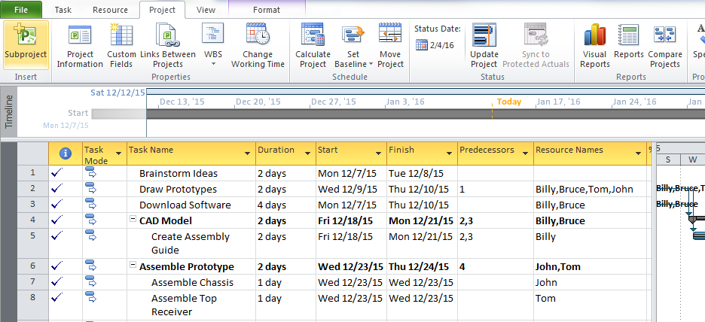
Enabling Auto Scheduling Mode
Press “FILE”

Slide 5
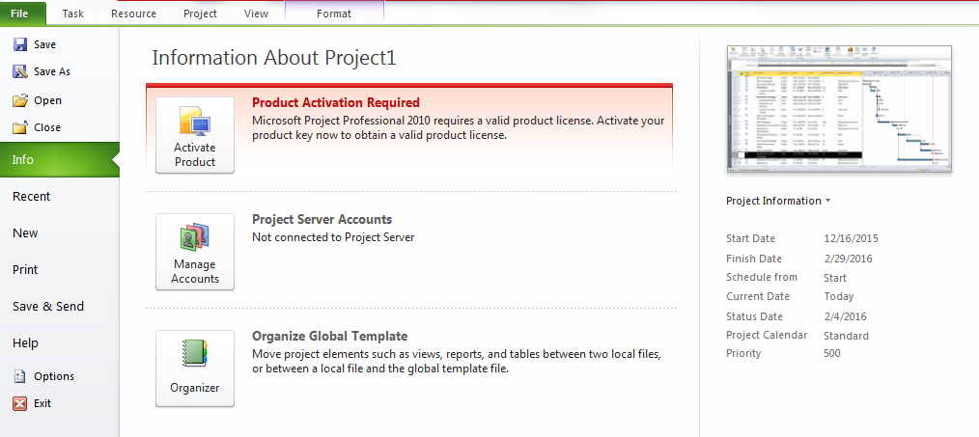
Enabling Auto Scheduling Mode
Press “OPTIONS”

Slide 6
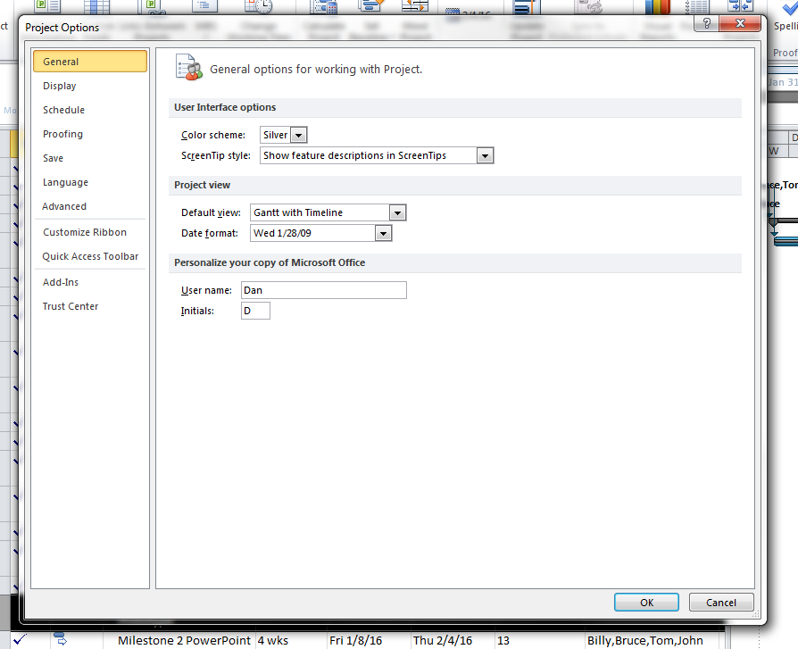
Enabling Auto Scheduling Mode
Press “ADVANCED”

Slide 7
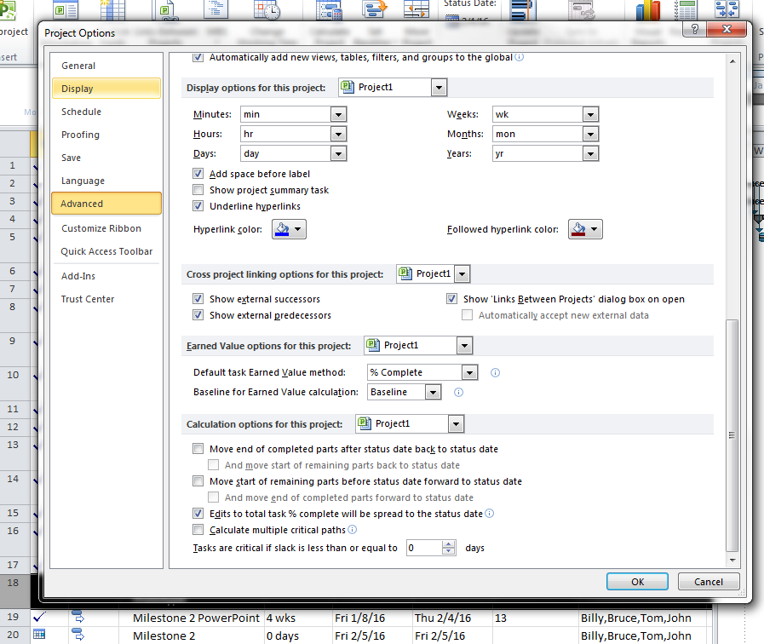
Enabling Auto Scheduling Mode
Scroll to the bottom and check the box before “Edits to total %...”

Slide 8
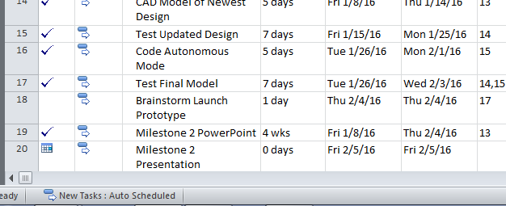
Enabling Auto Scheduling Mode
Press this button to open a small menu and select “Auto Scheduled” from it

Slide 9
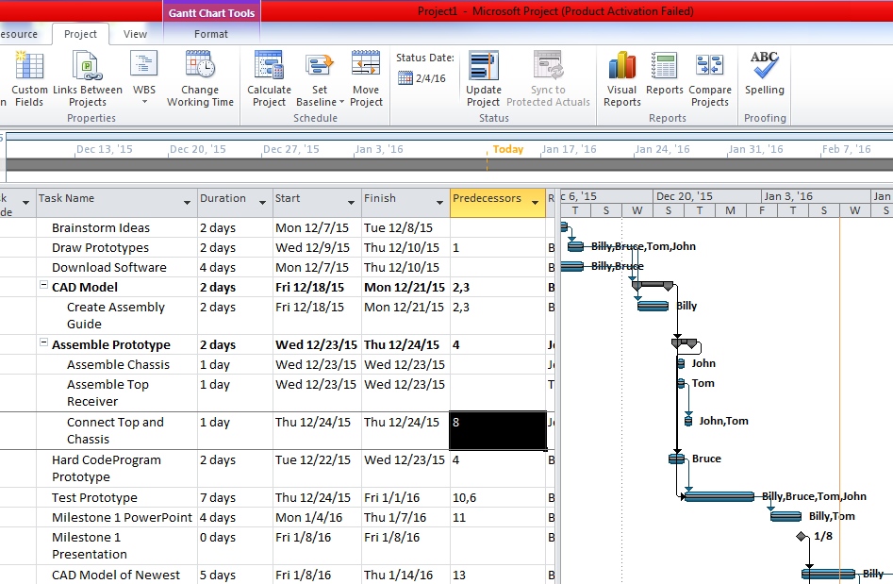
Status Date
Use the Status Date to control where the Progress Line is
It’s right here

Slide 10
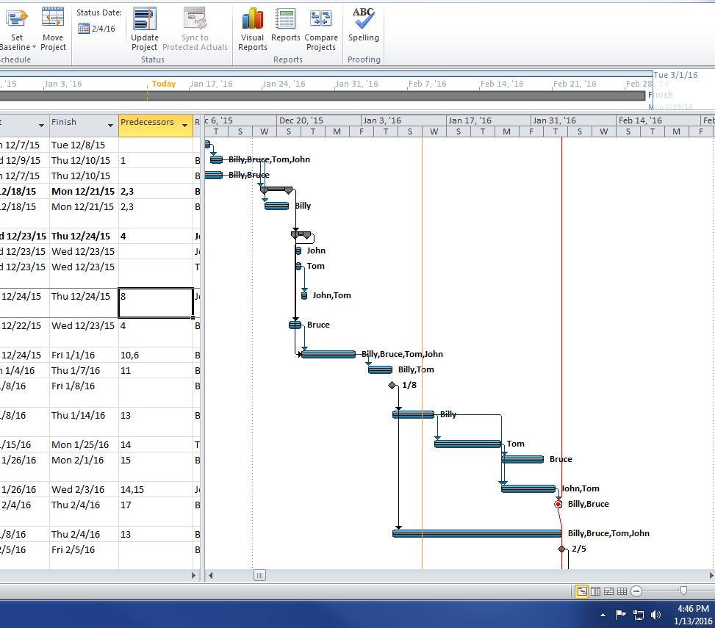
Status Date
You can also use “Update Project” to set the Status Date and update any completion percentages before that date

Slide 11
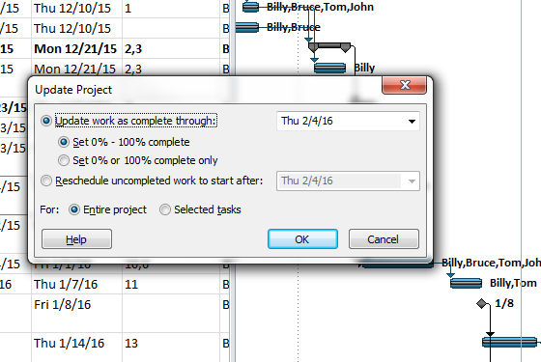
Status Date
Use this menu to change completion percentage
Use this dropdown menu to change the date

Slide 12
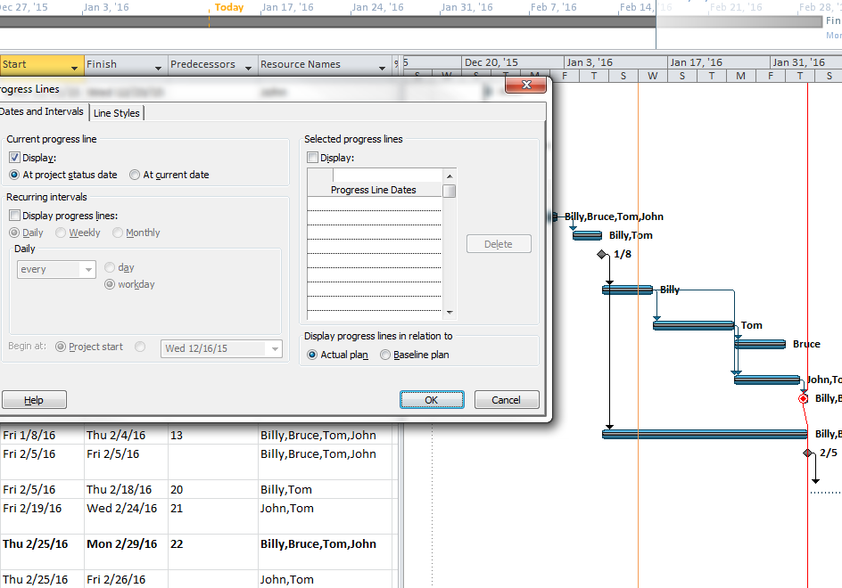
Adding Progress Line
To add a Progress Line, right click on the timeline and select “Progress Line”

Slide 13
Adding Progress Line
Then press “Display” then “At Project Date”

Slide 14
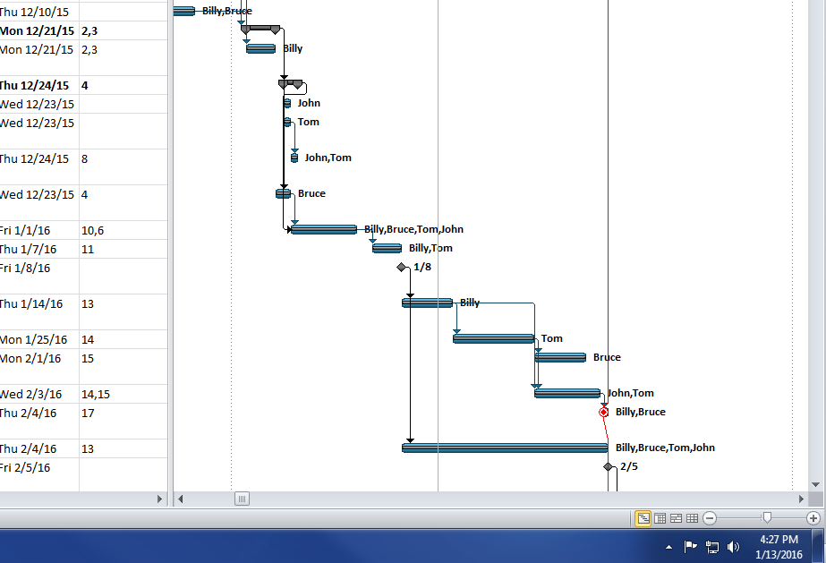
Change Timescale
Press this little button at the bottom right
(Timescale is set automatically to 1 Day = 8 Hours)

Slide 15
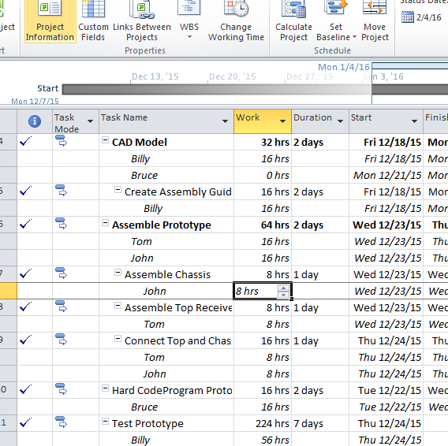
Change Timescale
Select the box, and change the time
Anything under 8 hours will remain 1 day, it will not let you set more than 8 hours/day

Slide 16
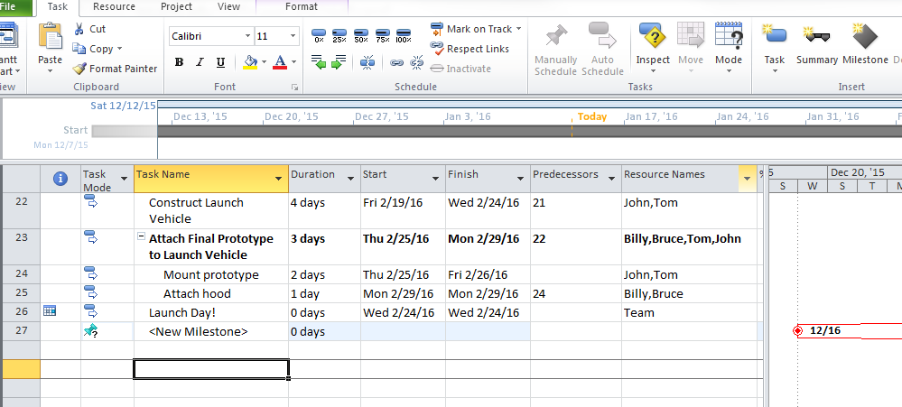
Adding Milestones
Press “Milestone” to add a milestone, it’ll appear below as a <New Milestone>

Slide 17
Create/Change Resources
First press this little button in the lower right hand corner

Slide 18
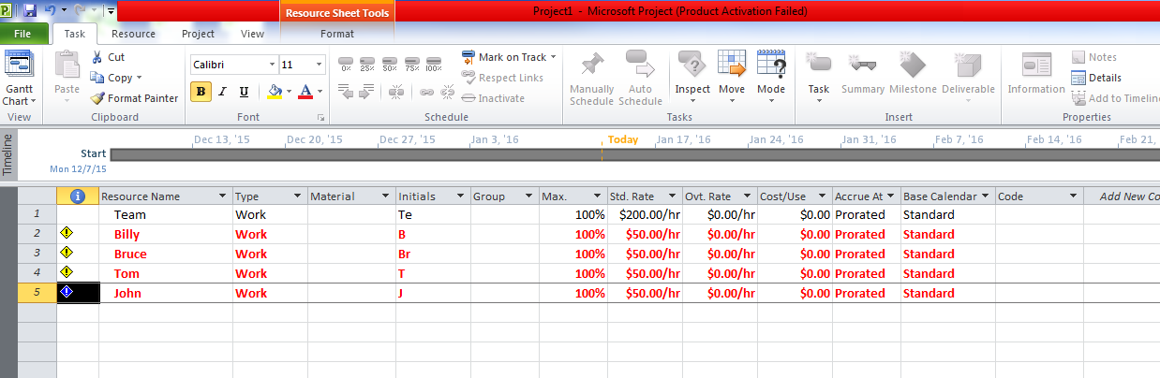
Create/Change Resources
It’ll open this page to see the individual resources and hourly rates <Std. Rate>
*the red means they are “overallocated” meaning they’re doing too much at once, but they’re hard workers, so it’s okay—they’ll power through it.

Slide 19
Create/Change Resources
Press this little button to return to chart view

Slide 20
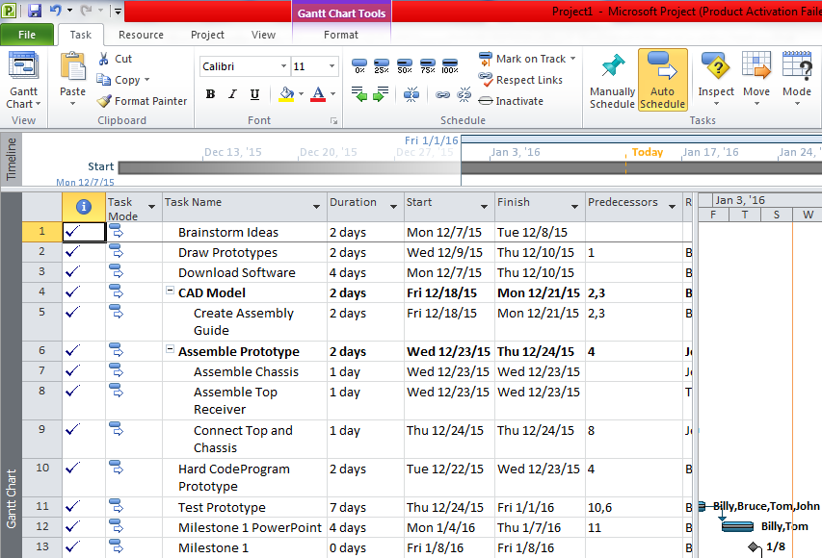
Calculating Labor Times
Press “Project”

Slide 21
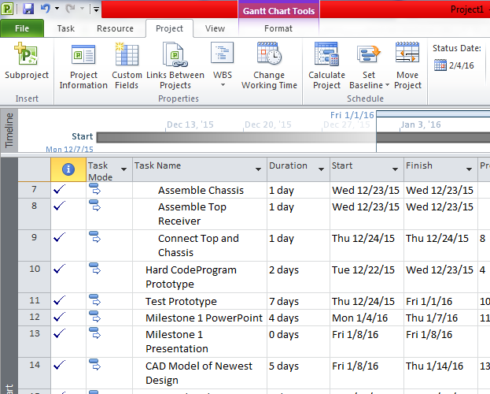
Calculating Labor Times
Press “Project Information”

Slide 22
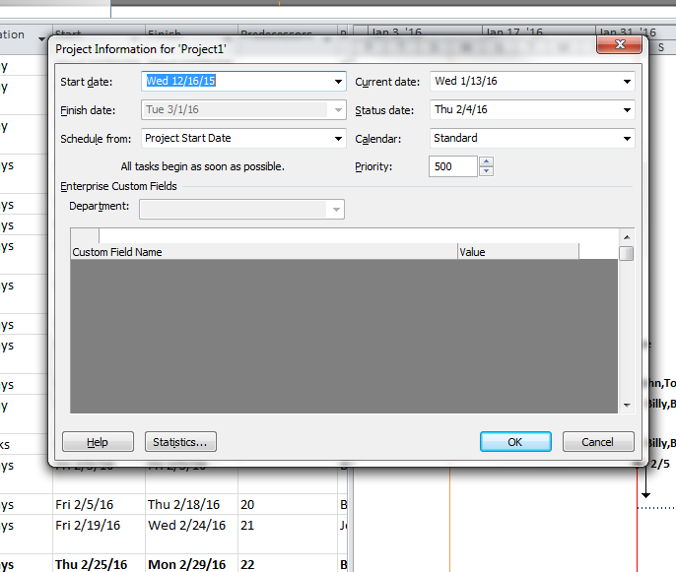
Calculating Labor Times
Press “Statistics”

Slide 23
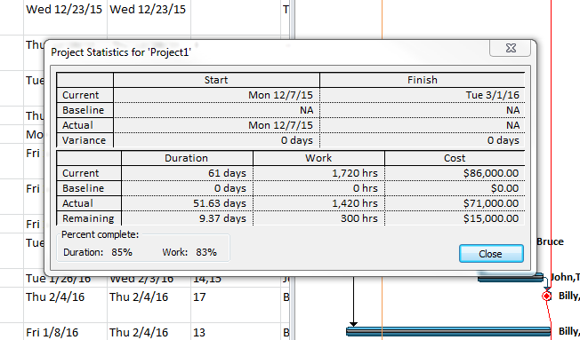
Calculating Labor Times
Here is the cost, as well as the Actual Payment (to the current date) and the remaining cost (until the end)

Slide 24
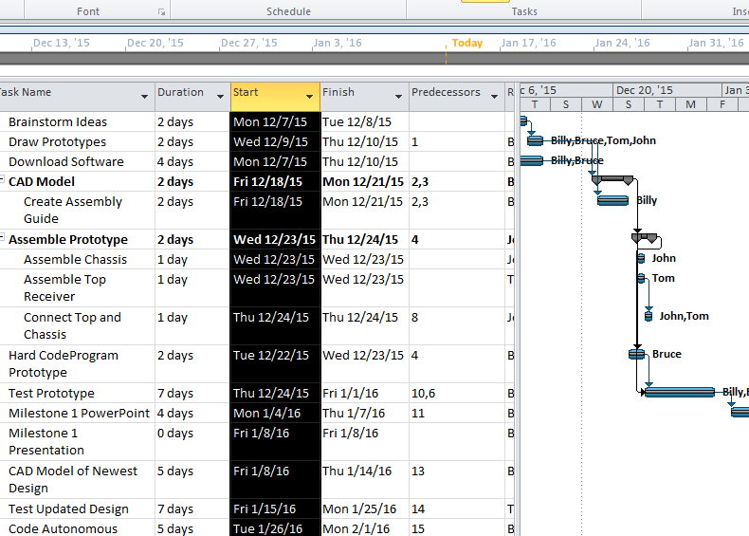
Copy Picture Into Presentation
Highlight every row

Slide 25
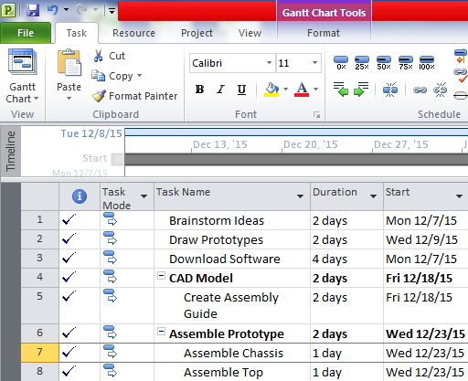
Copy Picture Into Presentation
Press the drop down menu next to “Copy”

Slide 26
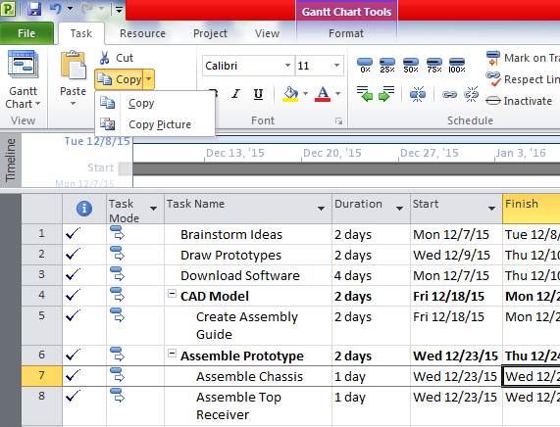
Copy Picture Into Presentation
Select
“Copy Picture”

Slide 27
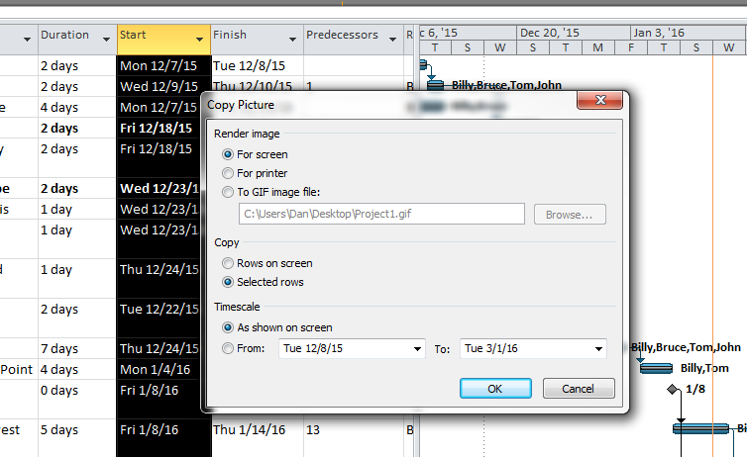
Copy Picture Into Presentation
Press “Selected Rows” then OK

Slide 28
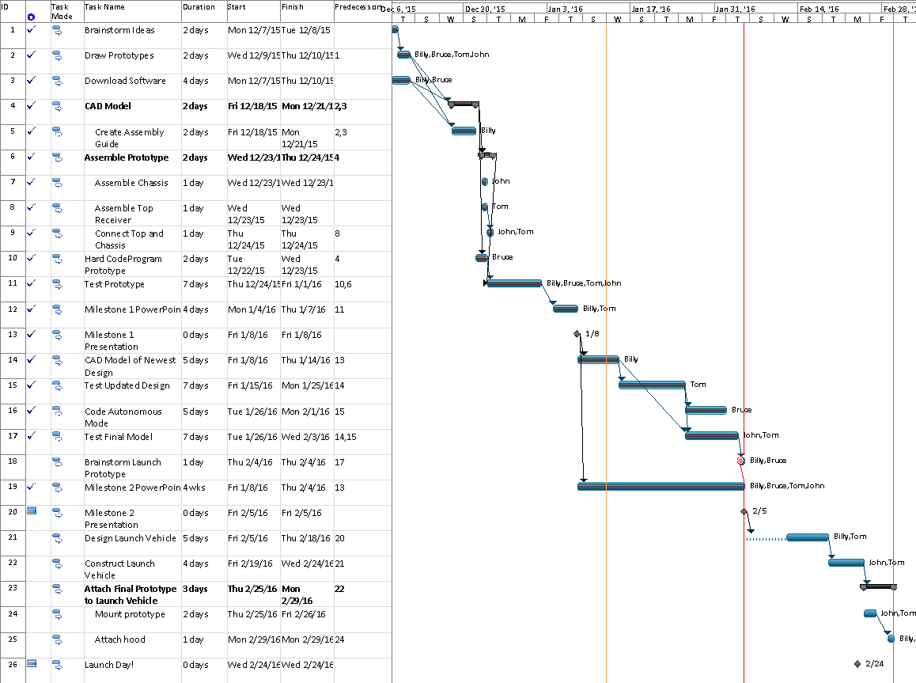
Copy Picture Into Presentation
Then you can copy and paste it into anything you want
(like Paint or PowerPoint)

