Slide 1
Introduction to
Fusion 360
Guides/Tips/Walkthrough

Slide 2

Overview
  Workspace
  Sketch
  Fillet
  Model
  Loft/Sweep
  Read Stress Test Results
  Start a Project
  Open Properties Tab

Slide 3

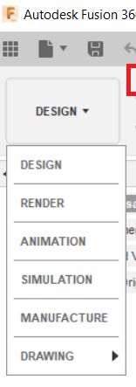

Intro to Workspace
7 Workspaces:
Design: For drawing 3D models and surfaces
Generative Design: A form of artificial intelligence to output efficient design
Render: Create photorealistic renderings of components and products.
Animation: Animate assemblies to see if they function as expected or to show functionality
Simulation: to perform various stress analyses on the designs
Manufacture: to assist with manufacturing the part on various digital fabrication tools
Drawing: Create shop drawings of designs for manufacturing

Slide 4
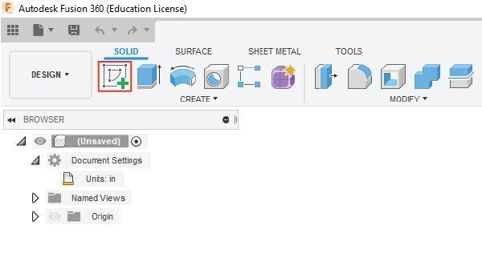
How to: Sketch
Start a 2D Sketch by clicking Create Sketch
Using the Sketch Dimension tool and the Constraints functions, the base shape and 3D model can be edited without starting over

Slide 5
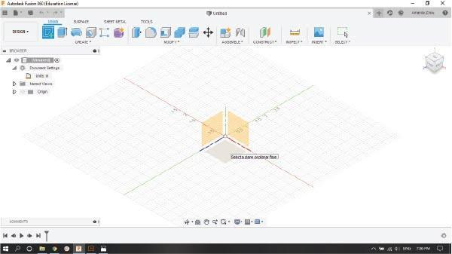
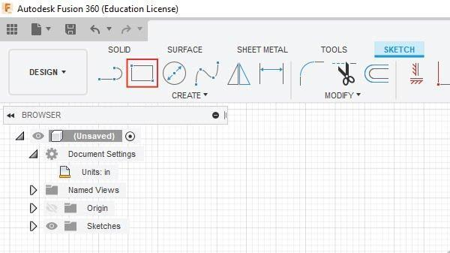
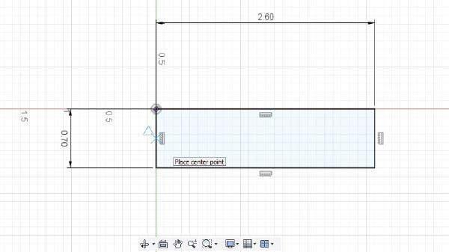
How to: Sketch
Select the XZ plane
Sketch section of the toolbar

Slide 6
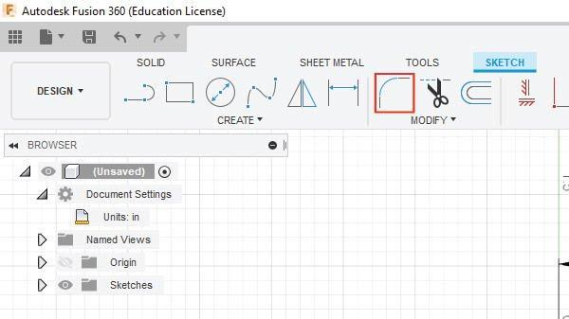
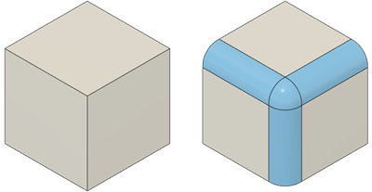
How to: Fillet
Select the Fillet tool from the Modify section of the toolbar and select one of the two intersecting lines

Slide 7
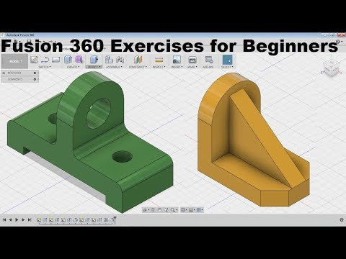
How to: Model- Extrude
0:44-1:00

Slide 8
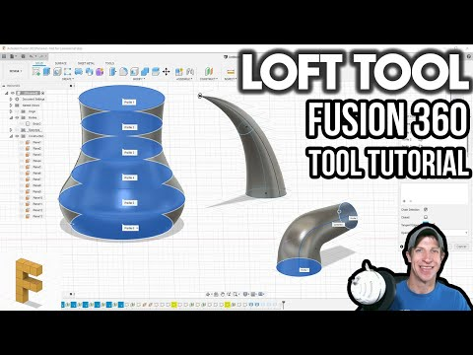
How to: Loft/Sweep
Loft (0:18-0:55) is used to create a 3D extrusion in any direction to connect two profiles of any shape. Sweep is similar except it only requires one profile and a path line.
These are useful for creating rectangular extrusions at an angle or circular extrusions in multiple directions (for any extrusions at an angle this is recommended).

Slide 9
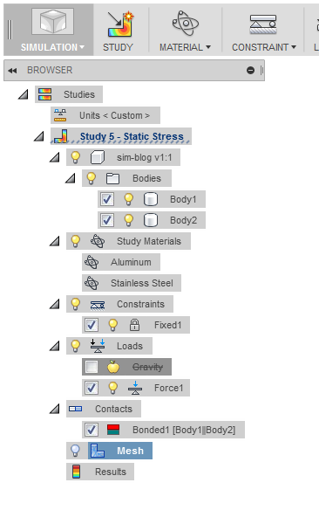
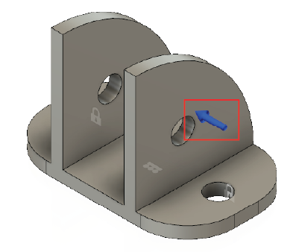
How to: Read Stress Test Results
To see the material of the model, open the Static Stress study in the Browser, and open the Study Materials tab.
In this image, you can see the direction of the force and the location of the constraints.
By double clicking the blue force arrow, you can determine the location of the load being applied and the magnitude of the force in Newtons.

Slide 10
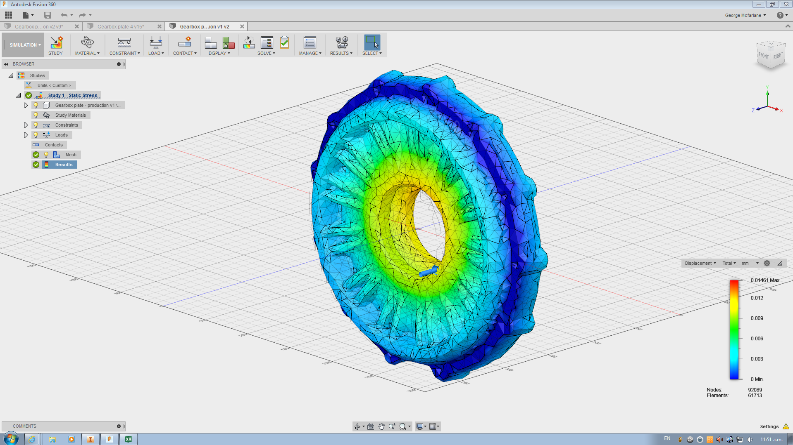
How to: Read Stress Test Results
In the Browser, select Mesh → Generate Mesh
The blue represents a safety factor of 8+, which means it can easily sustain the force being applied to it.
The green means it can sustain the load but it can border being unsafe.
The yellow means it can barely sustain the load and will start bending in that region.
Red means it will fracture and fail at that location.

Slide 11
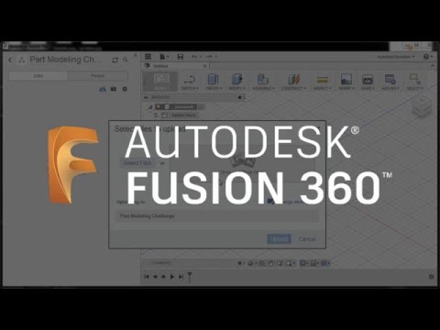
How to: Start a Project

Slide 12
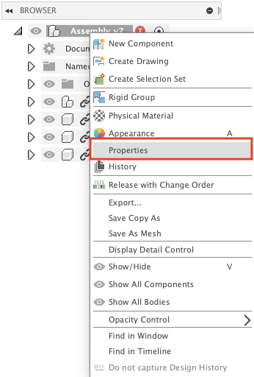
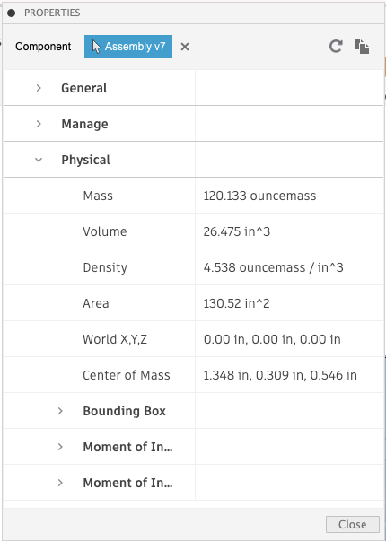
How to: Open Properties Tab
Right-click the model name at the top of the browser tree or a specific component of an assembly.
Select Properties.
Scroll down and expand the Physical section.

Slide 13
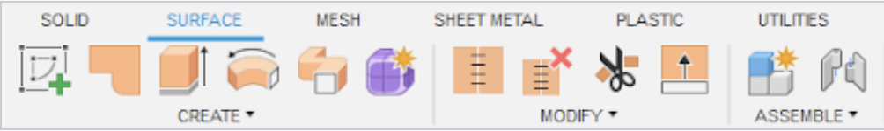
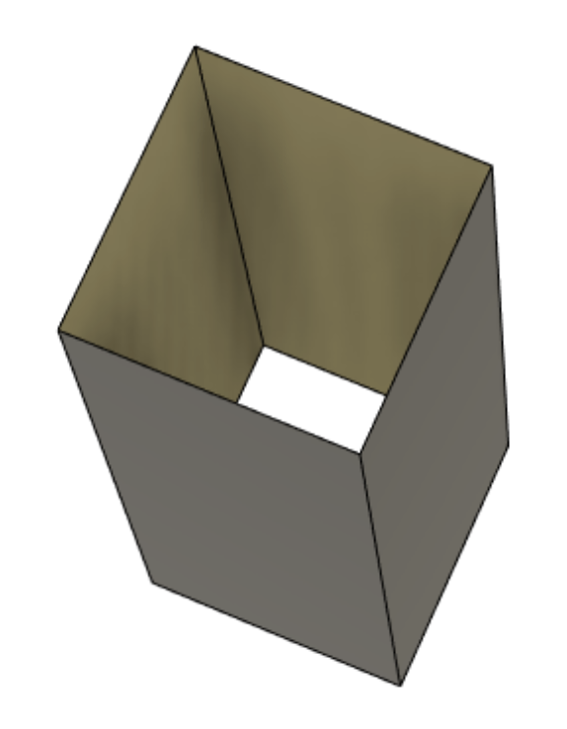
How to: Fixing Designs Made as Surfaces
Surface bodies can be made using the tools under the Surface tab indicated by the orange icons.
Below is an example of a surface extrude where the sides are extruded but there is no top or base closing the feature

Slide 14
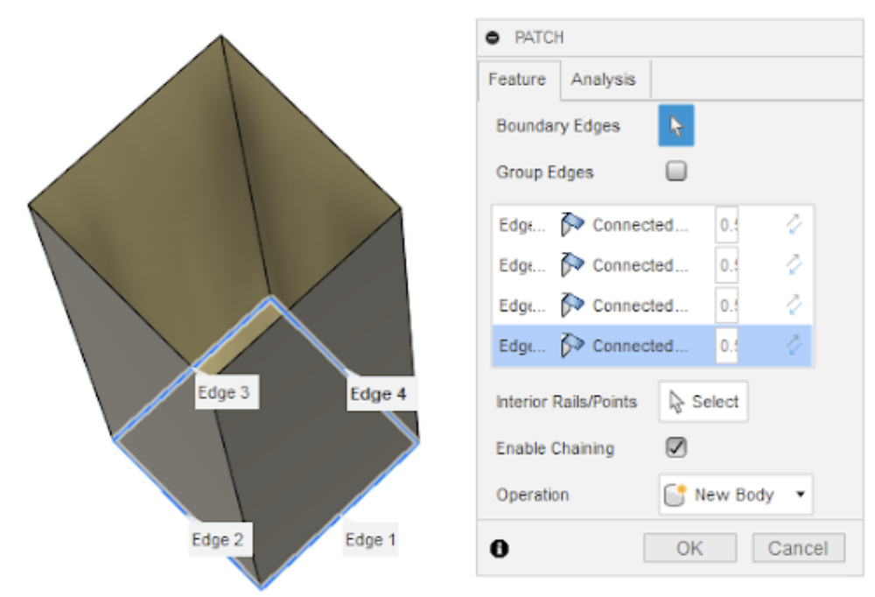
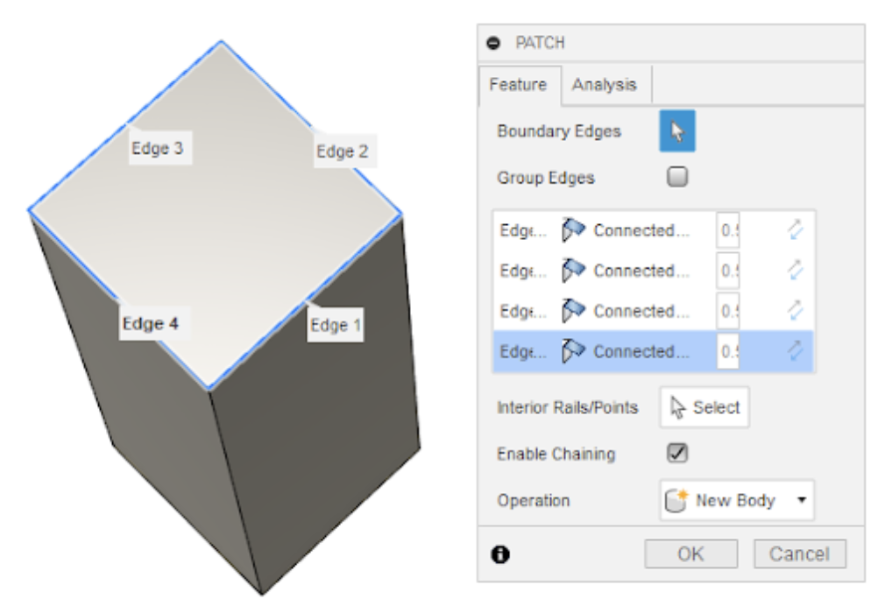
How to: Fixing Designs Made as Surfaces
The following steps will convert a surface body into a solid body.
1. Using the Patch under create, select an edge on one of the open faces and press OK on the window that appears on the right hand side.
2. Repeat Step 1 for the other open face.

Slide 15
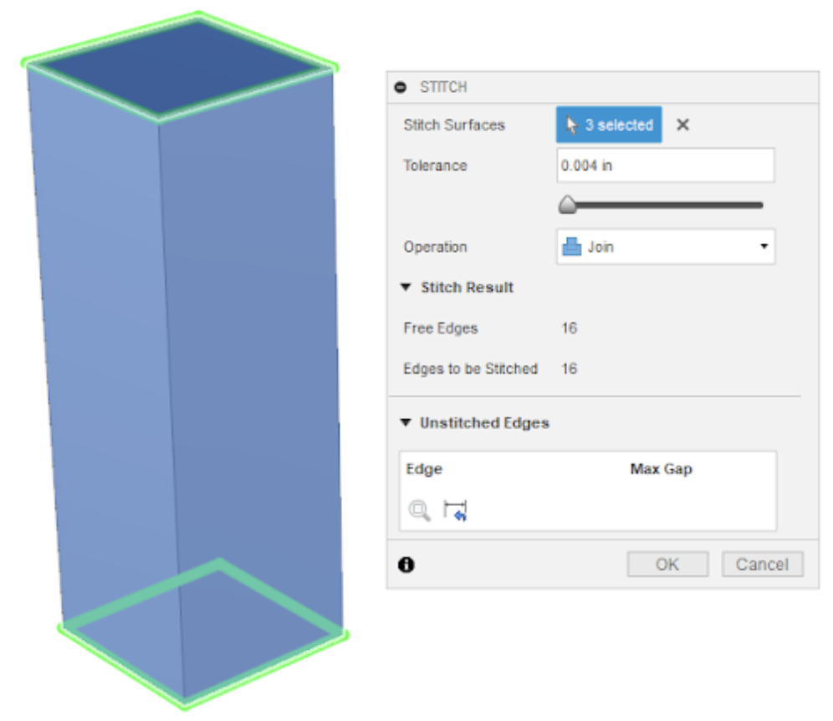
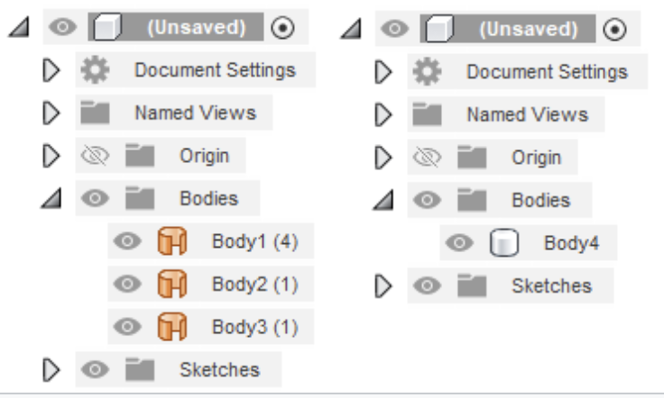
How to: Fixing Designs Made as Surfaces
3. Once all the sides have been fully enclosed, select the Stitch tool under modify and select all the faces. For Operation, select Join to combine the faces into a solid body and then select OK.
4. The changes can be confirmed by looking at the bodies in the file.

