Slide 1


INTRODUCTION TO LABVIEW & DIGITAL LOGIC
EG1003 | LAB 5

Slide 2

OVERVIEW
Objective
Background Information
Materials
Procedure
Assignment
Closing
Figure 1: Semiconductor Courtesy of Scoop.it
1

Slide 3
OBJECTIVE
Understand graphical programming in LabVIEW
Design two systems in LabVIEW that address a problem statement:
  Heating and cooling system
  Alarm system using digital logic
Obtain physical data with the virtual instruments
2

Slide 4
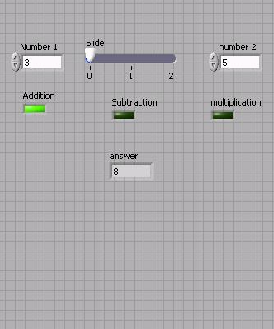
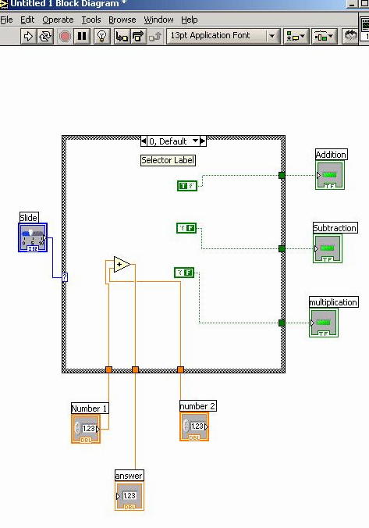
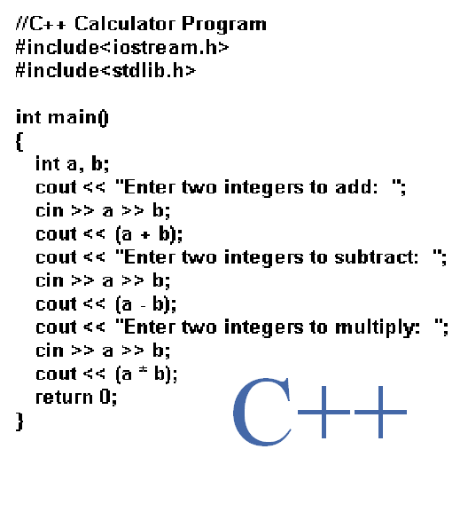
BACKGROUND INFORMATION
LabVIEW – Laboratory Virtual Instrument Engineering Workbench
  Used to design systems for data acquisition, instrument control,
  and industrial automation
  Uses graphical programming language based on G
Figure 2: Text-Based (Left)
and Graphic-Based (Right)
Programming Languages
3

Slide 5
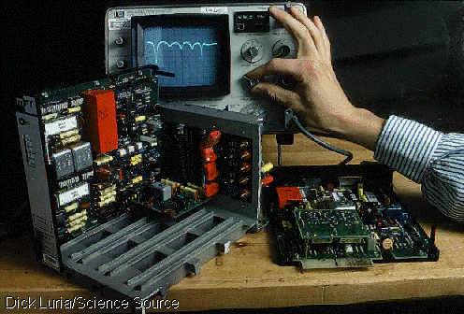
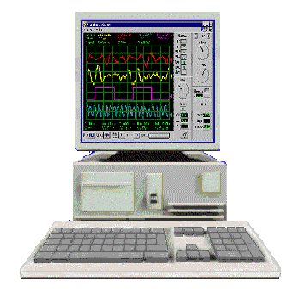
BACKGROUND INFORMATION
Virtual Instrument (VI) – programs created within LabVIEW
  Programming and functionality simulate physical instruments
  The instrument hardware is non-physical and based on the computer
Figure 3: Physical Instrument (Left) vs. Virtual Instrument (Right)
4

Slide 6
BACKGROUND INFORMATION
The LabVIEW interface:
  Front Panel
  where the program is controlled and executed, and the user interacts with the instrument
  Back Panel/Block Diagram
  where the program is written
5

Slide 7
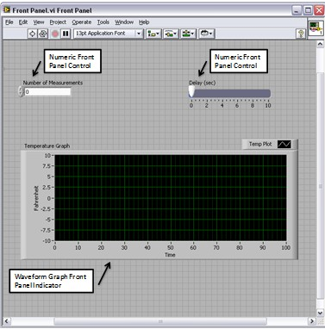
BACKGROUND INFORMATION
Front panel:
  Controls – inputs that allow a user to supply information to the VI
  Indicators – outputs that display results based on the inputs to the VI
  Controls and indicators are located on the controls palette
Figure 4: Controls and Indicators
Courtesy of National Instruments
6

Slide 8
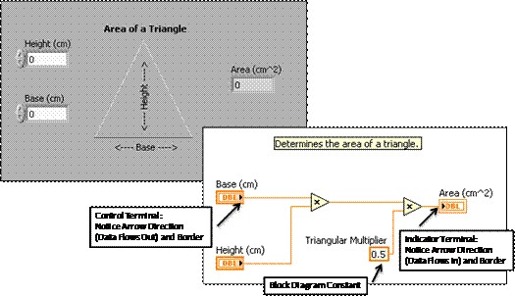
BACKGROUND INFORMATION
Back panel (aka block diagram):
  Terminals – objects placed on the front panel appear on the back panel
  Functions and structures – perform operations on controls and supply data to indicators
  Functions and structures are located on the functions palette
Figure 5: Terminals and Functions Courtesy of National Instruments
7

Slide 9

BACKGROUND INFORMATION
Tools palette – helps in navigating the environment of the back panel
  Operating tool – changes values of controls
  Positioning tool – positions, resizes, selects objects
  Labeling tool – creates and edits text
  Wiring tool – wires nodes on the back panel
  Scrolling tool – used to scroll in the window
Figure 6: Tools Palette
8

Slide 10
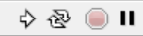
BACKGROUND INFORMATION
Toolbar – used to execute and stop the program
  Run – runs the program once
  Run Continuously – runs the program until the program is stopped
  Abort Execution – stops program
  Pause – pauses the program
Figure 7: Toolbar
9

Slide 11
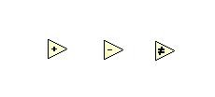
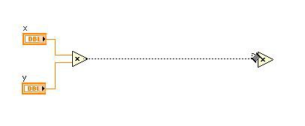
BACKGROUND INFORMATION
Functions – fundamental operating elements
  Have input and output terminals to pass data in and out
  Can perform numeric, Boolean, comparison operations, and more
Figure 8: Examples of Functions Courtesy of
National Instruments
10

Slide 12
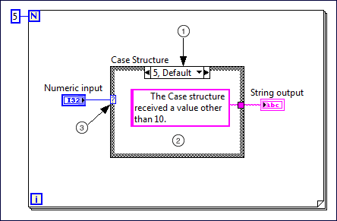
BACKGROUND INFORMATION
Structures – used for process control and include for loops, while loops, and case structures
Case structure – similar to if/else statements, contains multiple subdiagrams with different outputs depending on the input value
In Figure 9:
  1 – value for case to execute
  2 – code that executes for case
  3 – inputs data to case structure
Figure 9: Example of a Case Structure Courtesy of National Instruments
11

Slide 13
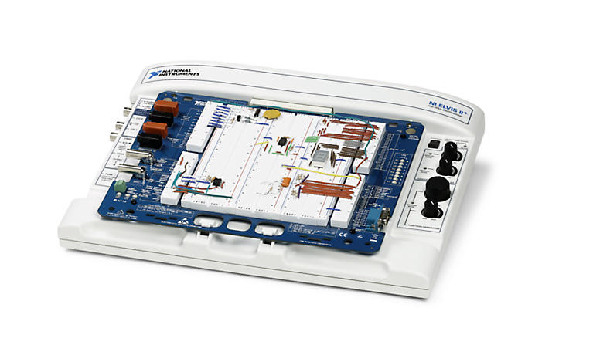
BACKGROUND INFORMATION
NI ELVIS II+ board – National Instruments' Educational Laboratory Virtual Instrumentation Suite
  Modular engineering device that includes a breadboard, power supply, ground, thermocouple, etc.
  Interfaces the VIs with physical devices
Figure 10: NI ELVIS II+ Board Courtesy of National Instruments
12

Slide 14
MATERIALS
Computer with LabVIEW 2019 software
Materials for in-person lab:
  NI ELVIS II+ prototyping board
  Prebuilt Heat Cube circuit
13

Slide 15

PROBLEM STATEMENT
Farmer Georgi has a hen on his 350-acre farm that produces high-quality eggs
  To maintain the quality of the eggs, he needs a heating & cooling system
  To protect the hen from a fox who has been wandering around the farm, he needs an alarm system
Figure 11: Farmer Georgi’s Farm
Courtesy of ThoughtCo
14

Slide 16
PROBLEM STATEMENT
Part I: Heating & Cooling System
Must be able to be controlled manually or automatically
In manual mode:
  The heater and AC can be turned on/off by the user
In automatic mode:
  The AC turns on when the temperature is above 80˚F
  The heater turns on when the temperature is below 60˚F
  Both are turned off when the temperature is between 60-80˚F
15

Slide 17
PROCEDURE
Part I: Heating & Cooling System
Create the system in LabVIEW – the exact steps are detailed in the manual
Interface the system with a heat cube to sense real-world temperature
Simulate the system…
  on an NI ELVIS II+ board (In-Person)
  on TinkerCAD (Remote)
Submit a ZIP file with both VIs to the EG1003 website by 11:59 PM the night before Lab 6
16

Slide 18
QUESTIONS?

Slide 19
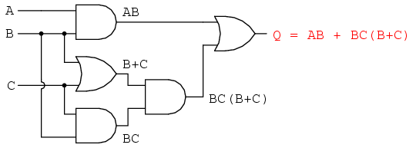
BACKGROUND INFORMATION
Digital logic:
  Conceptual language behind modern computer systems
  Two values of true and false (1 and 0) that lead to complicated decisions
Truth table – shows all the possible input combinations and their associated outputs (example on next slide)
Figure 12: Boolean Circuit Courtesy of
All About Circuits
18

Slide 20
BACKGROUND INFORMATION
Think of this example
An ATM has three options:
  Print statement
  Withdraw money
  Deposit money
The ATM will charge a fee when:
  Money is withdrawn
  A statement is printed without depositing money
Table 1: Truth Table for ATM Example
Inputs |  |  | Output
P (Print) | W (Withdraw) | D (Deposit) | C (Charge)
0 | 0 | 0 | 0
0 | 0 | 1 | 0
0 | 1 | 0 | 1
0 | 1 | 1 | 1
1 | 0 | 0 | 1
1 | 0 | 1 | 0
1 | 1 | 0 | 1
1 | 1 | 1 | 1
19

Slide 21
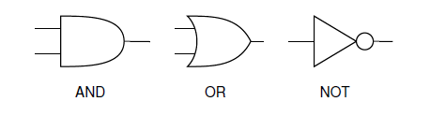



BACKGROUND INFORMATION
Logic gates:
  NOT gate – inverts the input
  AND gate – both inputs must be true for the output to be true
  OR gate – if either input is true the output will be true
Table 2: Logic Gates
 | NOT | AND | OR
Symbol
Arithmetic Operation
# of Inputs | 1 | 2+ | 2+
20

Slide 22
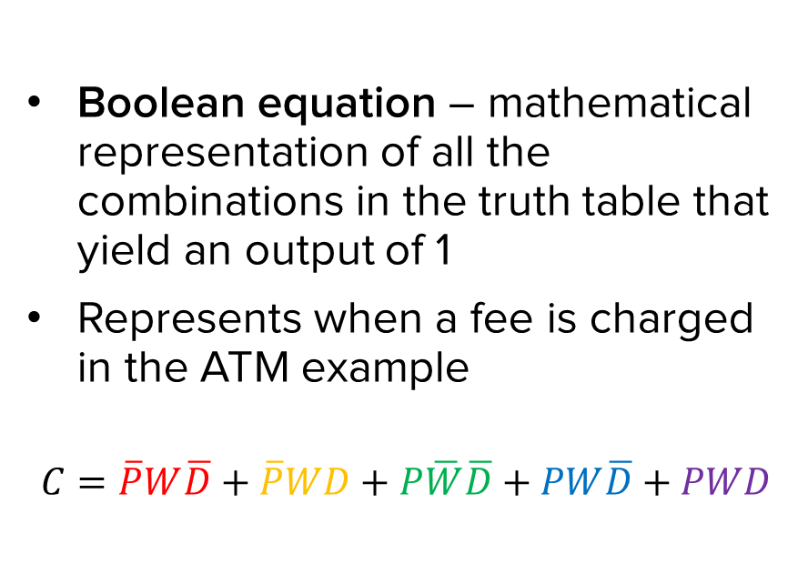
BACKGROUND INFORMATION
Table 3: Truth Table for ATM Example with True Combinations
Inputs |  |  | Output
P (Print) | W (Withdraw) | D (Deposit) | C (Charge)
0 | 0 | 0 | 0
0 | 0 | 1 | 0
0 | 1 | 0 | 1
0 | 1 | 1 | 1
1 | 0 | 0 | 1
1 | 0 | 1 | 0
1 | 1 | 0 | 1
1 | 1 | 1 | 1
21

Slide 23
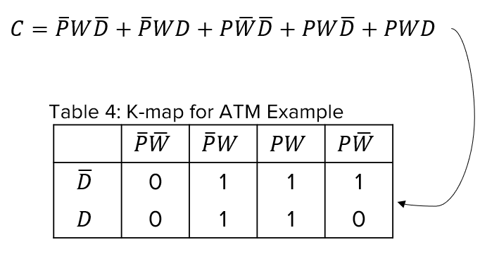
BACKGROUND INFORMATION
Karnaugh map (K-map) – two-dimensional representation that shows the common characteristics of the inputs
Only one value can change at a time between adjacent rows and columns
22

Slide 24
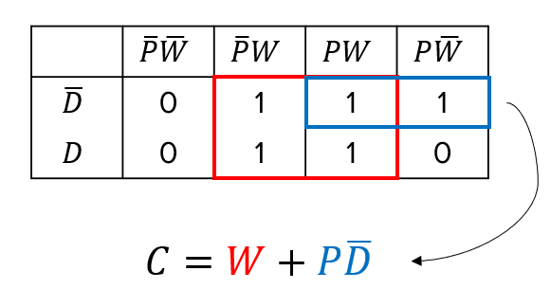
BACKGROUND INFORMATION
Simplified Boolean equation – mathematical representation of true values in the K-map
  Box together 1s in the K-map
  Number of cells in a box must be a
  power of 2 (1, 2, 4, 8, etc.)
  Look for the biggest boxes first
  Boxes can overlap
Simplified equation is determined by constant variable(s) in each box
23

Slide 25






BACKGROUND INFORMATION
Combinational logic circuit – graphical representation of the simplified Boolean equation
OR
AND
NOT
Figure 13: Combinational Logic Circuit for ATM Example
24

Slide 26
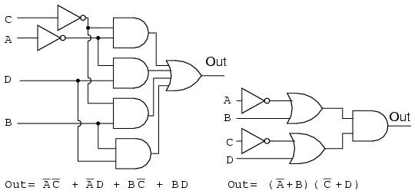
BACKGROUND INFORMATION
Minimization of Boolean functions
  K-map used to simplify complex Boolean equations
  Reduces complexity of logic circuit
  Increase efficiency and decrease cost in implementation
Figure 14: Complex Logic Circuit (Left) vs.
Simplified Logic Circuit (Right)
25

Slide 27
MATERIALS
Computer with LabVIEW 2019 software
Materials for in-person lab:
  A 7432 IC (4 dual-input OR gates)
  A 7408 IC (4 dual-input AND gates)
  A 7404 IC (6 single-input NOT gates)
  NI ELVIS II+ prototyping board
  Two 100 kΩ resistors
  Electrical leads
26

Slide 28
PROBLEM STATEMENT
Part II: Alarm System
Farmer Georgi has two barns
  Think of Barn 1 as “1” and Barn 2 as “0” in the truth table
A fox, hen, and corn can be in either barn at anytime
Design an alarm system that will sound when:
  The fox and hen are in the same barn
  The hen and corn are in the same barn
27

Slide 29
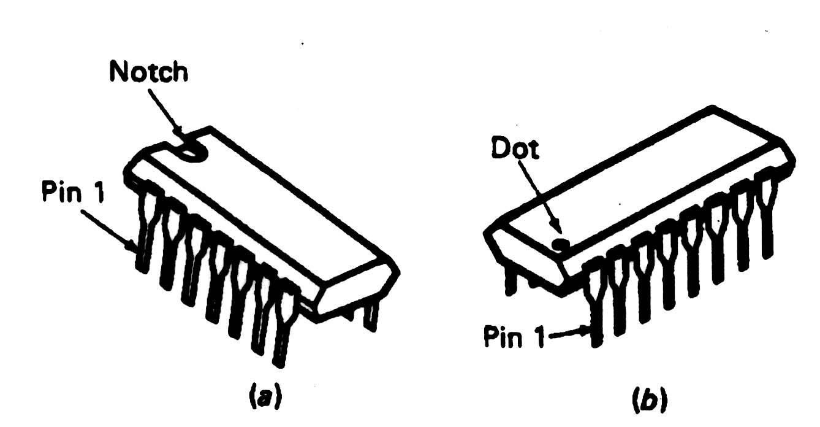
PROCEDURE
Part II: Alarm System
Create a logic circuit for the alarm system
  Build a truth table
  Create a Boolean equation
  Build a K-map
  Create a simplified Boolean equation
  Draw a combinational logic circuit
Build the logic circuit in LabVIEW
Figure 15: IC Chip
28

Slide 30
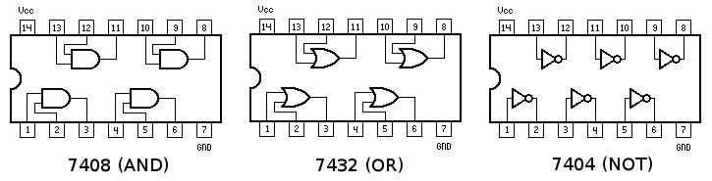
PROCEDURE
Part II: Alarm System
Test the integrated circuit (IC) chips (In-Person)
Circuit the system…
  on an NI ELVIS II+ board (In-Person)
  on TinkerCAD (Remote)
Figure 16: Diagram of AND/OR/NOT IC Chips
29

Slide 31
ASSIGNMENT
Submit a ZIP file with both VIs to the EG1003 website by 11:59 PM the night before Lab 6
Individual Extra Credit lab report:
  Answer discussion questions in manual
  Explain how k-maps help simplify the circuitry
  Include screenshots of the LabVIEW VIs (front and back panels)
  Include the truth table, both Boolean equations, and k-map
  Due at 11:59 PM the night before Lab 6
Team presentation:
  Address discussion points in manual
  Include screenshots of the LabVIEW VIs (front and back panels)
30

Slide 32

CLOSING
Submit a ZIP file of both VIs to the EG1003 website
Take screenshots of the front and back panels of the VIs
Everyone should use the software on their own computers
Submit all work electronically
31

Slide 33
CLOSING
Required Pre-Lab Activity for Lab 6:
Complete the online NYU Tandon MakerSpace Safety Orientation training
Requires watching three videos
  Covid-19 Policies and Updates
  Safety Orientation
  Ultimaker
Refer to the Lab 6A manual page for more information
17

Slide 34
QUESTIONS?

