Slide 1

RAPID ASSEMBLY & DESIGN (RAD) WORKSHOP
LAB 4B
EG 1004 Introduction to Engineering & Design

Slide 2


OVERVIEW
Objective
Background Information
Materials
Procedure
IDBE Implementation
Assignment
Closing
Figure 1: Raspberry Pi (Left) and OpenCV (Right) Courtesy of Wikipedia

Slide 3
OBJECTIVE
Explore the capabilities of the Raspberry Pi and Pi Camera Module
Develop a Python script for color detection using OpenCV
Control a servo motor with Raspberry Pi
Notes:
Maybe something about versus an Arduino

Slide 4
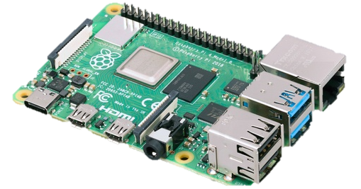
BACKGROUND INFORMATION
Raspberry Pi
  Credit card sized computer
  Used for electronic projects
  Runs on Raspberry Pi OS (a Debian-based operating system)
  Has a CPU, GPU, and RAM
Figure 2: Raspberry Pi 4
Notes:
Background info: The Pi, hardware of the pi, Python, OpenCV, NumPy, camera module

Slide 5
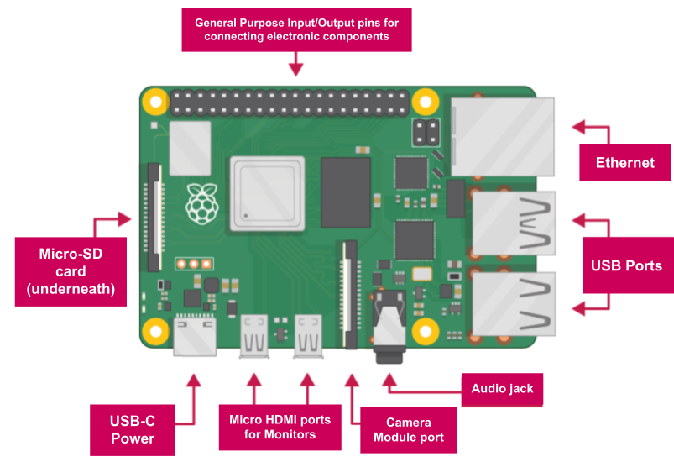
BACKGROUND INFORMATION
Raspberry Pi 4 - Hardware
  SD card slot
  USB ports
  Camera module port
  Micro HDMI port
  USB-C power
  Audio jack
  Ethernet port
Figure 3: Raspberry Pi 4 Hardware Overview

Slide 6
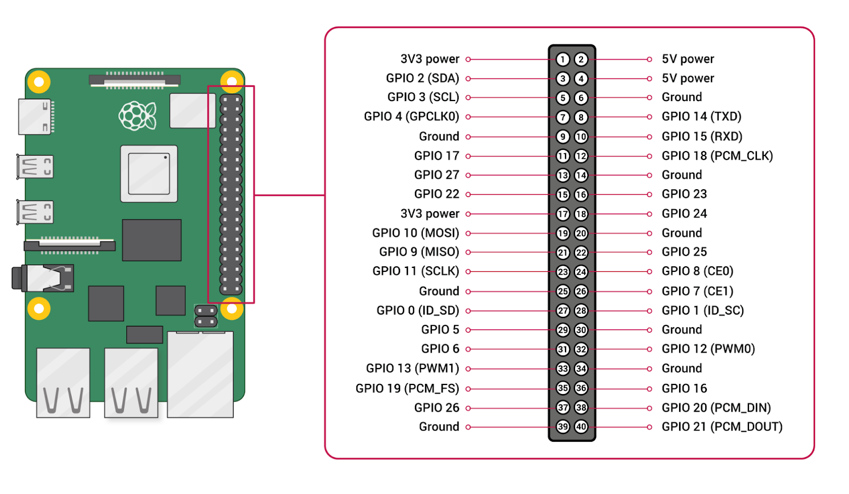
BACKGROUND INFORMATION
Raspberry Pi - Hardware
  28 General Purpose Input/Output (GPIO) pins
  4 Power pins
    Two 3.3V
    Two 5V
  8 Ground pins
Figure 4: Raspberry Pi GPIO Pinout

Slide 7
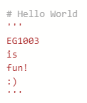
BACKGROUND INFORMATION
Python
  Text-based programming language
  Syntax
    No closing mark needed after each line
  Comments
    Line comments – begin with #
    Block comments – begin and end with ‘’’
Figure 5: Line and Block Comments

Slide 8
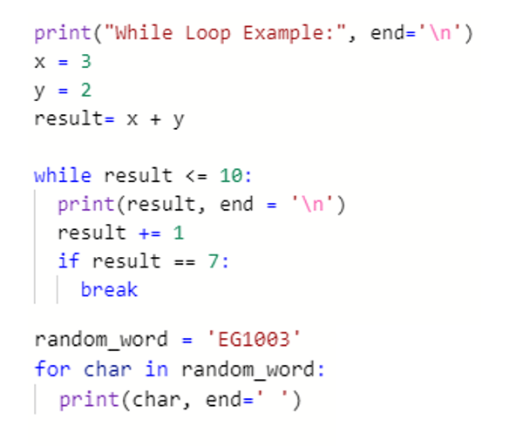
BACKGROUND INFORMATION
Python – Loops
  While loops
    Executed so long as the condition is true
  For loops
    Iterates over a set sequence
  Break statements
    Used to break out of a loop at any time, regardless of the condition
Figure 6: While and For Loops, and Break statements

Slide 9

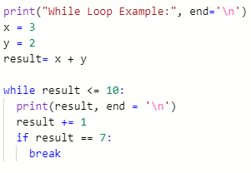
BACKGROUND INFORMATION
While Loop
For Loop
Break Statements
  Executed so long as the condition is true
  Executed so long as the condition is true
  Executed so long as the condition is true
Notes:
The video has NO AUDIO, so make sure to walk through and narrate what is happening. The first thing they do here is a loft, and then a sweep.

Slide 10
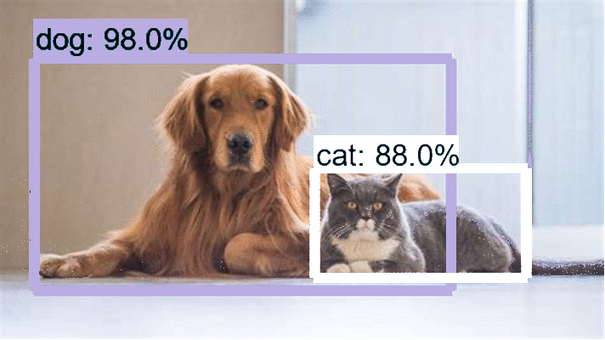
BACKGROUND INFORMATION
OpenCV – Computer Vision
  Image and video processing
  Object and Color Detection
  Applications
    Face recognition
    Driverless car navigation
Figure 7: Raspberry Pi 4 Hardware Overview

Slide 11
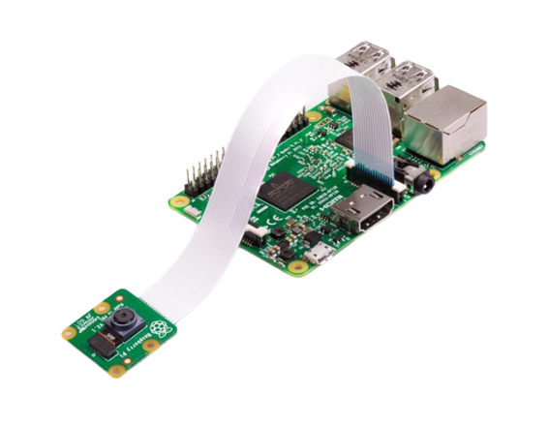
BACKGROUND INFORMATION
Pi Camera Module
  Used to capture still images and HD videos
  Ribbon cable attaches to the camera module port
  Controlled with Python code
    PiCamera Library
Figure 8: Raspberry Pi with Camera Module Courtesy of Raspberry Pi Foundation

Slide 12
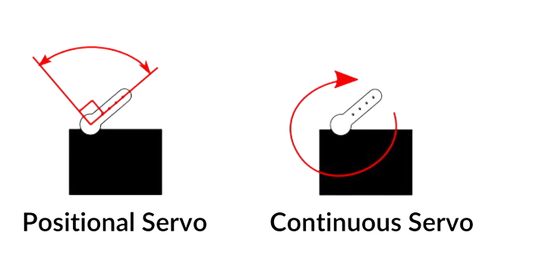
BACKGROUND INFORMATION
Servo Motors
  Continuous Rotation Servo
    Shaft spins continuously
    Definite control over speed & direction
  Positional Rotation Servo
    Can be written to a specific angle
    Range of rotation - 180°
    Definite position control
Figure 9: Positional vs. Continuous Servo Motors

Slide 13
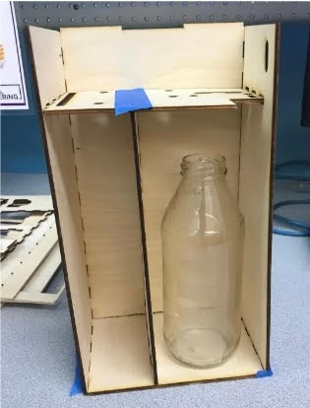
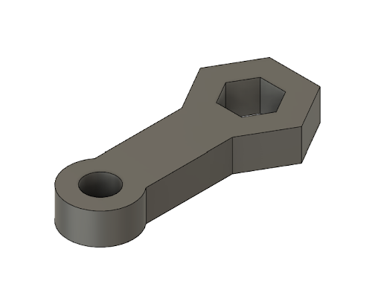
BACKGROUND INFORMATION
Manufacturing for RAD
  Parts can be 3D printed, laser cut, built in the OL craft station
  Examples include:
    Custom mechanical parts
    Custom structural parts
    Battery, motor shield, sensor housing units
Talk to your RAD mentor about using machines in the MakerSpace
Figure 10: Laser cut housing (left), Servo Motor attachment for hexagonal #2 pencil (right)

Slide 14
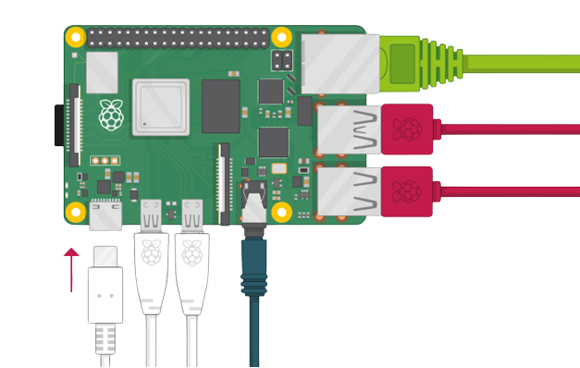
MATERIALS
Raspberry Pi with SD card
Raspberry Pi Camera Module
Monitor with Micro HDMI to HDMI Cable
USB Keyboard
USB Mouse
Power Supply
Continuous Servo
Figure 11: Raspberry Pi Setup
Courtesy of Raspberry Pi Foundation
Notes:
Maybe something about versus an Arduino

Slide 15
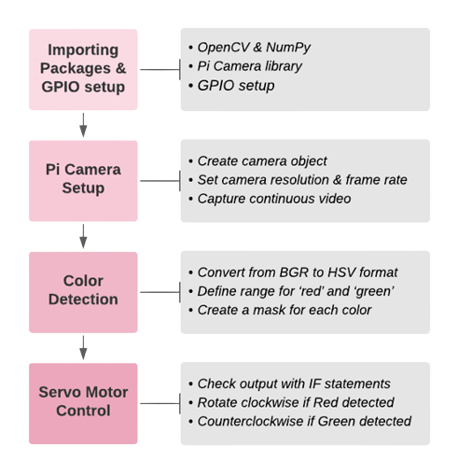
PROCEDURE
Part 1: Testing the camera module
Part 2: Color Detection using OpenCV
  Section 1 – Importing necessary packages
  Section 2 – Pi Camera Setup
  Section 3 – Color Detection for ‘Red’ and ‘Green’
  Section 4 – Servo Motor Control
Figure 12: Part 2 Workflow
Notes:
Maybe something about versus an Arduino

Slide 16

IDBE IMPLEMENTATION
Opportunity for Accessible Design
  Text-to-speech conversion
  Hazard detection for visually impaired
Consider:
  Who are you designing for?
  What changes could be made to improve accessibility and usability?
Figure 13: Accessible design supports a wide variety of people

Slide 17
ASSIGNMENT
No lab report for lab 4
No presentation for lab 4
Notes:
Maybe something about versus an Arduino

Slide 18
CLOSING
Have each section of the code approved by a TA
Handle the camera module gently!
Cameras are sensitive to static. Earth yourself prior to handling the module
All students must attempt to complete the code
TAs are always available for assistance
Notes:
Maybe something about versus an Arduino

Slide 19
QUESTIONS?
Notes:
Maybe something about versus an Arduino

Slide 20
NEXT STOPS
First mentor meeting!
Draft the Preliminary Design Investigation (PDI) report
Begin working on the Milestone 1 Presentation
Create a preliminary CAD drawing of the prototype
Create a preliminary flowchart of code
Finalize materials to be purchased and fabrication method(s)
Notes:
Maybe something about versus an Arduino

