Slide 1

RECITATION 4
EG1003

Slide 2
AGENDA
Ethics in Engineering
How to Give a Milestone Presentation
1

Slide 3
BRIEF REMINDERS
Unexcused absences are zeros
Each lecture is one percent of your final grade
To request a makeup lab go to EG website
Plagiarism is a very serious offense
Stay on top of deadlines
Learn from your mistakes
2
Notes:
Absences must be excused through the office of student affairs or you will not be able to complete makeup labs, receive a grade for your report or presentations. Communication is key!
Attendance at lecture adds up over time, make it a priority to attend every lecture.
If your lab absence is excused/in the process of being excused, you may request a makeup lab through the EG website.
Plagiarism is not a small slip up. It is a very major offense. Remember that for most courses, including this one, software are used to detect plagiarism.
Stay on top of your deadlines- this is a tough way to loose points since you are doing the work anyway, just do it on time.
Grow from mistakes you’ve made on presentations and lab reports by reviewing feedback from your TAs, Professors and Writing Consultants. As the semester goes on, you will be penalized for repeatedly making the same mistakes

Slide 4
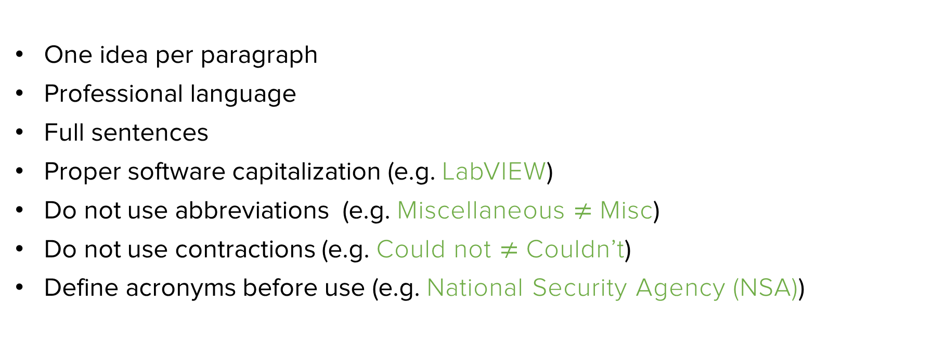
LAB REPORT TIPS
One idea per paragraph
Professional language
Full sentences
Proper software capitalization (e.g. LabVIEW)
Do not use abbreviations (e.g. Miscellaneous $≠$ Misc)
Do not use contractions (e.g. Could not $≠$ Couldn’t)
Define acronyms before use (e.g. National Security Agency (NSA))
3
Notes:
As you continue to write more lab reports, keep these common mistakes in mind. Also remember to read the feedback on your lab reports and make corrections in future reports.

Slide 5
ETHICS IN ENGINEERING

Slide 6
What ethical issues will arise with the advent of autonomous vehicles?
DISCUSSION QUESTION
5
Notes:
**Give students time to discuss this question in groups and/or have a larger group discussion**

Slide 7
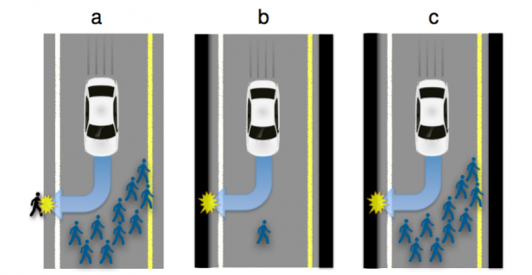
ETHICS OF AUTONOMOUS VEHICLES
Who decides the value of human lives?
Figure 1: Traffic situations with inevitable harm
6
Notes:
Option A has two outcomes: the car can continue straight on course and kill several pedestrians or swerve and kill one passer-by
Option B has two outcomes: the car can continue straight on course and kill one passer-by or swerve and kill its passenger
Option C has two outcomes: the car can continue straight on course and kill several pedestrians or swerve and kill its passenger
There are not objective, correct answers to each of these situations. Autonomous technology cannot make its own ethical decisions, the engineers who program and design the technology do.

Slide 8
What ethical issues will arise with the advent of at home genetic testing?
DISCUSSION QUESTION
7
Notes:
**Give students time to discuss this question in groups and/or have a larger group discussion**

Slide 9
What ethical issues will arise with the advent of facial recognition?
DISCUSSION QUESTION
8
Notes:
**Give students time to discuss this question in groups and/or have a larger group discussion**

Slide 10
ETHICS SUMMARY
New technology will raise many ethical questions
Your technical perspective and voice will be important
You must work with policy-makers, business leaders, and the public
National Society of Professional Engineers Code of Ethics (https://www.nspe.org/resources/ethics/code-ethics)
  Fundamental Canons
  Rules of Practice
  Professional Obligations
2
Notes:
Absences must be excused through the office of student affairs or you will not be able to complete makeup labs, receive a grade for your report or presentations. Communication is key!
Attendance at lecture adds up over time, make it a priority to attend every lecture.
If your lab absence is excused/in the process of being excused, you may request a makeup lab through the EG website.
Plagiarism is not a small slip up. It is a very major offense. Remember that for most courses, including this one, software are used to detect plagiarism.
Stay on top of your deadlines- this is a tough way to loose points since you are doing the work anyway, just do it on time.
Grow from mistakes you’ve made on presentations and lab reports by reviewing feedback from your TAs, Professors and Writing Consultants. As the semester goes on, you will be penalized for repeatedly making the same mistakes

Slide 11
QUESTIONS?

Slide 12
HOW TO GIVE A MILESTONE PRESENTATION

Slide 13
MILESTONES & BENCHMARKS
Milestones
Three Milestones through semester (1, 2 & 3)
Each Milestone has a presentation
Update progress on semester-long design project (SLDP)
Benchmarks
Two Benchmarks during semester
(A and B)
List of tasks to complete for each Benchmark
Tasks are semester-long design project (SLDP) dependent
16

Slide 14
MILESTONE PRESENTATION
OVERVIEW
Three Milestone presentations through the semester
Timed five-minute presentation
Update on progress of SLDP
Professional sales pitch presentation
Be a bit more creative with these presentations!
17

Slide 15
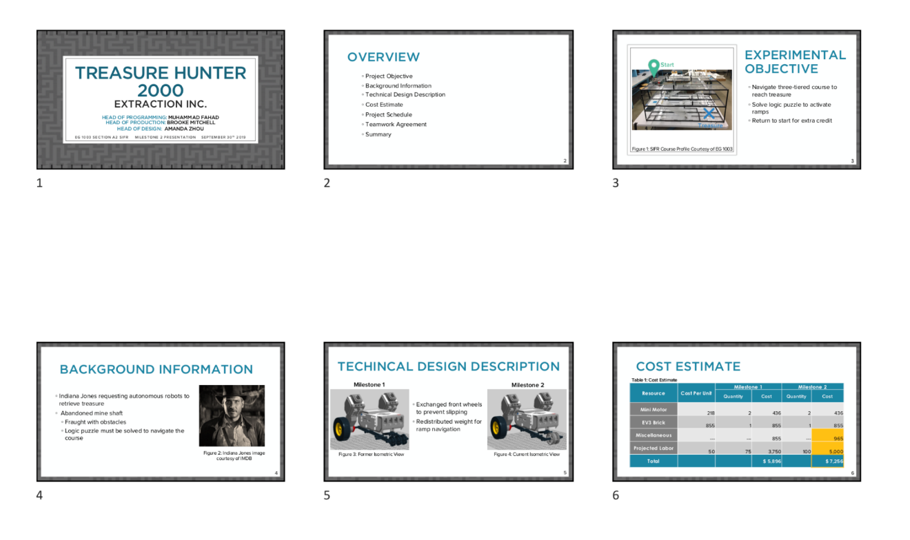
MILESTONE PRESENTATION
OVERVIEW
Submission:
EG1003 Website at 11:59 PM night before recitation
Figure 7: Multiple slide view
18

Slide 16
MILESTONE PRESENTATION
FORMAT
Consistent format and order for all Milestone presentations:
Title
Agenda
Project Objective
Background Information
Technical Design Description
Cost Estimate
Project Schedule
Teamwork Agreement
(MS 1 Only)
Summary
Title
Different format than lab presentations!
19

Slide 17

TITLE SLIDE
Product name
Company name
Group members with company titles
EG1003 section
Date
You create! Remember to be professional!
Figure 8: Title sample slide
20

Slide 18
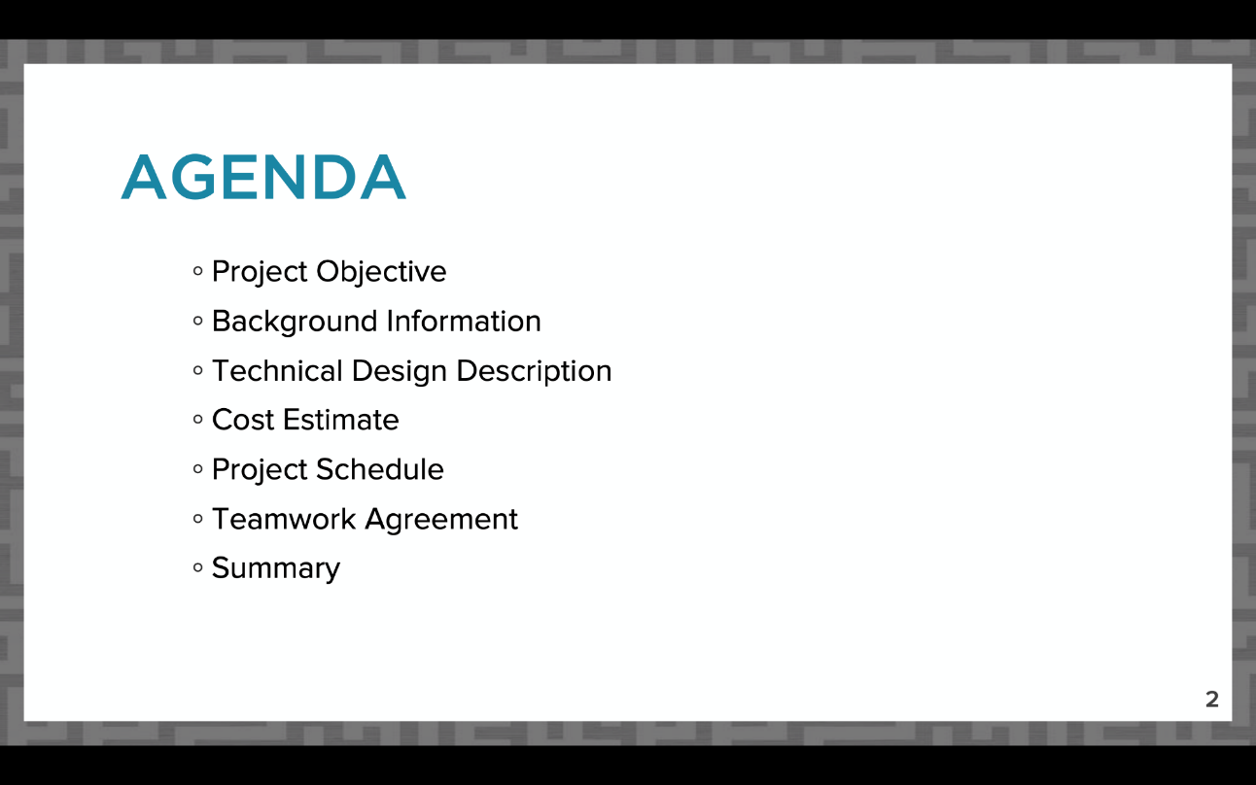
AGENDA SLIDE
Slide title “Agenda”
No need to read slide aloud during presentation
Same agenda slide/order for all Milestone presentations!
Figure 9: Agenda slide sample
21

Slide 19
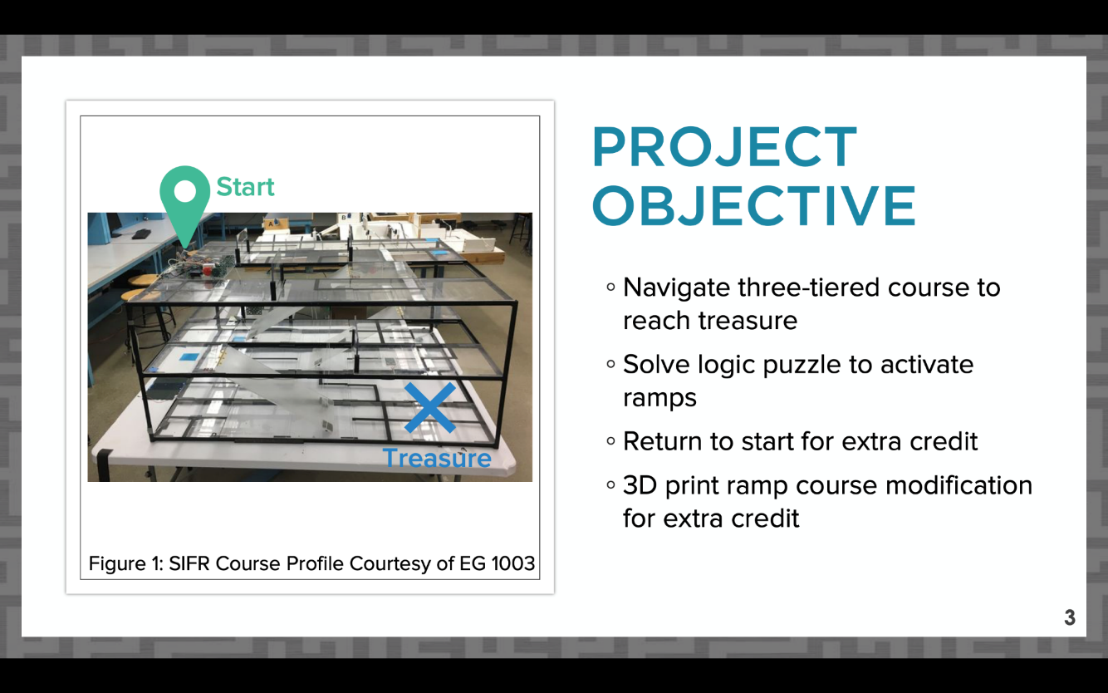
PROJECT OBJECTIVE SLIDE
Slide title “Project Objective”
What are you doing in your project?
Include overall approach
Extra credit points you’re aiming to earn
Figure 10: Project objective sample slide
22

Slide 20
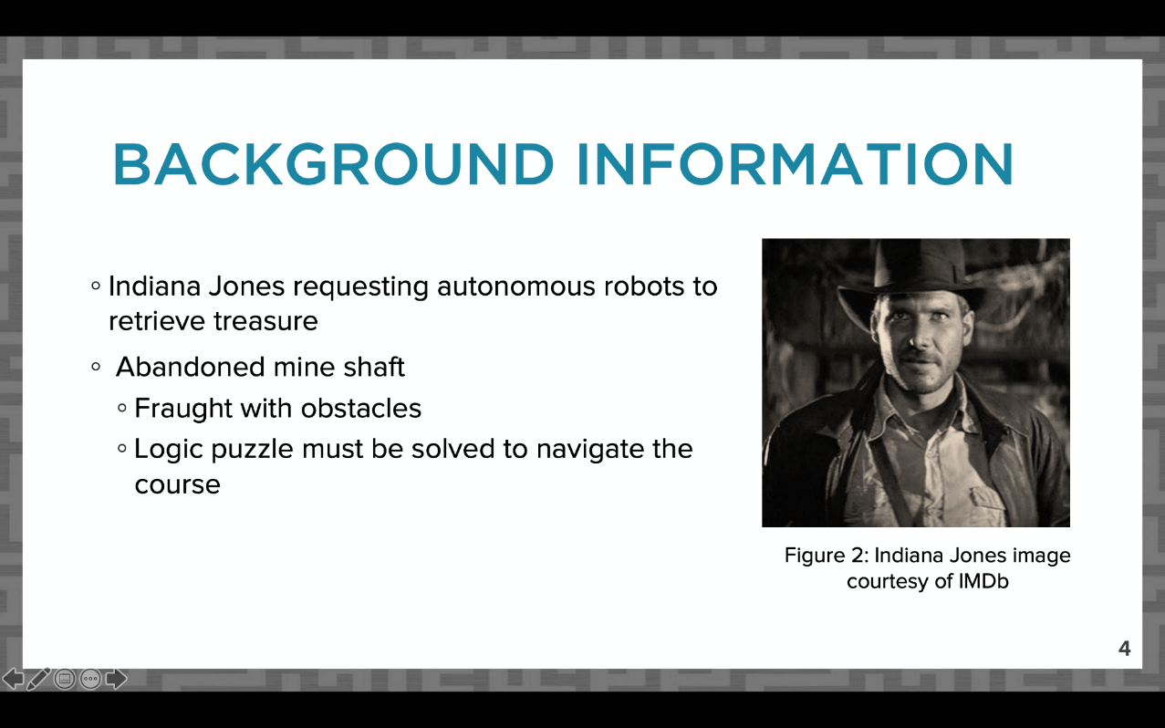
BACKGROUND INFORMATION
SLIDE
Slide title “Background Information”
Why are you completing the project?
Paraphrase project description from student manual
Include a short mission statement
Figure 11: Background information sample slide
23

Slide 21
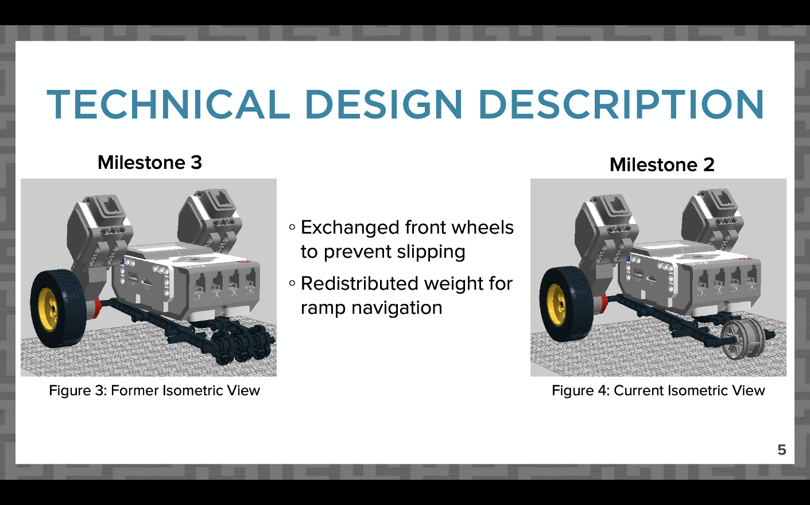
DESIGN DESCRIPTION SLIDES
Slides titled “Technical Design Description”
How does your project work?
All required CAD views
Coding snapshot and description
(if applicable)
For future Milestones, compare changes in design
Figure 12: Sample CAD design change comparison
24

Slide 22
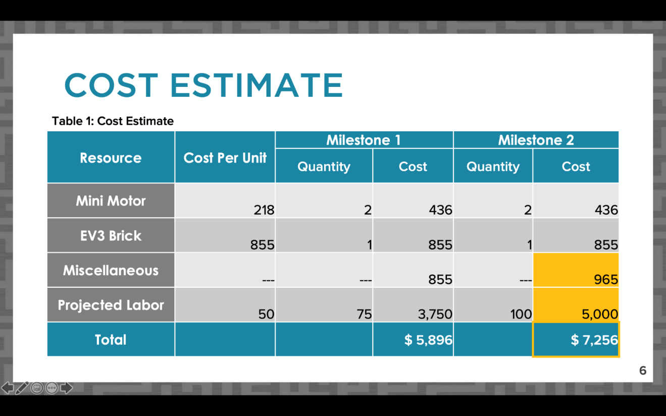
COST ESTIMATE SLIDE
Slide title “Cost Estimate”
Table should be professional and readable
List major parts individually, group smaller cost items under “miscellaneous”
Include labor cost for projected hours worked
Figure 13: Sample cost estimate slide
25

Slide 23
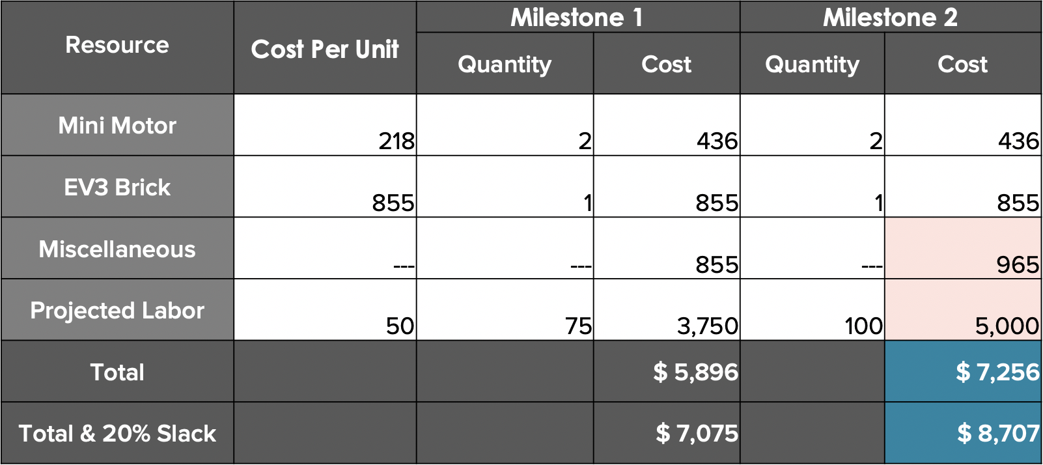
COST ESTIMATE SLIDE
Compare changes in cost between Milestones
Full dollar amounts
Highlight total cost
Use online cost resources
Optional 20% slack for unexpected costs
Table 1: Sample cost estimate
26

Slide 24
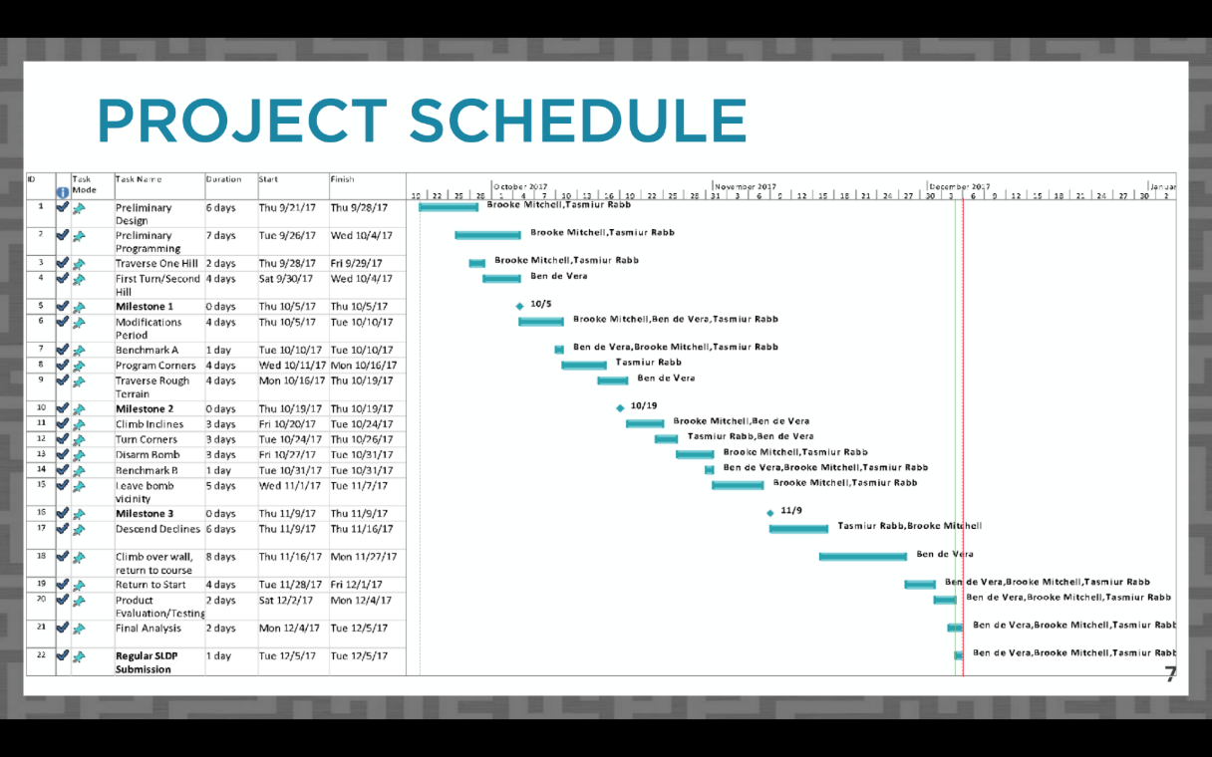
PROJECT SCHEDULE SLIDE
Slide title “Project Schedule”
Copy picture function
  Do not screenshot
Include table, Gantt chart, and
progress line in image
Refer to Microsoft Project Student Guide presentation for instructions
  VCL copy picture instructions
Figure 14: Project schedule sample slide
27

Slide 25
TEAMWORK AGREEMENT SLIDE
Slide title “Teamwork Agreement”
Milestone 1 presentation only
Full instructions for agreement on student manual
Summarize agreement:
  Communication
  Meetings
  Differences in opinion
  Responsibilities
  Workload
28

Slide 26
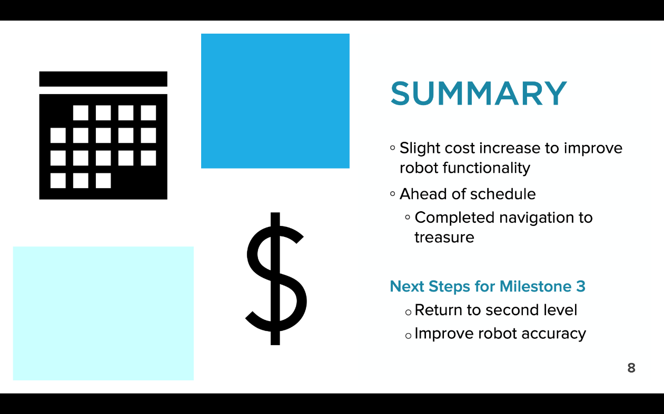
SUMMARY SLIDE
Slide title “Summary”
Overall assessment on project
Are you on schedule?
Are you on budget?
Include next steps for the following milestone
Figure 15: Conclusion sample slide
29

Slide 27
QUESTIONS?

