Slide 1
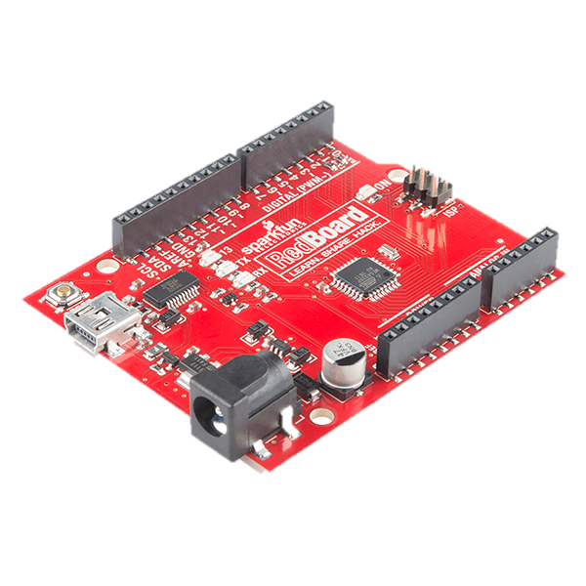
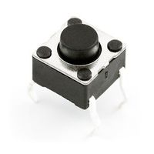
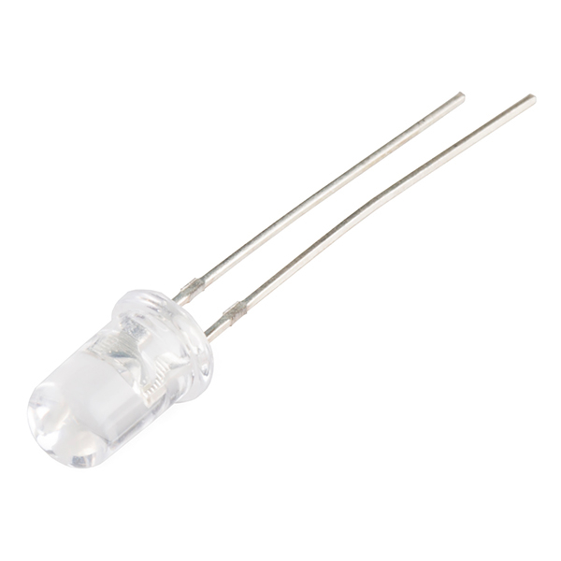
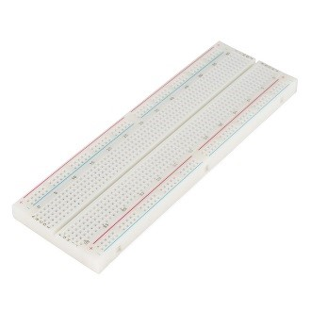
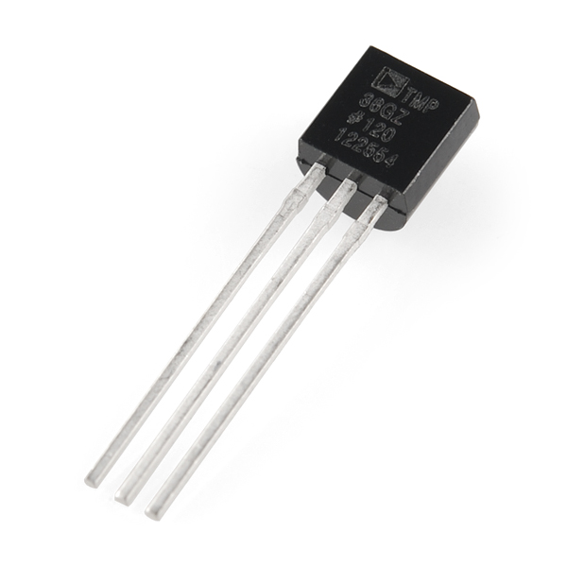
Prototyping with Microcontrollers
and Sensors

Slide 2
Overview
Objective
Background Information
Problem Statement
Materials
Procedure
Assignment
Closing

Slide 3
Objective
Demonstrate basic principles of electricity,
breadboarding, and Arduino programming

Slide 4
Background Information
Electricity
Movement of electrons
Electrical voltage: difference in charge
Measured in Volts (V)
Electrical current: movement of electrons when there is a difference in charge
between two points in a conductive wire.
Measured in Amperes (A)
Flows opposite of the electrons
Electrical resistance: certain materials resist a flow of electrons
Measured in Ohms (Ω)

Slide 5
Ohm’s Law
V = I * R
Mathematical relationship between current, voltage and resistance
Only when you have a resistor!

Slide 6
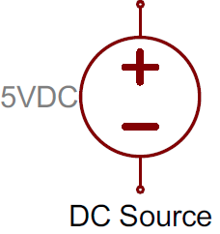
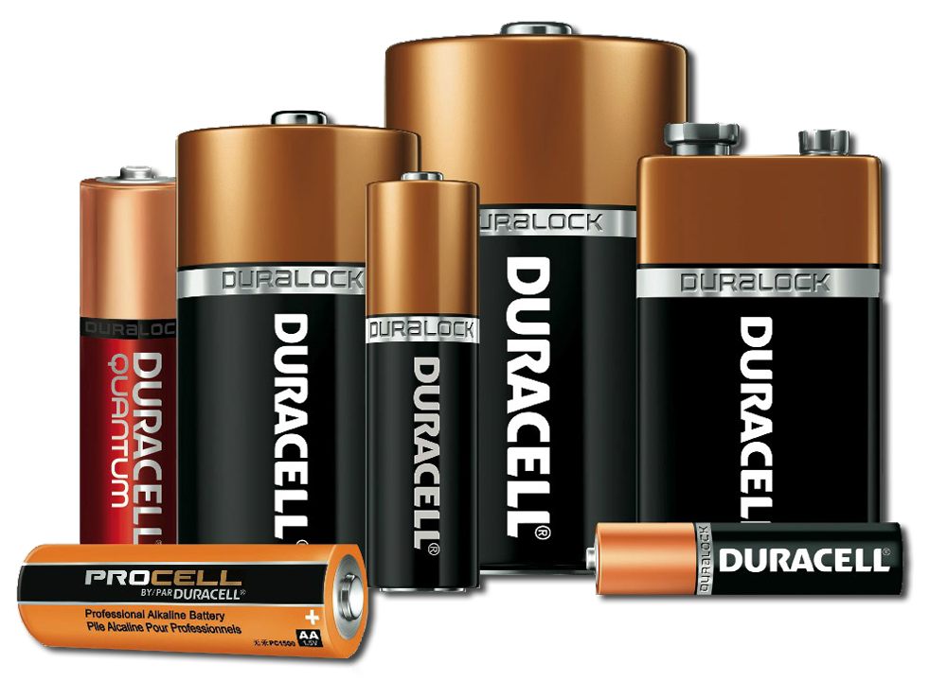
Electronic Components
DC (Direct Current) Voltage Sources
Powers circuits due to a voltage difference between terminals
Usually batteries (AA, AAA, etc.)
Polarized

Slide 7
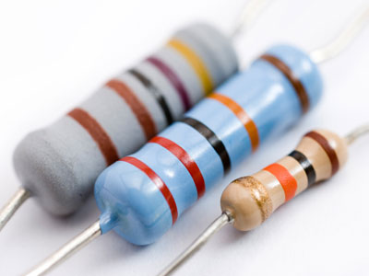
Electronic Components
Resistors: components that reduce the amount of current flowing through a circuit
Convert the current to thermal energy
Can be used to control voltages and currents
Color-coded with their resistance
Not polarized

Slide 8
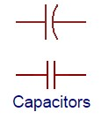
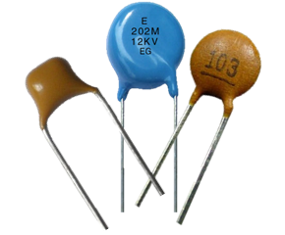
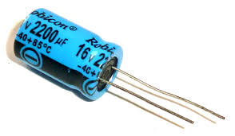
Electronic Components
Capacitors: store energy in an electrical field and
dissipate it at a later time
Capacitance: measure of how much charge a capacitor can store
Measured in Farads (F)
Consistent voltage released
Can be polarized

Slide 9
Electronic Components
Inductors: store energy in a magnetic field and then
dissipate it at a later time
Inductance: measure of how much energy an inductor can store
Measured in Henries (H)
Consistent current
Not polarized

Slide 10
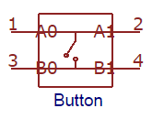
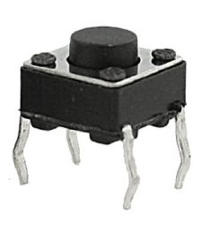
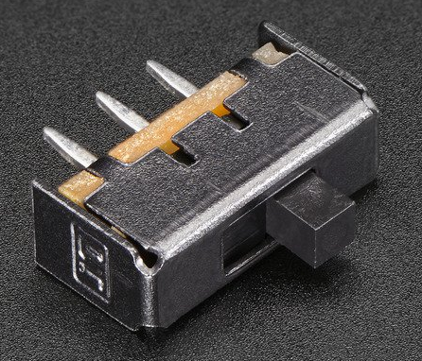
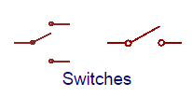
Electronic Components
Push Buttons and Switches: mechanical devices that
interrupt or divert current
Basic push buttons are polarized
Basic switches are not polarized

Slide 11
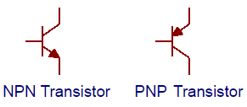
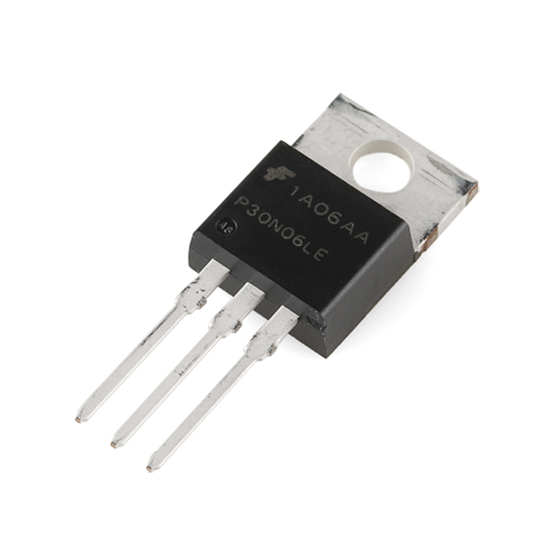
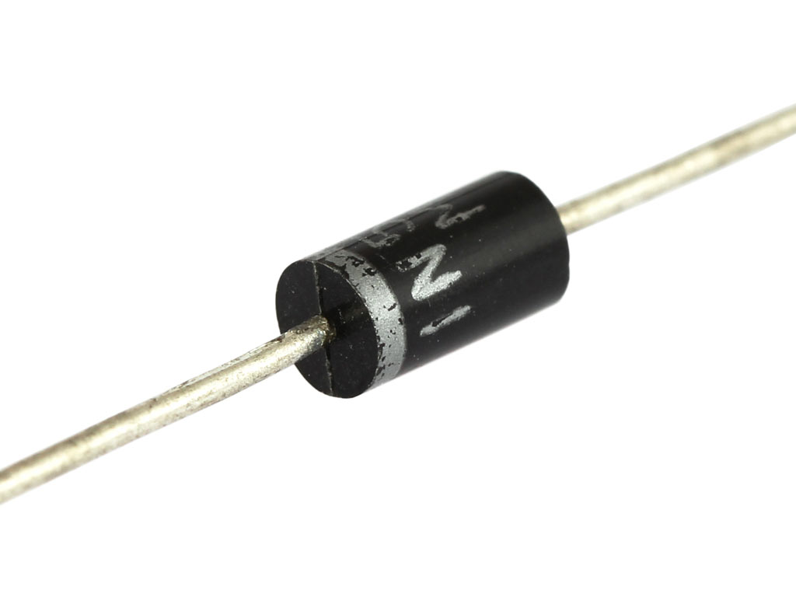
Electronic Components
Diodes and Transistors (BJT/MOSFETS)
Diodes: components that allow current to only pass in one direction
MOSFETs: electrical components that act as electrically controlled switches

Slide 12
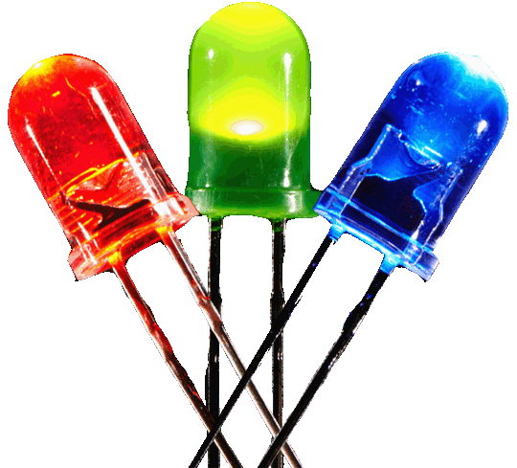
Electronic Components
Light Emitting Diodes (LEDs): small electric lights
that require low voltages and currents
Orientation matters!
Usually require a resistor (typically 220 Ω or 470 Ω)
Polarized!

Slide 13
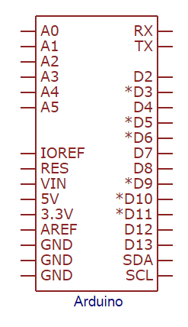
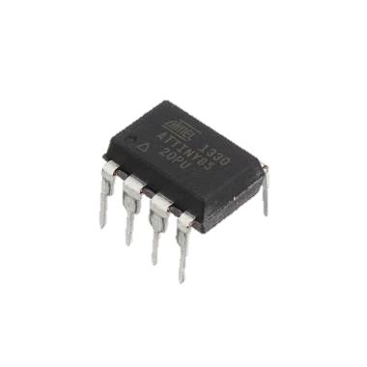
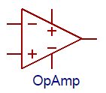
Electronic Components
IC (Integrated Circuit) Chips: small electrical
circuits that usually carry out one specific
purpose
Come in all sizes, specifications, and for all purposes
Comparators: they compare two different voltages
IC chips ARE polarized

Slide 14
Electronic Components
Analog vs. Digital Signals
An electrical signal is a quantifiable voltage that carries information
Digital Signals Analog Signals
Have two discrete states: LOW and HIGH When signal is LOW, most devices output a voltage level of 0V. When signal is HIGH, most devices output a voltage level of 5V (or 3.3V) | Infinite amount of voltage values The range 0V-5V is mapped to the range 0-1023 Example: Value 255 = ~1.246V Many electronic components are inherently analog

Slide 15
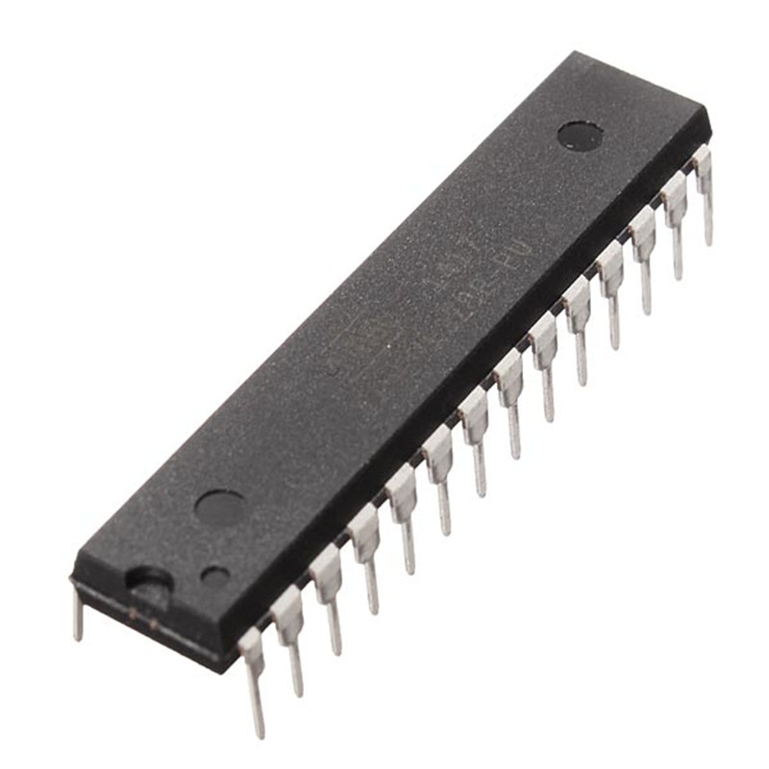
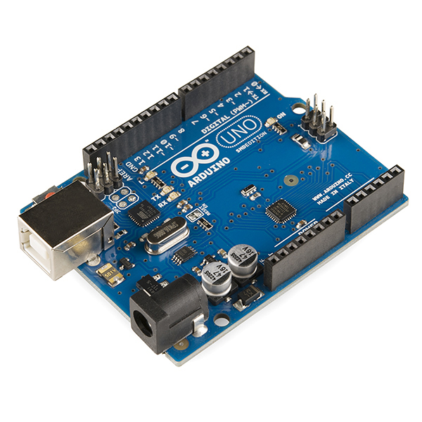
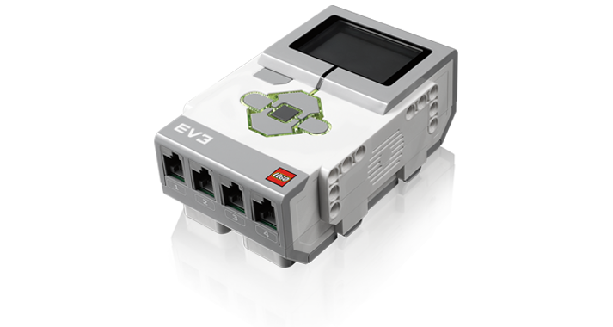
Microcontrollers
Microcontrollers: low-cost, programmable computers
without any of the peripherals (such as a mouse,
keyboard, or a screen)
Have direct access to the input and output pins
Reads from sensors and performs actions accordingly
Are present in many electrical appliances (such as microwaves)

Slide 16
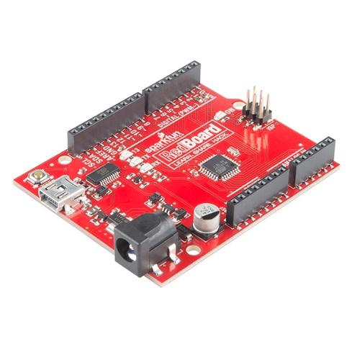
We will be using an Arduino UNO board created by Sparkfun for this lab

Slide 17
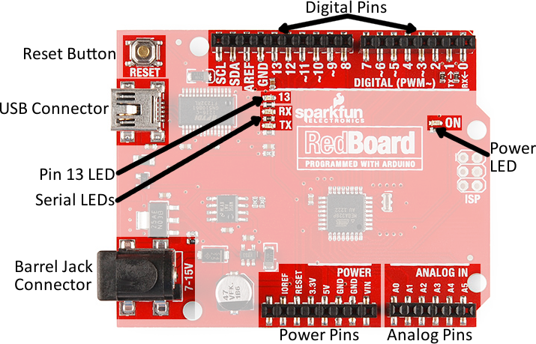
Arduino Hardware
Overview of the RedBoard
Reset Button: restarts the board
USB Connector: provides power and connects to computer
Pin 13 LED: operable without making an LED circuit
Serial LEDS: shows if the Arduino is transmitting or receiving data from pins 0, 1, or the USB connection

Slide 18
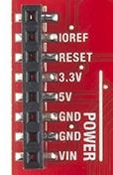
Power Pins
Power Pins
3.3V: Usually used to power low-voltage sensors
5V: Most common power pin used to power circuits
GND: Ground pin (0V)
VIN: Voltage-In can be used to power the board using a battery

Slide 19
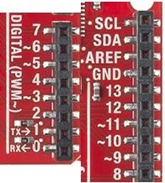
I/O Pins
I/O Pins
A0-A5: identical analog pins that can read sensors or control analog devices
Pins A0-A3 are more stable than A4-A5
Pins 0-1: transmitting and receiving pins
Not used in this lab
Pins 2-12: digital pins that can switch between HIGH states and LOW states
Pin 13: connected to the on-board LED

Slide 20
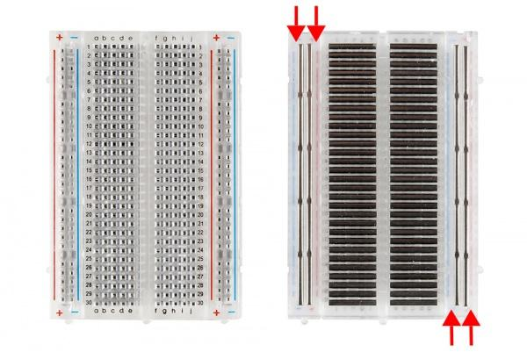
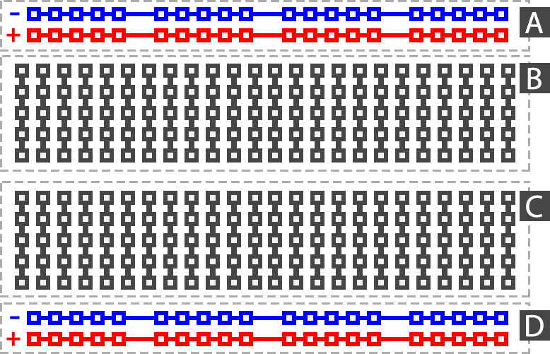
Building Circuits on a Breadboard
Breadboards: are small boards that are commonly used for circuit prototyping

Slide 21
Arduino Programming
The Arduino programming language is based on C/C++, but it is designed to be simpler and easier to learn.
The most intuitive way to think about programming is like building with LEGO blocks: you are given certain rules you have to follow and different building blocks to use.

Slide 22
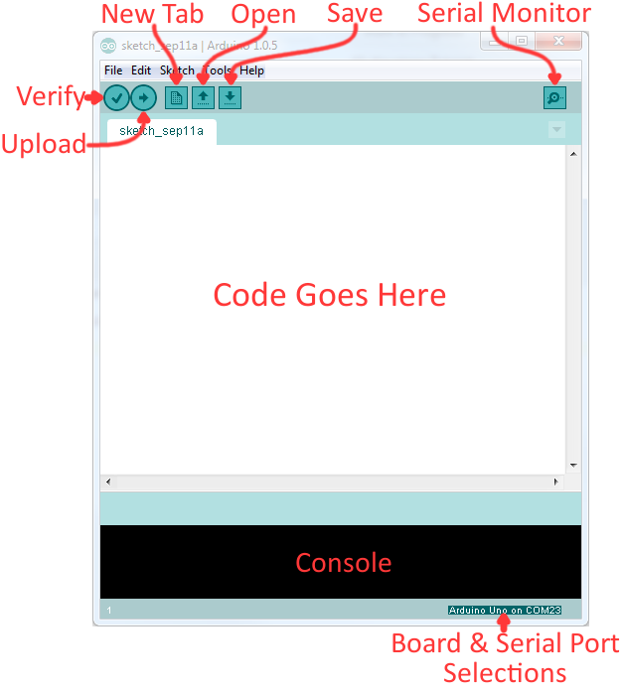
The Arduino IDE
Verify: checks code for errors and points to where the errors occurred
Upload: verifies and sends code to the Arduino board if no errors
Console: shows any errors the software found in hardware
Serial Monitor: a tool to see the program as it’s running

Slide 23
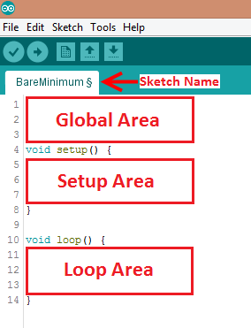
The Arduino IDE
Programs written in Arduino
are called sketches with 3 different areas:
Global: Important variables, constants and imported libraries
Setup: activates the pins and sensors used
this code only runs once
Loop: code that runs continuously
Ex. reading sensors and turning pins HIGH or LOW

Slide 24
The Rules and Building Blocks
General Rules:
Every line must end with a semicolon ‘;’ UNLESS it’s a conditional, loop, function or imported library
Always unplug the Arduino before modifying circuit
Comments start with a //
Text that the program ignores
Used to label and explain code

Slide 25
Constants and Variables
Variables store different types of data (numbers, letters, sentences, etc.)
Change what data they hold through mathematical operations
Constants cannot change their value

Slide 26
Datatypes

Slide 27
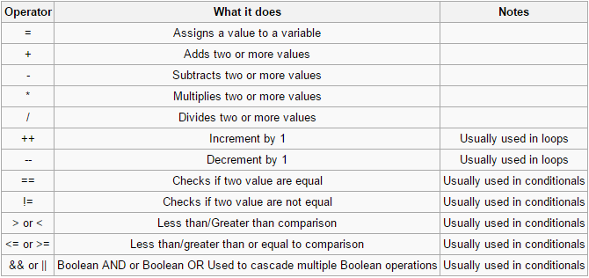
Operators

Slide 28
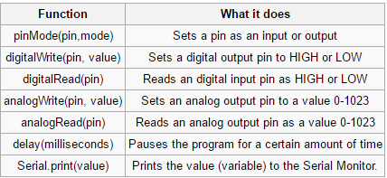
Common Functions

Slide 29
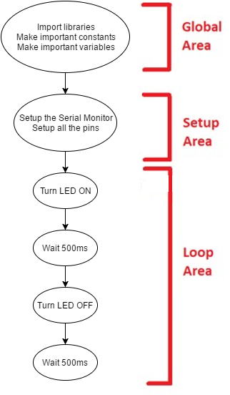
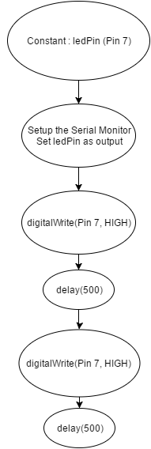
Flowcharts

Slide 30
Materials and Equipment
Arduino UNO microcontroller and USB cable
Computer with Arduino IDE
Breadboard and jumper wire
Resistors
LED
Pushbutton
TMP36

Slide 31
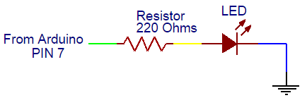
Activity 1
Make a simple LED blinking circuit
Make a simple LED blinking circuit using the programming flowchart and circuit diagram in the figure:

Slide 32
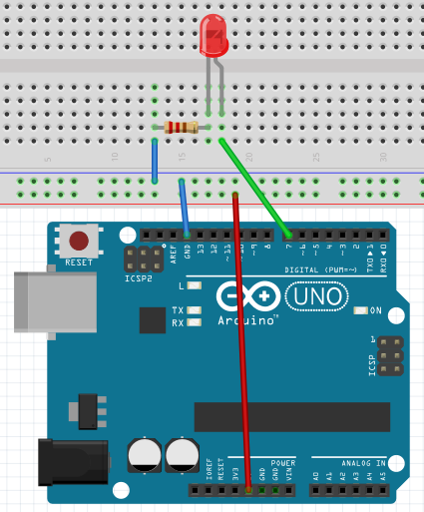
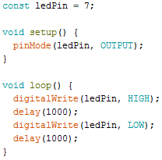
Activity 1
Wire the LED to the breadboard (see figure below)
Short leg of LED must be connected to GND
Resistor is NECESSARY
LED will burn out if no resistor
Type the following code into a new sketch
The LED circuit will be used in the next two activities - do not deconstruct it

Slide 33
Activity 1

Slide 34
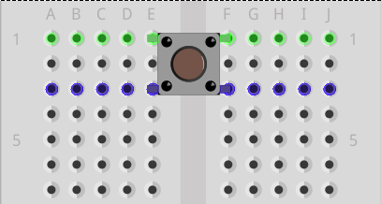
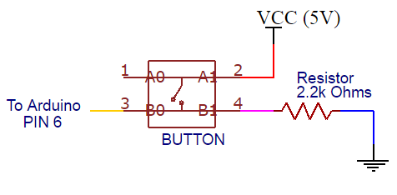
Activity 2
Control the LED using a button
Add a button to the circuit from activity 1
LED should be on when the button is pressed and off when the button isn’t pressed.
See the button schematic below: pins 1 and 2 are connected, and pins 3 and 4 are connected
Breadboard the circuit diagram in the figure and sketch a flowchart of the program needed. Have a TA verify the flowchart.

Slide 35
Activity 2
Write the Arduino program to implement the flowchart
Create a constant to the pin the button is connected to
Button will be a digital input
Create an integer that will hold the button state:
To check the state of the button (pressed vs not pressed), use the following code:

Slide 36
Activity 2

Slide 37
Activity 3
Introduce a loop into the program so the LED flashes three times
Sketch a flowchart
Hint: Use a For-loop! The circuit does not need any modifications.
Modify your code and test it

Slide 38
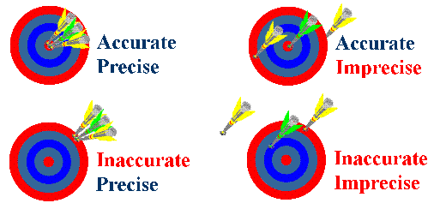
Product Evaluation

Slide 39
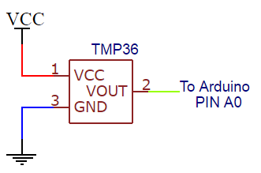
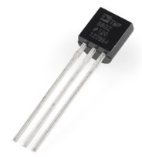
Activity 4
Program the Arduino to record and display temperature
Carefully disconnect everything plugged into the breadboard and Arduino and recreate the circuit below:

Slide 40
Activity 4
Sketch a flowchart and have it verified by a TA
Use the +5 V pin from the Arduino board as your positive voltage connection
Convert the output voltage into temperature readings (in Celsius) by using a scale factor of 10 mV/°C
The Arduino should read the sensor every five seconds
Don’t forget to use an analog pin (Pin A0), convert the voltage reading and then print it out!
Take 5 measurements of the room using the temperature sensor in one minute intervals
Use this data for the accuracy and precision measurements of your temperature sensor

Slide 41
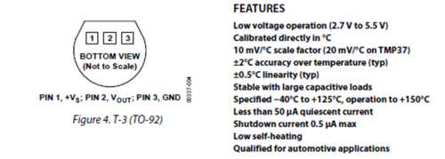
Activity 4
TAs will provide the actual room temperature. Use the following temperature sensor specifications.

Slide 42
Activity 4
Converting the temperature from “Arduino Units” to Celsius:
Convert “Arduino Units” to a voltage value
0-1023 is mapped from 0V to 5V
How much voltage is each “Arduino Unit”
Offset the voltage value by 500mV
Convert offset voltage to Celsius (10mV/1°C)

Slide 43
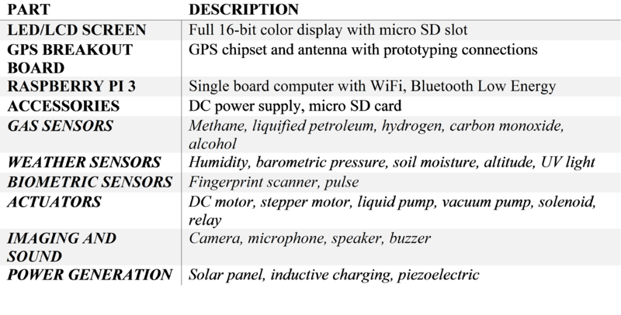
Activity 5
Brainstorming! (Your SLDP)

Slide 44
Assignment
Lab Report
Team Presentation
Discuss ALL topics in this presentation and manual
Include Pictures!

