Slide 1

Heat Transfer & Thermal Insulation

Slide 2
Overview
Objective
Background
Materials
Procedure
Report / Presentation
Closing

Slide 3
Objectives
Design and construct container to minimize heat loss from within
Understand concept of minimal design
Understand:
  Thermodynamic systems
  Temperature
  Heat and heat transfer

Slide 4
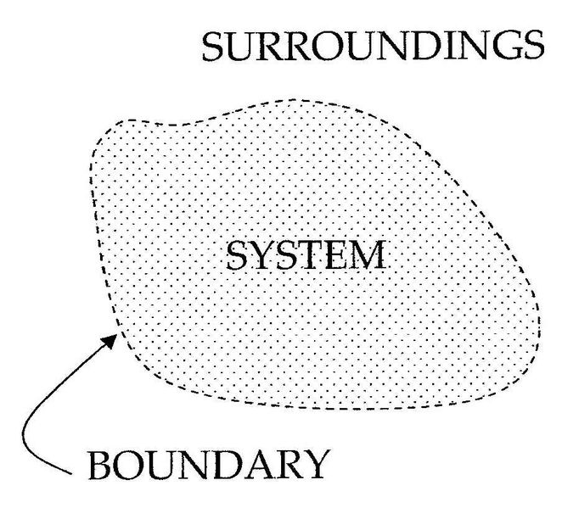
Thermodynamic Systems
Part of the universe separated from the surroundings by a boundary (real or imaginary)
3 types of systems:
  Open system: exchange energy and matter
  Closed system: exchange energy
  Isolated system: no exchange

Slide 5
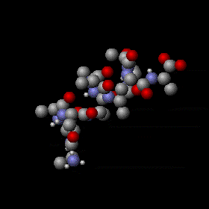
Temperature
Qualitative laymen perception:
    Hot, warm, cold…
Physical property of system:
  Average kinetic energy of atoms and/or molecules
  Absolute zero occurs when average kinetic energy is zero (0ºK)

Slide 6
Heat & Heat Transfer
Heat: thermal energy (total kinetic energy of all atoms and/or molecules)
Heat transfer: passage of thermal energy from hot to cold body
Can NEVER be stopped, only SLOWED DOWN

Slide 7
Equilibrium
Equilibrium reached
  Temperature at all points in a system are equal
65º
125º
39º
70º
70º
70º
25º
90º
70º
70º
50º
58º
70º
70º
95º
80º
70º
70º
73º
70º
Initial State
Final State

Slide 8
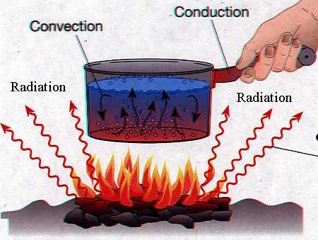
Means of Heat Transfer
Three types of heat transfer covered:
  Conduction: through matter (solids)
  Convection: through fluids
  Radiation: does not require medium

Slide 9
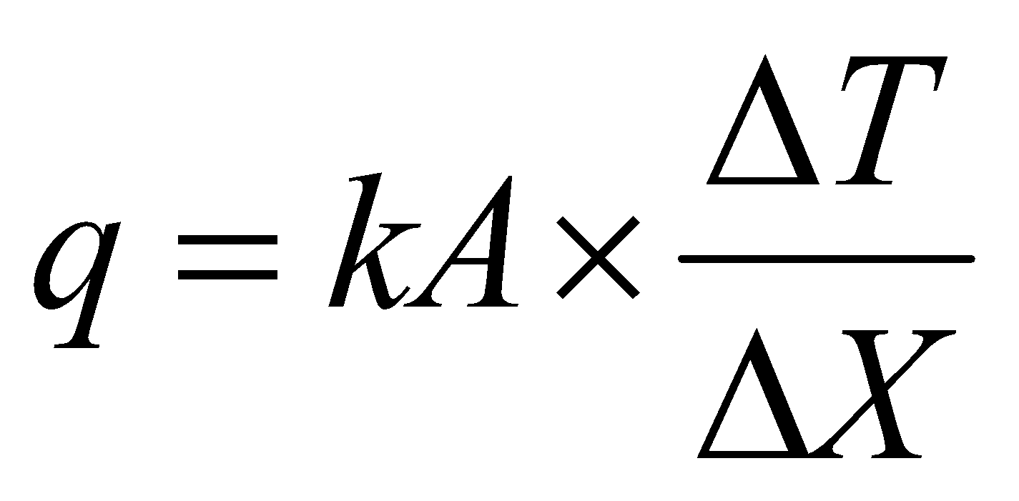
Conduction
100°F
200°F
Heat transferred through a solid body
q = Heat transferred
per unit time
Δ T = Difference in
temperature
Δ X = Length of material
k = Coefficient of
thermal conductivity
A = Cross-sectional area

Slide 10
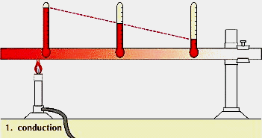
Example of Conduction
Atoms are heated and begin to vibrate
Vibrating atoms hit adjacent atoms, increasing temperature
Heat travels atom to atom up to the end of the rod

Slide 11
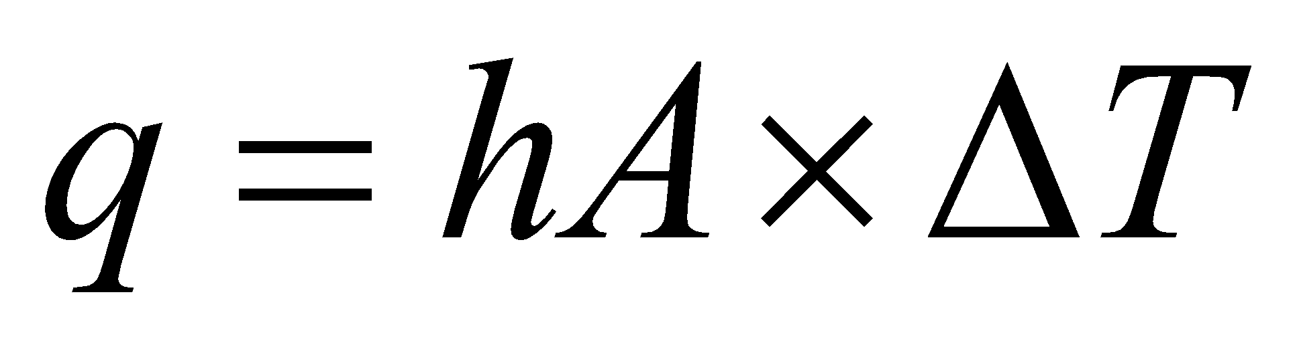
Convection
Heat transferred by mass transport of atoms
Heat transfer between solid and fluid
  (liquid or gas)
Two types of convection
q = Heat transferred per unit time
Δ T = difference in
temperature
h = coefficient of
convection
A = cross-sectional area
Iron
Water

Slide 12
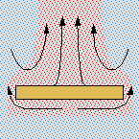

Types of Convection
Natural Convection
  Density of fluid changes with temperature
  Fluids expand as temperature rises and density decreases
  Buoyant forces dominate
Forced Convection or Advection
  Fluid flow caused by a device or environment
  More heat transfer than natural convection
  Buoyancy has little effect on direction of flow

Slide 13
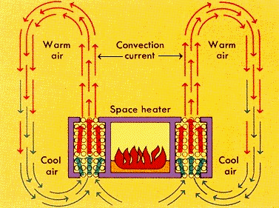
Examples of Natural Convection
Atoms move around and are heated by fire
Warm air rises
  (less dense)
Transfers energy to adjacent (air) molecules
Warm air cools, becomes more dense, and sinks
Process repeats

Slide 14
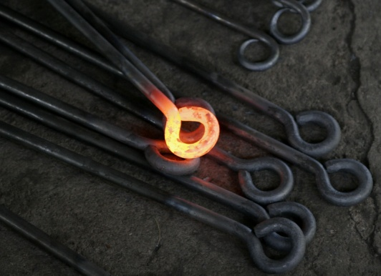
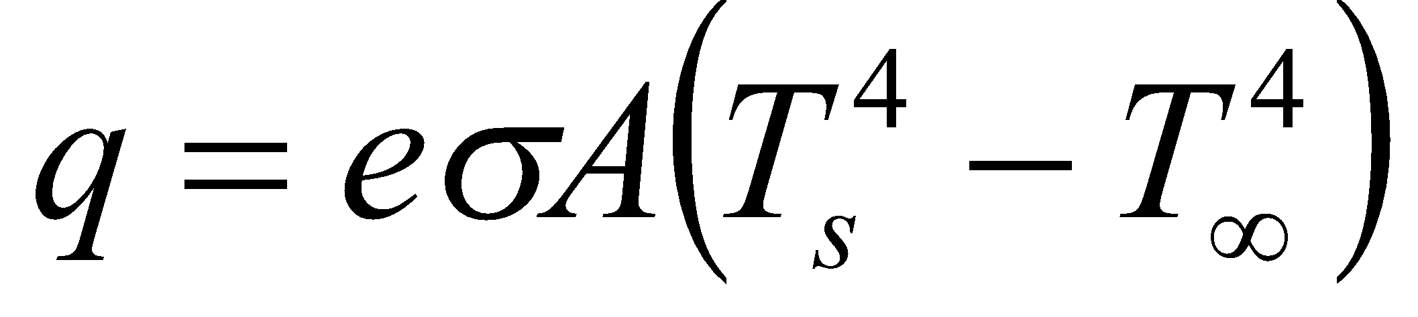
Radiation
Energy exchanged between bodies in form of electromagnetic waves
Can travel through a vacuum (requires no medium)
q = heat transferred per unit time T_{s} = surface temperature (absolute)
e = constant of emissivity T∞ = surrounding temperature (absolute)
A = surface area σ = Stefan-Boltzmann’s constant

Slide 15
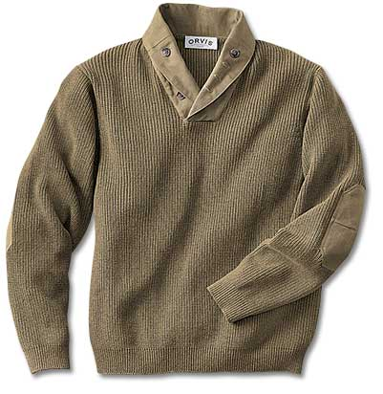
Thermal Insulation
Slows down heat transfer
Examples:
  Clothing
  Walls of houses
  Refrigerators
  Thermos bottles

Slide 16
Material Price List
Minimal design - ability to design an object that is both functional and economical
  Goal 1: Maximize functionality
  Goal 2: Minimize cost

Slide 17
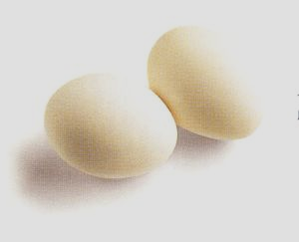
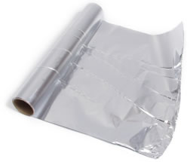
Materials
Foam chips
Plastic wrap
Tape
Aluminum foil
Cup
  Styrofoam
  Paper
Plastic cup lid
Boiled egg
Thermocouple and wire connectors
Thermal LabVIEW program

Slide 18
Problem Statement
Design/construct insulating container to accept hot egg just removed from boiling water
Container should minimize heat loss from egg
Use minimal design concepts

Slide 19
Materials
Large foam cup………………….………$0.50
Lid…………………………………………$0.25
Paper cup…………………….……….….$0.40
Styrofoam pieces.…………….……….. $0.05 / 6
Tape …………………………….….…… $0.10/ ft
Aluminum foil ……………………..…… $0.30/ ft²
Plastic wrap ………………….….……..$0.02 / ft²

Slide 20
Rules of the Competition
A container must be purchased
All materials must remain inside chosen container
Container cannot be larger than largest cup provided
No external heat sources may be used
Start recording data when container cover is closed and egg is inside
Container may not be held or covered during temperature readings
Egg may not be returned to water (no “restarts”)
At least one cup must be used
Egg shell may not be cracked
Container must remain on surface of testing area
Thermocouple must only be taped to surface of egg shell
Design Specs.
Disqualifications
Declaration of winners

Slide 21
Rules of Competition
Disqualifications occur when:
Any materials are outside the container
Container is held during testing
Any external heating source is used
Testing not started within 30 seconds of receiving egg
Design Specs
Disqualifications
Declaration of winners

Slide 22
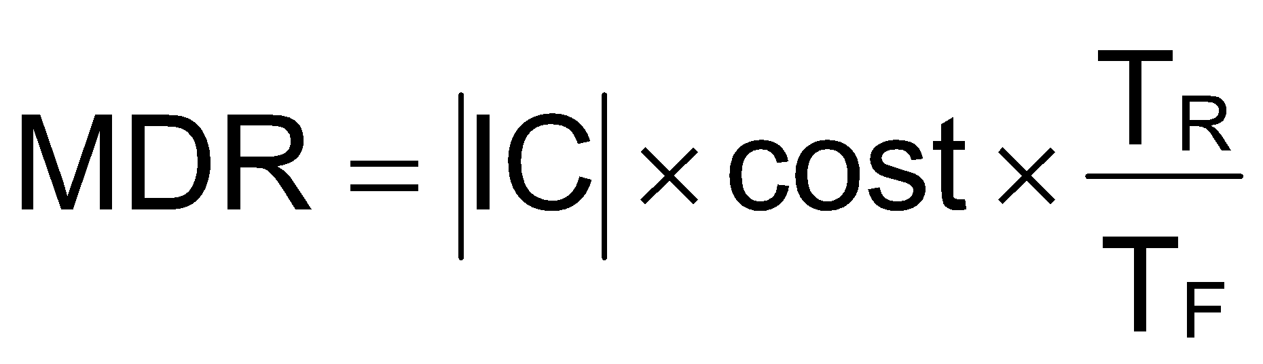
Rules of Competition
IC = insulating capability of container
IC is slope of first 15 minutes of the heat loss plot
T_{R} is room temperature, T_{F} is final thermocouple temperature
Team with lowest Minimal Design Ratio wins
Extra points for Recitation Presentation
  Winning team +1
  2nd place team +0.5 (4 or more teams)
  3rd place team +0.2 (8 or more teams)
Design Specs
Disqualifications
Declaration of winners

Slide 23
Procedure
Pre-Test
Observe provided material
Brainstorm for possible designs
Sketch design on paper
  Label properly
Construct design according to your sketch
  Note design changes
Create price list detailing your design
Pre-Test
Test
Post-Test

Slide 24
Procedure
Test
  * TA performs test using an unmodified cup (control experiment)
  Receive boiled egg from instructor
  Tape one end of thermocouple wire to egg (constant contact is essential)
  Insert egg with attached thermocouple
  Insert thermistor
Pre-Test
Test
Post-Test

Slide 25
Procedure
Test
  Attach thermometer (Note: You have <60 seconds to complete steps 3, 4, and 5)
  Quickly close container
  Start LabVIEW & Arduino programs
  Take reading from thermometer every 15 seconds for 15 minutes
Pre-Test
Test
Post-Test

Slide 26
Procedure
Post-Test
LabVIEW program has run for 15 minutes
  Excel table automatically created after test
Use data on table to create Excel graph of Temperature vs. Time
Use Serial Plotter in Arduino to graph Temperature vs. Time
Use Excel to table and graph thermometer data
Show table and graph to TA
  TA will initial lab notes that table and graph have been created
Pre-Test
Test
Post-Test

Slide 27
Procedure
Post-Test
Save table and graph
Have photo taken of container
Pre-Test
Test
Post-Test

Slide 28
Assignment: Report
MANDATORY TEAM lab report
Title page
Discussion topics in the manual
Include a picture of your design
Scan in lab notes (ask TA for assistance)
  TA must initial that table and graph
Include table, graph, and photo of container

Slide 29
Assignment: Presentation
Team presentation
State rules of competition
Describe your design and its concepts
Explain steps taken to complete lab
Professional-looking tables and graph
How could your current design be improved?
Refer to “Creating PowerPoint Presentations” found on EG website

Slide 30
Closing
Have all original data signed by TA
Each team member should have turn using software
Submit all work electronically
Return all unused materials to TA
Discard egg after testing

