Slide 1


The Timeshifter
Hour Glass, Inc.
Eve Fishinevich (Project Coordinator)
Rondell Sinanan (Head of Research)
Date of Presentation: 11/99/9999
Notes:
To replace this picture, just select and delete it. Then use the Insert Picture icon to replace it with one of your own!

Slide 2
Agenda
Company Profile
Project Description
Cost Estimate
Project Schedule
Advantages of Product
Conclusion

Slide 3
Company Profile
Hour Glass, Inc.
Founded in March 1995
Concentrated in quantum mechanics
Company Goal: To change history for the better good
Previous clients: United Nations, United States Department of Homeland Security

Slide 4

Company Profile
 | Eve Fishinevich Project Coordinator |  | Rondell Sinanan Head of Research
Graduate of NYU School of Engineering BS in Chemical Engineering MS in Biomedical Engineering |  | Graduate of NYU School of Engineering BS/MS in Mechanical Engineering

Slide 5

Project Description
Requirements:
  Retrieve one item from the past
  Retrieve one item from the future
NASA is soliciting designs for a time
machine to find alternate energy
sources

Slide 6
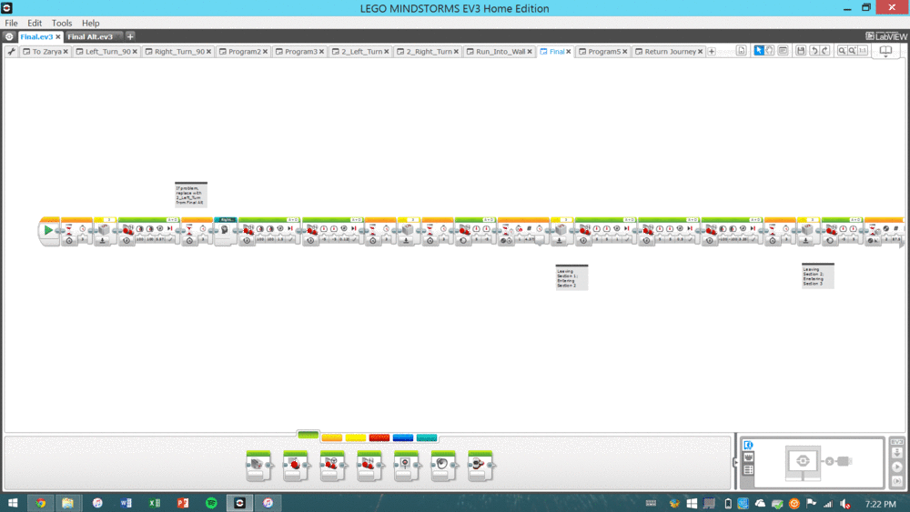
Project Description
Our robot uses quantum technology to warp time
Travels 50 years in 30 seconds
  Faster than goal rate by 30 seconds!

Slide 7
Project Description
Top View
Front View
CAD DRAWING
CAD DRAWING

Slide 8
Project Description
Isometric View
Most Detailed Side View
CAD DRAWING
CAD DRAWING

Slide 9
Cost Estimate
Item/Employee | Quantity | Unit Cost | Cost
Item 1 | # | $$$ | $$$
Item 2 | # | $$$ | $$$
Item 3 | # | $$$ | $$$
Miscellaneous | # | $$$ | $$$
Labor | # | $$$ | $$$
Total | $$$
Notes:
*VERBALLY STATE THAT COST HAS NOT CHANGED (IN THIS CASE)*

Slide 10
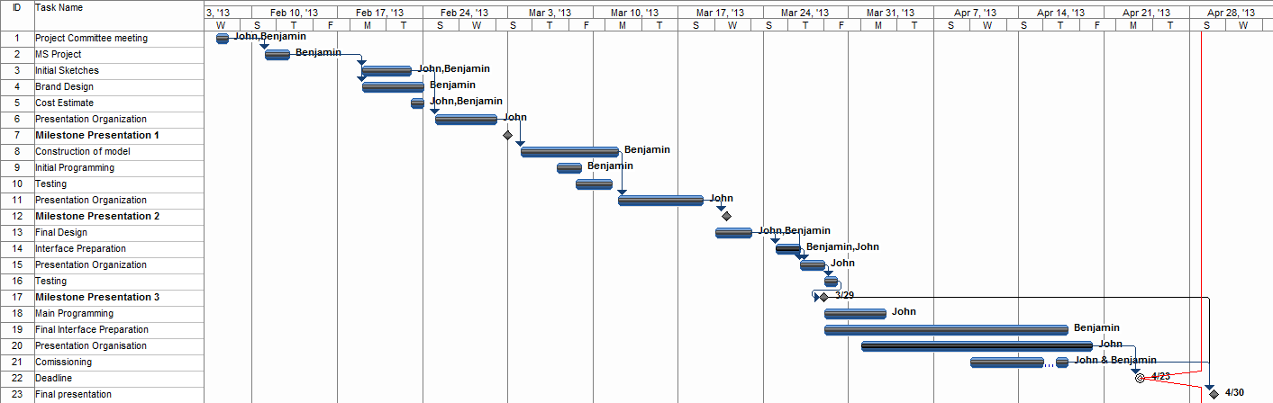
Project Schedule

Slide 11
Advantages
Successfully completed the mission
Retrieved Sabre Tooth Tiger
Retrieved Force-Field Generator

Slide 12
Advantages
First of its kind
Proven results
IT WORKS!

Slide 13

Conclusion
Why is Time Shifter the right choice for you?
We are the best at what we do
Lots of experience
Previous successful projects
Guaranteed customer satisfaction

Slide 14
The Timeshifter
Hour Glass, Inc.
Eve Fishinevich (Project Coordinator)
Rondell Sinanan (Head of Research)
Date of Presentation: 11/99/9999
Notes:
To replace this picture, just select and delete it. Then use the Insert Picture icon to replace it with one of your own!

