Slide 1

RECITATION 10
EG1003

Slide 2
AGENDA
Resume Review
Graduate School
How to Give the Final Project Presentation
1

Slide 3
RESUME REVIEW

Slide 4
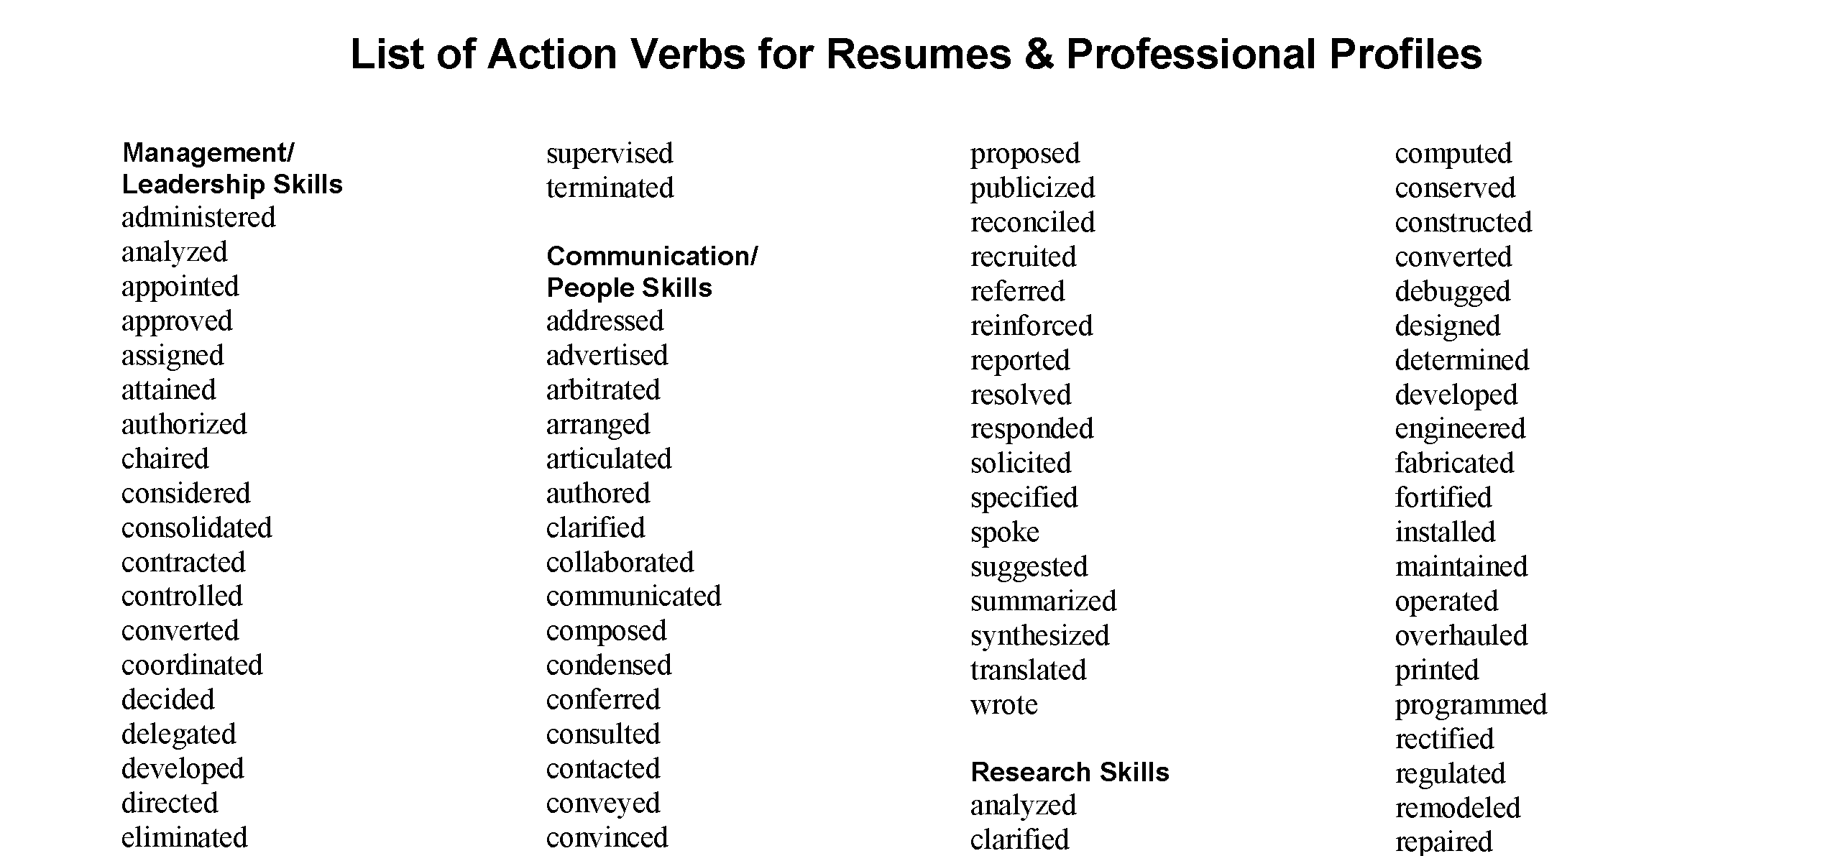
RESUME ACTION VERBS
Learn More
Figure 1: Action verbs for resumes courtesy of Washington State University
3

Slide 5
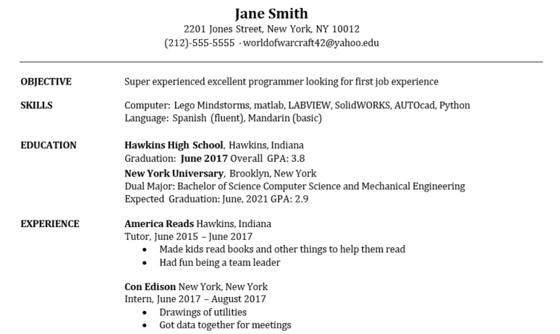
SPOT THE ERRORS
4
Notes:
Using the knowledge that you have gained today and in past recitations, what suggestions would you make to Jane to improve their resume? **Ask students to raise their hands and participate**

Slide 6
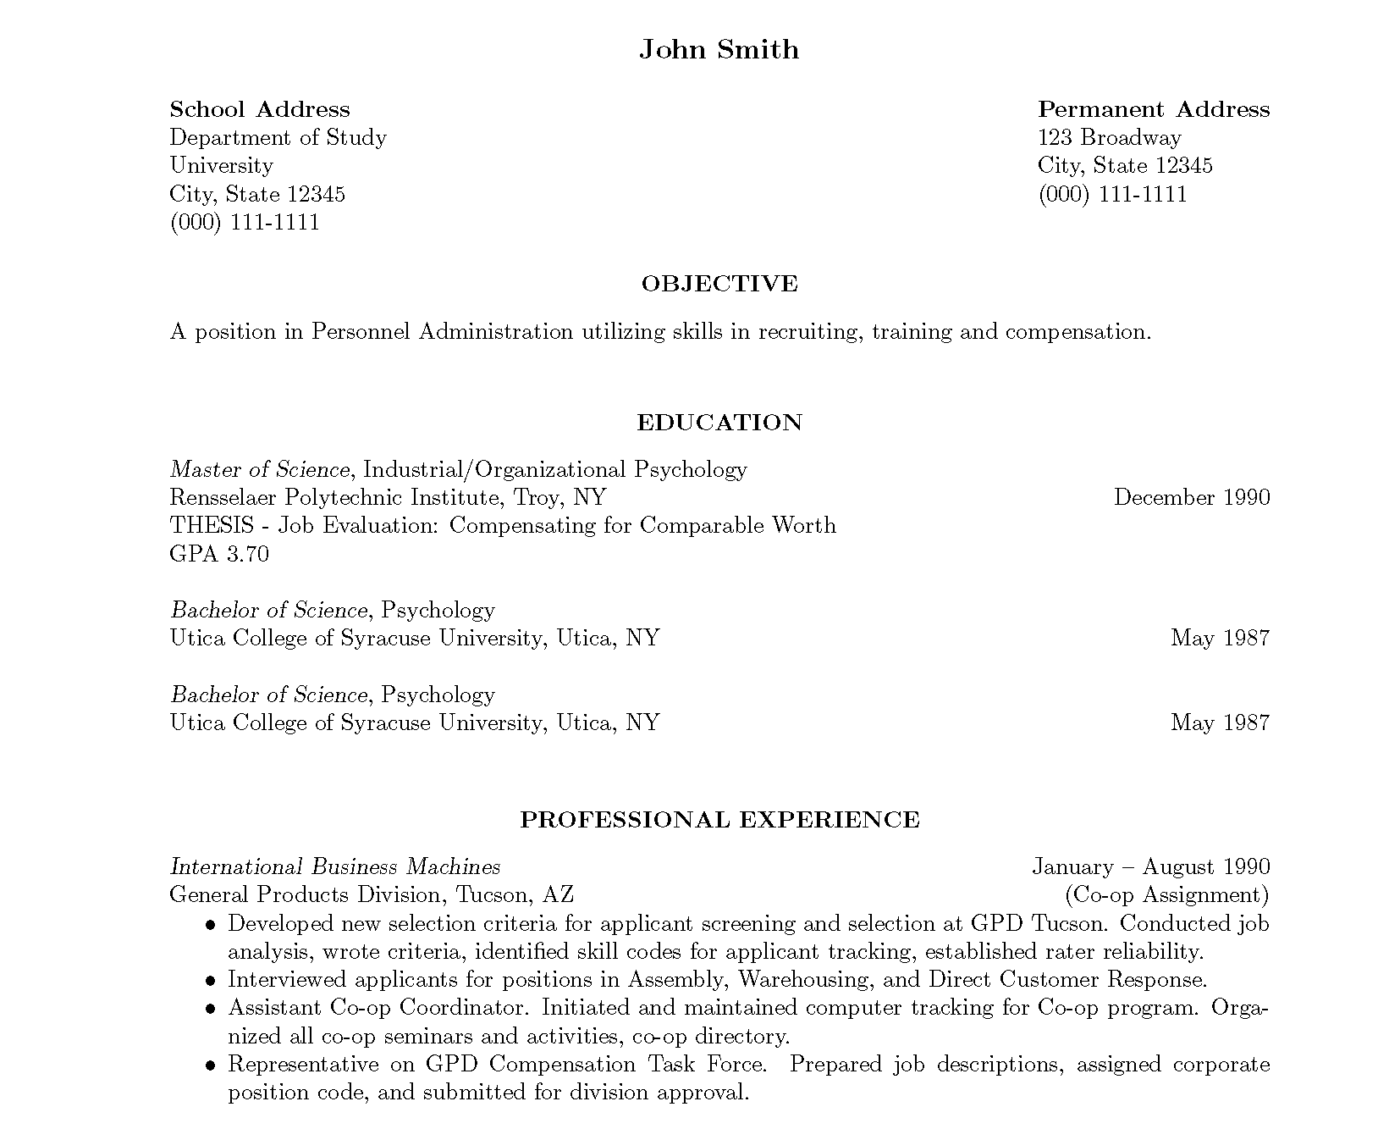

LaTeX
5
Notes:
LaTeX is a software for document preparation and is largely what is used when creating scientific papers to manage formatting. This also is a good resource for completing your resume as shown on the right instead of using Microsoft Word.

Slide 7
GRADUATE SCHOOL

Slide 8
BE PREPARED TO TALK GPA
Table 1: Academic honors at NYU courtesy of NYU
 | Summa Cum Laude (5%) | Magna Cum Laude (15%) | Cum Laude (25%)
CAS | 3.919 | 3.795 | 3.665
Gallatin | 3.951 | 3.889 | 3.793
Liberal Studies | 3.954 | 3.864 | 3.799
Nursing | 3.97 | 3.863 | 3.744
SPS | 3.947 | 3.843 | 3.668
Silver | 3.978 | 3.899 | 3.809
Steinhardt | 3.916 | 3.841 | 3.747
Stern | 3.896 | 3.798 | 3.696
Tandon | 3.863 | 3.679 | 3.492
Tisch | 3.903 | 3.819 | 3.728
8

Slide 9

UNDERGRAD VS GRAD
Undergraduate (Design)
  Create a meal from a recipe
Masters (Analysis)
  Create a recipe for a meal
Doctoral (Modeling)
  Create a meal
Figure 2: Cognitive growth courtesy of Reddit
9

Slide 10

FINDING A PROGRAM
US News and World Report
  Skewed by funding and test scores
Talk to alumni
Visit campuses
Specialized interests
10

Slide 11
FACTORS TO CONSIDER
Do some research on the university
  Student activities
  Course options, research, teaching
  Professors and projects
Your advisor is the most important consideration
Talk to professors at NYU
Location is critical for job market
11

Slide 12


APPLYING
Prepare for the GRE
  Take several practice exams
Three recommendation letters
  Academic references better
  Connections are most important
Personal statement
12

Slide 13

OPPORTUNITIES
Graduate research assistant
Graduate teaching assistant
Fellowships
  NSF GRFP
  University
  Other program specific scholarships
13

Slide 14

PHD HUMOR
14

Slide 15
QUESTIONS?

Slide 16
HOW TO GIVE THE FINAL PROJECT PRESENTATION

Slide 17
SUBMISSION INSTRUCTIONS
Use Google form to submit
    Login to a new account on Gmail to submit
    Specific group login info listed on SLDP Submission tab of website
Due at the end of the final lab session
Files take time to upload, so start early
No late submissions are accepted!
17

Slide 18
SUBMISSION INSTRUCTIONS
All SLDPs:
    CAD files, initial sketch, drawings, Microsoft Project schedule, cost estimate
    Final Presentation
    Resumes
    Final Engineering Notebook
RAD & VEX only:
    Final code
HIR only:
    LEED accreditation report
    Walkthrough video
    Final construction schedule
    Power/AC/heat calculations
18

Slide 19
FINAL PRESENTATION
OVERVIEW
  During normal Recitation meeting time
  This is a sales presentation!
    Pitch your idea to a group of investors, not engineers
  Dress professionally
  Keep these questions in mind while creating the presentation:
  Why is your project valuable to investors & society?
  How can you present technical information to your audience?
19

Slide 20
FINAL PRESENTATION
OVERVIEW
  Five-minute presentation
  Feel free to invent and add material with discretion
  You may change slide titles
  Be creative, but be sure to include:
Title (first & last slides)
Agenda
Company Profile
Product Objective
Product Description
Conclusion
20

Slide 21

TITLE & AGENDA SLIDE
Title
Very similar to Milestones
Agenda
List order of content to be covered
No need to read aloud during presentation
Figure 1: Title Slide Example
21

Slide 22
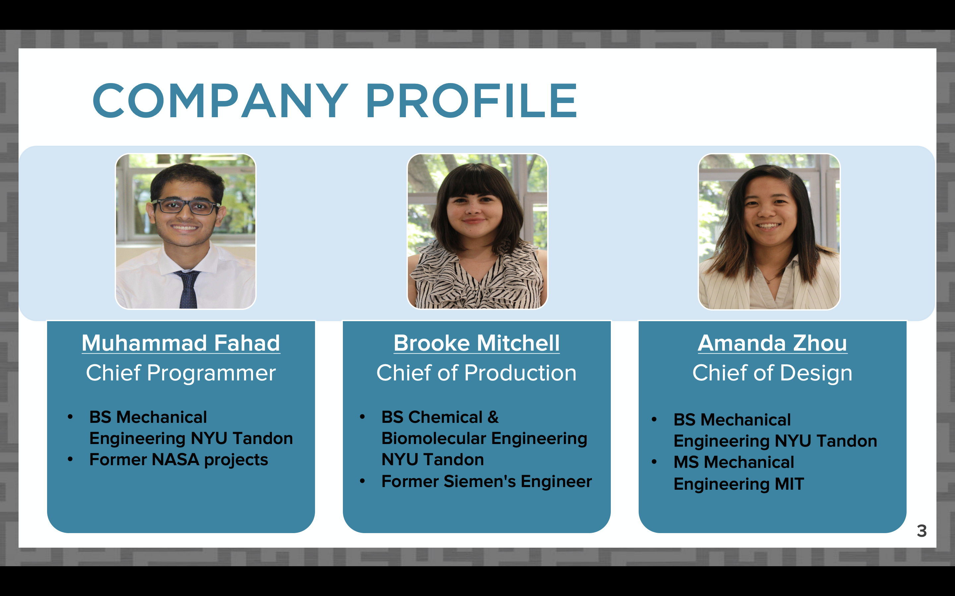
COMPANY PROFILE SLIDE
Founding of company and mission
Introduce team member’s qualifications & roles
  Qualifications should be real
  Practice selling your experience
Many teams choose to utilize headshots
Figure 2: Company Profile Slide Example
22

Slide 23

PRODUCT OBJECTIVE SLIDES
Problem Statement:
What is the purpose of your product?
Who does your product help?
What problem does your product solve?
Build Context:
Why should investors invest in your company/product?
How is your product unique?
Figure 3: Product Objective Slide Example
23

Slide 24
PRODUCT DESCRIPTION SLIDES
Product Walkthrough
Design features and strategy
CAD views and commented code (if applicable)
Video of product in action
Market & Product Viability
Does your company have competitors?
How does your design compare to competitors – cost, quality, features?
Is the product versatile? Can it fulfill other needs?
Who will buy your product? For how much?
24

Slide 25
CONCLUSION SLIDE
Last chance to convince the investors!
Restate the problem your product solves
Remember to stay professional and positive
  Highlight the advantages of your product features
  Do not insult the competition
Consider adding pitch or theme here:
  “Together we can strengthen domestic security”
  “Extraction, Inc. – Knowledgeable, Innovative, and Professional”
25

Slide 26
QUESTIONS?

