Slide 1

American Sign Language (ASL) Glove
SpeakSign Inc.
December 6, 2018
Ricky Payares - Founder and Project Manager
Jules Kho - Software Developer
Karenna Rodriguez - Software Developer
Hellen Ekpo - Project Coordinator

Slide 2
Who is SpeakSign?

Slide 3
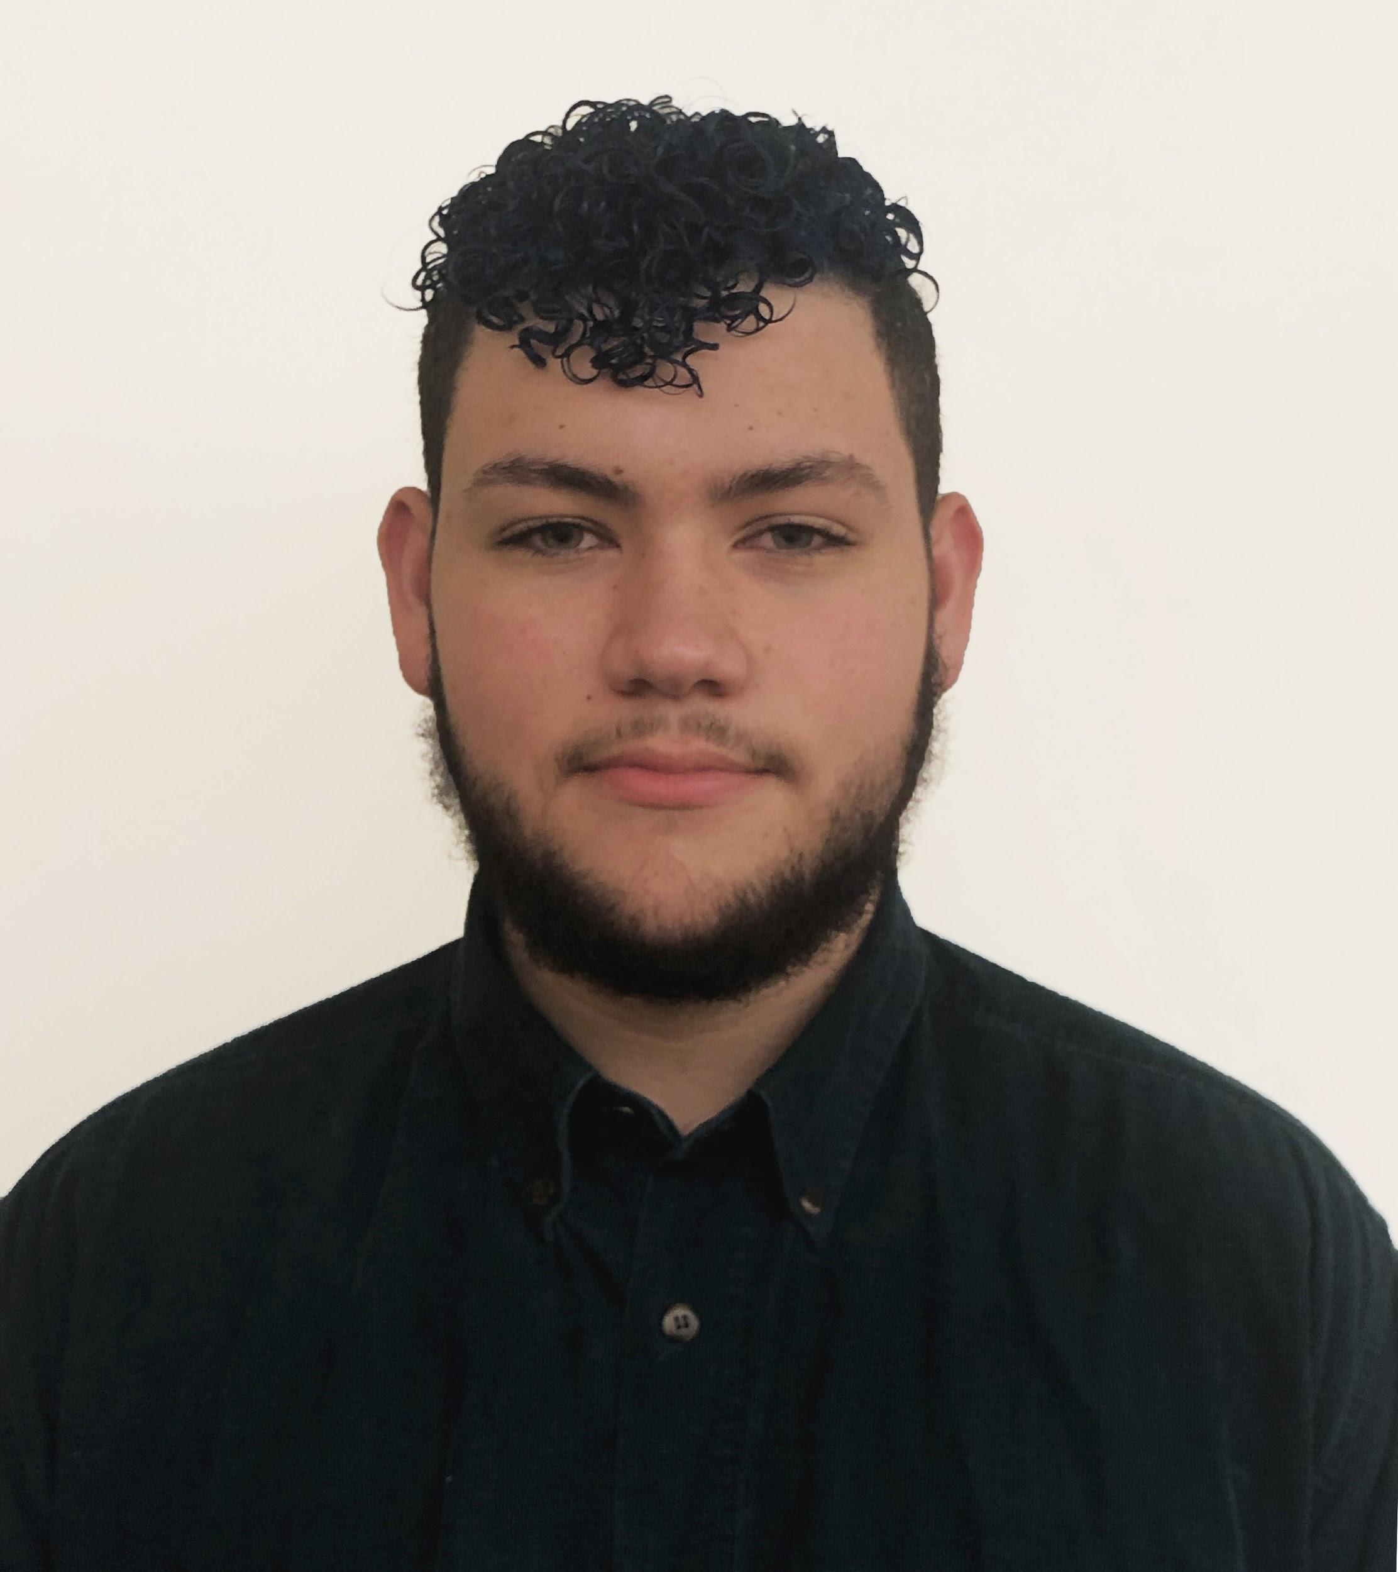
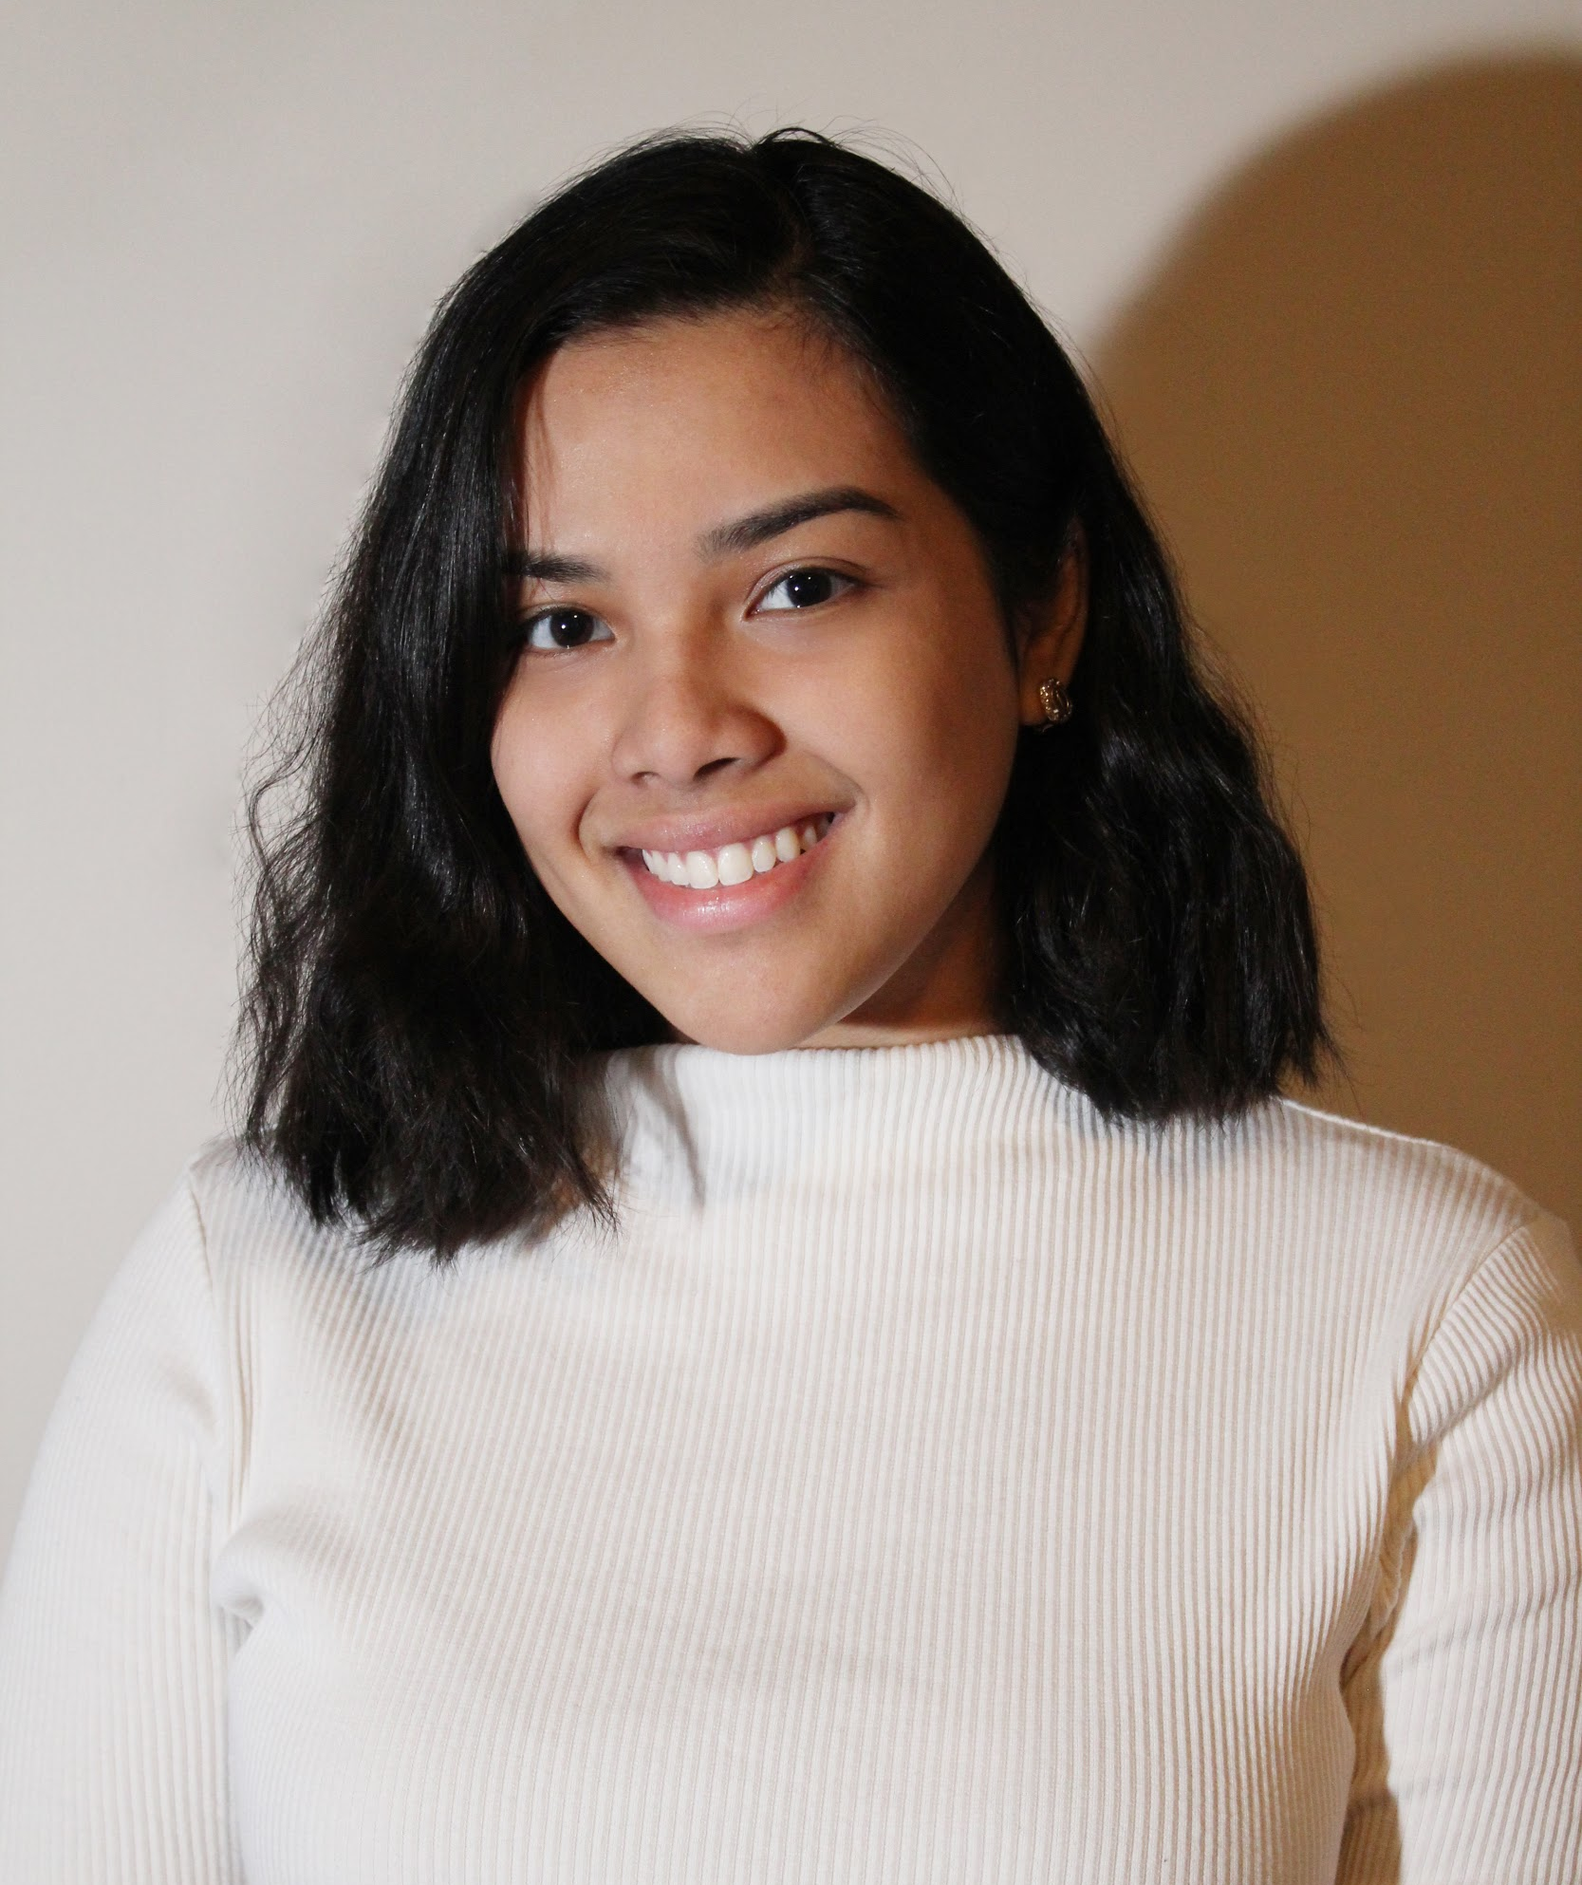
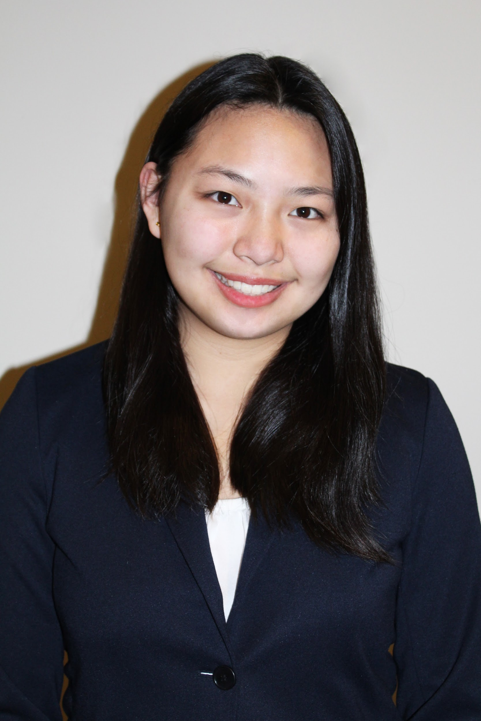
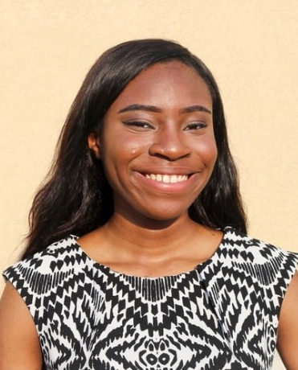
Company Profile
Ricky Payares
Karenna Rodriguez
Project Manager
Software Developer
Jules Kho
Hellen Ekpo
Software Developer
Project Coordinator

Slide 4
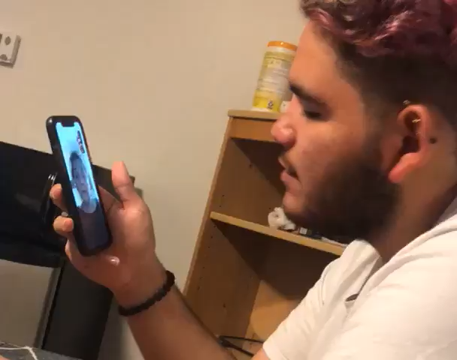
Company Profile (cont.)
Our mission
SpeakSign’s goal is to enable those who communicate through American Sign Language (ASL) to convey themselves to persons who do not understand the language.

Slide 5
The Problem

Slide 6
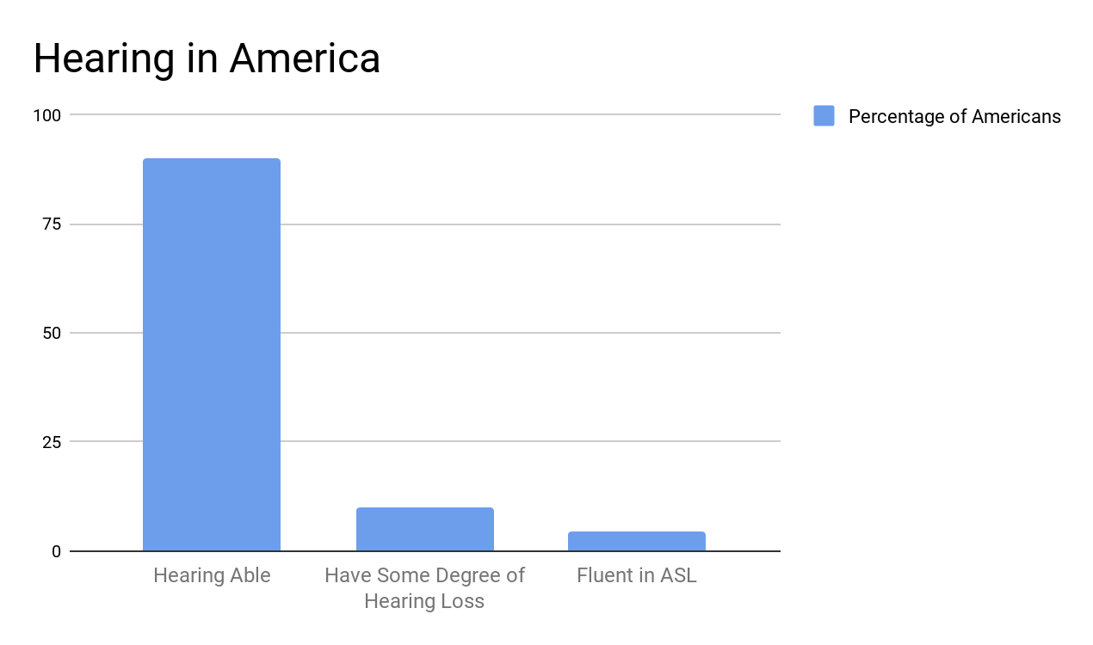
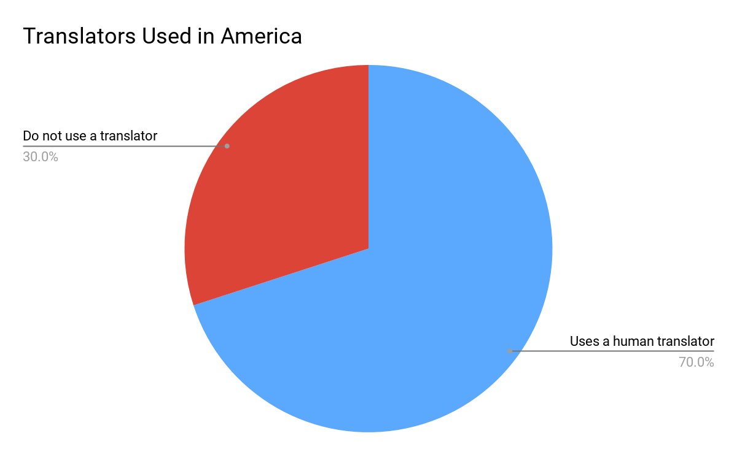
The Problem
1
https://www.startasl.com/american-sign-language

Slide 7
The ASL Glove

Slide 8
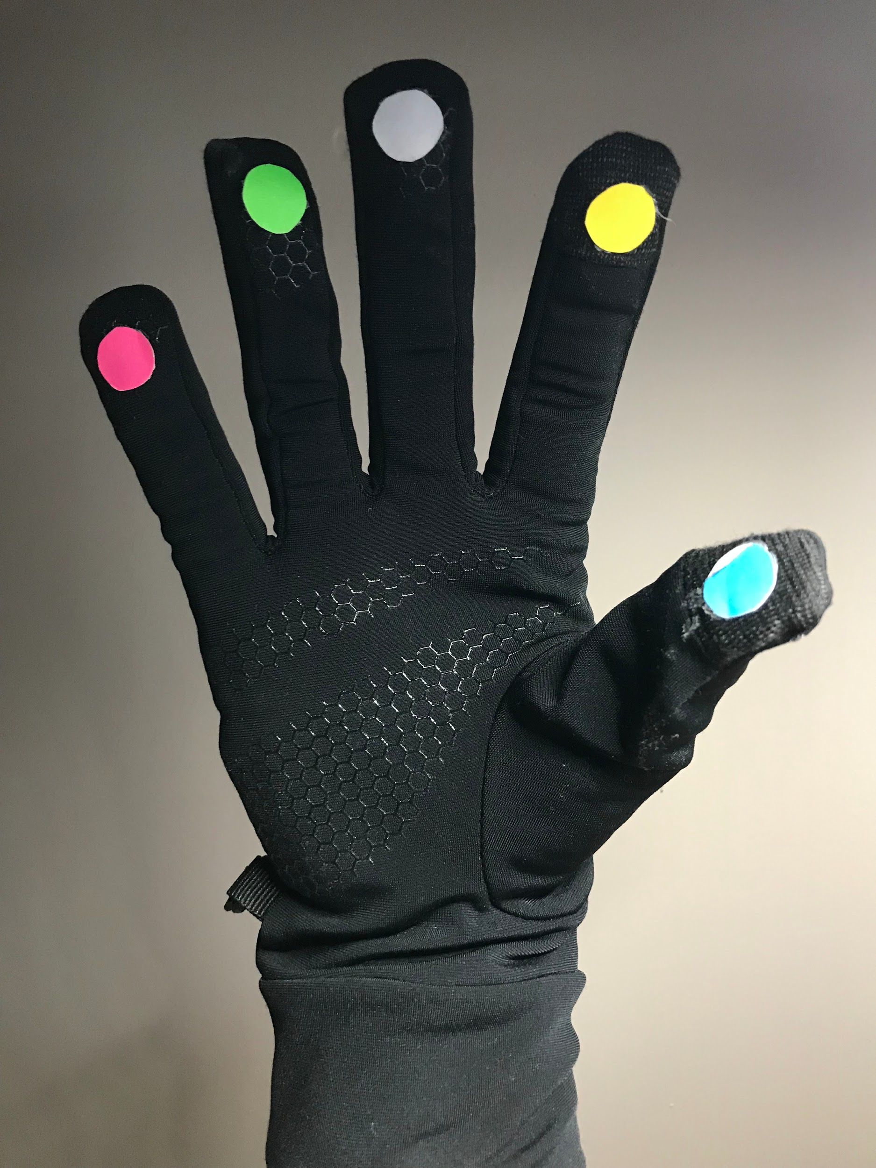
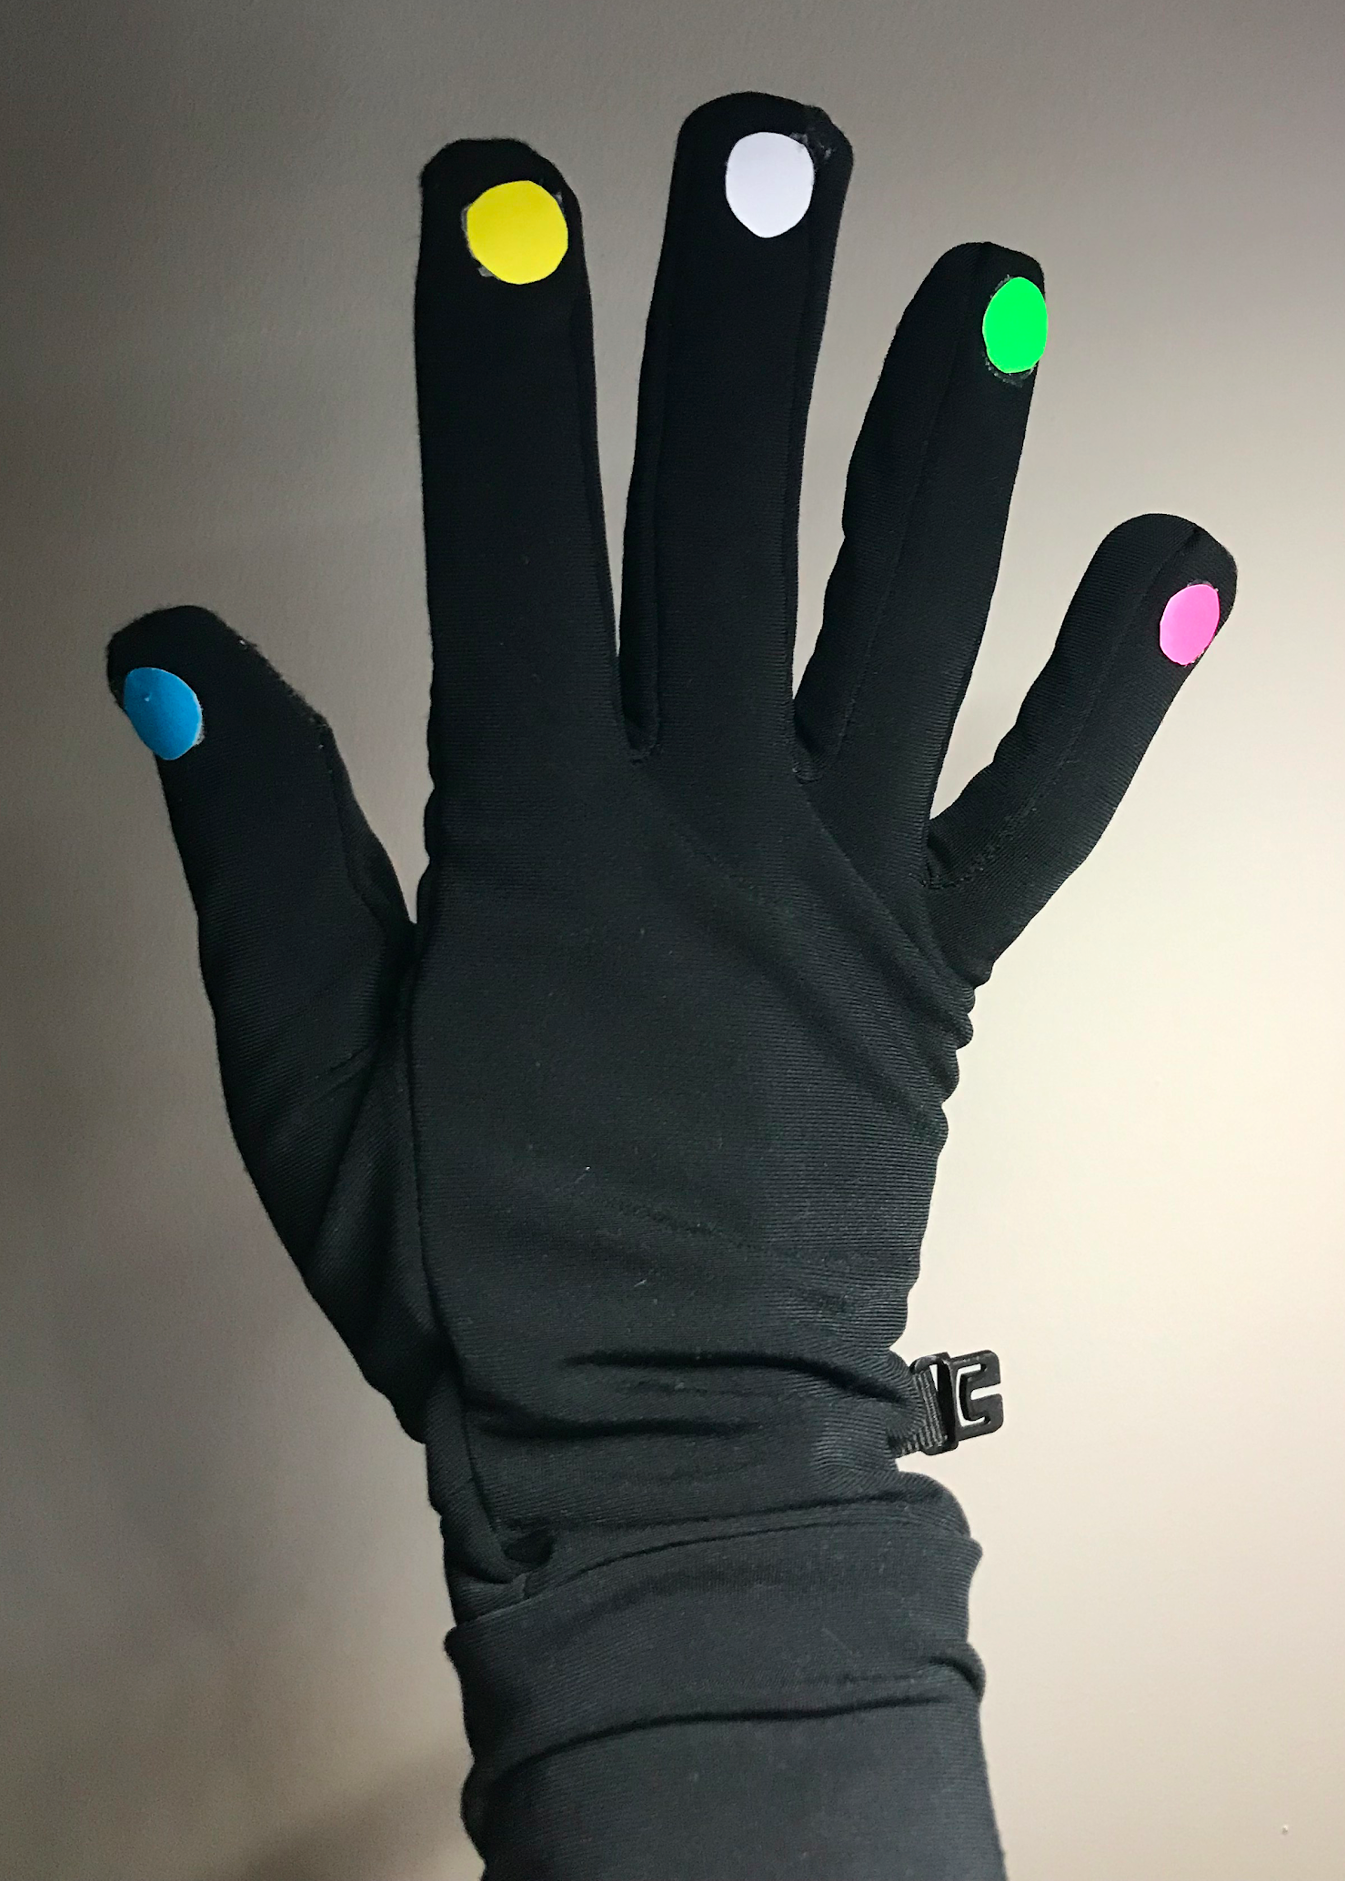
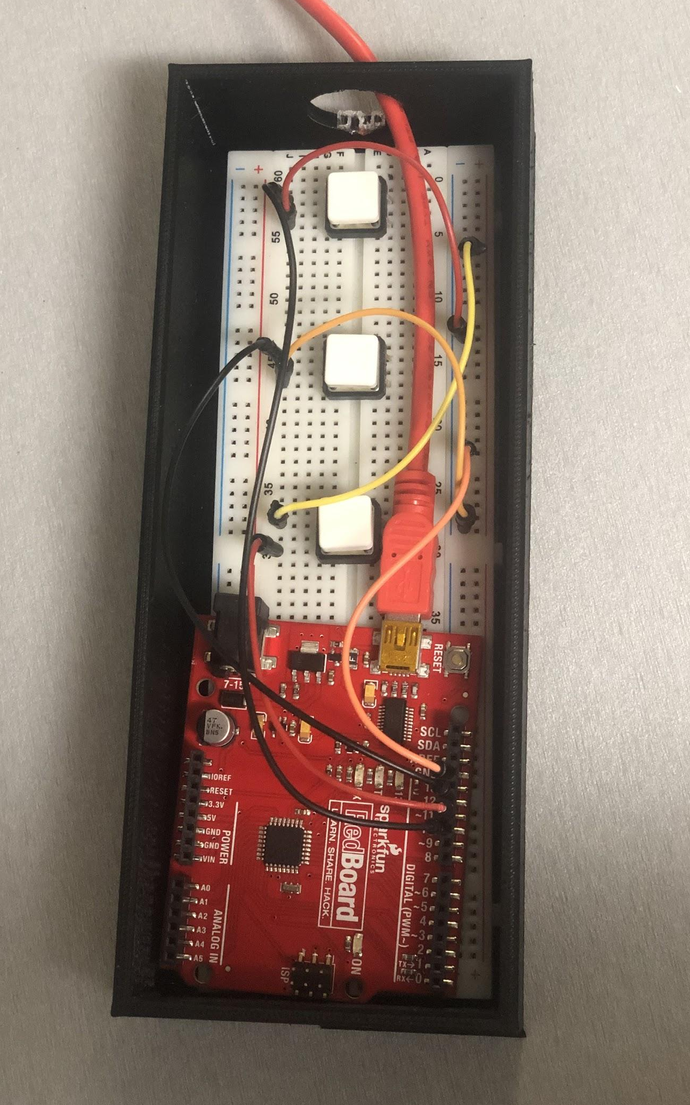
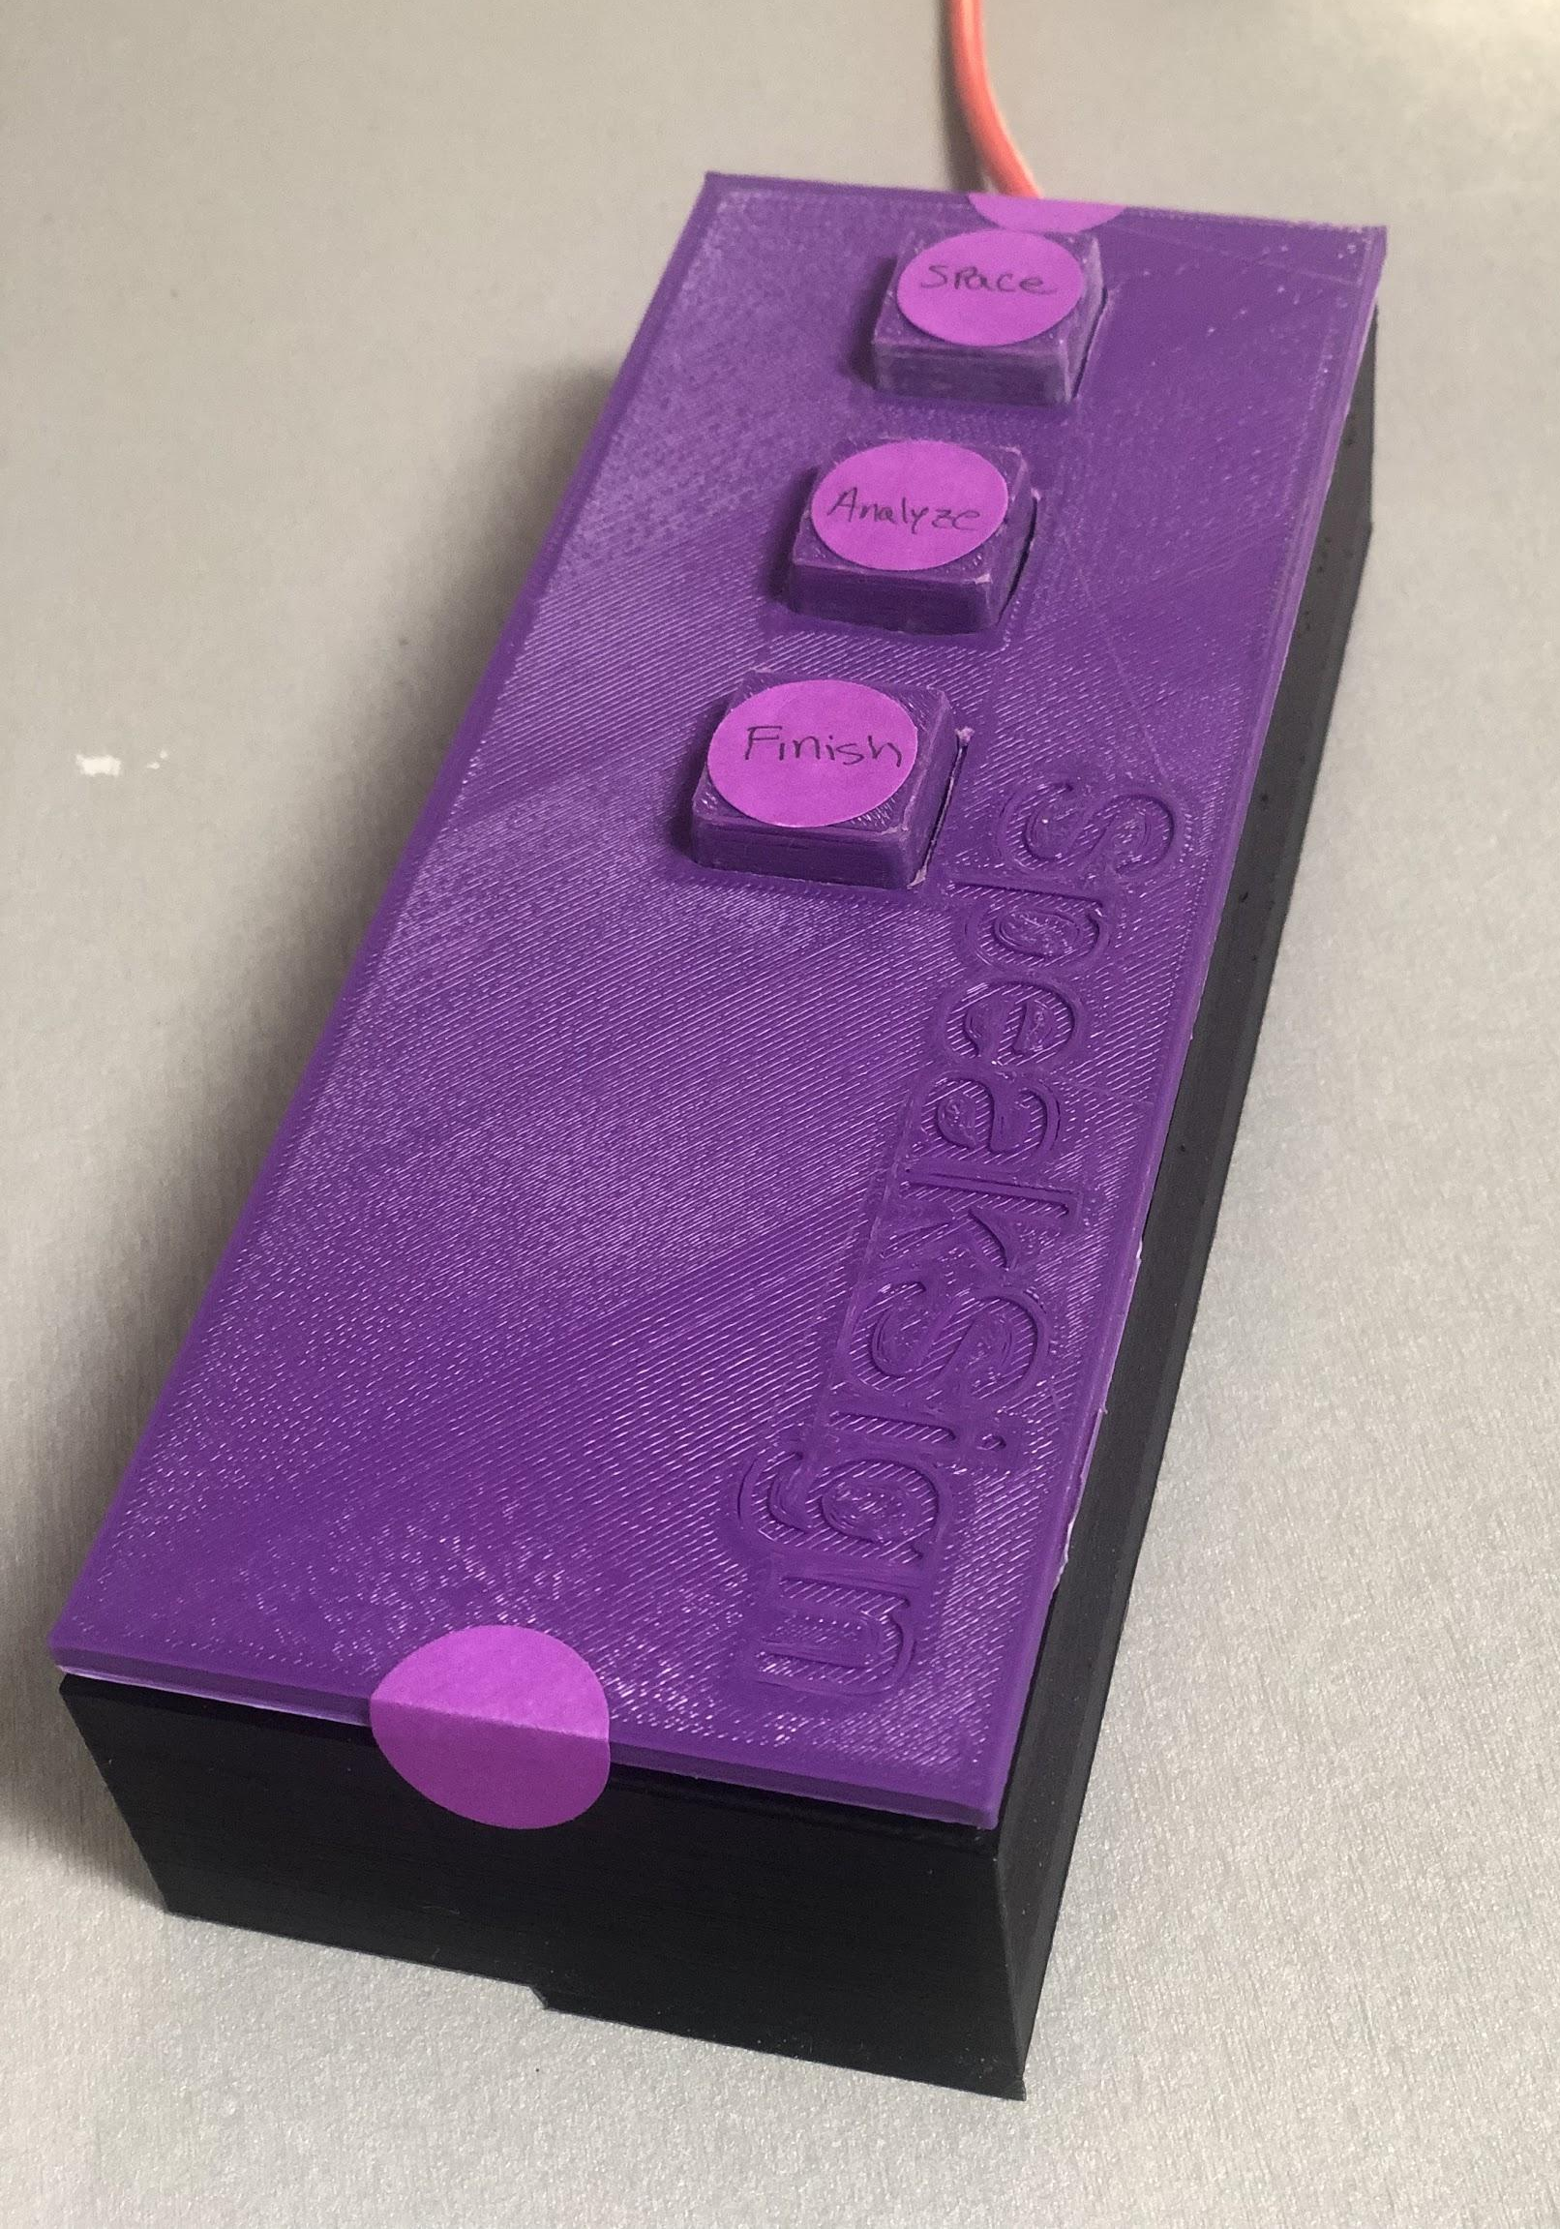
ASL Glove

Slide 9
ASL Glove Demonstration

Slide 10

Demonstration

Slide 11
Future Goals
Improve the color tracking
Increase the accuracy of translations
Start motion-based translations
Create a user interface

Slide 12
Why invest in SpeakSign?

Slide 13
Why SpeakSign?
High accuracy
Inexpensive
Accessible
Creators of inclusive technology

Slide 14
American Sign Language Glove
SpeakSign Inc.
Ricky Payares - Founder and Project Manager
Jules Kho - Software Developer
Karenna Rodriguez - Software Developer
Hellen Ekpo - Project Coordinator

