Slide 1
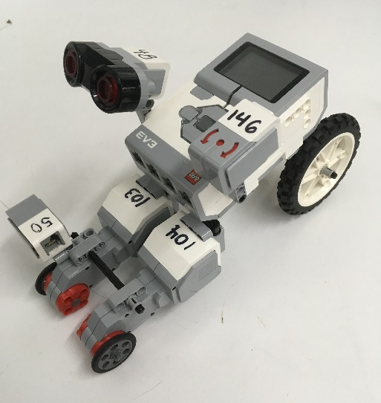
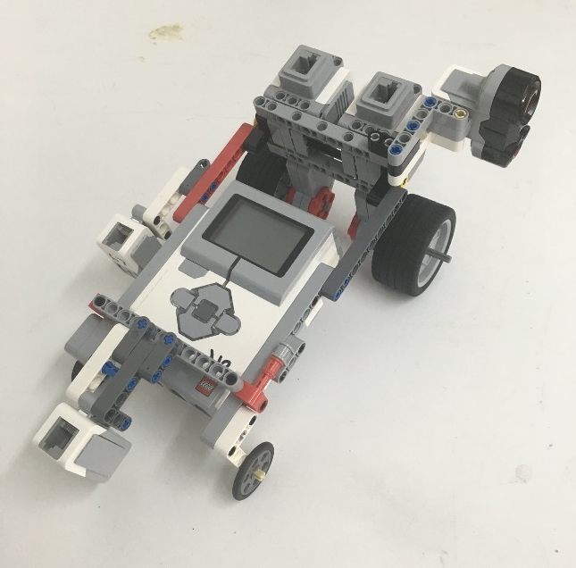
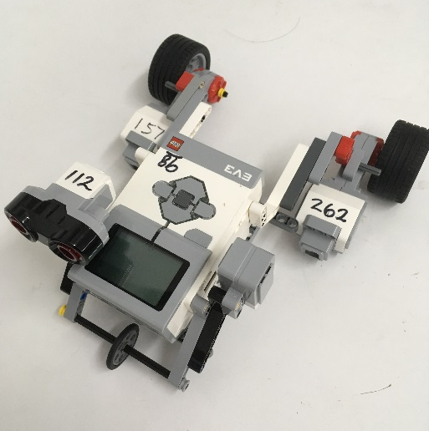
Product Evaluation & Quality Improvement

Slide 2

Overview
Objective
Background Information
Materials
Procedure
Report
Closing

Slide 3
Objective
Create code for a pre-built robot and test it against the EG standards for accuracy and precision
Emphasize the importance of product evaluation
Utilize sensors to demonstrate differences between hardcoding and sensors coding

Slide 4
Background Information
Design Analysis
Engineers perform prototype testing
  Look for improvement suggestions
  Continuously improves product quality
Tests are performed to a company standard
  If the standard is met, the product is acceptable
  If standard not met, product may be redesigned or withdrawn

Slide 5
Background Information
Accuracy
  Comparison of the average of the results to the standard
Precision
  Repeatability of the results
  How close are the results to each other?
Tolerance
  The precision standard set by the manufacturer

Slide 6
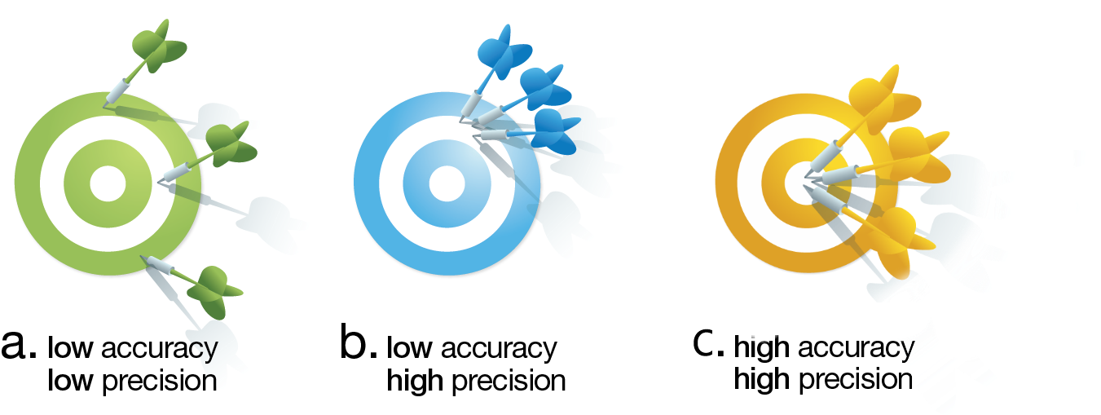
Background Information

Slide 7
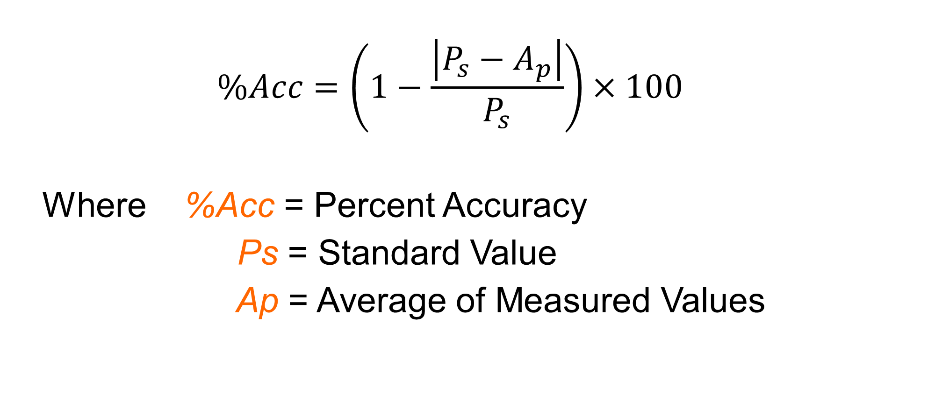
Background Information
$$\%Acc=\left(1−\frac{\left|P_{s}−A_{p}\right|}{P_{s}}\right)×100$$
Where %Acc = Percent Accuracy
Ps = Standard Value
Ap = Average of Measured Values

Slide 8
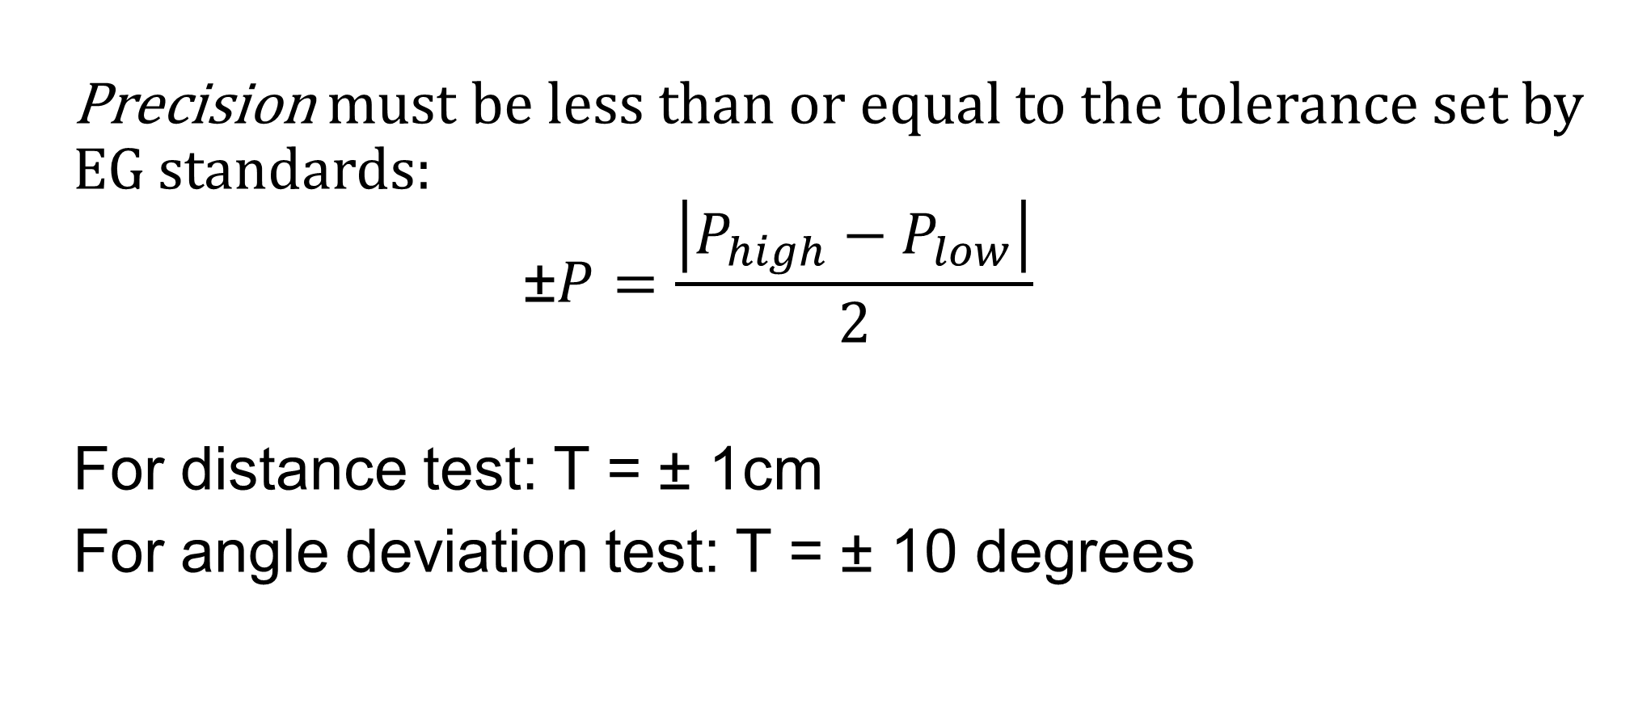
Background Information
Precision must be less than or equal to the tolerance set by EG standards:
$$\text{±}P=\frac{\left|P_{high}−P_{low}\right|}{2}$$
For distance test: T = ± 1cm
For angle deviation test: T = ± 10 degrees

Slide 9
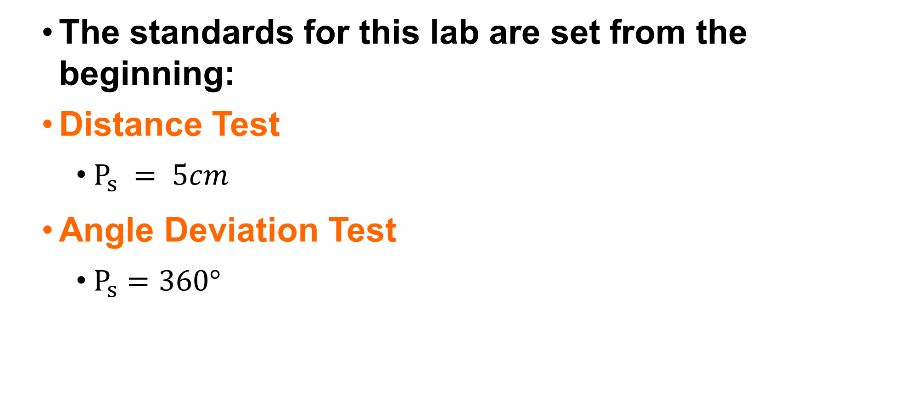
Background Information
The standards for this lab are set from the beginning:
Distance Test
  $P_{s} = 5cm$
Angle Deviation Test
  $P_{s}=360°$
wall
Measure distance from wall
θ in degrees
Target = 5cm

Slide 10
Background Information
Quality Improvement
Analyzing the design
Testing the design
  Through physical or mathematical modeling or computer modeling
Does the robot perform to standard?
  If no, what can be done to improve its functionality?
  If yes, what can be done to improve its performance beyond the standard?

Slide 11
Background Information
Reverse Engineering
Understanding how a product functions
  Disassembly of said product
  Noting the key components
Carried out in both software and hardware fields

Slide 12
Background Information
Sensors
Evaluates the robot’s surroundings
Creates inputs to control loops and switches
Three sensors used in this lab
  Light sensor (measures light properties)
  Gyro sensor (measures orientation)
  Ultrasonic sensor (measures distance)

Slide 13
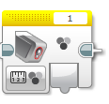
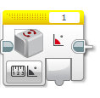
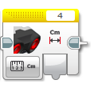
Background Information
Sensors

Slide 14
Background Information
Switches perform different actions depending on the input
  “If-else” statements
Loops continuously loop sections of code repeatedly until the end statement occurs
  Set amount of time, distance from wall, etc.

Slide 15
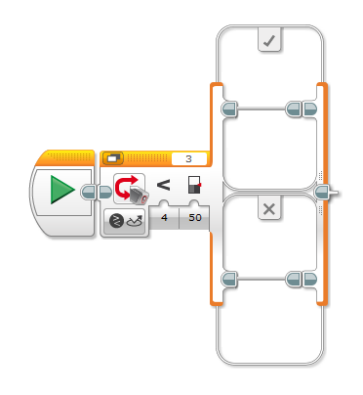
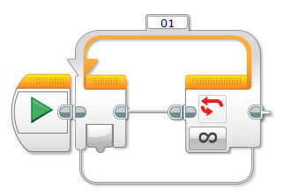
Background Information
Switches and Loops

Slide 16
Background Information
Ports 1, 2, 3, and 4 are for sensors and other inputs
Ports A, B, C, and D are for motors and other outputs
Port View displays sensor readings in real-time on the EV3 brick
  Ex. information for light intensity must be determined using port view to make the line-following code

Slide 17
Materials
Mindstorms Kit w/ Pre-Built Robot
Computer with Mindstorms Software
Protractor and Ruler
Mini-Course

Slide 18
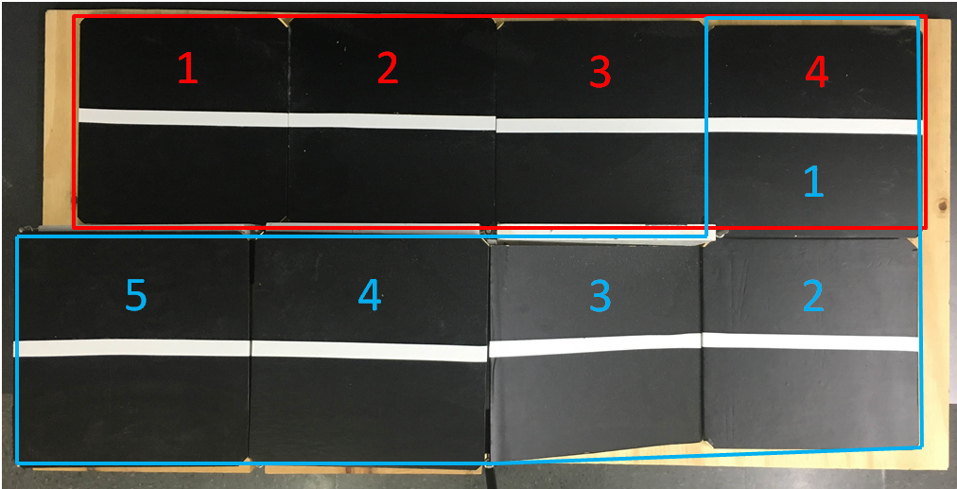
Procedure – Course Diagram
Red = Section 1
Blue = Section 2

Slide 19
Procedure - Overview
Analyze assigned pre-built robot
  Modify robots to travel Sections 1 & 2
  Maximum 20 minutes
Run four trials per test
  Section 1 with modified design – no sensors
  Section 1 with modified design – with sensors
Determine if robot meets the 80% EG Standard for accuracy and the acceptable tolerances for precision
Compete in a timed trial of Section 2

Slide 20
Procedure – Product Evaluation
Receive pre-built robot from TA
Analyze robot for faults in design
Modify robot to perform the tasks later in the lab
  Section 1 – Accuracy and Precision Tests
      Four straight tiles
  Section 2 – Timed Competition Trial
      Turn and travel up ramp
Maximum of 20 minutes spent on this part

Slide 21
Procedure – Hardcoding
Create distance/angle test program following the manual instructions
  Only for Section 1
Test different values to find optimal settings
  Rotations, time, power, etc.
Conduct four trials once ideal settings are found
  Distance & Angle Deviation results are recorded simultaneously in the Datasheet template
Take screenshots of code

Slide 22
Procedure – Sensors Coding
Assess data collected and any observations
Consider how it works
  What can the sensors on the robot accomplish that hardcoding can’t?
Make necessary adjustments by adding sensors to the code following the manual’s instructions
  Find optimal values for sensors
Retest using modified code and record data into Datasheet
Take screenshots of code

Slide 23
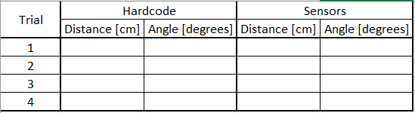
Procedure - Data
Tabulate raw data in the Datasheet
  Download the template by clicking the text in the manual

Slide 24
Procedure - Results
Tabulate results for each test in a chart:
2 charts total
It must pass all accuracy tests at a percentage of at least 80% and meet the acceptable tolerances
 | Accuracy | % Acc | Pass/Fail | Precision | Tolerance | Pass/Fail
Distance Test
Angle of Deviation Test

Slide 25

Procedure - Competition
Create a line of code utilizing sensors to travel the second section of the course as fast as possible
The robot cannot be physically modified before the competition
The team with the highest competition ratio wins
Accuracy and precision values must be taken from the same table

Slide 26
Report
Individual lab report
Title page
Discussion topics in the manual
MUST include spreadsheet with test results, competition results, standard, average, accuracy, and precision

Slide 27
Presentation
Team presentation
Follow “Assignment” guidelines on EG Manual
Include photos of robot
Include screenshots of all code

Slide 28
Closing
Share tasks – each team member should take a turn building the code
Have all original data signed by a TA
Remember to submit all work electronically
Return all unused materials to TAs

Slide 29

Product Evaluation & Quality Improvement
QUESTIONS?

