Slide 1

SAFETY GUIDELINES
EG1003 | LAB 1

Slide 2

WHAT IS SAFETY?
To protect life and property from harm
or damage
Safety protects:
  Personal well-being
  Public well-being
  Proper business environment
Figure 1: Safety things courtesy of
CYB Human Resources
1

Slide 3
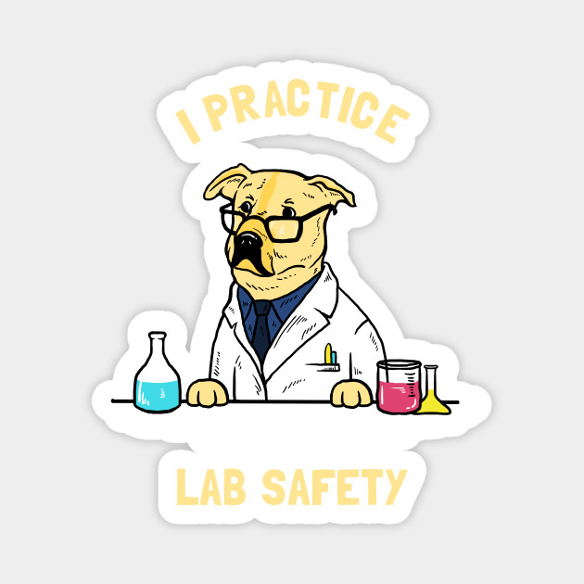
NEED FOR SAFETY
Helps maintain a hazard-free workplace
Creates a comfortable workplace
Keeps order and responsibility
Figure 2: Safety dog courtesy of TeePublic
2

Slide 4

SAFETY STAFF
General Engineering
Head TAs
Tandon School of Engineering
Dr. Charles Martucci, RH 701E, x3613
3

Slide 5
EMERGENCY NUMBERS
Contact | Phone Number
Emergency Closings | (212) 998-1220
Guard Stations | Rogers Hall: (646) 997-3537 Dibner: (646) 997-3727
Public Safety | (212) 998-2222
Wellness | (212) 443-9999
Facilities & Operations | (212) 998-1001
Environmental Health & Safety | (212) 998-1450
4

Slide 6
COVID SAFETY RULES
Wear PPE at all times
  Everyone must be wearing face masks, face shields, and gloves
Limit contact with materials
Clean up after yourselves
  Please wipe down any materials/workspaces at the end of lab (e.g. keyboards, iPods, etc.)
Record your seating assignment in NYUClasses after every lab
  EG1003 → Tools → Seating Assignment
Failure to follow COVID protocols will result in removal from lab
5
Notes:
Face shields and gloves will be provided by NYU
Pretty much everyone should only touch the things they need to touch to do the lab
Students will switch seats as we mix up lab groups during the semester, they must record them after every lab

Slide 7
BASIC SAFETY RULES
Be alert
  Note marked exits
  Know where the fire extinguishers and first aid kits are located
Know your peers and TAs, do not admit strangers
Be tidy
  Dispose of garbage properly, do not leave paper lying around
  Store materials in cabinets
5

Slide 8

BASIC SAFETY RULES
Be courteous
  Do not eat, drink, or smoke in labs
  Do not overcrowd the laboratories
  Maintain a business environment
Be smart
  Never work alone
  No horseplay or shouting
6

Slide 9

BASIC ELECTRICAL SAFETY
Avoid exposed wires, use electrical tape to cover them
Keep electrical cords off the floor and to a minimum
Outlets are for electrical plugs only
  i.e. No paper clips, scissors, fingers, etc.
Never force a wrong plug into an outlet
No open drinks or containers
When working with fluids, be extremely cautious
7

Slide 10

BASIC MECHANICAL SAFETY
In lab, only TAs should use mechanical tools
Wear proper accessories (goggles, gloves, ear protection, etc.) when working with tools
All tools should be used on a workbench
Work near a window or well-ventilated area
Do not use broken equipment
Notify a TA immediately if equipment is broken
8

Slide 11
RECAP
Know & follow the safety rules
Report any problems to the safety staff
Maintain a business environment
THINK
SAFETY
ALWAYS………..
9

Slide 12
QUESTIONS?

