Slide 1

INTRODUCTION TO EG1003
EG1003 | RECITATION 1

Slide 2
AGENDA
2
Course Objectives
Course Format
Absence & Tardy Policies
Grading Breakdown
Course Resources
Questions

Slide 3



COURSE OBJECTIVES
3
Explore concentrations of engineering
Develop professional skills
  Teamwork
  Oral communication
  Written communication
Develop technical skills

Slide 4




COURSE FORMAT
4
Lecture
1 hr / week
Lab
3 hrs / week
Recitation
1.5 hrs / week
Semester-Long Design Project

Slide 5
LECTURE
5
Department and guest lecturers cover engineering aspects
Mandatory attendance
  ID scanned during first five minutes
  Don’t be late!

Slide 6
LABORATORY
6
Rotating lab groups of 2-3 students
Weekly lab report due at 11:59 pm on night before the next lab
Weekly quiz (first 10 minutes only)
  Lab material
  Lecture material
Makeup labs requested on EG website

Slide 7

RECITATION
7
Student presentations on labs & projects
Professor and TA material on becoming a well-rounded engineer:
  Engineering career pathways
  Professional skills
  Engineering mindset
  Technical writing

Slide 8
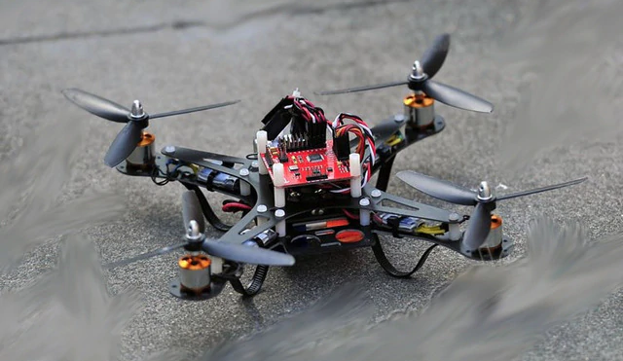
SEMESTER-LONG DESIGN PROJECT
8
Ten-week project
Teams of 2-3 students
More info to come
Figure 1: Sample SLDP RAD Project courtesy of EG 1003

Slide 9
ABSENCE & TARDY POLICIES
9
Lecture
  Attendance in first five minutes
Laboratory
  No extensions on quiz time for tardiness
  Lab doors shut 30 minutes into class
Recitation
  Unexcused absences result in 0 on presentation
  Door shuts 10 minutes into class
  Your group will present without you

Slide 10

ABSENCE & TARDY POLICIES
10
Notify Professor and Recitation TA in advance of absence
Excused absences processed through NYU Tandon Student Affairs
Full absence & tardy policies on EG Manual

Slide 11
GRADING BREAKDOWN
11
Item | Percentage of Grade
TA Lab Reports | 20%
WC Lab Reports | 20%
Lab Quizzes | 5%
Recitation Presentations | 15%
Semester-Long Design Project | 30%
Lecture Attendance | 10%

Slide 12
COURSE RESOURCES
12
EG Website
eg.poly.edu
Assignment submission
Course announcements
Syllabus & schedule
Grades
EG Lab Manual manual.eg.poly.edu
Lab & project information
Course material
Course policies
Help and how-tos

Slide 13
QUESTIONS?
13

