Slide 1
EGuitar1003
The Musician’s Notebook

Slide 2
Our Team
Carina Tan
Joel Mendoza
Jay Patel
Software Developer
Lead Designer
Electrical Engineer

Slide 3
The Average Guitar
Inconvenient
Expensive
Single-Functioned
Heavy
Large
Typically over $100
Many over $500
Notes are only played
Cannot record notes

Slide 4
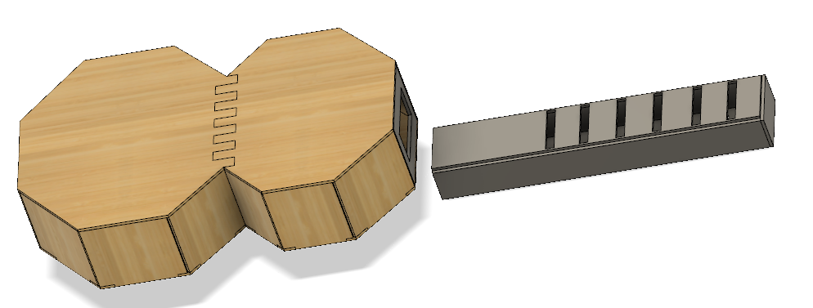
Presenting the EGuitar1003
“The device every musician needs— and can have”
“Where music meets engineering”

Slide 5
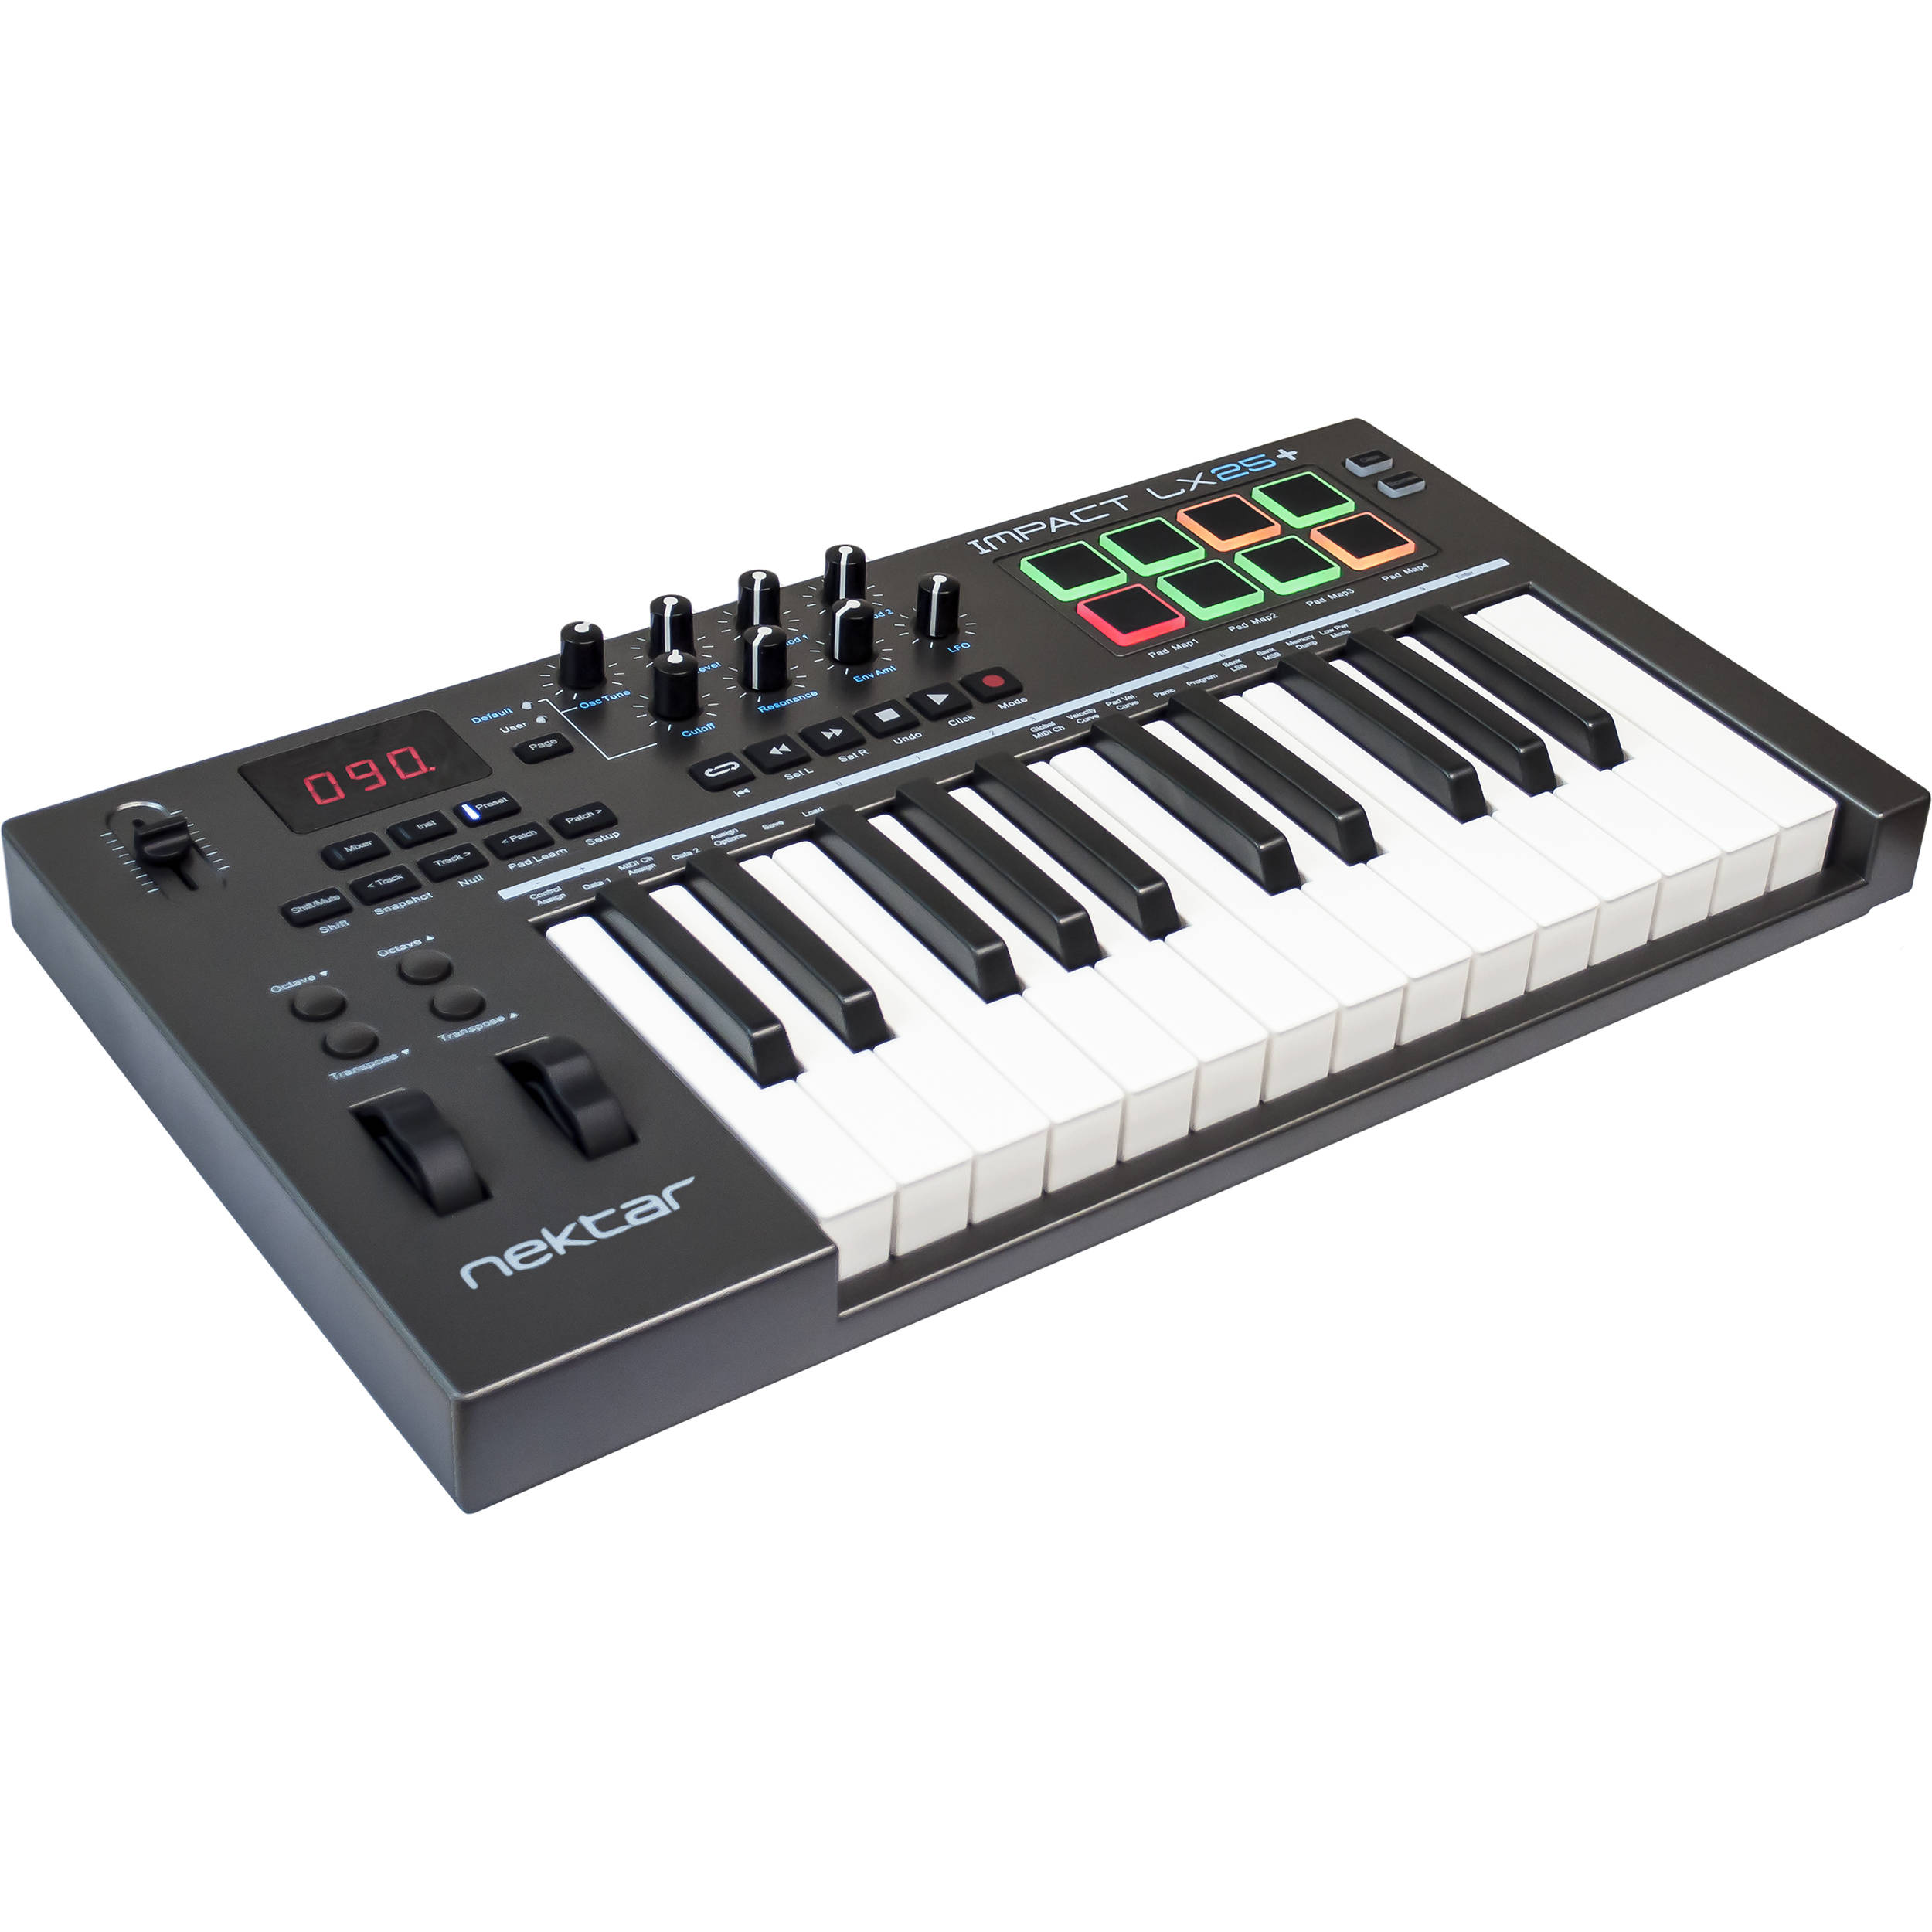
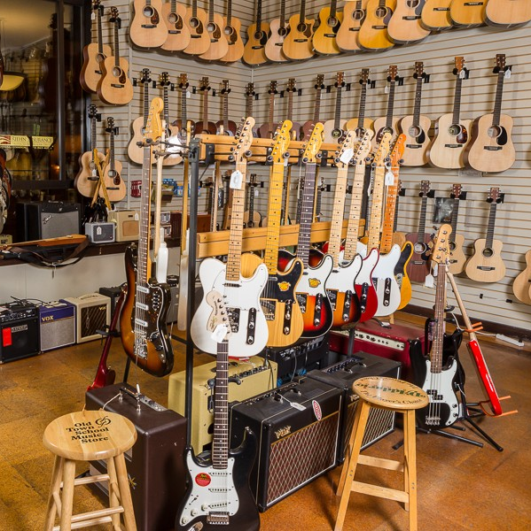
Future Plans
1
2
3
Compatibility
Speaker system
Marketing

Slide 6
EGuitar1003
The Musician’s Notebook

