Slide 1
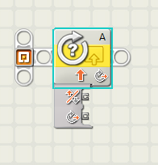
Sensors

Slide 2
Overview
Objective
Concept
Materials
Procedure
Report/Presentation
Closing

Slide 3
Objective
Design sensor programs
  Mindstorms: Use sensors to stop a motor when a red ball is detected
Apply sensors to Semester-Long Design Project

Slide 4
Concept: Control Systems
System created to read and analyze data
Use analyzed data for appropriate action
Examples:
  Thermal controls
  Lighting systems
  Alarm systems
  Motion sensors

Slide 5

Concept: Switches
Switches
  Allow program to perform different
  actions depending on a certain
  condition
  If “Condition A” then “Action A”
  else “Action B”

Slide 6

Concept: Loops
Loops
  Allow program to run part of a code
  multiple times as long as a certain
  condition is met
  While “Condition A” do “Action 1”

Slide 7
Concept: Sensors
Sensors
  Read data from test environment
  Data converted to digital format for computer
Some sensor types:
  Light
  Temperature
  Ultrasonic
  Touch
Sensors connect to different control devices:
  LEGO -> EV3
  Thermocouple -> DAC -> PC

Slide 8
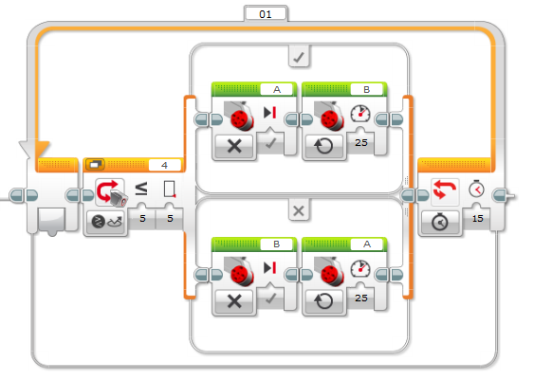
Concept: Light Sensor
Measures:
  Color
  Ambient light intensity
  Reflected light intensity
Is used as the condition in the
switch for a line follower
  For example: if “reflected light
  intensity < 5” then “move motor 1”
  else “move motor 2”

Slide 9
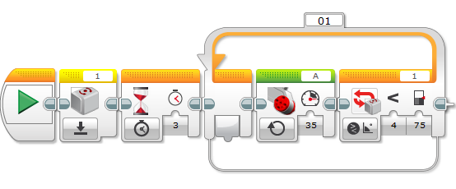
Concept: Gyro Sensor
Measures:
  Current angle
  Rate at which it is turning
Is used as the loop condition
  While “gyro angle reads < 75
  degrees” “move motor”
(not used in this lab)
Needs to be reset before each use

Slide 10
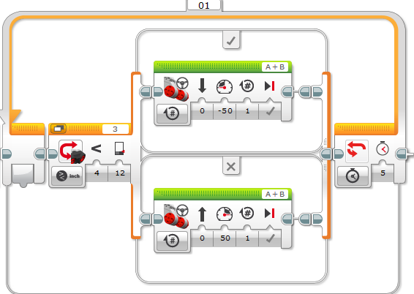
Concept: Ultrasonic Sensor
Measures:
  Distance to some objects
  (cm or in)
Is used similarly to the
light sensor (switch
statement condition)

Slide 11
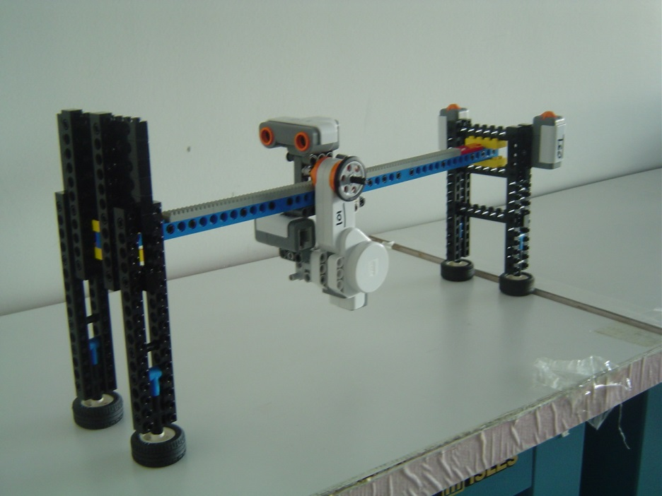
Materials
Mindstorms sensor program
  EV3
  Test assembly
  Computer with Mindstorms
LabVIEW sensor programs
  Computer with LabVIEW & DAC
  Thermocouple

Slide 12
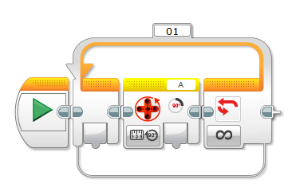
Procedure: Rotation Sensor
Write a program that moves the robot forward for 3 sec
  Add a code that reads the number of rotations during the 3 sec
Write a program that displaying the number of rotations, but the stops robot after 3 rotations

Slide 13
Procedure: Ultrasonic Sensor
If the sensor detects a distance greater than 40 in, a happy face should appear, for a distance of less than 40 in, a sad face should appear
If the sensors detect a distance less than 40 in but greater than 30 in, a caution sign should appear. But for a distance less than 40 in but greater than 30 in, a sad face should appear

Slide 14
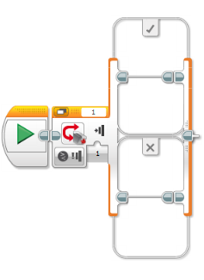
Procedure: Touch Sensor
Write a program in which your robot
would move when the touch sensor
is pressed, and would stop when the
touch sensor was released

Slide 15
Procedure: Light Sensor
Write a program for obtaining
the light intensity and
displaying it on the
EV3’s screen

Slide 16
Report/Presentation
No report for this lab
No presentation for this lab
Milestone due next recitation

Slide 17
Closing
Have all lab notes signed by TA
Each team member should have a turn using the software
Return all unused materials to TAs

Slide 18

Sensors
QUESTIONS?

