Slide 1


Computer-Aided Design (CAD) Introduction
EG1004 | UAI Lab 1

Slide 2
OVERVIEW
Objective
Background Information
Materials
Procedure
Closing

Slide 3
OBJECTIVE
Become familiar with engineering CAD software
Recreate given models from scratch in Fusion 360

Slide 4
BACKGROUND INFORMATION
Part 1: Software Overview

Slide 5
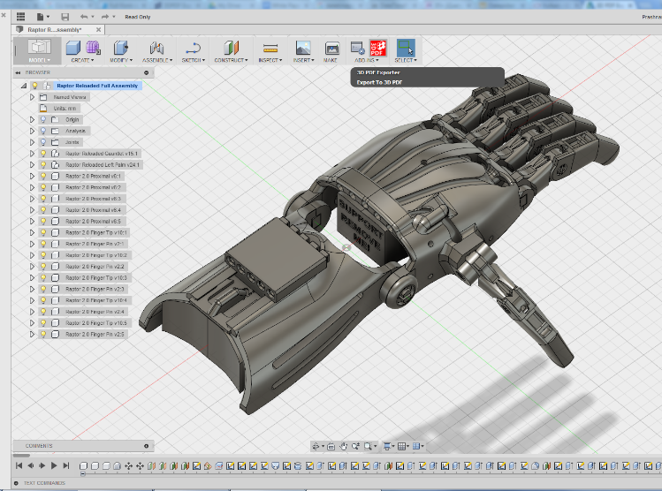
BACKGROUND INFORMATION
Fusion 360
  CAD software
  Creates 3D drawings of engineering designs
  Also used for CAM, rendering, simulation, etc.
  Enables fast & cheap iteration and design validation
Figure 1: Fusion 360 in use courtesy of Autodesk

Slide 6
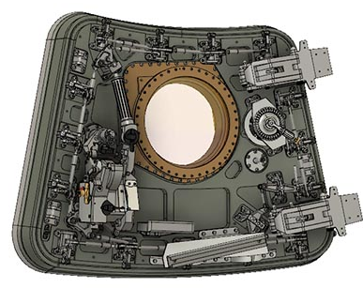
BACKGROUND INFORMATION
Additional Software Information
  Ultimaker Cura - Computer-aided manufacturing (CAM) software for 3D printers
  Fusion 360 Assemblies - Used to display an assembled product of separate parts, validate fitment, or simulate motion.
Figure 2: Fusion Assembly in use courtesy of Autodesk

Slide 7
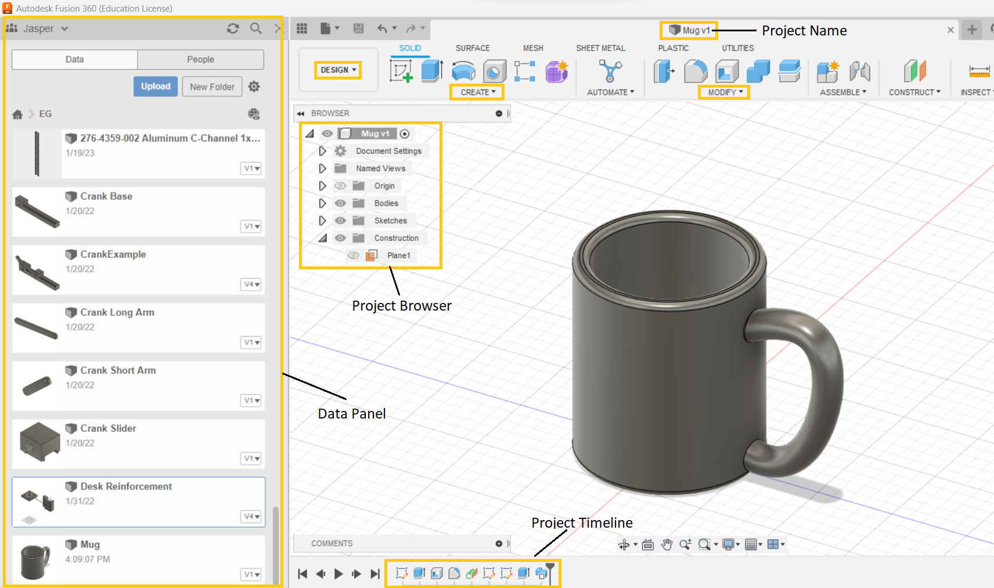
BACKGROUND INFORMATION
Fusion 360 Design Workspace
  Create - Tools to create a new body
  Modify - Tools to modify existing bodies
  Project Timeline - Tracks changes to project
  Project Browser - List of all existing sketches, bodies, etc
  Data Panel - Cloud based file system for Fusion 360
Figure 3: Fusion 360 Design Workspace by Prototyping Committee

Slide 8

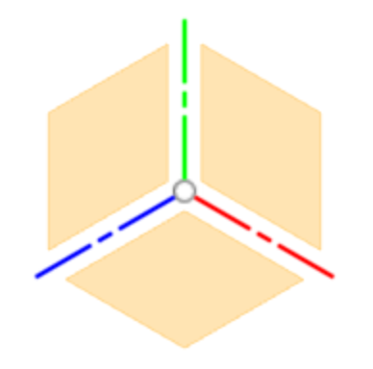
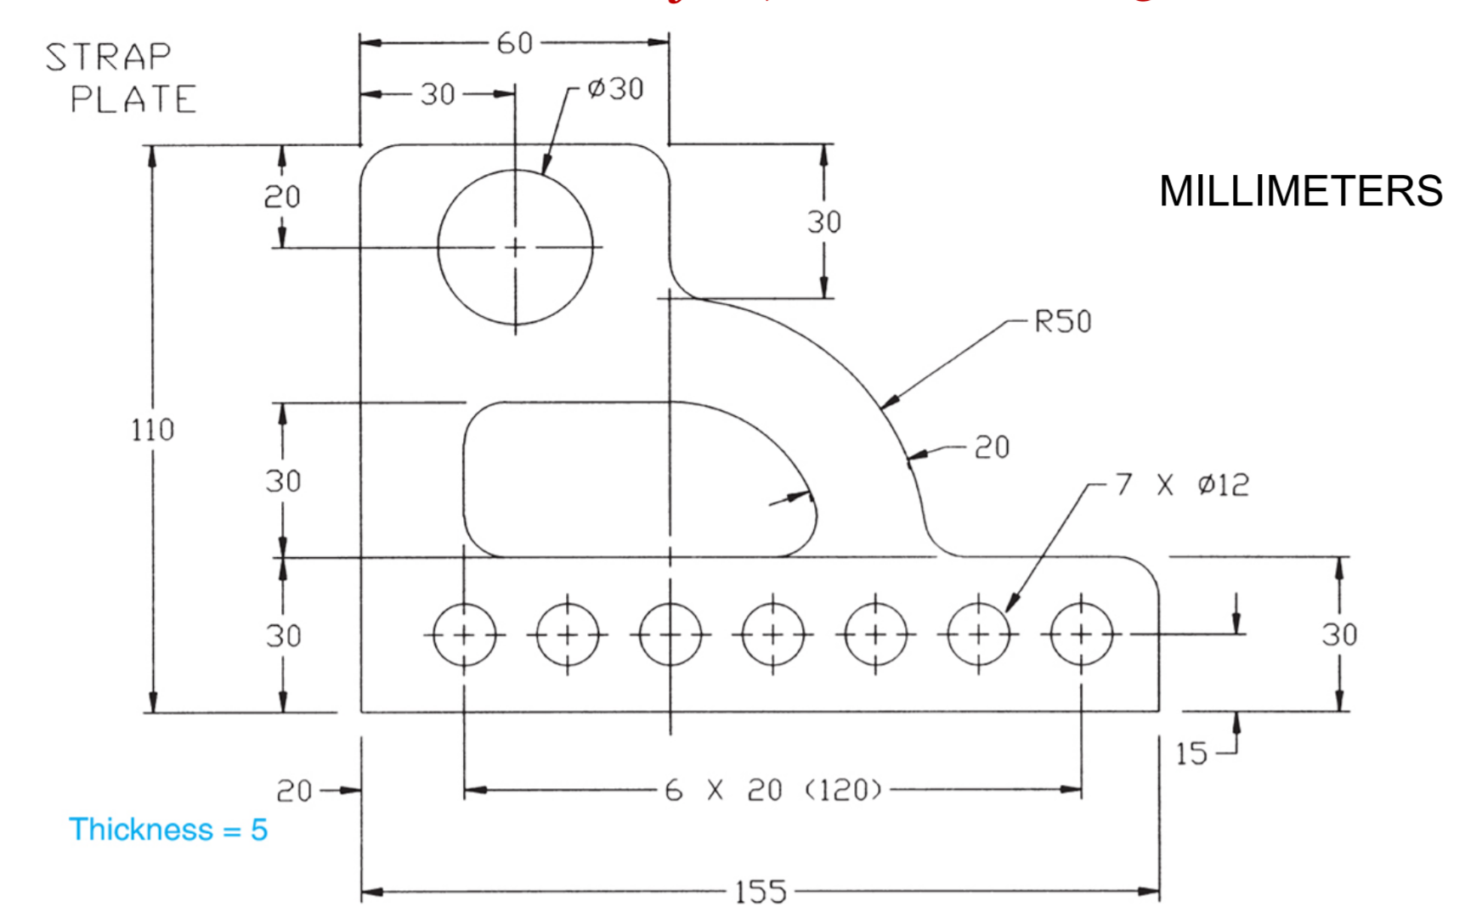
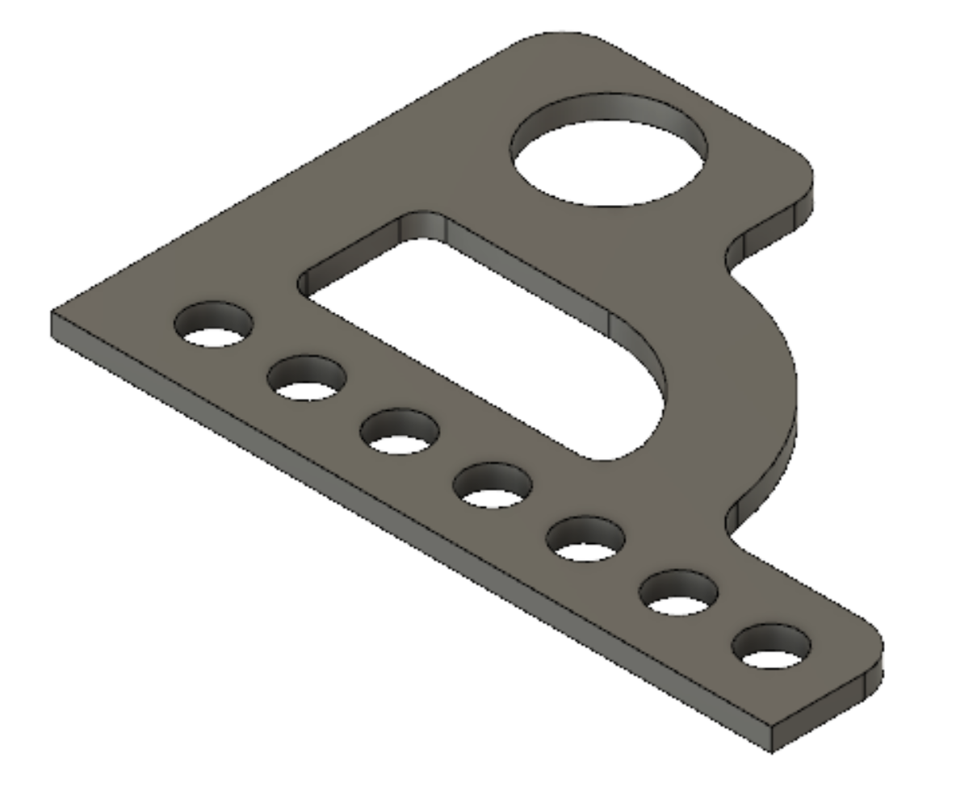
BACKGROUND INFORMATION
Fusion 360 Workflow
  Sketch - Click to create new sketch
  Select Plane - Select an origin plane, construction plane, or body face
  2D Sketch - Complete your sketch with the 2D sketch tools
  3D Body - Use a ‘Create’ function, such as extrude, to create a 3D body from sketch
  Details - Use a ‘Modify’ function to add details if necessary
Figure 4: Fusion 360 Workflow by Prototyping Committee

Slide 9
BACKGROUND INFORMATION
Part 2: Specific Fusion 360 Tools

Slide 10




BACKGROUND INFORMATION
Sketch Tools
  Shapes and Splines - Geometric shapes that can be resized and constrained
  Mirror & Pattern - Duplicates a sketch in an array pattern or about an axis
  Dimension - Defines lengths & angles in sketch with numerical value or equation
  Constraints - Defines geometric relationships between shapes (tangency, coincidence, etc)
Figure 5: Sketch Icons compiled by Prototyping Committee

Slide 11





BACKGROUND INFORMATION
Create Tools
  Extrude - Adds depth to a sketched cross-section perpendicular to sketch plane
  Revolve - Revolves a sketched cross-section about an axis
  Mirror - Mirrors a feature or body along a mirror plane
  Pattern (Rectangular & Circular) - Duplicates a feature or body in an array pattern or about an axis
Figure 6: Create Tool Icon compiled by Prototyping Committee

Slide 12


BACKGROUND INFORMATION
More Create Tools
  Loft - Creates transitional shape between distant sketch profiles
  Sweep - Sweeps a sketch profile along a path
Figure 7: Create Tool Icons compiled by Prototyping Committee

Slide 13


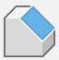
BACKGROUND INFORMATION
Modify Tools
  Fillet and Chamfer - Rounds or bevels a sharp edge
  Combine - Turn two or more intersecting bodies into one
Figure 8: Create Tools by Prototyping Committee

Slide 14
MATERIALS
Lab PC
Fusion 360 Educational Edition

Slide 15
PROCEDURE
Find group members and pick computer
Log into computers with Public Student account
Navigate to Autodesk website and create an account with NYU email address (each group member)
Open Fusion 360 on desktop or search in Windows search bar
Begin modelling parts

Slide 16
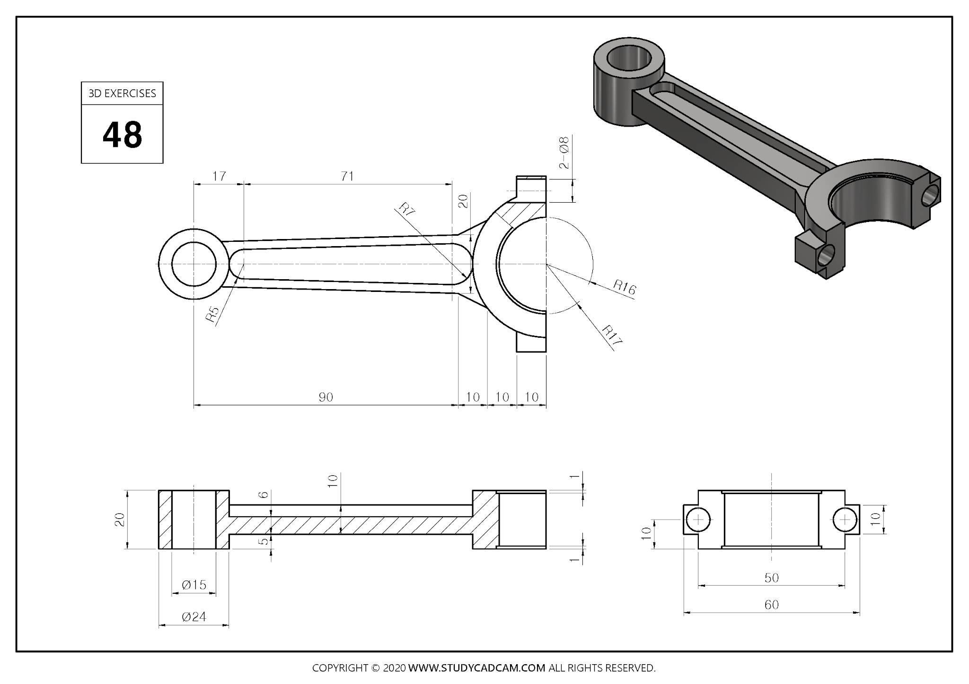
EXERCISE A
Model a connecting rod
Figure 9: Exercise A

Slide 17
EXERCISE A
Figure 10: Exercise A

Slide 18
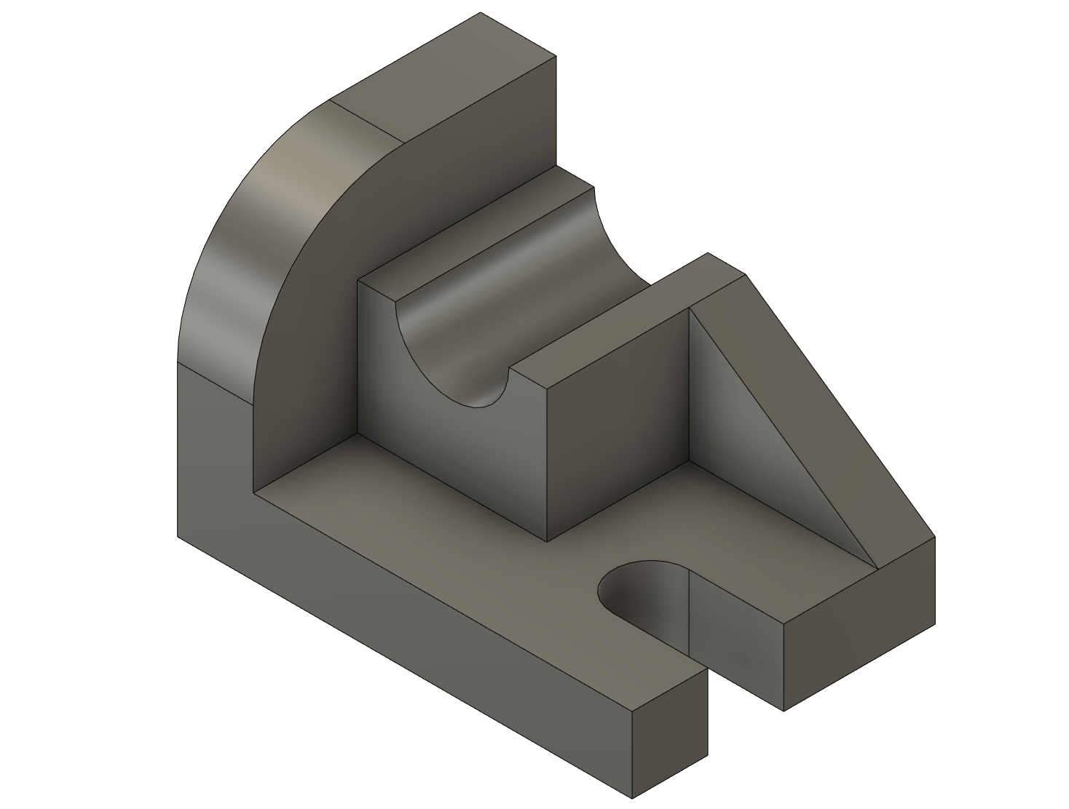
EXERCISE B
Model a practice shape
Figure 11: Exercise B

Slide 19
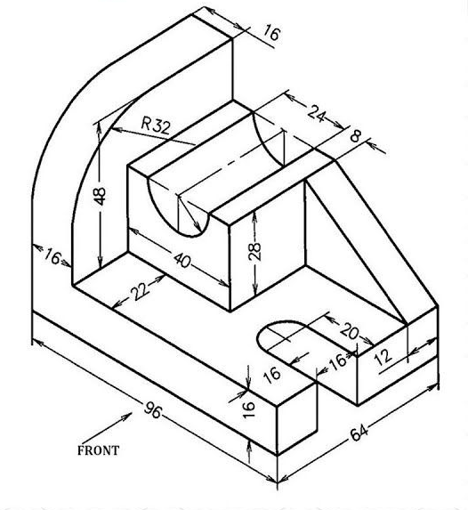
EXERCISE B
Figure 12: Exercise B

Slide 20
QUESTIONS?

