Slide 1

LAB REPORT OVERVIEW
EG1003 | RECITATION 3

Slide 2
ABSTRACT
The objective of “Lab 12: Hot Air Balloon Competition” was to design and build a hot air balloon and enter it in a competition. The competition was judged by a ratio that used time afloat in seconds, the cost of the balloon in dollars, and the payload (paperclips) the balloon carried. The highest ratio won.
On its first trial, the balloon had a ratio of 0. On its second trial, the balloon had a ratio of 6.25. It placed second among five balloons in the competition.
The first-place balloon had a highest ratio of 8.79. The third-place balloon had a highest ratio.
1

Slide 3
INTRODUCTION
The Principle of Archimedes says that these differences in temperature and gas density lead to the tendency of masses of hot air and hot air balloons to rise. Archimedes’ principle says that when a body is immersed in a fluid, which can be a liquid or a gas, it displaces the fluid around it. As a result of that displacement, a force called buoyancy is exerted on the body that is equal to the weight of the displaced fluid.
2

Slide 4
PROCEDURE
Two sheets of tissue paper were laid out side by side on a lab table and both were folded in half on their length. Using the glue stick, glue was applied along one width of one sheet of tissue paper. That width was then pressed on the width of the second sheet of tissue paper so they overlapped by roughly 2.5 cm. The remaining widths of the now one sheet of tissue paper were glued together the same way forming a tube made of tissue paper.
3

Slide 5
DATA/OBSERVATIONS
The first-place balloon had a ratio of 8.79 on its best trial. Its volume was 0.60 m³. Its cost remained $0.28 over its two trials. It had a time afloat of 1.23 s on its second trial with a payload of two paperclips.
The second-place balloon had a ratio of 0 on its first trial because it had no time afloat. Its volume was 0.48 m³. On its second trial, the balloon had a time afloat of 1 s with a payload of three paperclips. Its ratio on the second trial was 6.25.
4

Slide 6
CONCLUSION
Collectively, the items that were used in the initial design but discarded in the design that produced a time afloat cost $0.18. Had those items not been purchased, the second-place balloon’s cost would have been $0.30. Assuming its time afloat and payload remained 1 s and three paperclips, respectively, its ratio would have been 10, putting it into first place.
5

Slide 7

EQUATIONS
On a separate line, not in text
Centered
Number usually on right
${(x+a) }^{n} =\sum_{R−0}^{n}{k=\left({n \atop k}\right)x^{k}a^{n−k}}$ (1)
$a^{2}+b^{2}=c^{2}$ (2)
6

Slide 8
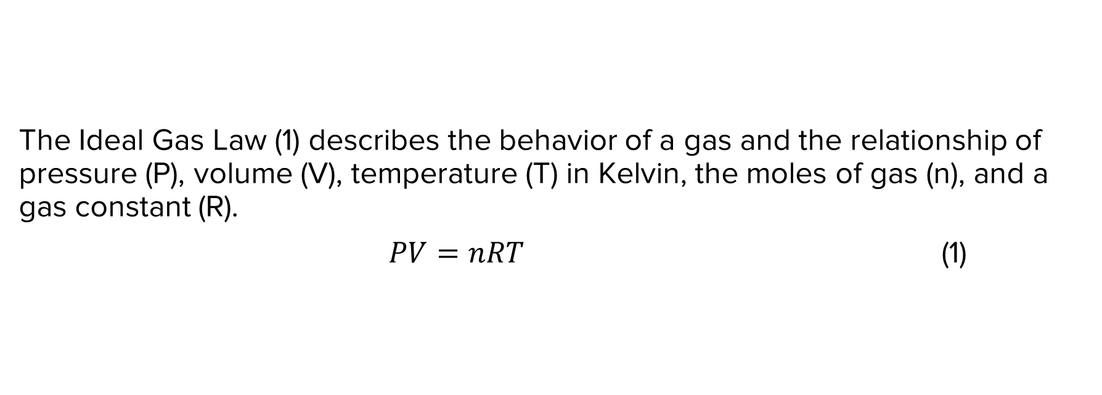
EQUATIONS
The Ideal Gas Law (1) describes the behavior of a gas and the relationship of pressure (P), volume (V), temperature (T) in Kelvin, the moles of gas (n), and a gas constant (R).
$PV=nRT$ (1)
7

Slide 9
EQUATIONS
Go to
“Insert” tab
Click on
“Equation”
Type your equation
Place # after the equation
Enter parentheses and number
Press enter
Correct font and type at “Home” tab
8

Slide 10
TABLES
Copy/paste tables from Excel using “Keep Source Formatting”
Labels must go above tables, aligned left and captioned
Number all tables consecutively, separate from figures
9

Slide 11
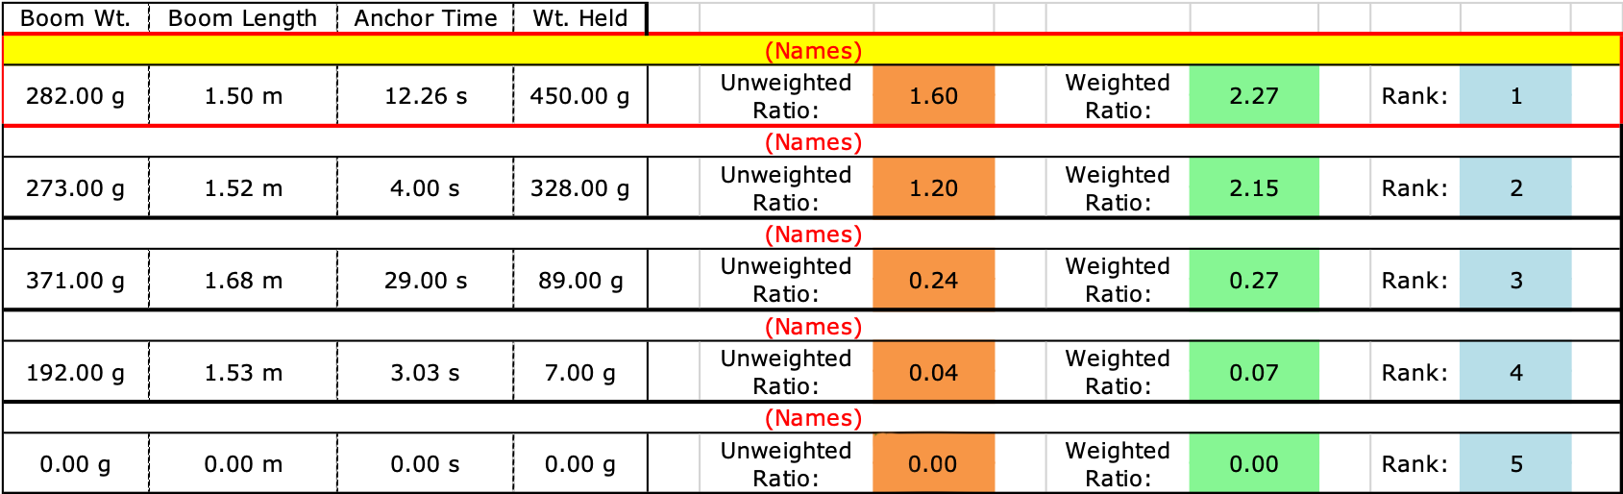
TABLES
Table 1: Boom Construction Competition Ranking
10

Slide 12
NUMBERING FIGURES
VS. TABLES
FIGURES
Graphs, charts, diagrams, infographics and images are all figures and numbered together
TABLES
Tables are their own type of item and are not numbered with figures
Labels must go over tables, aligned left and numbered consecutively
Labels must go under graphs and figures, aligned left and numbered consecutively
11

Slide 13
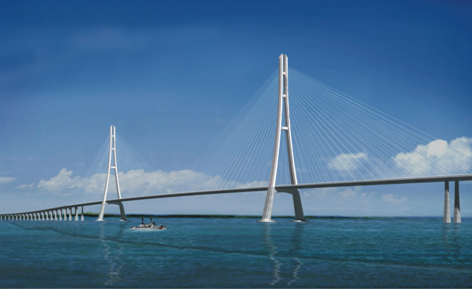
FIGURES
Figure 1: Anchor Time & Rank in Competition
Figure 2: Cantilever Bridge
12

Slide 14
QUESTIONS?

