Slide 1


The Timeshifter
Hour Glass, Inc.
Eve Fishinevich (Project Coordinator)
Rondell Sinanan (Head of Research)
Milestone 2
Date of Presentation: 09/99/9999
Section Z
Notes:
To replace this picture, just select and delete it. Then use the Insert Picture icon to replace it with one of your own!

Slide 2
Agenda
Project Objective
Background Information
Technical Design Description
Cost Estimate
Project Schedule
Summary

Slide 3
Project Objective
Petitioning for the creation of the world’s first working time machine
Aiming to retrieve force field generator & saber tooth tiger
Aiming to have it run at 50 years per minute

Slide 4

Background Information
Requirements:
  Retrieve one item from the past
  Retrieve one item from the future
NASA is soliciting designs for a time
machine to find alternate energy
sources

Slide 5
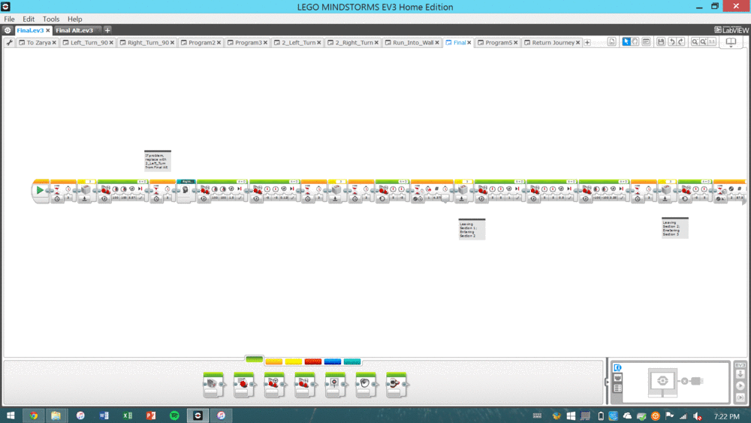
Technical Design Description
Our robot uses quantum technology to warp time
Travels 50 years in 3 minutes
  Faster by 2 minutes since Milestone 1
Figure 1: Mindstorms code

Slide 6
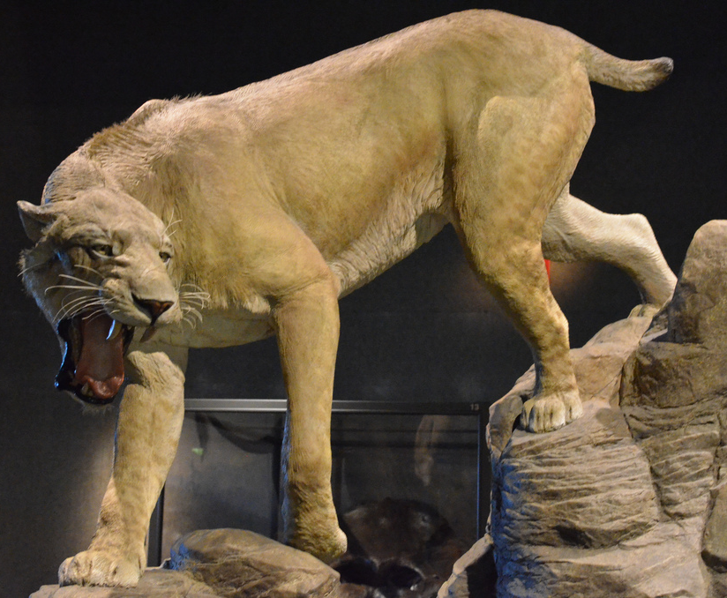
Technical Design Description
Successfully retrieved
sabretooth tiger from
the past
  Passed Benchmark A
Currently working to
retrieve item from
the future
Figure 2: Sabretooth tiger
Notes:
https://c1.staticflickr.com/9/8199/8247829737_4209055ac9_b.jpg

Slide 7
Technical Design Description
Figure 3: Top View
Figure 4: Front View
CAD DRAWING
CAD DRAWING

Slide 8
Technical Design Description
Figure 5: Isometric View
Figure 6: Most Detailed Side View
CAD DRAWING
CAD DRAWING

Slide 9
Cost Estimate
Item/Employee | Quantity | Unit Cost | Cost
Item 1 | # | $$$ | $$$
Item 2 | # | $$$ | $$$
Item 3 | # | $$$ | $$$
Miscellaneous | # | $$$ | $$$
Labor | # | $$$ | $$$
Total | $$$
Notes:
*VERBALLY STATE THAT COST HAS NOT CHANGED (IN THIS CASE)*

Slide 10
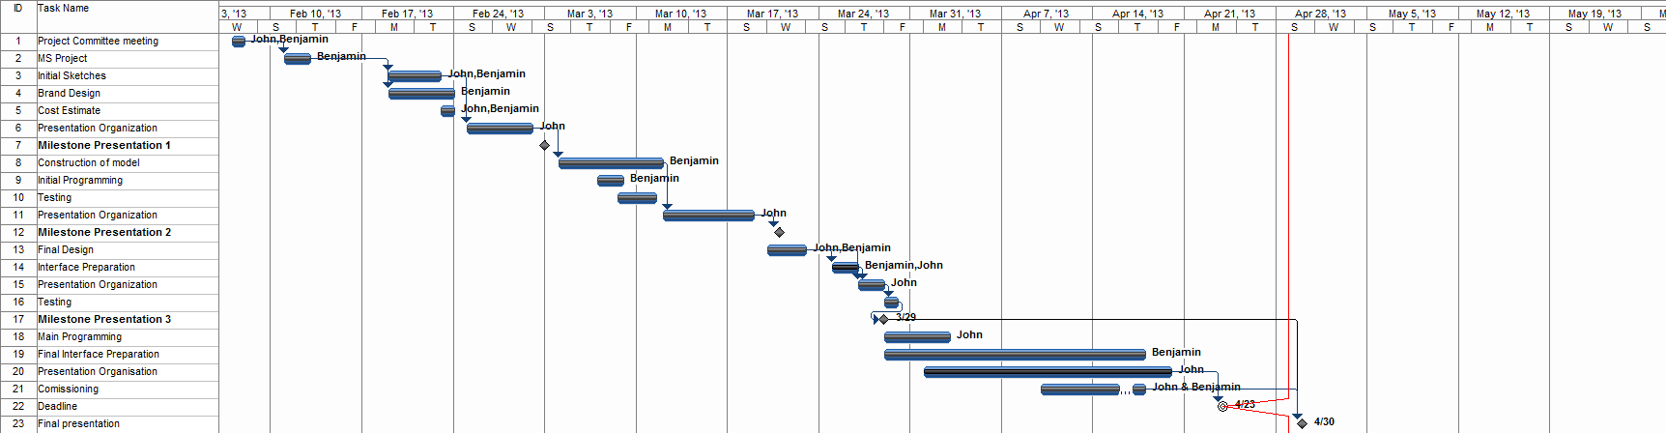
Project Schedule
Notes:
PROGRESS LINE SHOULD BE CLOSER TO THE MIDDLE SINCE IT’S ONLY MILESTONE 2!

Slide 11
Summary
We’re on schedule
  Item from past retrieved (Benchmark A)
  Working on retrieving item from the future
We’re on budget
By Milestone 3:
  Have the robot reach the future (Benchmark B)
  Continue optimizing design

Slide 12
The Timeshifter
Hour Glass, Inc.
Eve Fishinevich (Project Coordinator)
Rondell Sinanan (Head of Research)
Milestone 2
Date of Presentation: 09/99/9999
Section Z
Notes:
To replace this picture, just select and delete it. Then use the Insert Picture icon to replace it with one of your own!

