Slide 1
ojo
The Dyslexia Glasses
Leo Liu Andrew Qu Jeffrey Sun

Slide 2
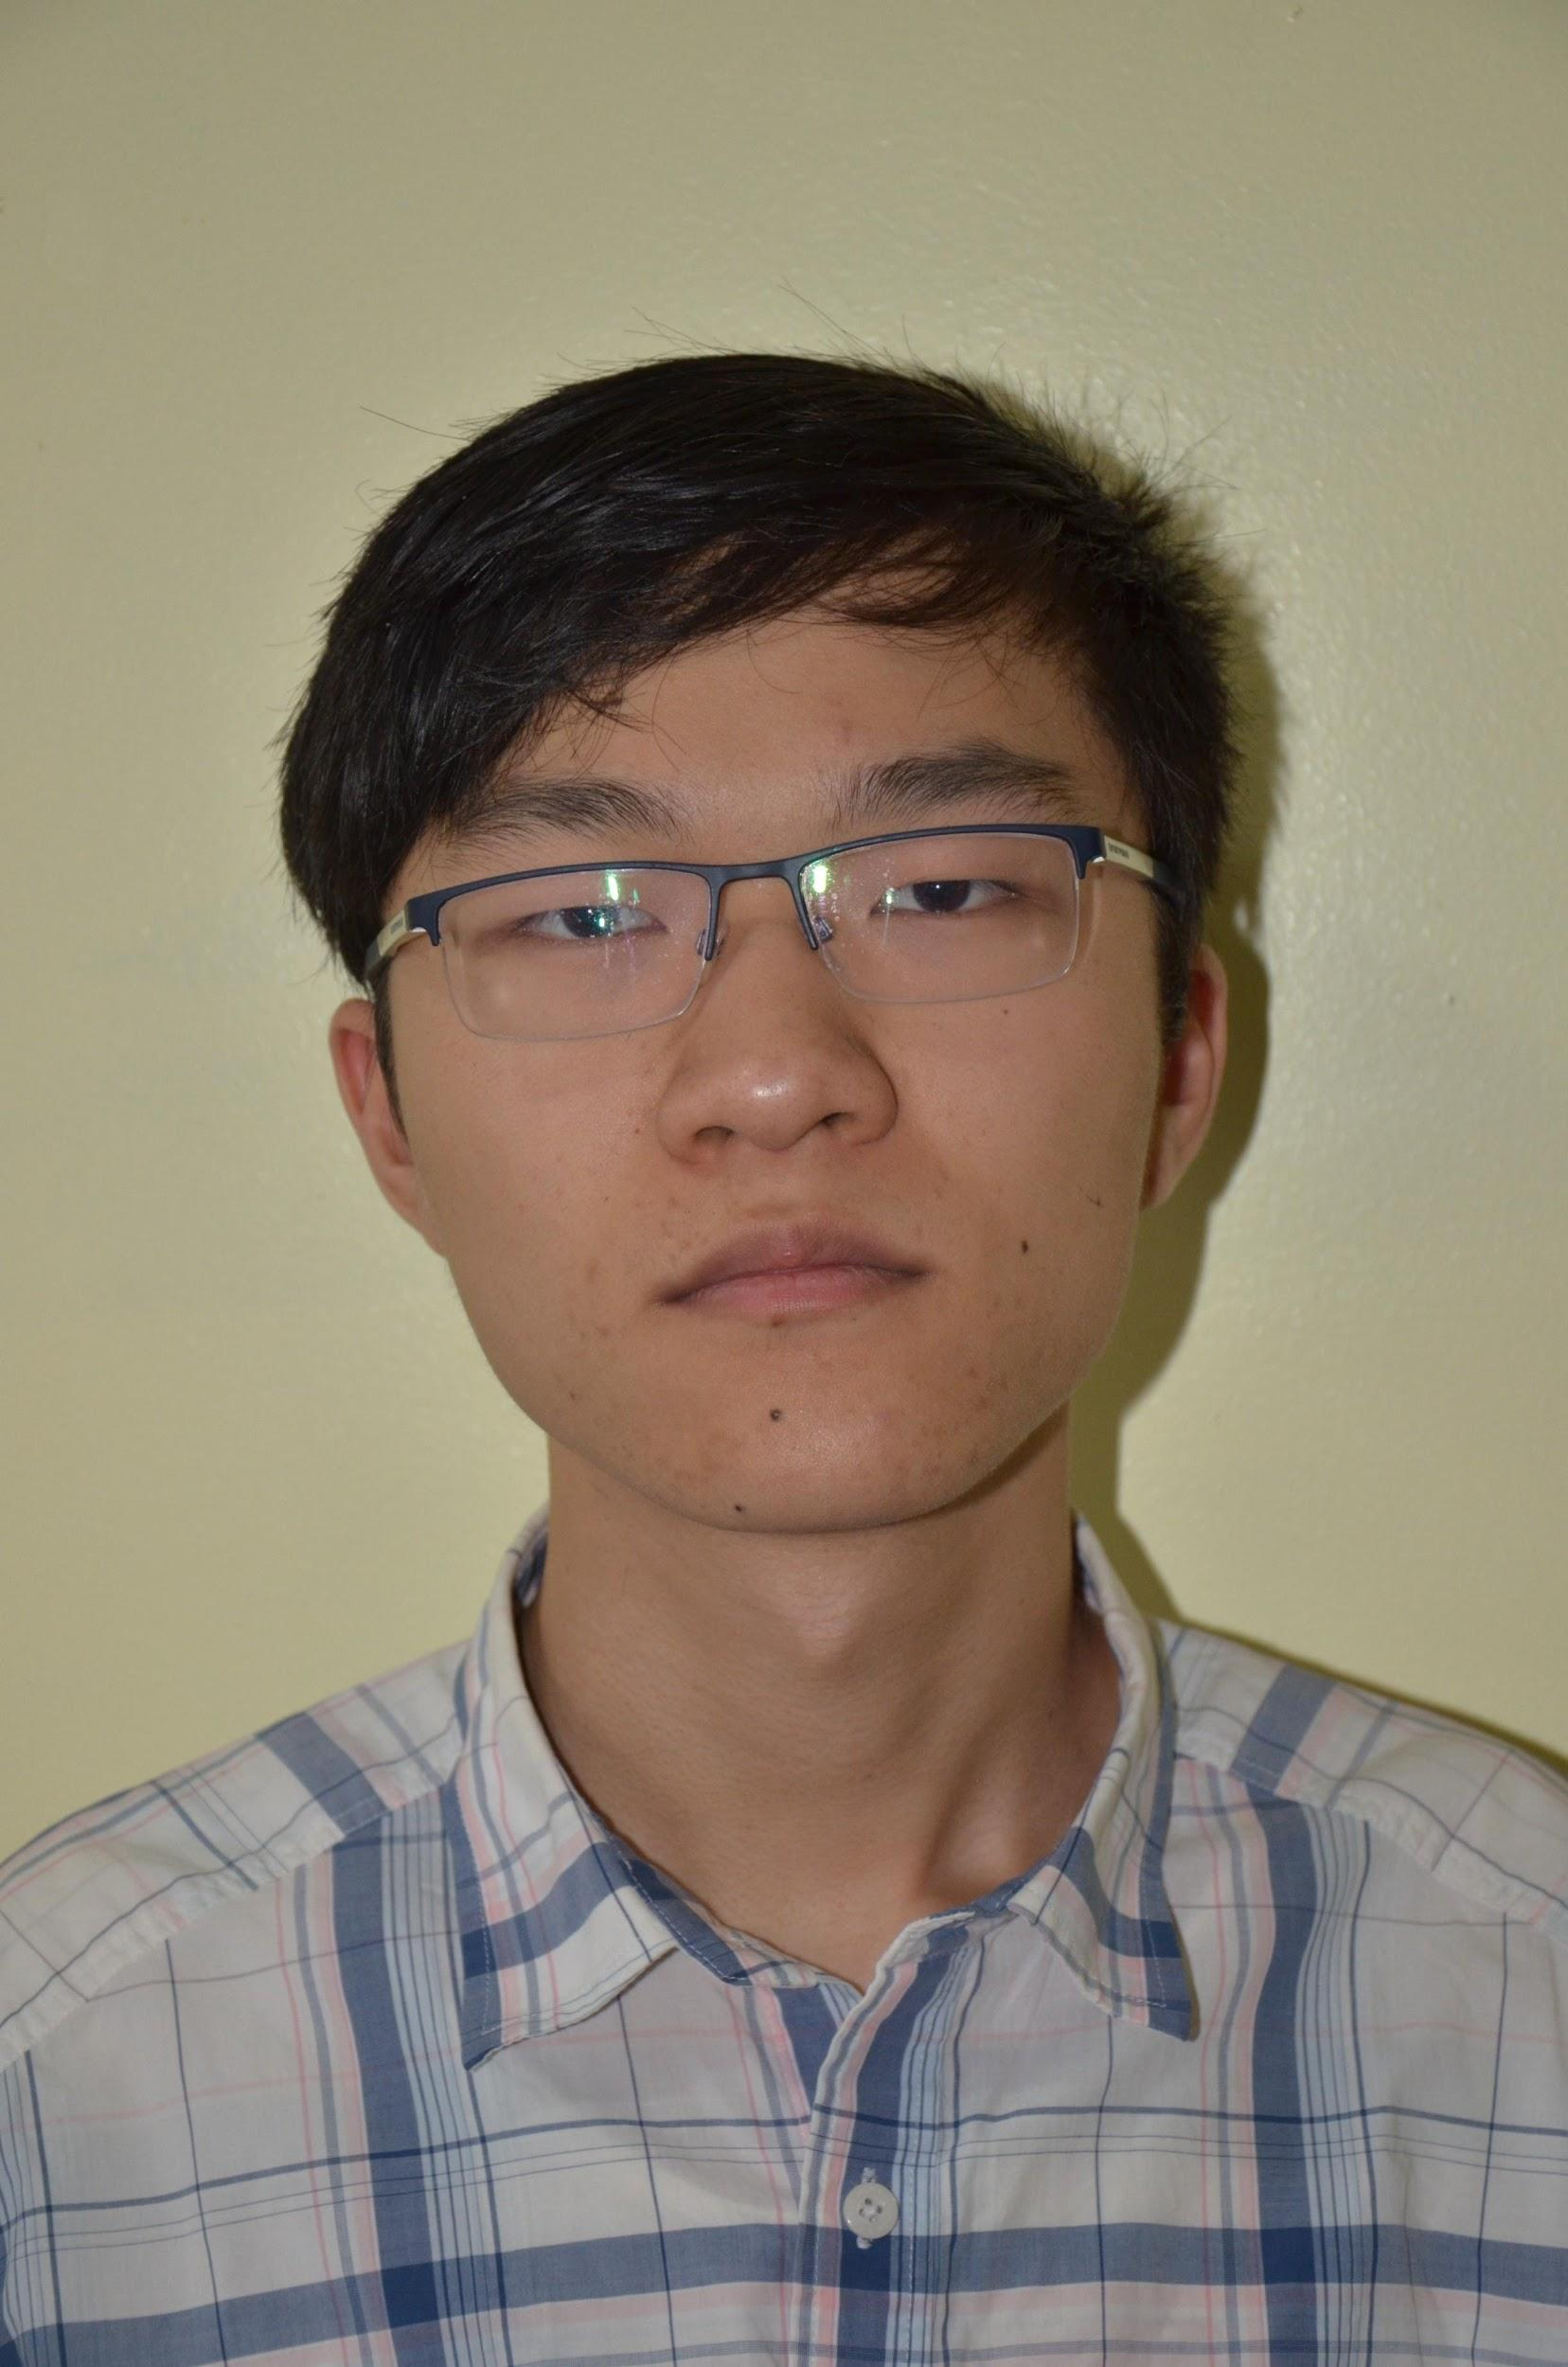
The Team
Leo Liu
Software Developer
BS Computer Science
Andrew Qu
Software Developer
BS Computer Science
Jeffrey Sun
Lead CAD
BS Mechanical Engineering

Slide 3
1.
Why Dyslexia?

Slide 4
DYSLEXIA
Affects up to 15% of Americans (43.5 Million)
Less than 1/3 of the children with dyslexia receive educational services
Reading impairment due to text “moving”

Slide 5
2.
What can be done?

Slide 6
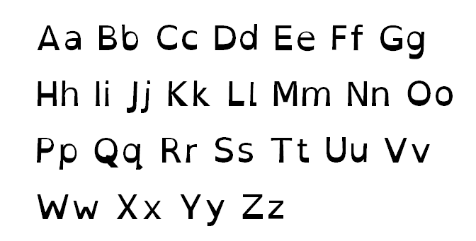
SPECIALIZED FONT
OpenDyslexic 3
Heavier bottoms
Wider openings
More spacing
More distinction

Slide 7
But few books are actually printed in this font

Slide 8
APP DEVELOPMENT

Slide 9
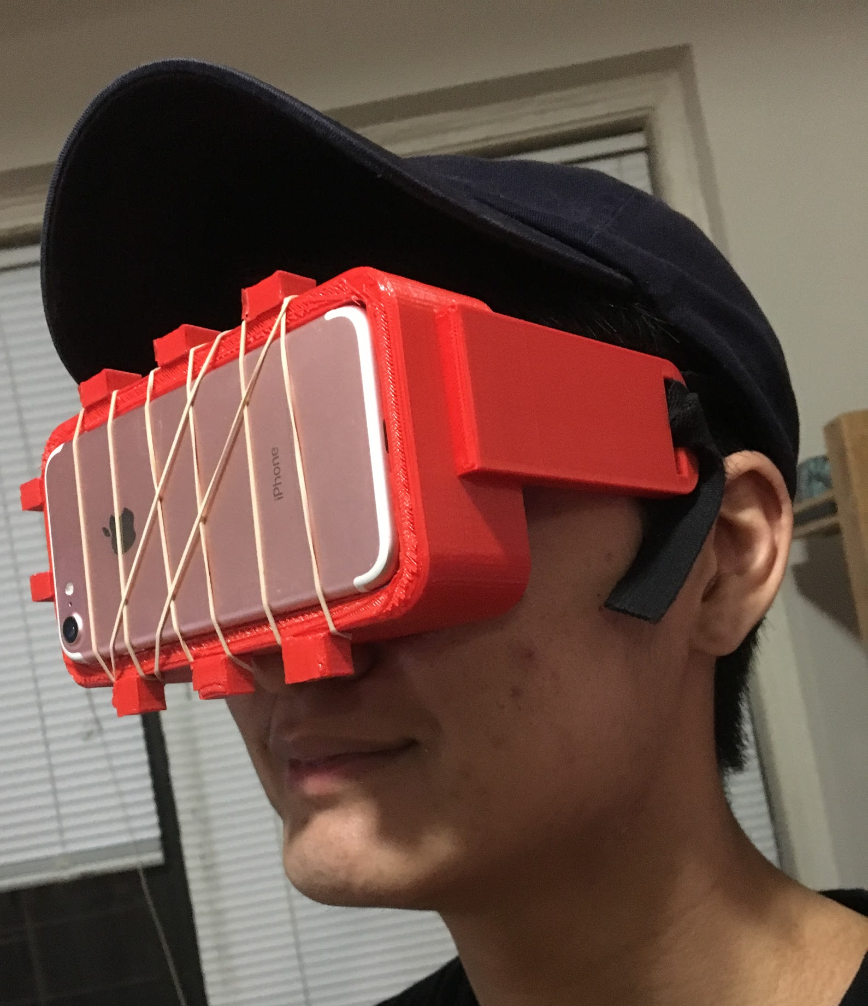
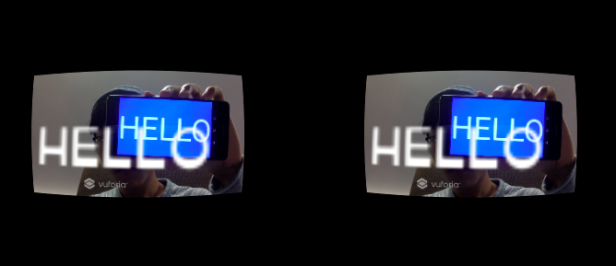

Slide 10
3.
Future Goals

Slide 11
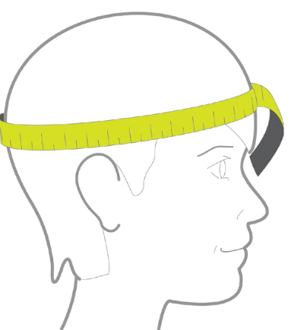

Slide 12
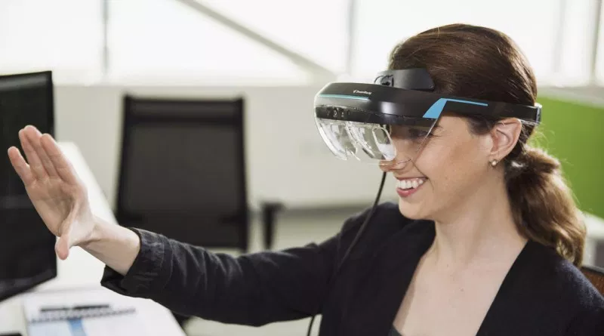

Slide 14
THANK YOU!
Questions?

