Slide 1
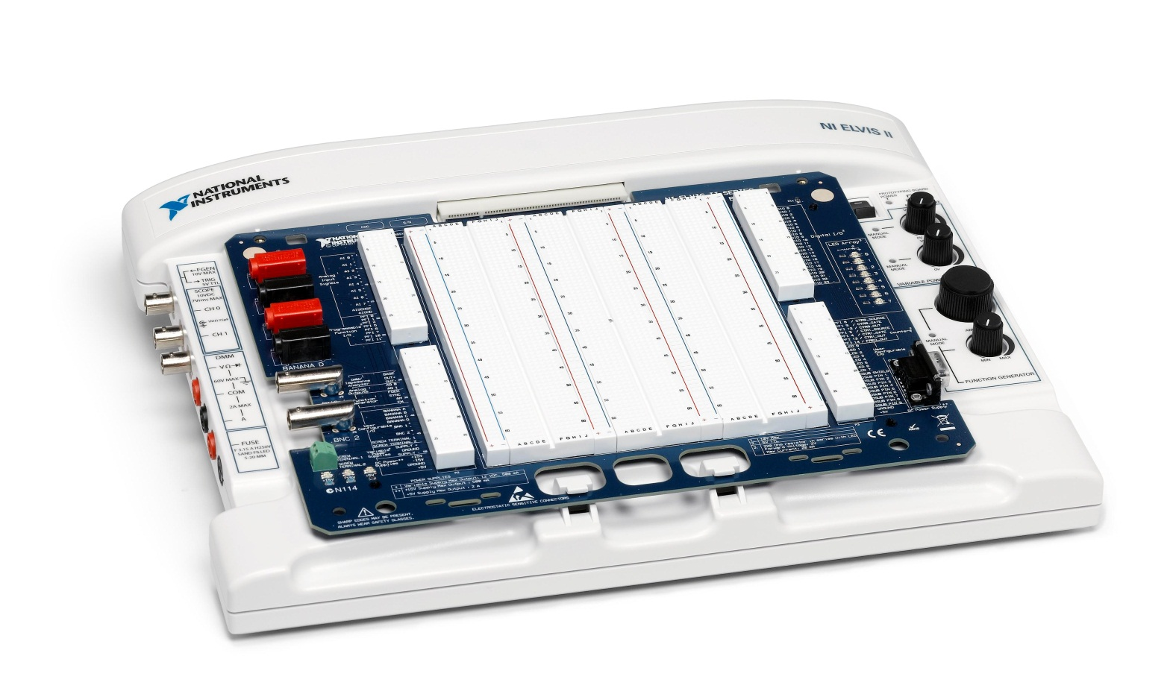
Introduction to NI-ELVIS

Slide 2
What is NI-ELVIS ?
Hands on design & prototyping platform
12 Integrated Instruments
Compatible with LabVIEW software

Slide 3
12 Integrated Instruments
Oscilloscope
Digital Multi-meter
Function Generator
Variable Power Supply
Bode Analyzer
Arbitrary Waveform Generator
2 Wire Current Voltage Analyzer
3 Wire Current Voltage Analyzer
Dynamic Signal Analyzer
Impedance Analyzer
Digital Reader
Digital Writer

Slide 4
Advantages
Integrated Instruments allow for quick and easy data acquisition
Frees up the workspace
Instruments can accessed from the NI-ELVIS platform and/or prototyping board
Multiple Instruments can be used at once

