Slide 1
INTRODUCTION TO THE SEMESTER LONG DESIGN PROJECT (SLDP)
ENGR-NY 9 | Recitation

Slide 2
Agenda
Project Introduction
Project Grading
SLDP Options
Additional Information

Slide 3
Project Introduction
7
Week Project
Three Project Options:
Self-watering Flowerpot
Solar-powered Rover
Biomedical Device
2-4
Team Members

Slide 4
Project Grading
Benchmarks
Two benchmarks
Completion of certain portions of project
Due dates on schedule on eg.poly.edu
Penalties for late completion
Extra credit for early completion
Benchmark
B
Benchmark
A
Benchmark A
Benchmark B

Slide 5
Project Grading
Commissioning
Completion of all tasks
Due date on schedule on eg.poly.edu
Can partially commission if unable to complete all tasks on time
Submission
Submission of all SLDP material
Due on same date as commissioning
Can submit early for extra credit
Benchmark A
Benchmark B
Commissioning
Submission

Slide 6
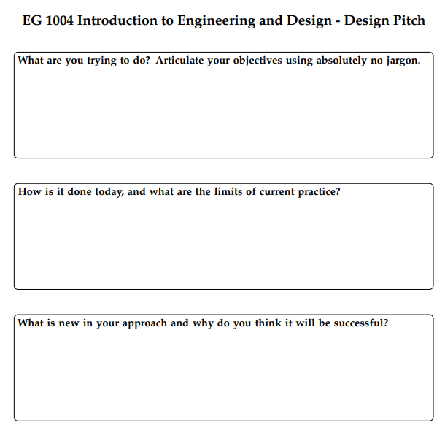
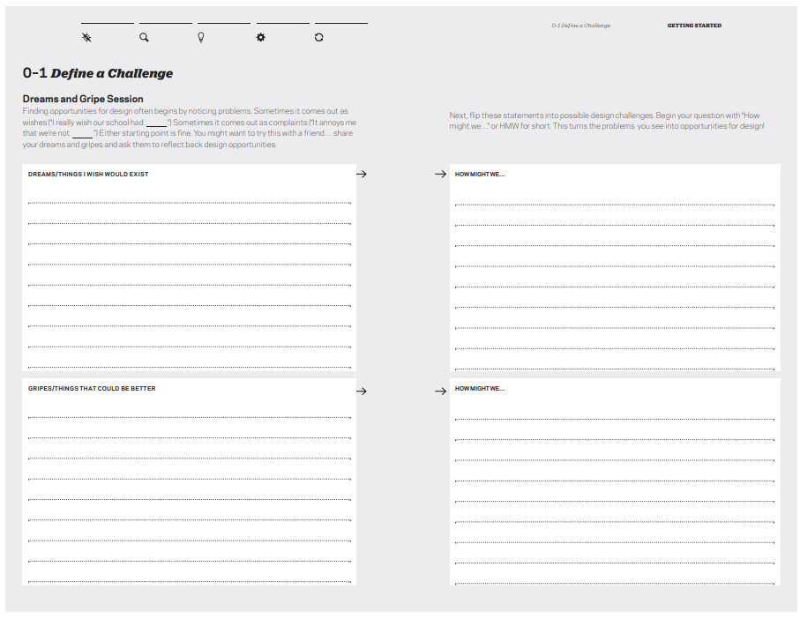
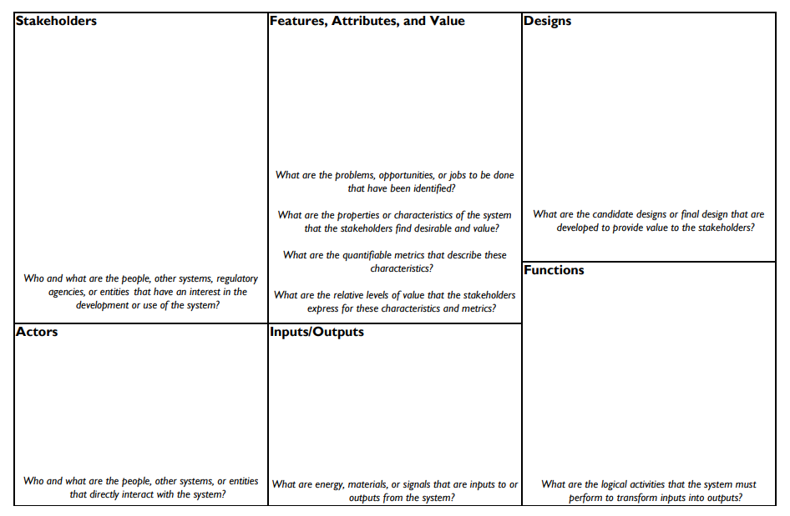
Milestone checkpoints
Milestone 1: Design Thinking
Milestone 2: Design Canvas
Milestone 3: Design Pitch

Slide 7
SLDP Team Google Drive
Your team must create a Drive folder for your team and share it with your professors & TAs!
All files you create for your SLDP must be in this Drive folder:
  Engineering notebook
  CAD files
  Code
  Circuit diagrams
  Progress pictures
  Product videos
  Presentations
  Budget spreadsheets
  Microsoft Project schedules
  Preliminary Design Investigation
  Final Design Report

Slide 8
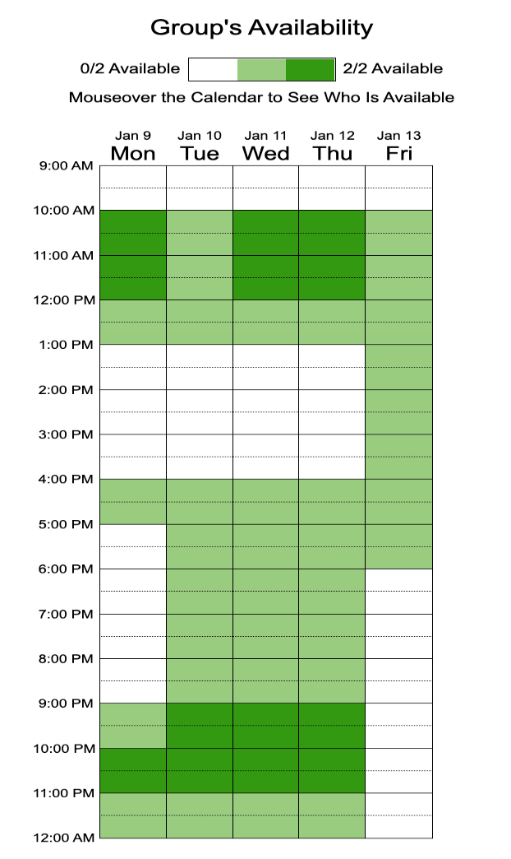
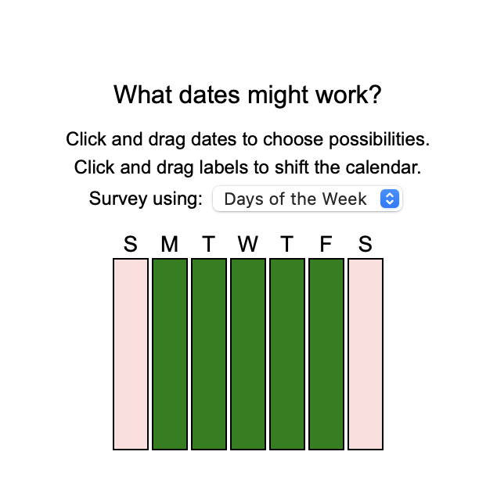
Scheduling Meetings
Steps to use:
One person creates the event
The link to the when2meet is sent to group members
Group members enter their name
Click and drag on times you are available
The darkest colors indicate where the most people are available

Slide 9
SLDP Options
Self-watering Flowerpot
Design a flowerpot
Use a microcontroller to maintain optimal soil moisture conditions
Respond to various environmental stimuli
Implement TWO sensors and ONE pump or mist maker

Slide 10
SLDP Options
Solar-powered Rover
Design a rover
Able to move autonomously
Complete a course

Slide 11
SLDP Options
Biomedical Device
Design a wearable device
Wearable on the human body
Provide valuable health or fitness information
Often used as assistive technology

Slide 12
Additional Information
Which projects interest you?
Refer to manual.eg.poly.edu for full project information
  3D printing requirements for each project are stated in the Manual
Speak with Professors and TAs for information regarding projects

Slide 13
QUESTIONS?

