Slide 1

SUSTAINABLE ENERGY VEHICLE
EG1003 | LAB 5

Slide 2
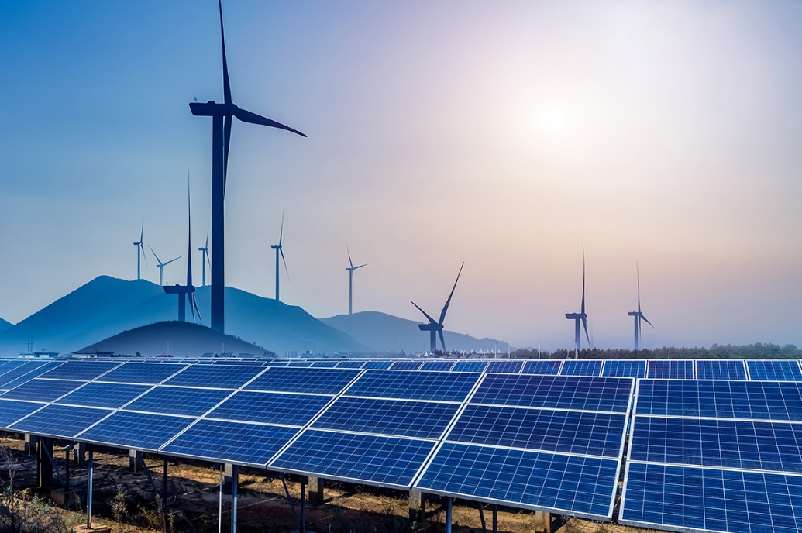
OVERVIEW
Objective
Background Information
Materials
Procedure
Assignment
Closing
Figure 1: Renewable Energy Sources
Courtesy of Physics World
1

Slide 3
OBJECTIVE
To evaluate energy storage devices
To evaluate different sources of renewable energy
To design a sustainable energy vehicle in Fusion 360
2

Slide 4
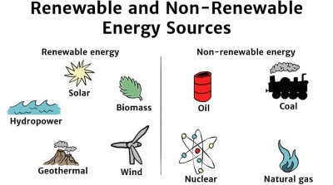
BACKGROUND INFORMATION
Renewable energy – energy harnessed from naturally replenished resources
Figure 2: Renewable vs. Non-Renewable Energy Sources Courtesy of Solar Schools
3

Slide 5
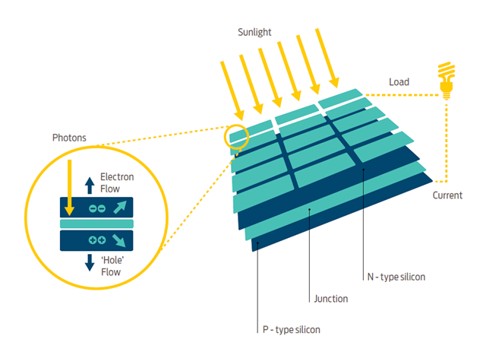
BACKGROUND INFORMATION
Solar panels – convert sunlight to electrical energy
  Incident sunlight excites electrons to
  next energy level, emitting energy
  Usually made of silicon
Figure 3: How Solar Panels Work
Courtesy of Good Energy
4

Slide 6
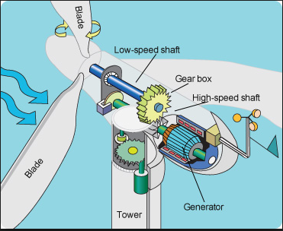
BACKGROUND INFORMATION
Wind turbine – converts wind energy to electrical energy
  Wind causes pressure difference on turbine blades
  Utilizes gear ratios to power generator
Figure 4: How Wind Turbines Work
Courtesy of Tech-Addict
5
Notes:
Rotating blades turn a low-speed shaft to a gearbox, which outputs power to an electrical generator through a high-speed shaft.

Slide 7
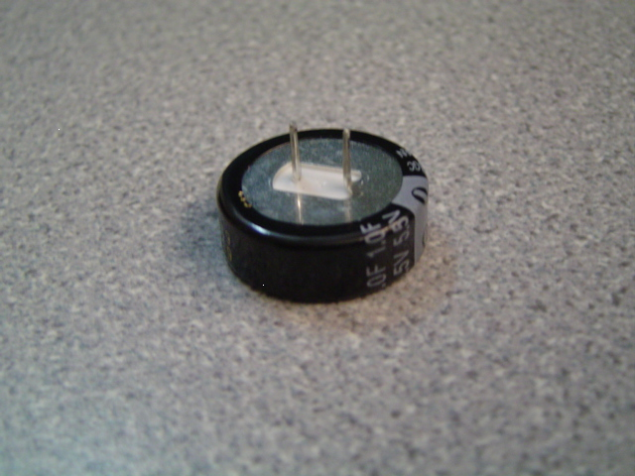
BACKGROUND INFORMATION
Capacitor – stores charge temporarily
  Are polarized
  Charged logarithmically (initially charges very fast but rate of charging slows down)
Positive
Negative
Figure 5: Polarized Leads of 1 Farad Capacitor
6

Slide 8


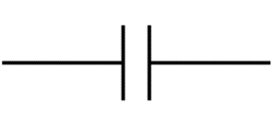

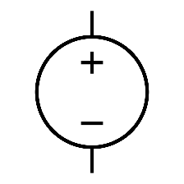
BACKGROUND INFORMATION
Symbols for common electrical components:
  Battery
  Capacitor
  DC source
  Voltmeter
  Ammeter
7

Slide 9
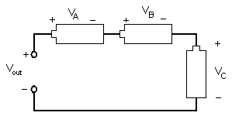
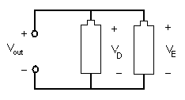


BACKGROUND INFORMATION
Series circuit
  Current is equal across components
  Voltage across each component:
  $${V_{out}=V}_{A}+V_{B}+V_{C}$$
Parallel circuit
  Current varies across components
  Voltage across each component:
  $${V_{out}=V}_{D}=V_{E}$$
Figure 6: Series Circuit
Figure 7: Parallel Circuit
8

Slide 10
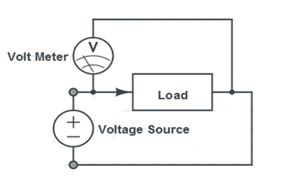
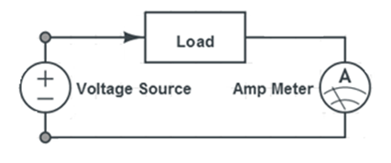
BACKGROUND INFORMATION
Digital multimeter – reads current and voltage across circuits
  Measure current in series, called ammeter
  Measure voltage in parallel, called voltmeter
Figure 8: Circuits for Using a Multimeter
9

Slide 11
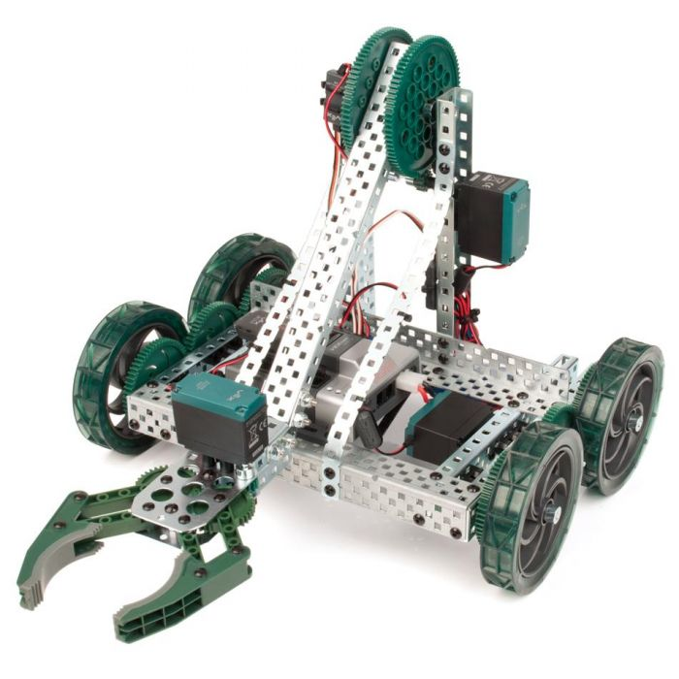
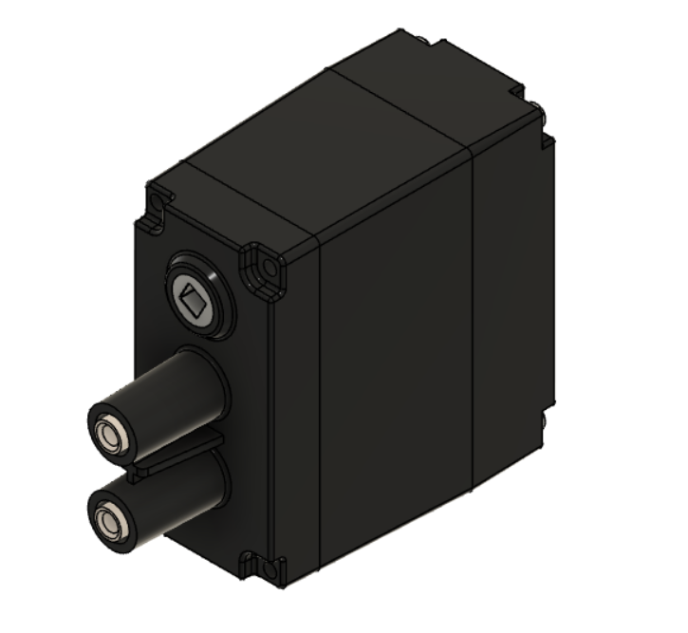
BACKGROUND INFORMATION
VEX Robotics – educational robotics kit used to design interactive robots
Commonly used to model capabilities of vehicles
Will be used to model sustainable energy vehicle design in Fusion 360
Figure 9: VEX Clawbot (Left) and VEX Motor (Right)
Courtesy of Robot Mesh
10

Slide 12
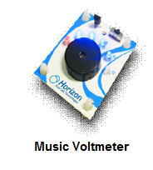
MATERIALS
Horizon wind-turbine
Sunforce 50013 1 W solar battery charger
Adjustable table fan
Heat lamp
3V power supply
Digital multimeter
Music voltmeter
1 F 5.5V capacitor
3 alligator clip sets
Virtual VEX Kit
11

Slide 13
PROCEDURE
Remote students will complete some of Part 1 and 2 on TinkerCAD
Part 1: Test the power storage device
  Charge a capacitor (In-Person & Remote)
Part 2: Test the assigned power source using music voltmeter/multimeter
  Solar panel (In-Person)
  Wind turbine (In-Person)
  Lemon battery (Remote)
  Potato battery (Remote)
  Data Analysis (Hybrid)
12

Slide 14
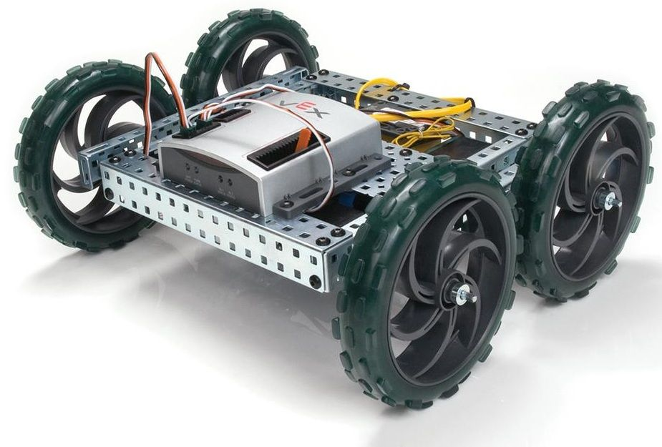
PROCEDURE
Part 3:
Design a sustainable energy vehicle using the power source of choice in Fusion 360 (Hybrid)
  Extra Credit
  Use Sweep to create wires that connects the capacitors to the motors
Figure 10: Simple VEX Robot courtesy of Chris and Jim CIM
13

Slide 15
PROCEDURE
Vehicle Design Rules:
The sustainable energy vehicle must carry the capacitors
Two motors are allowed
Modify the design to have a location to store the power storage device
The motors must be connected to a minimum of two wheels
14

Slide 16
ASSIGNMENT
Optional extra credit individual lab report:
  Answer discussion questions in manual
  Include picture and explanation of vehicle design
  Include spreadsheet with power source data
  Include pictures and screenshots of all circuits
  Due at 11:59 PM the night before Lab 6
Team presentation:
  Address discussion points in manual
15

Slide 17
CLOSING
Measure current in series and voltage in parallel
Submit all work electronically
Take screenshots of the vehicle design
Clean up workstations
Return all unused materials to the TA
16

Slide 18
CLOSING
Required Pre-Lab Activity for Lab 6:
Complete the online NYU Tandon MakerSpace Safety Orientation training
Requires watching three videos
  Covid-19 Policies and Updates
  Safety Orientation
  Ultimaker
Refer to the Lab 6A manual page for more information
17

Slide 19
QUESTIONS?

