Slide 1
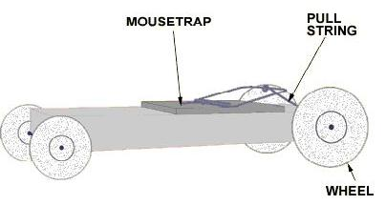
Mousetrap Vehicle Competition

Slide 2
Overview
What is a mousetrap vehicle?
How it works
The competition
  Design specifications
  Rules
  Scoring
  Extra credit

Slide 3
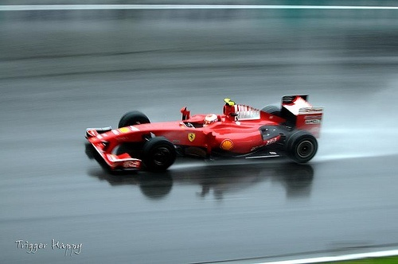
Objective
Design and construct a mousetrap vehicle
Competition
Which design travels furthest?

Slide 4
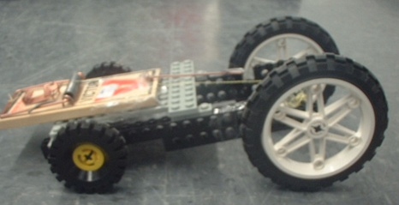
What is a Mousetrap Vehicle?
A vehicle powered only by a standard mousetrap

Slide 5
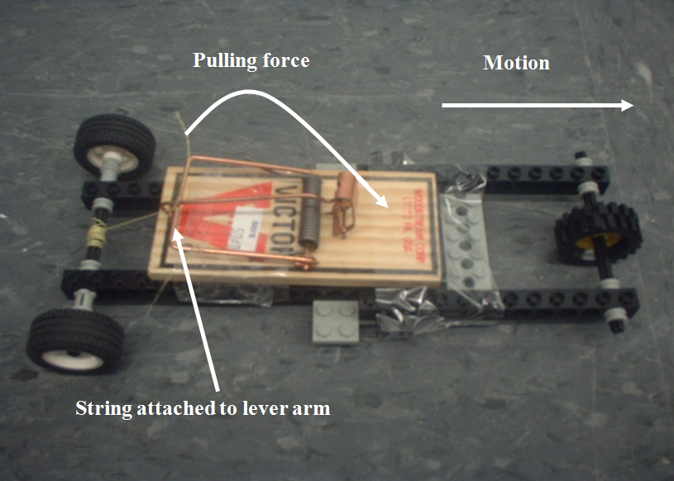
What is a Mousetrap Vehicle?
Lever arm pulls string
String rotates drive-axle
Drive-axle moves wheels to create forward motion
String wrapped
around drive-axle

Slide 6
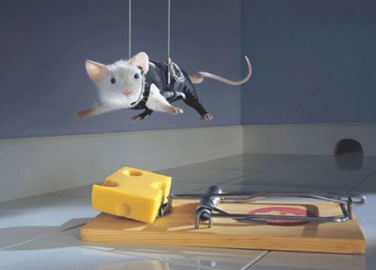
Materials
Robolab kit
Mousetrap
Kevlar string
Tape

Slide 7
Procedure
Brainstorm design using LEGO parts
Sketch design
Construct

Slide 8
Design Specifications
Sketch must be drawn and initialed by TA before construction
Minimum of 1 wheel
Projectile designs not permitted
Mousetrap may be attached with tape
Mousetrap is only source of power
Mousetrap may not be physically altered

Slide 9
Competition
Load and position vehicle at starting line
Release mousetrap vehicle
Each team will have up to 3 trials (time permitting)
Modifications between trials permitted

Slide 10
Rules
Start
Pushing not allowed
Vehicle must not be touched once started
Linear distance traveled will be measured by TA
For collisions (wall, person) distance will be measured from start to point of impact

Slide 11
Extra Credit
+10 points extra for greatest linear distance in section
Bonuses for other places as shown in the grading policy

Slide 12
Report
Individual lab report required
Discuss advantages and disadvantages of your design

Slide 13
Closing
Have photo taken of your design
  Required for lab report
Disassemble vehicle
  Return complete Robokit & mousetrap
  Remove all tape from parts

Slide 14

Mousetrap Vehicle Competition
QUESTIONS?

