Slide 1


INTRODUCTION TO DIGITAL LOGIC
LAB 5
EG 1004 Introduction to Engineering & Design

Slide 2

OVERVIEW
Objective
Background Information
Materials
Procedure
Competition Rules
IDBE Implementation
Assignment
Closing
Figure 1: Semiconductor Courtesy of Scoop.it

Slide 3
OBJECTIVE
To design a combinational logic circuit for a given problem statement
To build and test the circuit on a breadboard

Slide 4
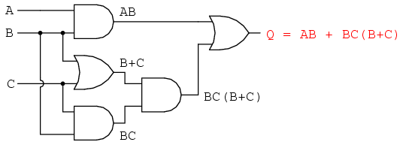
BACKGROUND
Digital logic
  Conceptual language behind modern computer systems
  Two values of true and false (1 and 0) that lead to complicated decisions
Truth Table
Shows all the possible input combinations and their associated outputs
(example on next slide)
Figure 2: Boolean Circuit Courtesy of
All About Circuits
Notes:
Tandon Areas of Excellence
Sustainability
Urban
Telecommunications & IT
Health
Artificial Intelligence
Professional Skills & Tandon Resources
MakerSpace & RAD
Teamwork & Vertically Integrated Projects
Career Services
Project Management & Technical Writing
World Trade Center Construction

Slide 5
BACKGROUND
Table 1: Truth Table for ATM Example
Example
An ATM has three options:
  Print statement
  Withdraw money
  Deposit money
The ATM will charge a fee when:
  Money is withdrawn
  A statement is printed without depositing money
Inputs |  |  | Output
P (Print) | W (Withdraw) | D (Deposit) | C (Charge)
0 | 0 | 0
0 | 0 | 1
0 | 1 | 0
0 | 1 | 1
1 | 0 | 0
1 | 0 | 1
1 | 1 | 0
1 | 1 | 1
Notes:
Tandon Areas of Excellence
Sustainability
Urban
Telecommunications & IT
Health
Artificial Intelligence
Professional Skills & Tandon Resources
MakerSpace & RAD
Teamwork & Vertically Integrated Projects
Career Services
Project Management & Technical Writing
World Trade Center Construction

Slide 6
BACKGROUND
Table 1: Truth Table for ATM Example
Example
An ATM has three options:
  Print statement
  Withdraw money
  Deposit money
The ATM will charge a fee when:
  Money is withdrawn
  A statement is printed without depositing money
Inputs |  |  | Output
P (Print) | W (Withdraw) | D (Deposit) | C (Charge)
0 | 0 | 0 | 0
0 | 0 | 1
0 | 1 | 0
0 | 1 | 1
1 | 0 | 0
1 | 0 | 1
1 | 1 | 0
1 | 1 | 1
Notes:
Tandon Areas of Excellence
Sustainability
Urban
Telecommunications & IT
Health
Artificial Intelligence
Professional Skills & Tandon Resources
MakerSpace & RAD
Teamwork & Vertically Integrated Projects
Career Services
Project Management & Technical Writing
World Trade Center Construction

Slide 7
BACKGROUND
Table 1: Truth Table for ATM Example
Example
An ATM has three options:
  Print statement
  Withdraw money
  Deposit money
The ATM will charge a fee when:
  Money is withdrawn
  A statement is printed without depositing money
Inputs |  |  | Output
P (Print) | W (Withdraw) | D (Deposit) | C (Charge)
0 | 0 | 0 | 0
0 | 0 | 1 | 0
0 | 1 | 0
0 | 1 | 1
1 | 0 | 0
1 | 0 | 1
1 | 1 | 0
1 | 1 | 1
Notes:
Tandon Areas of Excellence
Sustainability
Urban
Telecommunications & IT
Health
Artificial Intelligence
Professional Skills & Tandon Resources
MakerSpace & RAD
Teamwork & Vertically Integrated Projects
Career Services
Project Management & Technical Writing
World Trade Center Construction

Slide 8
BACKGROUND
Table 1: Truth Table for ATM Example
Example
An ATM has three options:
  Print statement
  Withdraw money
  Deposit money
The ATM will charge a fee when:
  Money is withdrawn
  A statement is printed without depositing money
Inputs |  |  | Output
P (Print) | W (Withdraw) | D (Deposit) | C (Charge)
0 | 0 | 0 | 0
0 | 0 | 1 | 0
0 | 1 | 0 | 1
0 | 1 | 1
1 | 0 | 0
1 | 0 | 1
1 | 1 | 0
1 | 1 | 1
Notes:
Tandon Areas of Excellence
Sustainability
Urban
Telecommunications & IT
Health
Artificial Intelligence
Professional Skills & Tandon Resources
MakerSpace & RAD
Teamwork & Vertically Integrated Projects
Career Services
Project Management & Technical Writing
World Trade Center Construction

Slide 9
BACKGROUND
Table 1: Truth Table for ATM Example
Example
An ATM has three options:
  Print statement
  Withdraw money
  Deposit money
The ATM will charge a fee when:
  Money is withdrawn
  A statement is printed without depositing money
Inputs |  |  | Output
P (Print) | W (Withdraw) | D (Deposit) | C (Charge)
0 | 0 | 0 | 0
0 | 0 | 1 | 0
0 | 1 | 0 | 1
0 | 1 | 1 | 1
1 | 0 | 0
1 | 0 | 1
1 | 1 | 0
1 | 1 | 1
Notes:
Tandon Areas of Excellence
Sustainability
Urban
Telecommunications & IT
Health
Artificial Intelligence
Professional Skills & Tandon Resources
MakerSpace & RAD
Teamwork & Vertically Integrated Projects
Career Services
Project Management & Technical Writing
World Trade Center Construction

Slide 10
BACKGROUND
Table 1: Truth Table for ATM Example
Example
An ATM has three options:
  Print statement
  Withdraw money
  Deposit money
The ATM will charge a fee when:
  Money is withdrawn
  A statement is printed without depositing money
Inputs |  |  | Output
P (Print) | W (Withdraw) | D (Deposit) | C (Charge)
0 | 0 | 0 | 0
0 | 0 | 1 | 0
0 | 1 | 0 | 1
0 | 1 | 1 | 1
1 | 0 | 0 | 1
1 | 0 | 1
1 | 1 | 0
1 | 1 | 1
Notes:
Tandon Areas of Excellence
Sustainability
Urban
Telecommunications & IT
Health
Artificial Intelligence
Professional Skills & Tandon Resources
MakerSpace & RAD
Teamwork & Vertically Integrated Projects
Career Services
Project Management & Technical Writing
World Trade Center Construction

Slide 11
BACKGROUND
Table 1: Truth Table for ATM Example
Example
An ATM has three options:
  Print statement
  Withdraw money
  Deposit money
The ATM will charge a fee when:
  Money is withdrawn
  A statement is printed without depositing money
Inputs |  |  | Output
P (Print) | W (Withdraw) | D (Deposit) | C (Charge)
0 | 0 | 0 | 0
0 | 0 | 1 | 0
0 | 1 | 0 | 1
0 | 1 | 1 | 1
1 | 0 | 0 | 1
1 | 0 | 1 | 0
1 | 1 | 0
1 | 1 | 1
Notes:
Tandon Areas of Excellence
Sustainability
Urban
Telecommunications & IT
Health
Artificial Intelligence
Professional Skills & Tandon Resources
MakerSpace & RAD
Teamwork & Vertically Integrated Projects
Career Services
Project Management & Technical Writing
World Trade Center Construction

Slide 12
BACKGROUND
Table 1: Truth Table for ATM Example
Example
An ATM has three options:
  Print statement
  Withdraw money
  Deposit money
The ATM will charge a fee when:
  Money is withdrawn
  A statement is printed without depositing money
Inputs |  |  | Output
P (Print) | W (Withdraw) | D (Deposit) | C (Charge)
0 | 0 | 0 | 0
0 | 0 | 1 | 0
0 | 1 | 0 | 1
0 | 1 | 1 | 1
1 | 0 | 0 | 1
1 | 0 | 1 | 0
1 | 1 | 0 | 1
1 | 1 | 1
Notes:
Tandon Areas of Excellence
Sustainability
Urban
Telecommunications & IT
Health
Artificial Intelligence
Professional Skills & Tandon Resources
MakerSpace & RAD
Teamwork & Vertically Integrated Projects
Career Services
Project Management & Technical Writing
World Trade Center Construction

Slide 13
BACKGROUND
Table 1: Truth Table for ATM Example
Example
An ATM has three options:
  Print statement
  Withdraw money
  Deposit money
The ATM will charge a fee when:
  Money is withdrawn
  A statement is printed without depositing money
Inputs |  |  | Output
P (Print) | W (Withdraw) | D (Deposit) | C (Charge)
0 | 0 | 0 | 0
0 | 0 | 1 | 0
0 | 1 | 0 | 1
0 | 1 | 1 | 1
1 | 0 | 0 | 1
1 | 0 | 1 | 0
1 | 1 | 0 | 1
1 | 1 | 1 | 1
Notes:
Tandon Areas of Excellence
Sustainability
Urban
Telecommunications & IT
Health
Artificial Intelligence
Professional Skills & Tandon Resources
MakerSpace & RAD
Teamwork & Vertically Integrated Projects
Career Services
Project Management & Technical Writing
World Trade Center Construction

Slide 14
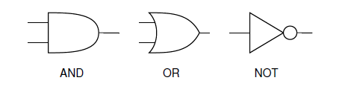
Logic Gates
BACKGROUND
NOT gate
AND gate
OR gate
Both inputs must be true for the output to be true
If either input is true, the output will be true
Inverts the input
Table 2: Logic Gates
 | NOT | AND | OR
Symbol
Arithmetic Operation | $$\overline{A}$$ | $$A∙B or AB$$ | $$A+B$$
# of Inputs | 1 | 2+ | 2+
Notes:
Tandon Areas of Excellence
Sustainability
Urban
Telecommunications & IT
Health
Artificial Intelligence
Professional Skills & Tandon Resources
MakerSpace & RAD
Teamwork & Vertically Integrated Projects
Career Services
Project Management & Technical Writing
World Trade Center Construction

Slide 15

BACKGROUND
Table 3: Truth Table for ATM Example with True Combinations
Inputs |  |  | Output
P (Print) | W (Withdraw) | D (Deposit) | C (Charge)
0 | 0 | 0 | 0
0 | 0 | 1 | 0
0 | 1 | 0 | 1
0 | 1 | 1 | 1
1 | 0 | 0 | 1
1 | 0 | 1 | 0
1 | 1 | 0 | 1
1 | 1 | 1 | 1
Boolean Equation
Mathematical representation of all the combinations in the truth table that yield an output of 1
Represents when a fee is charged in the ATM example
$$C=$$
Notes:
Tandon Areas of Excellence
Sustainability
Urban
Telecommunications & IT
Health
Artificial Intelligence
Professional Skills & Tandon Resources
MakerSpace & RAD
Teamwork & Vertically Integrated Projects
Career Services
Project Management & Technical Writing
World Trade Center Construction

Slide 16

BACKGROUND
Table 3: Truth Table for ATM Example with True Combinations
Inputs |  |  | Output
P (Print) | W (Withdraw) | D (Deposit) | C (Charge)
0 | 0 | 0 | 0
0 | 0 | 1 | 0
0 | 1 | 0 | 1
0 | 1 | 1 | 1
1 | 0 | 0 | 1
1 | 0 | 1 | 0
1 | 1 | 0 | 1
1 | 1 | 1 | 1
Boolean Equation
Mathematical representation of all the combinations in the truth table that yield an output of 1
Represents when a fee is charged in the ATM example
$C= \overline{P}W\overline{D}$
Notes:
Tandon Areas of Excellence
Sustainability
Urban
Telecommunications & IT
Health
Artificial Intelligence
Professional Skills & Tandon Resources
MakerSpace & RAD
Teamwork & Vertically Integrated Projects
Career Services
Project Management & Technical Writing
World Trade Center Construction

Slide 17

BACKGROUND
Table 3: Truth Table for ATM Example with True Combinations
Inputs |  |  | Output
P (Print) | W (Withdraw) | D (Deposit) | C (Charge)
0 | 0 | 0 | 0
0 | 0 | 1 | 0
0 | 1 | 0 | 1
0 | 1 | 1 | 1
1 | 0 | 0 | 1
1 | 0 | 1 | 0
1 | 1 | 0 | 1
1 | 1 | 1 | 1
Boolean Equation
Mathematical representation of all the combinations in the truth table that yield an output of 1
Represents when a fee is charged in the ATM example
$C= \overline{P}W\overline{D}+\overline{P}WD$
Notes:
Tandon Areas of Excellence
Sustainability
Urban
Telecommunications & IT
Health
Artificial Intelligence
Professional Skills & Tandon Resources
MakerSpace & RAD
Teamwork & Vertically Integrated Projects
Career Services
Project Management & Technical Writing
World Trade Center Construction

Slide 18

BACKGROUND
Table 3: Truth Table for ATM Example with True Combinations
Inputs |  |  | Output
P (Print) | W (Withdraw) | D (Deposit) | C (Charge)
0 | 0 | 0 | 0
0 | 0 | 1 | 0
0 | 1 | 0 | 1
0 | 1 | 1 | 1
1 | 0 | 0 | 1
1 | 0 | 1 | 0
1 | 1 | 0 | 1
1 | 1 | 1 | 1
Boolean Equation
Mathematical representation of all the combinations in the truth table that yield an output of 1
Represents when a fee is charged in the ATM example
$$C= \overline{P}W\overline{D}+\overline{P}WD+P\overline{W}\overline{D}$$
Notes:
Tandon Areas of Excellence
Sustainability
Urban
Telecommunications & IT
Health
Artificial Intelligence
Professional Skills & Tandon Resources
MakerSpace & RAD
Teamwork & Vertically Integrated Projects
Career Services
Project Management & Technical Writing
World Trade Center Construction

Slide 19

BACKGROUND
Table 3: Truth Table for ATM Example with True Combinations
Inputs |  |  | Output
P (Print) | W (Withdraw) | D (Deposit) | C (Charge)
0 | 0 | 0 | 0
0 | 0 | 1 | 0
0 | 1 | 0 | 1
0 | 1 | 1 | 1
1 | 0 | 0 | 1
1 | 0 | 1 | 0
1 | 1 | 0 | 1
1 | 1 | 1 | 1
Boolean Equation
Mathematical representation of all the combinations in the truth table that yield an output of 1
Represents when a fee is charged in the ATM example
$$C= \overline{P}W\overline{D}+\overline{P}WD+P\overline{W}\overline{D}+PW\overline{D}$$
Notes:
Tandon Areas of Excellence
Sustainability
Urban
Telecommunications & IT
Health
Artificial Intelligence
Professional Skills & Tandon Resources
MakerSpace & RAD
Teamwork & Vertically Integrated Projects
Career Services
Project Management & Technical Writing
World Trade Center Construction

Slide 20
BACKGROUND
Table 3: Truth Table for ATM Example with True Combinations
Inputs |  |  | Output
P (Print) | W (Withdraw) | D (Deposit) | C (Charge)
0 | 0 | 0 | 0
0 | 0 | 1 | 0
0 | 1 | 0 | 1
0 | 1 | 1 | 1
1 | 0 | 0 | 1
1 | 0 | 1 | 0
1 | 1 | 0 | 1
1 | 1 | 1 | 1
Boolean Equation
Mathematical representation of all the combinations in the truth table that yield an output of 1
Represents when a fee is charged in the ATM example
$$C= \overline{P}W\overline{D}+\overline{P}WD+P\overline{W}\overline{D}+PW\overline{D}+PWD$$
Notes:
Tandon Areas of Excellence
Sustainability
Urban
Telecommunications & IT
Health
Artificial Intelligence
Professional Skills & Tandon Resources
MakerSpace & RAD
Teamwork & Vertically Integrated Projects
Career Services
Project Management & Technical Writing
World Trade Center Construction

Slide 21
BACKGROUND
Karnaugh Map (K-map)
$$C= \overline{P}W\overline{D}+\overline{P}WD+P\overline{W}\overline{D}+PW\overline{D}+PWD$$
Two-dimensional representation that shows the common characteristics of the inputs
Only one value can change at a time between adjacent rows and columns
Table 4: K-map for ATM Example
Notes:
Tandon Areas of Excellence
Sustainability
Urban
Telecommunications & IT
Health
Artificial Intelligence
Professional Skills & Tandon Resources
MakerSpace & RAD
Teamwork & Vertically Integrated Projects
Career Services
Project Management & Technical Writing
World Trade Center Construction

Slide 22
BACKGROUND
Karnaugh Map (K-map)
$$C= \overline{P}W\overline{D}+\overline{P}WD+P\overline{W}\overline{D}+PW\overline{D}+PWD$$
Two-dimensional representation that shows the common characteristics of the inputs
Only one value can change at a time between adjacent rows and columns
Table 4: K-map for ATM Example
 | $$\overline{P}\overline{W}$$
Notes:
Tandon Areas of Excellence
Sustainability
Urban
Telecommunications & IT
Health
Artificial Intelligence
Professional Skills & Tandon Resources
MakerSpace & RAD
Teamwork & Vertically Integrated Projects
Career Services
Project Management & Technical Writing
World Trade Center Construction

Slide 23
BACKGROUND
Karnaugh Map (K-map)
$$C= \overline{P}W\overline{D}+\overline{P}WD+P\overline{W}\overline{D}+PW\overline{D}+PWD$$
Two-dimensional representation that shows the common characteristics of the inputs
Only one value can change at a time between adjacent rows and columns
Table 4: K-map for ATM Example
 | $$\overline{P}\overline{W}$$ | $$\overline{P}W$$
Notes:
Tandon Areas of Excellence
Sustainability
Urban
Telecommunications & IT
Health
Artificial Intelligence
Professional Skills & Tandon Resources
MakerSpace & RAD
Teamwork & Vertically Integrated Projects
Career Services
Project Management & Technical Writing
World Trade Center Construction

Slide 24
BACKGROUND
Karnaugh Map (K-map)
$$C= \overline{P}W\overline{D}+\overline{P}WD+P\overline{W}\overline{D}+PW\overline{D}+PWD$$
Two-dimensional representation that shows the common characteristics of the inputs
Only one value can change at a time between adjacent rows and columns
Table 4: K-map for ATM Example
 | $$\overline{P}\overline{W}$$ | $$\overline{P}W$$ | $$PW$$
Notes:
Tandon Areas of Excellence
Sustainability
Urban
Telecommunications & IT
Health
Artificial Intelligence
Professional Skills & Tandon Resources
MakerSpace & RAD
Teamwork & Vertically Integrated Projects
Career Services
Project Management & Technical Writing
World Trade Center Construction

Slide 25
BACKGROUND
Karnaugh Map (K-map)
$$C= \overline{P}W\overline{D}+\overline{P}WD+P\overline{W}\overline{D}+PW\overline{D}+PWD$$
Two-dimensional representation that shows the common characteristics of the inputs
Only one value can change at a time between adjacent rows and columns
Table 4: K-map for ATM Example
 | $$\overline{P}\overline{W}$$ | $$\overline{P}W$$ | $$PW$$ | $$P\overline{W}$$
Notes:
Tandon Areas of Excellence
Sustainability
Urban
Telecommunications & IT
Health
Artificial Intelligence
Professional Skills & Tandon Resources
MakerSpace & RAD
Teamwork & Vertically Integrated Projects
Career Services
Project Management & Technical Writing
World Trade Center Construction

Slide 26
BACKGROUND
Karnaugh Map (K-map)
$$C= \overline{P}W\overline{D}+\overline{P}WD+P\overline{W}\overline{D}+PW\overline{D}+PWD$$
Two-dimensional representation that shows the common characteristics of the inputs
Only one value can change at a time between adjacent rows and columns
Table 4: K-map for ATM Example
 | $$\overline{P}\overline{W}$$ | $$\overline{P}W$$ | $$PW$$ | $$P\overline{W}$$
$$\overline{D}$$
$$D$$
Notes:
Tandon Areas of Excellence
Sustainability
Urban
Telecommunications & IT
Health
Artificial Intelligence
Professional Skills & Tandon Resources
MakerSpace & RAD
Teamwork & Vertically Integrated Projects
Career Services
Project Management & Technical Writing
World Trade Center Construction

Slide 27
BACKGROUND
Karnaugh Map (K-map)
$$C= \overline{P}W\overline{D}+\overline{P}WD+P\overline{W}\overline{D}+PW\overline{D}+PWD$$
Two-dimensional representation that shows the common characteristics of the inputs
Only one value can change at a time between adjacent rows and columns
Table 4: K-map for ATM Example
 | $$\overline{P}\overline{W}$$ | $$\overline{P}W$$ | $$PW$$ | $$P\overline{W}$$
$$\overline{D}$$ | 0
$$D$$
Notes:
Tandon Areas of Excellence
Sustainability
Urban
Telecommunications & IT
Health
Artificial Intelligence
Professional Skills & Tandon Resources
MakerSpace & RAD
Teamwork & Vertically Integrated Projects
Career Services
Project Management & Technical Writing
World Trade Center Construction

Slide 28
BACKGROUND
Karnaugh Map (K-map)
$$C= \overline{P}W\overline{D}+\overline{P}WD+P\overline{W}\overline{D}+PW\overline{D}+PWD$$
Two-dimensional representation that shows the common characteristics of the inputs
Only one value can change at a time between adjacent rows and columns
Table 4: K-map for ATM Example
 | $$\overline{P}\overline{W}$$ | $$\overline{P}W$$ | $$PW$$ | $$P\overline{W}$$
$$\overline{D}$$ | 0
$$D$$ | 0
Notes:
Tandon Areas of Excellence
Sustainability
Urban
Telecommunications & IT
Health
Artificial Intelligence
Professional Skills & Tandon Resources
MakerSpace & RAD
Teamwork & Vertically Integrated Projects
Career Services
Project Management & Technical Writing
World Trade Center Construction

Slide 29
BACKGROUND
Karnaugh Map (K-map)
$$C= \overline{P}W\overline{D}+\overline{P}WD+P\overline{W}\overline{D}+PW\overline{D}+PWD$$
Two-dimensional representation that shows the common characteristics of the inputs
Only one value can change at a time between adjacent rows and columns
Table 4: K-map for ATM Example
 | $$\overline{P}\overline{W}$$ | $$\overline{P}W$$ | $$PW$$ | $$P\overline{W}$$
$$\overline{D}$$ | 0 | 1
$$D$$ | 0
Notes:
Tandon Areas of Excellence
Sustainability
Urban
Telecommunications & IT
Health
Artificial Intelligence
Professional Skills & Tandon Resources
MakerSpace & RAD
Teamwork & Vertically Integrated Projects
Career Services
Project Management & Technical Writing
World Trade Center Construction

Slide 30
BACKGROUND
Karnaugh Map (K-map)
$$C= \overline{P}W\overline{D}+\overline{P}WD+P\overline{W}\overline{D}+PW\overline{D}+PWD$$
Two-dimensional representation that shows the common characteristics of the inputs
Only one value can change at a time between adjacent rows and columns
Table 4: K-map for ATM Example
 | $$\overline{P}\overline{W}$$ | $$\overline{P}W$$ | $$PW$$ | $$P\overline{W}$$
$$\overline{D}$$ | 0 | 1
$$D$$ | 0 | 1
Notes:
Tandon Areas of Excellence
Sustainability
Urban
Telecommunications & IT
Health
Artificial Intelligence
Professional Skills & Tandon Resources
MakerSpace & RAD
Teamwork & Vertically Integrated Projects
Career Services
Project Management & Technical Writing
World Trade Center Construction

Slide 31
BACKGROUND
Karnaugh Map (K-map)
$$C= \overline{P}W\overline{D}+\overline{P}WD+P\overline{W}\overline{D}+PW\overline{D}+PWD$$
Two-dimensional representation that shows the common characteristics of the inputs
Only one value can change at a time between adjacent rows and columns
Table 4: K-map for ATM Example
 | $$\overline{P}\overline{W}$$ | $$\overline{P}W$$ | $$PW$$ | $$P\overline{W}$$
$$\overline{D}$$ | 0 | 1 |  | 1
$$D$$ | 0 | 1
Notes:
Tandon Areas of Excellence
Sustainability
Urban
Telecommunications & IT
Health
Artificial Intelligence
Professional Skills & Tandon Resources
MakerSpace & RAD
Teamwork & Vertically Integrated Projects
Career Services
Project Management & Technical Writing
World Trade Center Construction

Slide 32
BACKGROUND
Karnaugh Map (K-map)
$$C= \overline{P}W\overline{D}+\overline{P}WD+P\overline{W}\overline{D}+PW\overline{D}+PWD$$
Two-dimensional representation that shows the common characteristics of the inputs
Only one value can change at a time between adjacent rows and columns
Table 4: K-map for ATM Example
 | $$\overline{P}\overline{W}$$ | $$\overline{P}W$$ | $$PW$$ | $$P\overline{W}$$
$$\overline{D}$$ | 0 | 1 |  | 1
$$D$$ | 0 | 1 |  | 0
Notes:
Tandon Areas of Excellence
Sustainability
Urban
Telecommunications & IT
Health
Artificial Intelligence
Professional Skills & Tandon Resources
MakerSpace & RAD
Teamwork & Vertically Integrated Projects
Career Services
Project Management & Technical Writing
World Trade Center Construction

Slide 33
BACKGROUND
Karnaugh Map (K-map)
$$C= \overline{P}W\overline{D}+\overline{P}WD+P\overline{W}\overline{D}+PW\overline{D}+PWD$$
Two-dimensional representation that shows the common characteristics of the inputs
Only one value can change at a time between adjacent rows and columns
Table 4: K-map for ATM Example
 | $$\overline{P}\overline{W}$$ | $$\overline{P}W$$ | $$PW$$ | $$P\overline{W}$$
$$\overline{D}$$ | 0 | 1 | 1 | 1
$$D$$ | 0 | 1 |  | 0
Notes:
Tandon Areas of Excellence
Sustainability
Urban
Telecommunications & IT
Health
Artificial Intelligence
Professional Skills & Tandon Resources
MakerSpace & RAD
Teamwork & Vertically Integrated Projects
Career Services
Project Management & Technical Writing
World Trade Center Construction

Slide 34
BACKGROUND
Karnaugh Map (K-map)
$$C= \overline{P}W\overline{D}+\overline{P}WD+P\overline{W}\overline{D}+PW\overline{D}+PWD$$
Two-dimensional representation that shows the common characteristics of the inputs
Only one value can change at a time between adjacent rows and columns
Table 4: K-map for ATM Example
 | $$\overline{P}\overline{W}$$ | $$\overline{P}W$$ | $$PW$$ | $$P\overline{W}$$
$$\overline{D}$$ | 0 | 1 | 1 | 1
$$D$$ | 0 | 1 | 1 | 0
Notes:
Tandon Areas of Excellence
Sustainability
Urban
Telecommunications & IT
Health
Artificial Intelligence
Professional Skills & Tandon Resources
MakerSpace & RAD
Teamwork & Vertically Integrated Projects
Career Services
Project Management & Technical Writing
World Trade Center Construction

Slide 35
BACKGROUND
Simplified Boolean Equation
Table 5: Simplified Boolean Equation for ATM Example
Mathematical representation of true values in the K-map
  Box together 1s in the K-map
  Number of cells in a box must be a
  power of 2 (1, 2, 4, 8, etc.)
  Look for the biggest boxes first
  Boxes can overlap
Simplified equation is determined by constant variable(s) in each box
 | $$\overline{P}\overline{W}$$ | $$\overline{P}W$$ | $$PW$$ | $$P\overline{W}$$
$$\overline{D}$$ | 0 | 1 | 1 | 1
$$D$$ | 0 | 1 | 1 | 0
$$C=$$
Notes:
Tandon Areas of Excellence
Sustainability
Urban
Telecommunications & IT
Health
Artificial Intelligence
Professional Skills & Tandon Resources
MakerSpace & RAD
Teamwork & Vertically Integrated Projects
Career Services
Project Management & Technical Writing
World Trade Center Construction

Slide 36
BACKGROUND
Simplified Boolean Equation
Table 5: Simplified Boolean Equation for ATM Example
Mathematical representation of true values in the K-map
  Box together 1s in the K-map
  Number of cells in a box must be a
  power of 2 (1, 2, 4, 8, etc.)
  Look for the biggest boxes first
  Boxes can overlap
Simplified equation is determined by constant variable(s) in each box
 | $$\overline{P}\overline{W}$$ | $$\overline{P}W$$ | $$PW$$ | $$P\overline{W}$$
$$\overline{D}$$ | 0 | 1 | 1 | 1
$$D$$ | 0 | 1 | 1 | 0
$$C=W$$
Notes:
Tandon Areas of Excellence
Sustainability
Urban
Telecommunications & IT
Health
Artificial Intelligence
Professional Skills & Tandon Resources
MakerSpace & RAD
Teamwork & Vertically Integrated Projects
Career Services
Project Management & Technical Writing
World Trade Center Construction

Slide 37
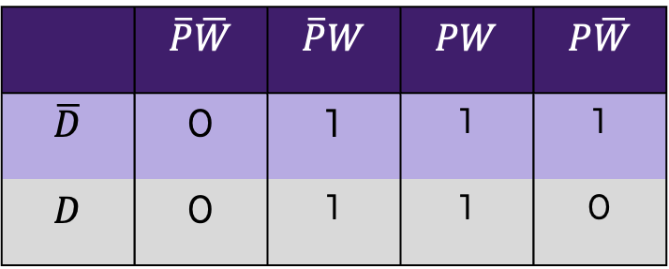
BACKGROUND
Simplified Boolean Equation
Table 5: Simplified Boolean Equation for ATM Example
Mathematical representation of true values in the K-map
  Box together 1s in the K-map
  Number of cells in a box must be a
  power of 2 (1, 2, 4, 8, etc.)
  Look for the biggest boxes first
  Boxes can overlap
Simplified equation is determined by constant variable(s) in each box
 | $$\overline{P}\overline{W}$$ | $$\overline{P}W$$ | $$PW$$ | $$P\overline{W}$$
$$\overline{D}$$ | 0 | 1 | 1 | 1
$$D$$ | 0 | 1 | 1 | 0
$$C=W+P\overline{D}$$
Notes:
Tandon Areas of Excellence
Sustainability
Urban
Telecommunications & IT
Health
Artificial Intelligence
Professional Skills & Tandon Resources
MakerSpace & RAD
Teamwork & Vertically Integrated Projects
Career Services
Project Management & Technical Writing
World Trade Center Construction

Slide 38


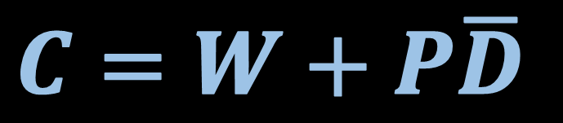



BACKGROUND
Combinational Logic Circuit – graphical representation of the simplified Boolean equation
OR
AND
NOT
Figure 3: Combinational Logic Circuit for ATM Example
Notes:
Tandon Areas of Excellence
Sustainability
Urban
Telecommunications & IT
Health
Artificial Intelligence
Professional Skills & Tandon Resources
MakerSpace & RAD
Teamwork & Vertically Integrated Projects
Career Services
Project Management & Technical Writing
World Trade Center Construction

Slide 39
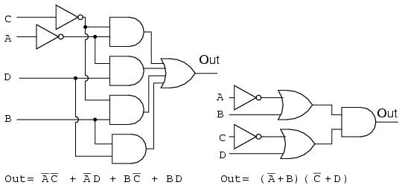
BACKGROUND
Minimization of Boolean functions
  K-map used to simplify complex Boolean equations
  Reduces complexity of logic circuit
  Would increase efficiency and decrease cost in implementation
Figure 4: Complex Logic Circuit (Left) vs.
Simplified Logic Circuit (Right)
Notes:
Tandon Areas of Excellence
Sustainability
Urban
Telecommunications & IT
Health
Artificial Intelligence
Professional Skills & Tandon Resources
MakerSpace & RAD
Teamwork & Vertically Integrated Projects
Career Services
Project Management & Technical Writing
World Trade Center Construction

Slide 40
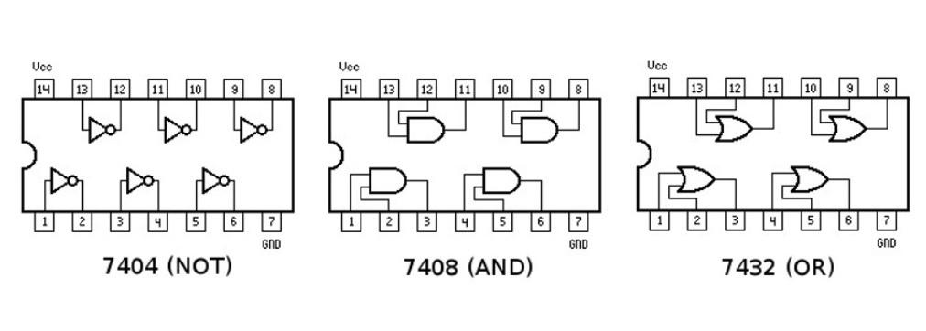
BACKGROUND
Integrated Circuits (ICs)
Chips that consist of small assemblies of electronic components
Logic Gate ICs consist of logic gates that can be used to prototype combinational logic circuits on a breadboard
Figure 5: Diagram of NOT/AND/OR IC Chips
Notes:
Tandon Areas of Excellence
Sustainability
Urban
Telecommunications & IT
Health
Artificial Intelligence
Professional Skills & Tandon Resources
MakerSpace & RAD
Teamwork & Vertically Integrated Projects
Career Services
Project Management & Technical Writing
World Trade Center Construction

Slide 41
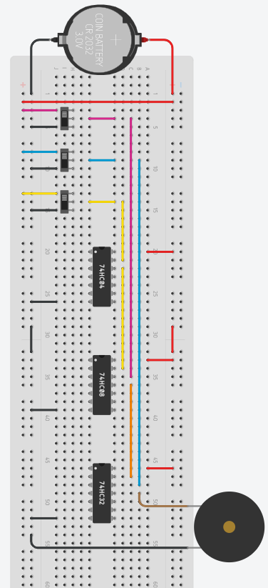



BACKGROUND
Print (P)
Withdraw (W)
Deposit (D)
Figure 6: Diagram of the example ATM circuit
Notes:
Tandon Areas of Excellence
Sustainability
Urban
Telecommunications & IT
Health
Artificial Intelligence
Professional Skills & Tandon Resources
MakerSpace & RAD
Teamwork & Vertically Integrated Projects
Career Services
Project Management & Technical Writing
World Trade Center Construction

Slide 42
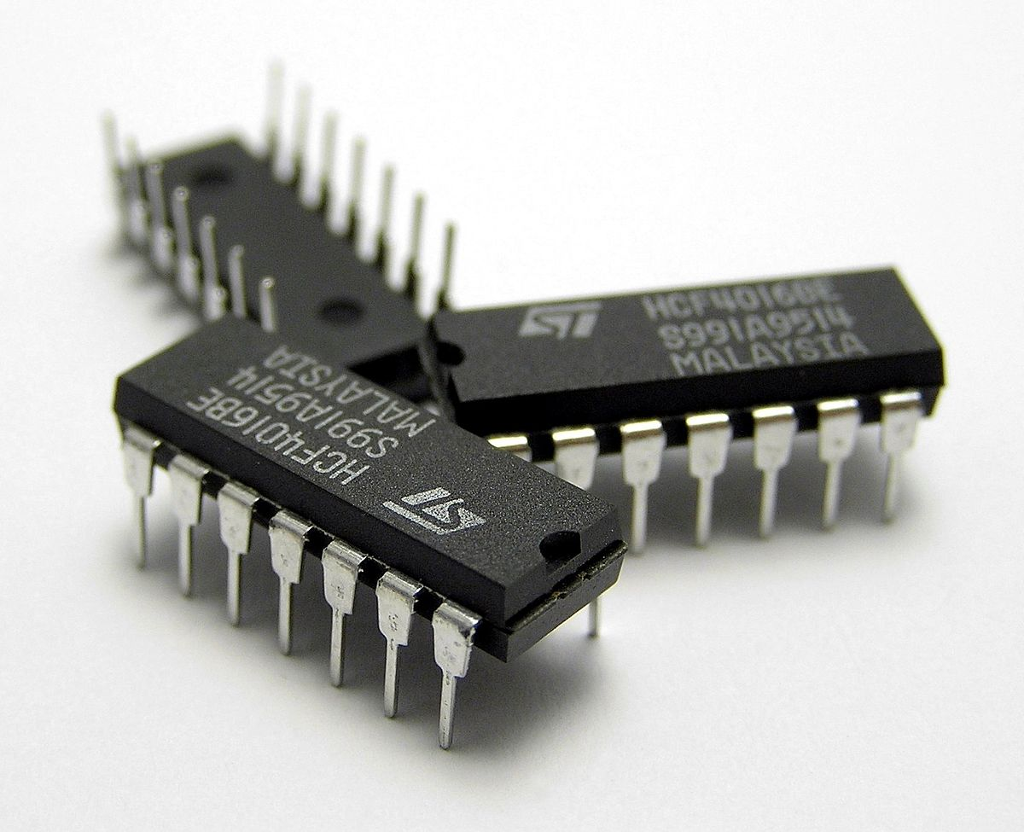

MATERIALS
A 7432 IC (4 dual-input OR gates)
A 7408 IC (4 dual-input AND gates)
A 7404 IC (6 single-input NOT gates)
Breadboard
5V Battery Case
LED
220 Ω Resistor
Slide Switches
Wires
Figure 7: Integrated circuit (IC) chips
courtesy of Wikipedia

Slide 43
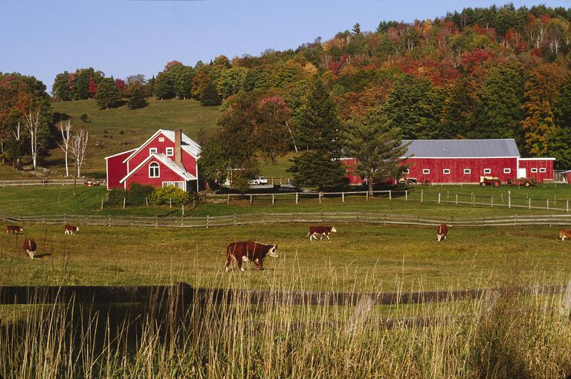
PROBLEM STATEMENT
Farmer Georgi has a hen on his 350-acre farm that produces high-quality eggs
To protect the hen from a fox who has been wandering around the farm and his grain, he needs an alarm system
Figure 8: Farmer Georgi’s Farm
Courtesy of ThoughtCo

Slide 44
PROBLEM STATEMENT
Farmer Georgi has two barns
  Think of Barn A as “0” and Barn B as “1” in the truth table
A fox, hen, and grain can be in either barn at anytime
Design an alarm system that will sound when:
  The fox and hen are in the same barn
  The hen and grain are in the same barn

Slide 45
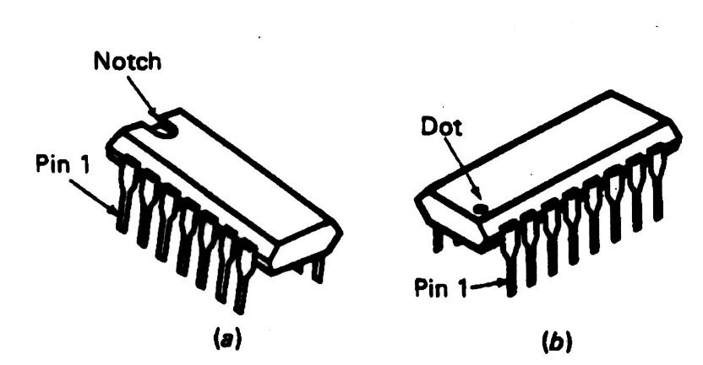
PROCEDURE
Part I: Formulate the Simplified Boolean Equation
Build a truth table for the alarm system
Create a Boolean equation
Build a K-map
Create a simplified Boolean equation
Draw a combinational logic circuit
  Add a light bulb to represent the alarm
Figure 9: IC Chip

Slide 46
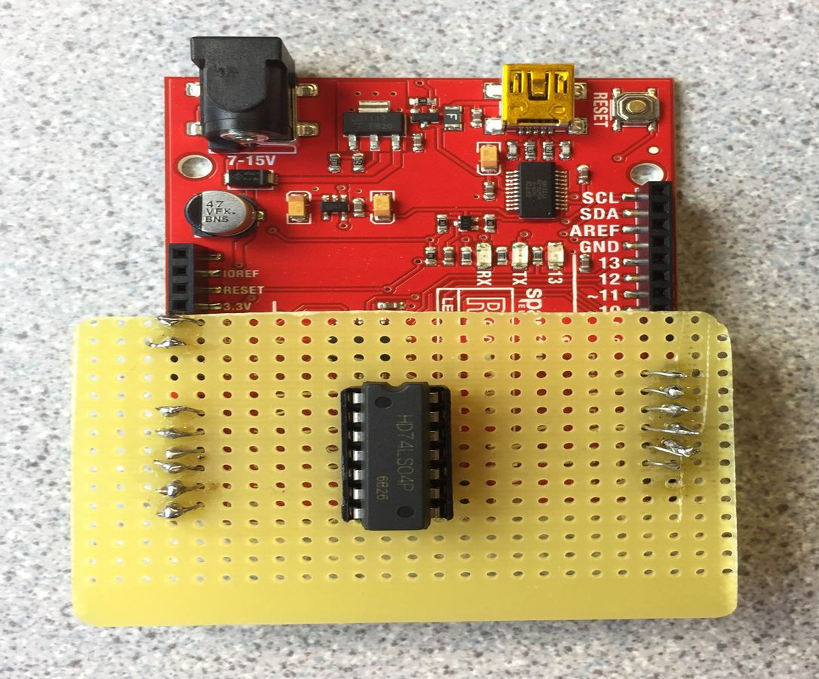
PROCEDURE
Part II: Test the IC Chips
Use the Arduino board setup by the TAs to test the NOT/OR/AND IC chips
The Arduino program will determine if the IC chips are functional or not
Orient the IC chips properly
Figure 10: IC chip tester

Slide 47
PROCEDURE
Part III: Build the Combinational Logic Circuit
Build and test the logic circuit on a breadboard
  Wire the combinational logic circuit using the IC chips
  Power (+5V) and ground the IC chips
  Orient the IC chips properly
Figure 11: Diagram of NOT/AND/OR IC Chips

Slide 48
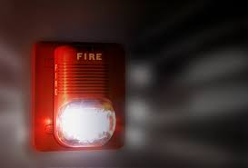
IDBE IMPLEMENTATION
Accessible Designs
  Designing an alarm with flashing lights is better for deaf users
  Reduces noise pollution
  But for visually impaired users, noise alarms are necessary
Be Aware– flashing lights and loud noises can have adverse effects on different people
As socially-aware engineers, what alarm solutions can you think of?
Figure 12: Flashing Fire Alarm
Notes:
Tandon Areas of Excellence
Sustainability
Urban
Telecommunications & IT
Health
Artificial Intelligence
Professional Skills & Tandon Resources
MakerSpace & RAD
Teamwork & Vertically Integrated Projects
Career Services
Project Management & Technical Writing
World Trade Center Construction

Slide 49
ASSIGNMENT
Team lab report:
  Answer discussion questions in manual
  Explain how k-maps help simplify the circuitry
  Include the truth table, both Boolean equations, and k-map
  Include pictures of the completed logic circuit
  Due at 11:59 PM the night before Lab 6
Team presentation:
  Address discussion points in manual
  Include pictures of the completed logic circuit
Notes:
Tandon Areas of Excellence
Sustainability
Urban
Telecommunications & IT
Health
Artificial Intelligence
Professional Skills & Tandon Resources
MakerSpace & RAD
Teamwork & Vertically Integrated Projects
Career Services
Project Management & Technical Writing
World Trade Center Construction

Slide 50
CLOSING
Take pictures of the completed logic circuit
Clean up workstations
Return all unused materials to the TA
Notes:
Tandon Areas of Excellence
Sustainability
Urban
Telecommunications & IT
Health
Artificial Intelligence
Professional Skills & Tandon Resources
MakerSpace & RAD
Teamwork & Vertically Integrated Projects
Career Services
Project Management & Technical Writing
World Trade Center Construction

Slide 51
QUESTIONS?

