Slide 1
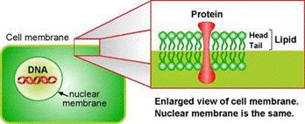
EG1003: Introduction to Engineering and Design
Biomedical Forensics

Slide 2
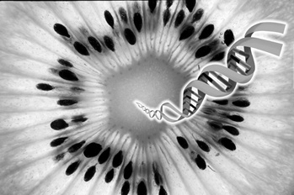
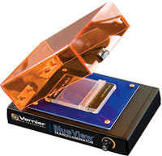
Overview
Objectives
Background information
Materials
Procedures:
Part 1: Forensic Academy
Part 2: Murder Mystery
Closing and Feedback

Slide 3
Objective
Understand and use basic forensic techniques:
DNA Extraction
Blood Typing
Fingerprinting
Blood Splatter Analysis
Understand how these techniques are used to solve a murder mystery

Slide 4
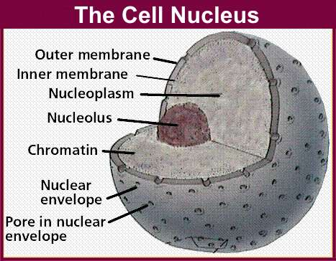
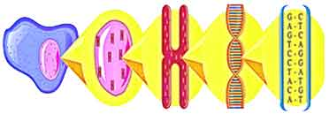
DNA Extraction
Process of breaking down cells to reach the nucleus
Double layer of lipids
Chromatin
Made of DNA and protein
chromatin
DNA
cell
nucleus
chromosome

Slide 5
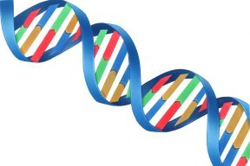
DNA Properties
Structure
Long polymer, double-helix shaped
Sugar-phosphate backbone
Phosphate group make DNA negatively charged
Polarity and solubility: “like dissolves like”
Most polar of all biopolymer
Soluble in polar solvent: water
Precipitated in non-polar solvent: alcohol
Helical backbone
DNA strands

Slide 6
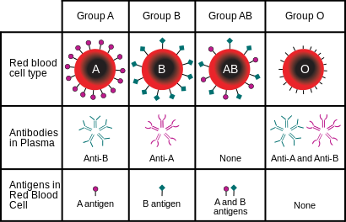
Forensic Techniques
Blood Typing
Using reactions to decode blood
Fingerprinting
Using observations to differentiate each type
Arch, Loop, Whirl
Drug Testing
Using reagents to determine unidentified powder substance

Slide 7
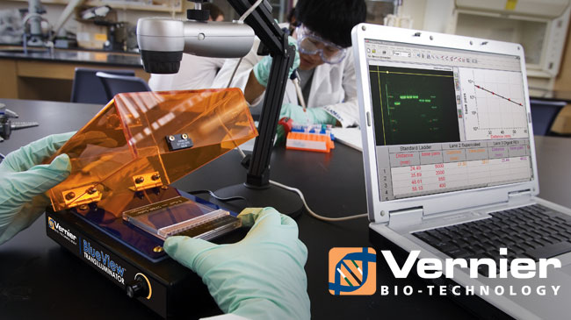
Materials
Fruit sample
Non-iodized table salt (NaCl)
Hand soap (clear, unscented)
95% isopropyl alcohol (0 °C)
Distilled water
Strainer
Plastic cups
Ziploc bag
Iron Magic Wand
Iron powder
Blood typing kit
White Paper
String
Meter stick

Slide 8
Procedural Steps
Part 1: Forensic Academy
DNA Extraction
Fingerprinting
Drug Testing
Blood Splatter

Slide 9
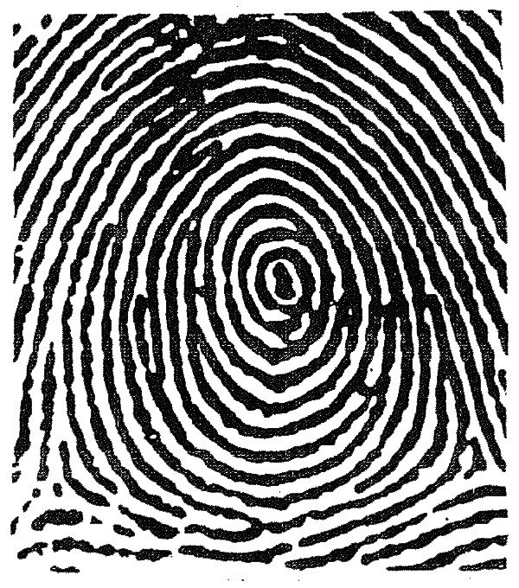
Procedural Steps
Part 2: Murder Mystery
Biological Dimensional Analysis
Blood Typing
Fingerprinting Testing

Slide 10
Closing and Feedback
Never let solution foam when or after adding soap
Once DNA is extracted, remember to rinse twice
After rinsing DNA, ask for TA assistance
Keep clear lab notes, have it scanned
Have a picture taken of your extracted DNA
Have a picture of the banding patterns on gel
Give improvements suggestions in lab report
Remember to include answers to questions asked in lab manual (YOUR ASSIGNMENT)

