Slide 1
INTRODUCTION TO ARDUINO CODING
ENGR-NY 2 | LAB 2

Slide 2
THE POWER OF MICROCONTROLLERS
Small computer that can perform simple tasks
Needed for rapid prototyping circuits and interfaces for interaction
Figure 1: SparkFun RedBoard Microcontroller

Slide 3
ARDUINO
Open-source hardware and software platform
Equipped with sts of digital and analog input and output pins to create prototypes
Figure 2: Microcontroller Options courtesy of PIJA Electronics

Slide 4
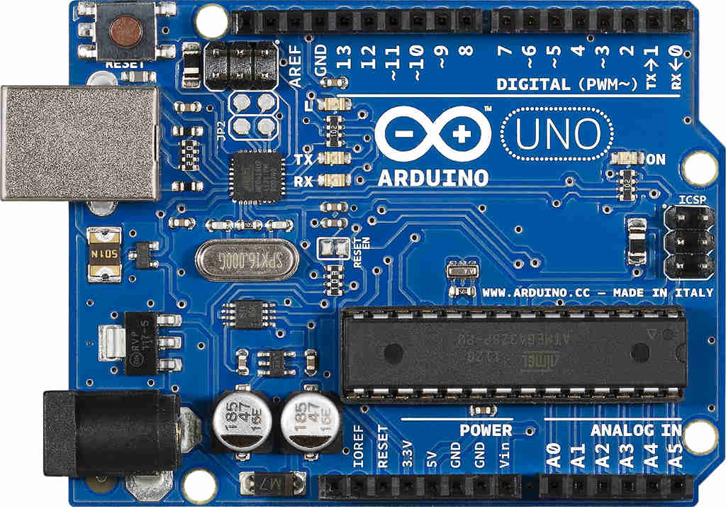
ANATOMY OF AN ARDUINO
Digital Pins
Micro USB Port
Power LED
Upload Status LEDs
Microcontroller
Battery (Non USB) Power Connect
Analog Pins
Power/Ground
Figure 3: Arduino Anatomy, courtesy of EduGonist

Slide 5
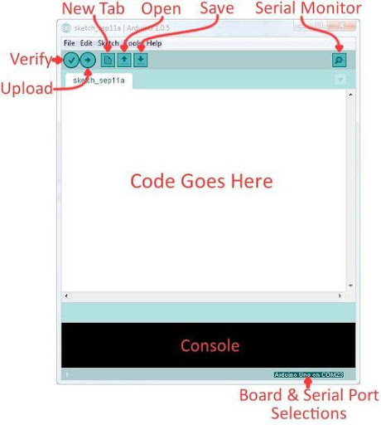
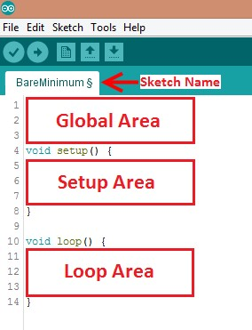
ARDUINO CODING PLATFORM
IDE - “Integrated Development Environment”
Edit, compile, and upload Code
Written in Arduino Programming Language (based on C/C++)
Figure 3: Arduino IDE
Figure 4: Code Areas

Slide 6
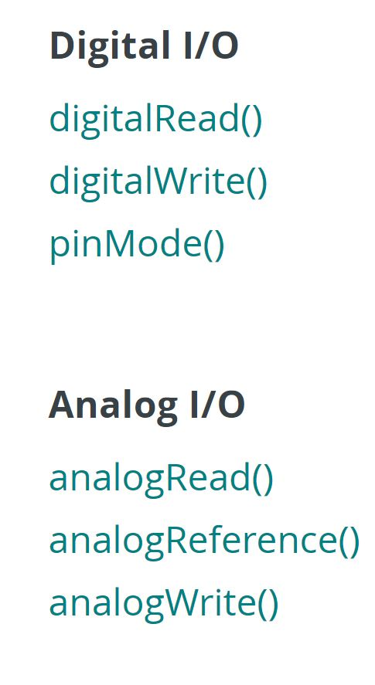
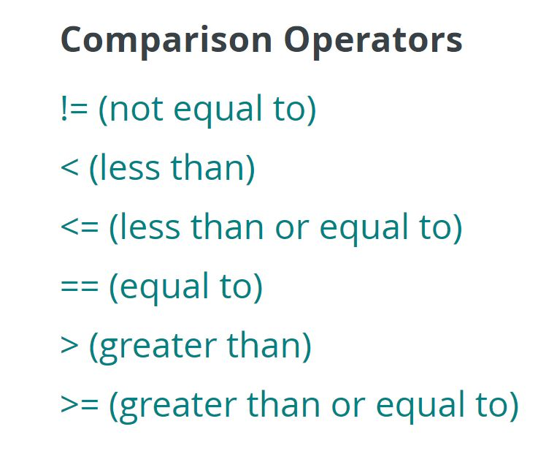
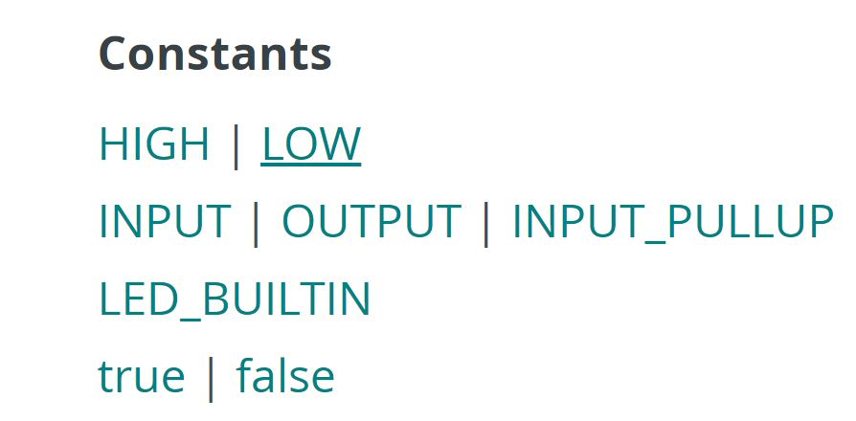
BASIC ARDUINO FUNCTIONS
Variables
int variable name = pin #
pinMode (variable name, input/output)
Images courtesy of Arduino’s website

Slide 7
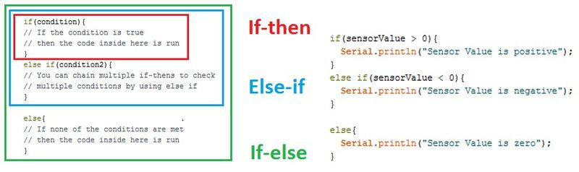
DECISIONS
Figure 12: Conditional Statements

Slide 8
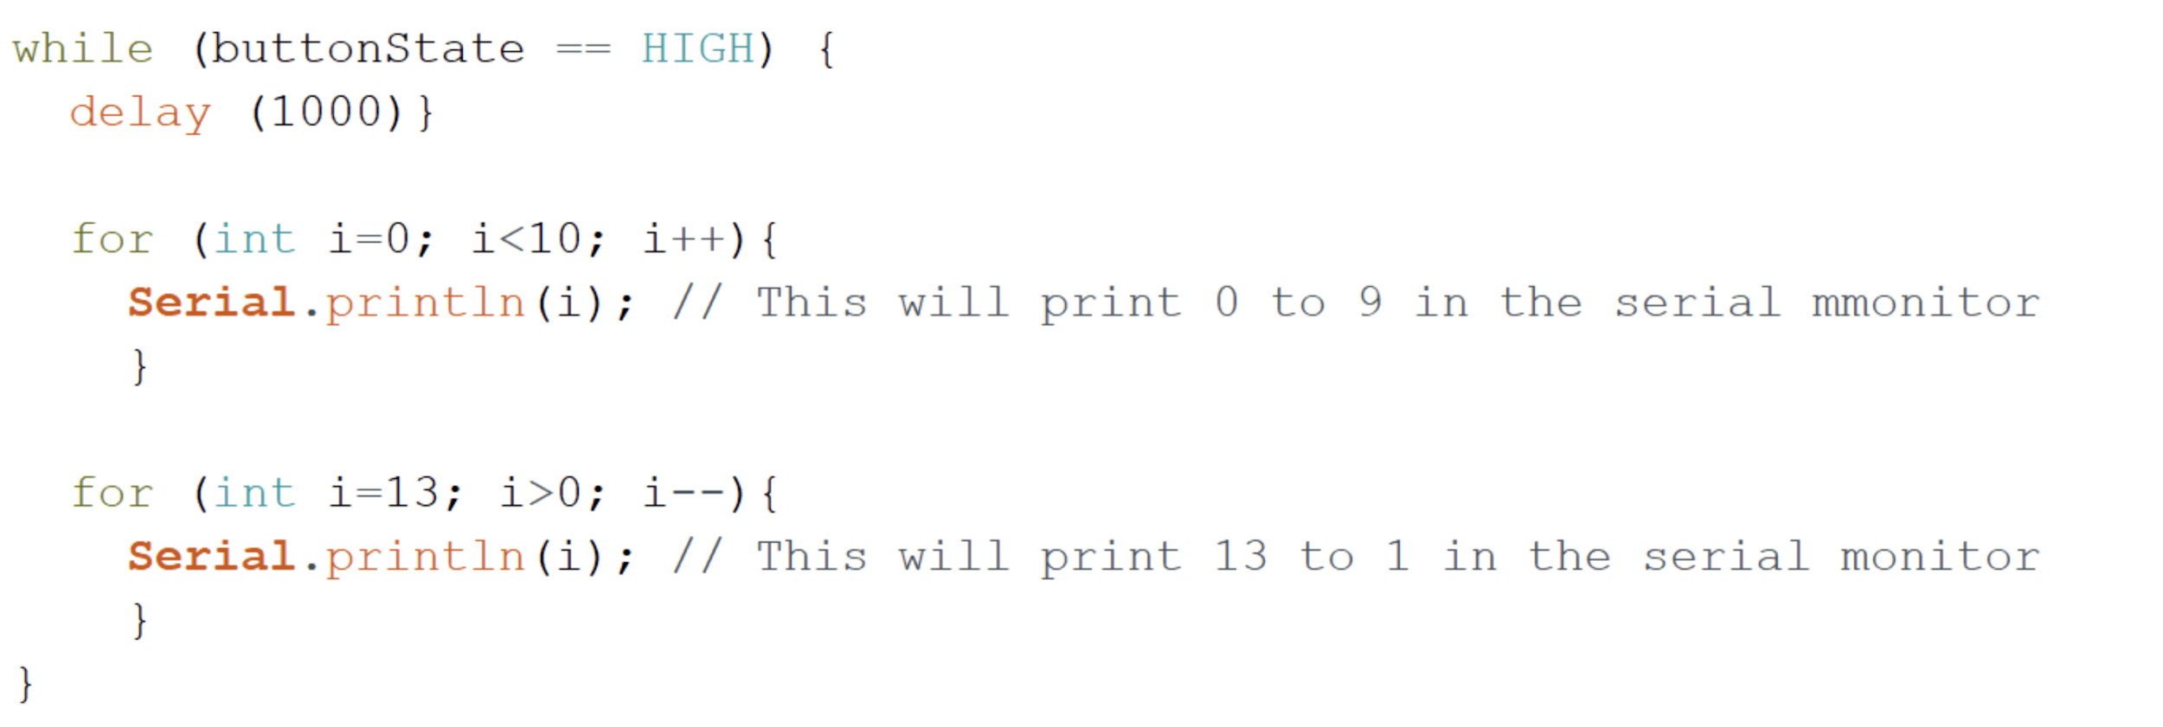
LOOPS
While loops
Loops
Runs code until end condition is met
Run sections of code repeatedly
For loops
Runs code for a specific number of times
Figure 13: While and For Loops

Slide 9
ARDUINO PINS
Digital Pins
Binary inputs (HIGH and LOW)
digitalRead(), digitalWrite()
Numbered 1-13
PWM = “Pulse with Modification”
analogWrite() with digital Pin
Analog Pins
Voltage Potential inputs (Range)
analogRead()
Labeled A0-A5
Common for Sensors
Figure 6: Digital I/O pins
Figure 7: Analog I/O pins

Slide 10
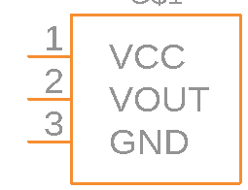
INPUTS / SENSORS
Sensors detect “surroundings”
Many different types exist: Distance (Ultrasonic), Pressure (Piezo), CO2, UV, Light intensity, Heat, Angular position (Gyro), Muscle Flexing, Touch, Force, Motion, Humidity, Water Level
VCC - “Voltage Common Collector”
VOUT - Sensor output as Voltage
GND - “Ground”
Figure 9: Sensor Diagram

Slide 11
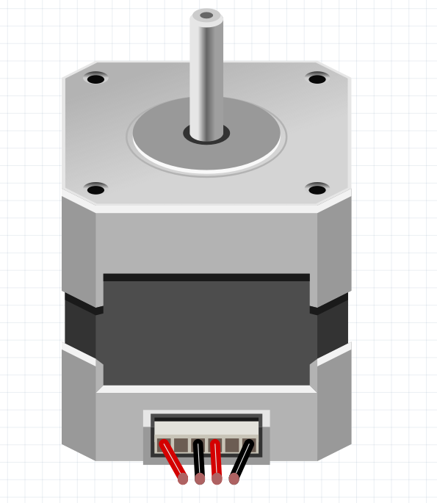
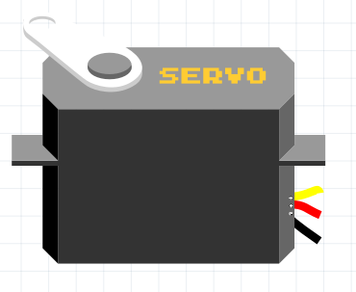
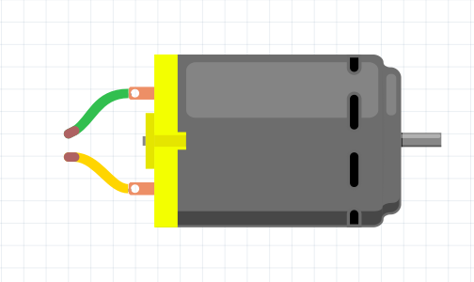
OUTPUTS / MOTORS
Motors convert electrical energy into mechanical energy
Figure 10: Servo Motor (Left), DC Motor (Middle), Stepper Motor (Right)

Slide 12
LIBRARIES
Sets of code that make it easier to connect to and use sensors. Some libraries are pre-downloaded as seen in the screenshot below and others need to be added.
Under Manage Libraries pre-installed libraries as well as libraries that are ready for installation. This is where you can find updates for pre-installed libraries
Under Add .ZIP Library you can import libraries that have been downloaded to your computer

Slide 13
RESOURCES
Instructables has great tutorials for just about everything
When in doubt, Google the sensor name or code, just be sure that the information is about the sensor you are using!
Other TAs: Chances are another TA has worked with something similar always feel free to ask questions in Slack
Online Library: This has helpful tutorial on Arduino and more

Slide 14
REFLECTION
Let’s revisit the Love-O-Meter

Slide 15
SKELETON AND SETUP
// named constant for the pin the sensor is connected to
const int sensorPin = ??; // pick an analog pin A0-A5 on the board to connect the sensor to
// room temperature in Celsius
const float baselineTemp = 20.0;
void setup() {
// open a serial connection to display values
Serial.begin(9600);
// set the LED pins as outputs
// the for() loop saves some extra coding
for (int pinNumber = 2; pinNumber < 5; pinNumber++) {
pinMode(pinNumber, OUTPUT);
digitalWrite(pinNumber, LOW);
}
}
void loop() {
…
delay(1);
}

Slide 16
READ SENSORS
// read the value on AnalogIn pin 0 and store it in a variable
int sensorVal = analogRead(sensorPin);
// send the 10-bit sensor value out the serial port
Serial.print("sensor Value: ");
Serial.print(sensorVal);
// convert the ADC reading to voltage
float voltage = (sensorVal / 1024.0) * 5.0;
// Send the voltage level out the Serial port
Serial.print(", Volts: ");
Serial.print(voltage);
// convert the voltage to temperature in degrees C
// the sensor changes 10 mV per degree
// the datasheet says there's a 500 mV offset = 0.5 V offset
// ((voltage – 0.5 V) times 100 )
Serial.print(", degrees C: ");
float temperature = (voltage - 0.5 ) * 100 ;
Serial.println(temperature);
$$10 mV per degree=10\frac{mV}{°C}=\frac{10 mV}{1 °C}→\frac{1 °C}{10 mV}$$ $$\frac{1 °C}{10 mV}=\frac{1 °C}{10 mV}×\frac{1000 mV}{1 V}=\frac{1000 °C}{10 V}=\frac{100 °C}{1 V}$$

Slide 17
LIGHT LEDS
// if the current temperature is lower than the baseline turn off all LEDs
if (temperature < baselineTemp + 2) {
digitalWrite(2, LOW);
digitalWrite(3, LOW);
digitalWrite(4, LOW);
} // if the temperature rises 2-4 degrees, turn an LED on
else if (temperature >= baselineTemp + 2 && temperature < baselineTemp + 4) {
digitalWrite(2, ??);
digitalWrite(3, ??);
digitalWrite(4, ??);
} // if the temperature rises 4-6 degrees, turn a second LED on
else if (temperature >= baselineTemp + 4 && temperature < baselineTemp + 6) {
digitalWrite(2, ??);
digitalWrite(3, ??);
digitalWrite(4, ??);
} // if the temperature rises more than 6 degrees, turn all LEDs on
else if (temperature >= baselineTemp + 6) {
digitalWrite(2, ??);
digitalWrite(3, ??);
digitalWrite(4, ??);
}

Slide 18
BREAK!

Slide 19
ACTIVITY 1
Light an LED when an object is less than 200cm away.

Slide 20
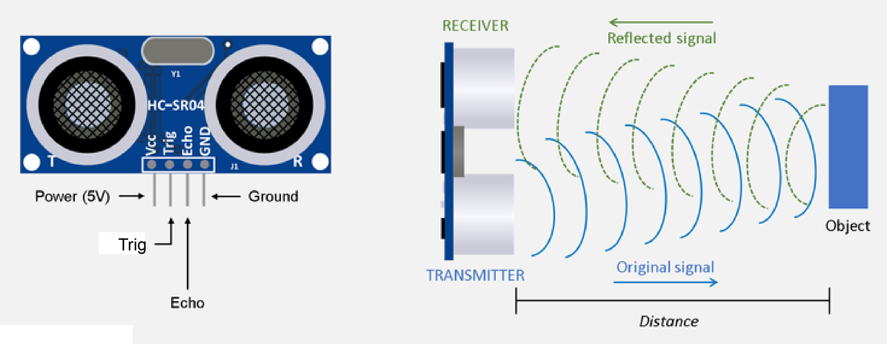
ULTRASONIC SENSORS
Sends out high frequency sound waves
Calculates time from signal sent to reflected signal received
“Trig” pin Sends out the sound wave (OUTPUT)
“Echo” pin receives the reflected sound (INPUT)
Distance [cm] = Speed of Sound [cm/μs] × ½ Time [μs]
Figure 12: Ultrasonic Sensor, Courtesy of osoyoo.com
Notes:
The speed of sound is 343 m/s = 0.0343 cm/us.

Slide 21
WORKING WITH SENSORS
Sensors will have specific commands that you may have to research and employ for your projects
Refer to online resources, such as https://www.arduino.cc/reference/en/
Ask us for help!

Slide 22
CODE FLOWCHART
Define Sensors and LED
We want to tell the Arduino which pins correspond to what sensor/LED, as well as letting it know if these pins are an input or an output
Trigger the Alarm as Needed
Now that the distance is measured we can turn on the LED “alarm” when the object is in range.
2
4
1
3
Send Signal to Find Distance
Next we want to send out a signal and have the Arduino calculate the distance from the sensor to the object.
Display if an Object is Near
When the LED lights up we also want to display on the serial monitor that an object is too close.

Slide 23
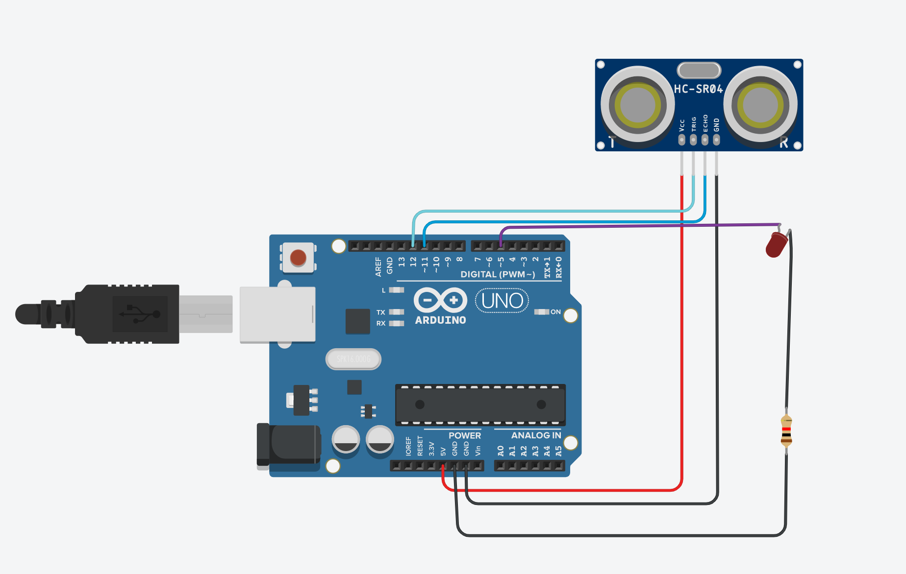
CIRCUIT ILLUSTRATION

Slide 24
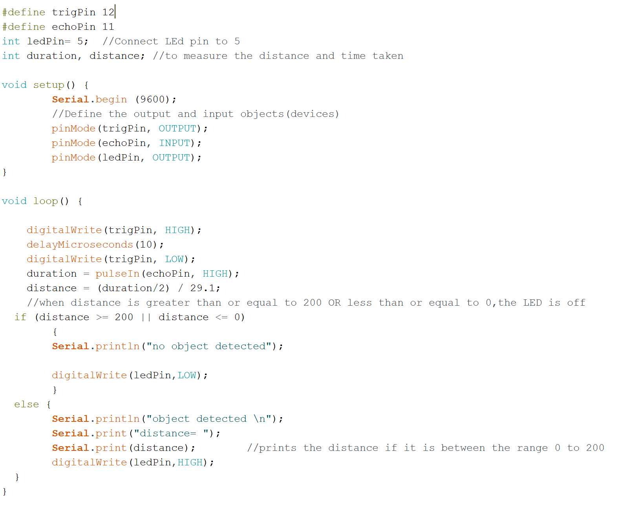
CODE

Slide 25
ACTIVITY 2
Also sound a buzzer when an object is less than 200cm away.

Slide 26
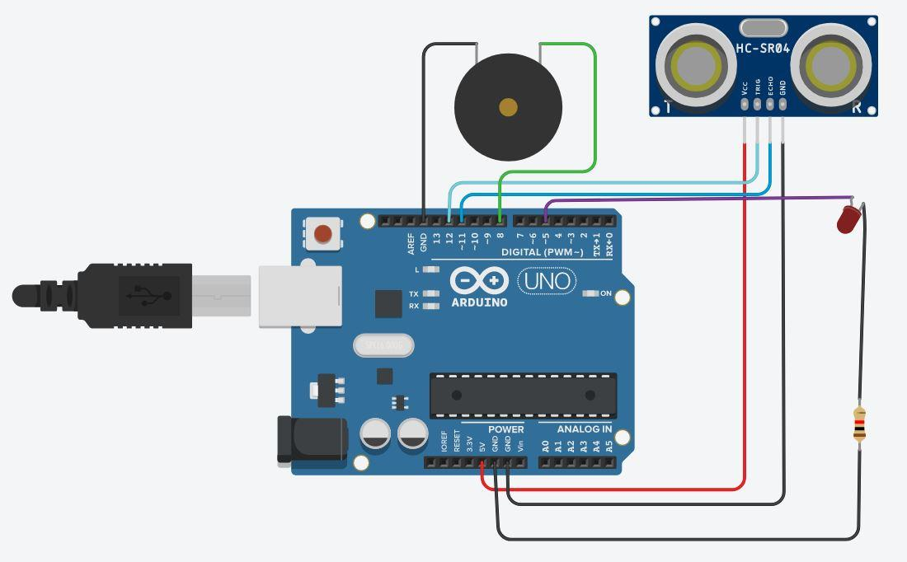
CIRCUIT ILLUSTRATION

Slide 27
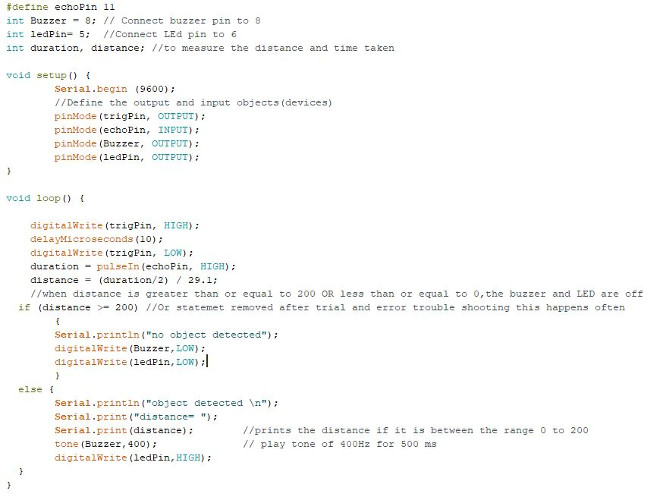
CODE

Slide 28
QUESTIONS?

