Slide 1

INTRODUCTION TO EG1004
EG1004 | RECITATION 1

Slide 2





COURSE OBJECTIVES
Explore concentrations of engineering
Develop professional skills
  Teamwork
  Oral communication
  Written communication
Explore technical tools & skills
Utilize the engineering design process
2

Slide 3




COURSE FORMAT
Lecture
1 hr. / week
Lab
3 hr. / week
Recitation
1.5 hr. / week
Semester-Long Design Project
3

Slide 4
ATTENDANCE POLICIES
Lecture
ID SWIPE
Lab
ID SWIPE
Recitation
PRESENTATION
Semester-Long Design Project
OWN TIME
4

Slide 5
ATTENDANCE POLICIES
Full absence & tardy policies on the EG1004 Manual
Lecture
NO MAKE UP
E-mail Recitation Professor
Lab
Makeup by Request
Visit Website
Recitation
E-mail Recitation Professor
Semester-Long Design Project
OWN TIME
5

Slide 6



LECTURE
Professors and industry experts lecture on engineering disciplines
Mandatory attendance
  Taken during first five minutes
  Don’t be late!
6

Slide 7
LABORATORY
Lab groups of 2-4 students
Weekly lab report due at 11:59 pm on night before the next lab
Weekly quiz
  Lab material
Makeup labs requested on EG website
7

Slide 8

RECITATION
Student presentations on labs & projects
Due at 11:59 pm the night before recitation
Professor and TA material on becoming a well-rounded engineer:
  Engineering career pathways
  Professional skills
  Engineering mindset
  Technical writing
8

Slide 9

SEMESTER-LONG DESIGN PROJECT (SLDP)
12-week project
Teams of 2-4 students
More info to come
Figure 1: Sample SLDP RAD project courtesy of EG1004
9

Slide 10
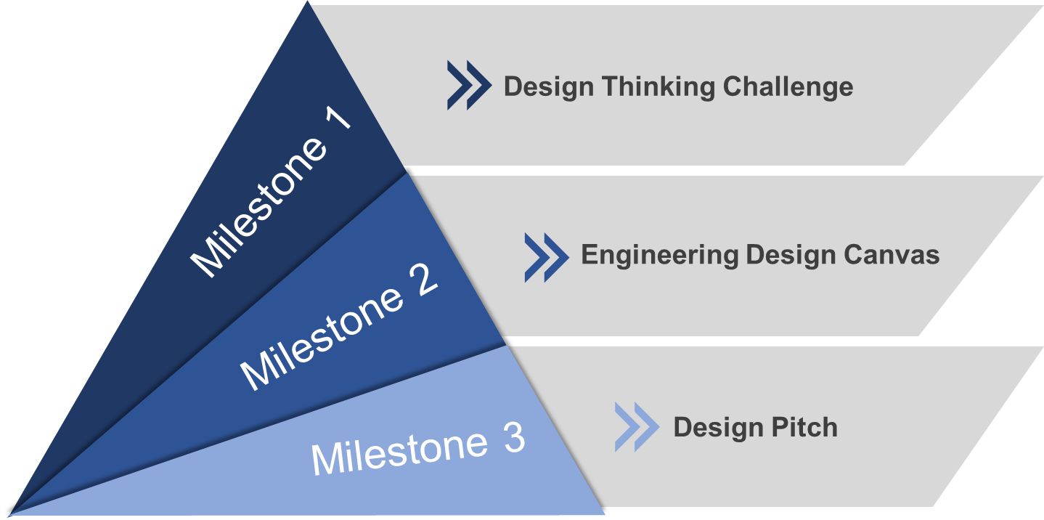

PROFESSIONAL SKILLS
Contributing to the Team’s Work
Interacting with Teammates
Having Relevant Knowledge, Skills & Abilities
Keeping the Team on Track
Expecting Quality
10

Slide 11


JOB APPLICATION PRACTICE
Tandon Career Services Lecture
Writing Professor Presentations
Compile a Mock Job Application
Resume
Cover Letter
LinkedIn Profile
ePortfolio
11

Slide 12
GRADING BREAKDOWN
Item | Percentage of Grade
Lab Quizzes | 5%
Professional Development | 10%
Lecture Attendance | 10%
TA Lab Reports | 15%
WP Lab Reports | 15%
Recitation Presentations | 15%
Semester-Long Design Project | 30%
12

Slide 13
COURSE RESOURCES
EG1004 Website
eg.poly.edu
Assignment submission
Course announcements
Syllabus & schedule
Grades
EG1004 Lab Manual manual.eg.poly.edu
Lab & project information
Course material & presentations
Course policies
Help and how-tos
13

Slide 14
QUESTIONS?

