Slide 1
INTRODUCTION TO CIRCUITRY
ENGR-NY 2 | LAB 1

Slide 2
TODAY’S AGENDA
1
Mini-lecture: Introduction to Electricity
2
Tutorial: Getting to Know Your Components
3
Activity: Build a Circuit!

Slide 3
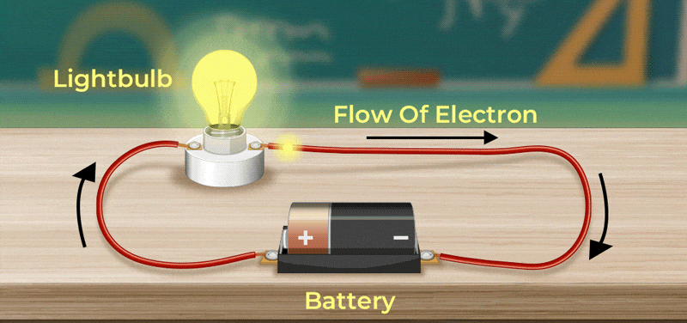
Electricity is Energy
Notes:
Electricity is the flow of electrons – negatively charged particles – from a source, like a battery, into a “load” – often applications we can actually experience, such as a light bulb turning on or noise out of a speaker.

Slide 4
Energy Flows from High to Low
What happens when you are in a heated room, and you open the window on a cold day?
Heat flows out of the room and thermal energy is lost!
What would impede the flow of heat out of the cold room? What would cause a resistance?
Notes:
Energy flows from high to low - consider what happens when you open a window on a cold day, from a heated room. What happens?
The temperature quickly decreases – the thermal energy decreases. The warmer the room was at the start, the more dramatic this might feel!
At the same time – what can prevent this flow from happening? Maybe something in front of the window, maybe opening the windows less…

Slide 5
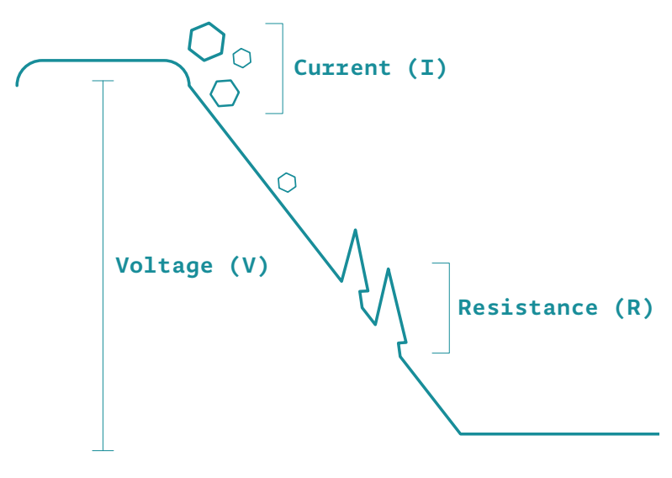
Key Vocabulary for Electricity
Current (I) is the flow of electricity through a point
Voltage (V) is the difference in energy between one point and another
Resistance (R) is an impedance to Current
Notes:
The same principles apply to electricity – (read the definitions, explaining analogously to temperature/the example used previously)

Slide 6
How do we go from one to the other?
Notes:
Electricity is the flow of electrons – negatively charged particles – from a source, like a battery, into a “load” – often applications we can actually experience, such as a light bulb turning on or noise out of a speaker.

Slide 7
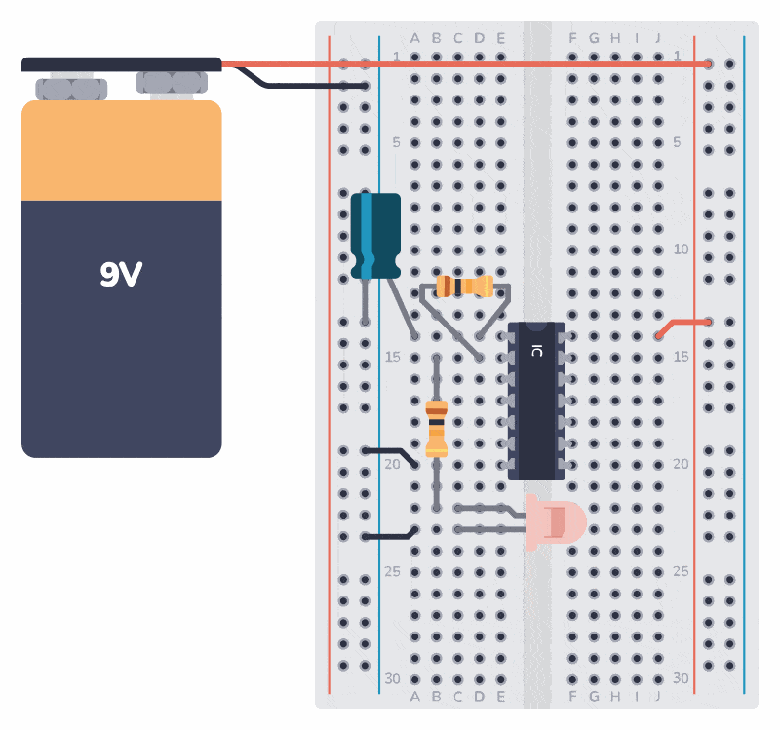
Circuits
Things to keep in mind:
There must be a complete path from the source (“power”, the battery in this case) to the point of least energy (“ground”)
Current will seek the path of least resistance – this can be a safety hazard!
Notes:
The same principles apply to electricity – (read the definitions, explaining analogously to temperature/the example used previously)

Slide 8
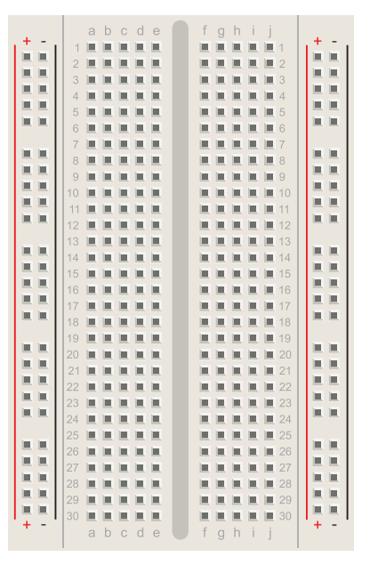
Take Out Your Breadboard
Power Bus
power and ground
connected lengthwise
Prototyping Area
5 holes connected horizontally
Notes:
The same principles apply to electricity – (read the definitions, explaining analogously to temperature/the example used previously)

Slide 9
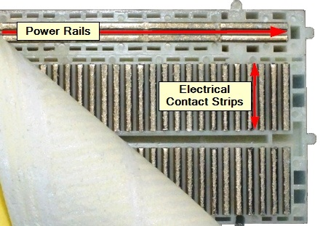
Take Out Your Breadboard
Power Bus
power and ground
connected lengthwise
Prototyping Area
5 holes connected horizontally
Notes:
Have groups take out their breadboards - explain how they work
Peeling it back - conductive strips - metal where electricity can flow easily

Slide 10
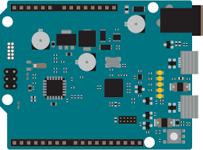
Your First Components
LED
Resistor
Switch
Arduino
Notes:
The same principles apply to electricity – (read the definitions, explaining analogously to temperature/the example used previously)

Slide 11
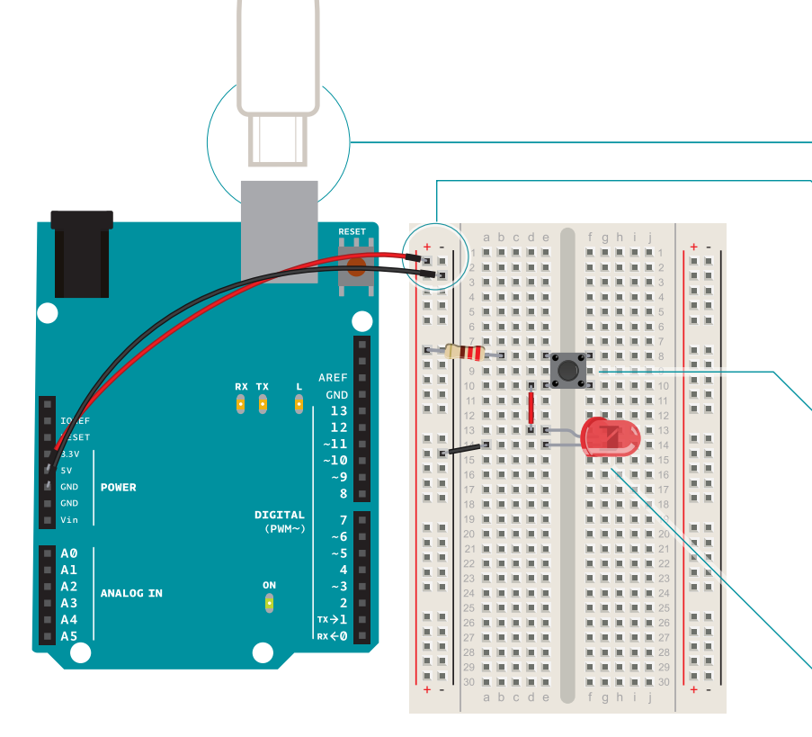
Let’s Build!
Refer to the handout provided for a step-by-step walkthrough of this activity
Please ask the TAs and professors for assistance if you need it!
Notes:
The same principles apply to electricity – (read the definitions, explaining analogously to temperature/the example used previously)

Slide 12
The Importance of the Resistor
Change out your resistor:
220 Ohm
1k Ohm
10k Ohm
What do you observe?
What impact does the resistor have on the brightness?
Notes:
The same principles apply to electricity – (read the definitions, explaining analogously to temperature/the example used previously)

Slide 13
Series and Parallel

Slide 14
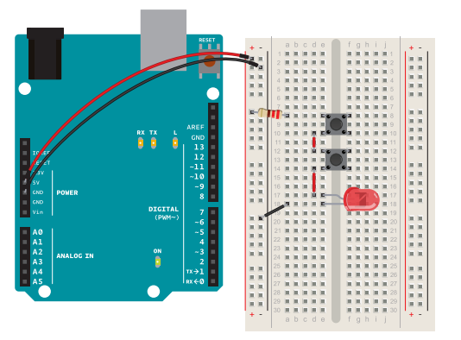
Let’s Build in Series!
Refer to the handout provided for a step-by-step walkthrough of this activity
Please ask the TAs and professors for assistance if you need it!
Notes:
The same principles apply to electricity – (read the definitions, explaining analogously to temperature/the example used previously)

Slide 15
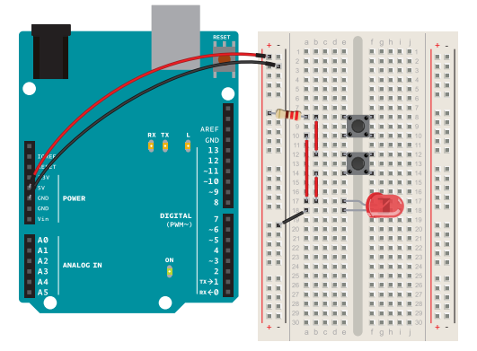
Let’s Build in Parallel!
Refer to the handout provided for a step-by-step walkthrough of this activity
Please ask the TAs and professors for assistance if you need it!
Notes:
The same principles apply to electricity – (read the definitions, explaining analogously to temperature/the example used previously)

Slide 16
Reflection Moment
What are our key takeaways?

Slide 17
Let’s Practice!

Slide 18
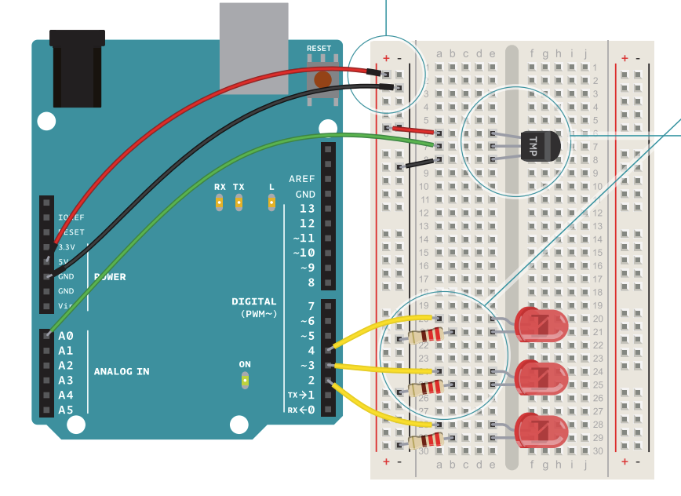
Working with a Sensor
Notes:
https://www.youtube.com/watch?v=UwTFfa_f4-0 - students can watch videos at their own pace in class
** INGRID TO PROVIDE CODE **

Slide 19
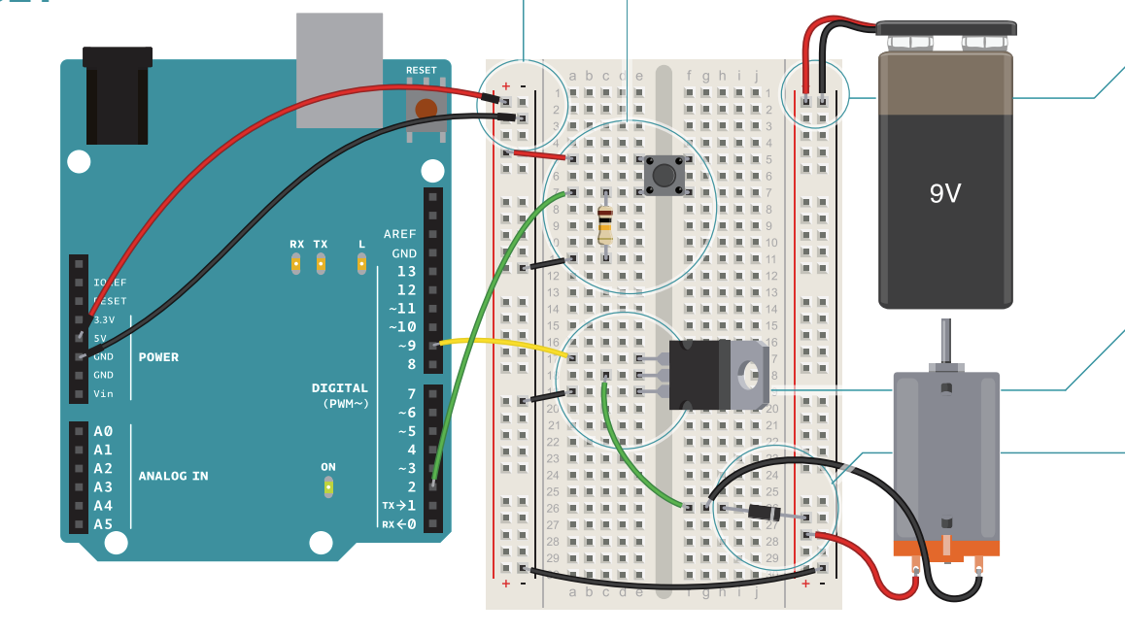
Working with a Motor

Slide 20
Reflection Moment
What are our key takeaways?

Slide 21
QUESTIONS?

