Slide 1
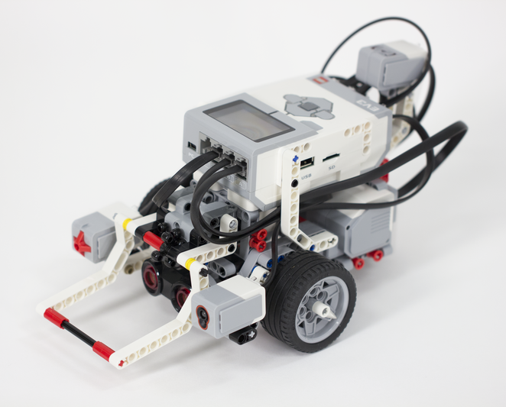
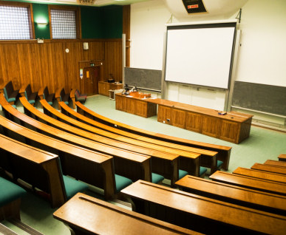
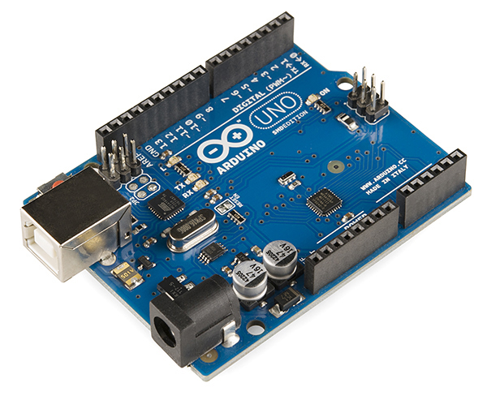
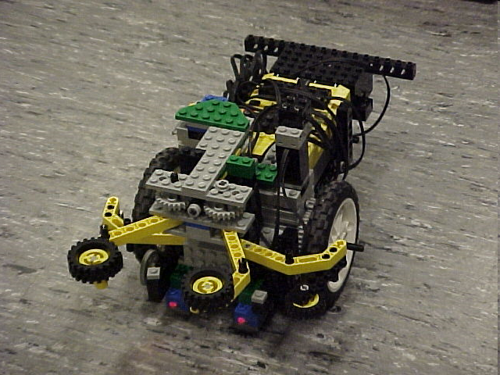
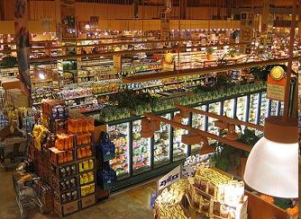
Semester-Long Design Project

Slide 2
Project Introduction
Project duration: Ten weeks
Teams of 2-3 people
Projects to choose from:
  Robot (six types)
  Campus Expansion
  Rapid Assembly & Design Challenge
  Nanorobotics Challenge

Slide 3
Project Grading
Item | % of Grade
Benchmarks and Commissioning | 50%
Final Presentation | 50%
NOTE: The SLDP counts toward 30% of your course final grade!

Slide 4

Project Grading
Benchmarks:
  Completion of a specified portion of the project
  Cumulative (Benchmark B includes Benchmark A)
  Two throughout semester
  Refer to schedule for due dates
  Penalties for not completing on time

Slide 5
Project Grading
Commissioning:
  Completion of all required tasks
  Last phase of project
  Refer to syllabus for due dates
  Failure to commission will result
  in penalties (partial commissioning)

Slide 6
Project Grading
Partial Commissioning:
  Benchmark A = 30% minimum
  Benchmark B = 70% minimum
  Any higher percentage achieved beyond your benchmark is decided by two TAs watching a full run

Slide 7
Project Grading
Project Submission:
  Submit all documents via EG website
  Google Form must be submitted for SLDP grade
  Any missing items will result in penalties
  Refer to syllabus for deadline
  Refer to Submission Guidelines

Slide 8
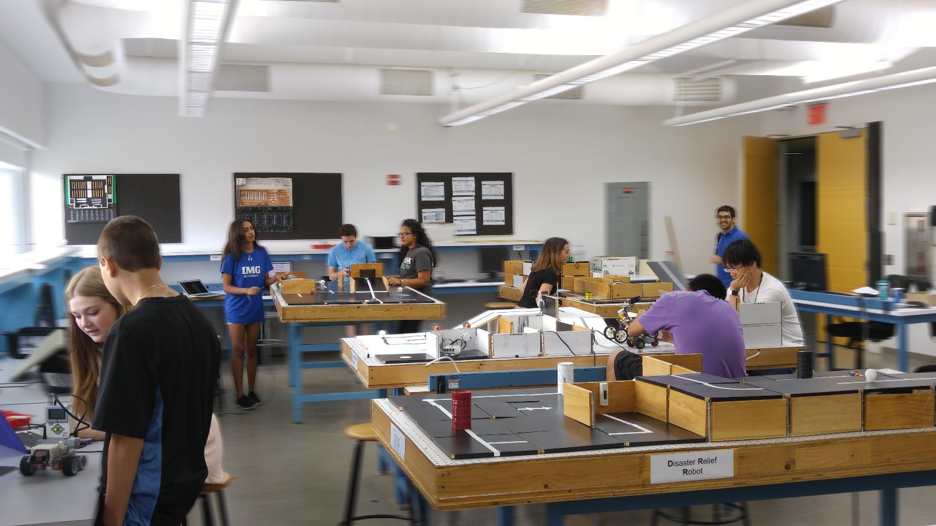
SLDP Options
Six Robot Variants
Housing and Innovation
in Revit
Nanorobotics Challenge
Rapid Assembly & Design Challenge

Slide 9
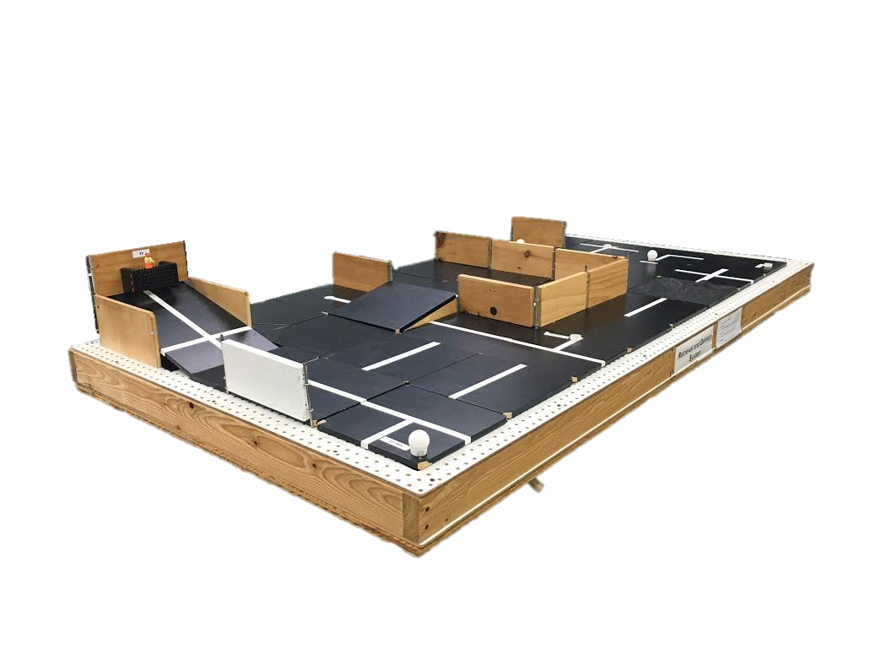
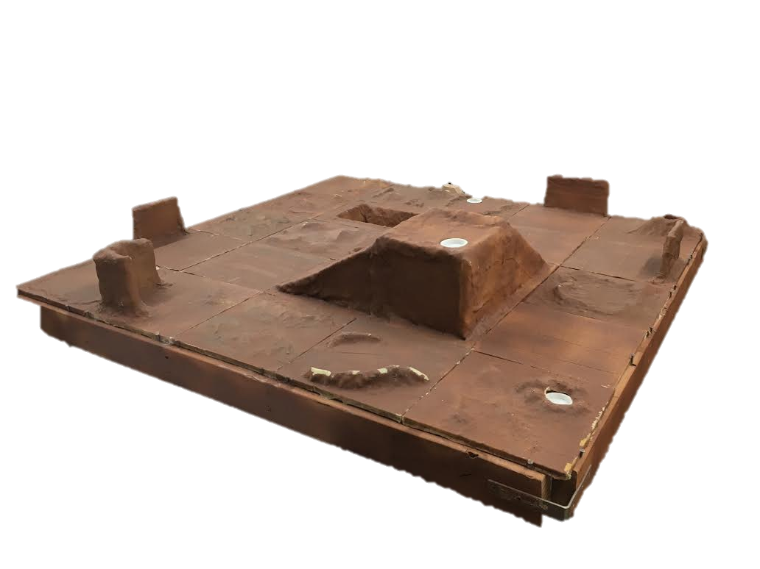
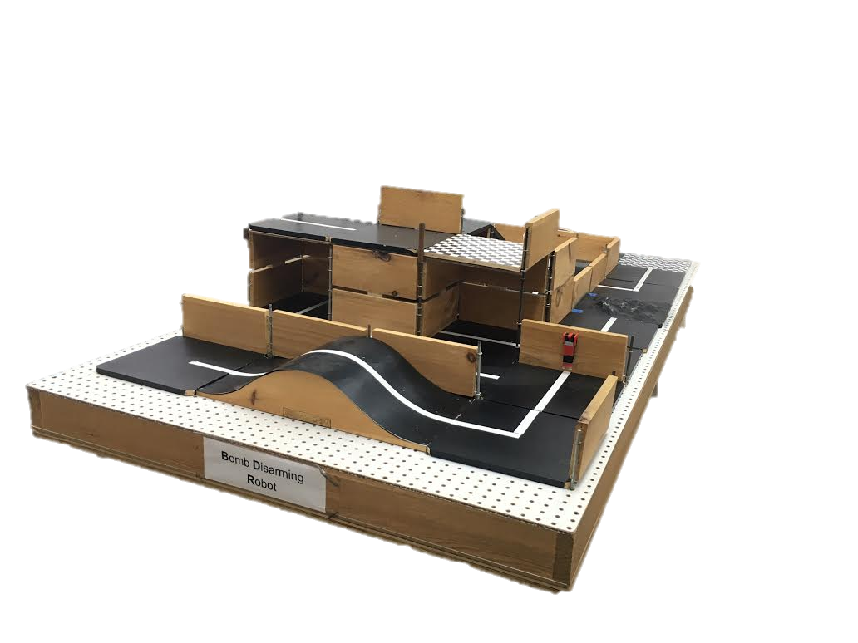
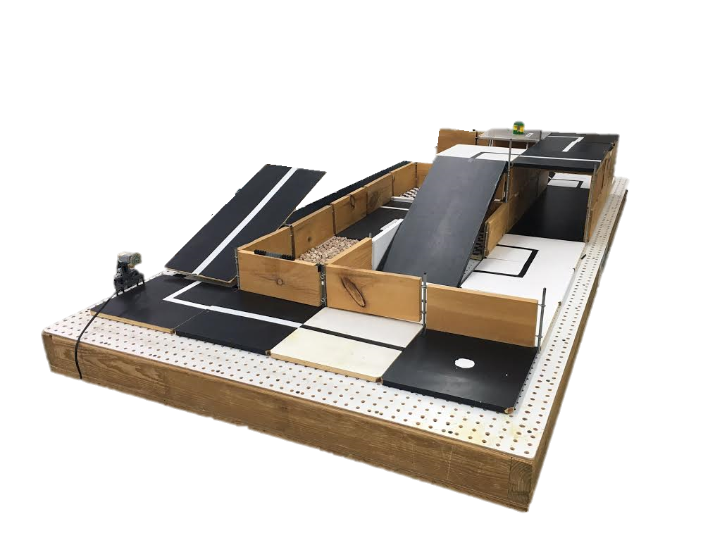
SLDP Options
Example Robot Variants

Slide 10
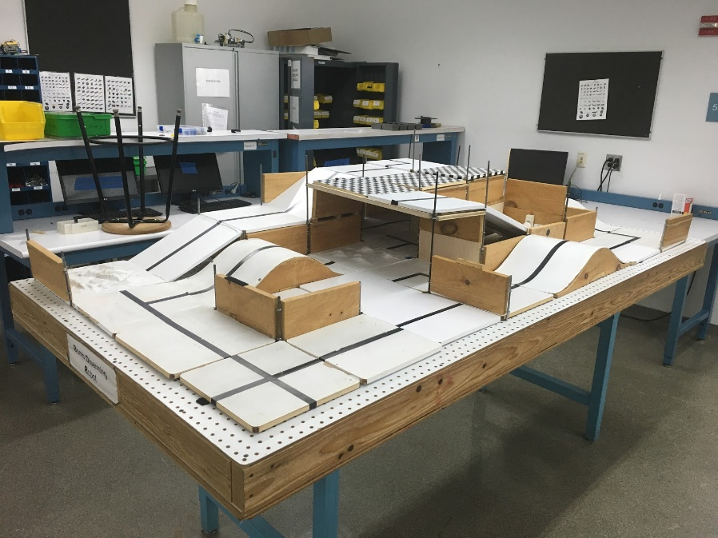
SLDP Options
Bomb Disarming Robot (BDR)
Disarm bomb and return to start
Avoid decoy bombs
Robot must be able to autonomously
navigate the obstacle course provided
Robot must fit in a start area that is 25cm x 25cm
Maximum height is 20cm

Slide 11
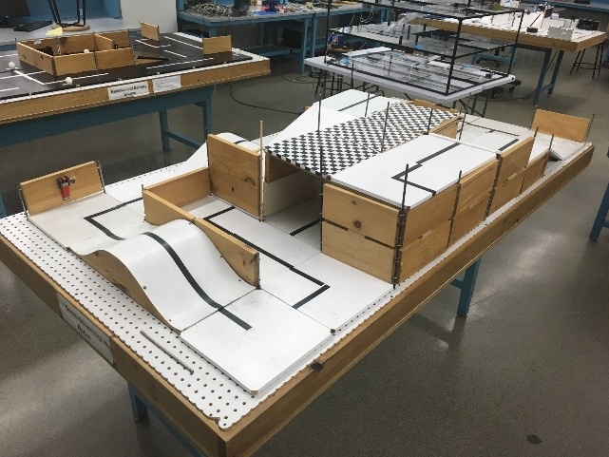
SLDP Options
Bomb Disarming Robot (BDR)
Allowed
Jumping off
upper levels
Climbing walls
Prohibited
Arms
Slingshots
Projectiles
Extra Credit: Disable and/or retrieve triangulation device(s)

Slide 12

SLDP Options
Bomb Disarming Robot (BDR)
Benchmark A: Pass two hills
Benchmark B: Disarm bomb
Commission: Return to start
Extra Credit: Disable and/or retrieve triangulation device(s)

Slide 13
SLDP Options
Mars Rover Robot (MRR)
Collect one soil and one water reading
Pick up sensor between readings if necessary
Carry module(s) FROM start TO respective tile
Answer Data Specifications questions

Slide 14
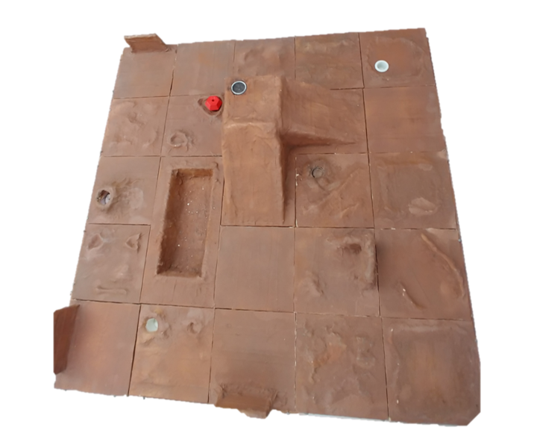
SLDP Options

Slide 15
SLDP Options
Mars Rover Robot (MRR)
Benchmark A:
Obtain one reading
Benchmark B:
Obtain first reading
Return to pick up module if necessary
Obtain second different reading
Commission:
Obtain a water and soil reading
Return to landing site
Conduct all corresponding tests and answer Data Spec questions

Slide 16
SLDP Options
Mars Rover Robot (MRR)
Extra Credit:
Obtain all 3 types of readings
Cross the canyon
Traverse up and down mountain
Collect reading from an EC tile

Slide 17
SLDP Options
Retrieval & Delivery System (RDS)
Retrieve fuel cells
Deliver them to three different hospitals
Hospitals consume power at different
levels of efficiency
Deliver a total of at least 200 hours of battery life
The robot must fit in a start area that is 25cm x 25cm

Slide 18
SLDP Options
Retrieval & Delivery System (RDS)
Fuel Cells
Center of tile = 25 hrs
Edge of tile = 30 hrs
Corner of tile = 35 hrs
Power Supply
Yellow = 1x
Blue = 2x
Red = 3x
Extra Credit: Additional fuel cells
  Depends on extra number of cells, not hours

Slide 19
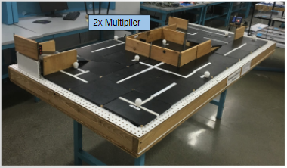
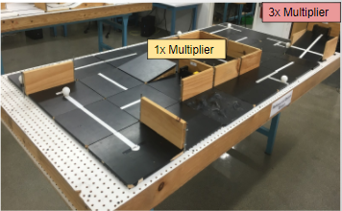
SLDP Options
Retrieval & Delivery System (RDS)

Slide 20
SLDP Options
Retrieval & Delivery System (RDS)
Benchmark A: Deliver 50 hrs
Benchmark B: Deliver 125 hrs total
Commission: Deliver 200 hrs total
Extra Credit: Additional fuel cells
  Depends on extra number of cells, not hours

Slide 21
SLDP Options
Search & Recovery Robot (SRR)
Retrieve lost space module Zarya and return to start
The robot must fit in a start area that is 25cm x 25cm
Extra Credit: Retrieve other modules; Traverse moon dust

Slide 22
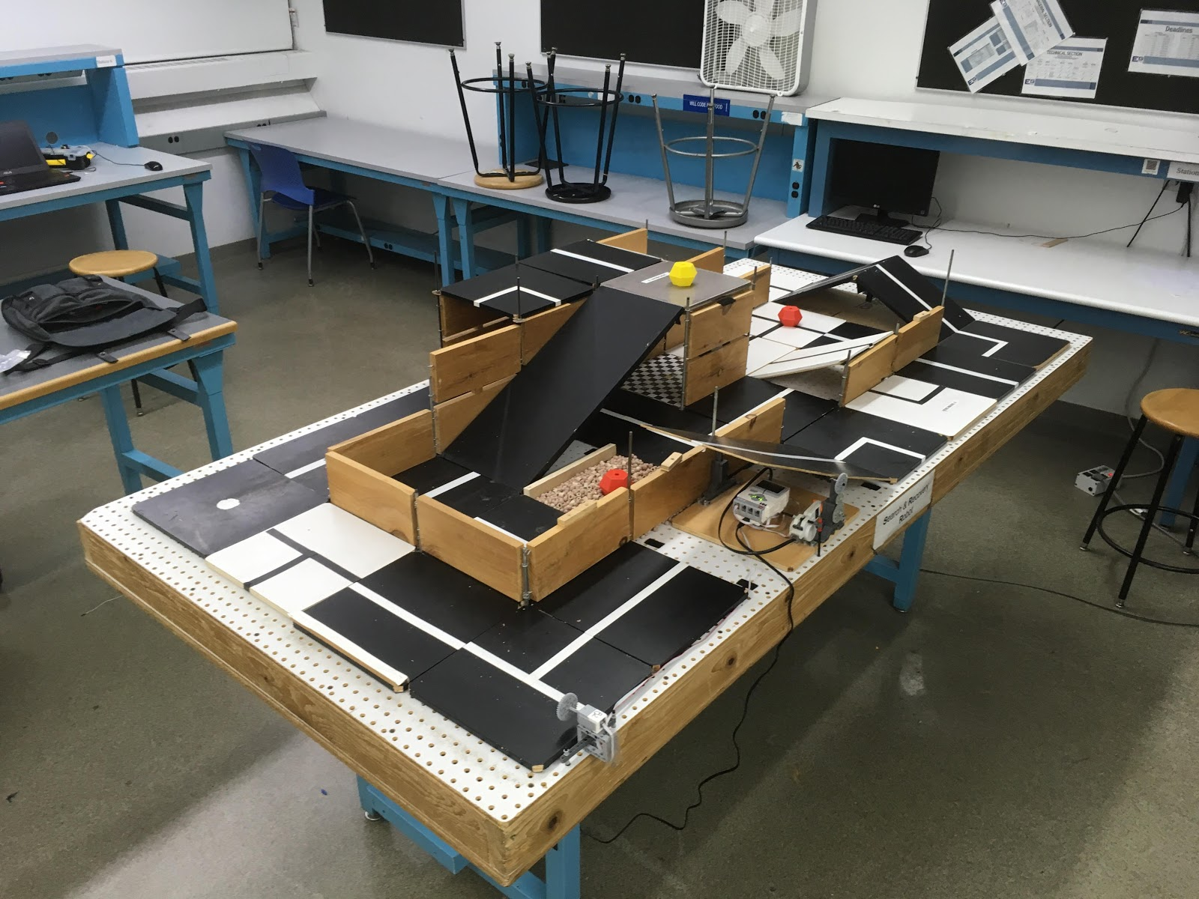
SLDP Options
Search & Recovery Robot (SRR)

Slide 23
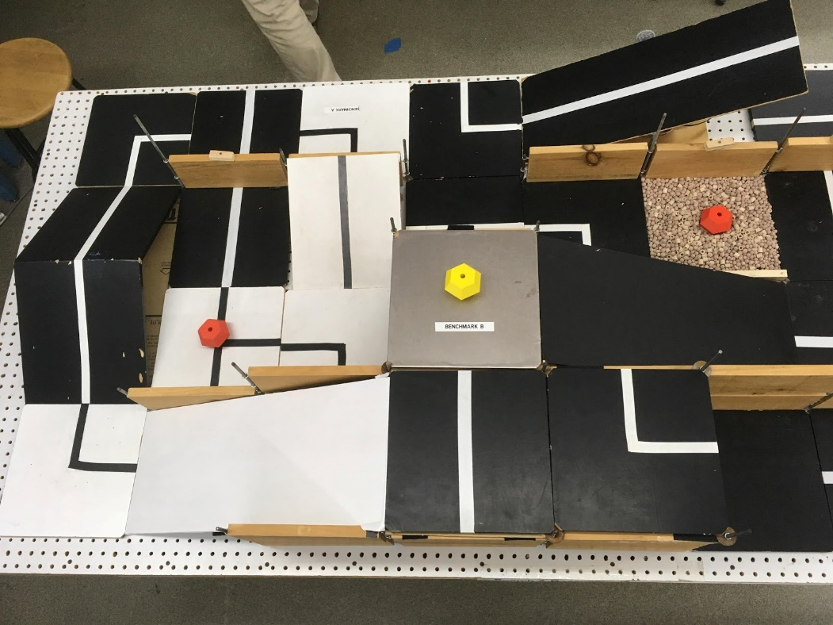
SLDP Options
Search & Recovery Robot (SRR)
Modules
Quest Zarya Unity

Slide 24
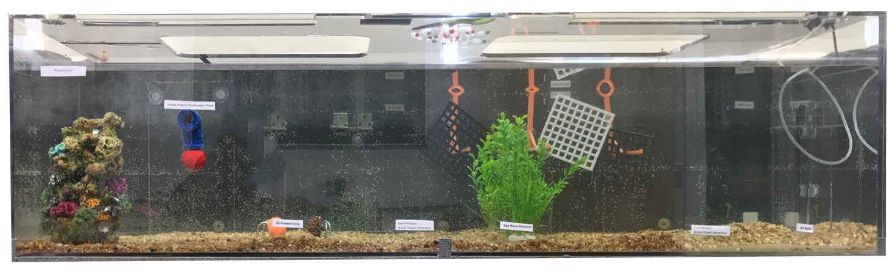
SLDP Options
Autonomous Underwater Vehicle (AUV)
Navigate underwater
Complete tasks for sea lab project
Collect 100 points in 5 minutes
Robot must be less than 1ft x 1ft x 1ft
Extra Credit: Completing additional tasks after reaching 100 points

Slide 25
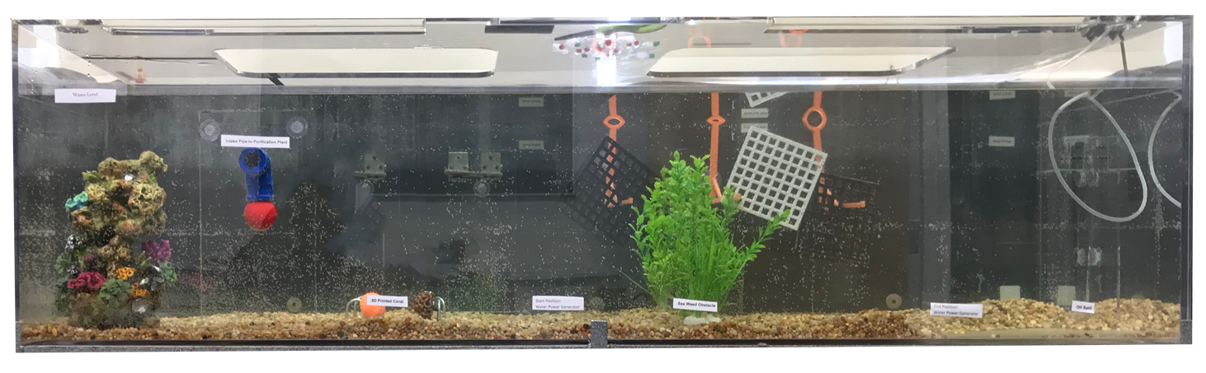
Autonomous Underwater Vehicle (AUV)
Water tank

Slide 26
SLDP Options
Search & Recovery Robot (SRR)
Benchmark A: Traverse Hill Tile (Path 1) OR Traverse Bridge (Path 2)
Benchmark B: Retrieve Zarya
Commission: Return to start with Zarya
Extra Credit: Retrieve other modules; Traverse moon dust

Slide 27
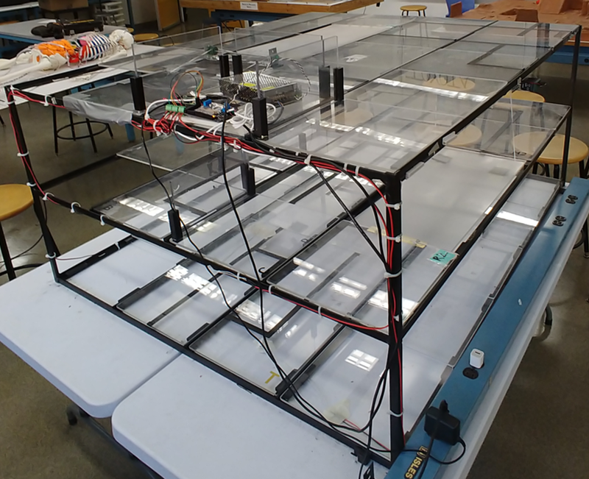
SLDP Options
Subterranean Infiltrator & Fortune Retriever (SIFR)
Solve logic problem to reach bottom of mineshaft
Retrieve the treasure
The robot must fit in a start area that is 12 in. by 12 in. by 11 in.

Slide 28
SLDP Options
Subterranean Infiltrator & Fortune Retriever (SIFR)
Extra Credit
Using ramp 3/reed switch 4
Return to middle layer
Return to start

Slide 29
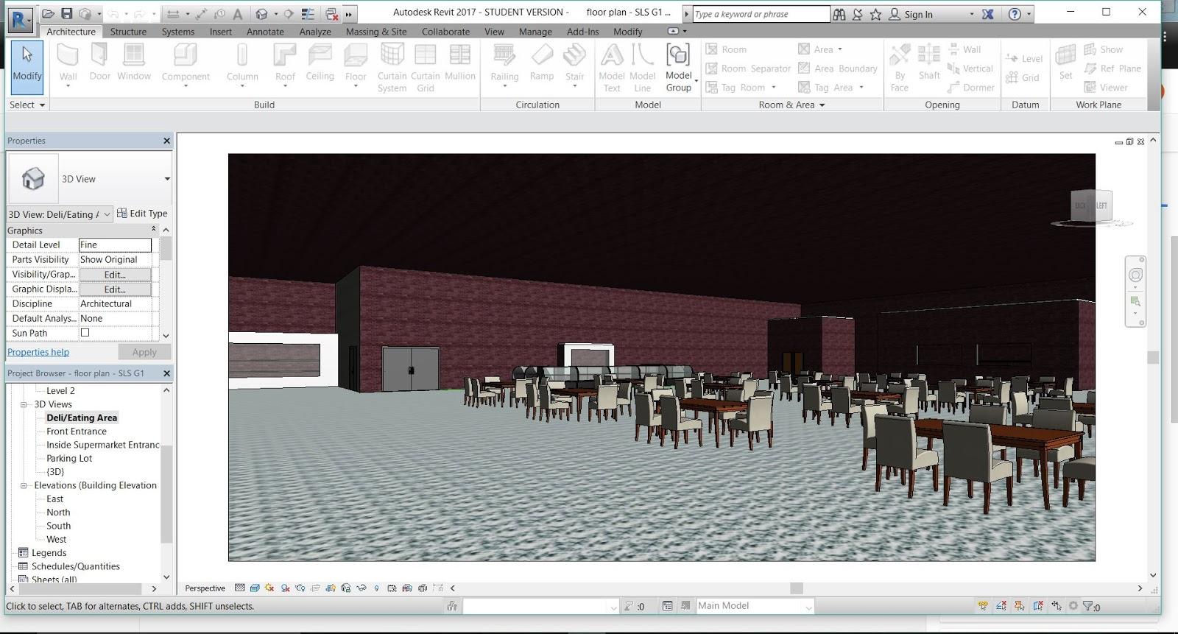
SLDP Options
NYU Housing and Innovation in Revit
Create a 3D Revit Model of a
college campus extension to
NYU Tandon
Plan utilities layout
      Electrical system
      Plumbing system
      HVAC system

Slide 30
SLDP Options
Housing and Innovation in Revit (HIR)
Benchmark A
  One recreational space design
  One 20-student classroom design
  One 40-student classroom design
Benchmark B
  Everything from Benchmark A
  All classroom designs
  Facility of choice
  Electrical, plumbing, and HVAC for one dorm

Slide 31
SLDP Options
Housing and Innovation in Revit (HIR)
Commission:
Revit drawings
  Floor plans for all floors (minimum 6)
  Plumbing system
  Electrical system
  HVAC system
  Front elevation
  Most detailed side
  Gold LEED certification
Model of Building:
  3-D Revit model (in software)
Extra Credit:
  3-D printed exterior of building
  Platinum LEED certification

Slide 32

SLDP Options
Housing and Innovation in Revit (HIR)
LEED Description:
Leadership in Energy & Environmental Design (LEED) is a green building certification program
Different levels of certification
  LEED Silver (2 categories)
  LEED Gold (4 categories) - Mandatory
  LEED Platinum (All 6 categories) – Extra Credit
Teams choose the ones that best fit their design

Slide 33
SLDP Options
Housing and Innovation in Revit (HIR)
LEED Categories:
Location & Transportation
Sustainable Sites
Water Efficiency
Energy & Atmosphere
Indoor Environmental Quality
Innovation

Slide 34
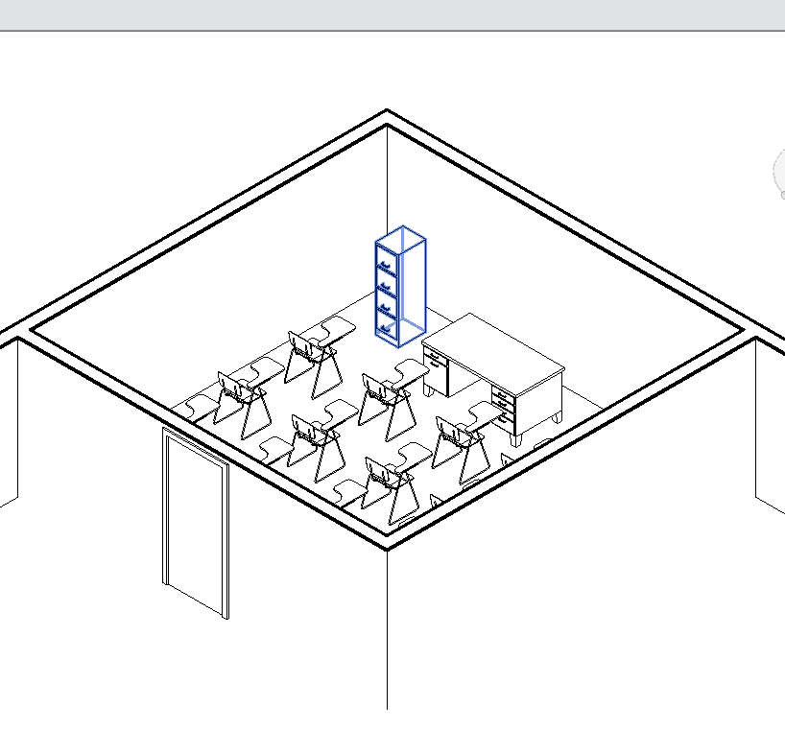
SLDP Options
Housing and Innovation in Revit (HIR)
Examples:

Slide 35
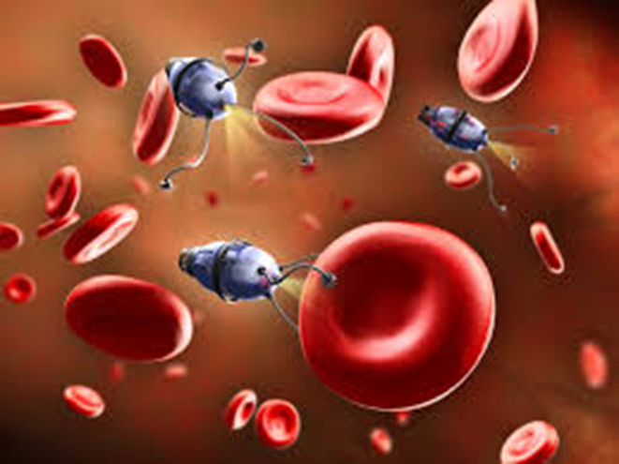
SLDP Options
Nanorobotics Challenge
Develop an autonomous nanorobot that can:
  Travel through the bloodstream
  Diagnose health issues
  Cure diseases

Slide 36
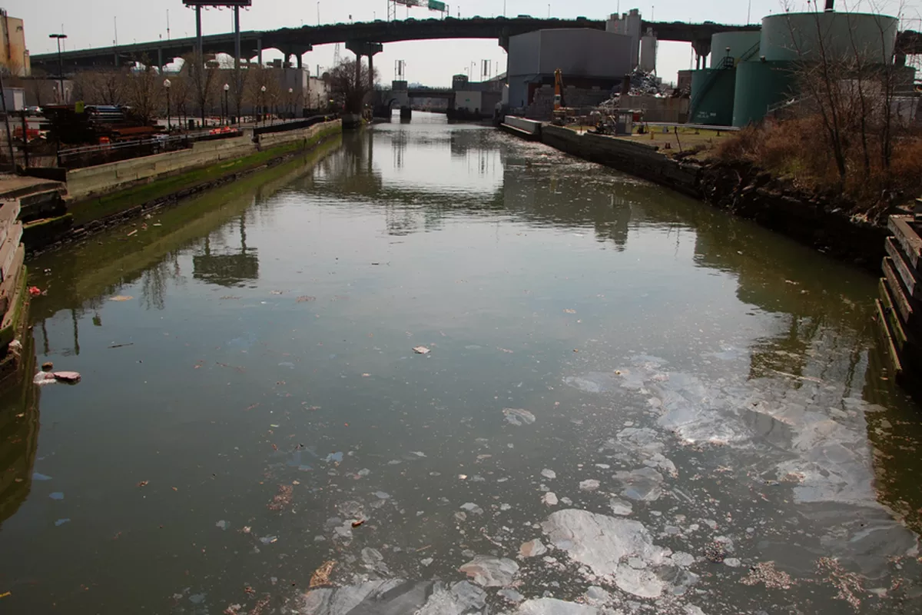
SLDP Options
Nanorobotics Challenge (NRC)
Jesse swam in Gowanus Canal
  Program nanorobot to detect, find, and cure his illnesses
Jesse is represented by light-up skeleton in EG Modelshop
Interact with nanorobot via HTTP API

Slide 37
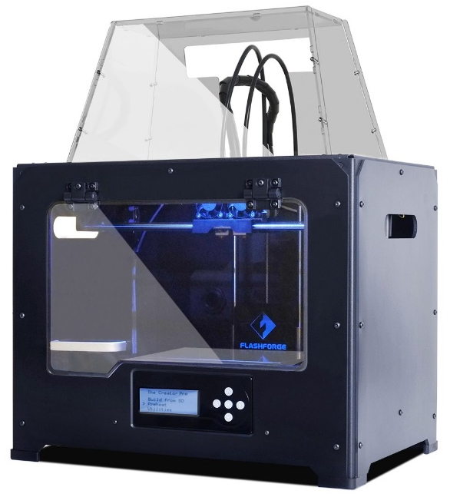
3D Printing Extra Credit
Design your own SLDP team logo
  Due by Milestone 2 Presentations
Be creative with your design
  Design must be approved by a Prototyping Lab TA
  Cannot be only text like Lab 1
  Multiple colors are available: purple, black, white,
  yellow, red, green, pink, light blue, blue, clear
  More info on 3D Printing Extra Credit page on lab manual

Slide 38
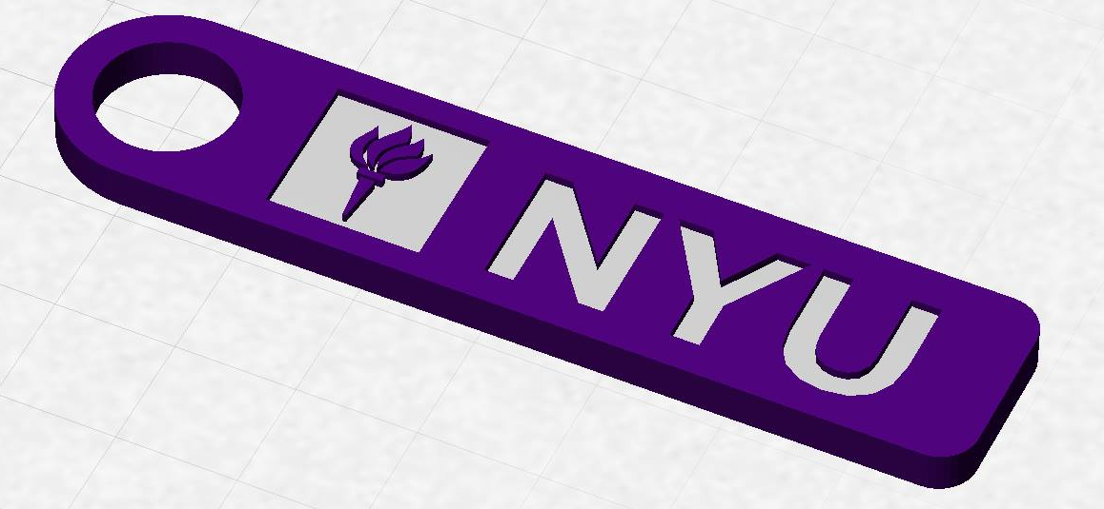
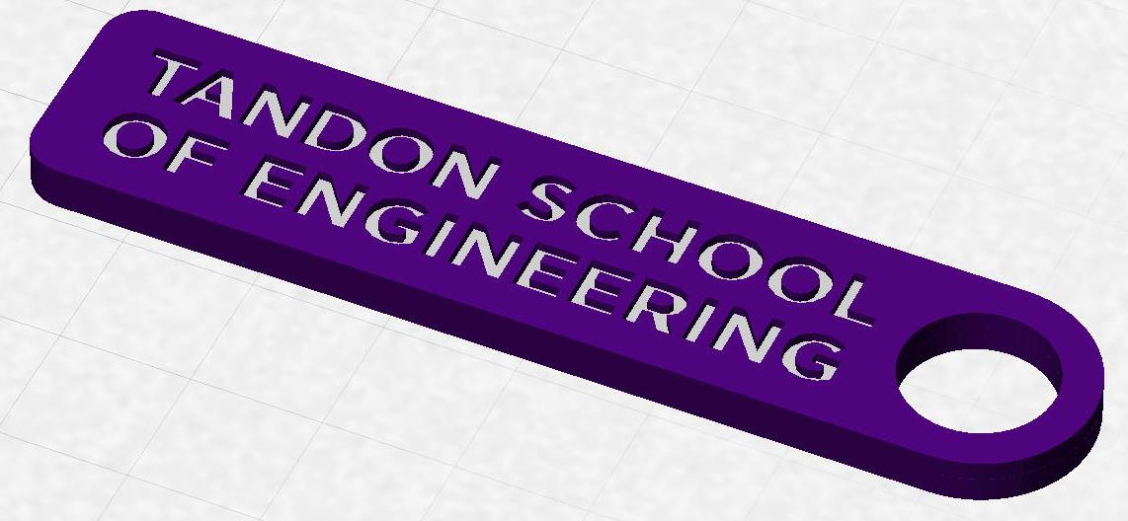
3D Printing Extra Credit
Constraints:
  Maximum weight of 15 grams
  No copyrighted logos
  Must be attached to robot or worn
  as pin during Final Presentation

Slide 39
3D Printing Extra Credit ADVANCED
Create a prototype of a custom, 3D-printed robot part or terrain modification (robots), or model of building (HIR)
Constraints:
  Due by Milestone 2 Presentations
  YOU MUST HAVE A CONTINGENCY PLAN if the piece does not
  work or cannot be printed
  For full list of constraints see the 3D Printing Extra Credit page on lab manual
You can receive one-on-one instruction in the EG Prototyping Lab, but you may also print parts in the MakerSpace with ProtoLab approval

Slide 40
3D Printing Extra Credit Submission
Submit your design at eg.poly.edu under the
3D Printing Submission tab
  Your first submission is due by Milestone 2
  Your design(s) must be a .stl file
  After your submission has been received you will be contacted by a TA to come start your print

Slide 41
Closing
Refer to manual.eg.poly.edu for details
Think about which project interests you
Brainstorm ideas
Speak with professors and TAs regarding projects

Slide 42

Semester-Long Design Project
QUESTIONS?

