Slide 1

RECITATION 11
EG1003

Slide 2
AGENDA
Data Visualization
Snowball Effect
1

Slide 3
DATA VISUALIZATION
Notes:
Beyond classic examples of data visualization in charts, data visualization is the core of a continuously growing snowball that allows engineers to ideate and innovate.

Slide 4
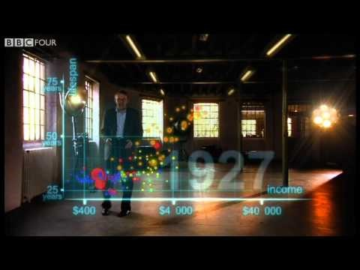
Recitation 11 Intro

Slide 5
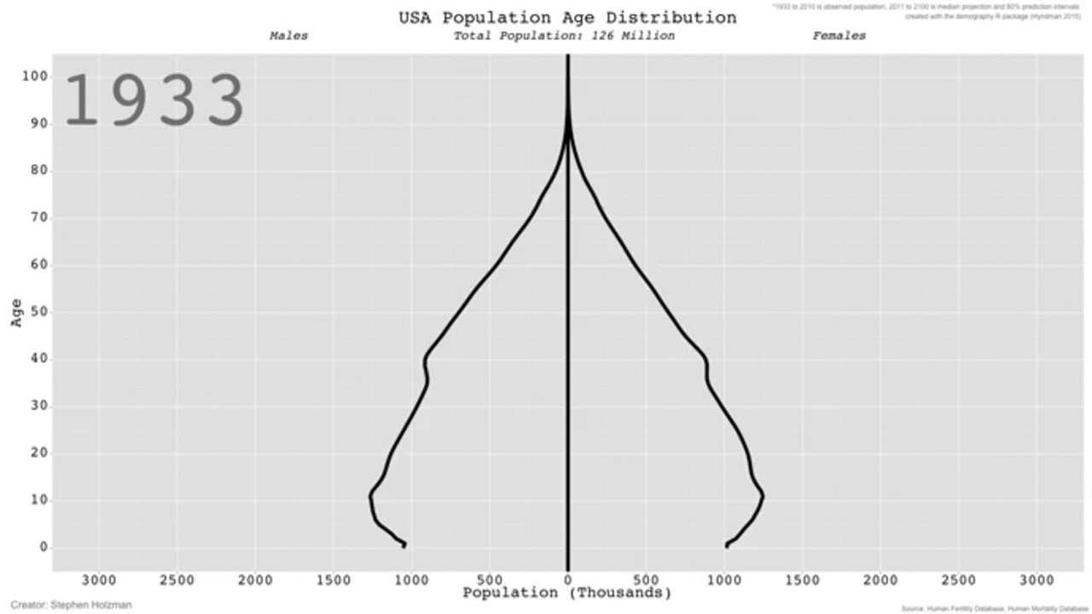
UNCERTAINTY & TIME
Figure 1: Population age distribution over time
4

Slide 6
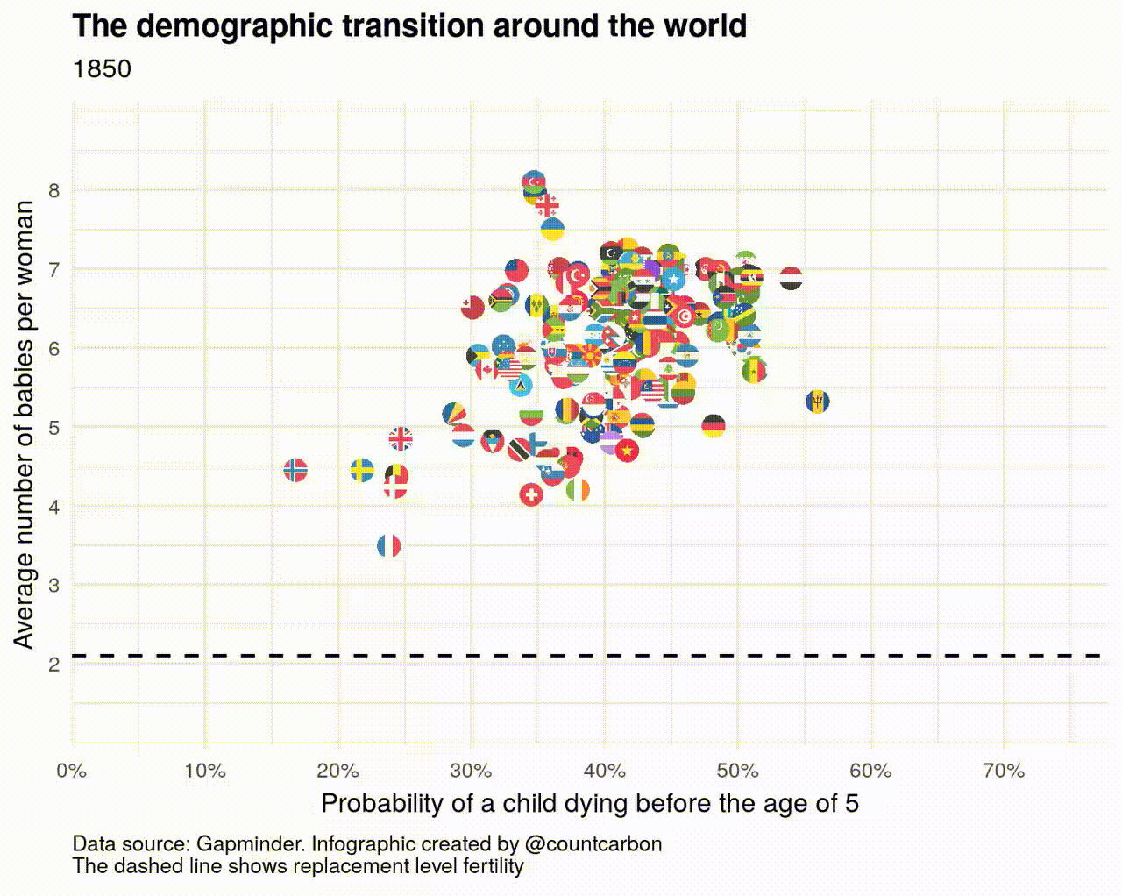
TRENDS & PATTERN RECOGNITION
Figure 2: Demographic transition around the world
5

Slide 7
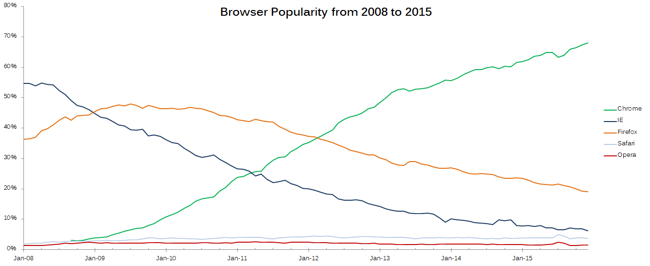
EXAMINING RELATIONSHIPS
Figure 3: Browser popularity over time courtesy of Reddit
6

Slide 8
THE SNOWBALL EFFECT OF DATA VISUALIZATION
Notes:
Beyond classic examples of data visualization in charts, data visualization is the core of a continuously growing snowball that allows engineers to ideate and innovate.

Slide 9
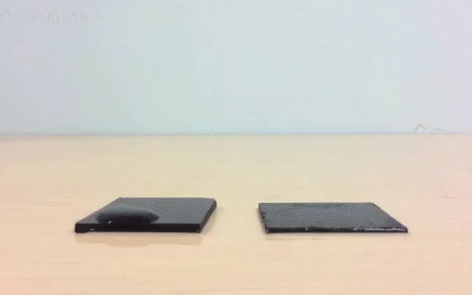
EXPLAINING CONCEPTS
8

Slide 10
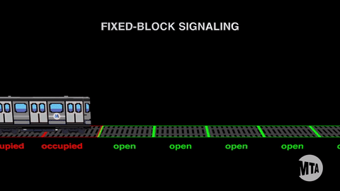
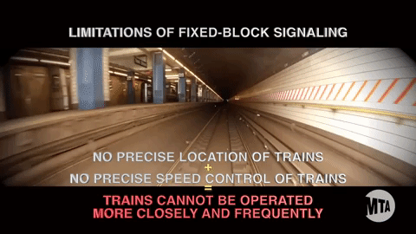
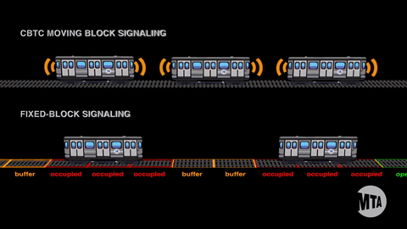
IDENTIFYING PROBLEMS
Learn More
9

Slide 11
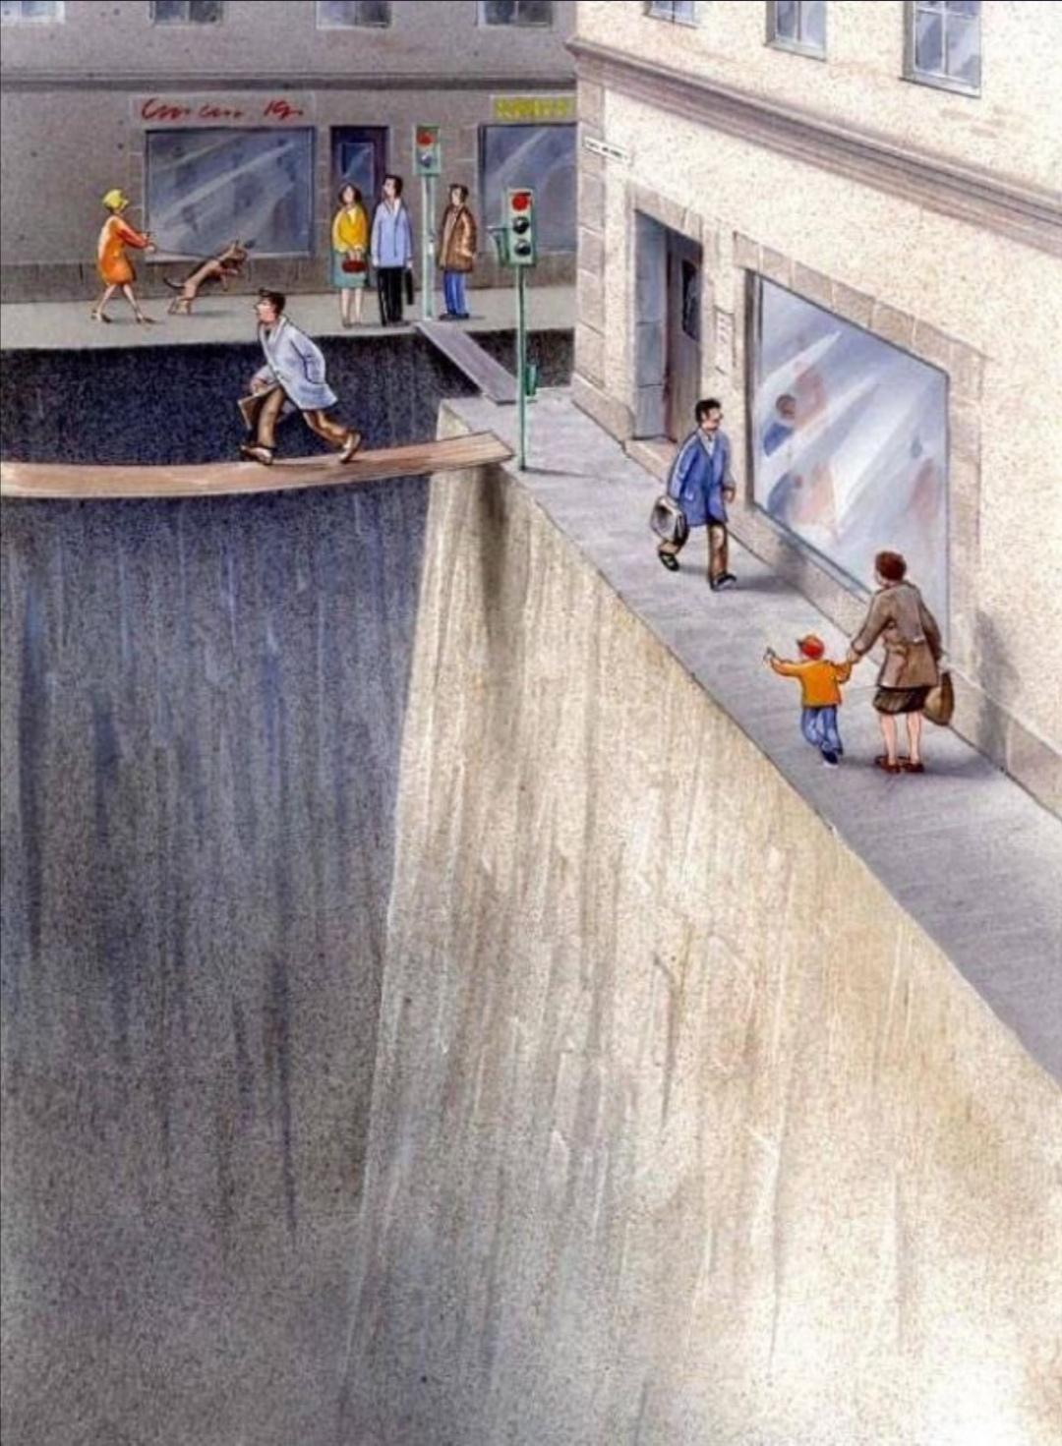
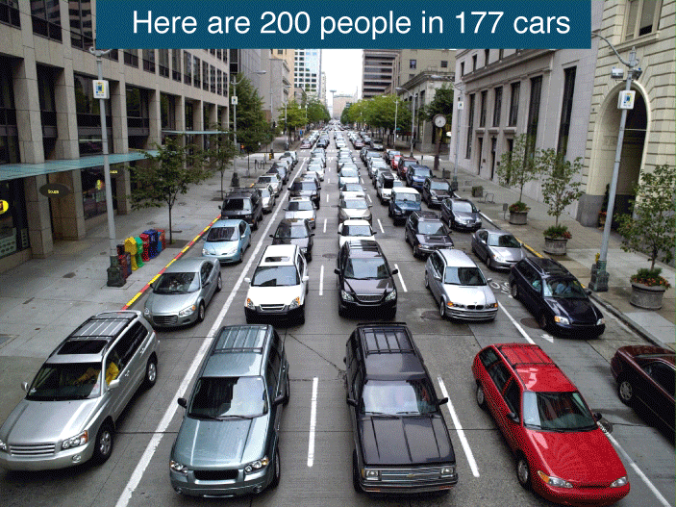
USE DIFFERING PERSPECTIVES
10

Slide 12
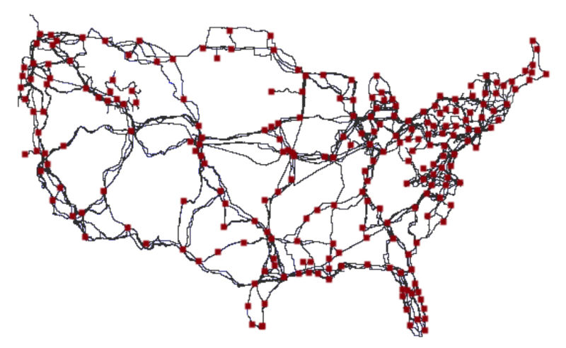
DATA COLLECTION
Figure 4: Image courtesy of Gizmodo
11
Notes:
**Ask students what they think this map shows** Answer: Major Internet Cables

Slide 13
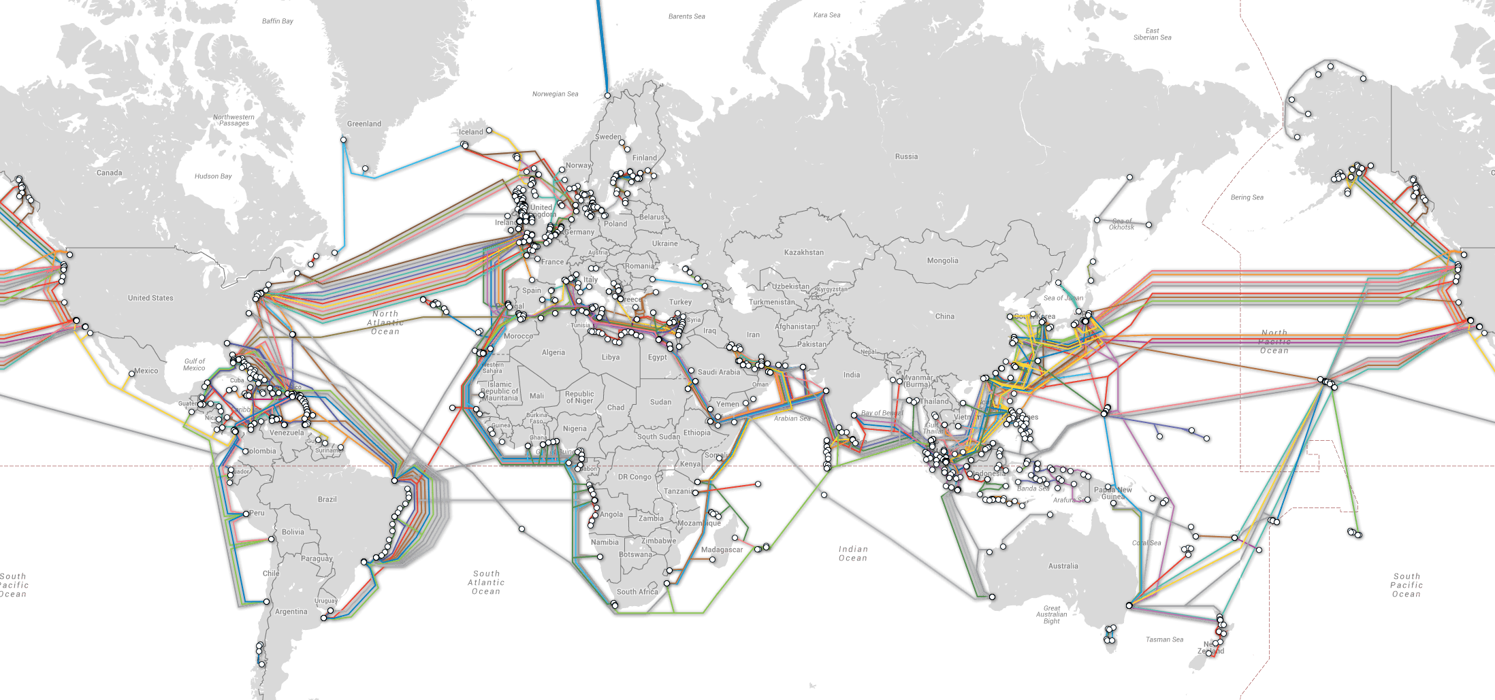
DATA MANAGEMENT
Figure 5: Image courtesy of Reddit
12
Notes:
**Ask students what they think this map shows**

Slide 14
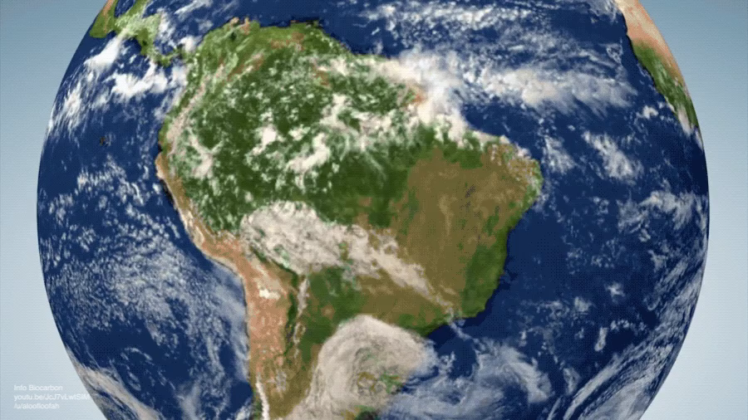
INNOVATIVE SOLUTIONS
13
Notes:
**Ask students what they think this map shows**

Slide 15
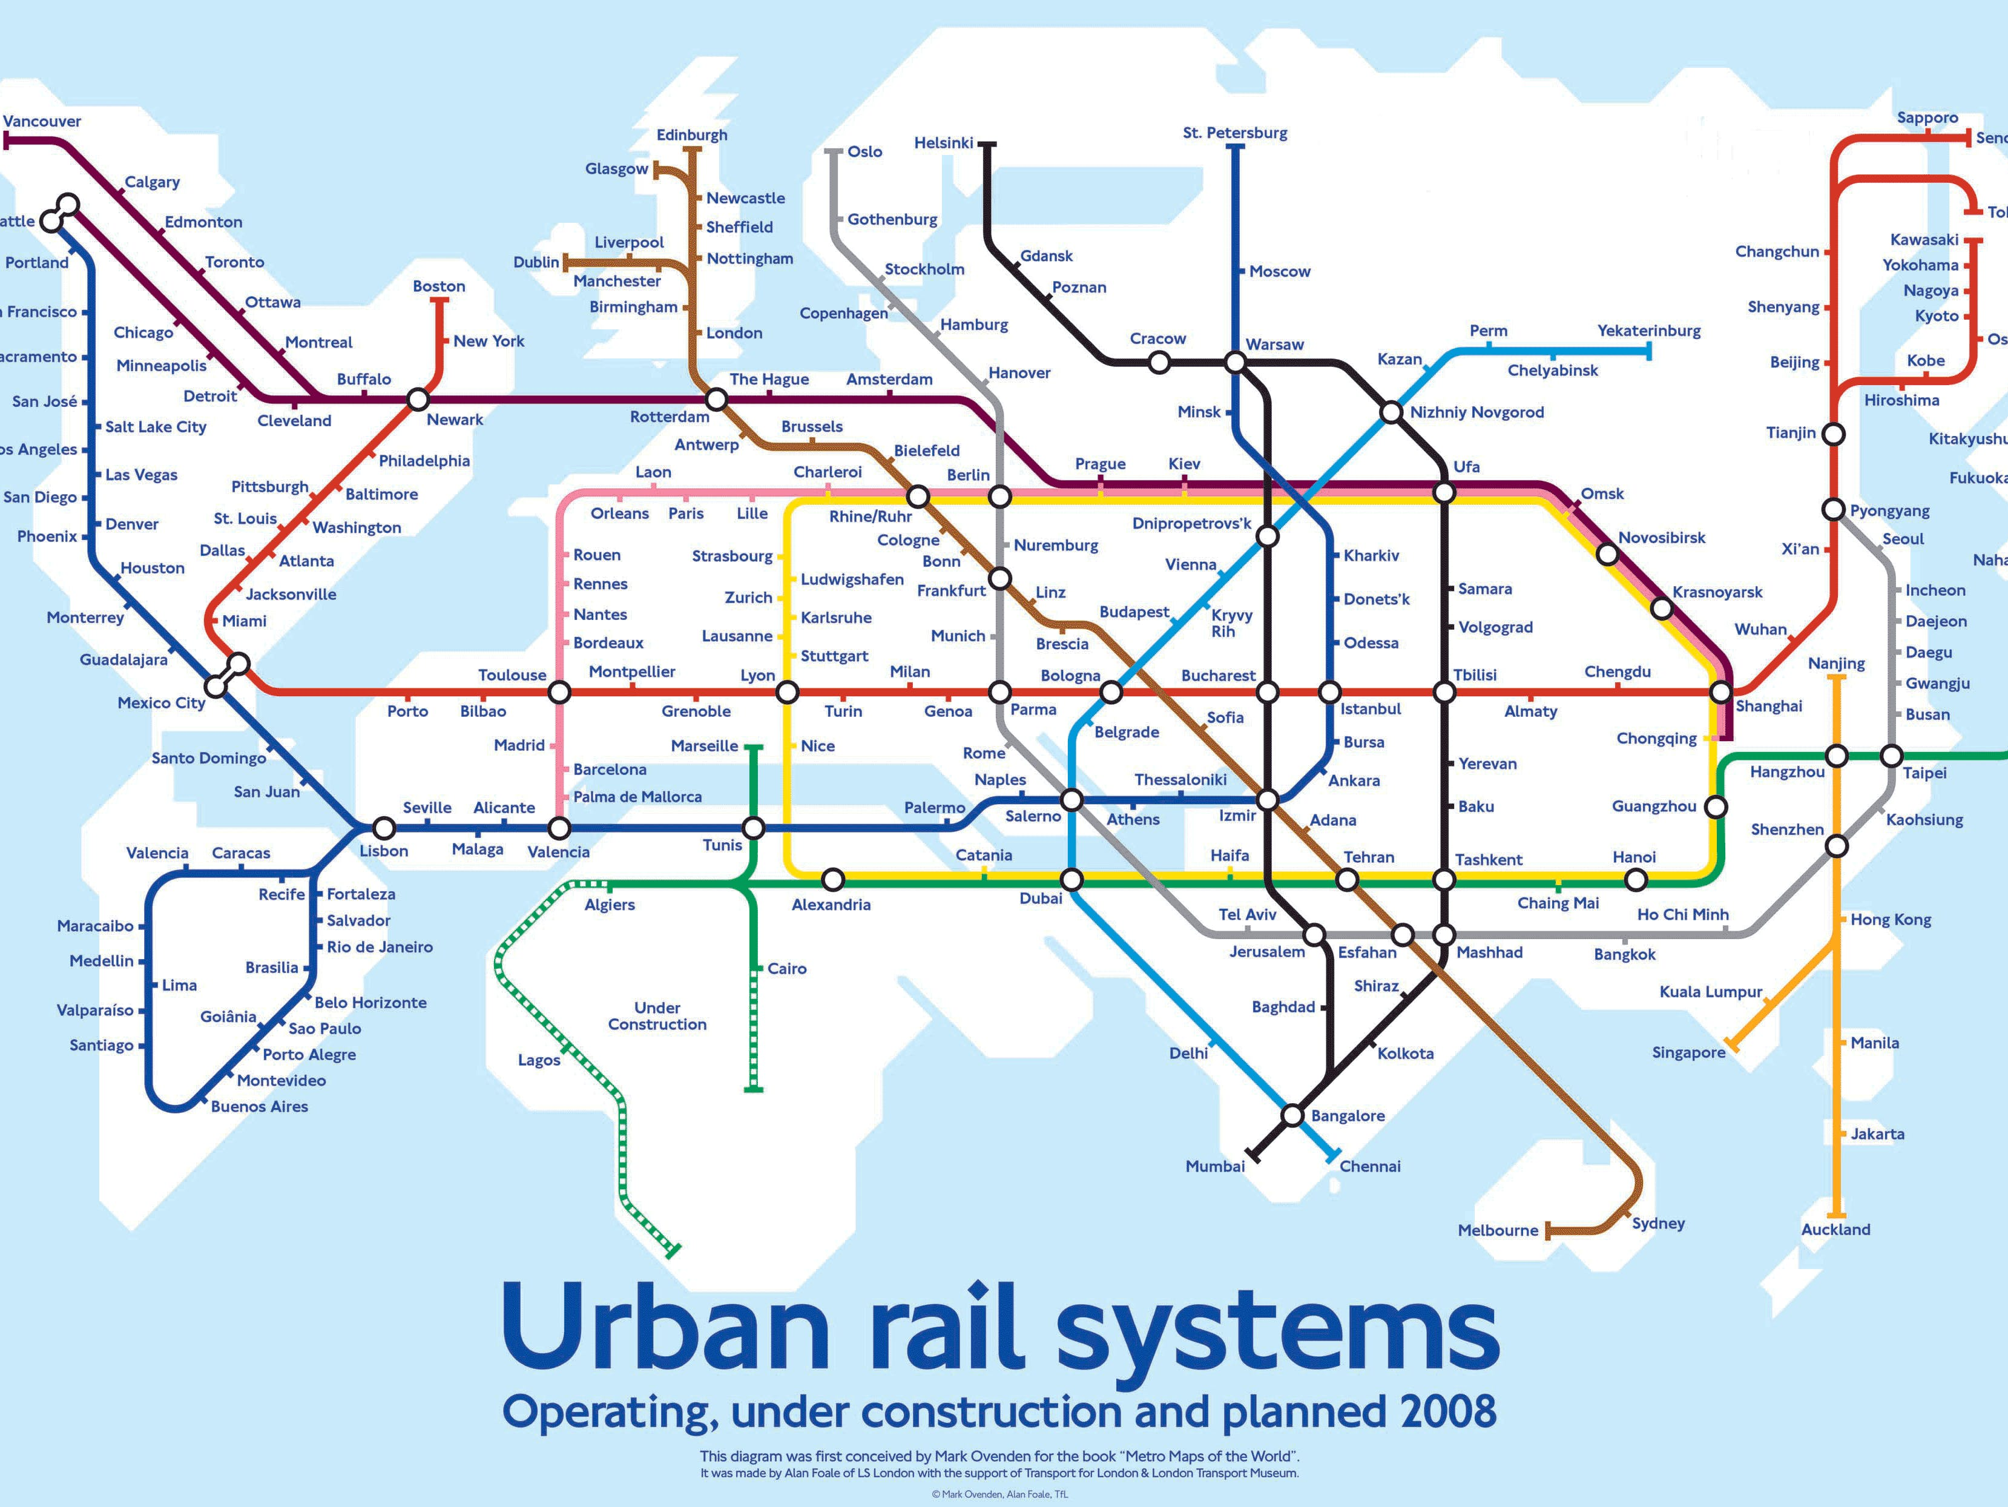
NOVEL IDEAS
Figure 6: Urban rail system
14

Slide 16
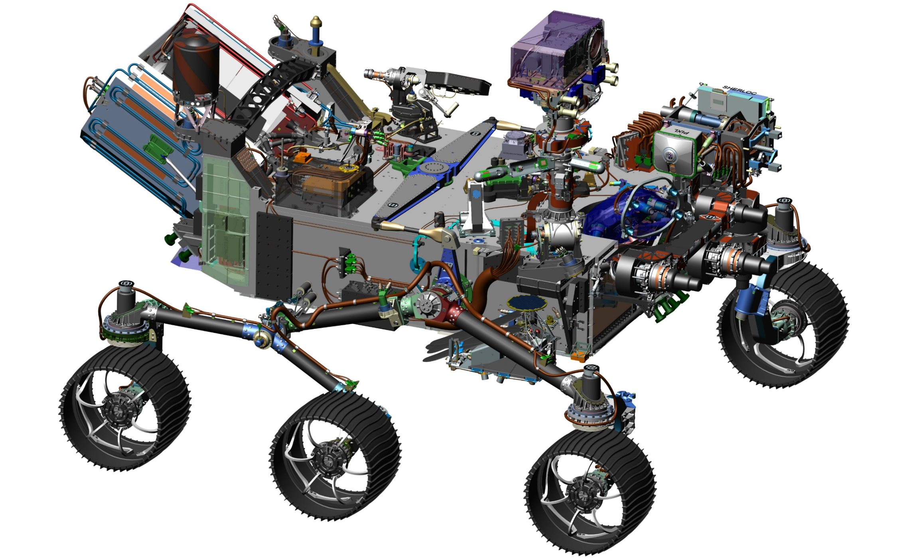
SPECIFICATIONS, DIMENSIONS, PRODUCTION
15

Slide 17
QUESTIONS?

