Slide 1

Lemon Car Competition

Slide 2
Overview
Experimental Objective
Background Information
Materials
Procedure
Assignment
Conclusion

Slide 3
Experimental Objective
Determine potency of reducing agents
Create chemical cells to generate electricity
Use capacitors to store/release energy
Build car powered by chemical reaction

Slide 4
Background Information
Fundamental ideas
Redox (reduction/oxidation) reactions
Batteries
Designing citrus cell batteries
Capacitors

Slide 5
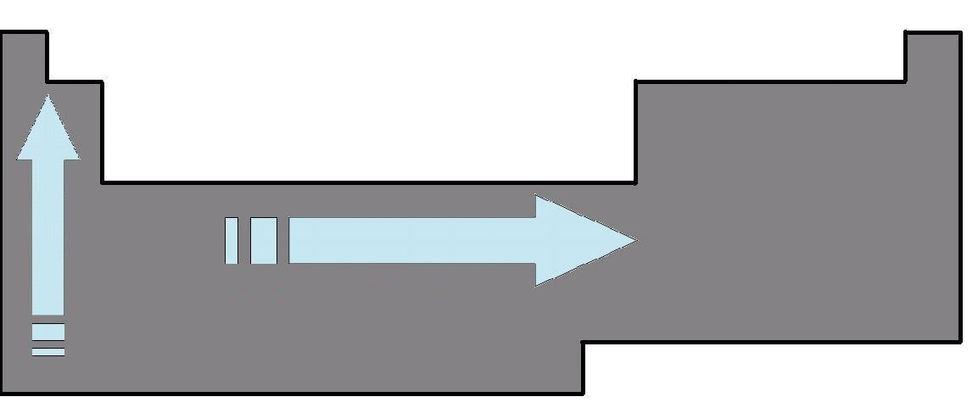
Fundamental Ideas
Electronegativity: measure of element’s attractions of another’s electrons
Ionization energy: energy to remove electron from atom and form a cation
Both properties
Increase:
left to right
bottom to top

Slide 6
Redox Reactions
When a reaction can be separated into oxidation and reduction:
Oxidation: electron loss
  ex: Mg → Mg⁺² + 2e⁻
Reduction: electron gain
    ex: O₂ + 4e⁻ → 2O⁻²

Slide 7
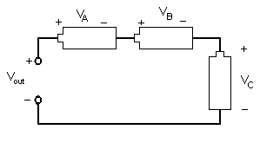
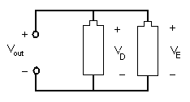
Batteries
Battery arrangement
  Series circuit increases voltage
  Parallel circuit increases current

Slide 8
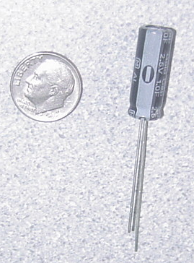
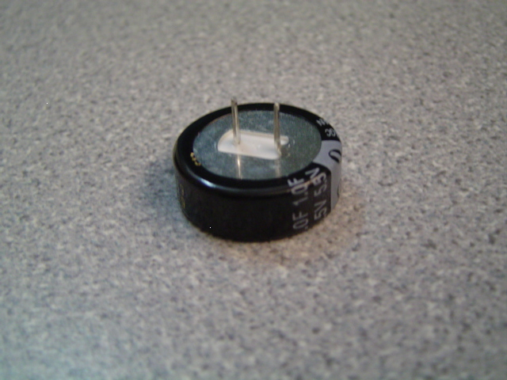
Capacitors
Store electrical energy
1F (Farad) Polarized Capacitor
Positive
Negative

Slide 9
Capacitor Charging
Capacitor charge limit is restricted by charge voltage
Maximizing applied voltage maximizes energy stored
Capacitor is charged in time increments called the time constant (tau):
τ =RC
R=resistance C=capacitance

Slide 10
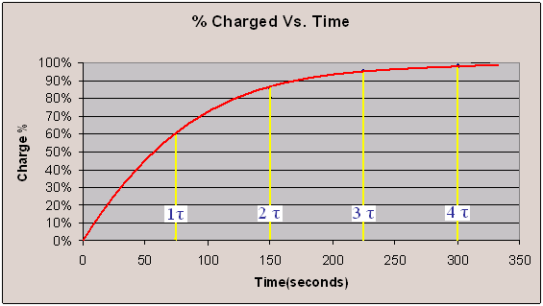
Percentage Charged
Charge is logarithmic
  It takes approximately 4τ to charge the capacitor
  Ex:

Slide 11
Designing of Citrus Cells
A citrus cell/battery
  Uses two different electrodes
  Citrus acid used as electrolyte

Slide 12

Electrolytic Solutions
Non-metallic part of circuit
Electrolytes dissociate free ions to create an electrically conductive solution
Lemon juice used as electrolyte

Slide 13
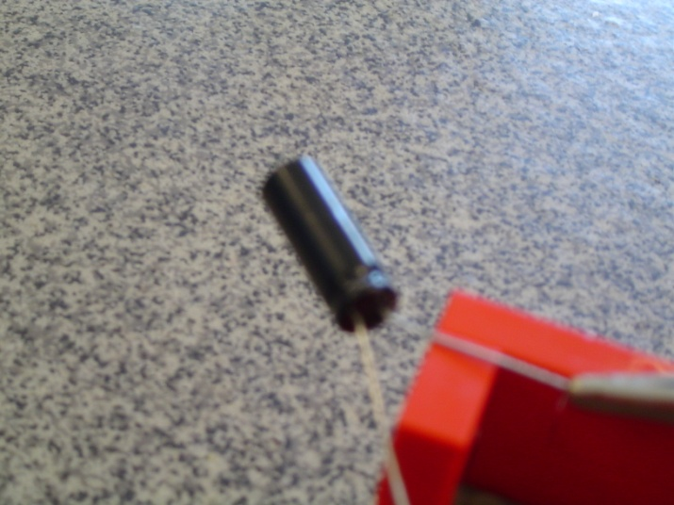
Materials
Lemons
Lemon Juice
Magnesium
Copper
Zinc
Nickel
Aluminum
3 Alligator Cable Sets
1 Farad 5.5v Capacitor
Standard Lego Car Chassis
Lego to Alligator Cable Clip Connector
Light Emitting Diode (LED)
Small Cups
Scissors
Tape
DMM (Digital Multi Meter)
Large Plates
Sandpaper

Slide 14
Procedure
Part 1
  Determine voltage potential of electrodes
  Determine positive and negative poles
Part 2
  Light up LED using two lemon cells with most potent electrode pairs
Part 3
  Decide on the power source
  Chemical cell or capacitor
  Design/Build your car to accept power source

Slide 15
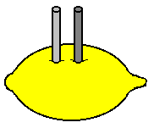
Procedure
Part 1
  Acquire Material
  Squeeze/roll lemon
  Insert electrodes into lemon 0.5cm from each other
  Connect electrodes to DMM
  Record Voltage
  Determine polarity of lemon cell

Slide 16
Procedure
Part 2
  Create second citrus cell
  Connect two citrus cells in series
      Attach to LED
      Is it lit?

Slide 17
Procedure
Part 3
  Choose your electrodes (remember cost)
  Design your power source
      Chemical or capacitor
    Design car for power source
      Allow 15 min for capacitor to charge
    Create a sketch/pricelist
    TA must sign your work
    Enter competition

Slide 18
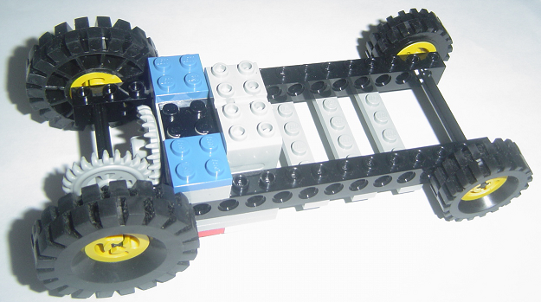
Competition
Factors that will effect the CR (Competition Ratio) are:
  Distance (linear) traveled in a max of 60 seconds
  Cost of components
Cost List
Item | Cost
Capacitor | $1.00
2oz Lemon Juice (with cup) | $0.25
1.5" Mg Strips | $1.00
Cu Strip | $0.25
Zn Strip | $0.50
Al Strip | $0.25
Ni Strip | $0.25
Lemon Car Components | $0.00

Slide 19
Assignment: Report
Team report
Title page
Discussion topics in the manual
Scan in data and lab notes
  (ask TA for assistance)

Slide 20
Assignment: Presentation
Team presentation
Include photos of the lemon car
Explain how the battery works

Slide 21
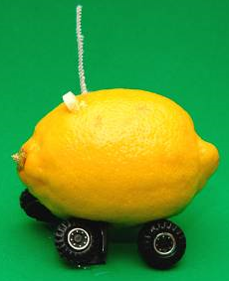
Conclusion
Return all electrodes to TA
Clean up all materials
Tas will tabulate competition results
Extra credit awarded according to manual

