Slide 1
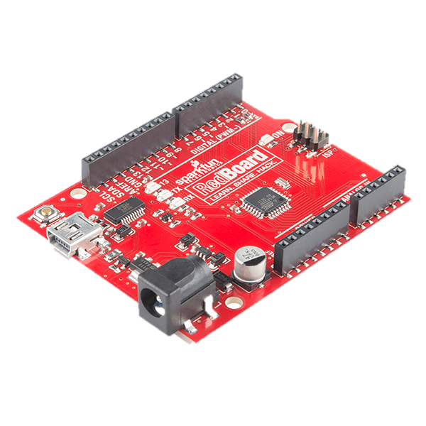
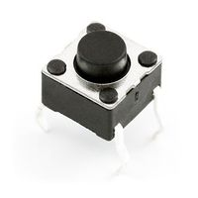
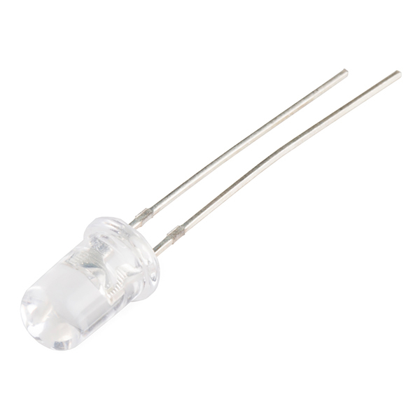
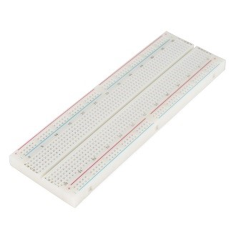
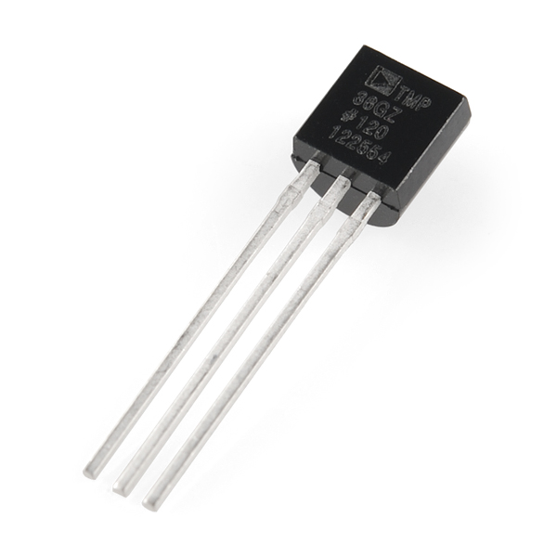
Prototyping with Microcontrollers
and Sensors

Slide 2
Overview
Objective
Background Information
Problem Statement
Materials
Procedure
Assignment
Closing

Slide 3
Objective
Demonstrate basic principles of electricity,
breadboarding, and Arduino programming

Slide 4
Background Information
Electricity
Movement of electrons
Electrical voltage: difference in charge
Measured in Volts (V)
Electrical current: movement of electrons in a conductive wire when there is a difference in charge between two points in the wire.
Measured in Amperes (A)
Flows opposite of the electrons
Electrical resistance: certain materials resist a flow of electrons
Measured in Ohms (Ω)

Slide 5
Ohm’s Law
V = I * R
Mathematical relationship between current, voltage and resistance
Only when you have a resistor!

Slide 6
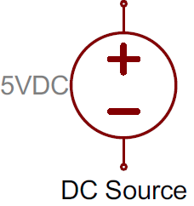
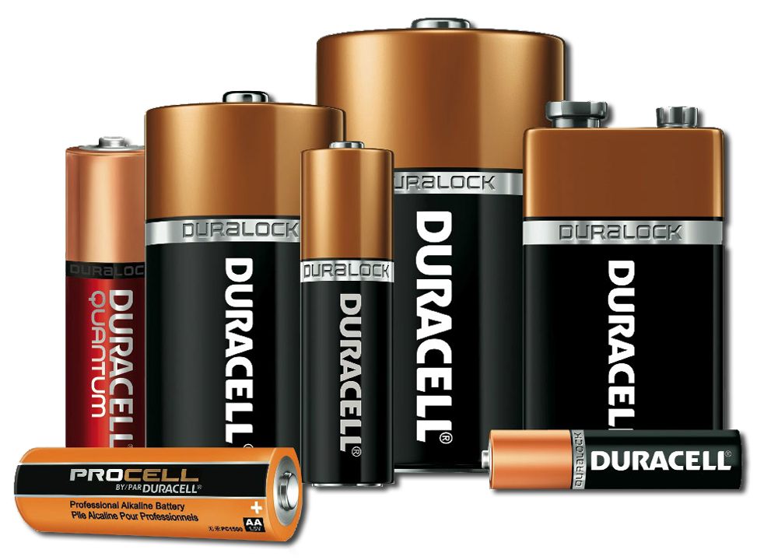
Electronic Components
DC (Direct Current) Voltage Sources
Power circuits because they have a voltage difference across their terminals
Usually batteries (AA, AAA, etc.)
Polarized

Slide 7
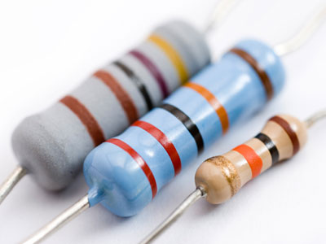
Electronic Components
Resistors: components that reduce the amount of current flowing through a circuit
Convert the excess current to thermal energy
Can be used to control voltages and currents
Color-coded with their resistance
Not polarized

Slide 8
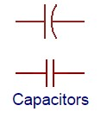
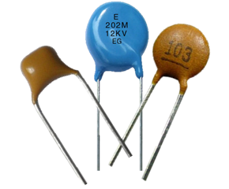
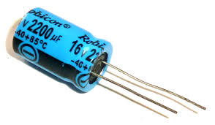
Electronic Components
Capacitors: store energy in an electrical field and then
dissipate it at a later time
Capacitance: measure of how much charge a capacitor can store
Measured in Farads (F)
Resist voltage changes by supplying or drawing current
Sometimes polarized!

Slide 9
Electronic Components
Inductors: store energy in a magnetic field and then
dissipate it at a later time
Inductance: measure of how much energy an inductor can store
Measured in Henries (H)
Resist current changes by dropping or increasing the voltage across itself
Not polarized

Slide 10
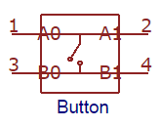
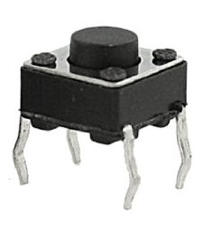
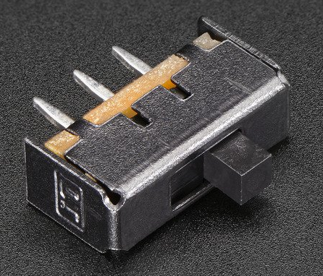
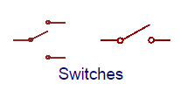
Electronic Components
Push Buttons and Switches: mechanical devices that
interrupt or divert current running through them
Basic push buttons are polarized
Basic switches are not polarized

Slide 11
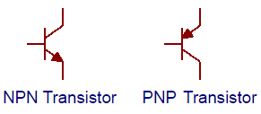
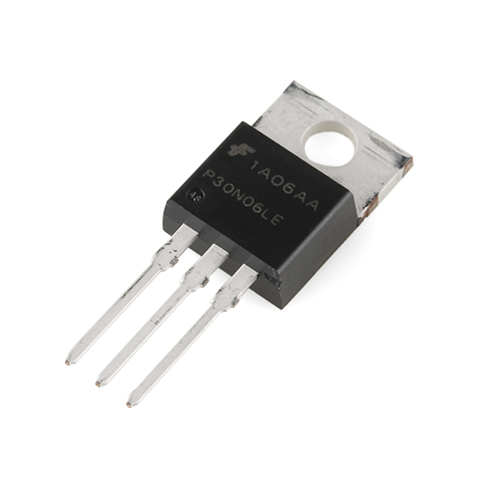
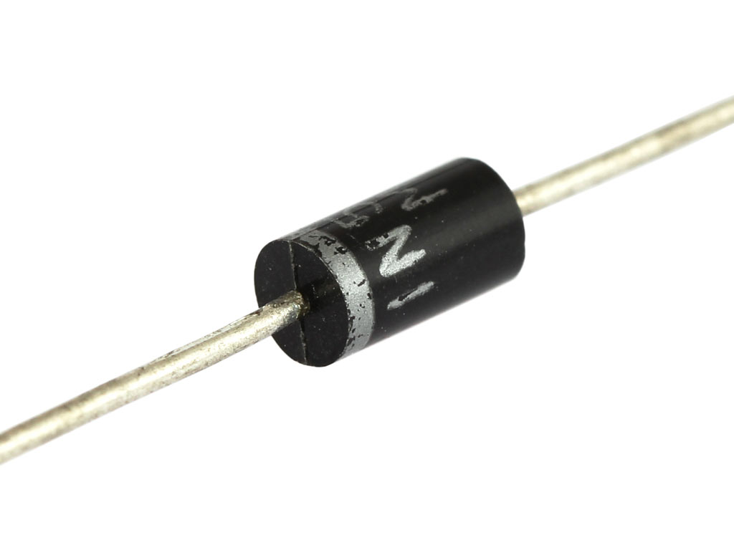
Electronic Components
Diodes and Transistors (BJT/MOSFETS)
Diodes are components that allow current to only pass in one direction
MOSFETs are electrical components that act as electrically controlled switches

Slide 12
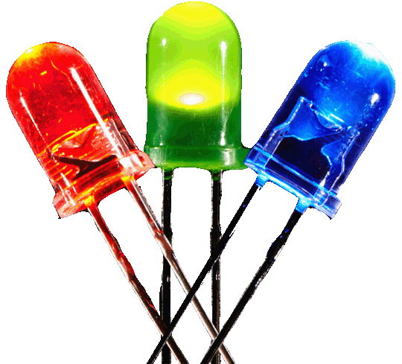
Electronic Components
Light Emitting Diodes (LEDs): small electric lights
which can be lit very brightly with fairly low voltages and
currents
Diode! Orientation matters!
Usually require a resistor (typically 220 Ω or 470 Ω)
Polarized!

Slide 13
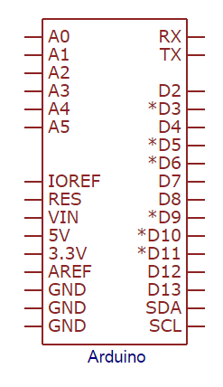
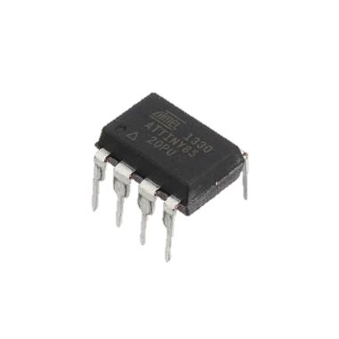
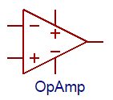
Electronic Components
IC (Integrated Circuit) Chips: contain small electrical
circuits inside them to usually carry out one specific
purpose
Come in all shapes, sizes, and specifications
Comparators (they compare two different voltages)
Op-Amps (they amplify low voltage signals)
Timers (they switch between high and low voltages quickly to time other devices)
IC chips ARE polarized

Slide 14
Electronic Components
Analog vs. Digital Signals
An electrical signal is any quantifiable quantity that can carry information using electricity
Digital Signals Analog Signals
Have two discrete states: LOW and HIGH When signal is LOW, most devices output a voltage level of 0V. When signal is HIGH, most devices output a voltage level of 5V (or 3.3V) | Infinite amount of voltage values The range 0V-5V is mapped to the range 0-1023 Example: Value 255 = ~1.246V Many electronic components are inherently analog

Slide 15
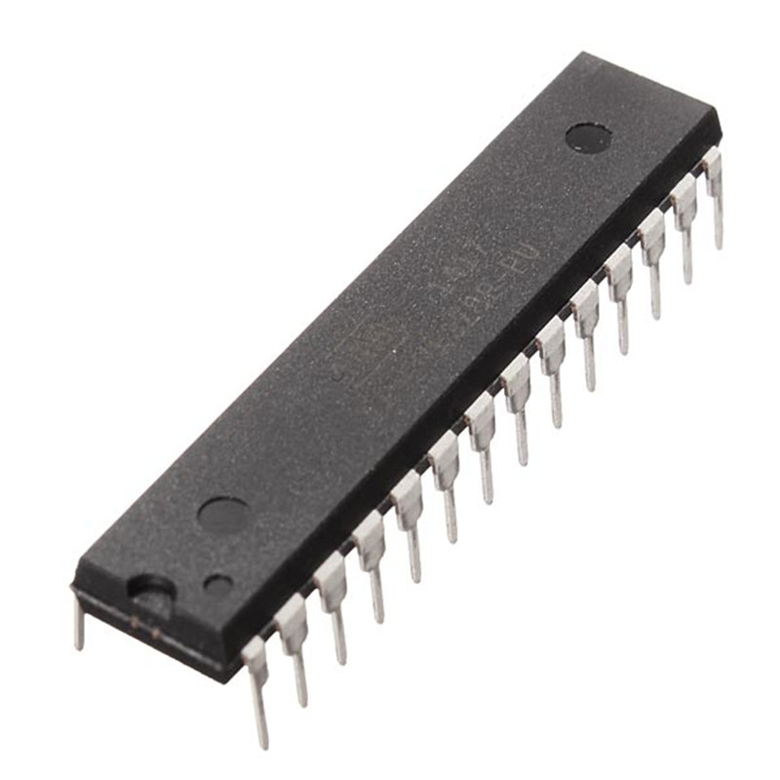
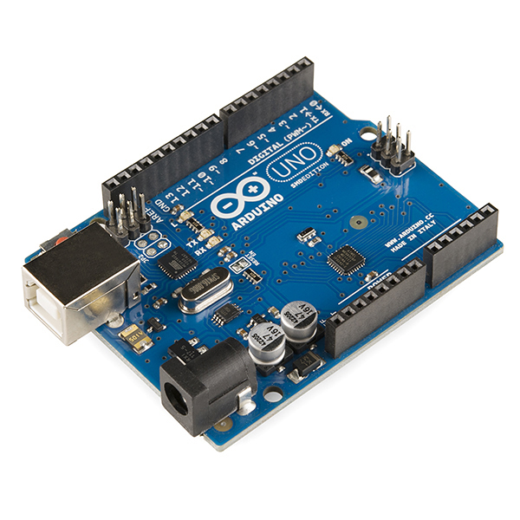
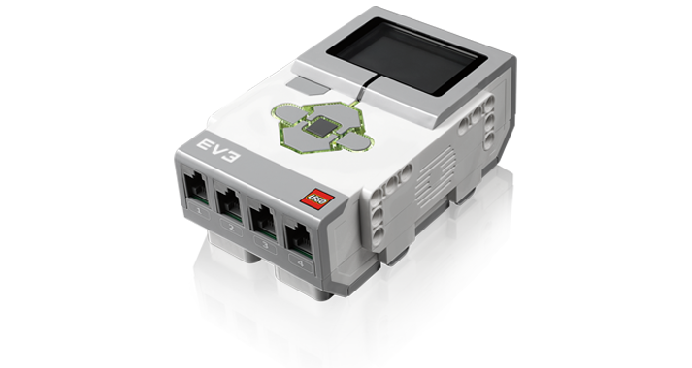
Microcontrollers
Microcontrollers: cheap, programmable computers
without any of the peripherals (such as a mouse,
keyboard, or a screen)
Have direct access to the input and output pins
Reads from sensors and perform actions accordingly.
Are present in many electrical appliances (such as microwaves)

Slide 16
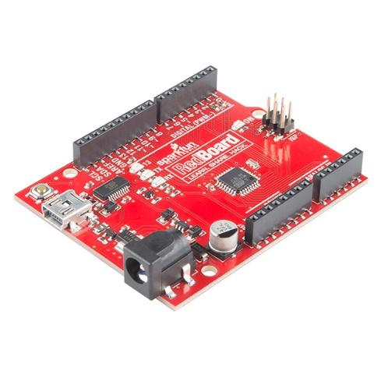
We will be using an Arduino UNO board created by Sparkfun for this lab

Slide 17
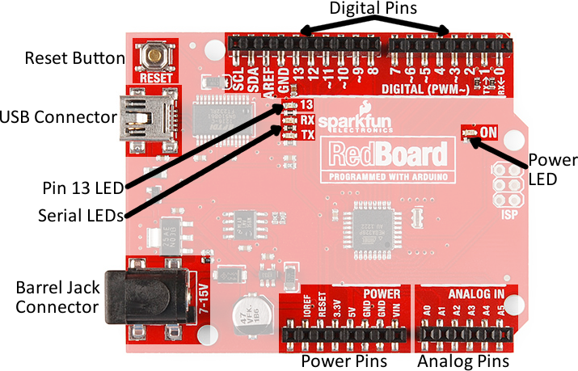
Arduino Hardware
Overview of the RedBoard
Reset Button: restarts the Board
USB Connector: will provide power and connect it to the computer
Pin 13 LED: an LED you can use without making an LED circuit
Serial LEDS: shows if the Arduino is transmitting or receiving data from pins 0, 1 or the USB connection

Slide 18
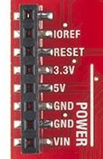
Power Pins
Power Pins
3.3V: Usually used to power low-voltage sensors
5V: Most common power pin used to power your circuits
GND: Ground pin which is 0V
VIN: Voltage-In can be used to power the
board using a battery

Slide 19
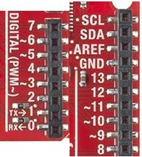
I/O Pins
I/O Pins
A0-A5: identical analog pins that can be used to read sensors or control analog devices
Pins A0-A3 are more stable than A4-A5
Pins 0-1: transmit and receive pins, don’t use these pins for this lab
Pins 2-12: digital pins that can be switched between HIGH states and LOW states
Pin 13: connected to the on-board LED

Slide 20
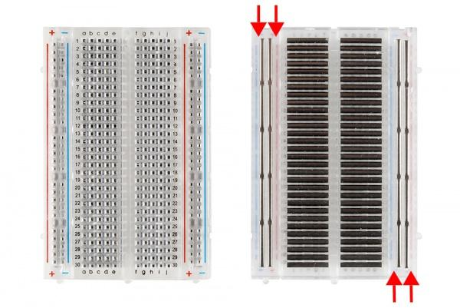
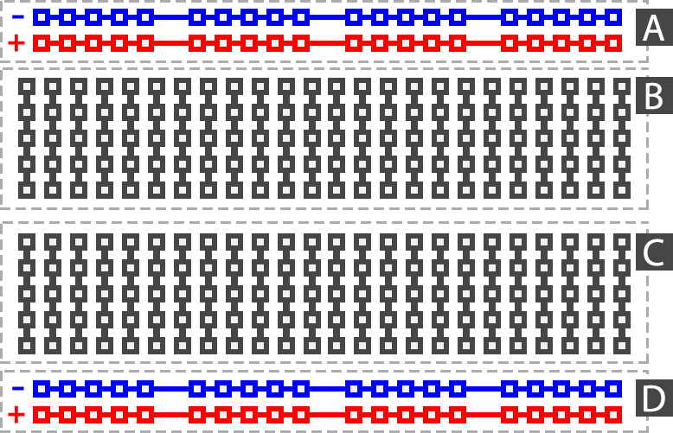
Building Circuits on a Breadboard
Breadboards: are small boards that are commonly used for circuit prototyping

Slide 21
Arduino Programming
The Arduino programming language is based on C/C++, but it is designed to be simpler and easier to learn.
The most intuitive way to think about programming is like building with LEGO blocks: you are given certain rules you have to follow and different building blocks to use.

Slide 22
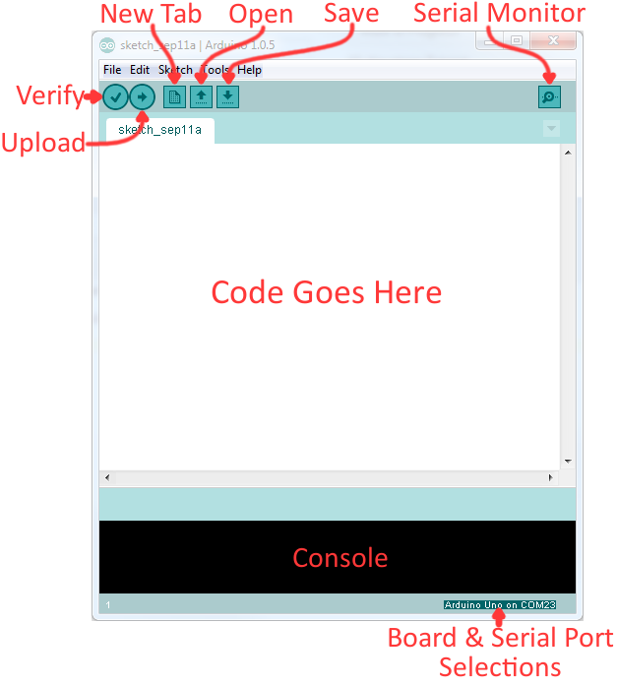
The Arduino IDE
Verify: checks your code for errors and points to where the errors occurred
Upload: verifies and sends your code to the Arduino board if there are no errors
Console: shows you any errors the software found in your hardware
Serial Monitor: a tool you can use to see how your program is running

Slide 23
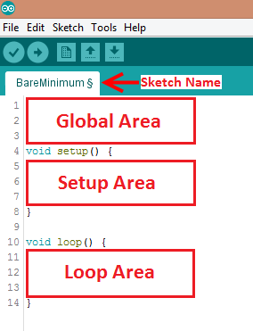
The Arduino IDE
Programs written in Arduino
are called sketches with 3 different areas:
Global: Important variables, constants and imported libraries go here
Setup: activate the pins and sensors used (this code only runs once)
Loop: the code that runs continuously (reading sensors and turning pins HIGH or LOW)

Slide 24
The Rules and Building Blocks
General
Every line must either end with a semicolon ‘;’ UNLESS it’s a conditional, loop, function or imported library
Comments start with a //
Comments are text that the program ignores
Used to label and explain code

Slide 25
Constants and Variables
Variables store different types of data (numbers, letters, sentences, etc.)
Variables change what data they hold through mathematical operations
Constants cannot change their value after it has been assigned

Slide 26
Datatypes

Slide 27
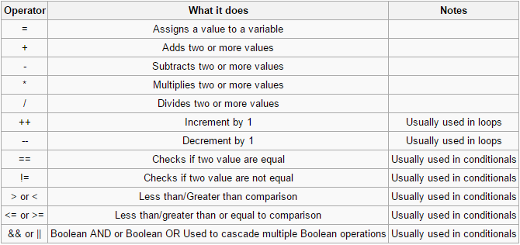
Operators

Slide 28
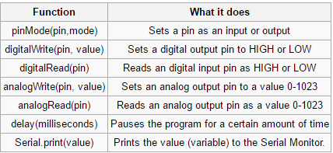
Common Functions

Slide 29
Materials and Equipment
Arduino UNO microcontroller and USB cable
Computer with Arduino IDE
Breadboard and jumper wire
Resistors
LED
Pushbutton
TMP36

Slide 30
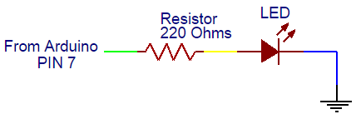
Activity 1
We will be making a simple LED blinking circuit.
The first activity will be making a simple LED blinking circuit. The programming flowchart and circuit diagram are in the figure.

Slide 31
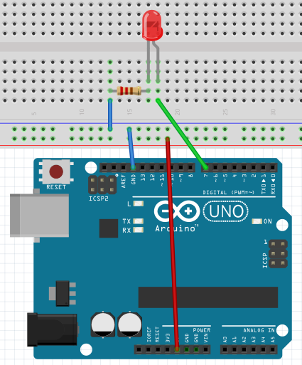
Activity 1
First, wire the LED to the breadboard like in the figure. Remember, since LEDs are polarized, their orientation matters. The shorter leg of the LED should be connected to the same row as GND. The resistor is NECESSARY, otherwise too much current would flow and the LED will burn out!
REMEMBER: The orientation of the LED matters!

Slide 32
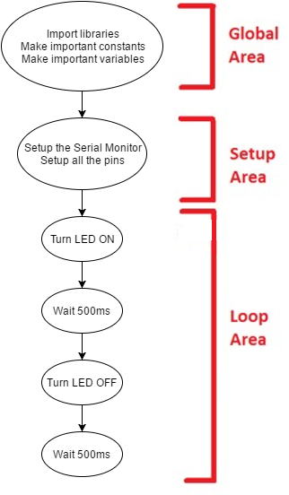
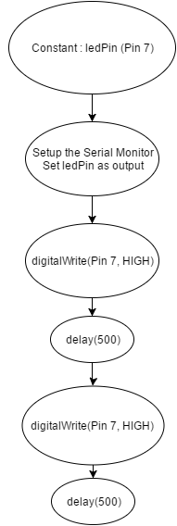
Flowcharts

Slide 33
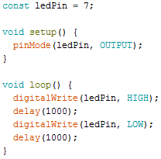
Activity 1
Now type the following code into a new sketch.
The flowchart uses Digital Pin 7 on the Arduino as an output. Therefore, create a constant that holds the number 7 and in the setup area set Pin 7 as an output using pinMode. Then, turn the LED on by using digitalWrite, have a delay of one second, turn the LED off by using digitalWrite and then set another delay of one second.
The LED circuit will be used in the next two activities. Do not deconstruct it.

Slide 34
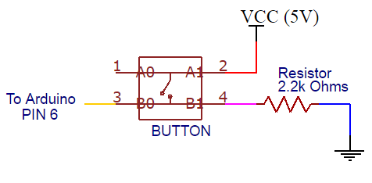
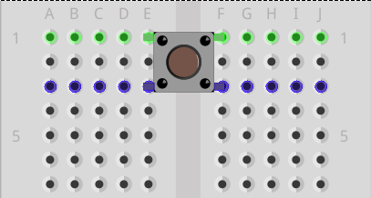
Activity 2
Activity 2 adds a button to the circuit from activity 1 and requires conditionals (think if-statement). The LED should be on when the button is pressed and off when the button isn’t pressed.
Before you breadboard the circuit look at the bottom side (pin side) of the button to examine which pins are connected. There is a line connecting the pins that are wired together internally on each side. See the schematic below, pins 1 and 2 are connected, and pins 3 and 4 are connected.
First, breadboard the circuit diagram in the figure and sketch a flowchart of the program needed. Have a TA verify the flowchart.

Slide 35
Activity 2
Write the Arduino program to implement the flowchart.
Remember to create a constant that holds the pin number to which the button is connected and that the button will be a digital input. After the button constant, create an integer that will hold the button state:
Within the loop function, you must check the state of the button (whether it is pressed or not pressed), using the following code:

Slide 36
Activity 3
Activity 3 introduces a loop into the program so the LED flashes three times. Make sure to sketch a flowchart and have a TA verify it.
Hint: Use a For-loop! The circuit does not need any modifications.

Slide 37
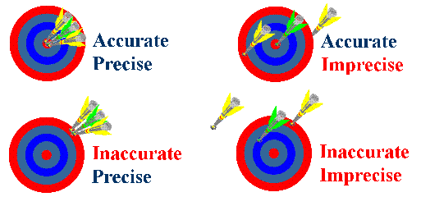
Product Evaluation

Slide 38
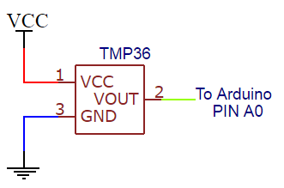
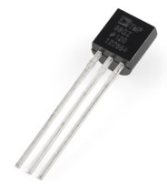
Activity 4
For Activity 4 the Arduino will read analog values from a temperature sensor and print out the temperature to the Serial Monitor. Carefully disconnect everything plugged into the breadboard and Arduino. Then, breadboard the circuit in Figure 6.

Slide 39
Activity 4
The TMP36 is an IC temperature sensor. The specifications of most IC chips can be found online. Below is a picture of the pinout and the specifications of the TMP36. The sensor requires a positive voltage (Vs), a ground connection (GND), and an analog input connection (Vout) to read the temperature data. Use the +5 V pin from the Arduino board as your positive voltage connection.
The output voltage can easily be converted to a temperature reading (in Celsius) by using a scale factor of 10 mV/°C. The Arduino should read the sensor every five seconds. Sketch a flowchart and have it verified by a TA before writing the program. Don’t forget to use an analog pin (Pin A0), convert the voltage reading and then print it out!

Slide 40
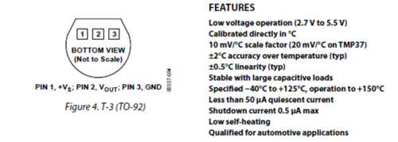
Activity 4
Take 5 measurements of the room using the temperature sensor with one minute intervals. Use this data for the accuracy and precision measurements of your temperature sensor. TAs will provide the actual room temperature. Use the following temperature sensor specifications.

Slide 41
Activity 4
Converting the temperature from “Arduino Units” to Celsius:
Convert “Arduino Units” to a voltage value
0-1023 is mapped from 0V to 5V
How much voltage is each “Arduino Unit”
Offset the voltage value by 500mV
Convert offset voltage to Celsius (10mV/1°C)

Slide 42
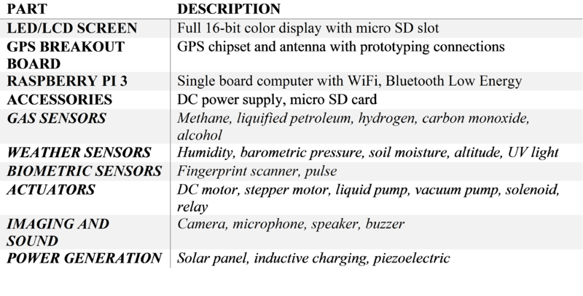
Activity 5
Brainstorming! (Your SLDP)

Slide 43
Assignment
Lab Report
Team Presentation
Discuss ALL topics in this presentation and manual
Include Pictures!

