Slide 1

RECITATION 4
EG1003

Slide 2
AGENDA
The Scientific Method
The Engineering Design Process
1

Slide 3
THE SCIENTIFIC METHOD
Notes:
Many students are familiar with the scientific method from high school or middle school. **Ask the class to name the parts of the scientific method**

Slide 4
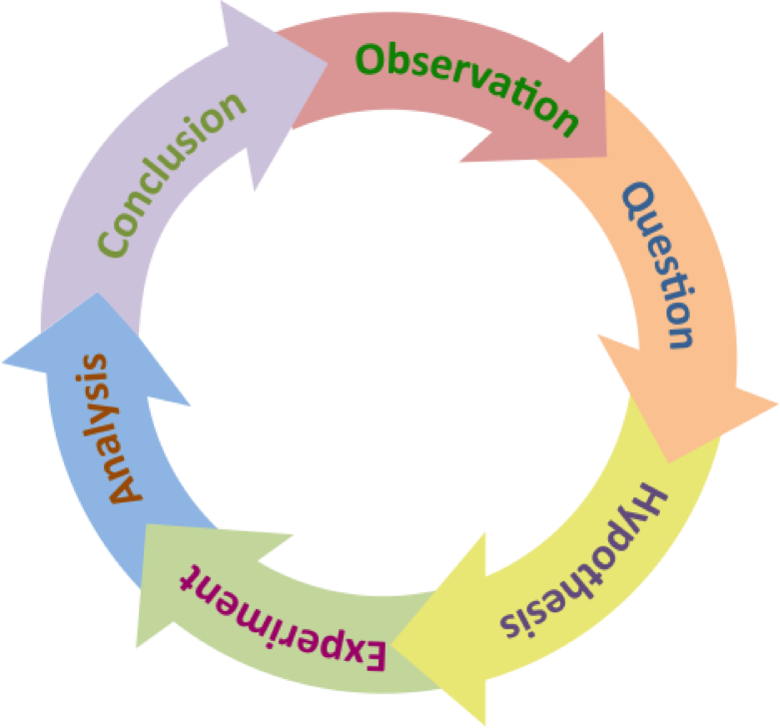
THE SCIENTIFIC METHOD
Research
Questions
Research
Method
Figure 2: Scientific method cycle courtesy of The Biology Primer
6
Notes:
**Briefly describe the scientific method** Perhaps the most important part of the scientific method is that it is cyclical and that often we follow this process intuitively as scientistic and engineers. The cycle can be broken up into two main parts: research questions and research methods.

Slide 5
THE ENGINEERING DESIGN PROCESS
Notes:
Many students are familiar with the scientific method from high school or middle school. **Ask the class to name the parts of the scientific method**

Slide 6
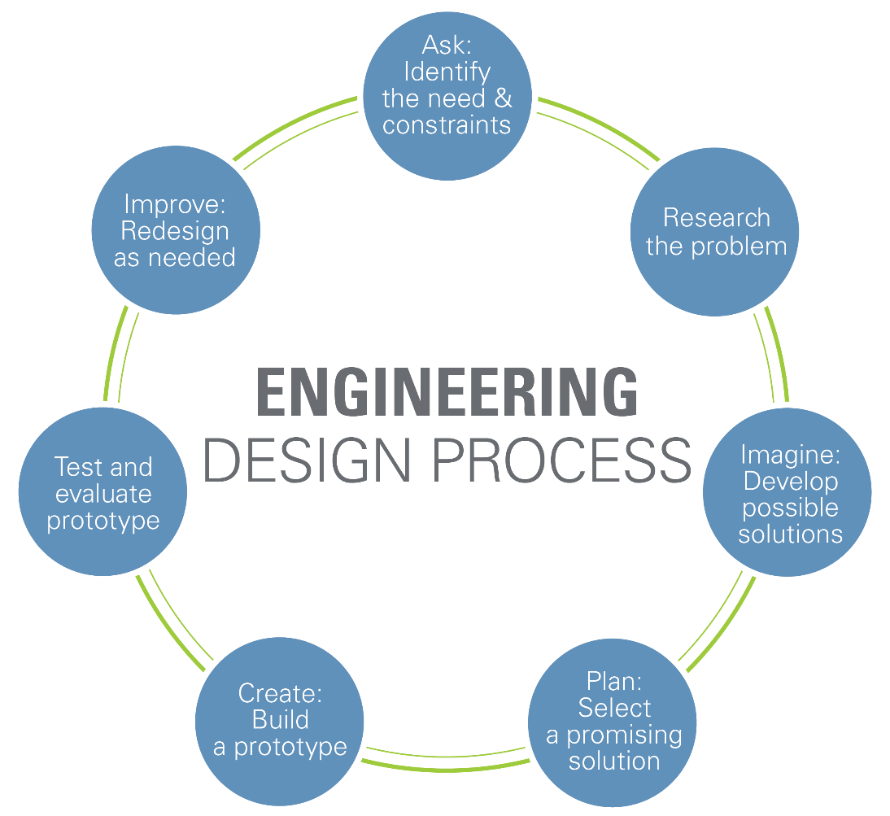
ENGINEERING DESIGN PROCESS
Figure 3: Engineering design cycle courtesy of Teach Engineering
8
Notes:
Similar to the scientific method, the engineering design process is also cyclical and follows the same general structure as the scientific method: proposing a question or a challenge and then testing with a certain methodology. **Breifly go over the engineering design process**. The prototyping steps are iterative and may require many different approaches in order to help address the need. It is important to note that no prototype is perfect and can always be further iterated to better solve the original problem using a set of standards to determine its effectiveness.

Slide 7
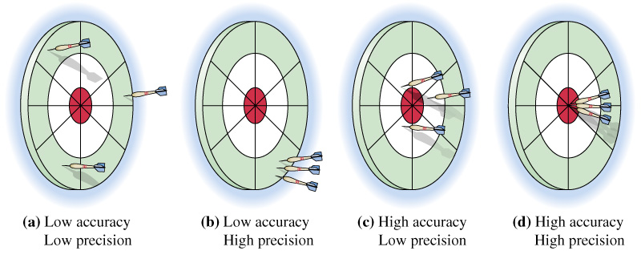
ACCURACY & PRECISION
Figure 4: Accuracy and precision visual courtesy of Extension Engine
9
Notes:
One of the considerations when reviewing the success of a prototype is the prototype’s accuracy and precision. If the determination of success is landing the darts in the red circle, high precision represents the repeatability of results and the accuracy represents the prototype’s ability to complete the goal.

Slide 8
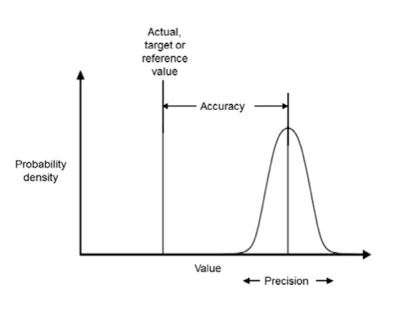
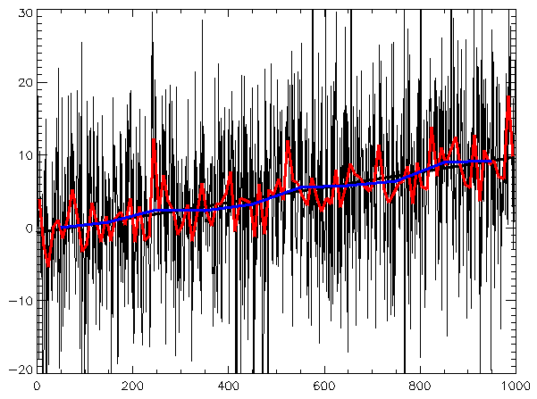
VARIABILITY
Figure 5: Accuracy and precision graphically courtesy of All Sensors
Figure 6: Variability and standard courtesy of Maksim
10
Notes:
Variability helps to describe the spread of the overall data compared to a reference value, The blue line in figure 6 above represents the reference value and the variance of the data is shown by the red spikes.

Slide 9
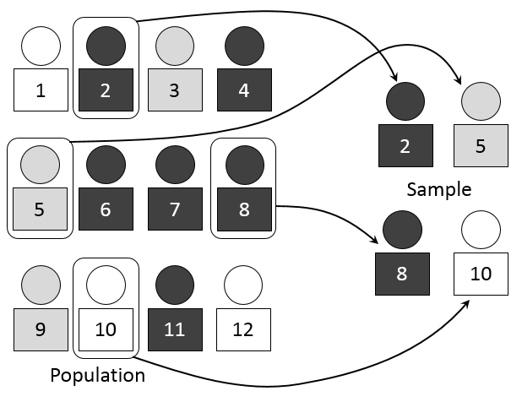

SAMPLING
Figure 7: Simple random sample courtesy of Mathprofdk
11
Notes:
When trying to complete a statistical analysis and draw conclusions for a given problem that involves a large population of many individuals, it is virtually impossible to record data from every single individual in a population. Simple random sampling, as show in Figure 7, shows a population of 12 people. Simple random sampling selects 4 people from this sample completely at random and records the data from these individuals. How do we know that the results we obtained represent the population instead of just the four people sampled? The equation on the right allows calculation of a minimum sample number considering various statistical factor values that help define the desired variance of the data.

Slide 10
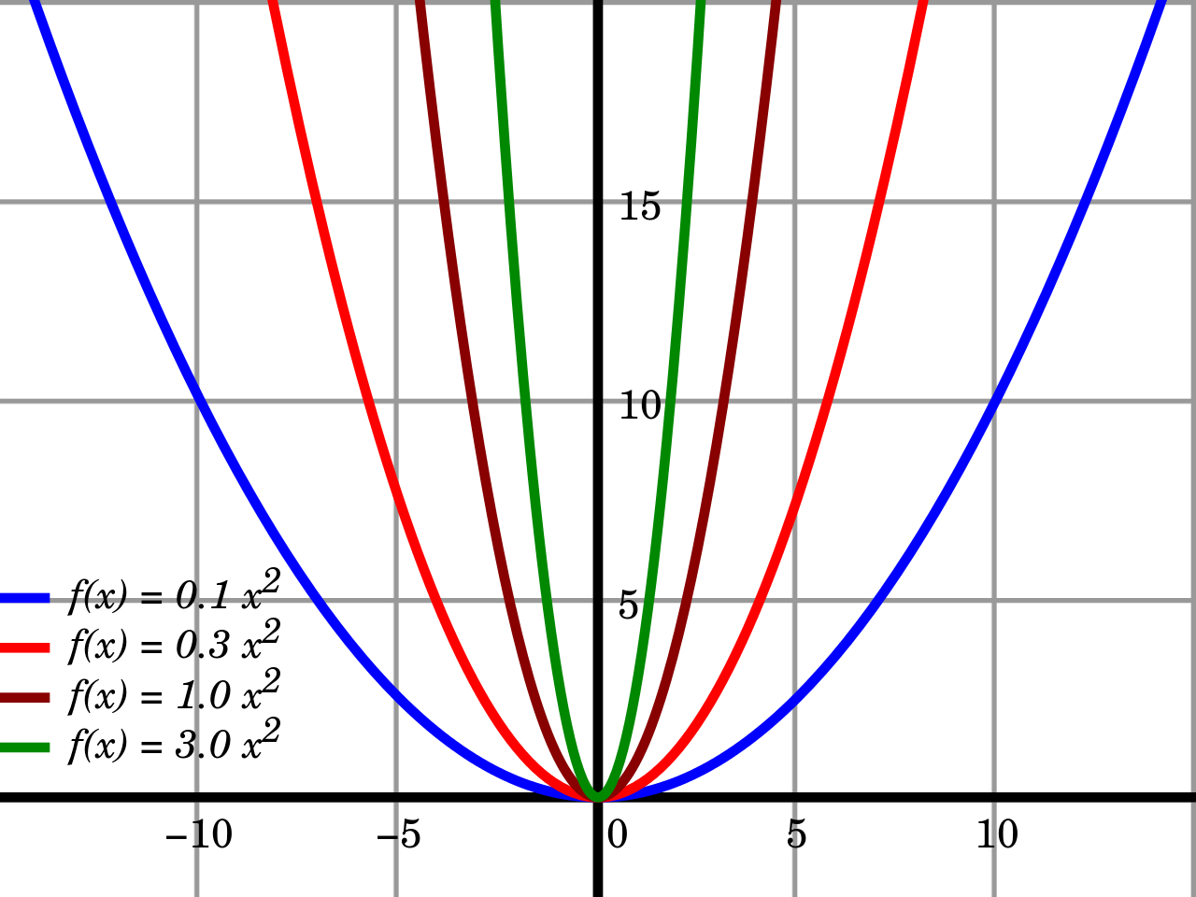
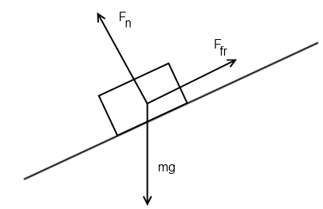
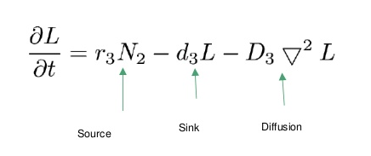
RELATIONSHIPS & ASSUMPTIONS
Figure 8, 9 &10: Mathematical relationships
12
Notes:
In order to make scientific progress, we build off the work of those in the past – luckily, we can use math and the results of those who came before us to create mathematical models that help describe and predict the behavior of what is being studied. For example, we know the relationship between a mass sitting on a slope experiencing the force of gravity, this mathematical equation which you will learn in physics is a result of combining a lot of observations and measurements into a model. As you go along in your academic career, you will find these models will become more complex and will help you solve less intuitive problems.

Slide 11
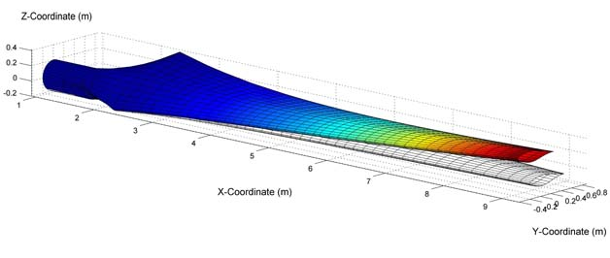

OPTIMAL DESIGN
Figure 11: Wind turbine model courtesy of University of Minnesota
13
Notes:
Mathematic relationships discovered overtime enable engineers to optimally design with a high level of precision and accuracy. With optimal designs, engineers can create technology that is useful and safe. These mathematical models are incorporated into CAD software to allow computerized prototyping.

Slide 12
QUESTIONS?

Slide 13
HOW TO GIVE A MILESTONE PRESENTATION

Slide 14
MILESTONES & BENCHMARKS
Milestones
Three Milestones through semester (1, 2 & 3)
Each Milestone has a presentation
Update progress on semester-long design project (SLDP)
Benchmarks
Two Benchmarks during semester
(A and B)
List of tasks to complete for each Benchmark
Tasks are semester-long design project (SLDP) dependent
16

Slide 15
MILESTONE PRESENTATION
OVERVIEW
Three Milestone presentations through the semester
Timed five-minute presentation
Update on progress of SLDP
Professional sales pitch presentation
Be a bit more creative with these presentations!
17

Slide 16
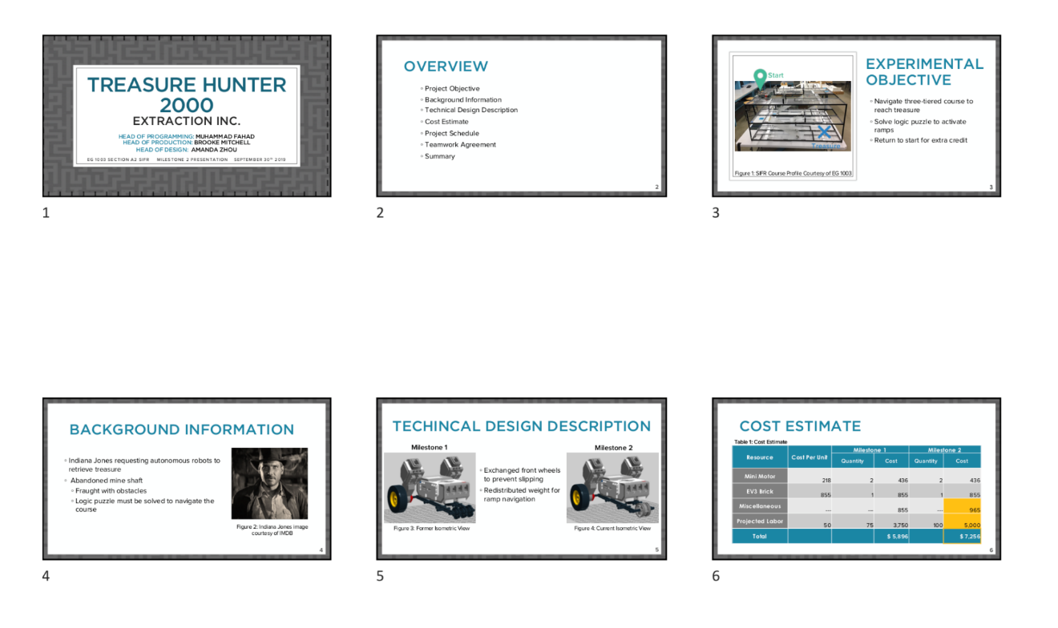
MILESTONE PRESENTATION
OVERVIEW
Submission:
EG1003 Website at 11:59 PM night before recitation
Figure 7: Multiple slide view
18

Slide 17
MILESTONE PRESENTATION
FORMAT
Consistent format and order for all Milestone presentations:
Title
Agenda
Project Objective
Background Information
Technical Design Description
Cost Estimate
Project Schedule
Teamwork Agreement
(MS 1 Only)
Summary
Title
Different format than lab presentations!
19

Slide 18

TITLE SLIDE
Product name
Company name
Group members with company titles
EG1003 section
Date
You create! Remember to be professional!
Figure 8: Title sample slide
20

Slide 19
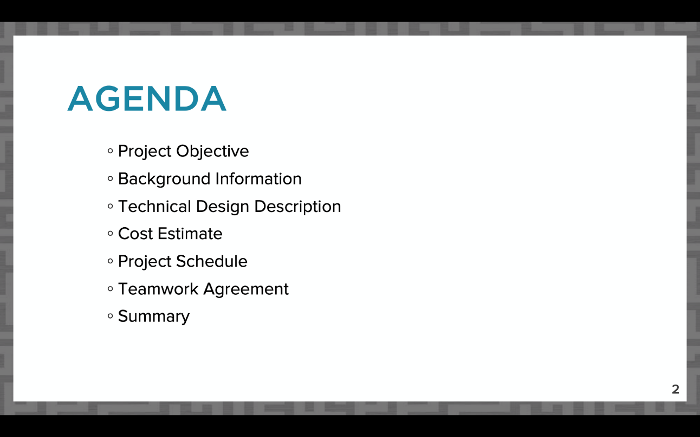
AGENDA SLIDE
Slide title “Agenda”
No need to read slide aloud during presentation
Same agenda slide/order for all Milestone presentations!
Figure 9: Agenda slide sample
21

Slide 20
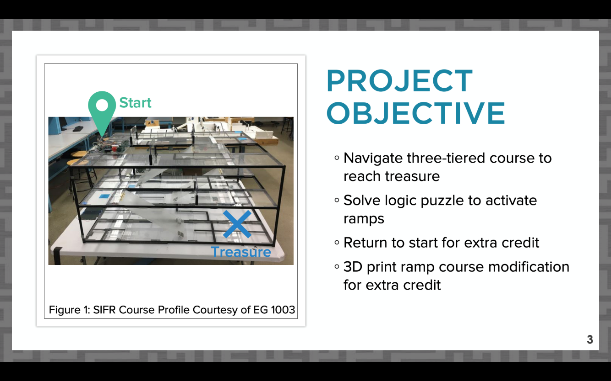
PROJECT OBJECTIVE SLIDE
Slide title “Project Objective”
What are you doing in your project?
Include overall approach
Extra credit points you’re aiming to earn
Figure 10: Project objective sample slide
22

Slide 21
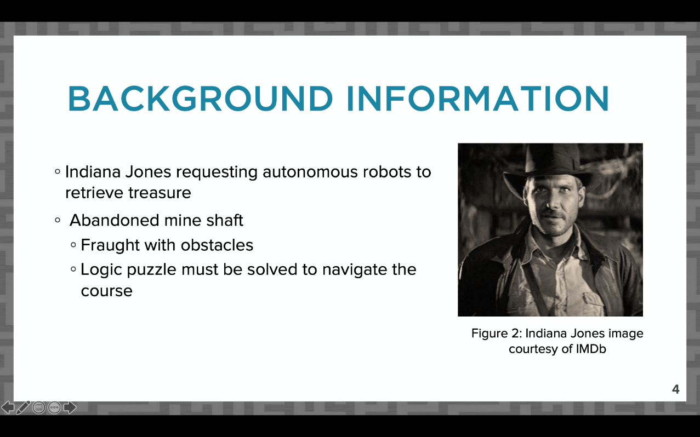
BACKGROUND INFORMATION
SLIDE
Slide title “Background Information”
Why are you completing the project?
Paraphrase project description from student manual
Include a short mission statement
Figure 11: Background information sample slide
23

Slide 22
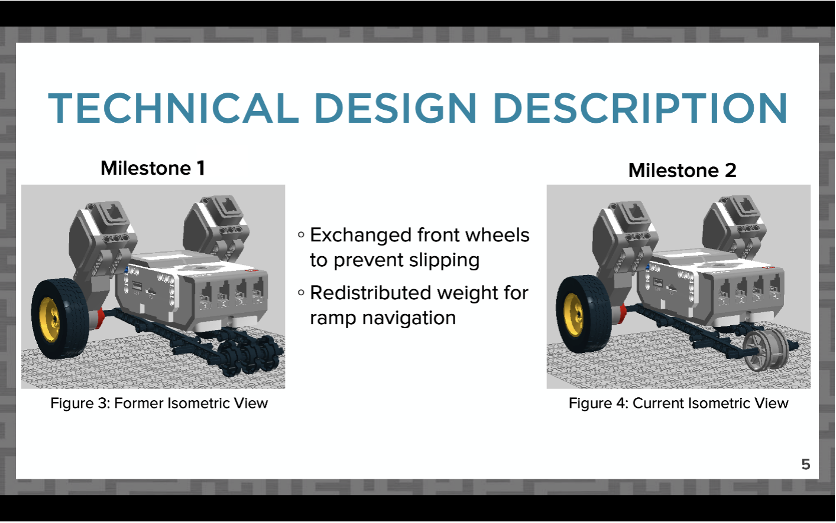
DESIGN DESCRIPTION SLIDES
Slides titled “Technical Design Description”
How does your project work?
All required CAD views
Coding snapshot and description
(if applicable)
For future Milestones, compare changes in design
Figure 12: Sample CAD design change comparison
24

Slide 23
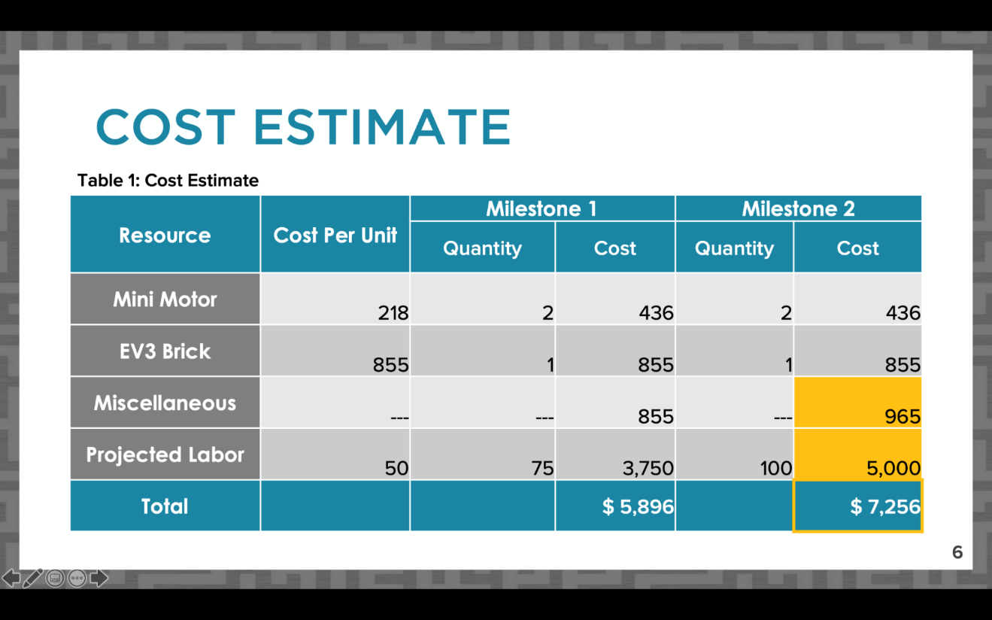
COST ESTIMATE SLIDE
Slide title “Cost Estimate”
Table should be professional and readable
List major parts individually, group smaller cost items under “miscellaneous”
Include labor cost for projected hours worked
Figure 13: Sample cost estimate slide
25

Slide 24
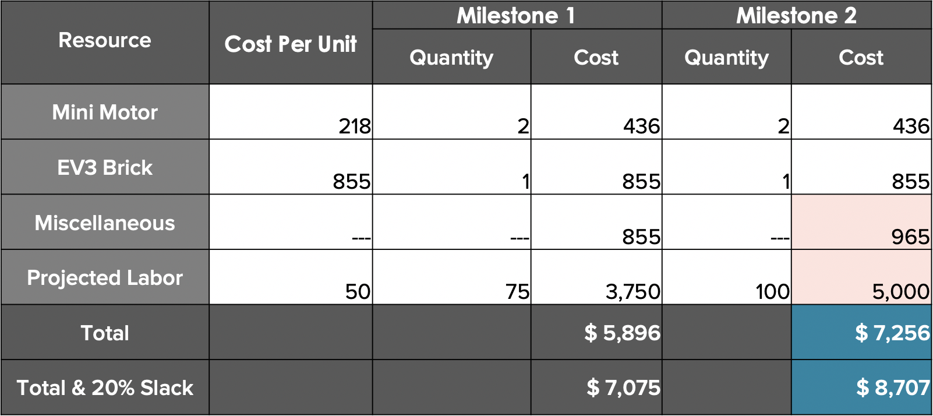
COST ESTIMATE SLIDE
Compare changes in cost between Milestones
Full dollar amounts
Highlight total cost
Use online cost resources
Optional 20% slack for unexpected costs
Table 1: Sample cost estimate
26

Slide 25
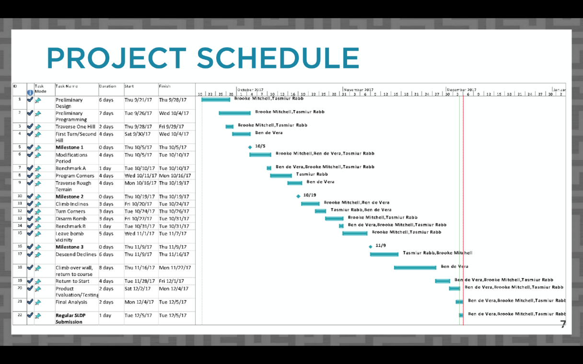
PROJECT SCHEDULE SLIDE
Slide title “Project Schedule”
Copy picture function
  Do not screenshot
Include table, Gantt chart, and
progress line in image
Refer to Microsoft Project Student Guide presentation for instructions
  VCL copy picture instructions
Figure 14: Project schedule sample slide
27

Slide 26
TEAMWORK AGREEMENT SLIDE
Slide title “Teamwork Agreement”
Milestone 1 presentation only
Full instructions for agreement on student manual
Summarize agreement:
  Communication
  Meetings
  Differences in opinion
  Responsibilities
  Workload
28

Slide 27
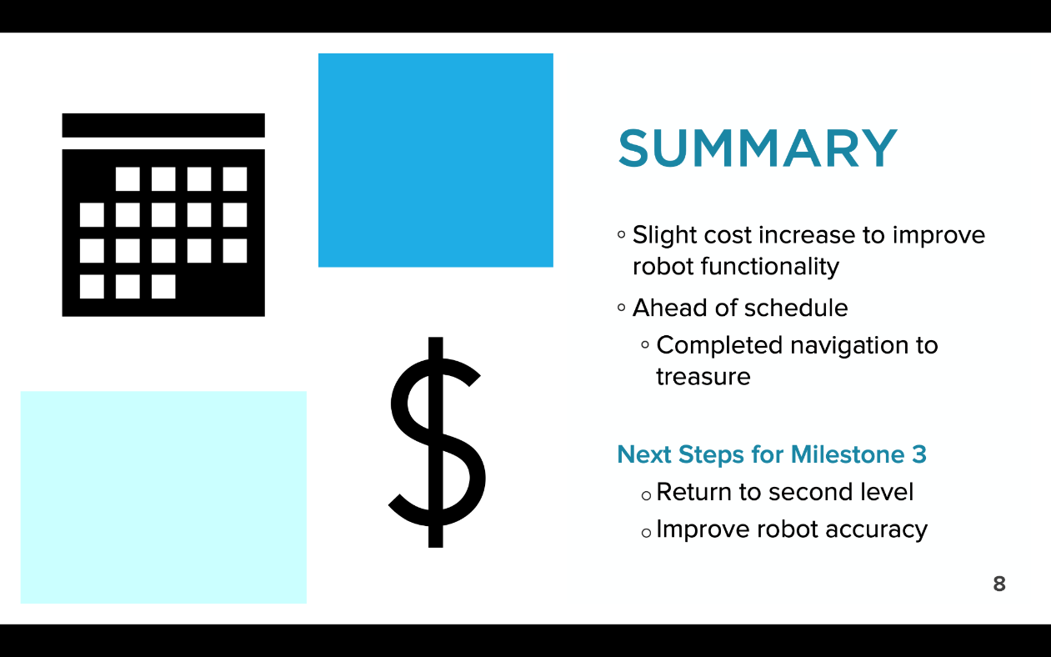
SUMMARY SLIDE
Slide title “Summary”
Overall assessment on project
Are you on schedule?
Are you on budget?
Include next steps for the following milestone
Figure 15: Conclusion sample slide
29

Slide 28
QUESTIONS?

