Slide 1
Circuitry
EG1004 | UAI Lab 2

Slide 2
OVERVIEW
Objective
Background Information
Materials
Procedure
Closing
1

Slide 3
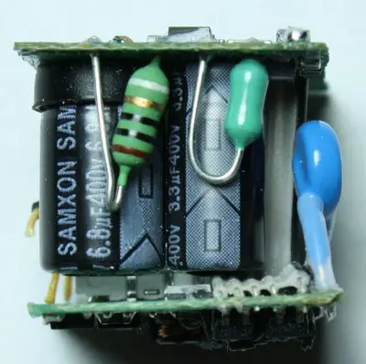
OBJECTIVE
To understand and observe the theory and introductory applications of circuitry through the construction of simple circuits.
Figure 1: iPhone Charger Construction
2

Slide 4
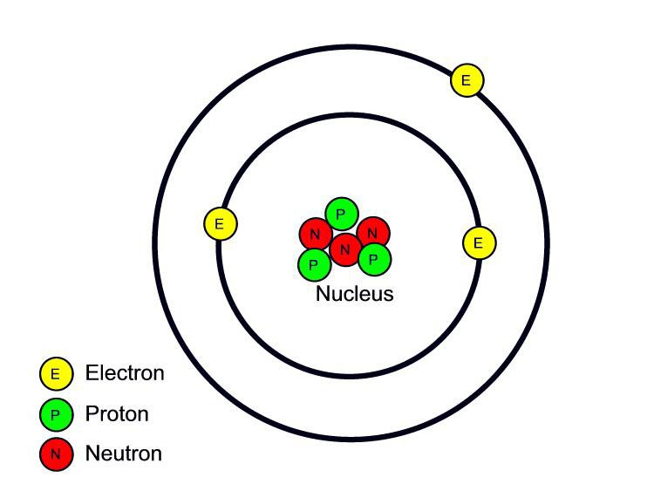
BACKGROUND INFORMATION
Electricity
A form of energy resulting from the existence of charged particles
Charge
Statically - Accumulation of charge
Dynamically - Current
Magnetism - Through coils
Figure 2: Lithium Atom
3

Slide 5
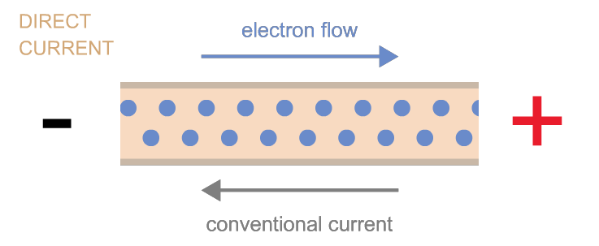
BACKGROUND INFORMATION
Current
The movement of electron flow
Movement is characterized by movement from High to Low Current
Electron flow is inverse to current flow
Figure 3: Current vs Electron Flow
4

Slide 6
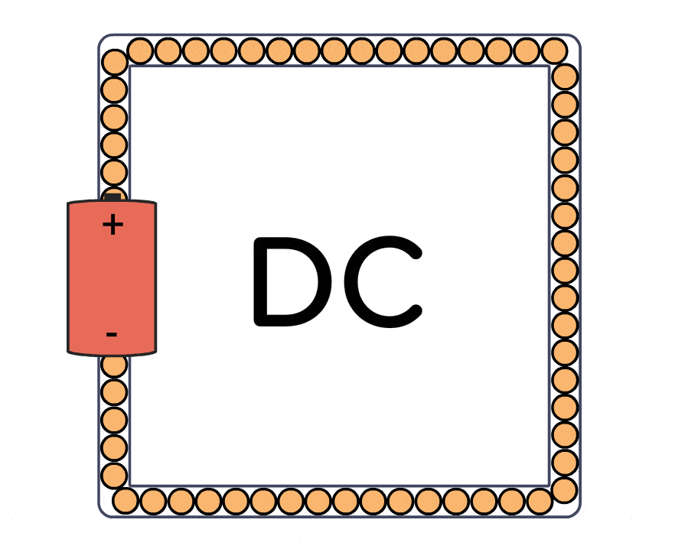
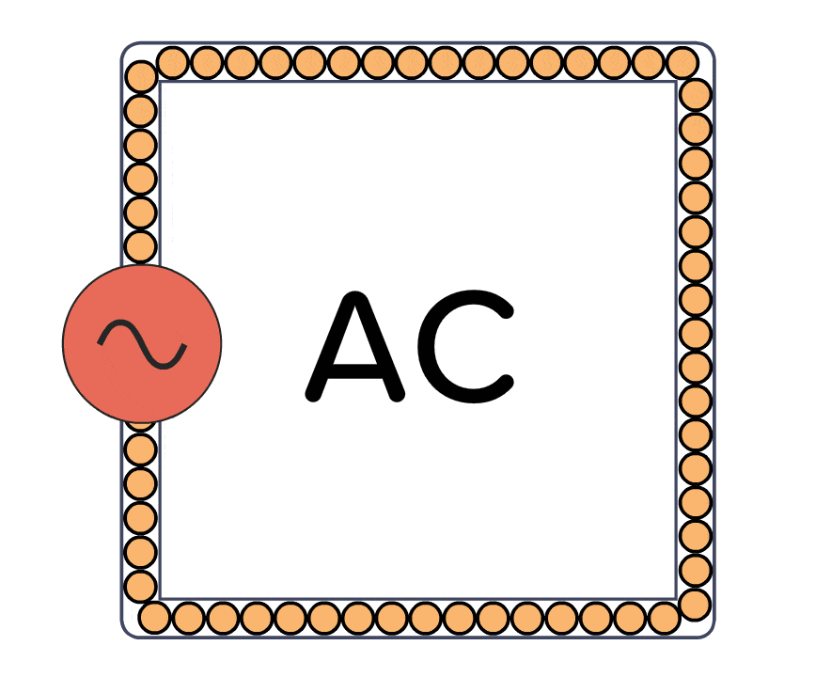
BACKGROUND INFORMATION
Current Types
Figures 4 & 5: Direct Current (left) & Alternating Current (right)
5

Slide 7
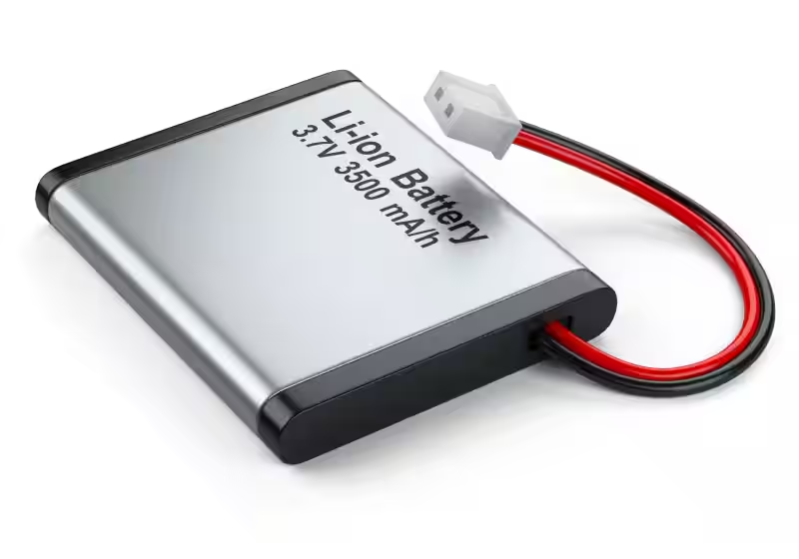
BACKGROUND INFORMATION
Direct Current
Current flows in one direction
Applications:
Batteries, solar cells, power supplies
Alternating Current
Current switches direction periodically
Applications:
Generators, turbines, outlets, signals
Figure 6: Lithium Ion Battery
Figure 7: Wind Turbine
6

Slide 8
BACKGROUND INFORMATION
Ohm’s Law
The relationship between DC current (I; amperes), voltage (V or E; volts), resistance (R; ohms), and power (w, watts).
Figure 8: Ohm’s Law Relationship Animation
7

Slide 9
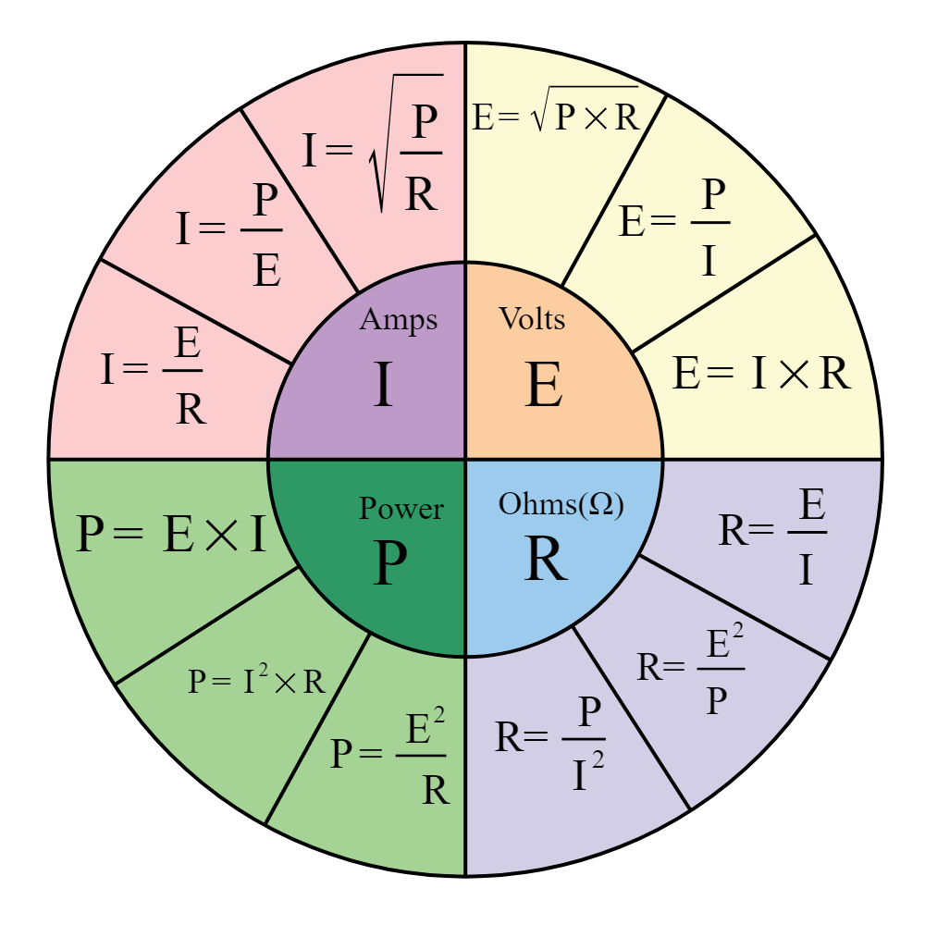
BACKGROUND INFORMATION
Ohm’s Law
Current (amperes): quantity of electrons passing at a given point; 1A = 6.28*1018 electrons/second
Voltage (volts): electrical pressure/force; voltage drop refers to the voltage for a conductor
Power (watts): work performed by current
Resistance (ohms): opposition to current flow
Figure 9: Ohm’s Law Equations
8

Slide 10
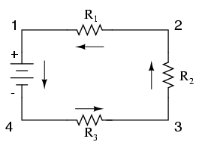
BACKGROUND INFORMATION
Series Circuit
Components connected share one node in common.
The positive end of one component connects to the negative of the component before it.
Total voltage is equal to the sum of all the voltage drops.
Current is the same throughout all components.
Total resistance is the sum of all resistances.
Figure 10: Series Circuit
9

Slide 11
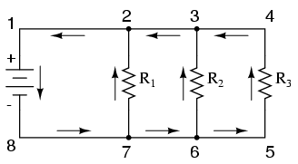
BACKGROUND INFORMATION
Parallel Circuit
Components connected share two nodes in common.
The positive end of one component connects to the positive end of the component before it. Same applies to the negative end.
Voltage is the same within each branch.
Total current is the sum of all currents.
Total resistance is the sum of the reciprocal of all resistances.
Figure 11: Parallel Circuit
10

Slide 12
BACKGROUND INFORMATION
Series Circuit Recap:
Vs = Vt = VR1 + VR2 + VR3
It = IR1 = IR2 = IR3
Rt = R1 + R2 + R3
Parallel Circuit Recap:
Vs = Vt = VR1 = VR2 = VR3
It = IR1 + IR2 + IR3
1/Rt = 1/R1 + 1/R2 + 1/R3
11

Slide 13
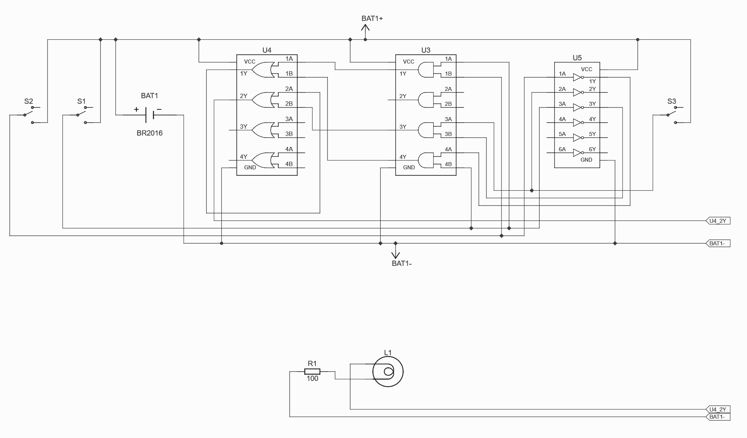
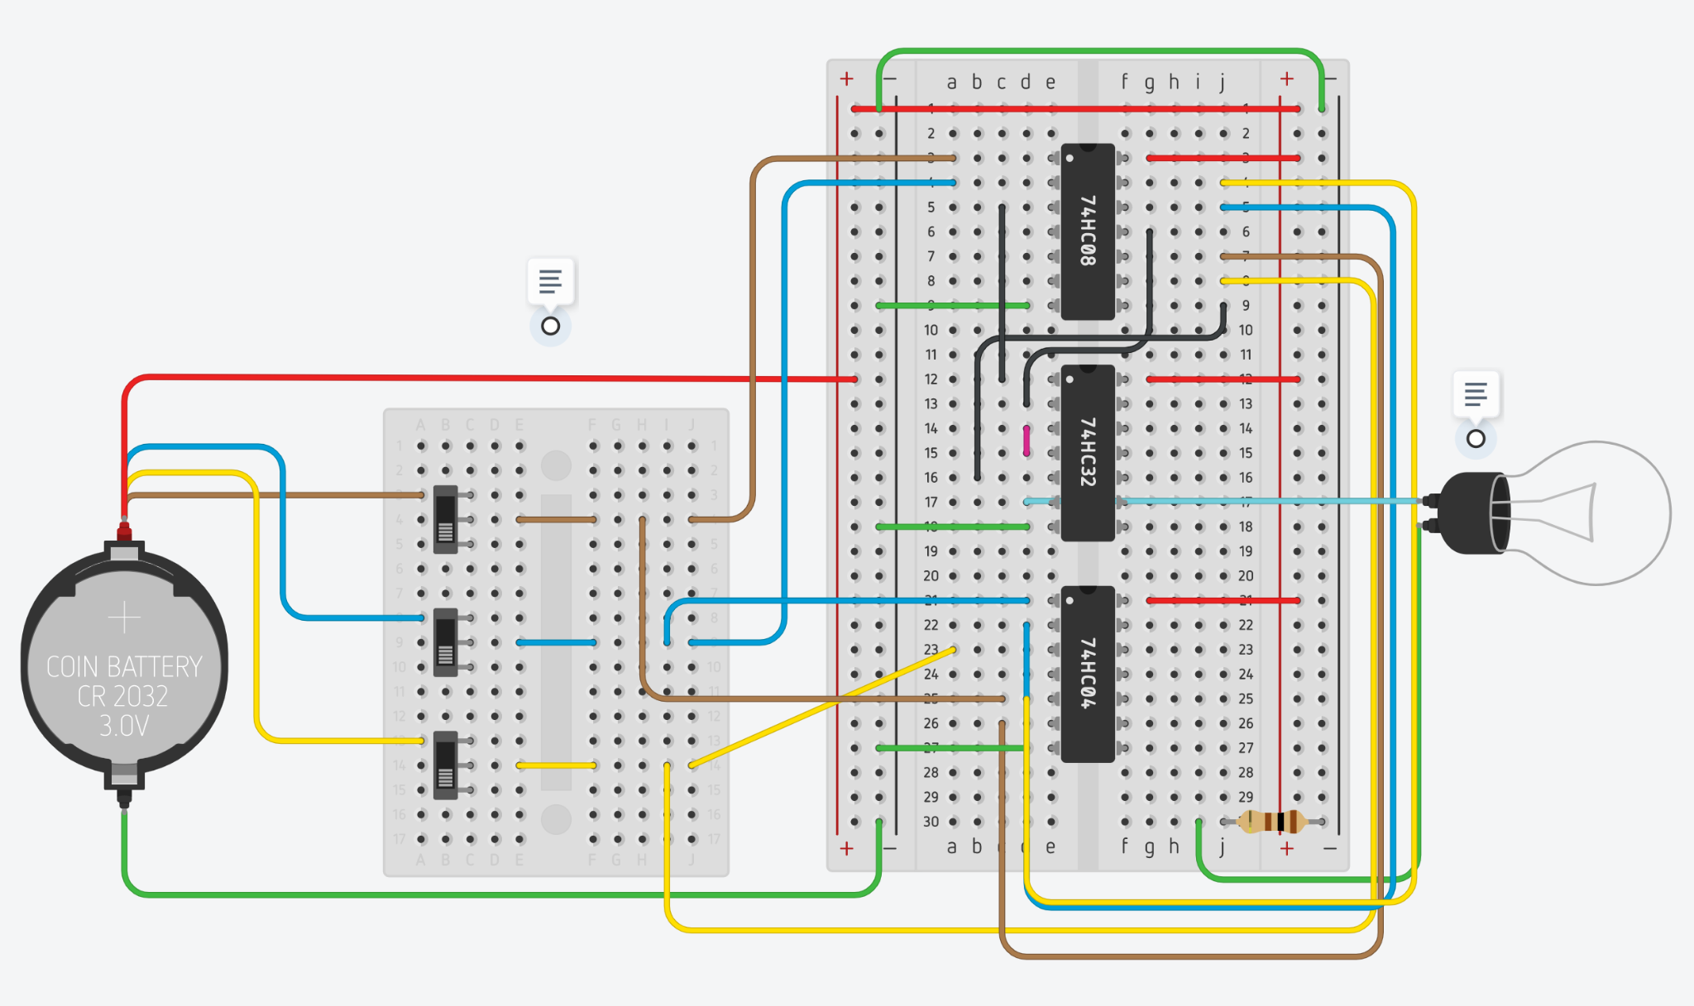
BACKGROUND INFORMATION
Diagram Types
Figures 14 & 15: Schematic (left) & Wiring Diagram (right)
12

Slide 14
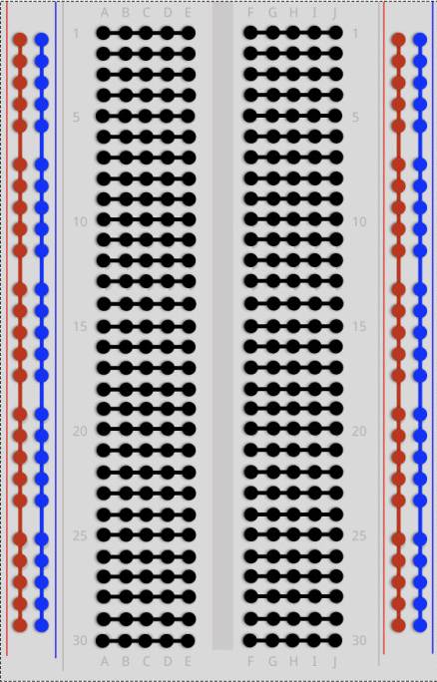
BACKGROUND INFORMATION
Breadboards
A solderless board used to prototype circuits through temporary connections.
Horizontal rows are connected (black). Vertical power rails are connected (red & blue).
Figure 12: Breadboard Arrangement
13

Slide 15
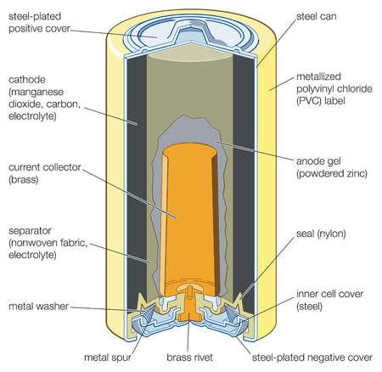
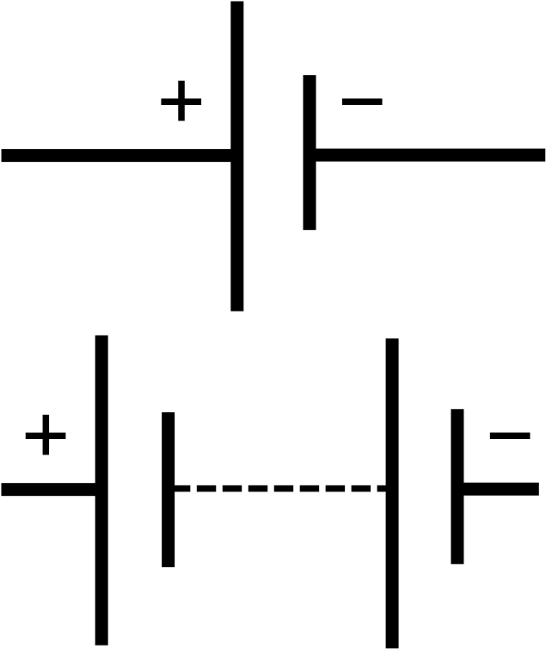
BACKGROUND INFORMATION
Batteries
Commonly dual celled
Coin batteries are represented by a single cell
Voltage supply for the circuit
Figure 13: Battery Schematic Symbols
Figure 14: Internal Chemical Composition of a Battery
14

Slide 16
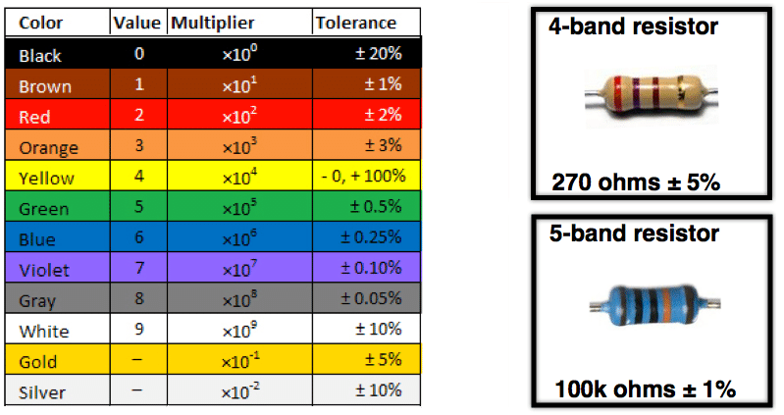
BACKGROUND INFORMATION
Resistors
Obstructs the flow of electrical current.
Bands refer to the resistance value
Color coded charts specify the value
Figure 17: Resistor Symbol
Figure 18: Resistor Color Band Chart
15

Slide 17
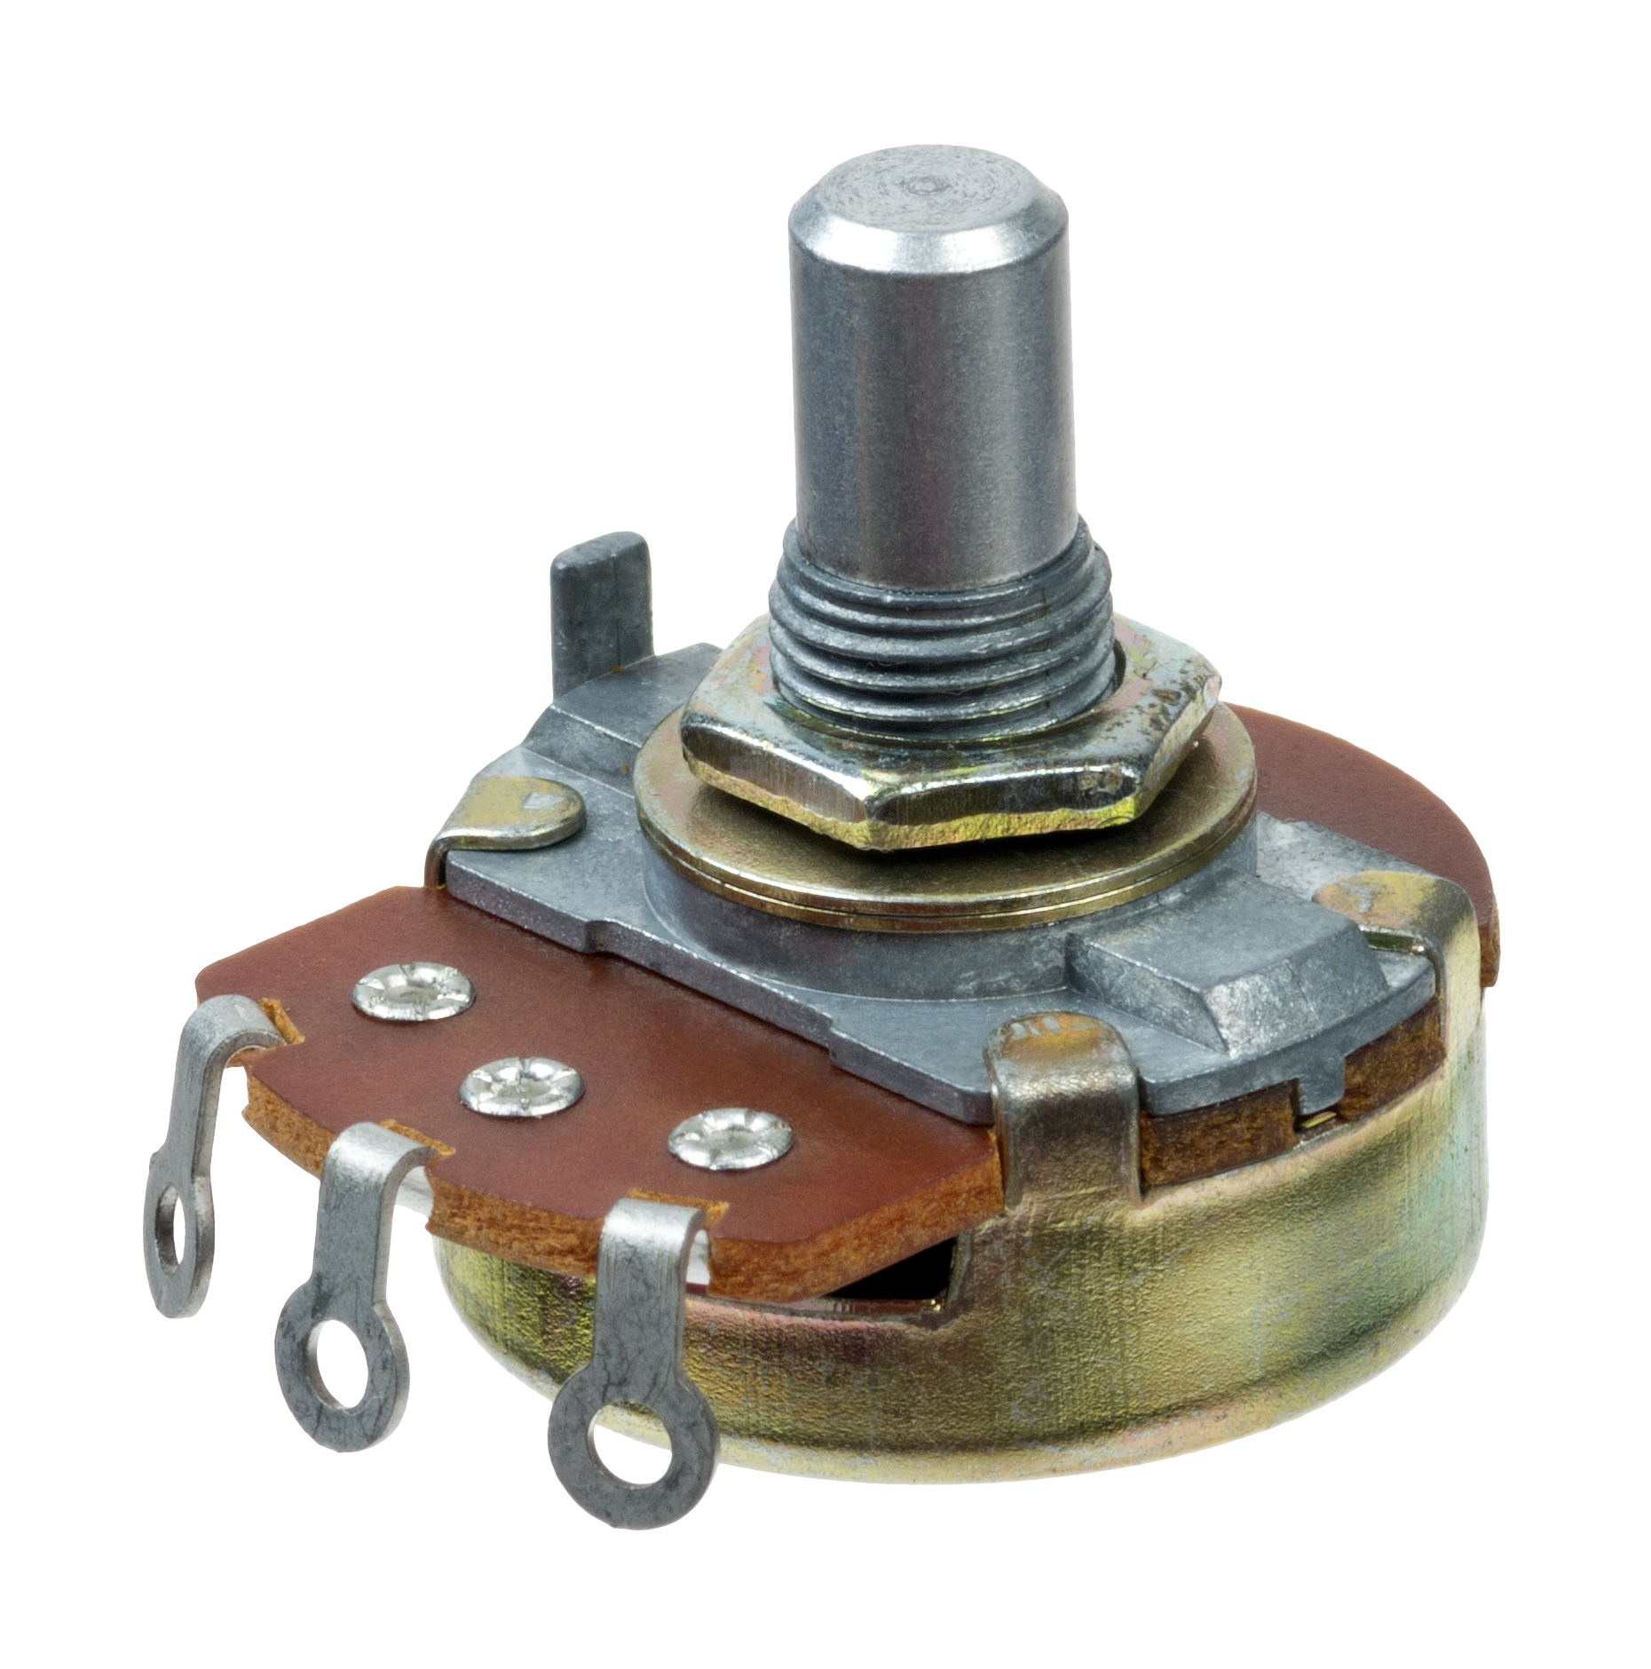
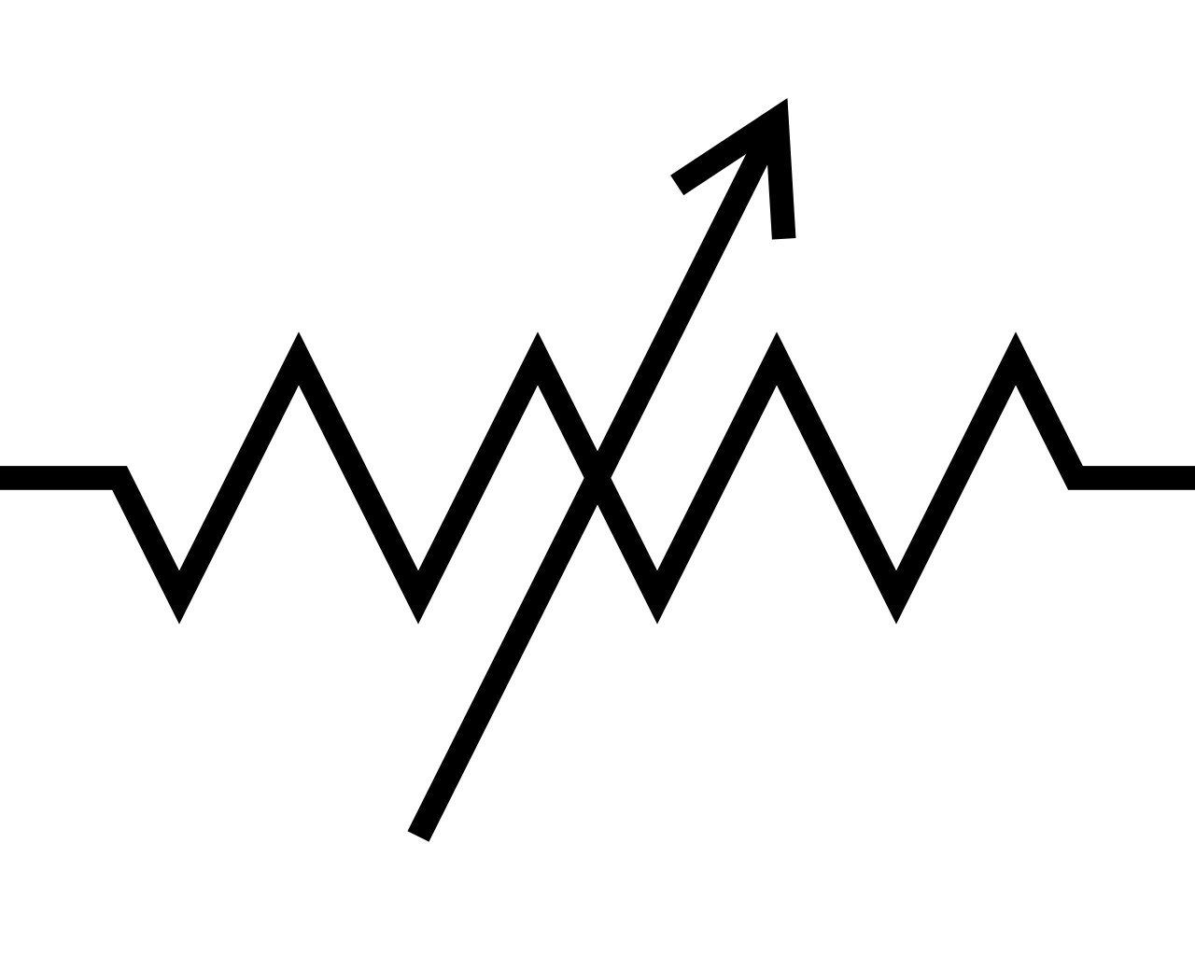
BACKGROUND INFORMATION
Potentiometers
Variable resistor
Second terminal is able to be adjusted to change resistance value
Figure 19: Potentiometer Symbol
Figure 20: Potentiometer
16

Slide 18
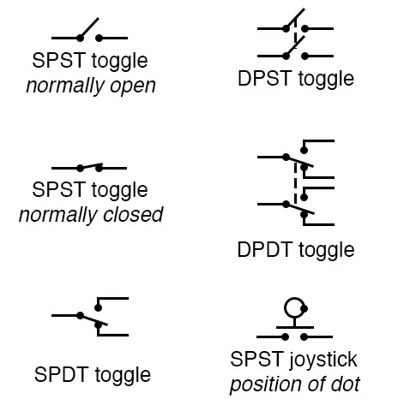
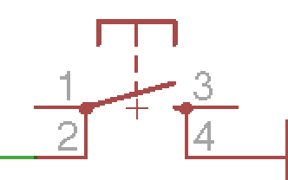
BACKGROUND INFORMATION
Passive Components
Buttons
Diverts current flow when pressed down through the mechanical change of the contact point
Switches
Switches current flow when toggled to a set configuration based on pulls (P) and throws (T)
Figures 21 & 22: Button & Switch Schematics
17

Slide 19
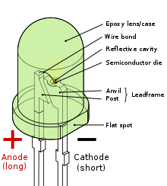
BACKGROUND INFORMATION
Diode & Light Emitting Diode (LED)
Diode
Allows current flow in one direction
LED
A type of diode that emits light when voltage passes through
Anode: Positive end, longer post, less filament
Cathods: Negative end, shorter post, more filament
Figures 23 & 24: LED Structure & Schematic Symbol
18

Slide 20
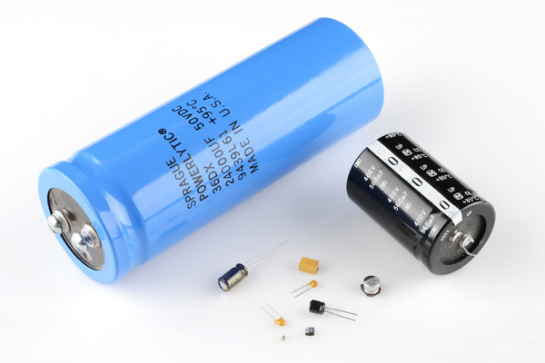
BACKGROUND INFORMATION
Capacitors
Store energy in the form of an electric field
Used for:
Decoupling (Bypass) - reduces voltage spikes that can damage other components
Power Supply Filtering - “convert” AC into DC
Local energy storage and supply
Signal Filtering & Timing
Figures 25 & 26: Capacitors & Schematic Symbol
19

Slide 21
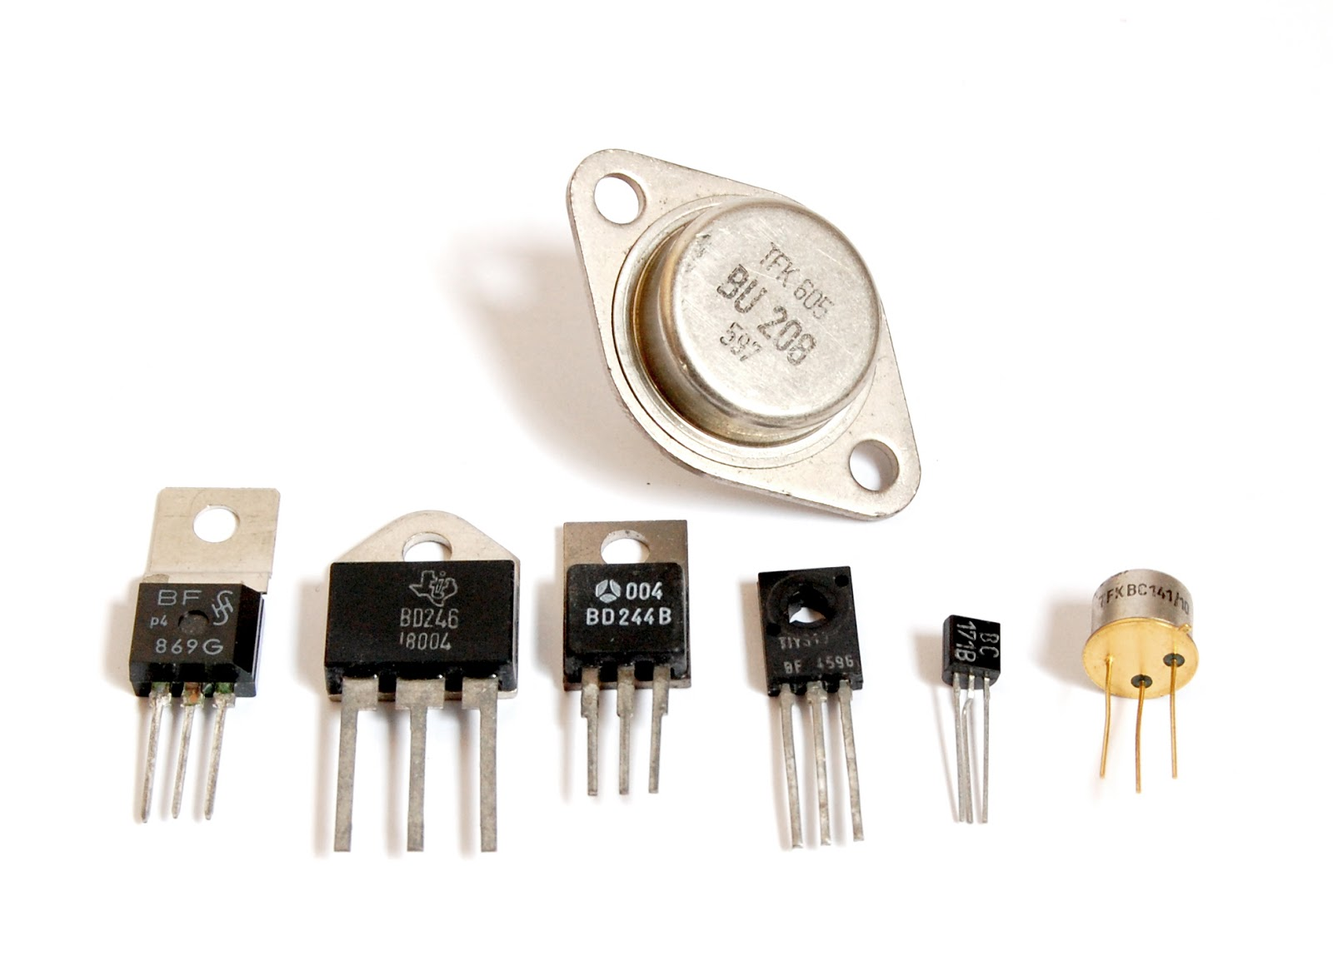
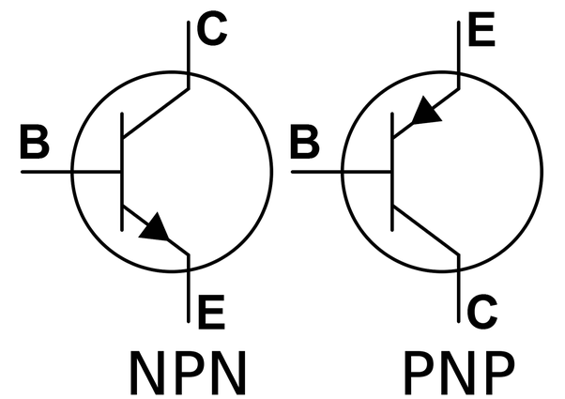
BACKGROUND INFORMATION
Transistors
Both a switch and an amplifier
Three poles:
base, collector, and emitter
source, drain, gate
For an NPN Transistor:
Base picks up a signal
Current diverts from the collector to emitter
Figures 27 & 28: Transistors & Schematic Symbols
20

Slide 22
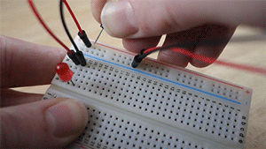
MATERIALS
Breadboard
Wires
Coin Cell Battery
Resistors
Colored LEDs
RGB LED
Slide Switch
Push Button
Potentiometers
21

Slide 23
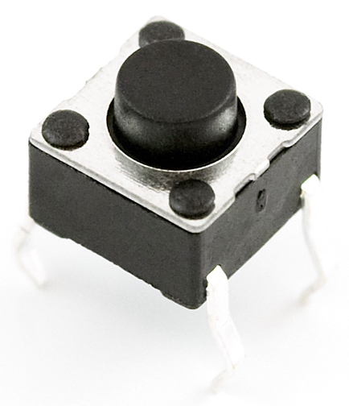
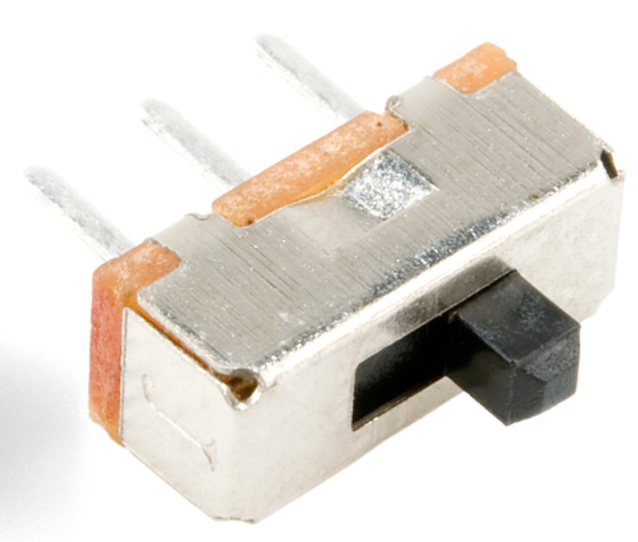
PROCEDURE
Construct the following circuits
Basic LED Circuit
Switch LED Circuit
Button LED Circuit
Switch & Button LED Circuit
RGB LED Circuit
22

Slide 24
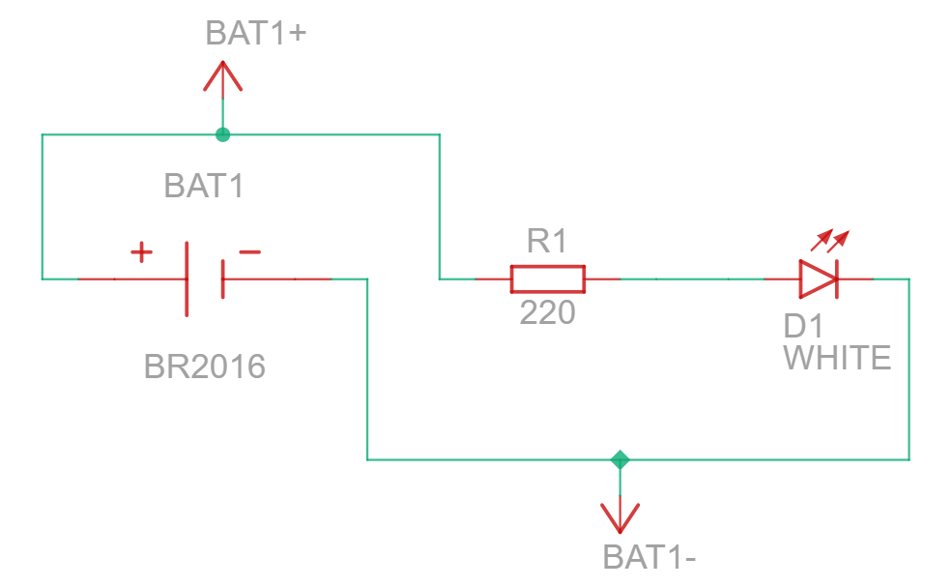
LED Circuit
Why is a resistor needed in the circuit?
Why is the resistor rated for 220Ω?
If I wanted to add another LED to the circuit but have the same brightness as LED1, how would I connect it?
3V

Slide 25
LED Circuit - Solutions
Why is a resistor needed in the circuit? The resistor is needed in the circuit to prevent the LED from burning out. Depending on the color of the LED the voltage range for an LED can fall between 1.4v and 3.2v with red having the lowest range and white having the highest range.
Why is the resistor rated for 220Ω? Based on the supplied voltage of 3v, having the resistor reduces the voltage coming into the LED into a safe range for lower end LEDs such as a red LED can operate safety (precisely it reduces it to 1.92v {for fun you can try to verify this using ohm’s law})
If I wanted to add another LED to the circuit but have the same brightness as LED1, how would I connect it? You could connect it in parallel so the additional LED would have the same voltage running through it as LED1.

Slide 26
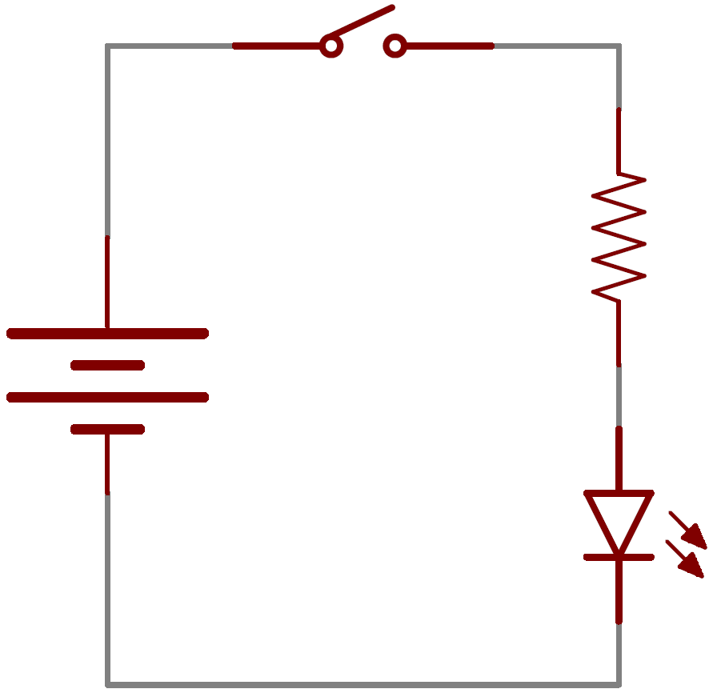
Switch Circuit
Why is the resistor before the LED but after the switch?
What would happen if the switch was replaced with a button in this configuration? Would it work properly?
220Ω
3V

Slide 27
Switch Circuit - Solutions
Why is the resistor before the LED but after the switch? The resistor can be placed before the switch but this configuration displaces the voltage past the switch so if you wanted to connect the switch’s open position to a different circuit, the starting voltage would be the unreduced voltage.
What would happen if the switch was replaced with a button in this configuration? Would it work properly? The button will not work properly as there is no higher resistance present to divert the flow off of the main LED circuit.

Slide 28
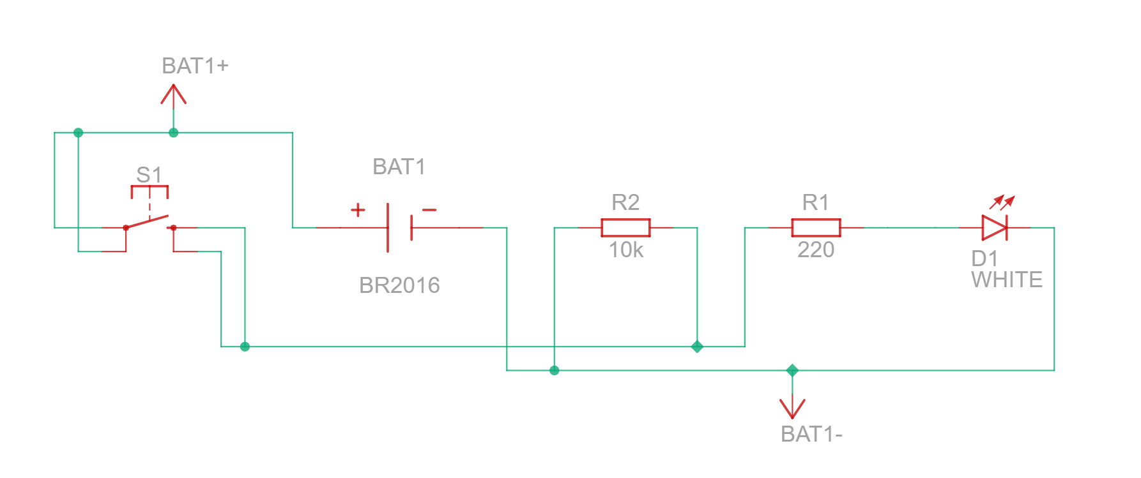
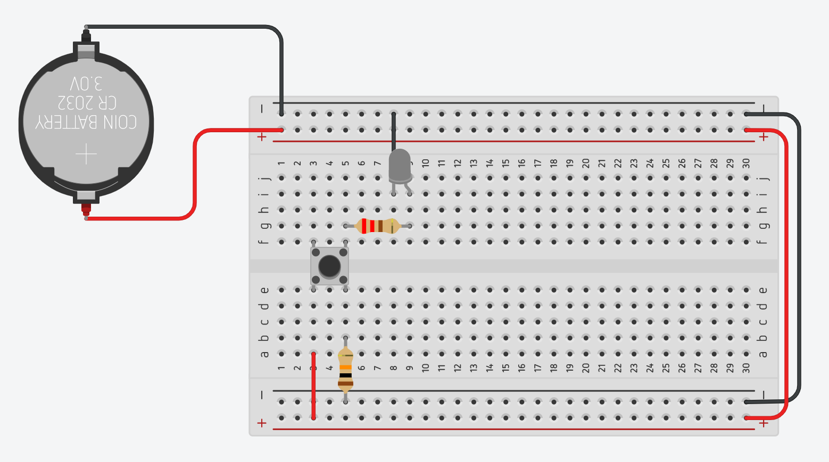
Button Circuit
3V
Why is there an additional resistor for the button?
What if the resistance of the LED was higher than the button?

Slide 29
Button Circuit
Why is there an additional resistor for the button? The additional resistor of higher resistance serves to divert the current down into the LED circuit when the button is pressed as current will move to areas of lower resistance over higher resistance.
What if the resistance of the LED was higher than the button? The button will likely not make the LED turn on, in addition the LED will not turn on at all if the resistance is to high that it sends lower voltage than the minimum required.

Slide 30
Combination Circuit
Your Turn - Goal: Control a LED from a button only when a switch is toggled
Provided:
Push Button Pole Diagram (top)
Slide Switch Pole Diagram (bottom)
Keep in Mind:
LED’s only operate at a certain value
The terminals of both a slide switch and a button

Slide 31
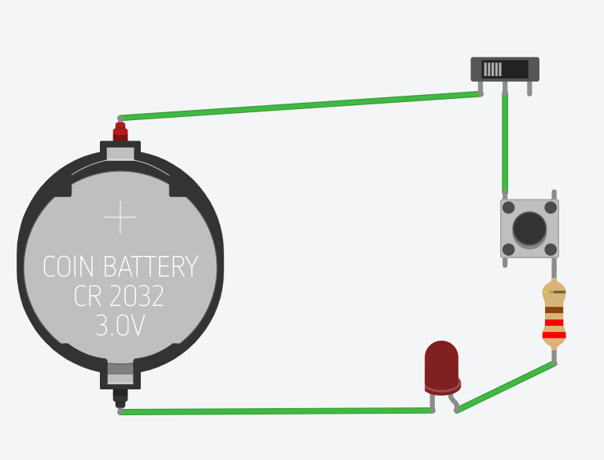
Combination Circuit - Solution
Your Turn - Goal: Control a LED from a button only when a switch is toggled
Looks probably weird since its off a breadboard…
the switch is set to power the circuit when in the first and second positions and the button causes the LED to light when the button is pressed. If this were in a breadboard, the top right side would need a higher resistance for directing the flow.
Solution made with Tinkercad

Slide 32
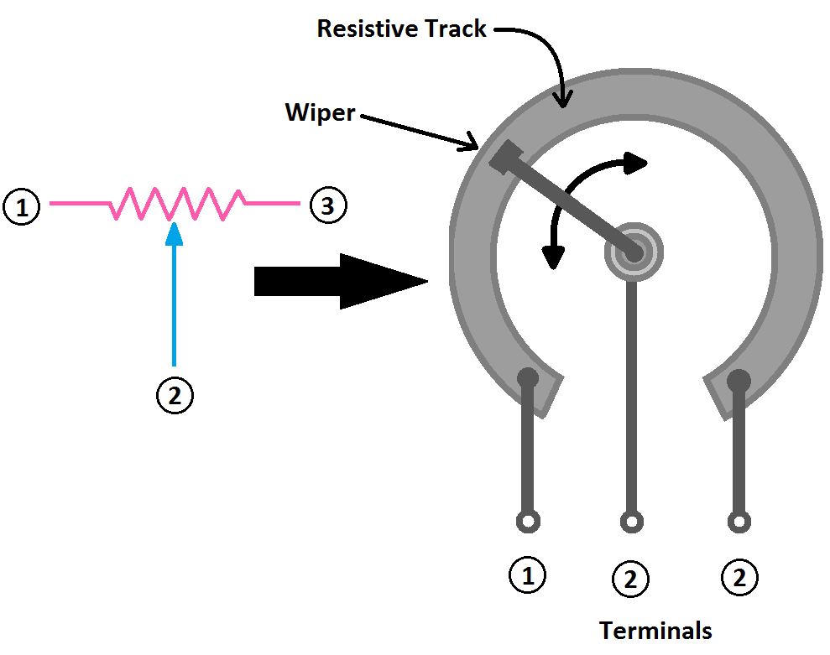
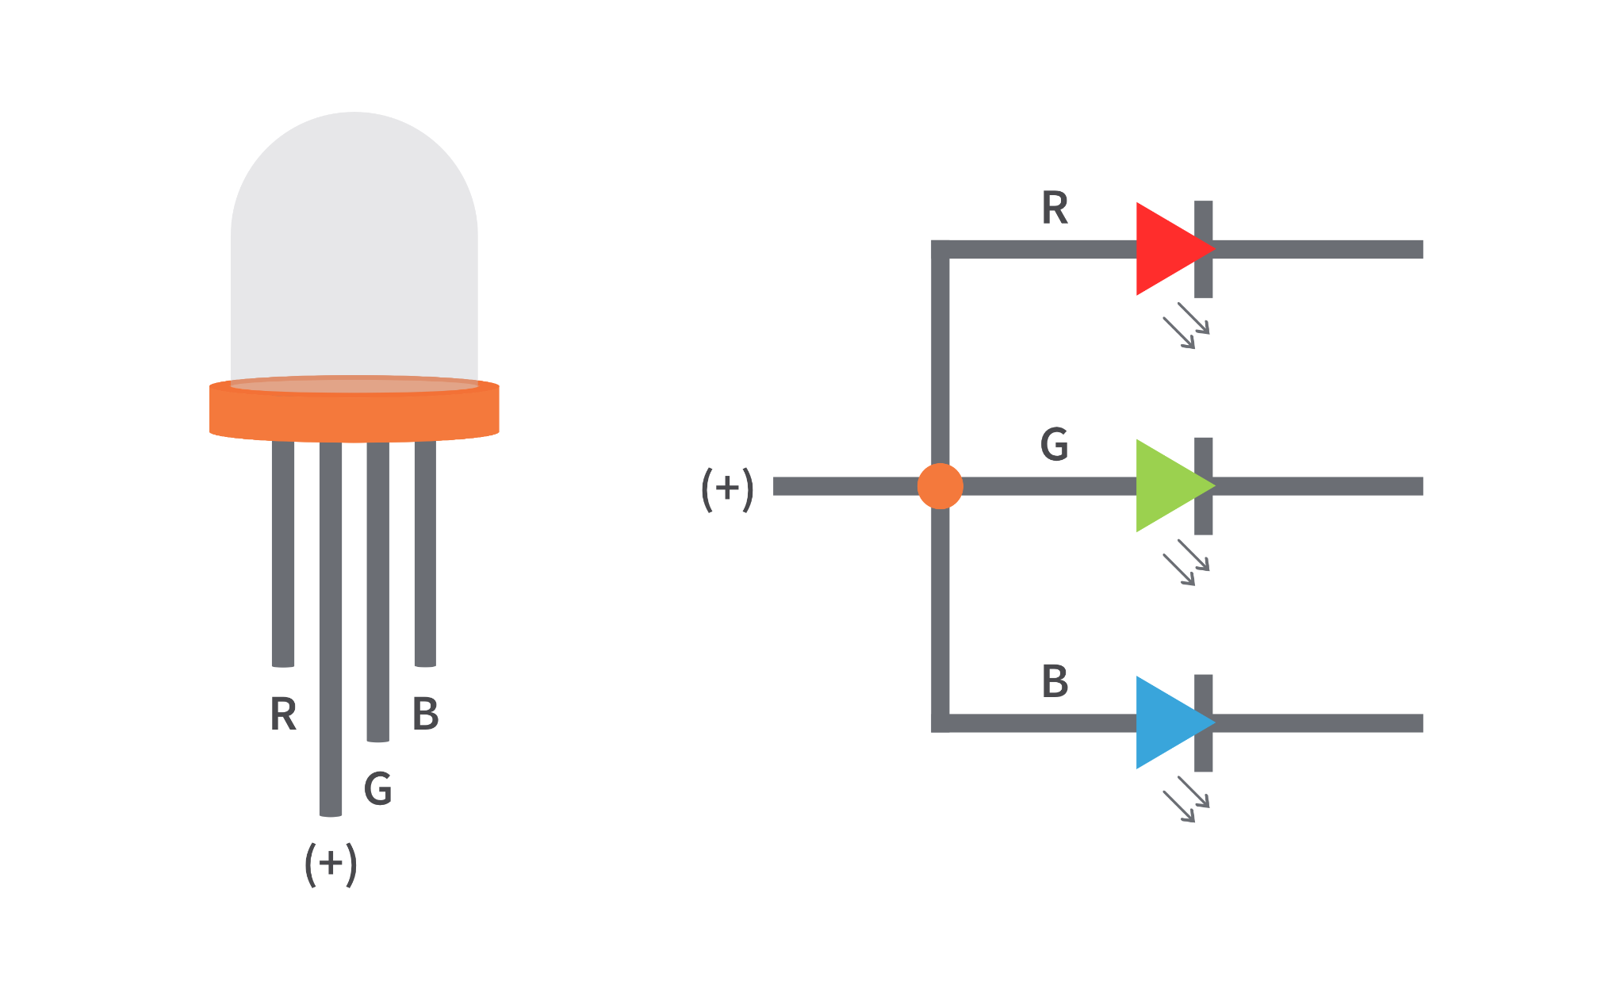
Potentiometer Circuit
Your Turn - Goal: Control a RGB LED with 3 potentiometers
Provided:
Potentiometer Schematic
RGB Schematic
Keep in Mind:
LED’s only operate at a certain value
RGB’s have three pins associated with each color

Slide 33
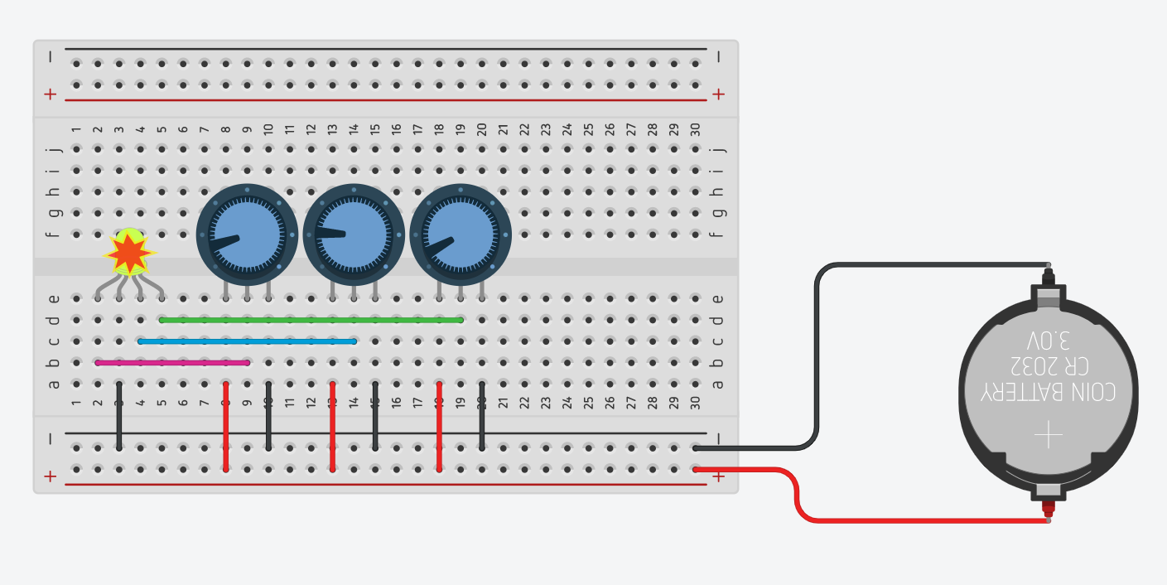
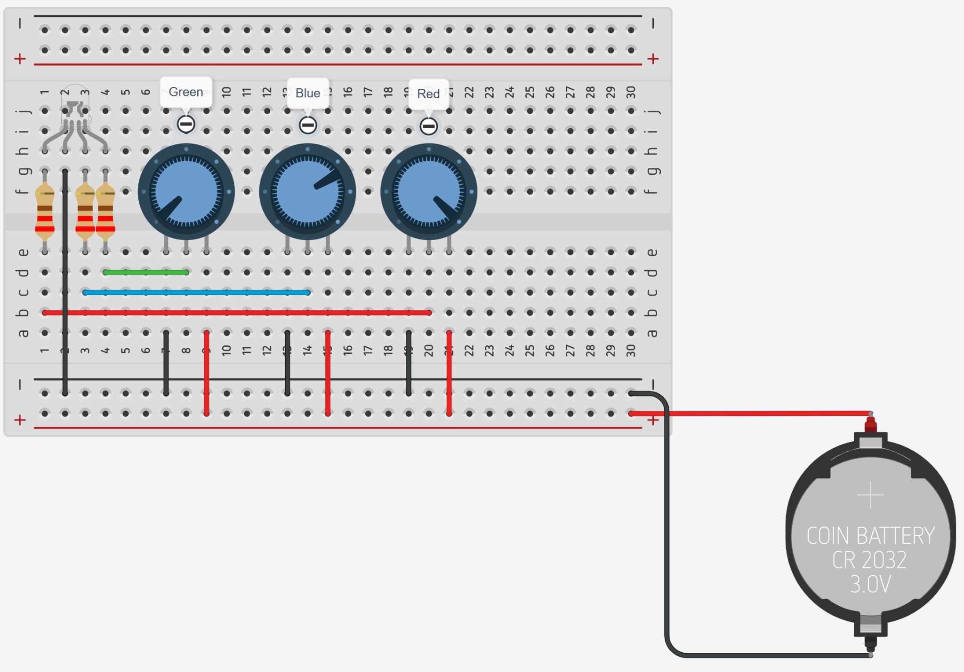
Potentiometer Circuit - Solution
Your Turn - Goal: Control a RGB LED with 3 potentiometers
There are two different solutions to this problem:
Having three potentiometers ranged from 0 to 100Ω so the value of the potentiometer is the direct resistance for the LEDs, issue with this configuration is the movements are not precise in changing the color and the risk to burn out the LED are high (above)
Having three same valued potentiometers serve as the gates for three 220Ω (below)
Solutions made with Tinkercad

Slide 34
Circuitry
EG1004 | UAI Lab 2

