Slide 1
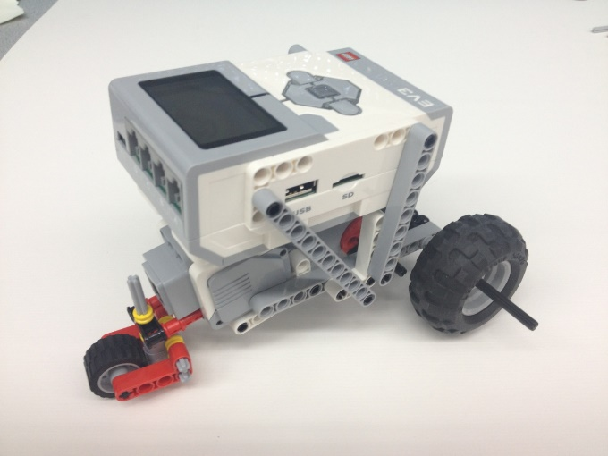
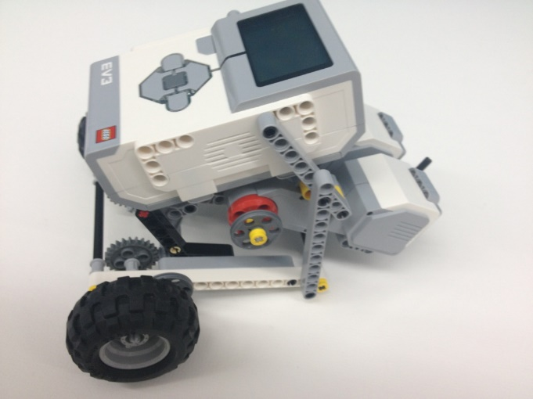
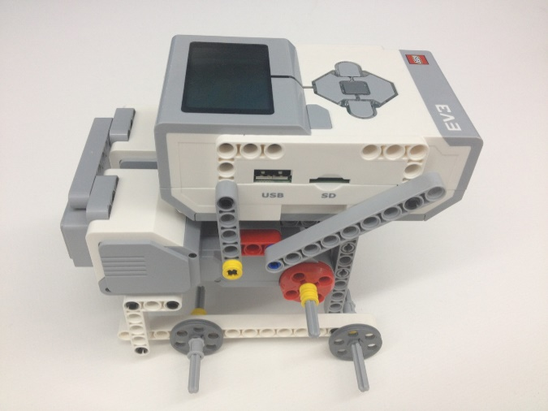
Product Evaluation & Quality Improvement

Slide 2

Overview
Objectives
Background Information
Materials
Procedure
Report
Closing

Slide 3
Objective
Build a robot and test it against the EG standards for accuracy and precision
Demonstrate the importance of product evaluation
Disassemble the robot and make quality improvements to the design

Slide 4
Background Information
Design Analysis
Engineers perform prototype testing
  Look for improvement suggestions
  Continuously improves product quality
Tests are performed to a company standard
  If the standard is met, the product is acceptable
  If standard not met, product may be redesigned or withdrawn

Slide 5
Background Information
Accuracy
  Comparison of the average of the results to the standard
Precision
  Repeatability of the results
  How close are the results to each other?

Slide 6
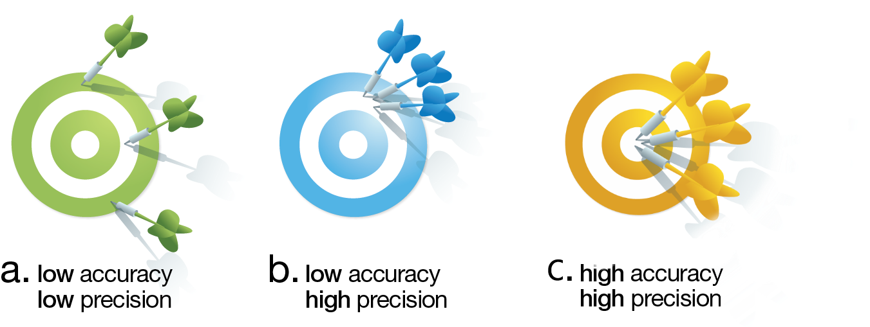
Background Information

Slide 7
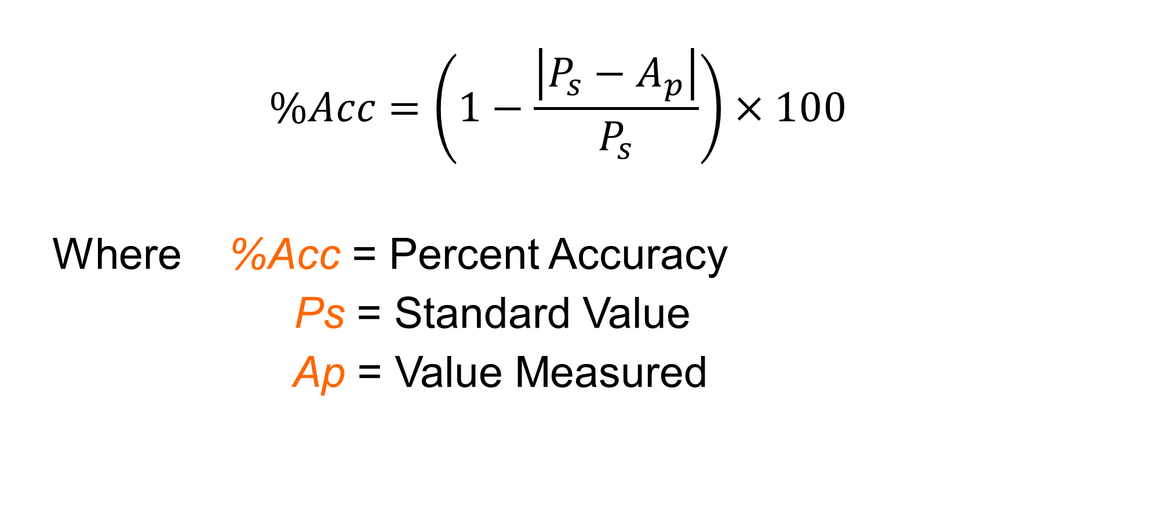
Background Information
$$\%Acc=\left(1−\frac{\left|P_{s}−A_{p}\right|}{P_{s}}\right)×100$$
Where %Acc = Percent Accuracy
Ps = Standard Value
Ap = Value Measured

Slide 8
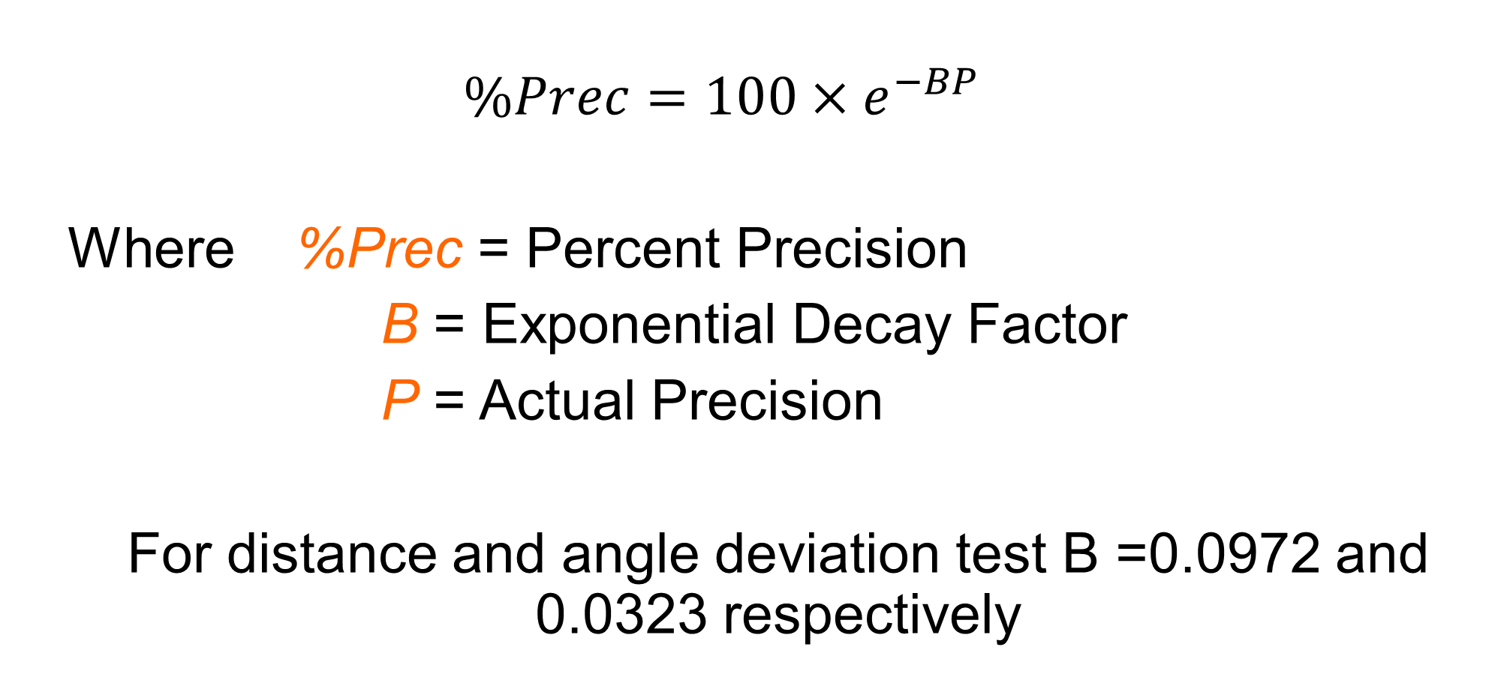
Background Information
$$\%Prec=100×e^{−BP}$$
Where %Prec = Percent Precision
B = Exponential Decay Factor
P = Actual Precision
For distance and angle deviation test B =0.0972 and 0.0323 respectively

Slide 9



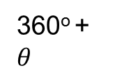

Background Information
Distance Test
  $P_{s}=\frac{distance traveled in 5 seconds}{5}×4$
Angle Deviation Test
  $P_{s}=360°$
Reference Point
360º + $θ$
Path traveled
$$θ$$
360º
Starting Point
360º - $θ$

Slide 10
Background Information
Quality Improvement
Analyzing the design
Testing the design
  Through physical or mathematical modeling or computer modeling
Does the robot perform to standard?
  If no, what can be done to improve its functionality?
  If yes, what can be done to improve its performance beyond the standard?

Slide 11
Background Information
Reverse Engineering
Understanding how a product functions
  Disassembly of said product
  Noting the key components
Carried out in both software and hardware fields

Slide 12
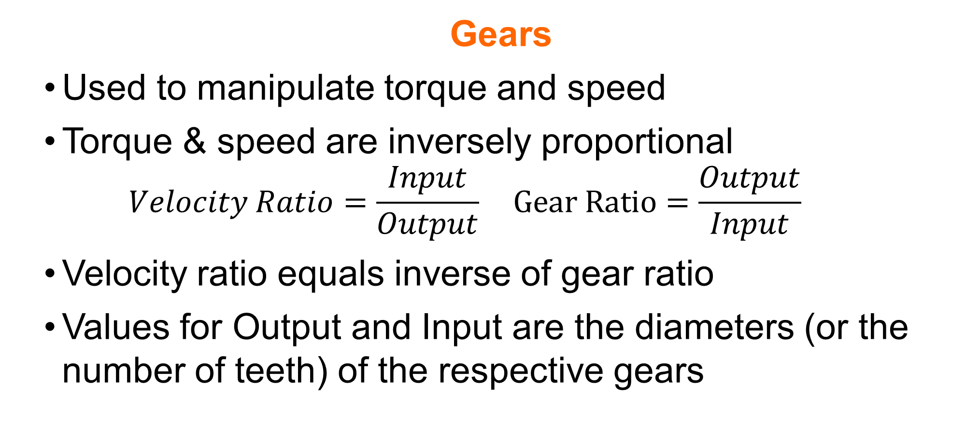
Background Information
Gears
Used to manipulate torque and speed
Torque & speed are inversely proportional
$Velocity Ratio=\frac{Input}{Output} Gear Ratio=\frac{Output}{Input}$
Velocity ratio equals inverse of gear ratio
Values for Output and Input are the diameters (or the number of teeth) of the respective gears

Slide 13
Background Information
Gears
There are many different types of gears
  Crown, worm, spur, rack, idler gears
Full description of each type of gear can be found on the EG Manual
Please take note of gear and velocity ratios since there are extremely useful with SLDP robots!

Slide 14
Materials
Mindstorms Kit
Computer with Mindstorms Software
Protractor and Ruler
Graph Paper

Slide 15
Procedure
Build a robot according to the robot provided by your TA
Program robot to perform two tests
  Distance
  Angle of Deviation
Determine if robot meets the 80% EG Standard
Reverse engineer the robot and make quality improvements to the design

Slide 16
Procedure - Testing
Distance & Angle Deviation tests are performed simultaneously
Create distance/angle test program
Download distance program to EV3
Run program for 5 seconds on testing paper to determine testing standard
Change program to run for 4 seconds
Record five trials and average these values

Slide 17
Procedure – Reverse Engineering
Assess data collected and any observations
Visually assess the robot’s design
Consider how it works
Sketch the front, top, and most detailed side of the robot (include dimensions)
Sketch the gear train and calculate the velocity and gear ratios (if applicable)

Slide 18
Procedure – Reverse Engineering
Before making changes to the original robot, remember to take a picture of it
Make necessary adjustments
Retest and collect data using modified robot
Take a picture of the final design
Sketch the front, top, and most detailed side of the robot (include dimensions)
Sketch the gear train and calculate the velocity and gear ratios (if applicable)

Slide 19
Procedure
Tabulate results in a chart:
It must pass all the tests at a percentage of at least 80%
 | Accuracy | % Acc | Pass/Fail | Precision | % Prec | Pass/Fail
Distance Test
Angle of Deviation Test

Slide 20
Report
Individual lab report
Title page
Discussion topics in the manual
MUST include spreadsheet with test results, standard, average, accuracy, precision, gear ratios, and velocity ratios

Slide 21
Presentation
Team presentation
Follow “Assignment” guidelines on EG Manual
Include photos of robot

Slide 22
Closing
Share tasks – one team member programs while the other builds the robot
Have all original data signed by a TA
Remember to submit all work electronically
Submit testing paper to TA at the beginning of next lab
Disassemble robot and sort parts into the kits
Return all unused materials to TAs

Slide 23

Product Evaluation & Quality Improvement
QUESTIONS?

