Slide 1

Electronic Filters

Slide 2
Overview
Objective
Background
Materials
Procedure
Report/Presentation
Closing

Slide 3
Objective
Learn about electrical filters
  Different types
  Uses
What is the -3dB point?
Create filters and a crystal set radio using multiple circuit elements
Identify filters based on generated graphs

Slide 4
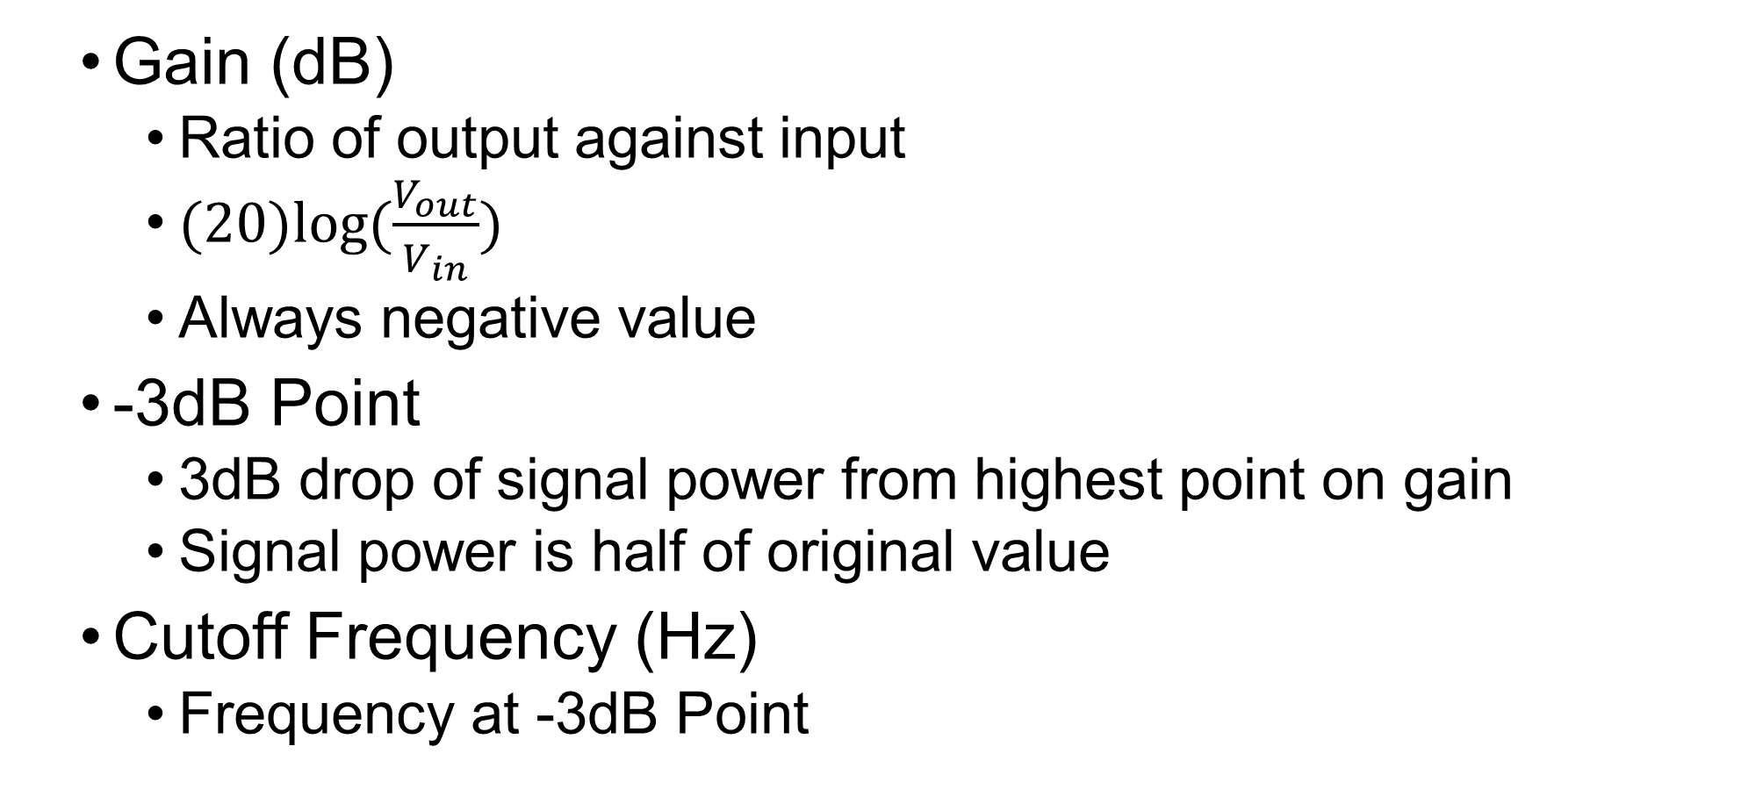
Frequency Response Graph
Gain (dB)
  Ratio of output against input
  $(20)log⁡(\frac{V_{out}}{V_{in}})$
  Always negative value
-3dB Point
  3dB drop of signal power from highest point on gain
  Signal power is half of original value
Cutoff Frequency (Hz)
  Frequency at -3dB Point

Slide 5
Frequency Response Graph
Plot Gain vs. Frequency of electrical signal
Semi-logarithmic scale
  Linear y-axis, logarithmic x-axis
Gain vs. Frequency
Max Gain (dB)
Gain (dB)
(linear scale)
Gain is 3 dB lower than the max
3 dB
Bandwidth
Cutoff Frequency
f (kHz)
(log scale)

Slide 6
What are Filters?
Eliminate unwanted frequencies
  High-pass or low-pass
Favor desired frequencies
  Band-pass
  Bandwidth: frequency range filter allows to pass
Example:
  Radio tunes in to particular station

Slide 7
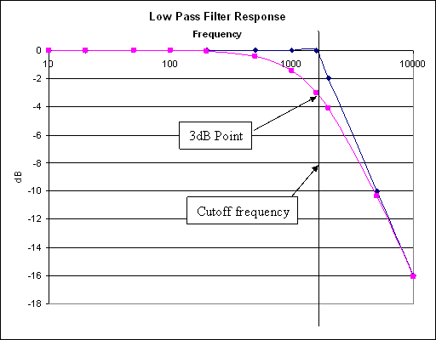
Basic Filter Types
Low-Pass Filter
Allows low frequencies to pass
3dB Point: -3dB
Cutoff Frequency: 1590 Hz
Bandwidth: 0-1590 Hz
IGNORE
PASS

Slide 8
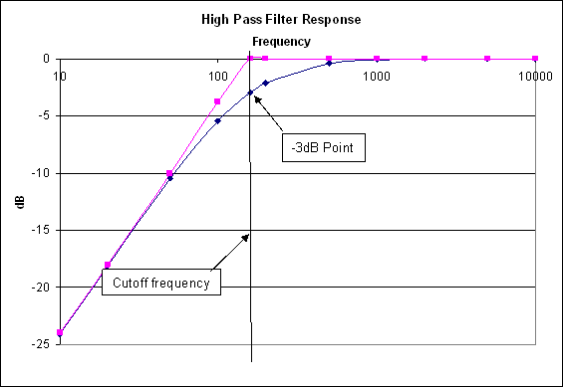
Basic Filter Types
High-Pass Filter
Allows high frequencies to pass
3dB Point: -3dB
Cutoff Frequency: 160 Hz
Bandwidth: 160 - ∞ Hz
IGNORE
PASS

Slide 9
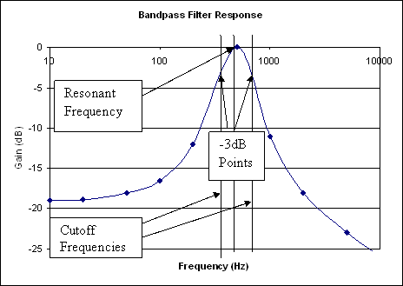
Basic Filter Types
Band-Pass Filter
Allows a limited range of
frequencies to pass
3dB Point: -3dB
Cutoff Frequency: 400 - 600 Hz
Bandwidth: 400 - 600Hz
Resonant Frequency
(High Response Point): 500 Hz
IGNORE
IGNORE
PASS

Slide 10
Electrical Terminology
Voltage (V)
  Potential difference in electrical energy
  Units = volts (V)
Current (I)
  Charge flow rate
  Can be positive or negative
  Units = amperes (A)

Slide 11
Electrical Elements
Resistor (R)
  Resists flow of electrical current
  Dissipates electrical energy as heat
  Often used to alter voltages in circuits
  Characterized by Ohm’s Law: V = I*R
  Not sensitive to frequency
  Uses a poor conductor (ex: carbon)
  Units = Ohms (Ω)
Symbol

Slide 12
Electrical Elements
Capacitor (C)
  Stores potential energy (V)
  Affected by voltage and frequency
  A pair metal plates separated by non-conductive material (ex: air)
  Electrical charge accumulates on plates
  Units = Farads (F)
Symbol

Slide 13
Electrical Elements
Inductor (L)
Stores and delivers energy in a magnetic field
Magnetic fields affect the current of a circuit
Effected by current and frequency
Is a coil of wire
Units = Henries (H)
Symbol

Slide 14
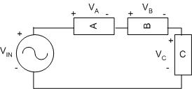
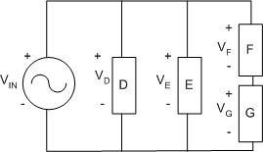
Electrical Wiring
Series
Same current through all elements
V_{in} = V_{A} + V_{B} + V_{C}
Parallel
Same voltage across all branches
V_{in} = V_{D} = V_{E} = V_{F} + V_{G}

Slide 15
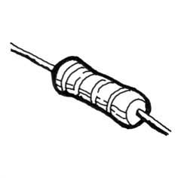
Materials
Resistors
Brown, black, yellow = 100KΩ
Brown, black, green = 1MΩ
Capacitors
102 = 0.001 µF
10J = 10pF
Inductors
1mH

Slide 16
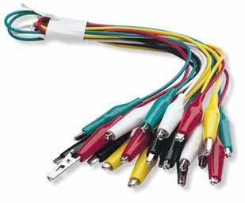
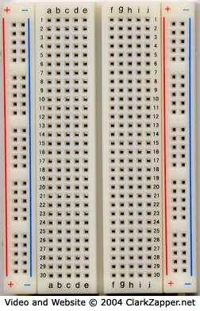
Materials
NI-ELVIS II+
Breadboard
Coaxial to alligator clip cable

Slide 17
Procedure – Testing
Plug in NI ELVIS II to PC Lab and turn it on
Select NI ELVISmx Instrument Launcher
Select FGEN in the Instrument Launcher
Set function generator to 1000Hz
Set the amplitude to 2 Vpp
Set signal route to FGEN BNC
Select Scope in the Instrument Launcher

Slide 18
Procedure – Data Analysis
Click run in both instruments
Calculate the
Test both of the circuits and determine their type
Assemble the radio

Slide 19
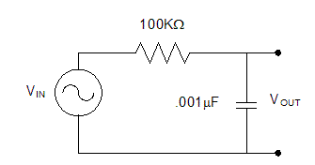
Procedure – Circuit 1
Connect the 100kΩ resistor and .001 µF capacitor in series

Slide 20
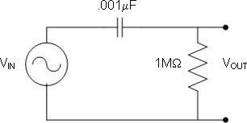
Procedure – Circuit 2
Connect 0.001 µF capacitor to 1 MΩ resistor in series

Slide 21
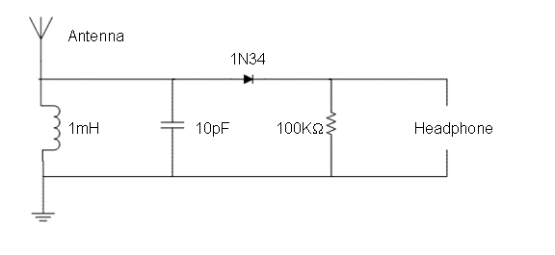
Assignment: Presentation
Assemble the circuit below (Crystal Radio)

Slide 22
Assignment: Report
Individual Report (one report per student)
Title page
Discussion topics in the manual
For all circuits
Include Excel tables and Gain vs. Frequency graphs
Determine filter type
Label each graph with determined filter type
OPTIONAL- Include photos of circuits and setup

Slide 23
Assignment: Report
Team Presentation
Include lab data
Professional-looking tables
Discussion topics in the manual
Include photos of circuits and setup
Refer to “Creating PowerPoint Presentations”
found in Online Manual

Slide 24
Closing
TA will assign which circuit you start with
Have all original data signed by your TA
All team members must actively participate
in experiment
Submit all work electronically
Return all materials to your TA

