Slide 1
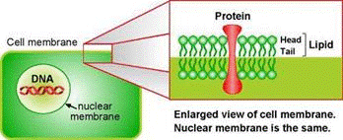
Biomedical
Forensics

Slide 2
Overview
Experimental Objective
Background Information
Materials
Procedures:
  Part 1: Forensic Academy
  Part 2: Murder Mystery
Conclusion

Slide 3
Experimental Objective
Understand and use basic forensic techniques:
  DNA Extraction
  Blood Typing
  Fingerprinting
  Blood Splatter Analysis
Solve a murder mystery

Slide 4

Background Information
DNA Extraction
DNA Properties
Forensic Techniques

Slide 5
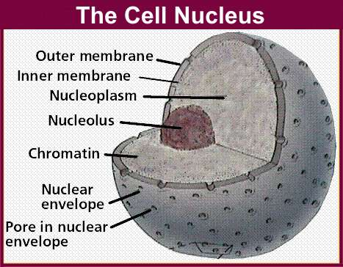
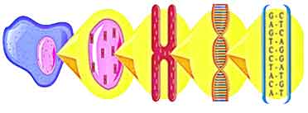
DNA Extraction
Process of breaking down cells to reach the nucleus
  Double layer of lipids
Chromatin
  Made of DNA and protein
chromatin
DNA
cell
nucleus
chromosome

Slide 6

DNA Properties
Structure:
  Long polymer, double-helix shaped
  Sugar-phosphate backbone
  Phosphate group make DNA negatively charged
Polarity and solubility: “like dissolves like”
  Most polar of all biopolymers
  Soluble in polar solvent: water
  Precipitated in non-polar solvent: alcohol
Helical backbone
DNA strands

Slide 7
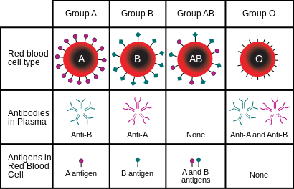
Forensic Techniques
Blood Typing
  Using reactions to decode blood
Fingerprinting
  Using observations to determine each type
  Arch, whirl, loop
Drug Testing
  Using reagents to determine unidentified powder substances

Slide 8
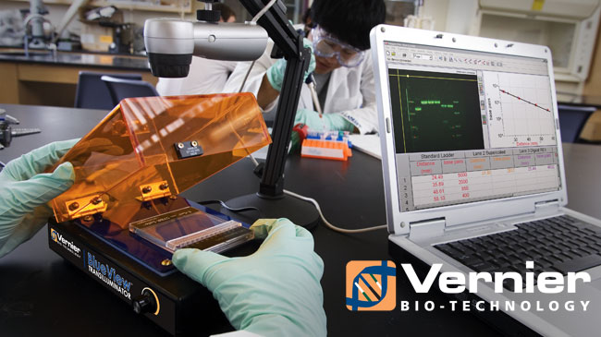
Materials
Fruit sample
Non-iodized table salt (NaCl)
Hand soap (clear, unscented)
95% isopropyl alcohol (0°C)
Distilled water
Strainer
Plastic cups
Ziploc bag
Iron Magic Wand
Iron powder
Blood typing kit
White paper
String
Meter stick

Slide 9
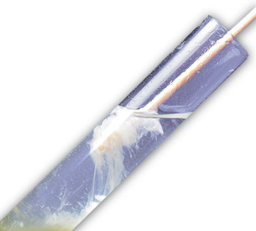
Procedure
Part 1: Forensic Academy
  DNA Extraction
  Fingerprinting
  Drug Testing
  Blood Splatter

Slide 10
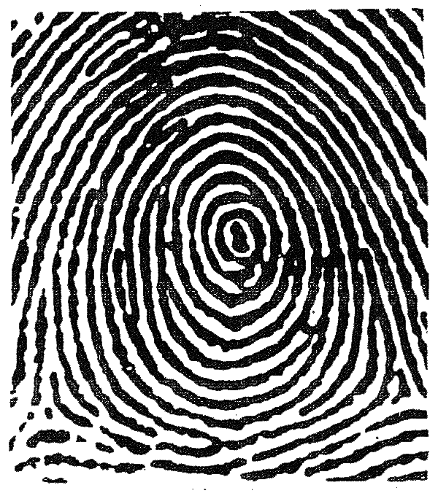
Procedure
Part 2: Murder Mystery
  Biological Dimensional Analysis
  Blood Typing
  Fingerprinting Testing

Slide 11
Assignment: Report
Team report
Title page
Discuss topics in manual
Scan in lab data and notes

Slide 12
Assignment: Presentation
Team presentation
Include photos of:
  DNA Extraction
  Fingerprinting Test
Include table of blood splatter results
State who the killer is

Slide 13
Conclusion
Never let solution foam when or after adding soap
Keep clear lab notes, have it scanned
Have a picture taken of your extracted DNA
Suggest improvements in lab report
Answer questions in lab manual in report

Slide 14

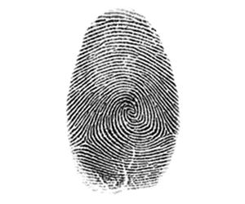
Biomedical Forensics
  Questions?

