Slide 1
Proper Sourcing / Academic Integrity
EG1004 | RECITATION 1

Slide 2
Agenda
Importance of Proper Citation
Professional Ethics
EG1004 Cheating Policies
Strategies to Avoid Cheating
Citing in Lab Reports
Questions
2

Slide 3
Scientific Papers are Evidence-Based
Direct evidence
Recorded, documented data
Calculation and synthesis
Properly cited from outside sources
Previous work acknowledged
Sources transparent & testable
New work contextualized
Validity of assertions testable
3

Slide 4
Consequences for Failing to Properly Source
Professional
Damage to science!
Academic
Escalating grade penalties based on severity
Loss of reputation, career
Civil penalties (lawsuits)
Failure on assignments or course, up to expulsion
4

Slide 5
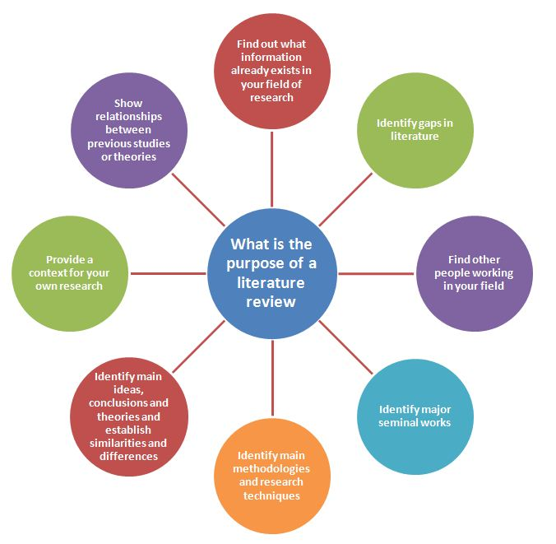
Literature Review in Scientific Reports
Figure 1: Literature review purpose courtesy of Michigan State University
5

Slide 6
Research Resources
Google Scholar
NYU Library (Free Access for NYU Students)
home.nyu.edu (login) > Research > Articles & Databases
NYU Libraries Citation Style Guide (guides.nyu.edu/citations)
scholar.google.com
Citation Rules and Styles
Purdue OWL (owl.purdue.edu)
6

Slide 7
Citing in EG1004 Lab Reports
Full citation in works cited section:
NYU Tandon School of Engineering. (2024). “Lab 11: Biomedical Forensics.” EG1004 Online Lab Manual. Accessed 5 November 2024 from manual.eg.poly.edu.
In text citation near info quoted or paraphrased:
(NYU Tandon, 2024)
7

Slide 8
Professional Ethnics in Engineering
National Society of Professional Engineers Code of Ethics
Responsibility for welfare, safety and health of the public
Uphold respectability of profession
Avoid deceptive acts
Full code of ethics at NSPE.org
Figure 1: NSPE Logo courtesy of NSPE
8

Slide 9
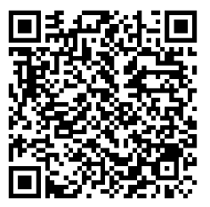
Violating Academic Integrity (Cheating)
Presenting others’ work as your own
Fabrication
Falsifying data or sources
Group work on individual tasks
Including AI-generated content
Unauthorized collaboration
Using same work in multiple courses or assignments
Duplicating work
Forgery
Altering an academic document
From the NYU Code of Conduct: Misrepresentation, deception, dishonesty, or any act of falsification to influence academic evaluation
9

Slide 10
EG1004 Cheating Policy
1st Offense
Zero on assignment, notify Student Affairs
2nd Offense
Fail EG1004
Software is used to
compare lab reports:
Peer submissions
Previous students
Other sources
10

Slide 11
Strategies to Avoid Cheating
Start Early
Don’t Share Work
Poor time management creates pressure to cheat
You are also penalized if your work is copied!
Use Outside Sources Properly
Cite lab manual and all sources
Don’t Copy Content (including your own, or generated with AI)
Papers are checked using software
Proper citation is modeled in Sample Lab Report
11

Slide 12
QUESTIONS?
12

