Slide 1
Student’s Guide to

Slide 2
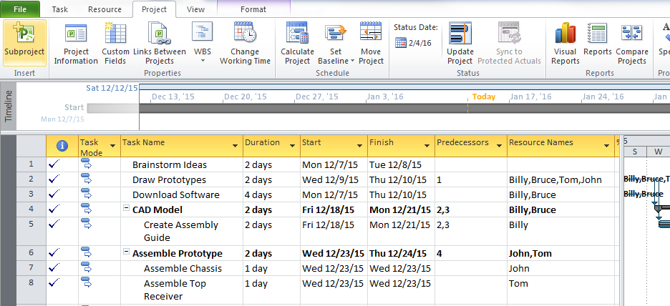
Press “FILE”

Slide 3
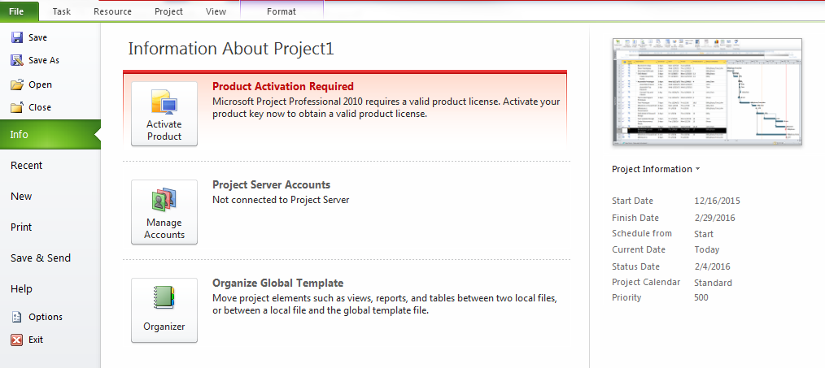
Press “OPTIONS”

Slide 4
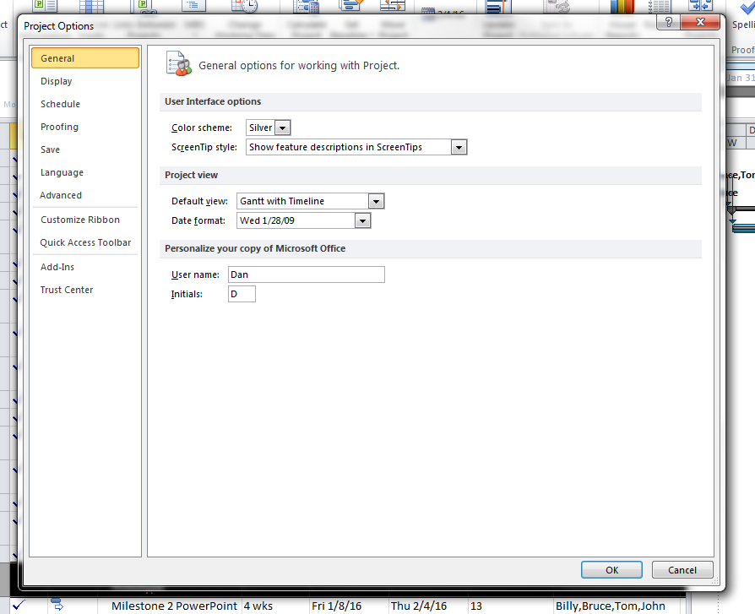
Press “ADVANCED”

Slide 5
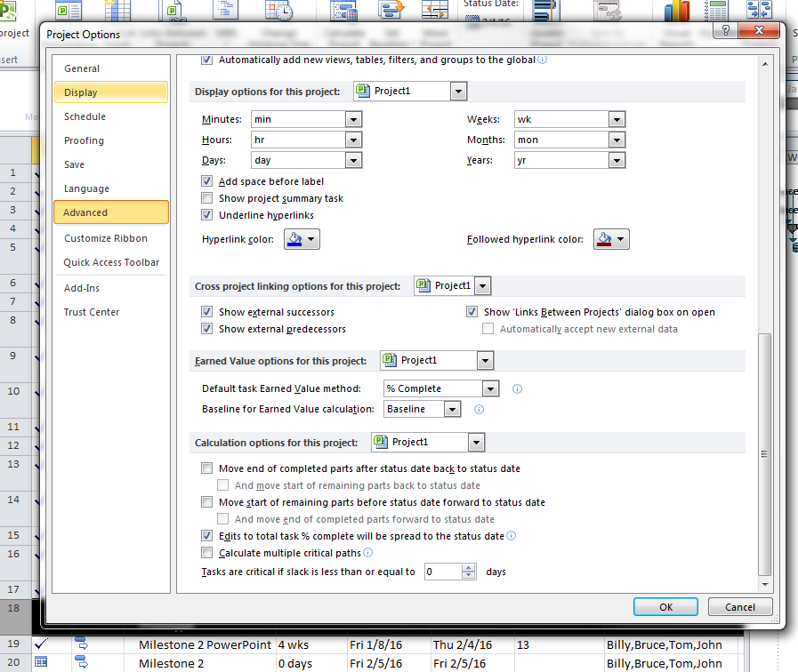
Scroll to the bottom and check the box before “Edits to total %...”

Slide 6
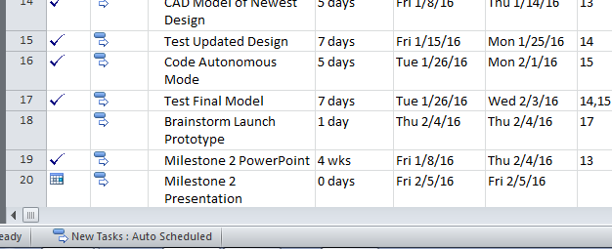
Auto Scheduling Mode
Press this button to open a small menu and select “Auto Scheduled” from it

Slide 7
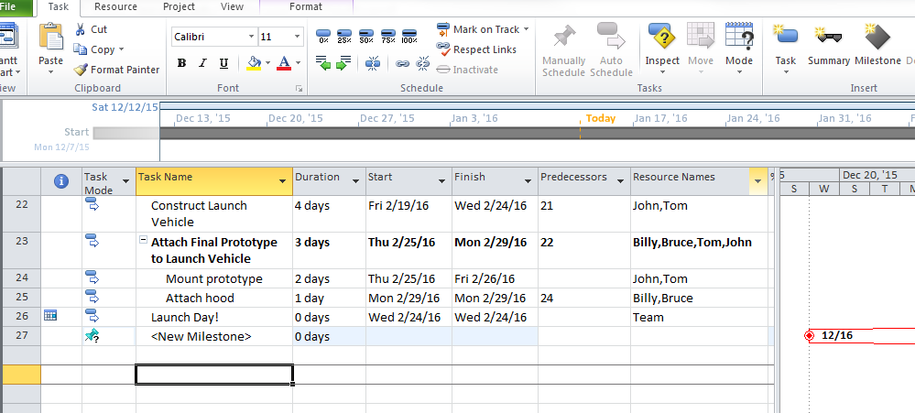
Milestones
Press “Milestone” to add a milestone, it’ll appear below as a <New Milestone>

Slide 8
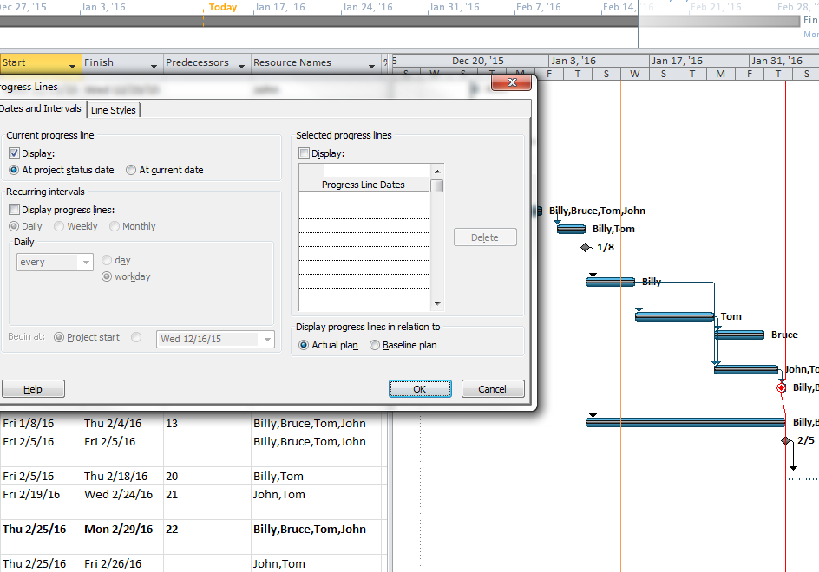
Progress Line
To add a Progress Line, right click on the timeline and select “Progress Line”
Then press “Display” then “At Project Date”

Slide 9
Create/Change Resources
First press this little button in the lower right hand corner

Slide 10
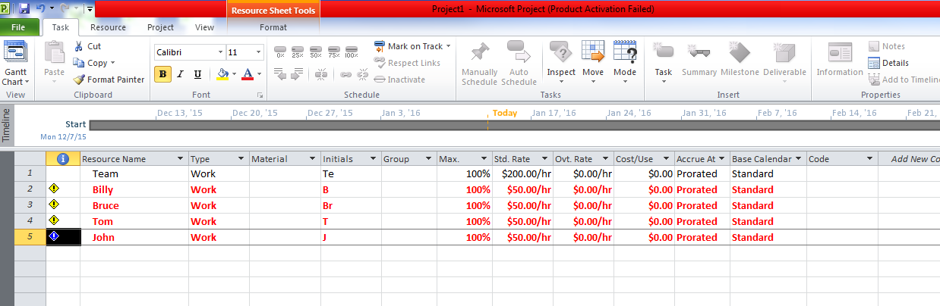
Create/Change Resources
It’ll open this page to see the individual resources and hourly rates <Std. Rate>
*the red means they are “overallocated” meaning they’re doing too much at once, but they’re hard workers, so it’s okay—they’ll power through it.

Slide 11
Create/Change Resources
Press this little button to return to chart view

Slide 12
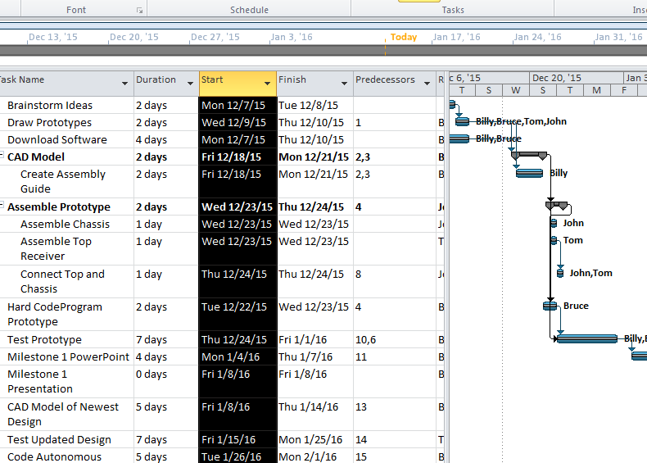
To Copy Picture Into Your Presentation
Highlight every row

Slide 13
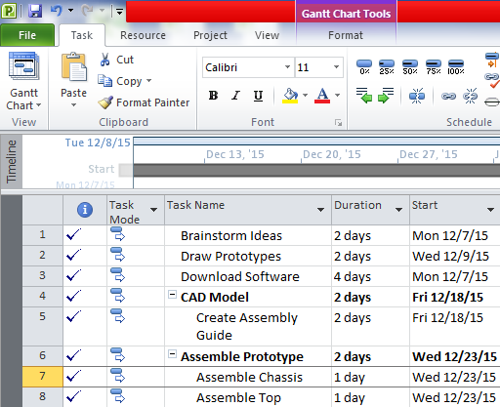
To Copy Picture Into Your Presentation
Press the drop down menu next to “Copy”

Slide 14
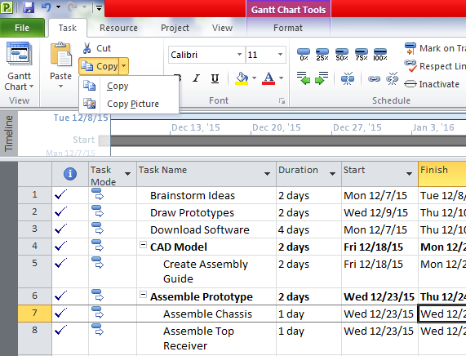
To Copy Picture Into Your Presentation
Select “Copy Picture”

Slide 15
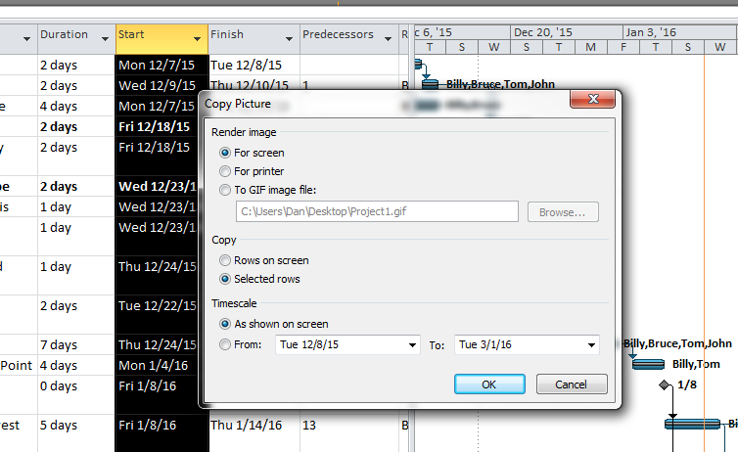
To Copy Picture Into Your Presentation
Press “Selected Rows” then OK

Slide 16
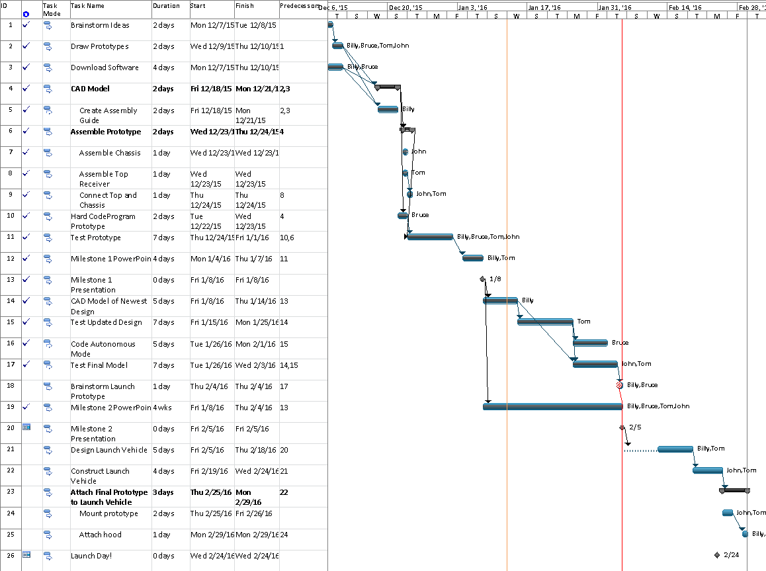
To Copy Picture Into Your Presentation
Then you can copy and paste it into anything you want (like Paint or PowerPoint)

Slide 17
Status Date
Use the Status Date to control where the Progress Line is
It’s right here

Slide 18
Status Date
You can also use “Update Project” to set the Status Date and update any completion percentages before that date

Slide 19
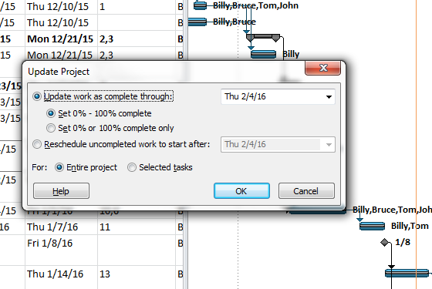
Status Date
Use this menu to change completion percentage
Use this dropdown menu to change the date

Slide 20
Change Timescale
Press this little button at the bottom right
(Timescale is set automatically to 1 Day = 8 Hours)

Slide 21
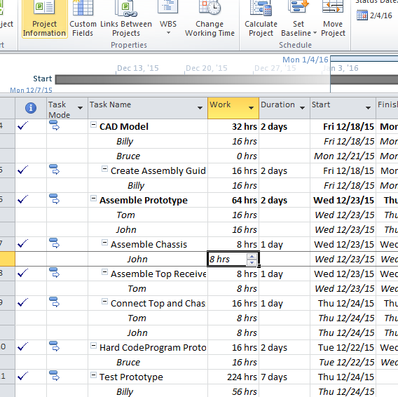
Change Timescale
Select the box, and change the time
Anything under 8 hours will remain 1 day, it will not let you set more than 8 hours/day

Slide 22
Calculating Labor Times
Press “Project”

Slide 23
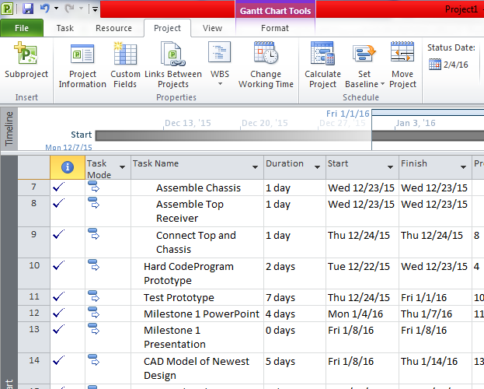
Calculating Labor Times
Press “Project Information”

Slide 24
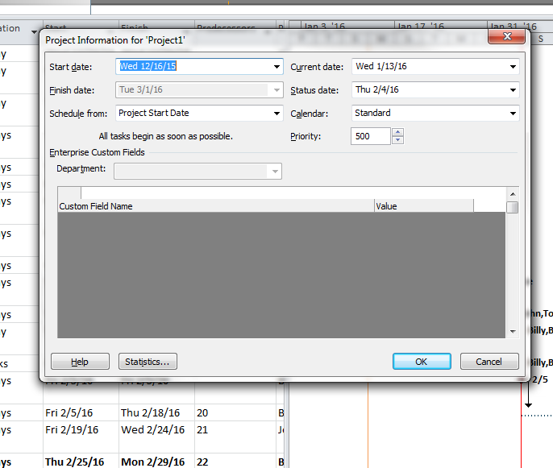
Calculating Labor Times
Press “Statistics”

Slide 25
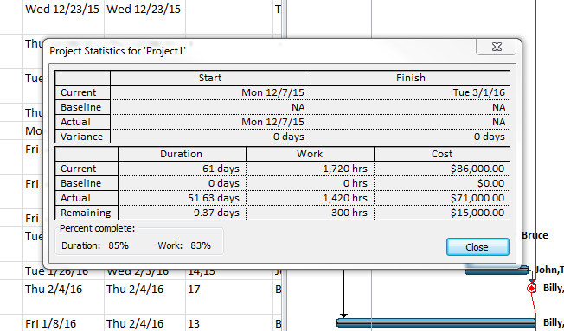
Calculating Labor Times
Here is the cost, as well as the Actual Payment (to the current date) and the remaining cost (until the end)

Slide 26
Requirements
Make sure you have:
Minimum of 20 tasks
Milestones
Responsible person for tasks shown
Progress line shown
“Copy Picture” is used instead of screenshotting

