Slide 1

HOW TO GIVE A MILESTONE PRESENTATION
EG1003 | RECITATION 3

Slide 2

AGENDA
Milestones & Benchmarks
Milestone Presentation Overview
Milestone Presentation Format
Questions
1

Slide 3
MILESTONES & BENCHMARKS
Milestones
Three Milestones through semester (1, 2 & 3)
Each Milestone has a presentation
Update progress on semester-long design project (SLDP)
Benchmarks
Two Benchmarks during semester (A and B)
List of tasks to complete for each Benchmark
Tasks are semester-long design project (SLDP) dependent
2

Slide 4
MILESTONE PRESENTATION
OVERVIEW
Three Milestone presentations through the semester
Timed five-minute presentation
Update on progress of SLDP
Professional sales pitch presentation
Be a bit more creative with these presentations!
3

Slide 5
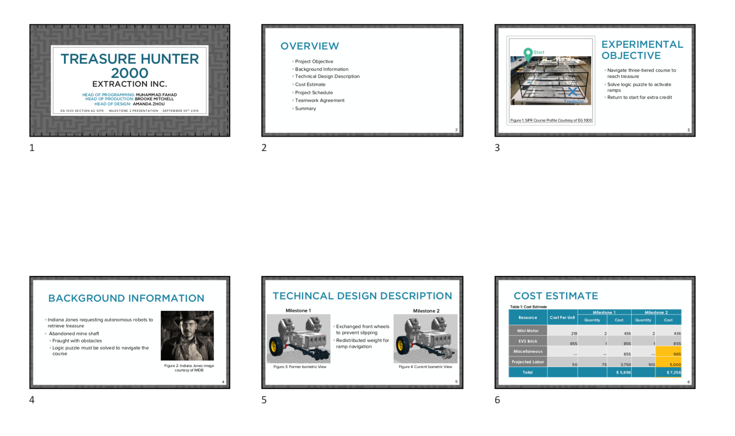
MILESTONE PRESENTATION
OVERVIEW
Submission:
EG1003 Website at 11:59 PM night before recitation
Two printed copies brought to recitation
  Six slides per sheet horizontal
  Stapled
Figure 1: In-class printout
4

Slide 6
MILESTONE PRESENTATION
FORMAT
Consistent format and order for all Milestone presentations:
Title
Overview
Project Objective
Technical Design Description
Cost Estimate
Project Schedule
Teamwork Agreement
(MS 1 Only)
Summary
Title
Different format than lab presentations!
5

Slide 7

TITLE SLIDE
Product name
Company name
Group members with company titles
You create! Remember to be professional!
Project name (i.e. BDR or RAD)
EG1003 section
Date
Figure 2: Title sample slide
6

Slide 8
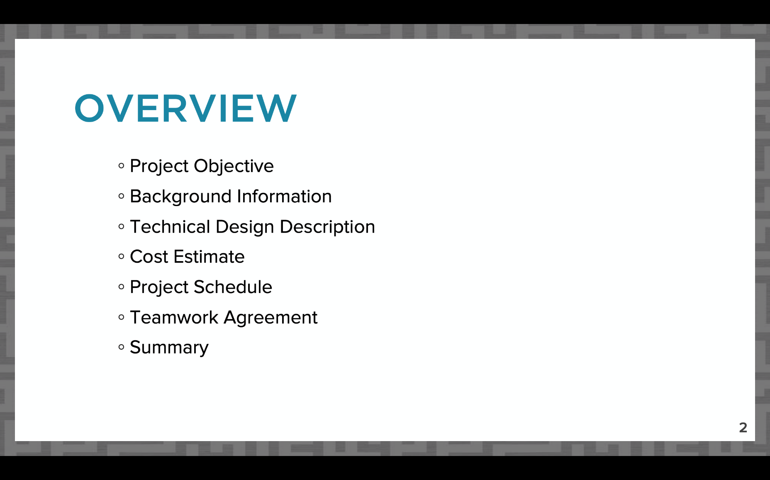
OVERVIEW SLIDE
Slide title “Overview”
No need to read slide aloud during presentation
Same overview slide/order for all Milestone presentations!
Figure 3: Overview slide sample
7

Slide 9
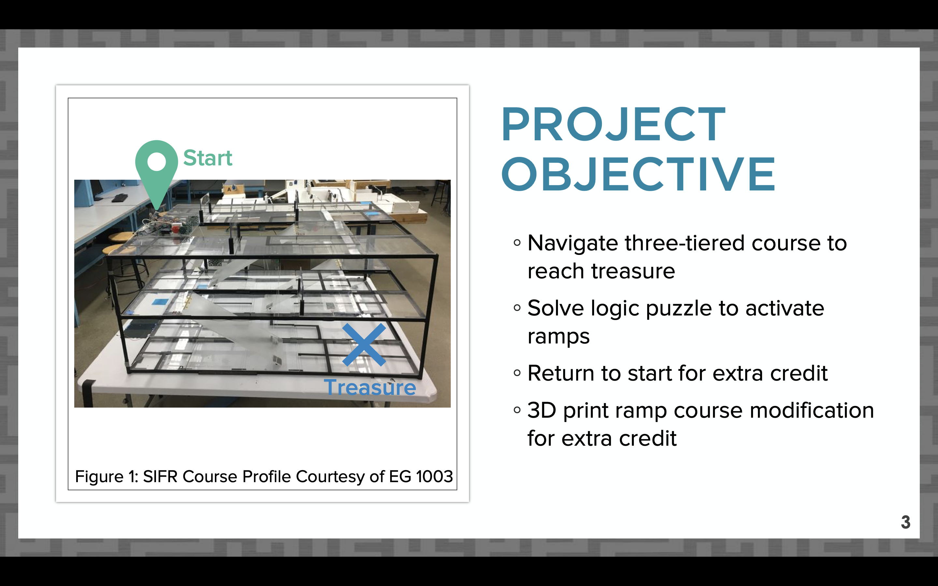
PROJECT OBJECTIVE SLIDE
Slide title “Project Objective”
What are you doing in your project?
Include overall approach
  Include photo of route for robot courses
Extra credit points you’re aiming to earn
Figure 4: Project objective sample slide
8

Slide 10
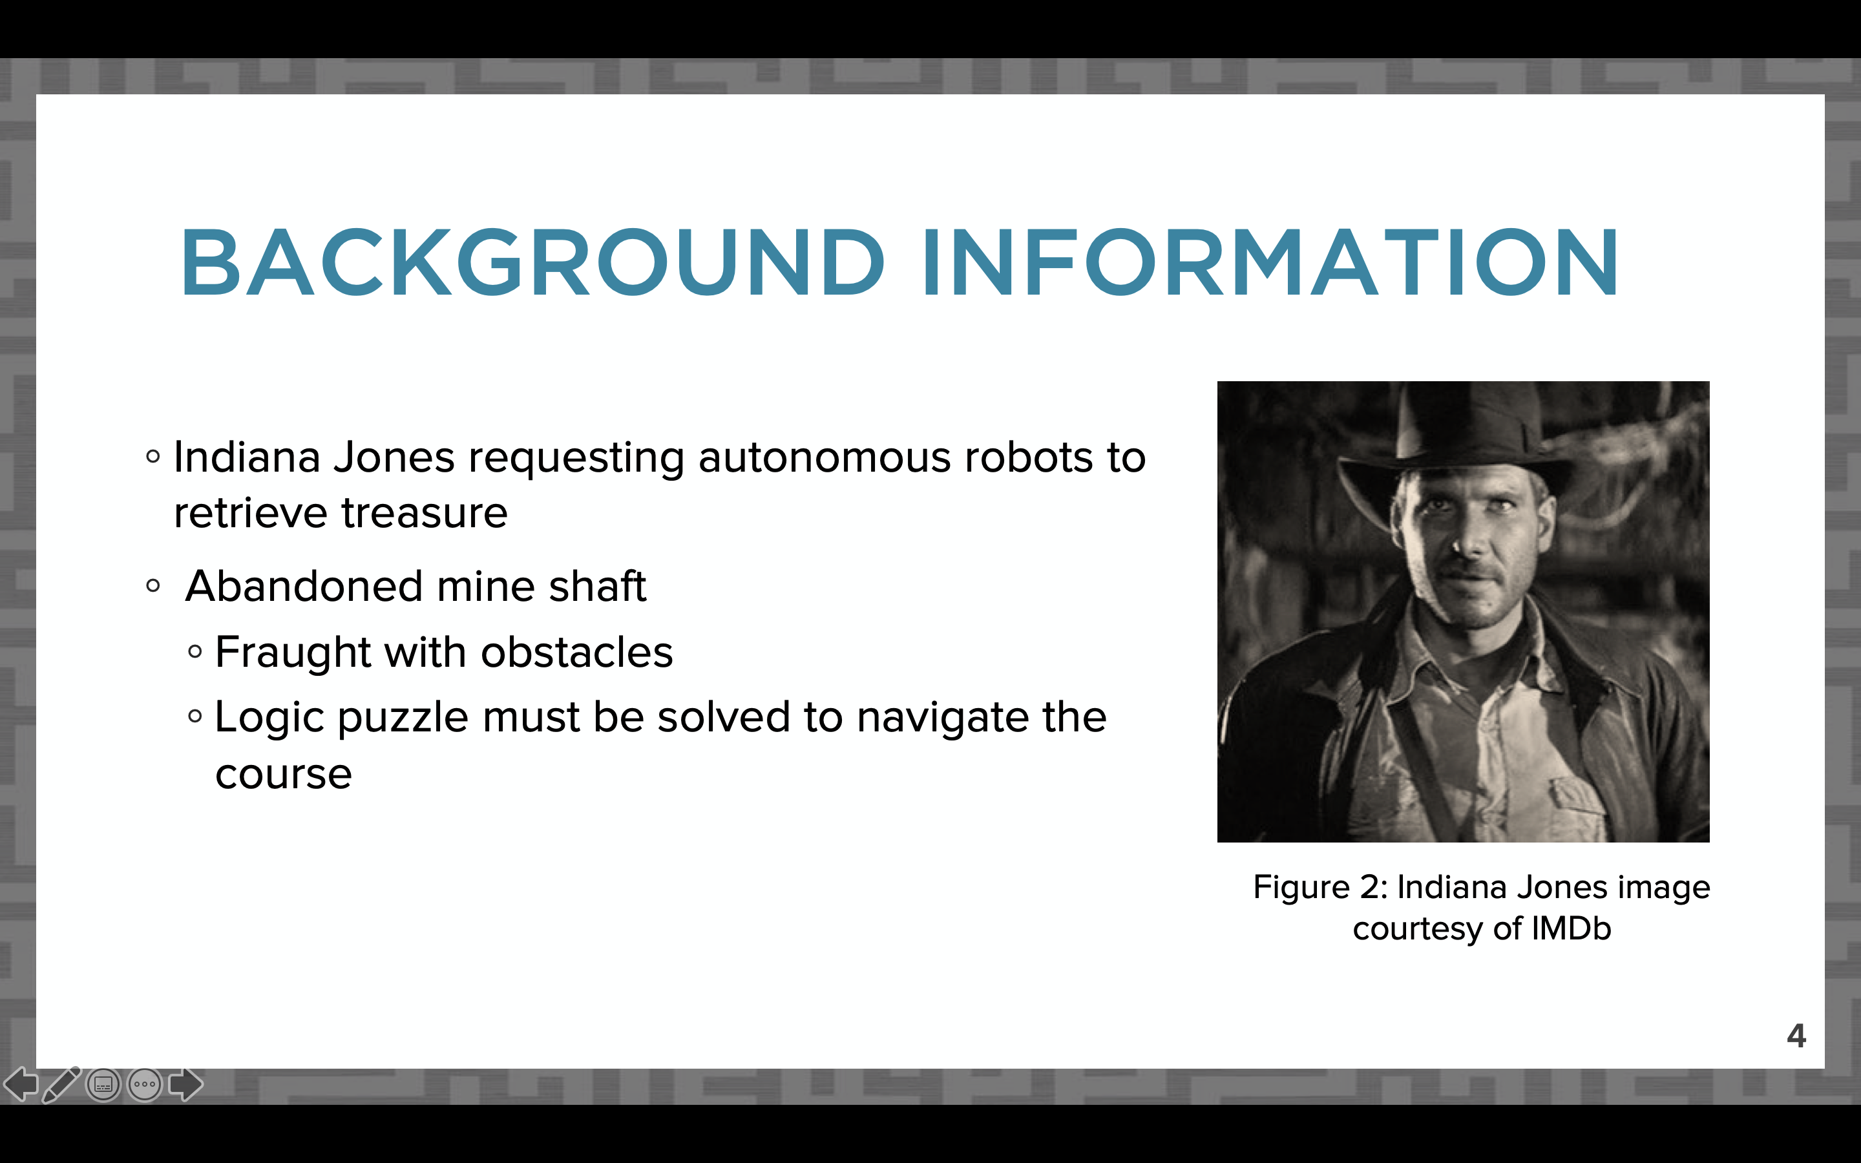
BACKGROUND INFORMATION
SLIDE
Slide title “Background Information”
Why are you completing the project?
Paraphrase project description from student manual
Figure 5: Background information sample slide
9

Slide 11
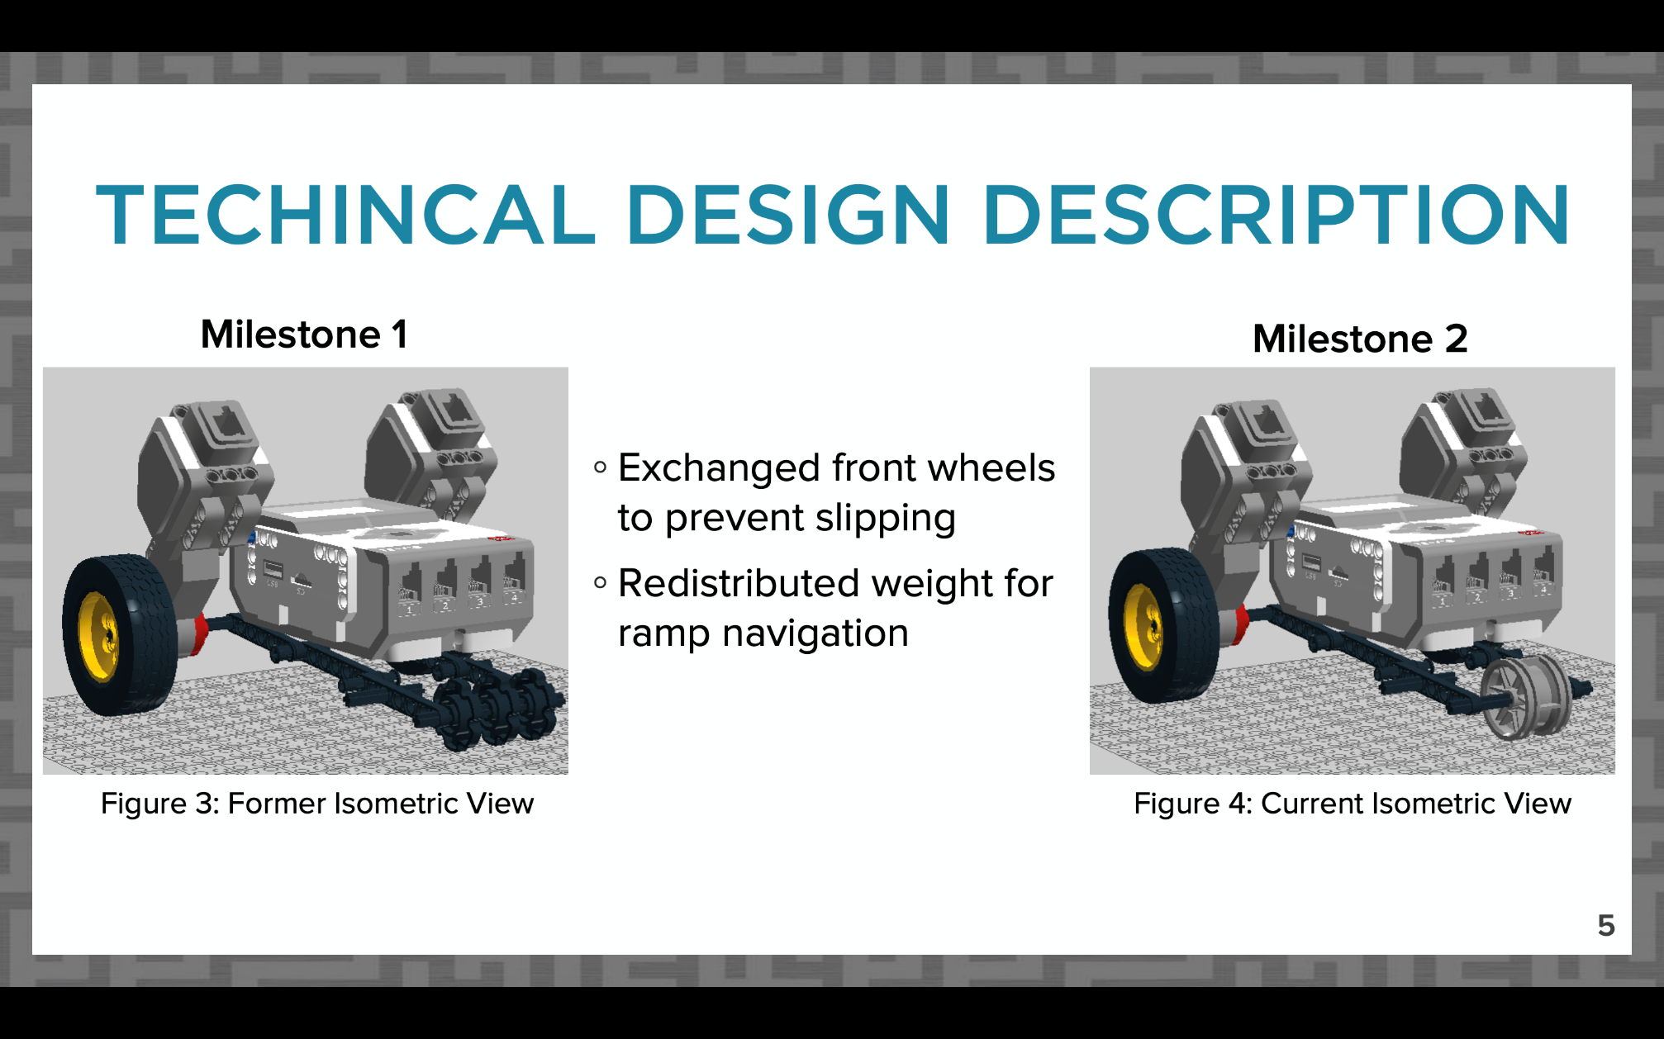
DESIGN DESCRIPTION
SLIDES
Slides titled “Technical Design Description”
How does your project work?
All required CAD views
Coding snapshot and description
(if applicable)
For future Milestones, compare changes in design
Figure 6: Sample CAD design change comparison
10

Slide 12
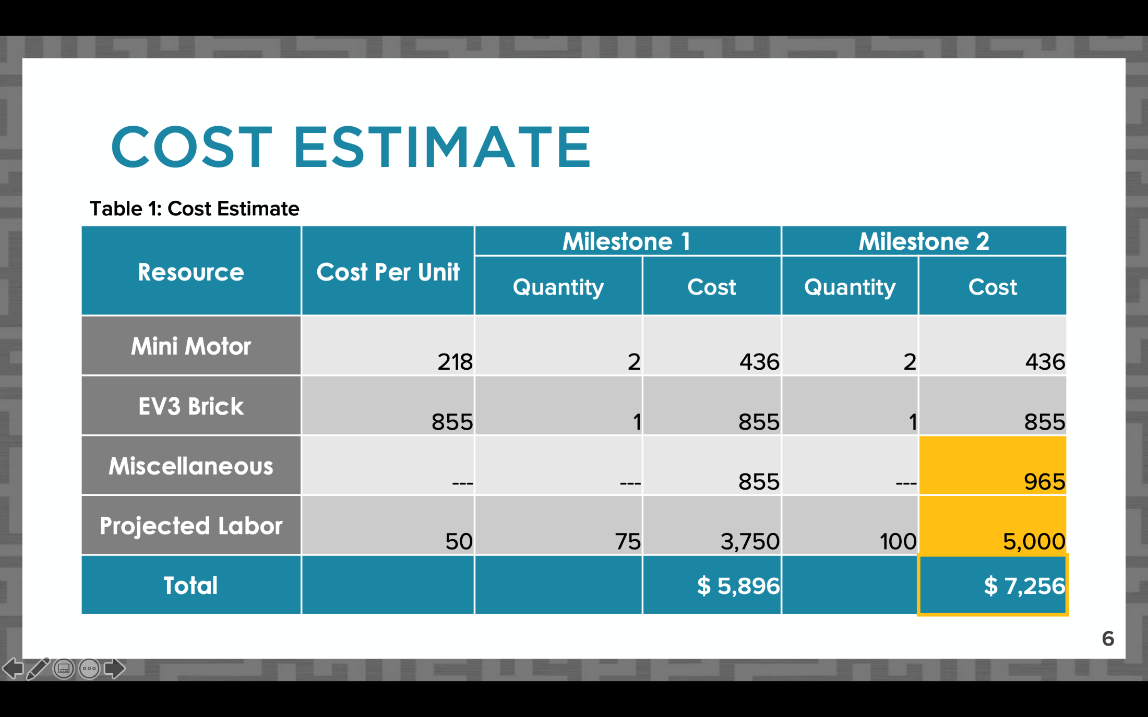
COST ESTIMATE SLIDE
Slide title “Cost Estimate”
Table should be professional and readable
List major parts individually, group smaller cost items under “miscellaneous”
Include labor cost for projected hours worked
Figure 7: Sample cost estimate slide
11

Slide 13
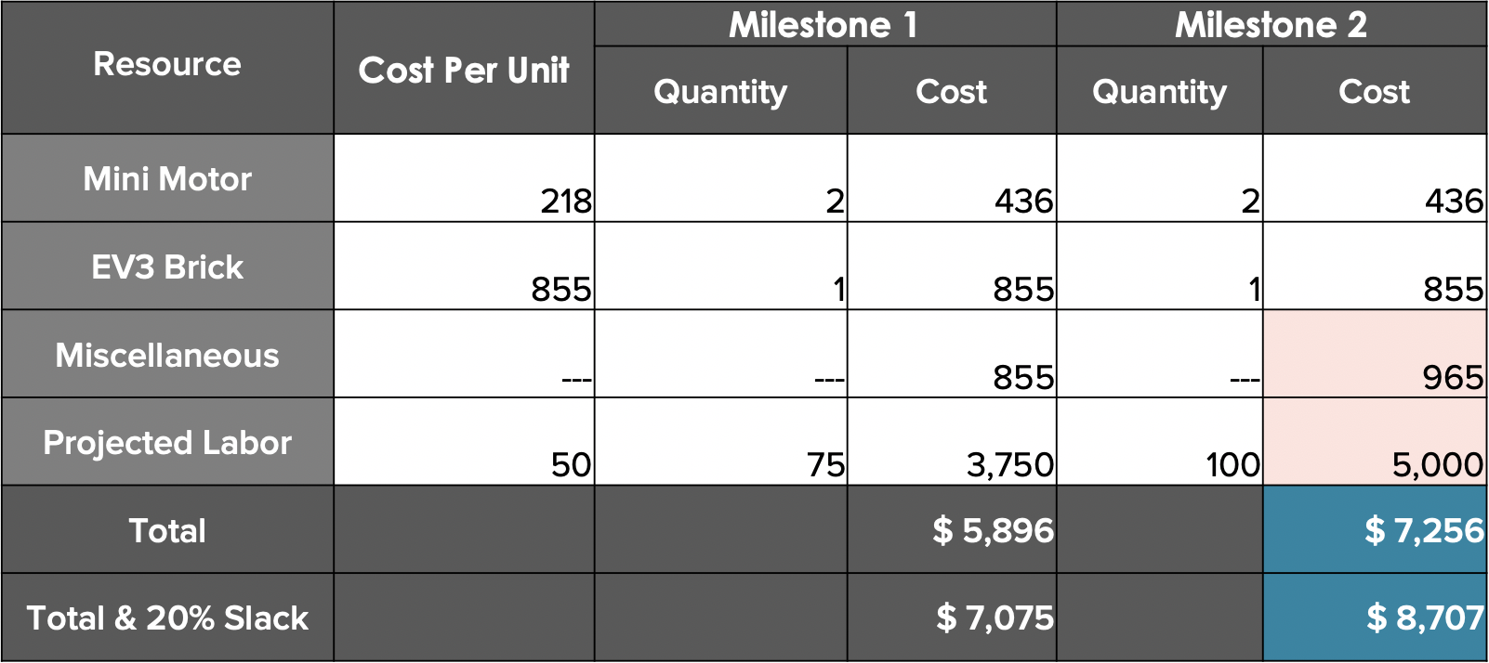
COST ESTIMATE SLIDE
Compare changes in cost on one slide for future Milestones
Full dollar amounts
Highlight total cost
Use online cost resources (LEGO pricelist on student manual)
Consider adding 20% slack for future unexpected costs
Table 1: Sample cost estimate
12

Slide 14
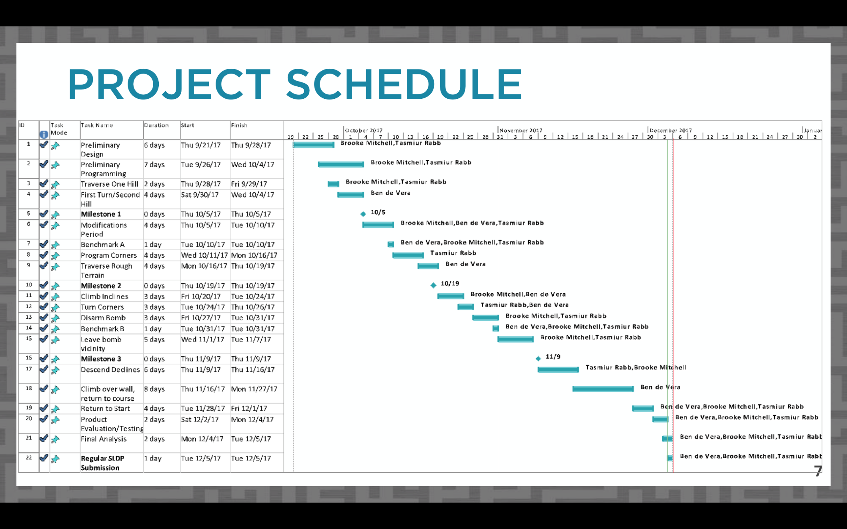
PROJECT SCHEDULE SLIDE
Slide title “Project Schedule”
Copy picture function
  Do not screenshot
Include table, Gantt chart, and progress line in image
Refer to Microsoft Project Student Guide presentation for instructions
  VCL copy picture instructions
Figure 8: Project schedule sample slide
13

Slide 15
TEAMWORK AGREEMENT SLIDE
Slide title “Teamwork Agreement”
Milestone 1 presentation only
Full instructions for agreement on student manual
Summarize agreement:
  Communication
  Meetings
  Differences in opinion
  Responsibilities
  Workload
14

Slide 16
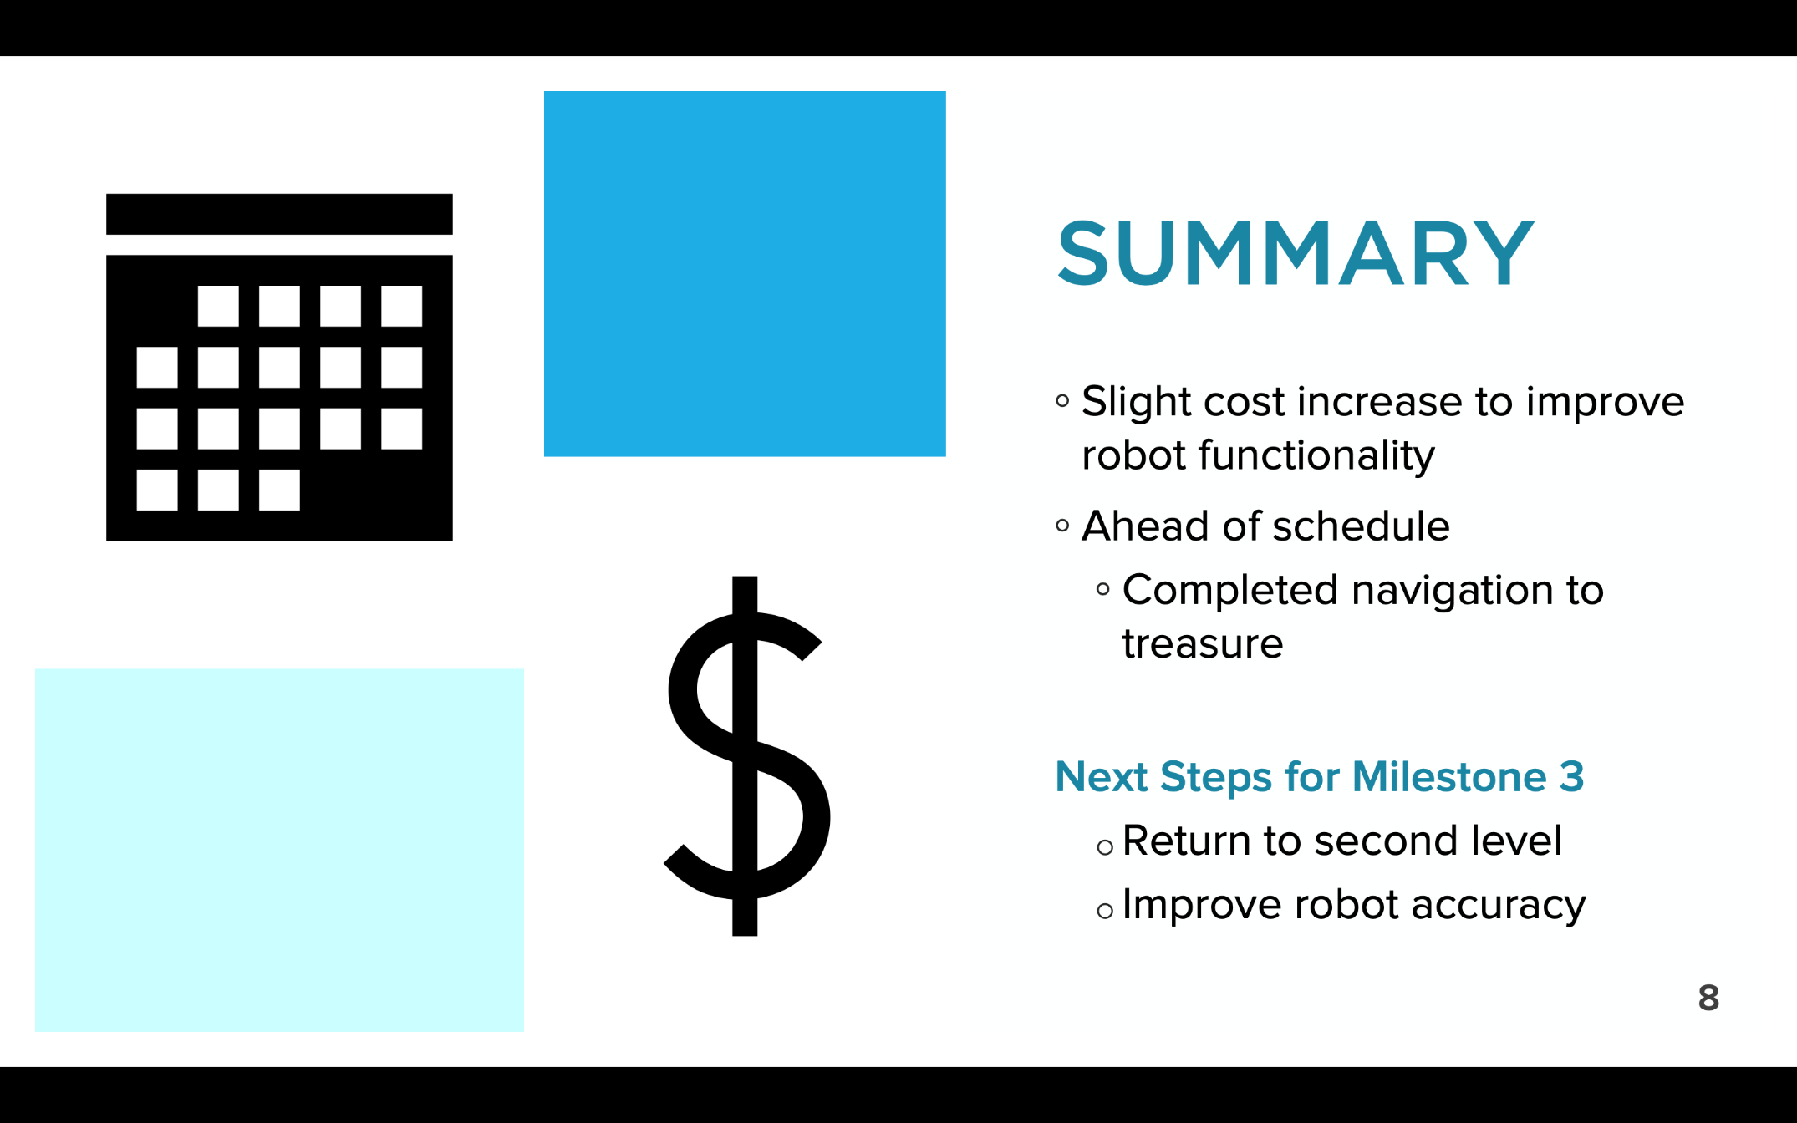
SUMMARY SLIDE
Slide title “Summary”
Overall assessment on project
Are you on schedule?
Are you on budget?
Include next steps for the following milestone
Figure 9: Conclusion sample slide
15

Slide 17
QUESTIONS?

