Slide 1
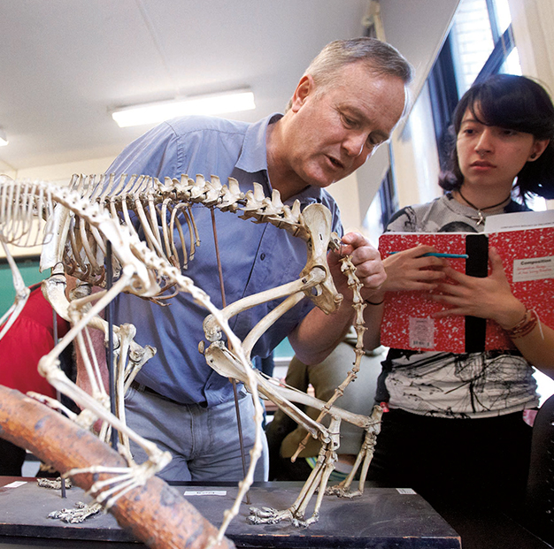
EG 1003: Introduction of Engineering and Design
Academic Honesty and Plagiarism
Giving credit where it’s due

Slide 2
Why is this important?
Severe penalties at Poly
Grades of zero
Failure of courses
Worse penalties in industry
Civil penalties (lawsuits)
Criminal penalties
Involuntary termination (getting fired)
It’s wrong
What you think matters – express your own thoughts

Slide 3
Types of Academic Dishonesty
Cheating
Showing performance that you don’t really have
Copying work during exams
Having others do work for you and claiming it as your own
Plagiarism
Using other people’s work without their knowledge or permission, and claiming it as your own

Slide 4
What’s the harm?
People assume you know things that you don’t
Gives everybody a bad name
“I hired that guy as a systems expert because he got an “A” in his Poly Operating Systems class, and he didn’t know anything. I’m never going to hire another Poly student.”

Slide 5
Types of Material
Work that is publicly available
Designed to be read and used by a wide audience
It’s how our civilization advances
You can use it to build your own ideas
You should give credit to the source to give them the recognition they deserve
Done via citation of the source

Slide 6
Types of Material
Work that is not publicly available
Author has specifically limited the audience
You have access as a matter of trust
You must honor that trust and keep the material private
You can ask the author for permission to distribute parts of the material more widely
Constitutes “intellectual property” and has value to them – don’t steal!

Slide 7
What Is Plagiarism?
Violation of the principles of the last several slides
Using public work without giving credit to the origin
Includes printed material and also material on the Internet
Includes photocopying material (e.g. texts) and electronic cut and paste
Using private work without permission

Slide 8
“Fair Use”
A legal term that embodies these principles for non-private published work
Part of United States copyright law
Complicated at times
Simple version:
If you’re using a little (sentence, formula, definition), it’s OK if you cite the source. It’s NOT OK to just use it
If you’re using a lot, it’s illegal (paragraphs, chapters)

Slide 9
Examples of Fair Use
For academics, can make class handouts of short passages from published work (with attribution)
Famous quotes
Attribution shows accuracy plus the source
Private use for background information
Material read at the public library for you to learn

Slide 10
Examples of non-fair use
Copying a text book to save money at the bookstore
Cutting and pasting material from Web sites without attribution
Copying MP3 files and giving them to your friends
Claiming a famous quote as your own, or not bothering to find the source
“We have met the enemy and he is us!” – Walt Kelly, Earth Day 1970

Slide 11
The Role of EG1003
Introduce you to common practice
Introduce you to industry practices
Introduce you to basic ethical and legal principles

Slide 12
Plagiarism in EG1003
Copying other lab reports
Claiming somebody else’s skill in writing reports as your own
Claiming somebody else’s technical skill as your own
Copying the online manual
The above, plus showing a depth of understanding you don’t have
The manual is the work of many, claiming as your own insults them

Slide 13
Temptation
Due to workload, it is tempting to copy other work
You want to mask shortcomings in technical skills or English
Don’t give in to temptation!
Better to have these recognized and helped by us than to hide them
We will enforce the rules
The entire EG1003 staff watches for dishonesty

Slide 14
Penalties
The first time you are caught with plagiarism on a lab report or presentation, you will get a zero (both TA and WC grades, as appropriate)
If a team report, all members get a zero
One of the most forgiving policies at Poly
If you do it again, even before you’re told about the first time, you get an automatic “F” grade for the course – no exceptions

