Slide 1

Rapid Assembly & Design (RAD) WORKSHOP
EG1003 | Lab 4B

Slide 2


OVERVIEW
Objective
Background Information
Materials
Procedure
Assignment
Closing
Figure 1: Raspberry Pi (Left) and OpenCV (Right) Courtesy of Wikipedia
1

Slide 3
OBJECTIVE
Explore the capabilities of the Raspberry Pi and Pi Camera Module
Develop a Python script for color detection using OpenCV
2
Notes:
Maybe something about versus an Arduino

Slide 4
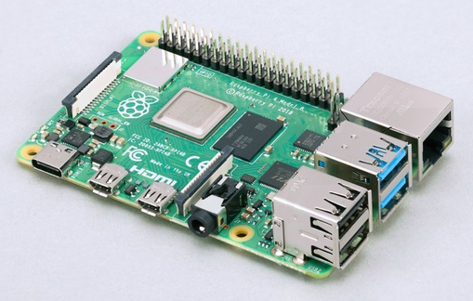
BACKGROUND INFORMATION
Raspberry Pi
  Credit card sized computer
  Used for electronic projects
  Runs on Raspberry Pi OS (a Debian-based operating system)
  Has a CPU, GPU, and RAM
Figure 2: Raspberry Pi 4
3
Notes:
Background info: The Pi, hardware of the pi, Python, OpenCV, NumPy, camera module

Slide 5
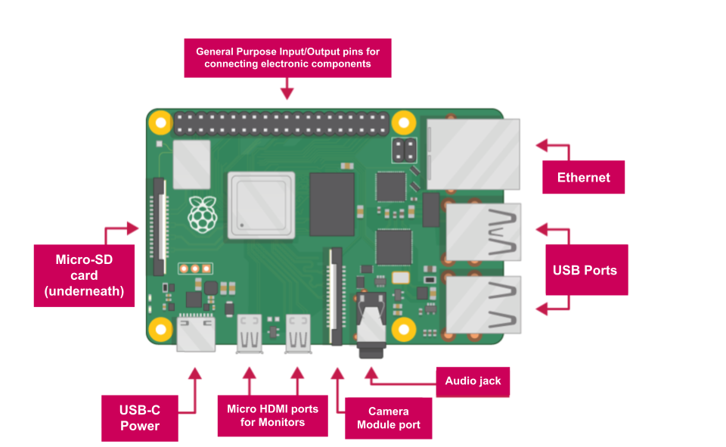
BACKGROUND INFORMATION
Raspberry Pi 4 - Hardware
  SD card slot
  USB ports
  Camera module port
  Micro HDMI port
  USB-C power
  Audio jack
  Ethernet port
Figure 3: Raspberry Pi 4 Hardware Overview
4

Slide 6
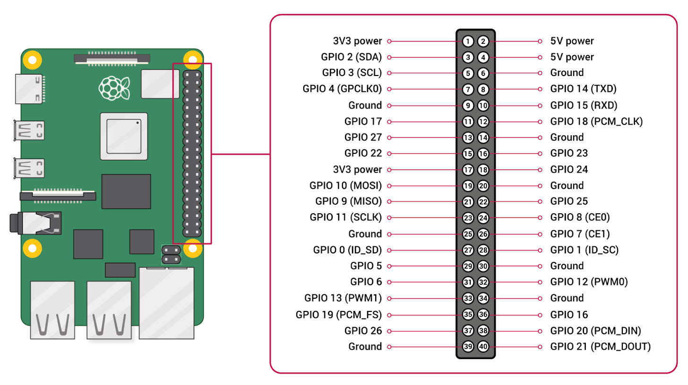
BACKGROUND INFORMATION
Raspberry Pi - Hardware
  28 General Purpose Input/Output (GPIO) pins
  4 Power pins
    Two 3.3V
    Two 5V
  8 Ground pins
Figure 4: Raspberry Pi GPIO Pinout
5

Slide 7
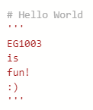
BACKGROUND INFORMATION
Python
  Text-based programming language
  Syntax
    No closing mark needed after each line
  Comments
    Line comments – begin with #
    Block comments – begin and end with ‘’’
Figure 5: Line and Block Comments
6

Slide 8
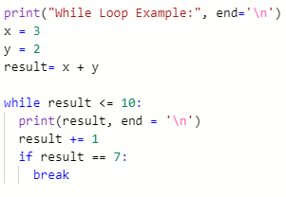

BACKGROUND INFORMATION
Python – Loops
  While loops
    Executed so long as the condition is true
  For loops
    Iterates over a set sequence
  Break statements
    Used to break out of a loop at any time, regardless of the condition
Figure 6: While and For Loops, and Break statements
7

Slide 9
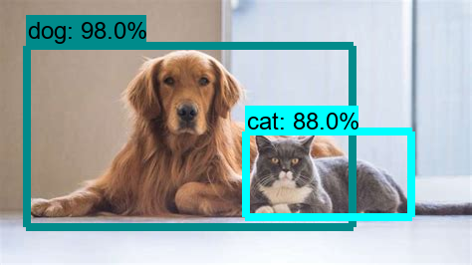
BACKGROUND INFORMATION
OpenCV – Computer Vision
  Image and video processing
  Object and Color Detection
  Applications
    Face recognition
    Driverless car navigation
Figure 7: OpenCV Object Detection Courtesy of Great Learning
8

Slide 10
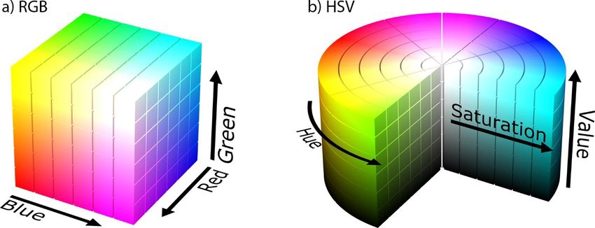
BACKGROUND INFORMATION
OpenCV – Color Spaces
  Images represented as 3D arrays
  Every pixel has a specific [B,G,R] value
    B – Intensity of Blue
    G – Intensity of Green
    R – Intensity of Red
  Can be converted to Hue, Saturation, Value (HSV)
    HSV describes color like human eye perceives it
    Suitable for color detection
Figure 8: BGR and HSV Color Models
9

Slide 11
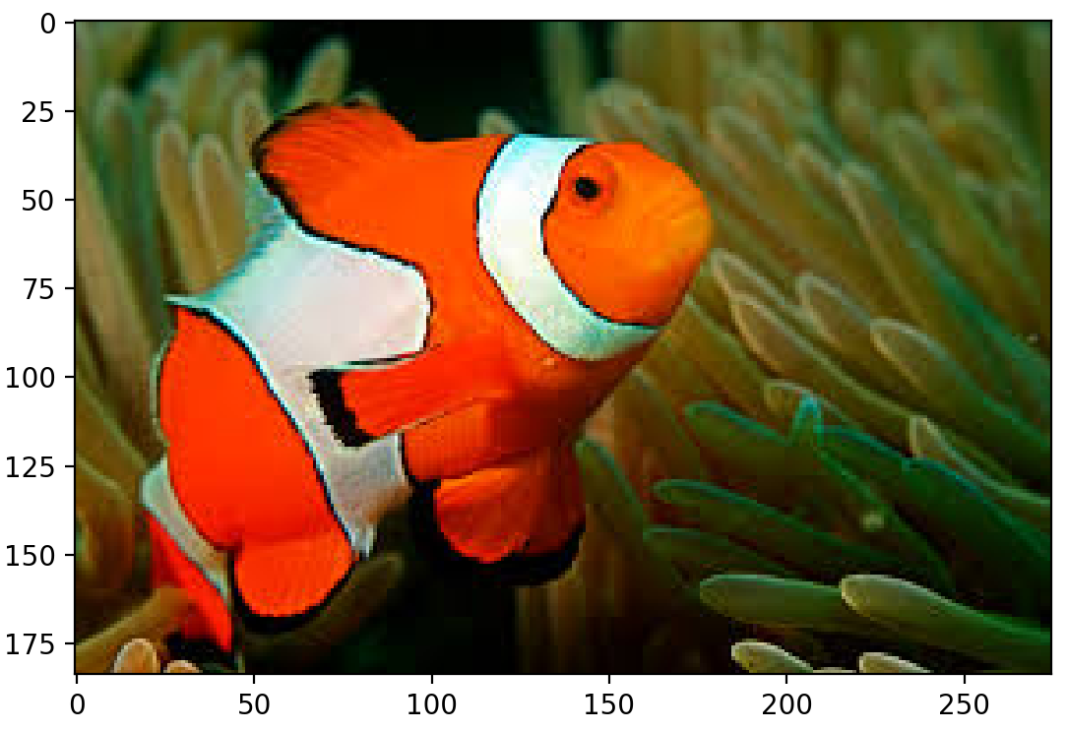
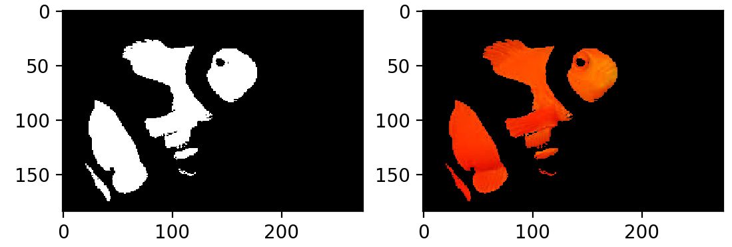
BACKGROUND INFORMATION
OpenCV – Commands
  cv2.cvtColor(image, conversion code)
    Conversion Code used in lab: cv2.COLOR_BGR2HSV
  cv2.imshow(window name, image)
    Displays image in a window
  cv2.inRange(image, lower, upper)
    Filters pixels that fall within specified range
    Output known as a ‘binary mask’
Figure 9: cv2.inRange() Output Courtesy of Real Python
10

Slide 12
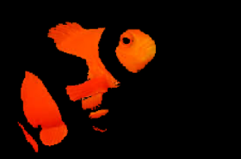
BACKGROUND INFORMATION
OpenCV – Commands
  cv2.bitwise_and(frame, frame, mask= my_mask)
    Bitwise AND operation
    Retains only pixels in the frame with a White value in the mask
  cv2.bitwise_or(frame1, frame2)
    Bitwise OR operation
    Retains non-zero pixels from both frames.
Figure 10: cv2.bitwise_and(..) Output Courtesy of Real Python
11

Slide 13
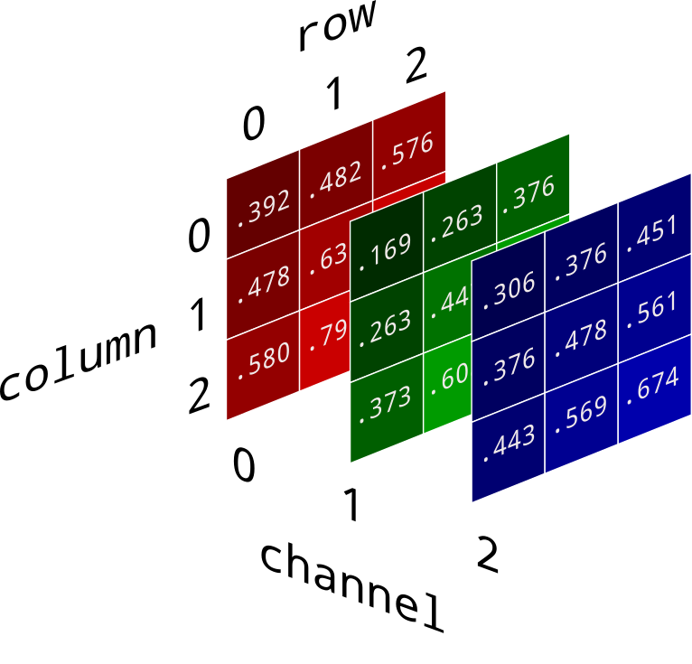
BACKGROUND INFORMATION
Numerical Python (NumPy) library
  Used for working with arrays
  OpenCV describes images as NumPy arrays
  np.array()
    Converts the input to an array data type
Figure 11: 3-dimensional NumPy array
12

Slide 14
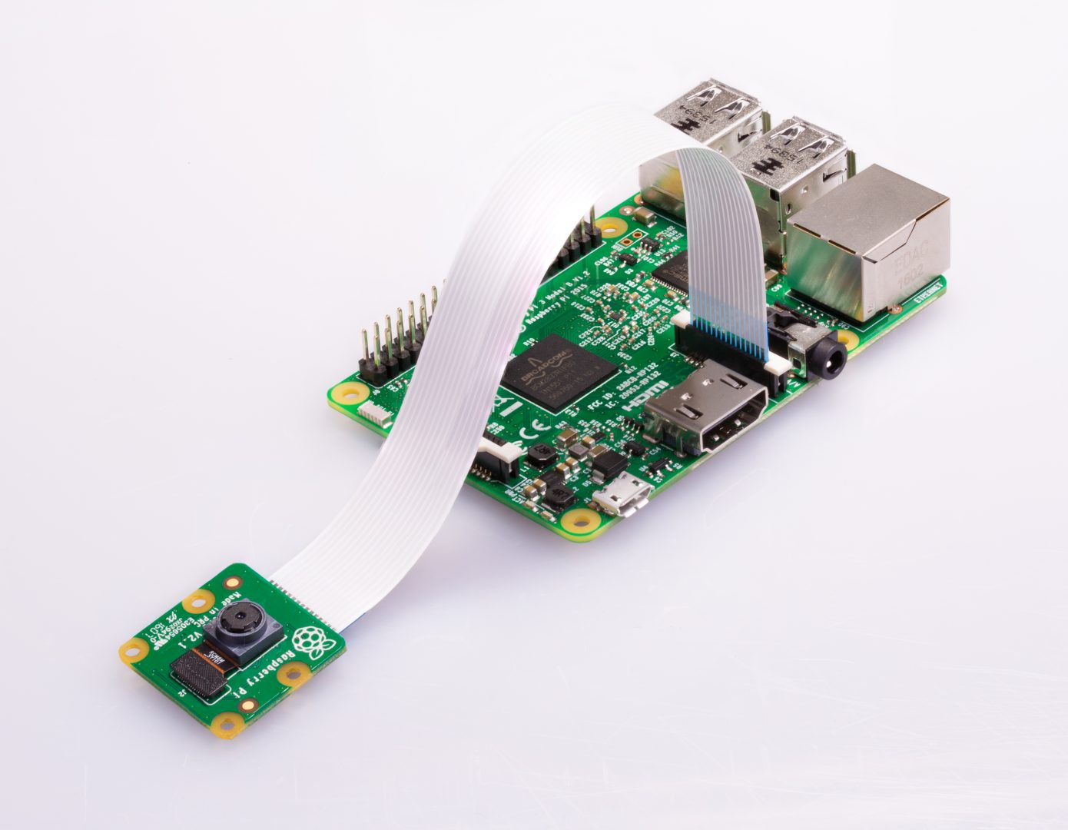
BACKGROUND INFORMATION
Pi Camera Module
  Used to capture still images and HD videos
  Ribbon cable attaches to the camera module port
  Controlled with Python code
    PiCamera Library
Figure 12: Raspberry Pi with Camera Module Courtesy of Raspberry Pi Foundation
13

Slide 15
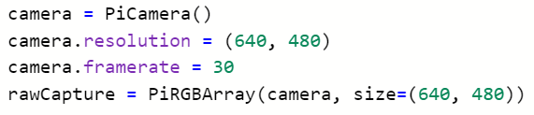
BACKGROUND INFORMATION
PiCamera Library
  PiCamera()
    To initialize a camera object
  camera.resolution = (width, height)
    Sets camera resolution
  camera.framerate = frame rate
    Sets the frame rate
  PiRGBArray(camera, options)
    Produces 3-D array from raw capture
    options parameter used to set the size of capture
Figure 13: PiCamera library commands
14

Slide 16
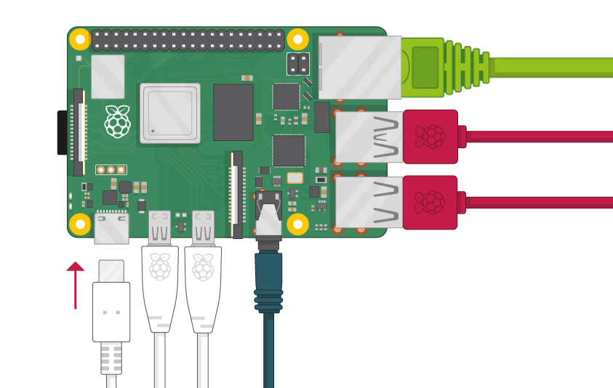
MATERIALS
Raspberry Pi with SD card
Raspberry Pi Camera Module
Monitor with Micro HDMI to HDMI Cable
USB Keyboard
USB Mouse
Power Supply
Figure 14: Raspberry Pi Setup
Courtesy of Raspberry Pi Foundation
15

Slide 17
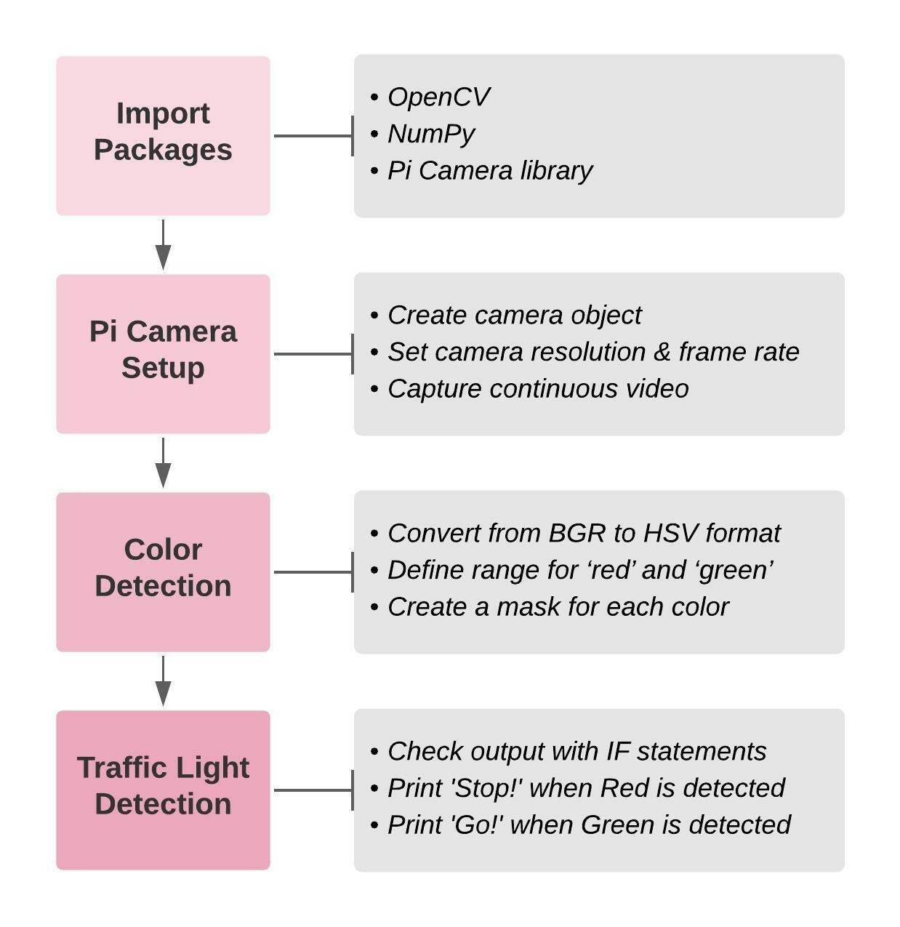
PROCEDURE
Part 1: Testing the camera module
Part 2: Color Detection using OpenCV
  Section 1 – Importing necessary packages
  Section 2 – Pi Camera Setup
  Section 3 – Color Detection for ‘Red’ and ‘Green’
  Section 4 – Prototyping a Traffic Light Detection system
Figure 15: Part 2 Workflow
16

Slide 18
ASSIGNMENT
No lab report for lab 4
No presentation for lab 4
17

Slide 19
CLOSING
Have each section of the code approved by a TA
Handle the camera module gently!
Cameras are sensitive to static. Earth yourself prior to handling the module
All students must attempt to complete the code
TAs are always available for assistance
18

Slide 20
QUESTIONS?

