Slide 1

Rapid Assembly & Design (RAD) WORKSHOP
EG1003 | Lab 4B

Slide 2


OVERVIEW
Objective
Background Information
Materials
Procedure
Assignment
Closing
Figure 1: Raspberry Pi (Left) and OpenCV (Right) Courtesy of Wikipedia
1

Slide 3
OBJECTIVE
Explore the capabilities of the Raspberry Pi and Pi Camera Module
Develop a Python script for color detection using OpenCV
Control a servo motor with Raspberry Pi
2
Notes:
Maybe something about versus an Arduino

Slide 4
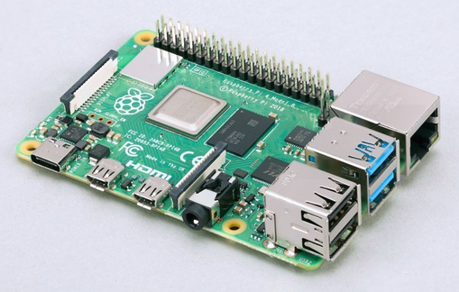
BACKGROUND INFORMATION
Raspberry Pi
  Credit card sized computer
  Used for electronic projects
  Runs on Raspberry Pi OS (a Debian-based operating system)
  Has a CPU, GPU, and RAM
Figure 2: Raspberry Pi 4
3
Notes:
Background info: The Pi, hardware of the pi, Python, OpenCV, NumPy, camera module

Slide 5
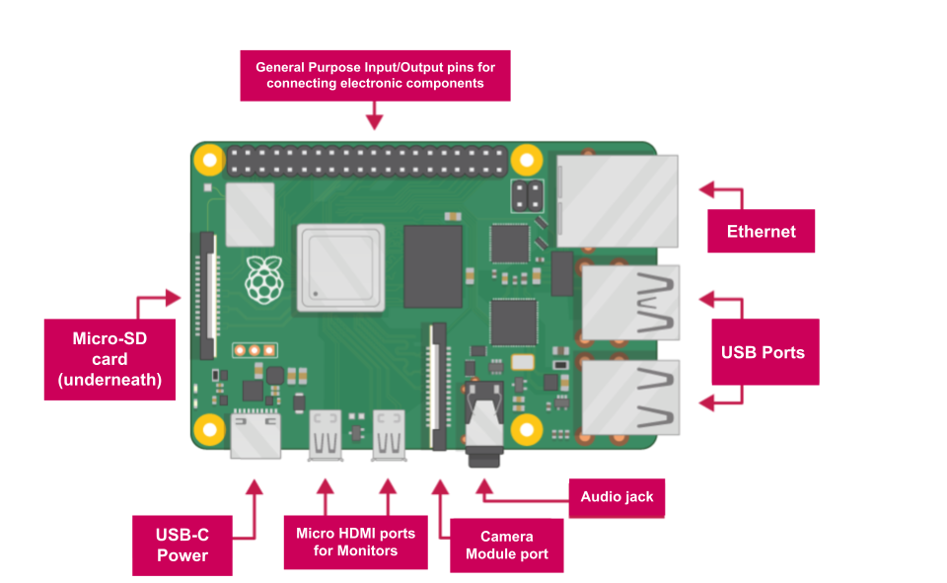
BACKGROUND INFORMATION
Raspberry Pi 4 - Hardware
  SD card slot
  USB ports
  Camera module port
  Micro HDMI port
  USB-C power
  Audio jack
  Ethernet port
Figure 3: Raspberry Pi 4 Hardware Overview
4

Slide 6
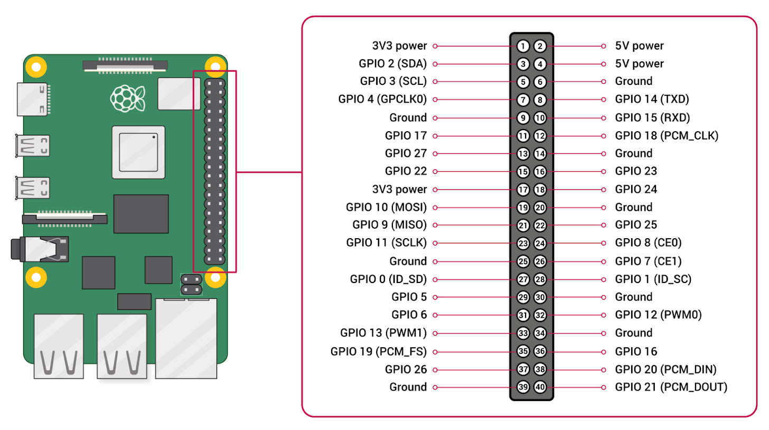
BACKGROUND INFORMATION
Raspberry Pi - Hardware
  28 General Purpose Input/Output (GPIO) pins
  4 Power pins
    Two 3.3V
    Two 5V
  8 Ground pins
Figure 4: Raspberry Pi GPIO Pinout
5

Slide 7
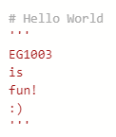
BACKGROUND INFORMATION
Python
  Text-based programming language
  Syntax
    No closing mark needed after each line
  Comments
    Line comments – begin with #
    Block comments – begin and end with ‘’’
Figure 5: Line and Block Comments
6

Slide 8
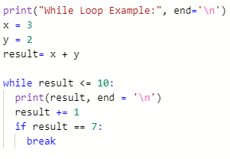

BACKGROUND INFORMATION
Python – Loops
  While loops
    Executed so long as the condition is true
  For loops
    Iterates over a set sequence
  Break statements
    Used to break out of a loop at any time, regardless of the condition
Figure 6: While and For Loops, and Break statements
7

Slide 9
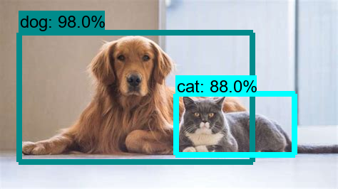
BACKGROUND INFORMATION
OpenCV – Computer Vision
  Image and video processing
  Object and Color Detection
  Applications
    Face recognition
    Driverless car navigation
Figure 7: OpenCV Object Detection Courtesy of Great Learning
8

Slide 10
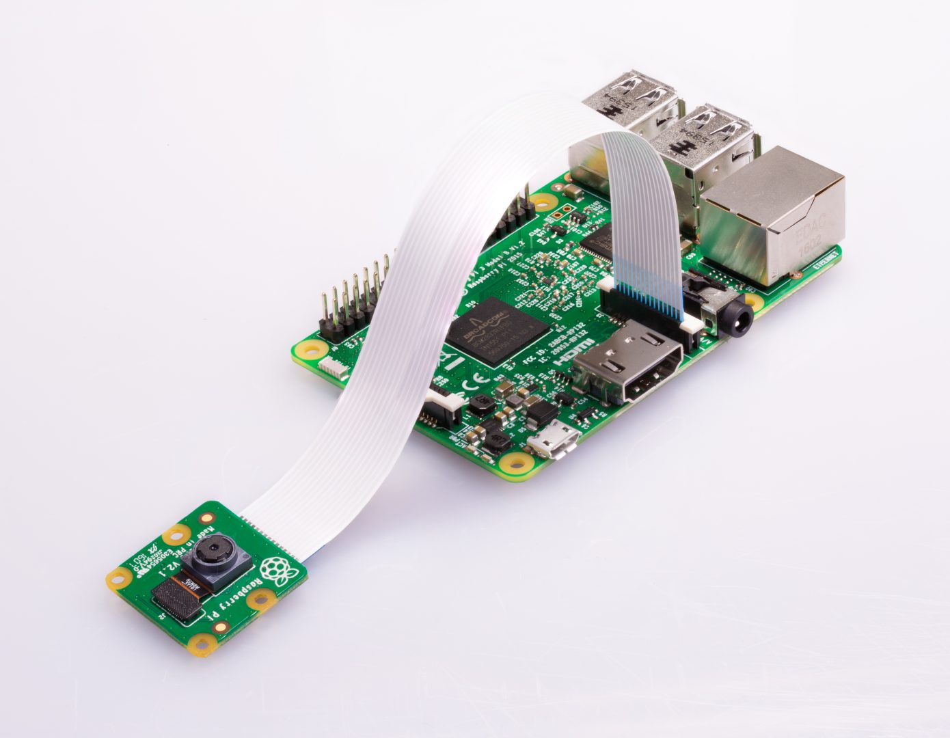
BACKGROUND INFORMATION
Pi Camera Module
  Used to capture still images and HD videos
  Ribbon cable attaches to the camera module port
  Controlled with Python code
    PiCamera Library
Figure 8: Raspberry Pi with Camera Module Courtesy of Raspberry Pi Foundation
9

Slide 11
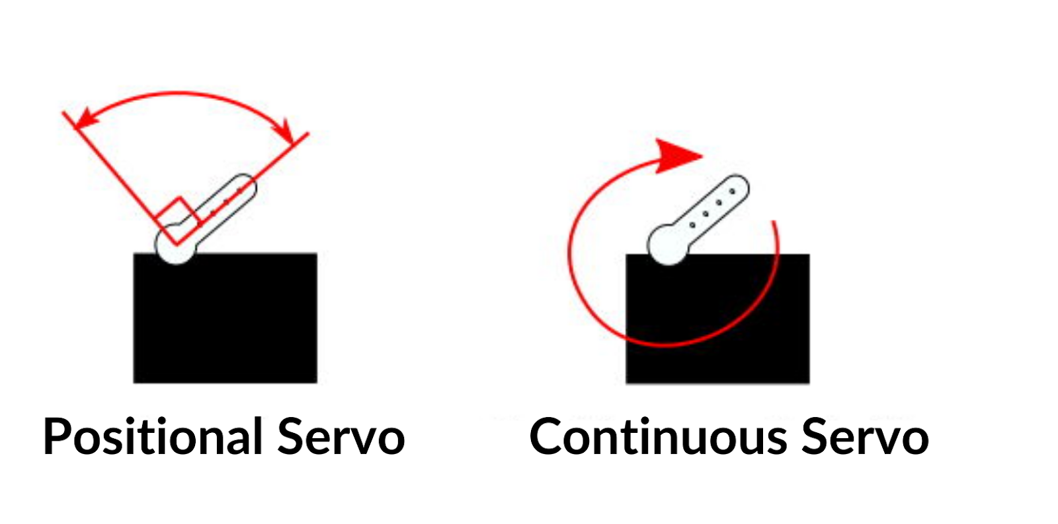
BACKGROUND INFORMATION
Servo Motors
  Continuous Rotation Servo
    Shaft spins continuously
    Definite control over speed & direction
  Positional Rotation Servo
    Can be written to a specific angle
    Range of rotation - 180°
    Definite position control
Figure 9: Positional vs. Continuous Servo Motors
10

Slide 12
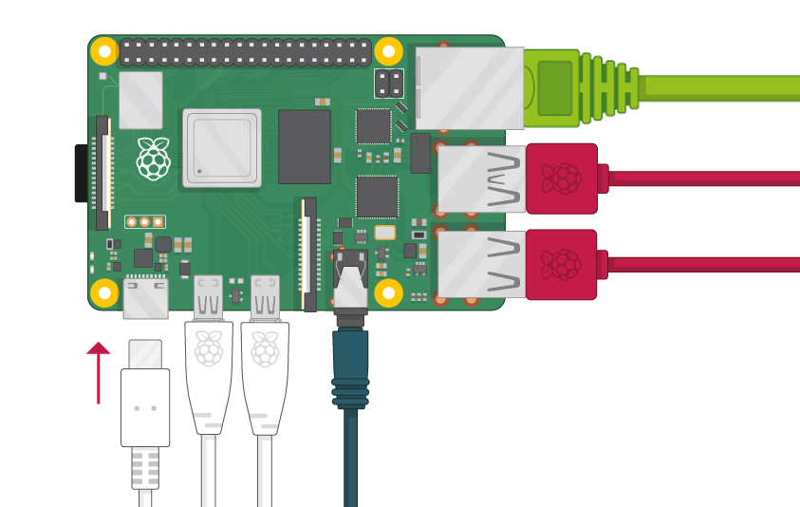
MATERIALS
Raspberry Pi with SD card
Raspberry Pi Camera Module
Monitor with Micro HDMI to HDMI Cable
USB Keyboard
USB Mouse
Power Supply
Continuous Servo
Figure 10: Raspberry Pi Setup
Courtesy of Raspberry Pi Foundation
11

Slide 13
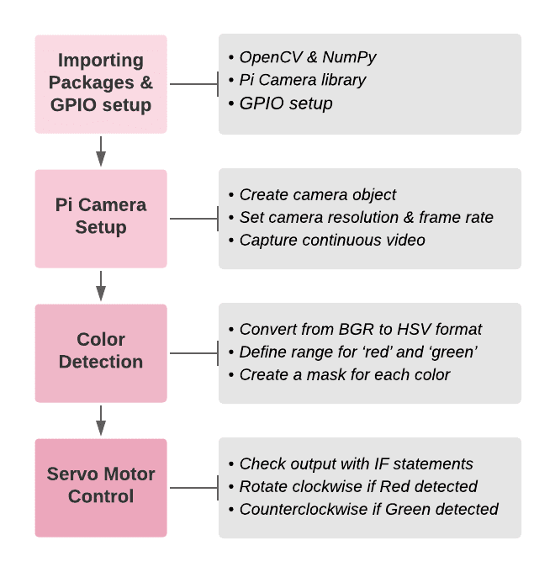
PROCEDURE
Part 1: Testing the camera module
Part 2: Color Detection using OpenCV
  Section 1 – Importing necessary packages
  Section 2 – Pi Camera Setup
  Section 3 – Color Detection for ‘Red’ and ‘Green’
  Section 4 – Servo Motor Control
Figure 11: Part 2 Workflow
12

Slide 14
ASSIGNMENT
No lab report for lab 4
No presentation for lab 4
13

Slide 15
CLOSING
Have each section of the code approved by a TA
Handle the camera module gently!
Cameras are sensitive to static. Earth yourself prior to handling the module
All students must attempt to complete the code
TAs are always available for assistance
14

Slide 16
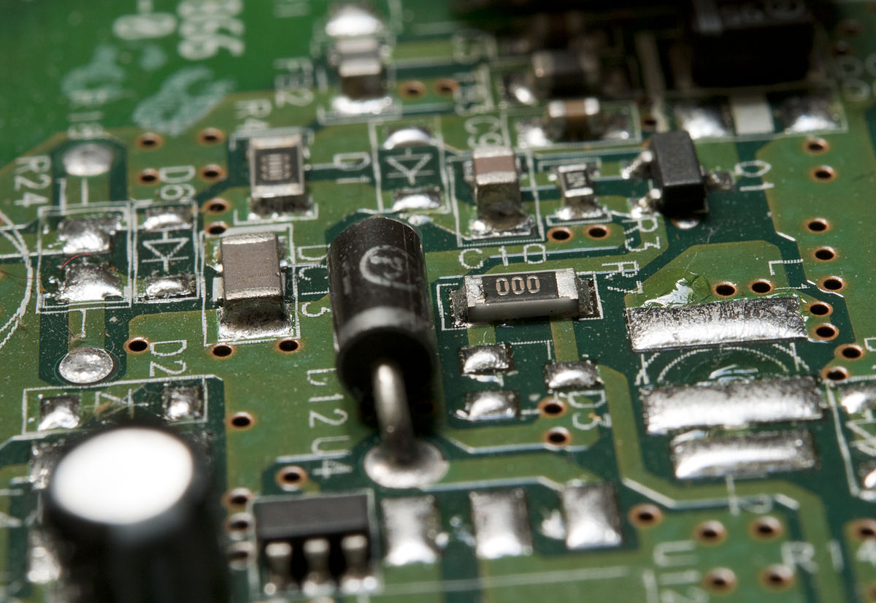



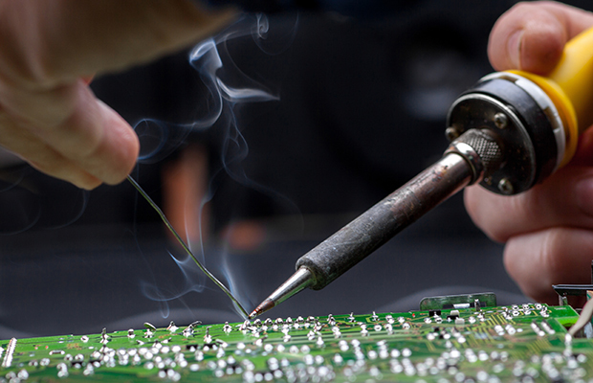


Technical Workshops
Starting next week will run twice a week
2 Sessions per topic
Held in Modelshop (JAB 573)
15

Slide 17
February
Sun | Mon | Tue | Wed | Thr | Fri | Sat
 |  | 1 | 2 | 3 | 4 | 5
6 | 7 | 8 | 9 | 10 | 11 | 12
13 | 14 | 15 | 16 | 17 | 18 | 19
20 | 21 | 22 | 23 | 24 | 25 | 26
27 | 28
CAD, Ideation & Manufacturing
2/23 Wednesday 7-8pm
2/27 Sunday 2-3pm
16

Slide 18
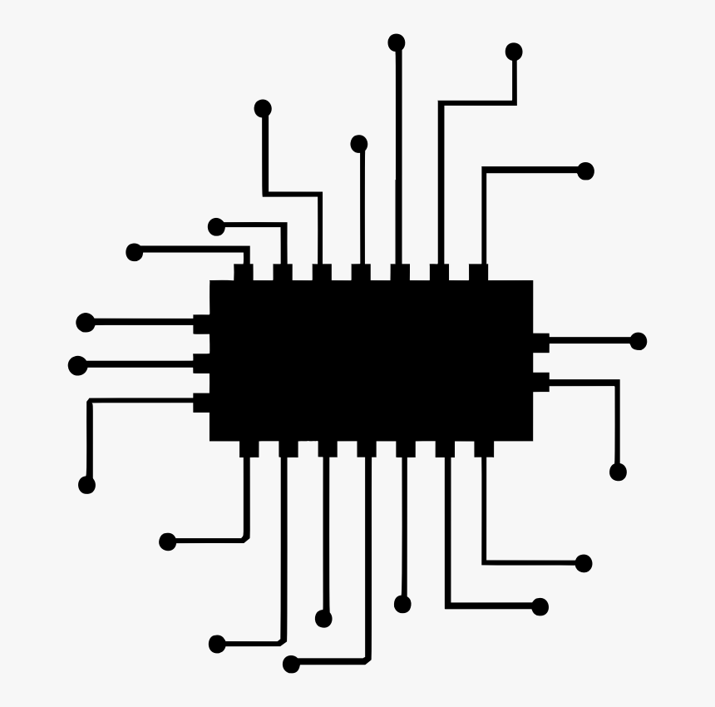

March
Sun | Mon | Tue | Wed | Thr | Fri | Sat
 |  | 1 | 2 | 3 | 4 | 5
6 | 7 | 8 | 9 | 10 | 11 | 12
13 | 14 | 15 | 16 | 17 | 18 | 19
20 | 21 | 22 | 23 | 24 | 25 | 26
27 | 28 | 29 | 30 | 31 | 1 | 2
Arduino
3/2 Wednesday 7-8pm
3/13 Sunday 2-3pm
Raspberry Pi
3/6 Sunday 2-3pm
3/9 Wednesday 7-8pm
Circuitry
3/16 Wednesday 7-8pm
3/27 Sunday 2-3pm
Revit
3/20 Sunday 2-3pm
3/23 Wednesday 7-8pm
Soldering
3/30 Wednesday 7-8pm
4/3 Sunday 2-3pm
17

Slide 19
QUESTIONS?

