Slide 1

SOFTWARE FOR
ENGINEERS
EG1003 | LAB 1A & 1C

Slide 2
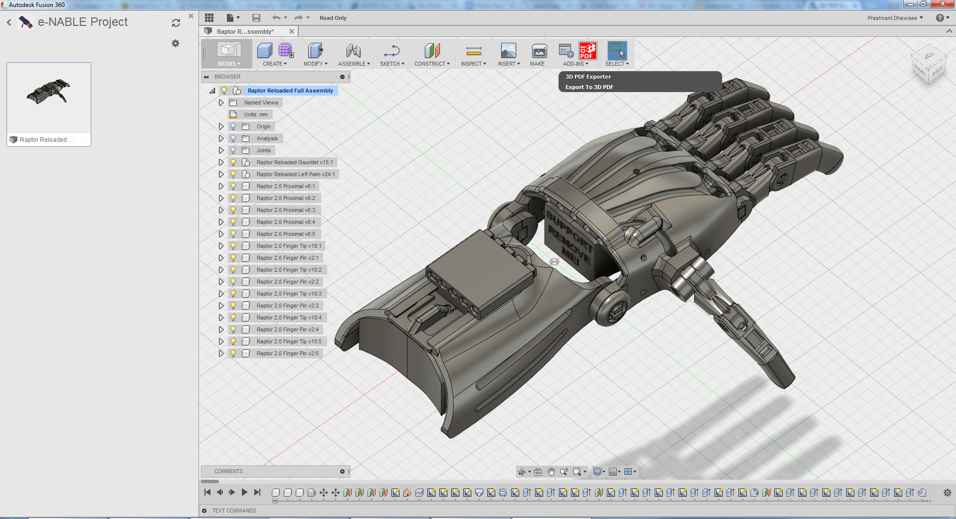
OVERVIEW
Objective
Background
Procedure
Assignment
Closing
Figure 1: Fusion 360 Courtesy of Autodesk
1

Slide 3


OBJECTIVE
Familiarization with software relevant to this course
Explore software tools
  Word
  PowerPoint
  Excel
  Fusion 360
Figure 2: Software Icons Courtesy of AppRecs
2

Slide 4
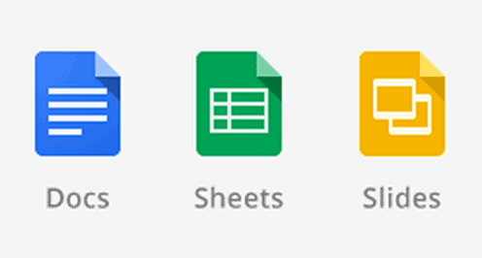
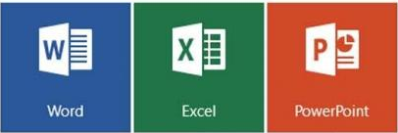
BACKGROUND
Microsoft Excel or Google Sheets
  Spreadsheet program
  Create tables, charts, graphs, data analysis
Microsoft Word or Google Documents
  Word processing program
  Create lab reports, proposals, documents
Microsoft PowerPoint or Google Slides
  Professional presentation program
Figure 3: G Suite (Top) and Microsoft Office (Bottom)
Courtesy of UNC Charlotte and Softpedia
3

Slide 5
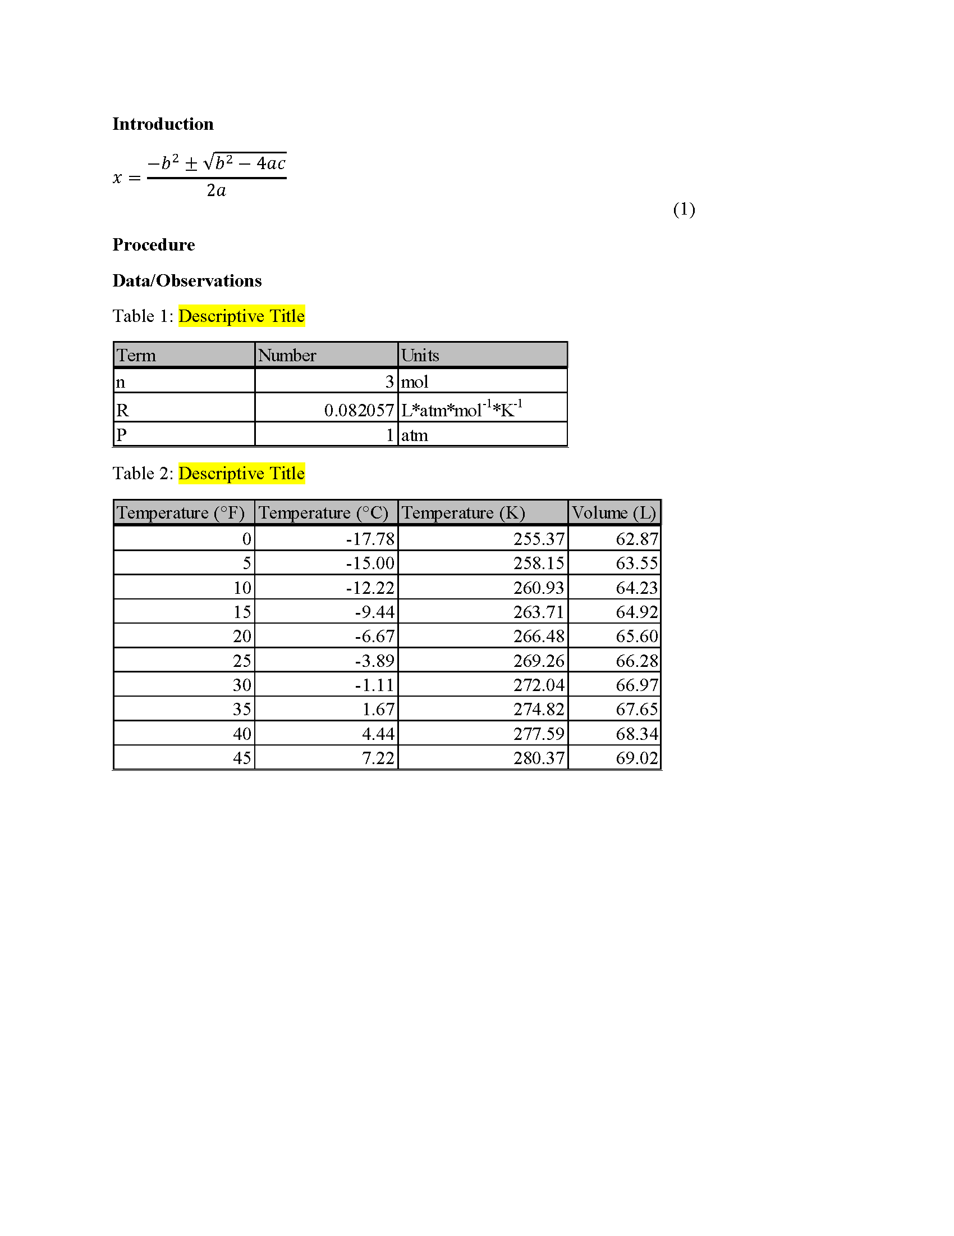
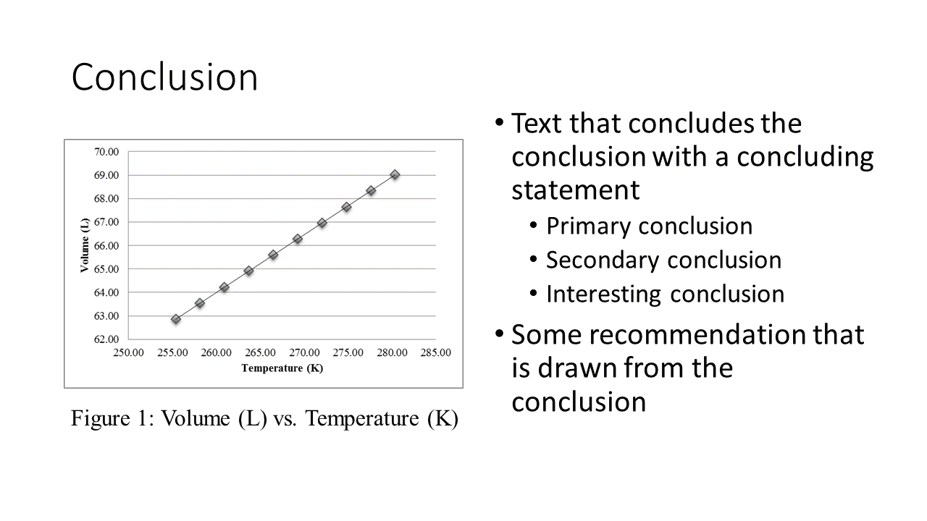
WORD AND POWERPOINT
Figure 4: Examples of Word (Left) and PowerPoint (Right)
4

Slide 6
EXCEL
Figure 5: Example of Excel
5

Slide 7

BACKGROUND
Fusion 360
  Computer-aided design (CAD) program
  Creates 3D drawings of engineering designs
  Also used for CAM, rendering, simulation, etc.
3D printing – allows for rapid prototyping and onsite manufacturing
Cura
  3D printing preparation application
Figure 6: Fusion 360 (Left) and Cura (Right) Courtesy of AppRecs and Wikipedia
6

Slide 8
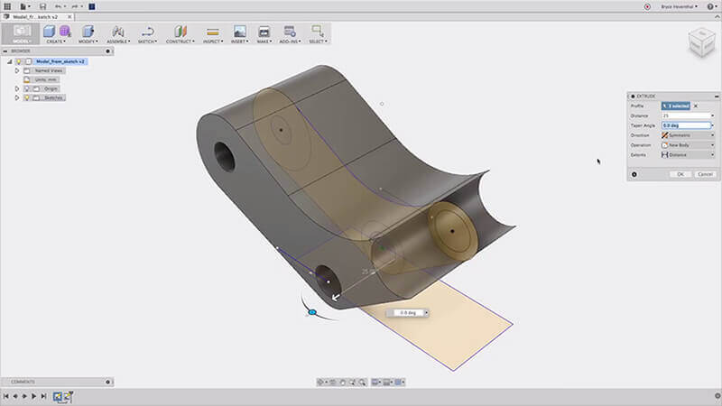
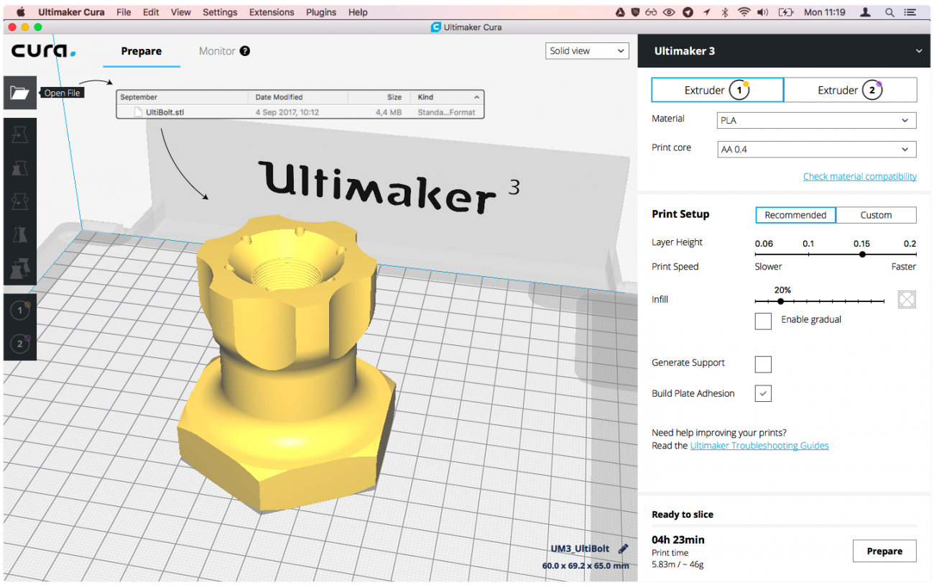
FUSION 360 AND CURA
Figure 7: Examples of Fusion 360 (Left) and Cura (Right) Courtesy of FabCafe and Ultimaker
7

Slide 9
PROCEDURE
Go to Lab 1A – Introduction to Microsoft Office
Excel
  Open premade Microsoft Excel Template
  Create tables and graph based on the Ideal Gas Law
  Fill in highlighted cells with correct values using equations
  Plot volume vs. temperature
Figure 8: Microsoft Excel Template to Fill
8

Slide 10
PROCEDURE
PowerPoint
  Recreate the Lab Presentation Template
Word
  Recreate the Lab Report Template
Match the given templates accurately
Attention to detail is a critical skill for engineers
Figure 9: Lab Report Template to Recreate
9

Slide 11
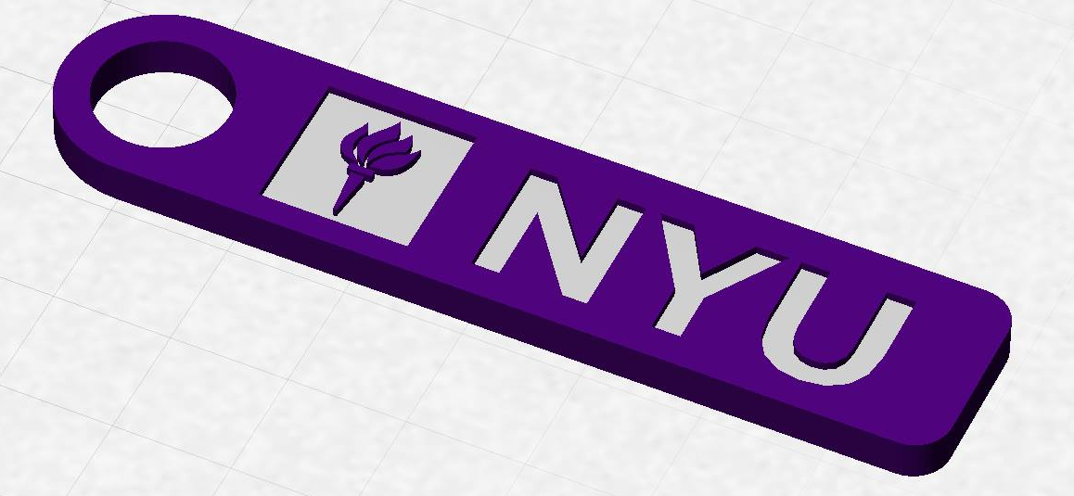
PROCEDURE
Go to Lab 1C – Introduction to 3D Printing
Fusion 360
  Use the manual tutorial to create an NYU keychain
  Save as STL file
Cura
  Setup the keychain model to be 3D printed
  Save as GCODE file
If time permits, explore Thingiverse
Figure 10: NYU Keychain to Design
10

Slide 12
ASSIGNMENT
No lab report for Lab 1A or Lab 1C
  There will be a lab report for Lab 1B
No presentation for Lab 1A or 1C
Submit a GCODE file on the EG1003 website (eg.poly.edu)
Due at 11:59 PM the night before Lab 2
11

Slide 13
CLOSING
All students must attempt to use the software
TAs are always available for assistance
Copy and paste all figures and tables as pictures
Must submit a GCODE file to the EG1003 website before next lab
No need to submit Word, PowerPoint, or Excel files
Go to the EG1003 student manual (manual.eg.poly.edu) for lab instructions
12

Slide 14
QUESTIONS?

