Slide 1

RECITATION 4
EG1003

Slide 2
AGENDA
Ethics in Engineering
How to Give a Milestone Presentation
1

Slide 3
BRIEF REMINDERS
Unexcused absences are zeros
Each lecture is one percent of your final grade
To request a makeup lab go to EG website
Plagiarism is a very serious offense
Stay on top of deadlines
Learn from your mistakes
2
Notes:
Absences must be excused through the office of student affairs or you will not be able to complete makeup labs, receive a grade for your report or presentations. Communication is key!
Attendance at lecture adds up over time, make it a priority to attend every lecture.
If your lab absence is excused/in the process of being excused, you may request a makeup lab through the EG website.
Plagiarism is not a small slip up. It is a very major offense. Remember that for most courses, including this one, software are used to detect plagiarism.
Stay on top of your deadlines- this is a tough way to loose points since you are doing the work anyway, just do it on time.
Grow from mistakes you’ve made on presentations and lab reports by reviewing feedback from your TAs, Professors and Writing Consultants. As the semester goes on, you will be penalized for repeatedly making the same mistakes

Slide 4
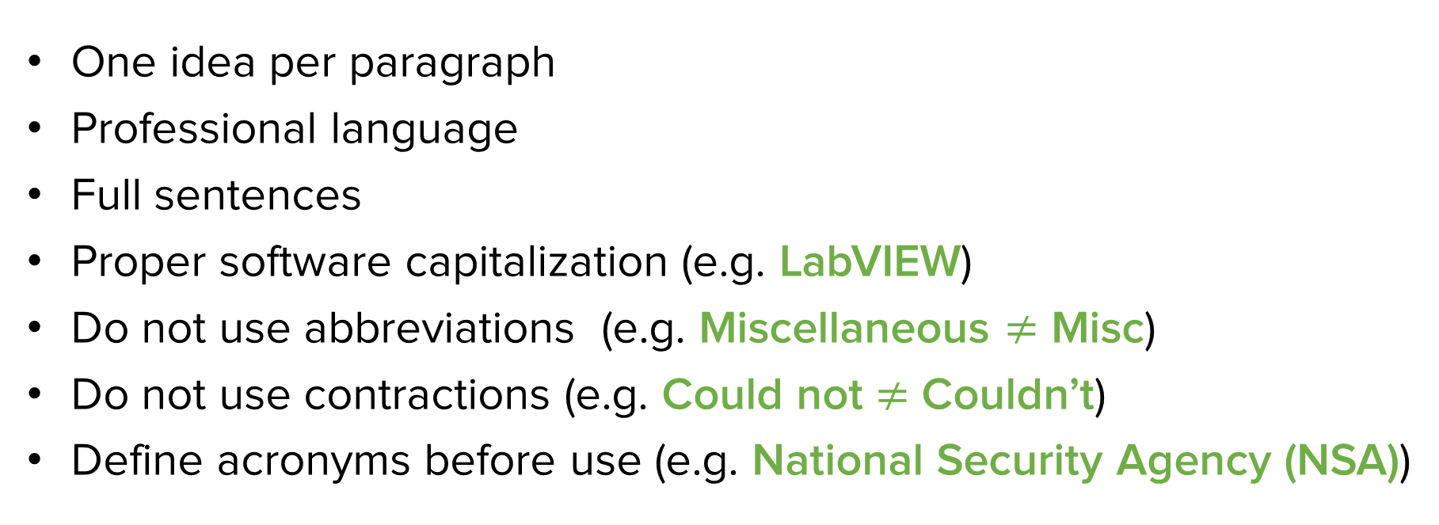
COMMON LAB REPORT
MISTAKES
One idea per paragraph
Professional language
Full sentences
Proper software capitalization (e.g. LabVIEW)
Do not use abbreviations (e.g. Miscellaneous $≠$ Misc)
Do not use contractions (e.g. Could not $≠$ Couldn’t)
Define acronyms before use (e.g. National Security Agency (NSA))
3
Notes:
As you continue to write more lab reports, keep these common mistakes in mind. Also remember to read the feedback on your lab reports and make corrections in future reports.

Slide 5
ETHICS IN ENGINEERING

Slide 6
What ethical issues will arise with the advent of autonomous vehicles?
DISCUSSION QUESTION
5
Notes:
**Give students time to discuss this question in groups and/or have a larger group discussion**

Slide 7
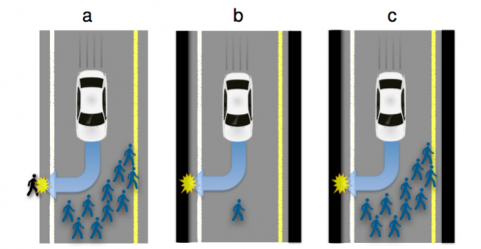
ETHICS OF AUTONOMOUS VEHICLES
Who decides the value of human lives?
Figure 1: Traffic situations with inevitable harm
6
Notes:
Option A has two outcomes: the car can continue straight on course and kill several pedestrians or swerve and kill one passer-by
Option B has two outcomes: the car can continue straight on course and kill one passer-by or swerve and kill its passenger
Option C has two outcomes: the car can continue straight on course and kill several pedestrians or swerve and kill its passenger
There are not objective, correct answers to each of these situations. Autonomous technology cannot make its own ethical decisions, the engineers who program and design the technology do.

Slide 8
What ethical issues will arise with the advent of at home genetic testing?
DISCUSSION QUESTION
7
Notes:
**Give students time to discuss this question in groups and/or have a larger group discussion**

Slide 9
What ethical issues will arise with the advent of facial recognition?
DISCUSSION QUESTION
8
Notes:
**Give students time to discuss this question in groups and/or have a larger group discussion**

Slide 10
DIGITAL PRIVACY
FBI vs Apple
Figure 2: Apple message to customers regarding FBI digital privacy policy
9
Notes:
In 2016 controversy and digital privacy discussion arose regarding a judge ordering Apple to assist the government in accessing data on an iPhone used by a shooter who killed 14 people in the 2015 San Bernardino attacks. The request to Apple from the FBI was to overhaul the digital privacy and security feature of making data inaccessible on an iPhone after 10 unsuccessful password attempts. Apple went on to refuse assistance and the Department of Justice was able to attain the data from the phone in an alternate way. Apple’s fear was that writing a software to overwrite this security feature would allow the government a “master key” into all other phones.

Slide 11
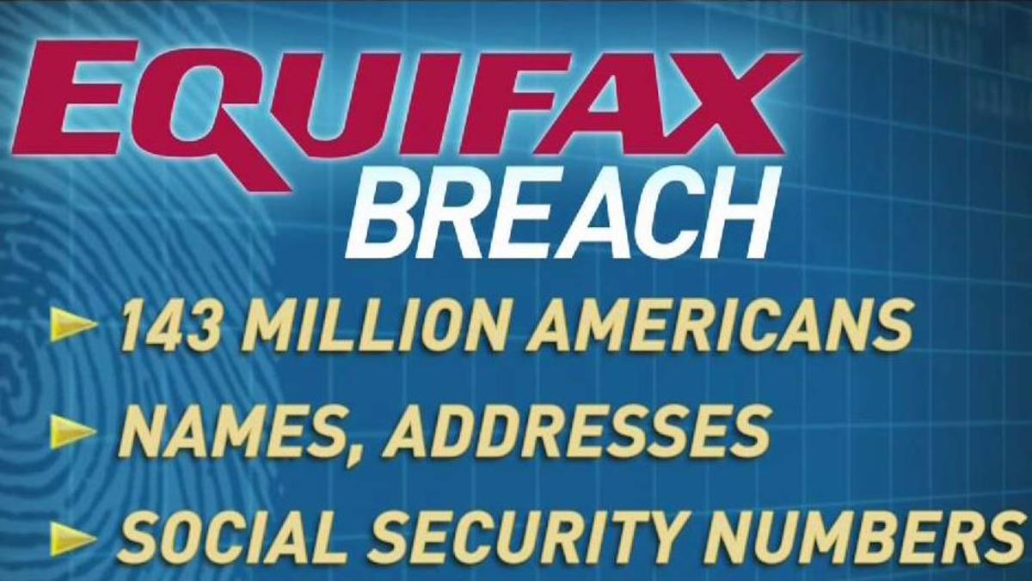
DIGITAL PRIVACY
Equifax Hack
Figure 3: Statistics of the impact of the Equifax breach in 2017
10
Notes:
In 2017 the private data of 143 million Americans who were customers of the credit bureau Equifax was breached. Equifax was determined to have been negligent with their cyber security, allowing hackers to use a well-known hacking technique. The company was also criticized for not informing customers and the general public that the breach had occurred until nearly a month later – putting victims at more risk for their personal information to be misused. Equifax eventually agreed to a global settlement of 425 million dollars to help individuals impacted by the breach.

Slide 12
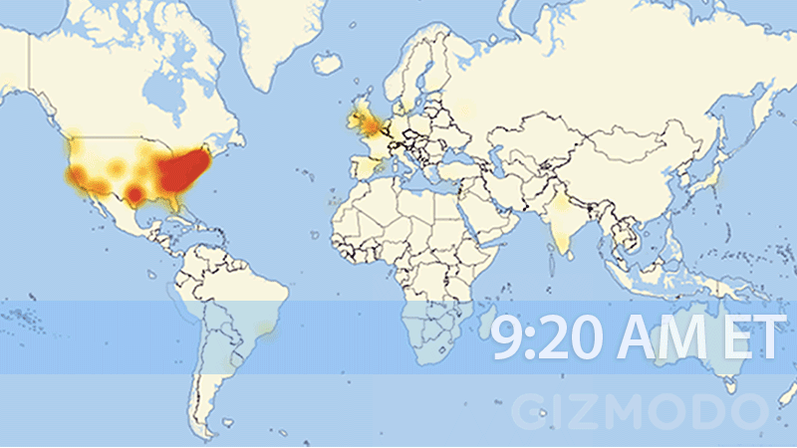
DIGITAL SECURITY
DDos Attack
Figure 4: Timelapse of US internet being wiped out courtesy of Gizmodo
11
Notes:
In 2016 a large Distributed Denial of Service (DDos) attack impacted primarily North America and Europe temporarily wiped out internet infrastructure. The figure above shows a time lapse of the internet outage spread across the United States.The Cyber attack targeted Domain Name System provider, Dyn.

Slide 13
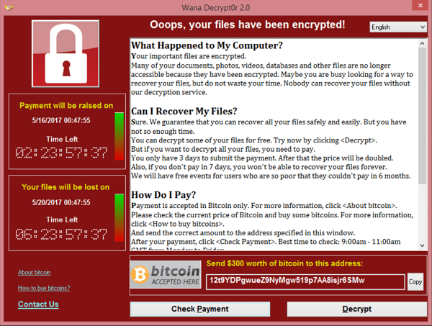
DIGITAL SECURITY
Ransomware
Figure 5: WannaCry ransomware window
12
Notes:
WannaCry Ransomware was a form of malicious software (aka malware) used to extort money from its victims. The malware was designed using stolen hacking tools designed by the National Security Agency which had been posted publicly on the internet. This specific malware infected over 300,000 private and public computers. Notably, in Europe , the computers of an entire hospital network and transportation system were victim to this attack.

Slide 14
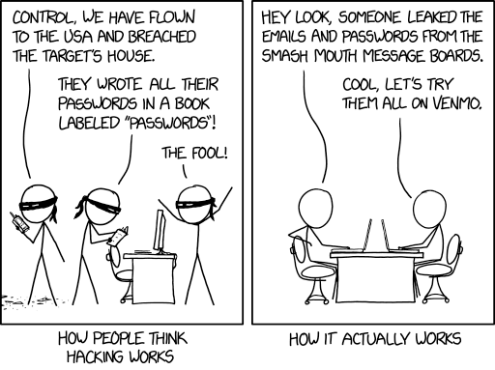
OPPORTUNISTIC HACKERS
Change your password and update your software often!
Figure 6: Hacker comic
13

Slide 15
QUESTIONS?

Slide 16
HOW TO GIVE A MILESTONE PRESENTATION
15

Slide 17
MILESTONES & BENCHMARKS
Milestones
Three Milestones through semester (1, 2 & 3)
Each Milestone has a presentation
Update progress on semester-long design project (SLDP)
Benchmarks
Two Benchmarks during semester (A and B)
List of tasks to complete for each Benchmark
Tasks are semester-long design project (SLDP) dependent
16

Slide 18
MILESTONE PRESENTATION
OVERVIEW
Three Milestone presentations through the semester
Timed five-minute presentation
Update on progress of SLDP
Professional sales pitch presentation
Be a bit more creative with these presentations!
17

Slide 19
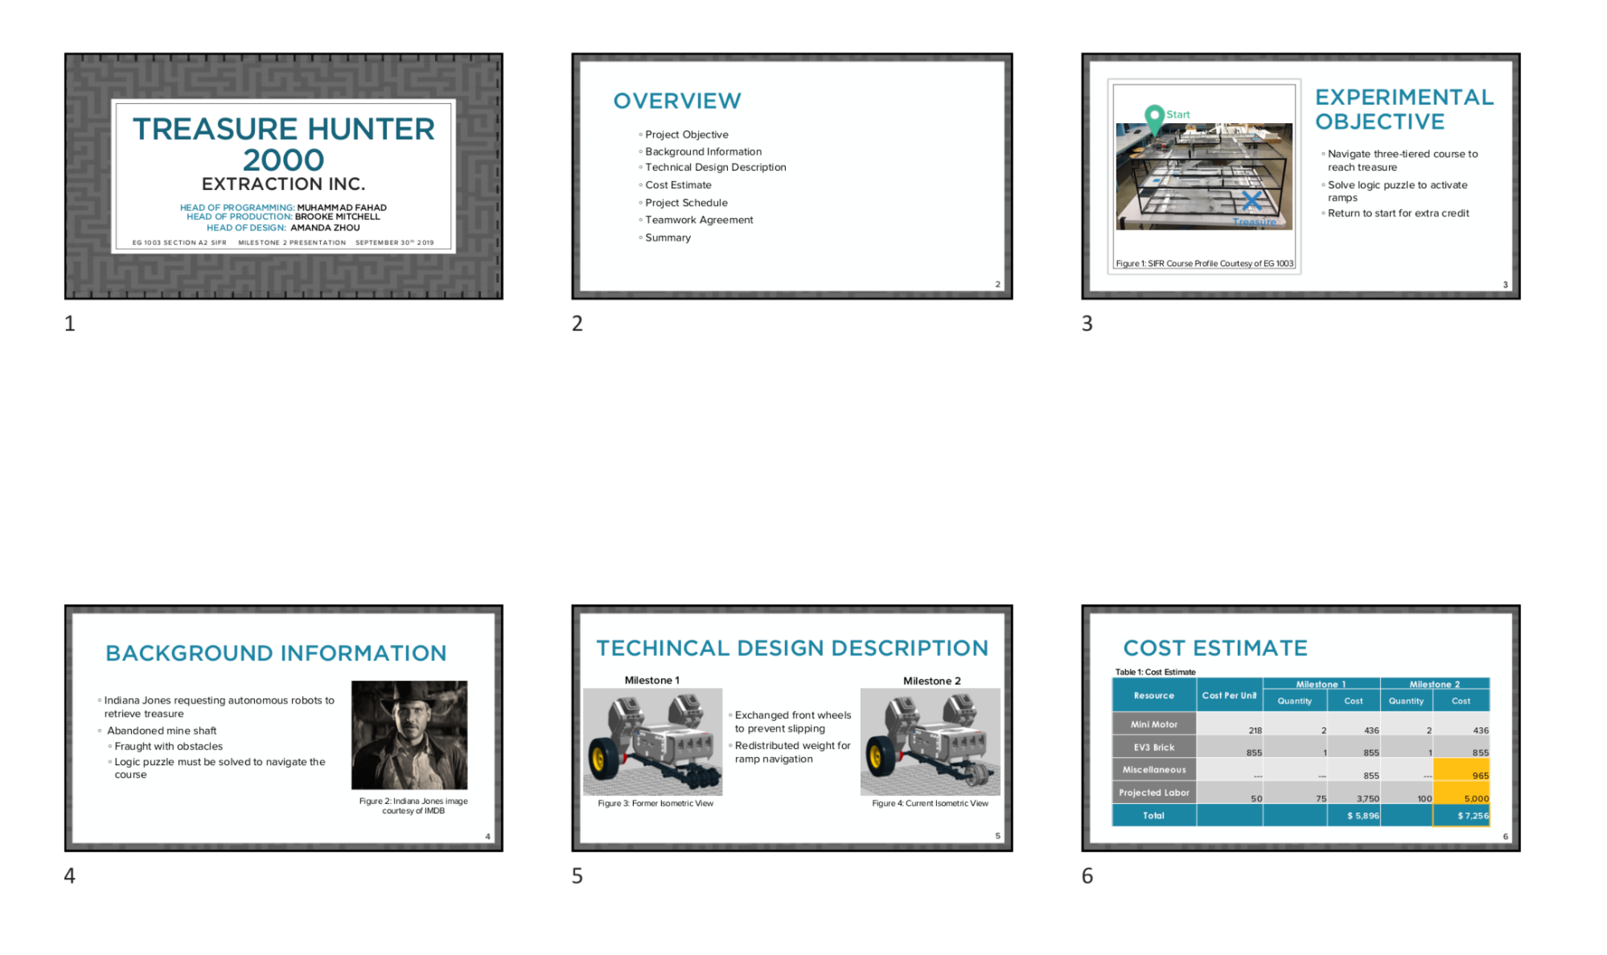
MILESTONE PRESENTATION
OVERVIEW
Submission:
EG1003 Website at 11:59 PM night before recitation
Figure 7: Multiple slide view
18

Slide 20
MILESTONE PRESENTATION
FORMAT
Consistent format and order for all Milestone presentations:
Title
Agenda
Project Objective
Technical Design Description
Cost Estimate
Project Schedule
Teamwork Agreement
(MS 1 Only)
Summary
Title
Different format than lab presentations!
19

Slide 21

TITLE SLIDE
Product name
Company name
Group members with company titles
EG1003 section
Date
You create! Remember to be professional!
Figure 8: Title sample slide
20

Slide 22
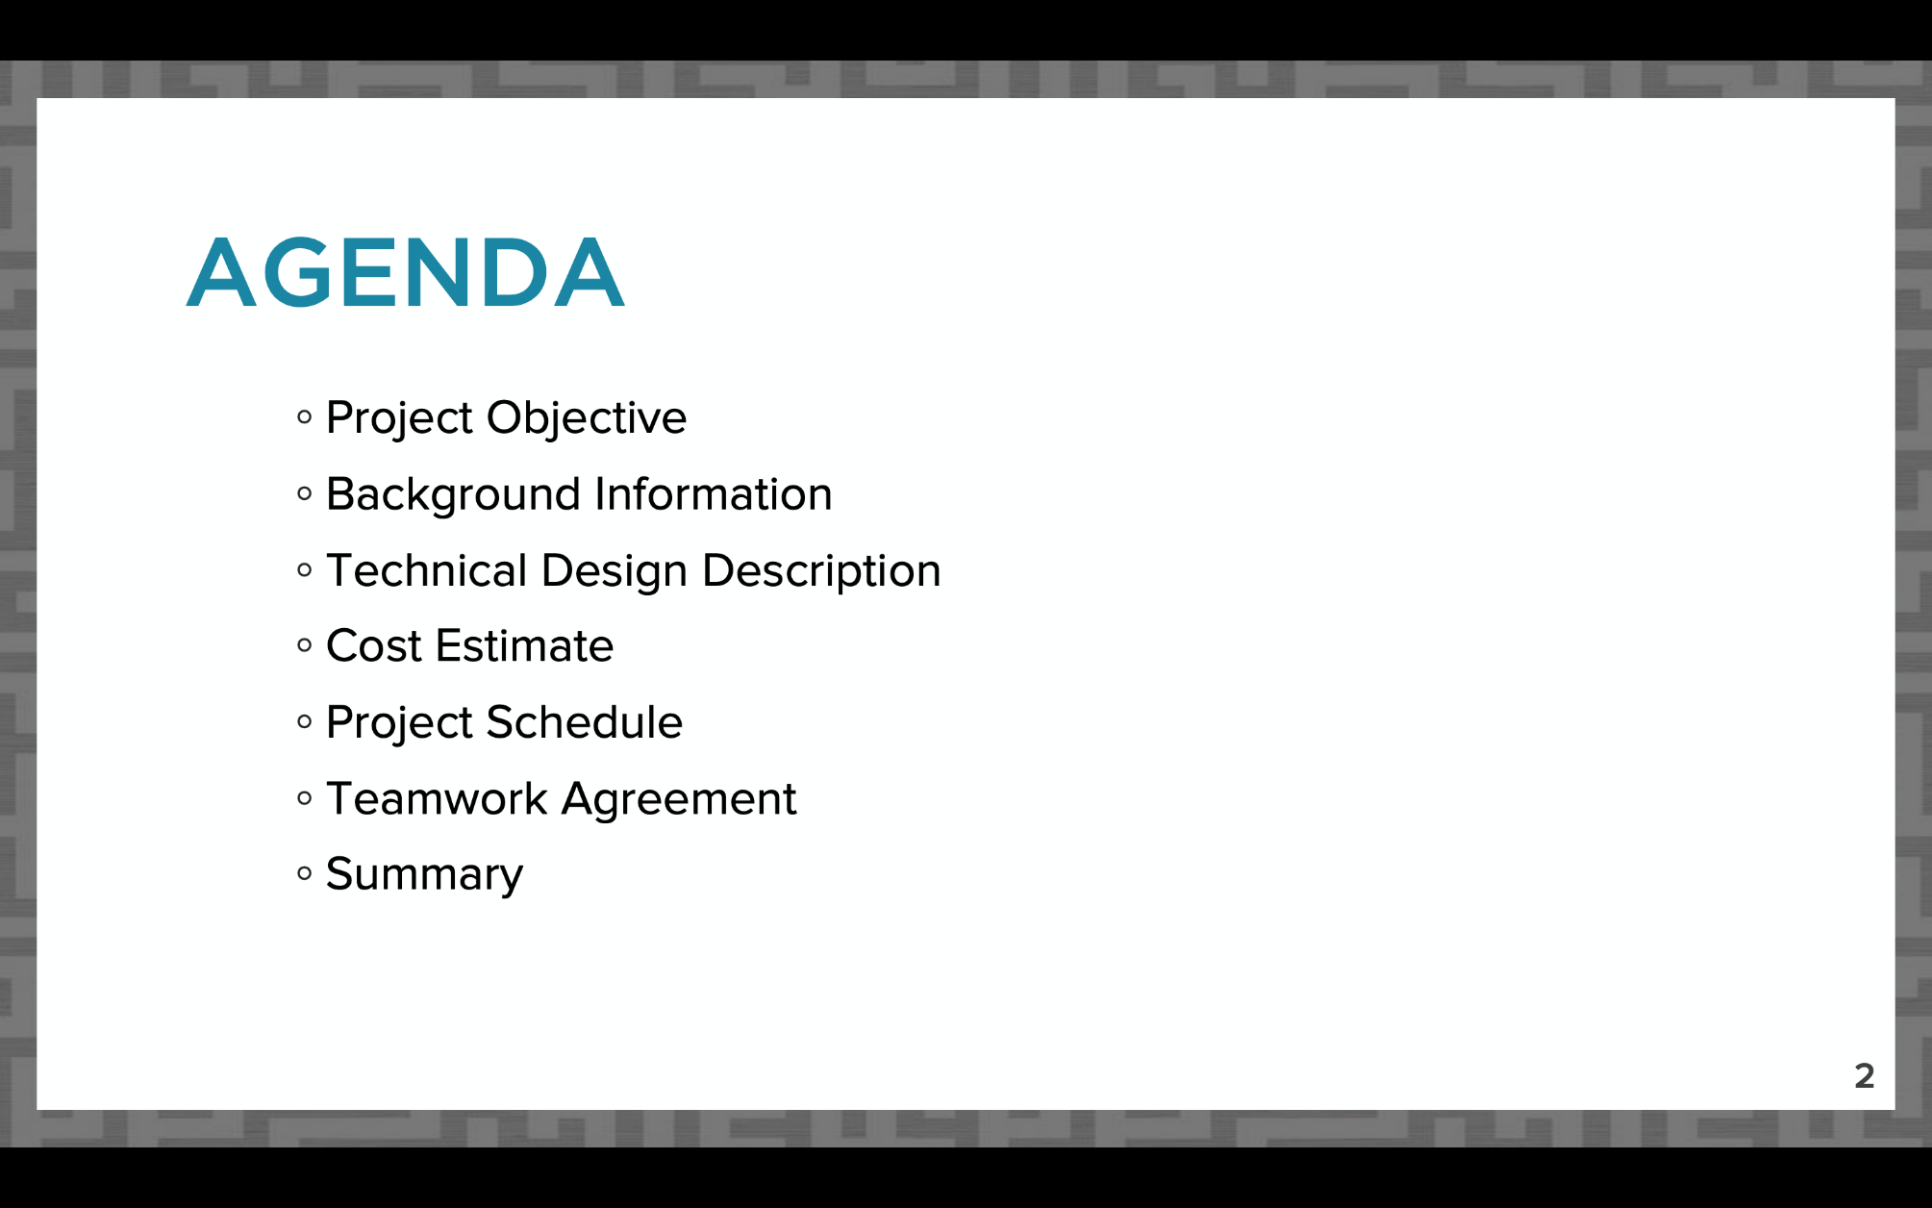
AGENDA SLIDE
Slide title “Agenda”
No need to read slide aloud during presentation
Same agenda slide/order for all Milestone presentations!
Figure 9: Agenda slide sample
21

Slide 23
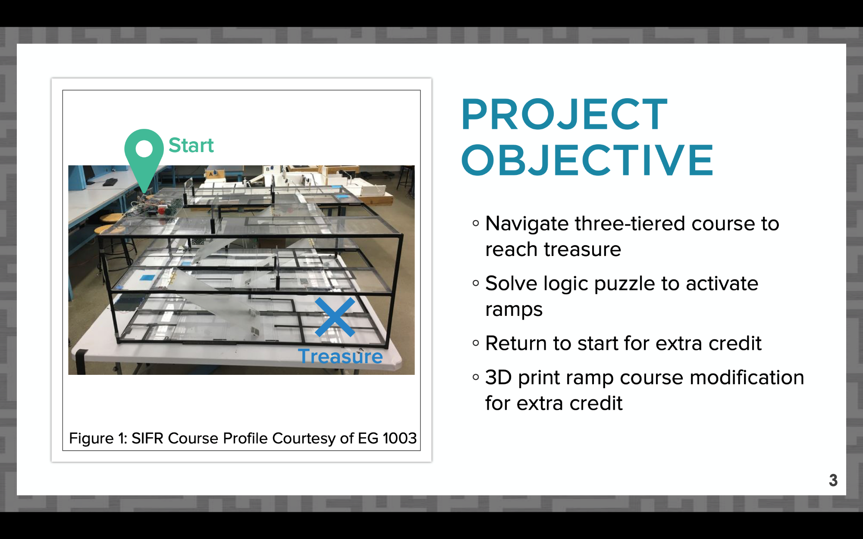
PROJECT OBJECTIVE SLIDE
Slide title “Project Objective”
What are you doing in your project?
Include overall approach
Extra credit points you’re aiming to earn
Figure 10: Project objective sample slide
22

Slide 24
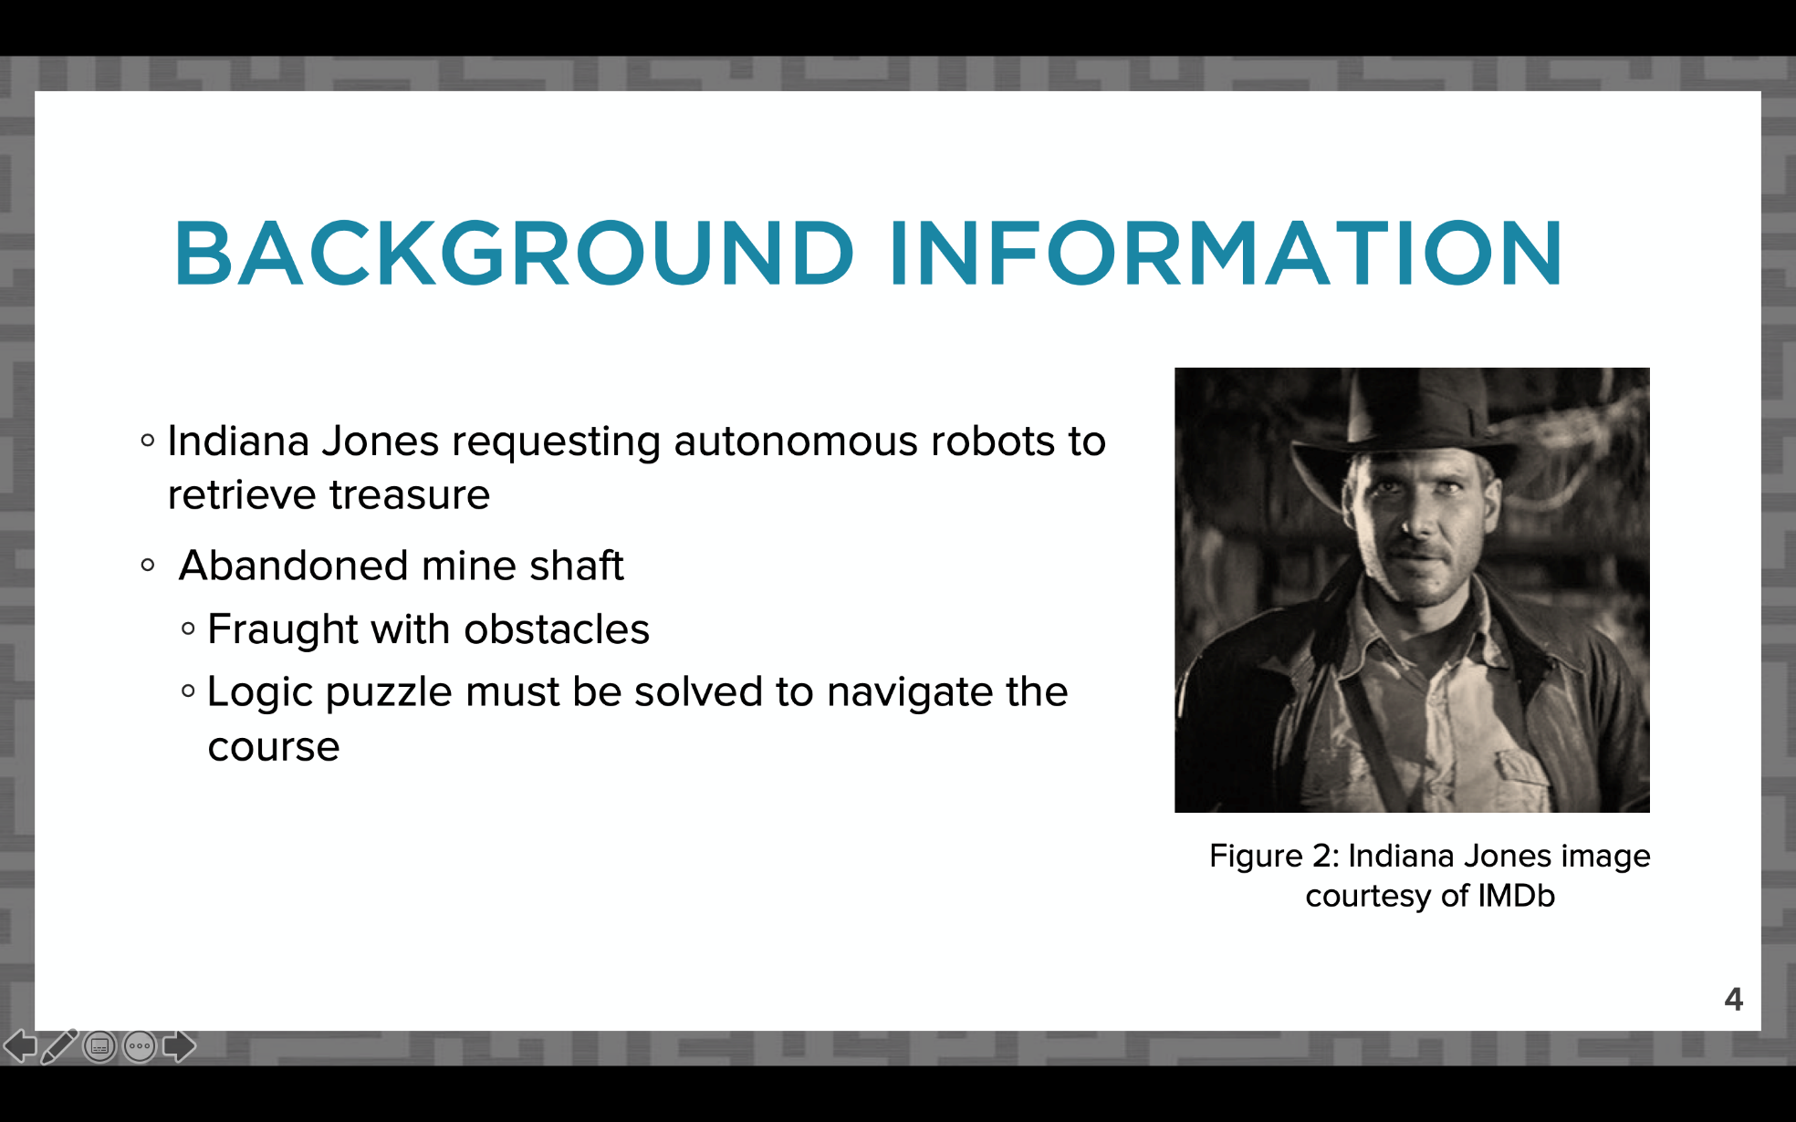
BACKGROUND INFORMATION
SLIDE
Slide title “Background Information”
Why are you completing the project?
Paraphrase project description from student manual
Figure 11: Background information sample slide
23

Slide 25
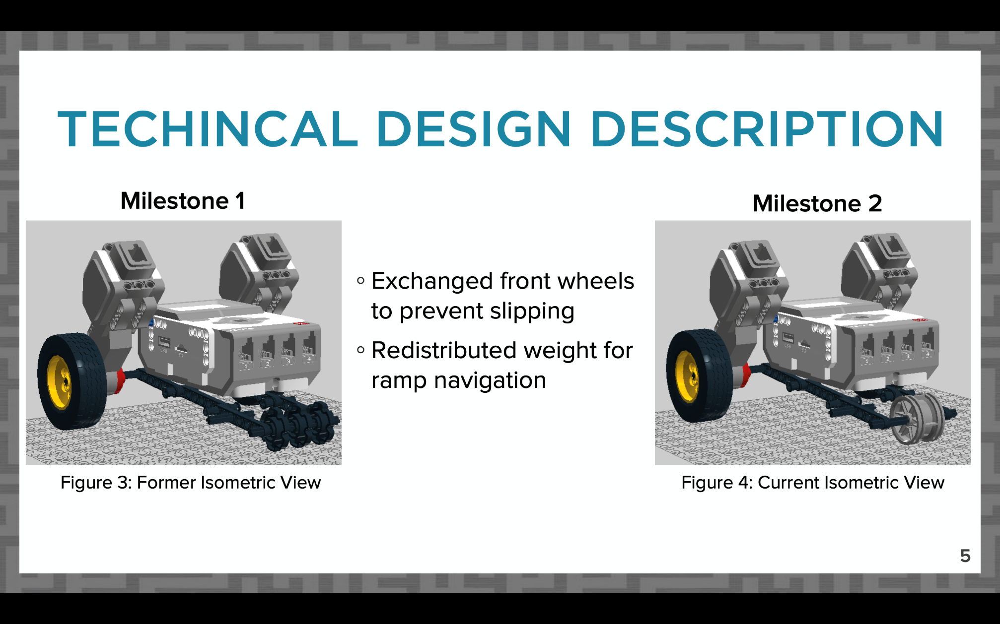
DESIGN DESCRIPTION SLIDES
Slides titled “Technical Design Description”
How does your project work?
All required CAD views
Coding snapshot and description
(if applicable)
For future Milestones, compare changes in design
Figure 12: Sample CAD design change comparison
24

Slide 26
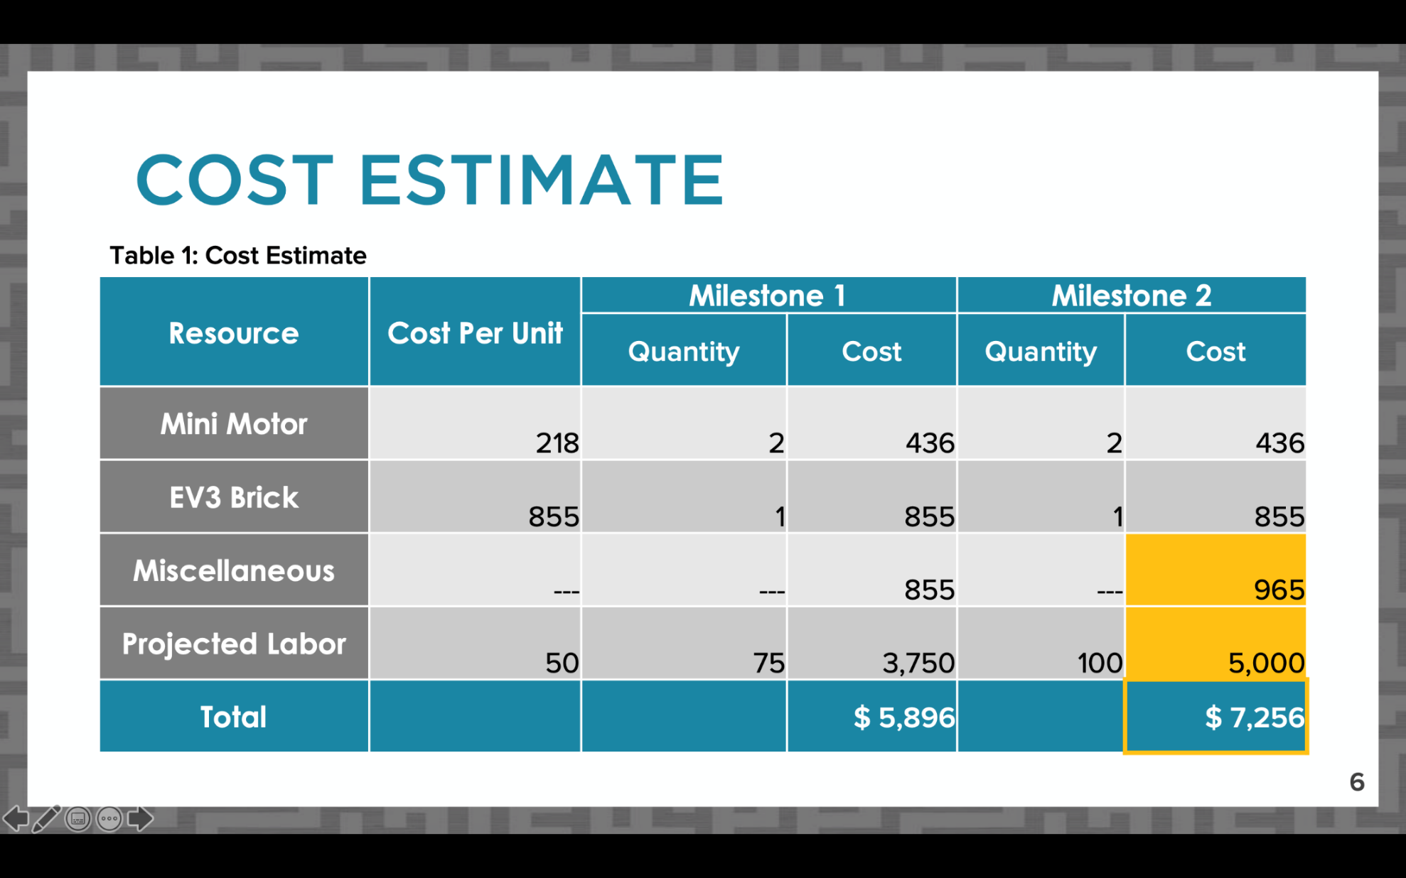
COST ESTIMATE SLIDE
Slide title “Cost Estimate”
Table should be professional and readable
List major parts individually, group smaller cost items under “miscellaneous”
Include labor cost for projected hours worked
Figure 13: Sample cost estimate slide
25

Slide 27
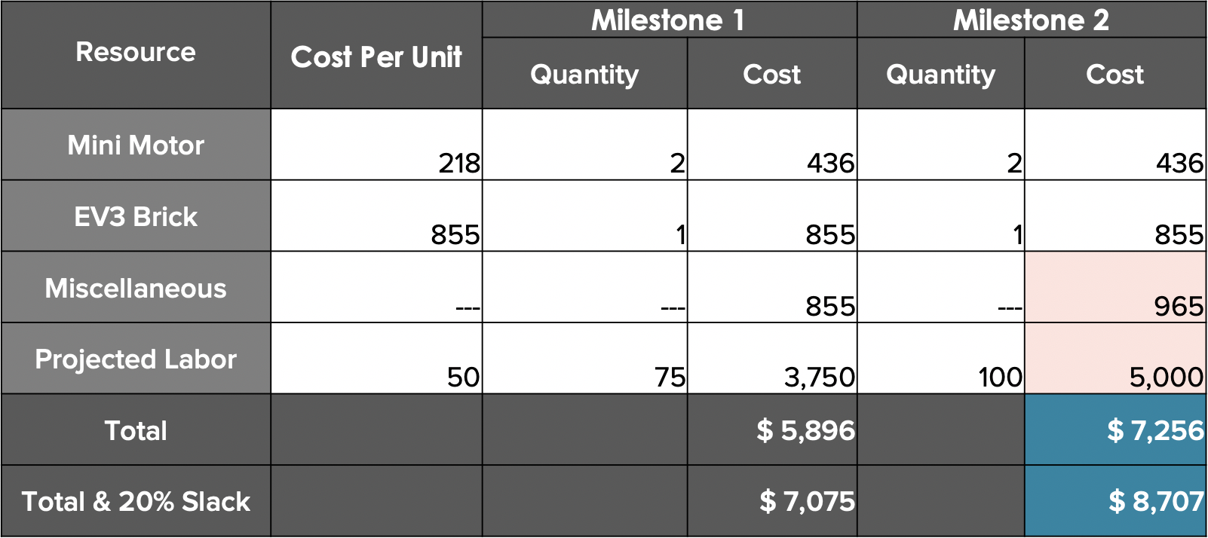
COST ESTIMATE SLIDE
Compare changes in cost between Milestones
Full dollar amounts
Highlight total cost
Use online cost resources
Optional 20% slack for unexpected costs
Table 1: Sample cost estimate
26

Slide 28
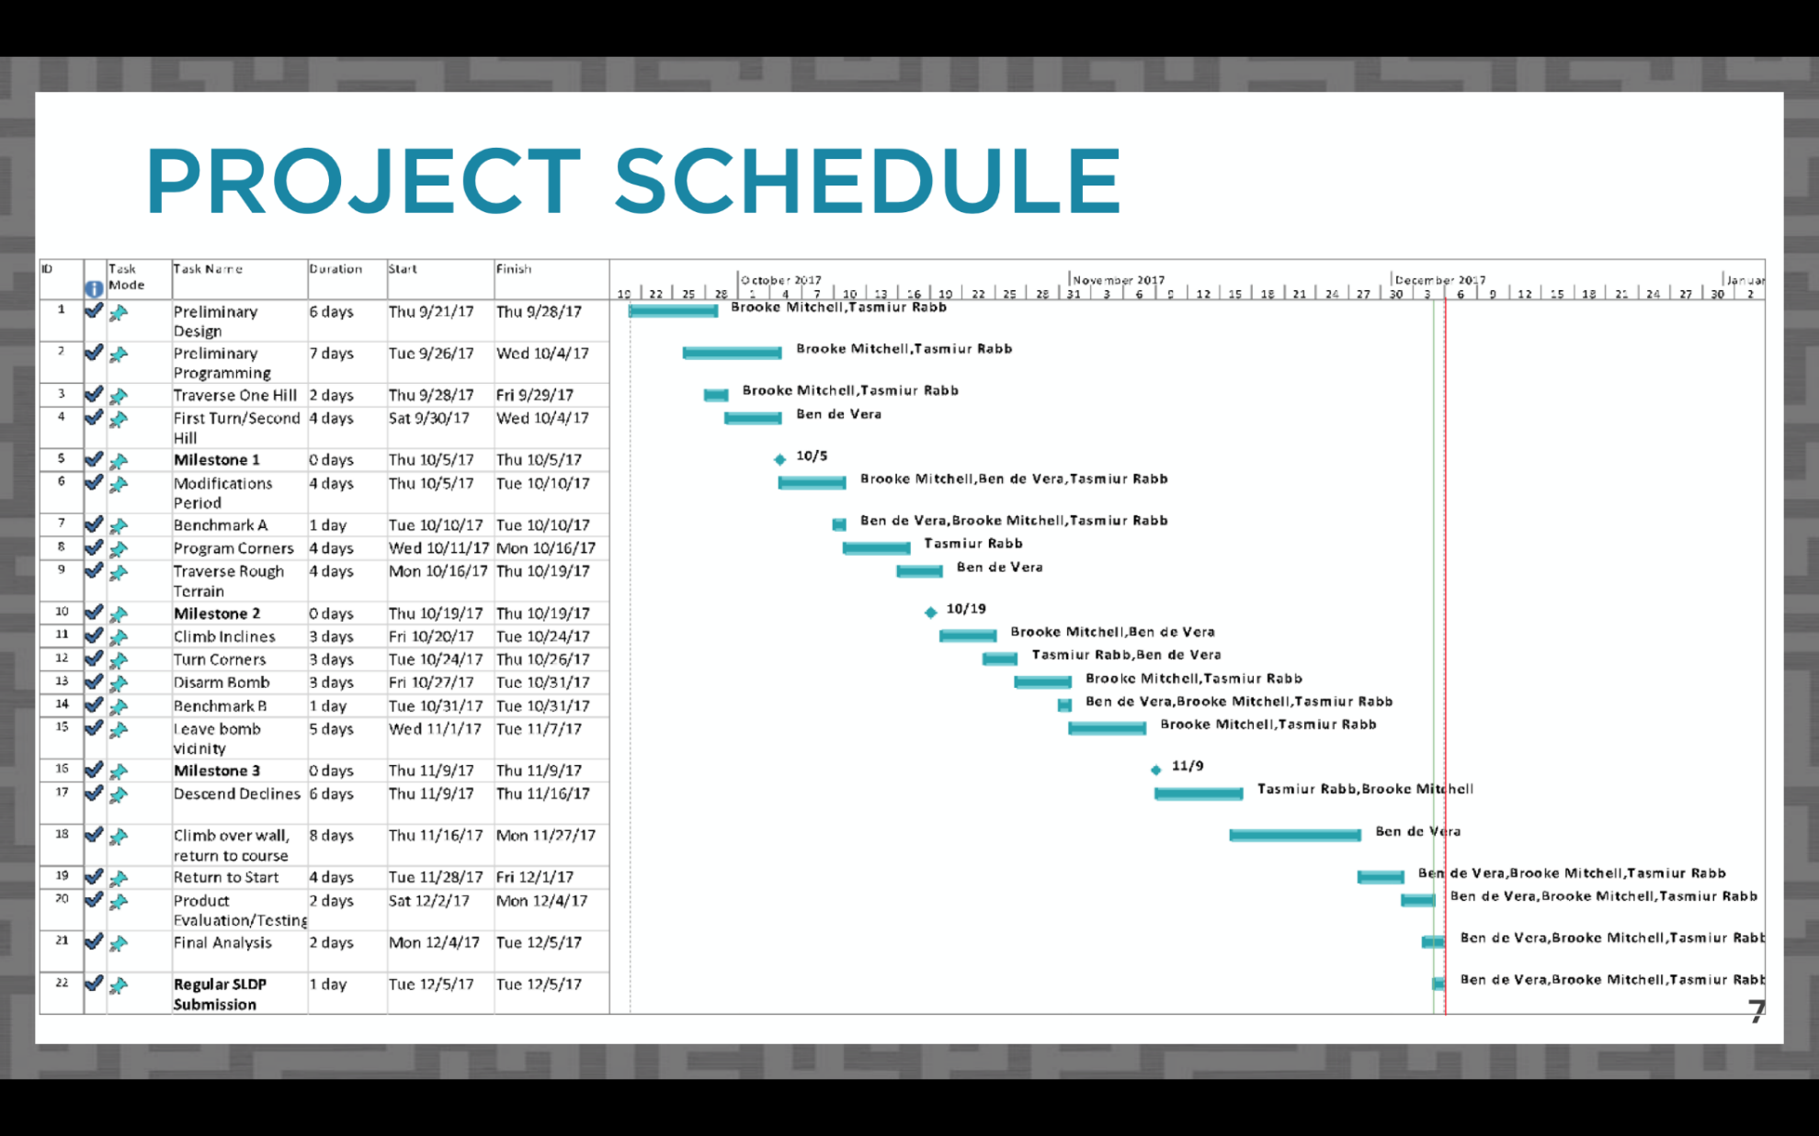
PROJECT SCHEDULE SLIDE
Slide title “Project Schedule”
Copy picture function
  Do not screenshot
Include table, Gantt chart, and progress line in image
Refer to Microsoft Project Student Guide presentation for instructions
  VCL copy picture instructions
Figure 14: Project schedule sample slide
27

Slide 29
TEAMWORK AGREEMENT SLIDE
Slide title “Teamwork Agreement”
Milestone 1 presentation only
Full instructions for agreement on student manual
Summarize agreement:
  Communication
  Meetings
  Differences in opinion
  Responsibilities
  Workload
28

Slide 30
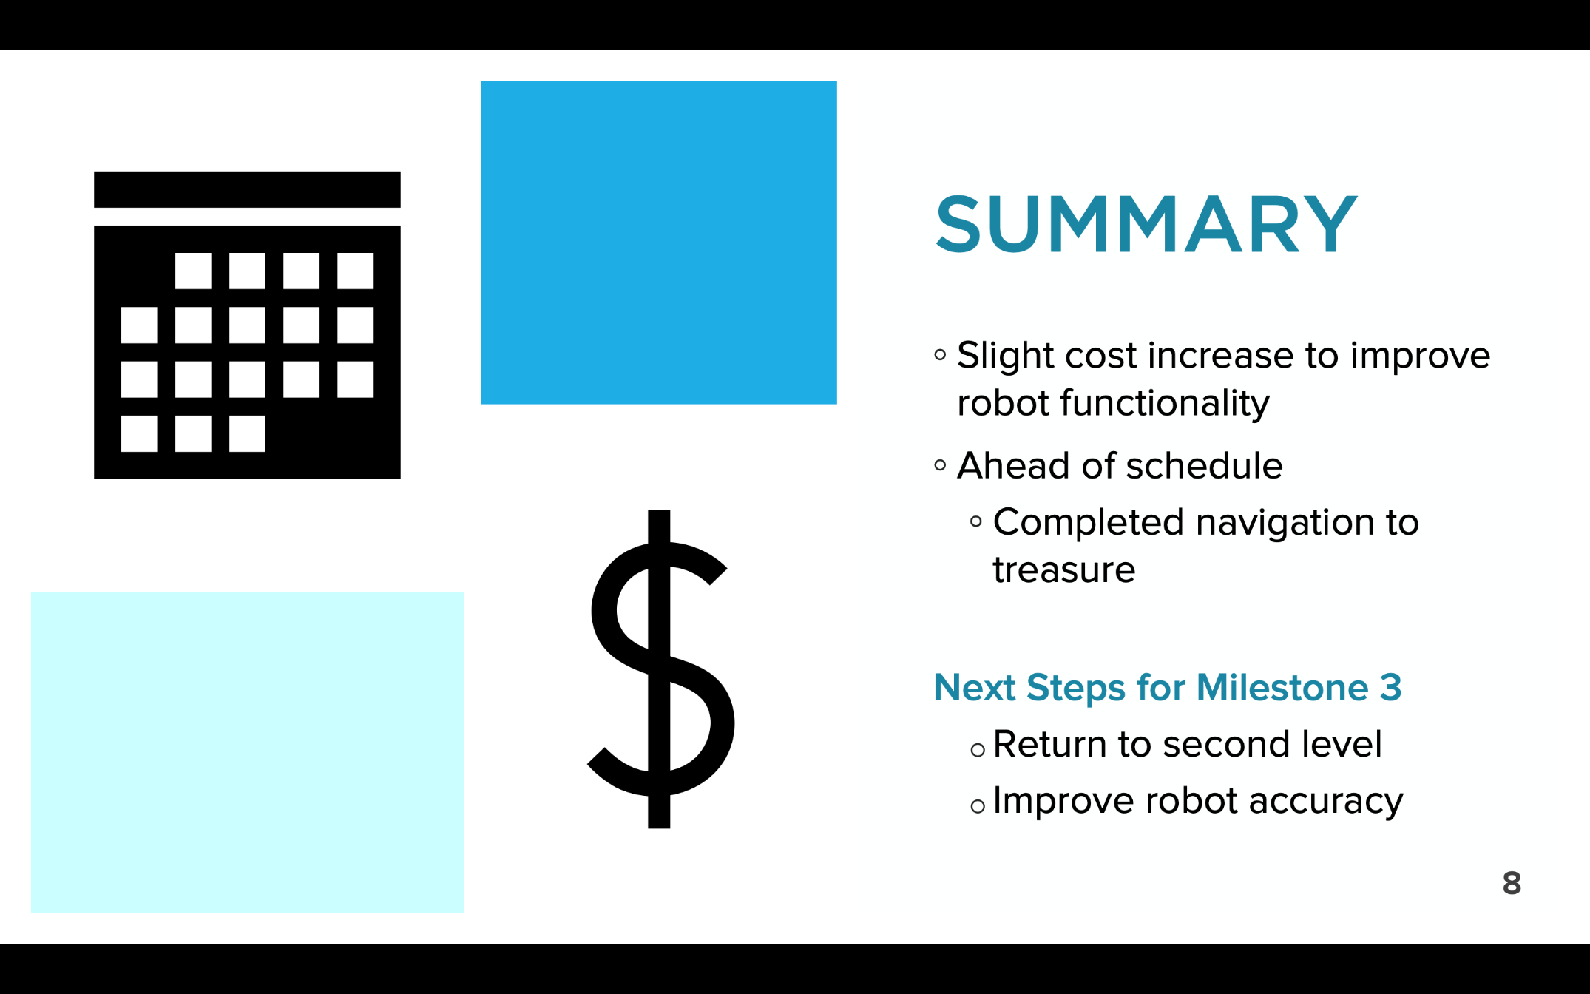
SUMMARY SLIDE
Slide title “Summary”
Overall assessment on project
Are you on schedule?
Are you on budget?
Include next steps for the following milestone
Figure 15: Conclusion sample slide
29

Slide 31
QUESTIONS?

