Slide 1
THE ART OF THE
COVER LETTER
EG1003 | RECITATION 11

Slide 2
What is a Cover Letter?
Cover letter: A letter of interest for a specific job position.
Addressed to hiring manager and/or direct supervisor.
States interest and relevant experience
1 page maximum
Often requested in addition to a resume and application
Tells a story about why you are the best candidate for the job
Figure 1 Courtesy of Michael Burrows

Slide 3
Resume x Cover Letter
What is the difference?
Resume
Lists all of your education, professional experience, and skills.
Comprehensive overview of career/jobs thus far.
Cover letter
Written in full sentences
Highlights professionalism plus career experiences that may not fit into a resume, or that are worth highlighting.
A cover letter does not need to talk about every single professional experience (as in, it is not comprehensive)

Slide 4
General Cover Letter Structure
Company address
Greeting: (Dear [insert name of hiring manager/supervisor],)
Introductory paragraph: What position are you applying for? How did you find this position? Were you referred?
1-2 paragraphs detailing relevant experiences/skills
1 paragraph detailing what you bring to the job
Sign off/signature (Sincerely, [insert name])

Slide 5
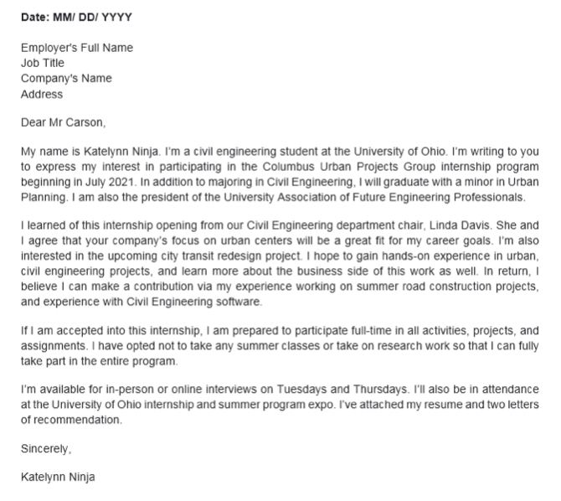
Sample Cover Letter
Figures 2a & 2b Courtesy of Cover Letter Ninja

Slide 6
The Best Cover Letters Are…
Professional and polished: Conveys professional, confident tone. No grammar/spelling errors.
Tailored specifically to the company and position: Speaks directly to the position/team you are applying to in the organization.
Pulled from most relevant previous experiences: Highlights responsibilities, skills, or experiences that would qualify you for the job.
Specific yet brief: Shares specific examples of numbers, metrics, or achievements at your previous positions
i.e., “I aided my team by increasing overall sales in 2021 by 15%”.

Slide 7
The Best Cover Letters…
Discuss how you add value: Companies want to know what value you will add for them, not how they can add value to your career.
Yes: “I believe I can add value to your infrastructure projects through my experience as a civil engineering intern.”
No: “I want to learn more about civil engineering projects through your company.”
1 page maximum: 3-4 short, easy to read paragraphs at most.

Slide 8
Cover Letter Editing Activity
Microsoft, Seattle, Washington
January 1, 2022
To Whom It May Concern:
My name is Taylor Swift, and I am thrilled to apply for the Software Engineering Internship at Microsoft this summer. I was referred to the open position by my computer science professor at NYU Tandon, Dr. John Doe, who has been my academic advisor for the past two years.
As an undergraduate at NYU Tandon, I have worked for the past year as a research assistant to Dr. Avery Smith, contributing to her work on biomedical software. I’ve taken extensive software programming coursework thus far, including Introduction to Computer Science; Introduction to Operating Systems; Programming and Entrepreneurship; and more. In addition to this, I am currently the treasurer of NYU Tandon’s Women in Software Engineering Society.
I am a singer and songwriter but I also love computer programming. In high school I was captain of my cross country team plus I was the lead in the drama club’s musical productions three years in a row, this is in addition to playing in our school’s marching band. My dad is the high school music teacher so being his student was a challenge, but a good one, and also during my freshmen year of college, I created a business-oriented audio editing software that won an award from the NYU Entrepreneurship Scholarship Program.
The reason I want to intern at Microsoft is because I really want to have a software engineering job in Seattle one day. In addition, I really want to hone my skills working as a member of a team of programmers. I am proficient in Python, C++, and other languages, and I would love the opportunity to bring these skills to Microsoft this summer.
Thanks for reading, and I hope to hear from you soon.

Slide 9
Cover Letter FAQs
How personal should the letter be?
If you have a connection to the company, say so in the introductory paragraph!
The focus of the letter is on you and your value—professional experiences relevant to the position only.
Not the place to tell your life story.
What do employers look for in a cover letter?
Good communication skills.
A strong understanding of the organization and position.
Professional skills and values.
This feels like bragging. Am I bragging?
Yes and no.
Confidence without apology is key, but humility and honesty are also vital.

Slide 10
Cover Letter FAQs
What if the job listing says “cover letter optional”?
Write one anyway. You will stand out.
Should I make a standard cover letter template?
Yes, but cover letters must always be customized to the specific position.
Will require even more time and care.
Where should I look for the name of the hiring manager or supervisor?
Company website, LinkedIn, professional connection (if you have one).
Still can’t find it? Select the most relevant senior person related to the position.

Slide 11
RESOURCES
EG1003 Student Manual:
EG1003 Writing Style Guide
Sample Lab Report
Writing Center:
Schedule an appointment online: nyu.mywconline.com
Entirely virtual this semester
Writing Consultants:
Available during recitation to answer questions
13

Slide 12
QUESTIONS?

