Slide 1
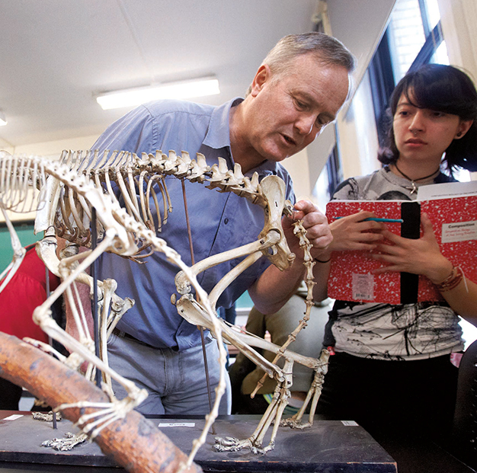
EG1003: Introduction to Engineering and Design
Lab Safety Guidelines

Slide 2
What is Safety?
To protect life and property from harm or damage.
Safety Protects:
Personal Well being
Public Well being
Proper business environment

Slide 3
Need for Safety
Helps maintain a hazard-free work place
Creates a comfortable work place
Keeps order and responsibility

Slide 4
Safety Staff
General Engineering
Head TAs RH 515A2, x3515
Polytechnic School of Engineering
Dr. Charles Martucci RH 316G, x3613

Slide 5
Emergency Numbers
Contact | Phone Number
Emergency Closings | 212-998-1220
Guard Stations | Rogers Hall 646-997-3537 Dibner 646-997-3727 Wunsch 718-632-5901
Client Services | 212-998-1001

Slide 6
Basic Safety Rules
Be Alert
Note marked exits
Know where the fire extinguishers and first aid kits are located
Know your students/TAs, do NOT admit strangers
Be Tidy
Dispose of garbage properly, do NOT leave paper lying around
Store materials in cabinets

Slide 7
Basic Safety Rules
Be Courteous
Do NOT eat, drink, or smoke in labs
Do NOT overcrowd the laboratories
Maintain a business environment
Be Smart
NEVER work alone, use the “Buddy System”
No horseplay or shouting

Slide 8
Electrical Safety Rules
Avoid exposed wires, use ELECTRICAL TAPE to cover them
Keep electrical cords off the floor and to a minimum
Outlet are for electrical plugs only
(i.e. NO paper clips, scissors, fingers, etc.)
Never force a wrong plug into an outlet
Water and electricity do NOT mix

Slide 9
Mechanical Safety Rules
Wear proper accessories (goggles/work gloves) when working with tools
All tools should be used on a workbench
Work near a window or well ventilated area
Do NOT use broken equipment
Notify a TA immediately

Slide 10
Re-Cap
Know & follow the safety rules
Report any problems to the safety representatives
Maintain a Business Environment
THINK
SAFETY
ALWAYS………..

